Slide 1
Carbon dioxide variability
at research station “Ice Base Cape Baranova”
during 2015 - 2019
Marina Loskutova¹, Ph.D. student in Applied Meteorology and Climatology
sofoniba614@gmail.com
A. Makshtas¹, T. Laurila² and E. Asmi²
¹Arctic and Antarctic Research Institute (AARI), Saint-Petersburg, Russian Federation ²Finnish Meteoriligical Institute (FMI), Helsinki, Finland

Slide 2
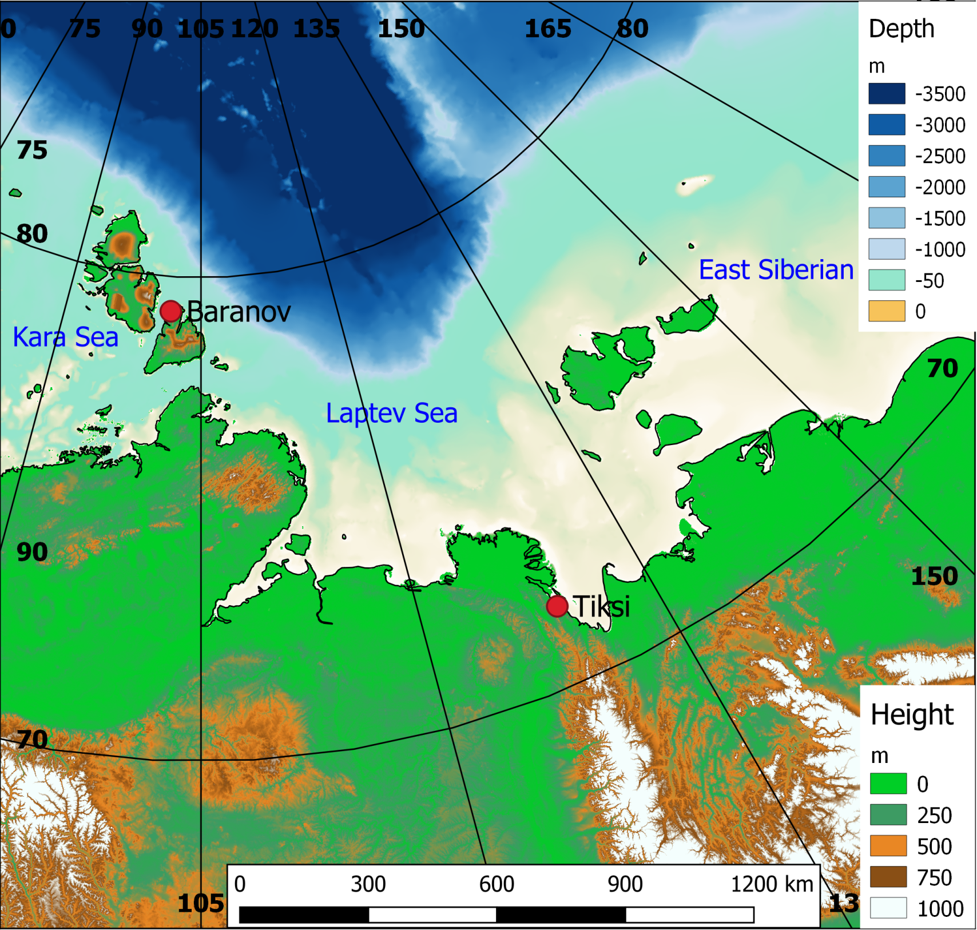
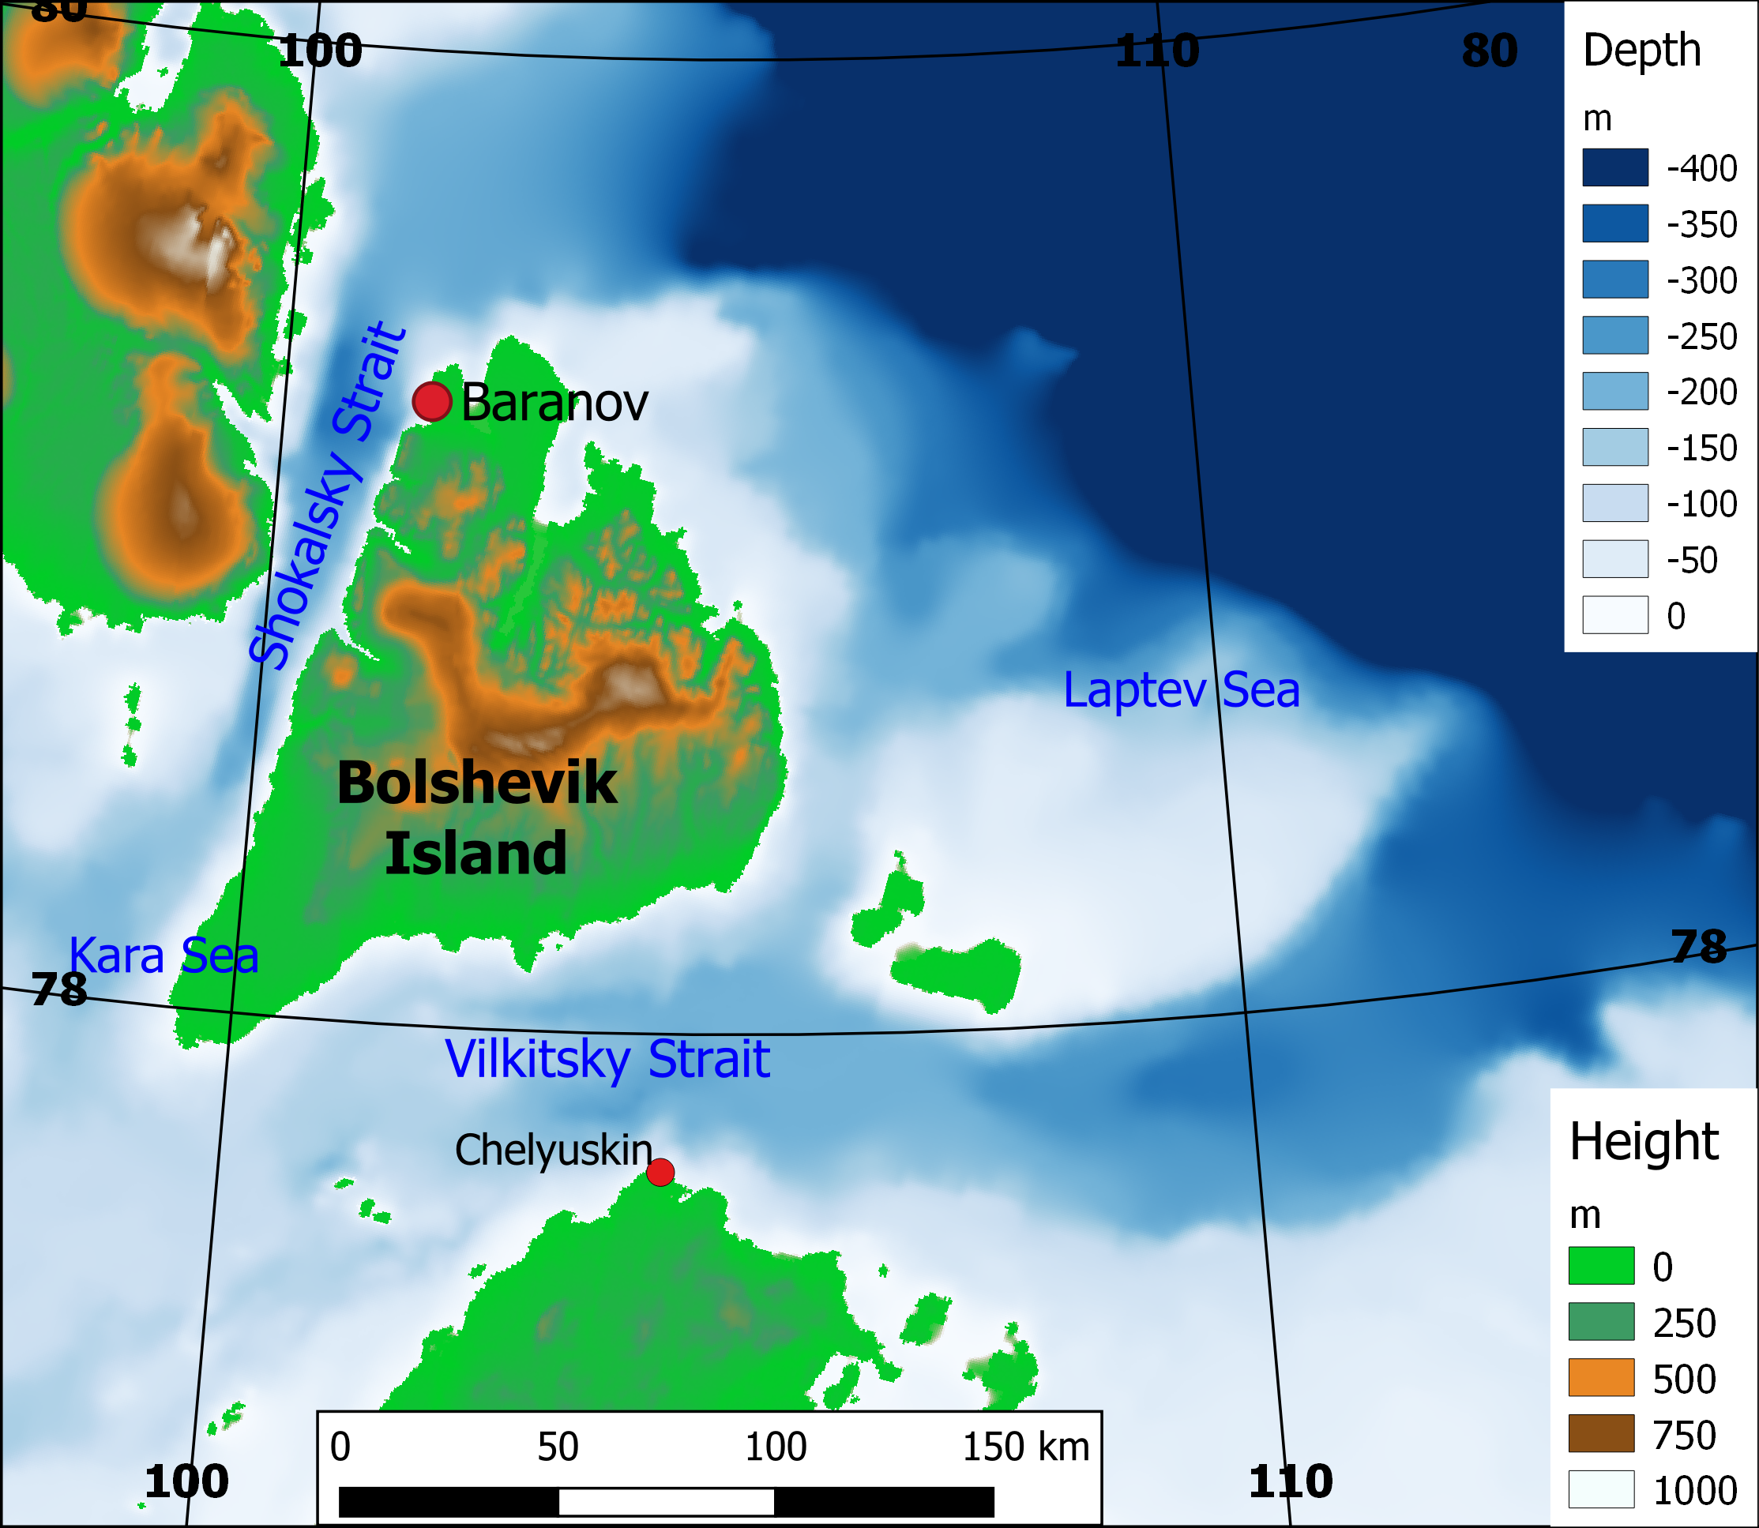
Measuring point
The Arctic region is one of the main areas of greenhouse gases sources due to large amount of biomass, carbon stocks in the soil and extensive wetlands. Since 2015 Arctic and Antarctic Research Institute in cooperation with Finnish Meteorological Institute have been measuring the continuous concentrations of water vapor, methane, carbon dioxide and carbon monoxide at Research Station "Ice Base Cape Baranova“.
Severnaya Zemlya Archipelago
Bolshevik Island
79.3 N, 101.8 E
30 m a.s.l.
Notes:
Map of the Laptev Sea with topography and bathymetry
2

Slide 3
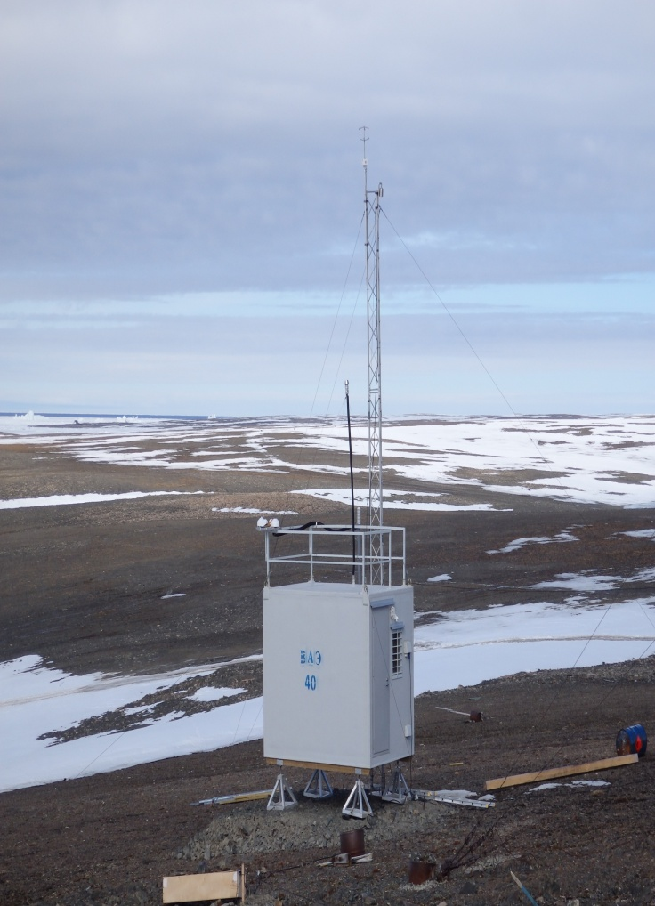
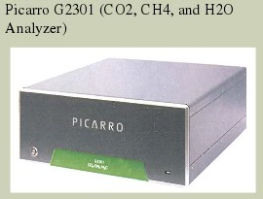
Finnish Meteorological Institute equipment for GH gases study
Cavity ringdown spectroscopy (CRDS) analyzer Picarro G2401 and four calibration standards are used for measurement. The sampling inlet is located at 10 m height.
Instrument capability | Measuring the concentration of CO₂ | Measuring the concentration of CH₄
Instrument range | 300 – 500 ppm | 1 – 3 ppm
Instrument accuracy | ±0.05ppm | ±0.0007 ppm

Slide 4
Data quality-control and pre-processing
Data preprocessing consists of deleting values obtained during power failures and 2 minutes after calibration. The values for wind directions corresponding to the transfer from diesel power station (90 - 145 °) and for wind speeds less than 3 m/s were also discarded because in this case polluted air may be distributed over the station homogeneously. After that data were adjusted taking into account the nearest calibration values by linear interpolation. Difference between target values and corrected ones are shown in the figure. According to WMO requirements, its absolute value should be less than or equal to 0.1 ppm.

Slide 5
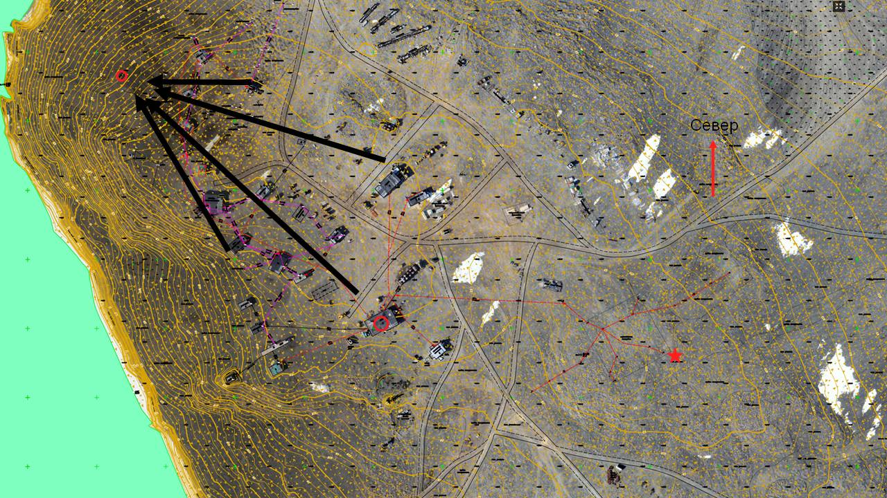
The initial data filtration
1. Calibration values of the gas analyzer (⁓2.3 %)
2. The values obtained in the wind direction, which coincides with the location of diesel power stations
(⁓13.4 %)
3. The nonexistence of turbulent mixing under low wind speed condition (less than 1 m /s) (⁓7.1 %)
Location of diesel power stations relative to the measuring point (which is equivalent of wind direction 95˚ - 145˚)

Slide 6
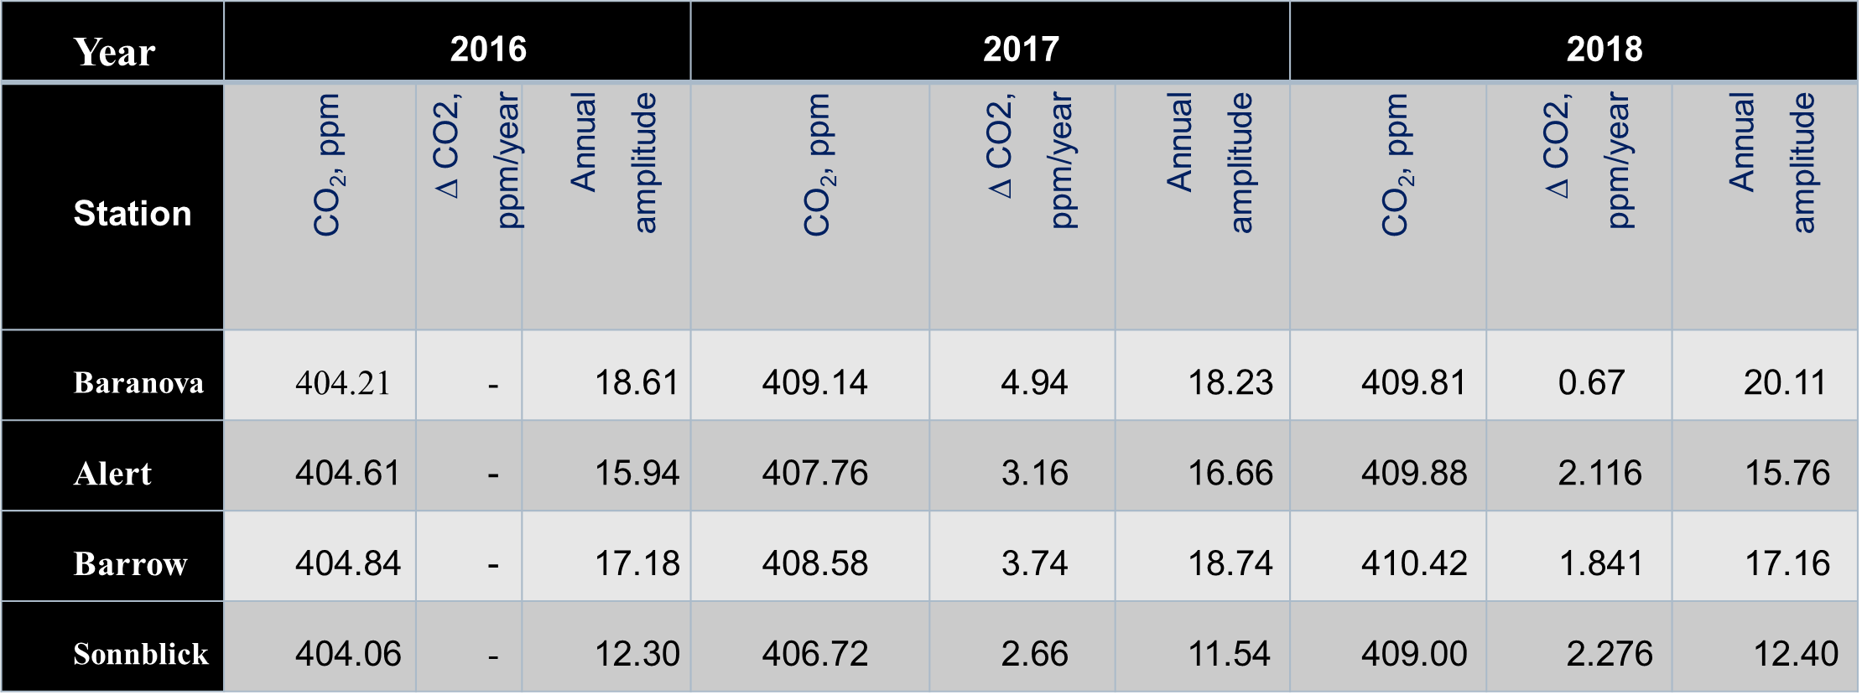
Annual variation of carbon dioxide
The CO₂ concentrations data averaged over each hour from October 2015 to December 2019 was used for further analysis. CO₂ time series are characterized by a pronounced annual variation with concentration decreasing in summer months. Uptake by terrestrial vegetation during the growing season and the absorption by sea phytoplankton in the absence of sea ice cover causes the annual variability of carbon dioxide. The annual amplitude is 18–20 ppm approximately, which is consistent with the data of Alert (82°30´N, 62°20´W) and Barrow (71°18´N, 156°44´W) polar stations (WDCGG, https://gaw.kishou.go.jp).

Slide 8
Thank you for attention!

