Slide 1
Learning Lyapunov stable Dynamical Embeddings of Geophysical Dynamics
Said Ouala¹,Lucas Drumetz¹, Bertrand Chapron², Ananda Pascual³, Fabrice Collard⁴, Lucile Gaultier⁴, Ronan Fablet ¹
IMT Atlantique, Lab-STICC, Brest, France
Ifremer, LOPS, Brest, France
IMEDEA, UIB-CSIC, Esporles, Spain
ODL, Brest, France

Slide 2
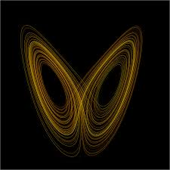
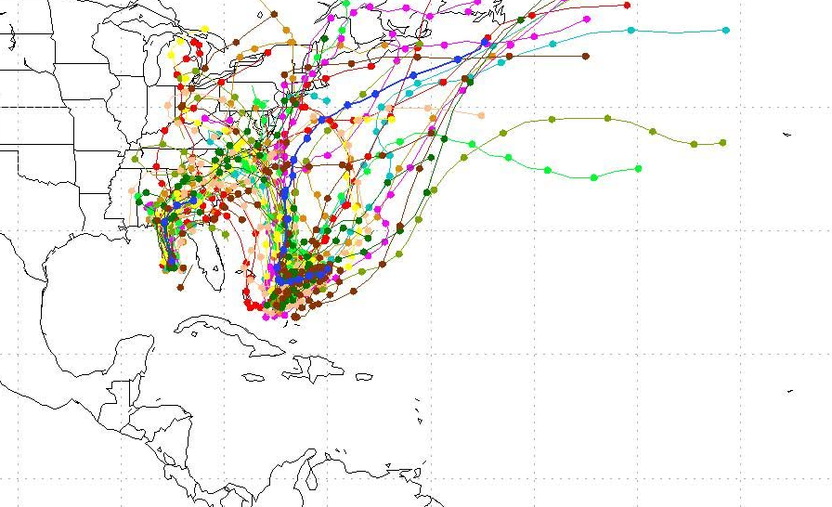
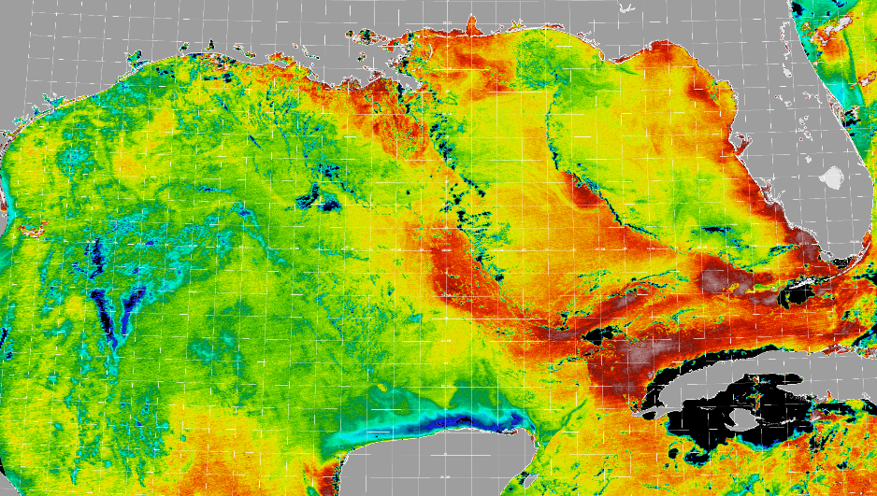
Problem statement
General context : Modeling ocean dynamics
Forecasting and Reconstruction Applications
Often equations are too complicated or unknown
→ Data-driven dynamical modeling
Chaotic dynamics : Non linear models with sensitive stability behavior
Partial and/or noisy observations ?

Slide 3
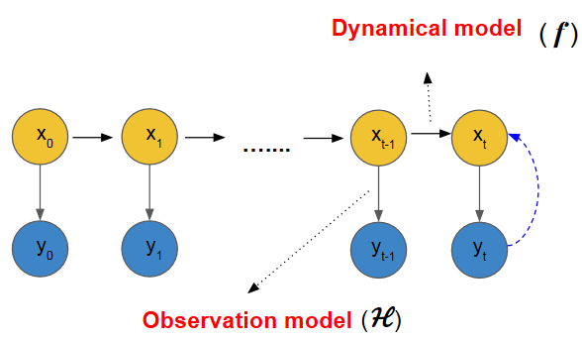
General Framework : State space formulation
Problem statement
X(t) : Hidden states
X(t) : Hidden states
Y(t) : Observations (noisy and/or sparse)
True State
Observation

Slide 4
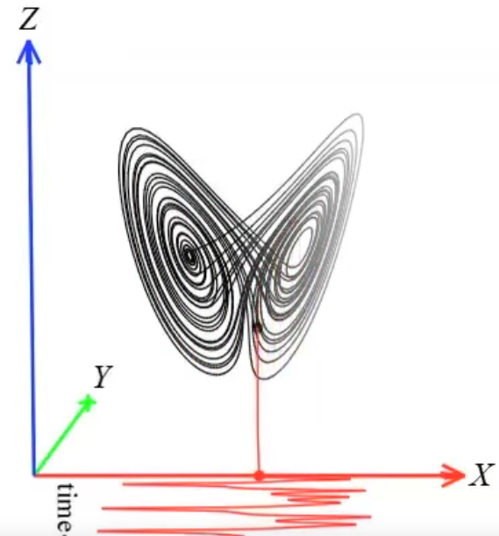
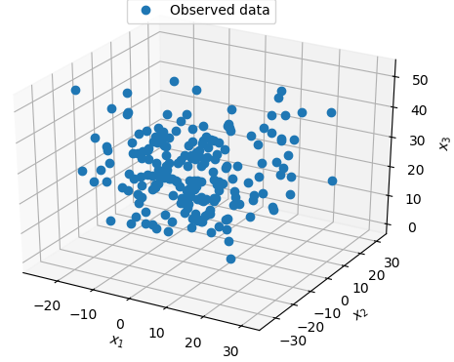
General Framework : State space formulation
Problem statement
Deterministic or stochastic models
Partial and noisy observations

Slide 5
Outline
Problem statement
Data driven model identification from a sequence of observations
Direct observations of the state space
Noisy and partial observations
Temporally sparse data
Partially observed systems
Discussion
Perspectives

Slide 6
Outline
Problem statement
Data driven model identification from a sequence of observations
Direct observations of the state space
Noisy and partial observations
Temporally sparse data
Partially observed systems
Discussion
Perspectives

Slide 7
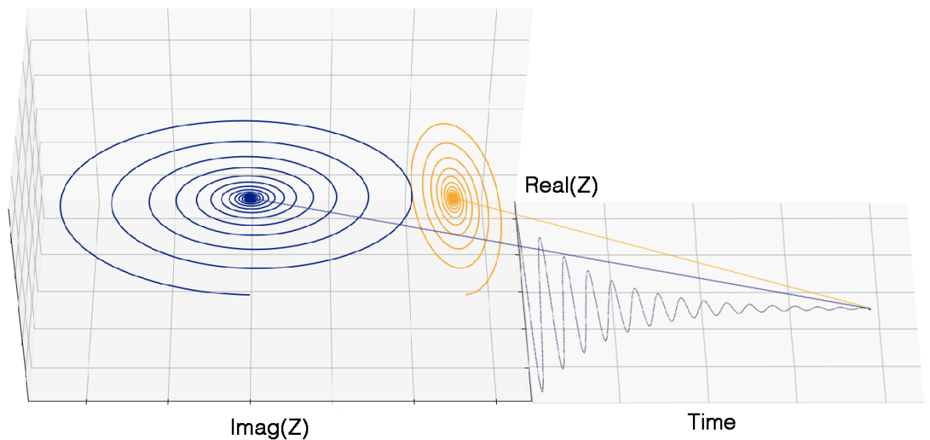
Partially observed systems
Unobservable Components
No Noise

Slide 8
UNOBSERVABLE COMPONENTS
Motivation
Sea surface tracers evolution depends on a lot of unseen variables (subsurface variables, fine-scale sea structures ...etc.).
The EOF decomposition gives only orthogonal modes, the model may depend on non-orthogonal variables.
From a dynamical system POV, we only observe few components of a higher dimensional governing equation.
ODE in the observation space => the observations are an embedding of the higher dimensionnal space

Slide 9
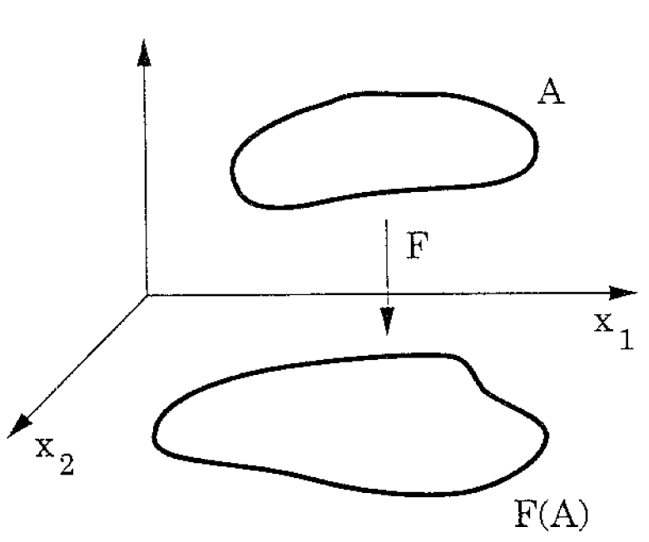
UNOBSERVABLE COMPONENTS
Motivation
An observation operator is an embedding of the hidden state space if :
The mapping doesn’t collapse points (one-to-one) or tangent directions (immersion)
Sauer et al. 1991

Slide 10
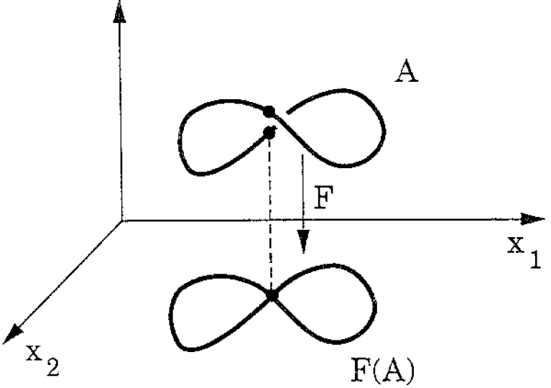
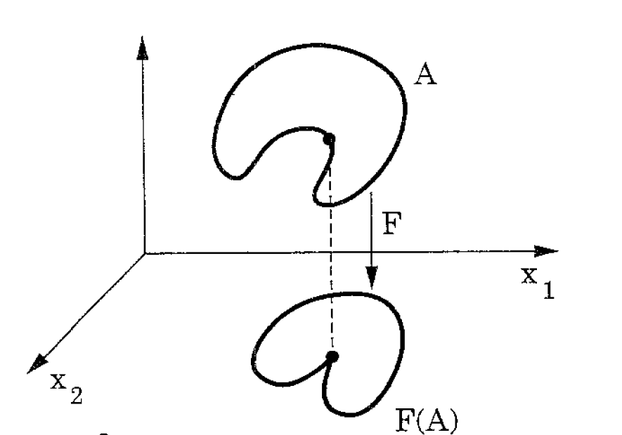
UNOBSERVABLE COMPONENTS
Motivation
An observation operator is an embedding of the hidden state space if :
Sauer et al. 1991
Sauer et al. 1991
The mapping is an immersion but fails to be one-to-one
The mapping is one-to-one
but fails to be an immersion

Slide 11
UNOBSERVABLE COMPONENTS
Motivation
What happens when the observation operator doesn’t form an Embedding of the hidden state space ?

Slide 12
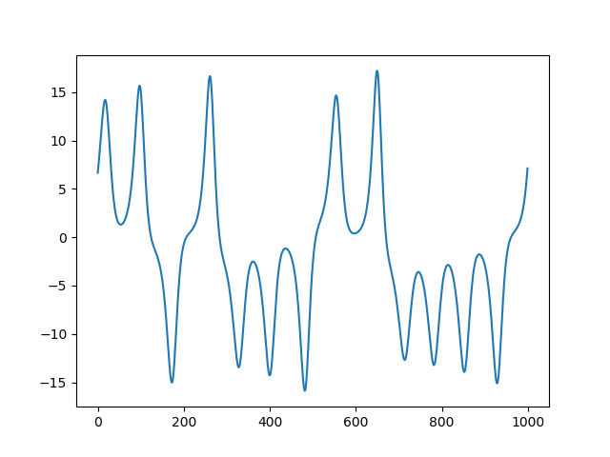
UNOBSERVABLE COMPONENTS : Issues with classical approach
Classical approach : dx/dt = f(x) ?

Slide 13
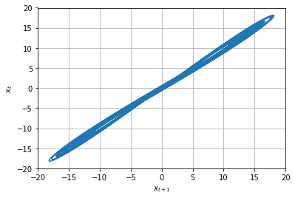
UNOBSERVABLE COMPONENTS : Issues with classical approach
Data are not
Classical approach : dx/dt = f(x) ?
The associated mapping $φ_{t}\left(x\left(0\right)\right)= \int_{t_{0}}^{t}{f\left(x\left(t^{′}\right)\right)dt′}$ is one-to-one
$φ_{t}\left(x\left(0\right)\right)$ = $φ_{t}\left(x\left(u\right)\right)$ ➔ $x\left(0\right)$ = $x\left(u\right)$

Slide 14
UNOBSERVABLE COMPONENTS : Conclusion
In several Real world problems, we are not (at all) provided with some components directly or indirectly influencing the variability of our underlying system
We need to find a higher dimensional space where our data will be an embedding of the true states
Synergie studie then include several other observations and hope for the best
Physically guided data driven : find the most appropriate manifold in a higher dimension that fits the best our obs

Slide 15
Find an embedded representation :
Our approach : Project our observation x into a high dimensional space $u$, with $u=[x,l1,l2,…,ln]$
Fit :
$$\frac{du}{dt}=f_{θ}\left(u\right)$$
With
$$u=[x,l1,l2,…,ln]$$
$$θ, l={argmin}_{θ,l}\{α|x(t) −G(\int_{{t−1}_{}}^{t}{f\left(u\left(t^{′}\right)\right)dt^{′}})|+(1−α)|u\left(t\right)−\int_{{t−1}_{}}^{t}{f\left(u\left(t^{′}\right)\right)dt^{′}}|\}$$

Slide 16
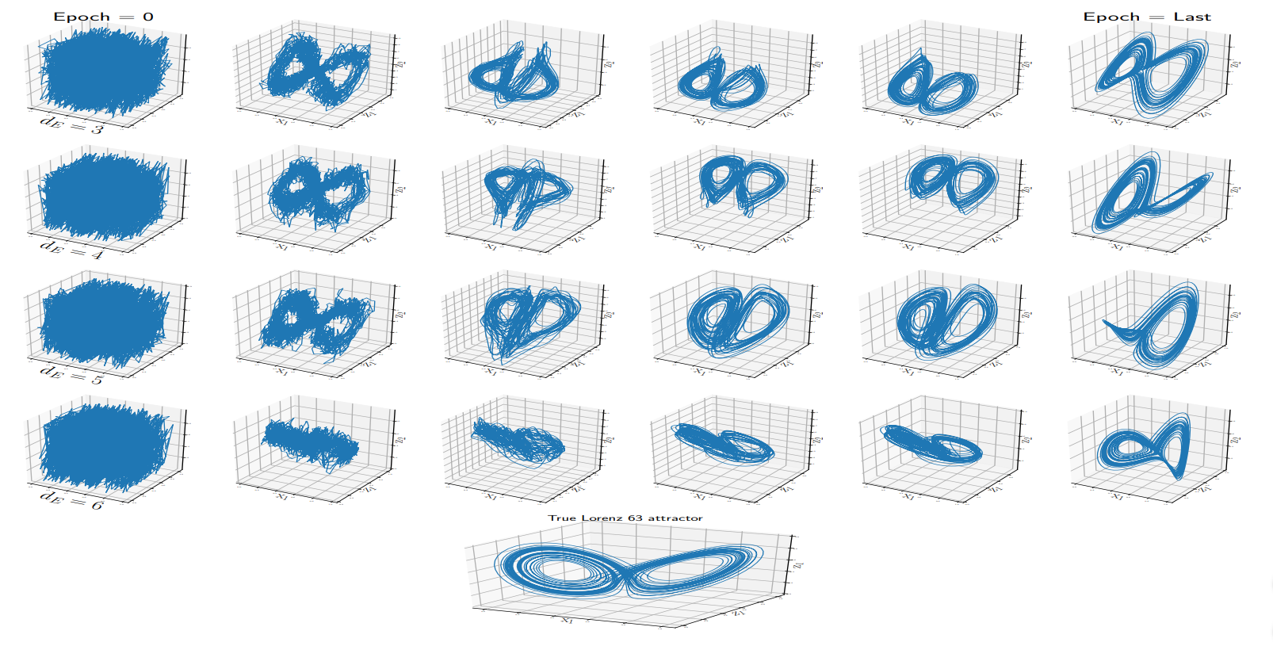
Physically guided data driven : State reconstruction

Slide 17
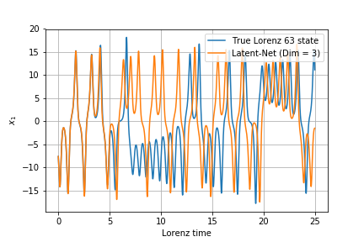
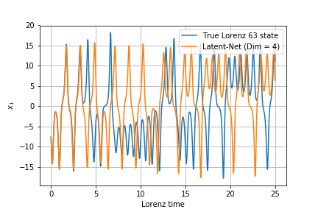
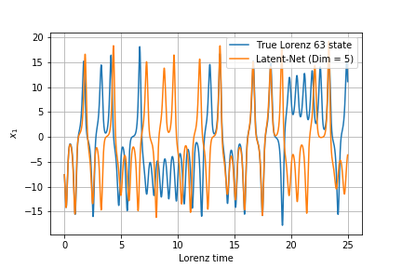
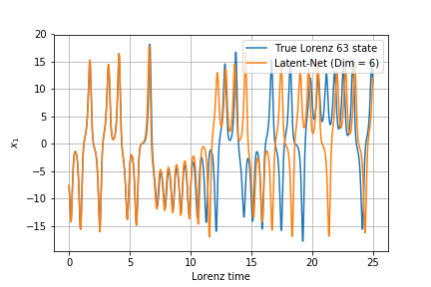
Physically guided data driven : Forecasting
Lyap = 0,82
Lyap = 0,96
Lyap = 0,82
Lyap = 0,87

Slide 18
Forecasting SLA :
OSSE based on realistic high-resolution ocean simulation data in the Western Mediterranean sea from WMOP configuration (Juza et al. 2016).
The Spatial resolution of 0.05 and a temporal resolution dt=1 day.
The data from January 2009 to December 2014 were used as training and we tested our approach on the first 347 days of the year 2015.
The EOF space dimension n=15, which amounts to capture 95% of the total variance.

Slide 19
Forecasting SLA realistic forecast up to ~ 170 days !

Slide 20
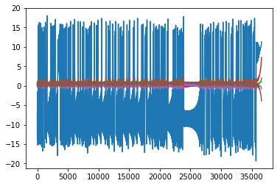
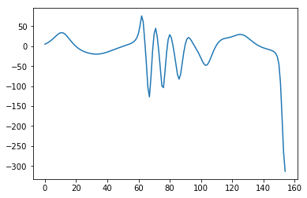
UNOBSERVABLE COMPONENTS
Issue
Our spawned manifold is not dense in the phase space :/

Slide 21
UNOBSERVABLE COMPONENTS
Idea
Boundedness constraints : Constraint the trajectories of the dynamical system to live in a closed ball in the phase space
The dynamical system is by construction stable (will not diverge)
The training data will (hopfully) make the model converge to the true limit cycle

Slide 22
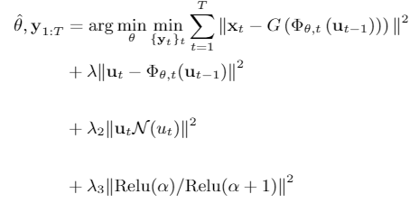
UNOBSERVABLE COMPONENTS
Idea
Boundedness constraints : Constraint the trajectories of the dynamical system to live in a closed ball in the phase space
In practice : Energy preserving non linearity + Negative eigenvalues of the linear part of (a shifted version of) the model (Schlegel et al. 2013):

Slide 23
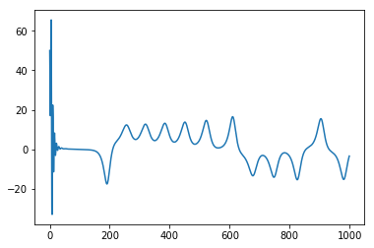
UNOBSERVABLE COMPONENTS
L63

Slide 24
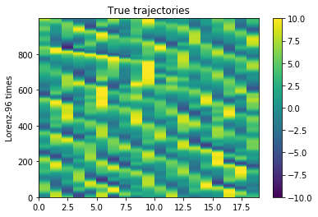
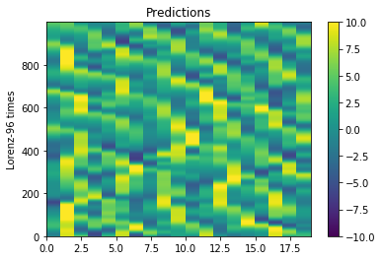
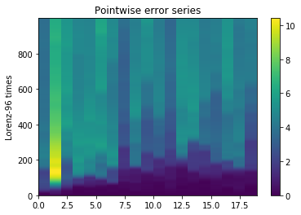
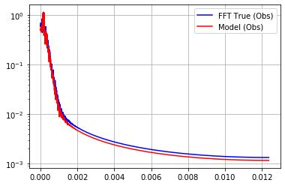
UNOBSERVABLE COMPONENTS
L96

Slide 25
UNOBSERVABLE COMPONENTS
Patch Based Shallow Water Equation
The length of the domain is set to 1000 km x 1000 km with a corresponding regular discretization of 80 x 80.
The temporal step size was set to satisfy the Courant–Friedrichs–Lewy condition (dt=20.41 seconds).
As training data, we took a patch of size 250km x 250km in the center of the 2D domain.
We use the first 49701 time steps as training data. The training data was projected into an EOF basis with a dimension n=5, which amounts to capture 75% of the total variance.

Slide 26
UNOBSERVABLE COMPONENTS
Patch Based Shallow Water Equation
True Shallow water
Model Simulation
Error (RMSE)

Slide 27
UNOBSERVABLE COMPONENTS
Patch Based Shallow Water Equation
Model Simulation from a perturbed initial condition
Model Simulation from a far initial condition
Model Simulation #1

Slide 28
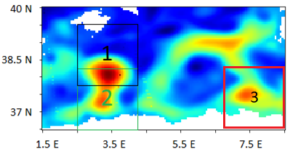
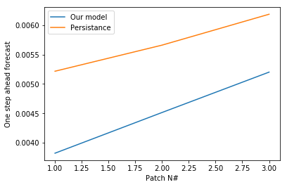
UNOBSERVABLE COMPONENTS
Patch Based Sea Level Anomaly (SLA)
Patch 1 : Training patch
Test on test set of patch 1, 2 and 3.

Slide 29
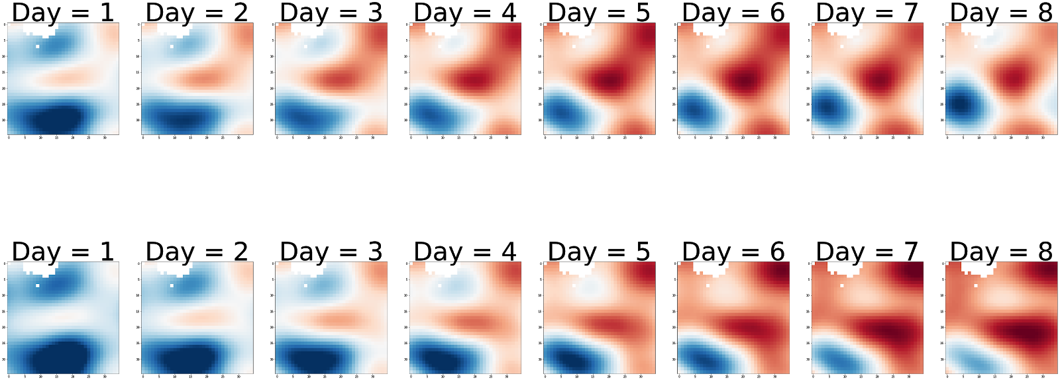
UNOBSERVABLE COMPONENTS
Patch Based Sea Level Anomaly (SLA)
Forecast on test set of patch # 1

Slide 30
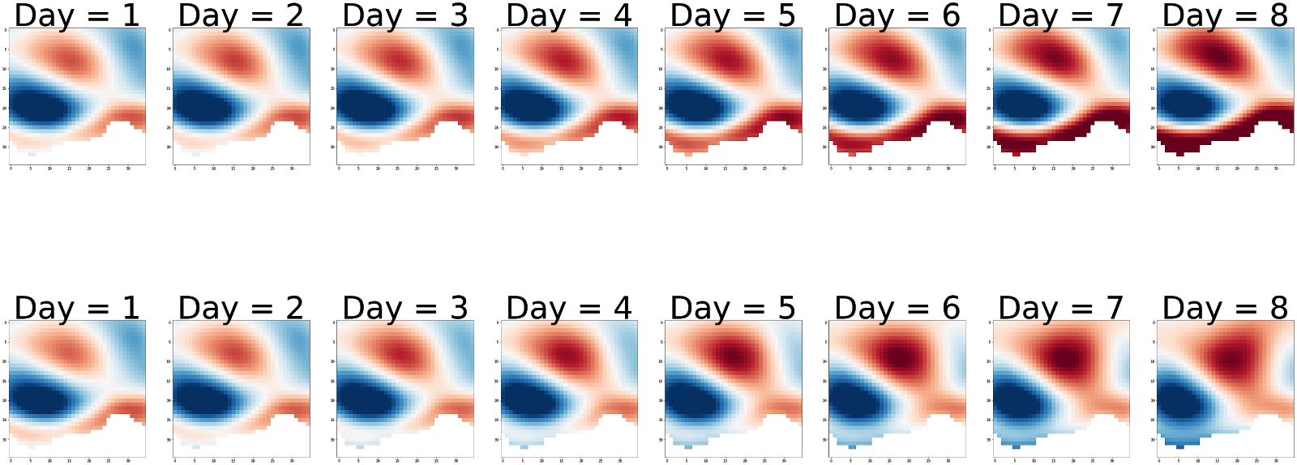
UNOBSERVABLE COMPONENTS
Patch Based Sea Level Anomaly (SLA)
Forecast on test set of patch # 2

Slide 31
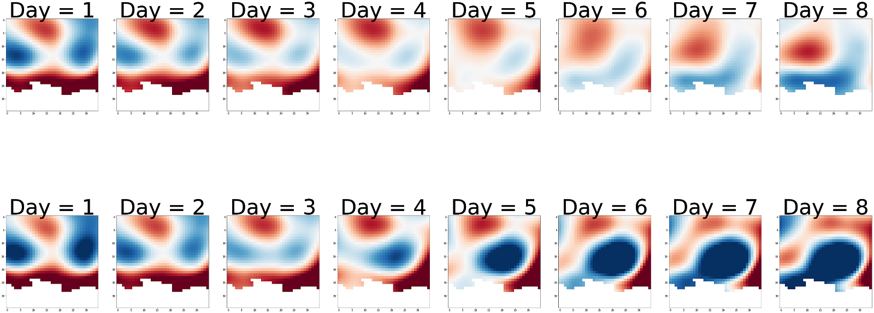
UNOBSERVABLE COMPONENTS
Patch Based Sea Level Anomaly (SLA)
Forecast on test set of patch # 3

Slide 32
UNOBSERVABLE COMPONENTS
Patch Based Sea Level Anomaly (SLA)
Model Simulation from a perturbed initial condition
Model Simulation

Slide 33
Links to koopman operator theory
Koopman operator : Infinite-dimensional linear operator propagating observables in time.
Observables: a function of the observations.
$$U_{t}g(x)=g(Φ_{t}(x))$$
With
$g(x)$ The observables and $U_{t}$ the koopman operator.

Slide 34
Find an embedded representation :
Our approach : Project our observation x into a high dimensional space $u$, with $u=[x,l1,l2,…,ln]$
Fit :
$$\frac{du}{dt}=Au$$
With
$$u=[x,l1,l2,…,ln]$$
$$θ, l={argmin}_{θ,l}\left\{α\left|x\left(t\right)−G\left(\int_{{t−1}_{}}^{t}{Au\left(t^{′}\right)dt^{′}}\right)\right|+\left(1−α\right)\left|u\left(t\right)−\int_{{t−1}_{}}^{t}{Au\left(t^{′}\right)dt^{′}}\right|\right\}$$

Slide 35
UNOBSERVABLE COMPONENTS
SWE
True State
Projection
Koopman
Error (MAE)

Slide 36
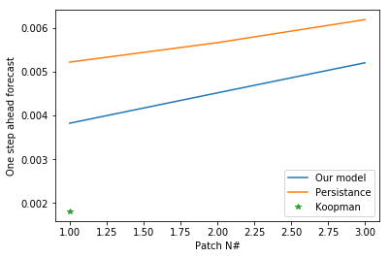
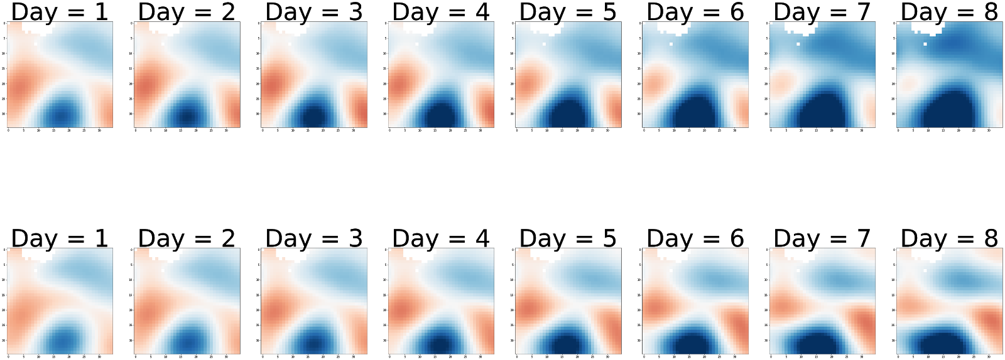
UNOBSERVABLE COMPONENTS
SLA (WMOP)

Slide 37
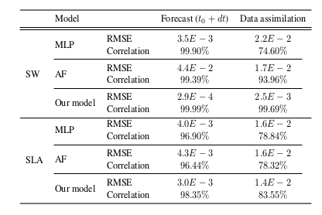
UNOBSERVABLE COMPONENTS
Data assimilation
Reconstruction RMSE :
Koopman RMSE :
1.3 E-2

Slide 38
UNOBSERVABLE COMPONENTS
SLA (WMOP)
True State
Projection
Koopman

Slide 39
Linear model ?
Pros :
Simple linear model (can be integrated analytically even without a laptop)
Easier to train
More suitable for data assimilation application (modulo good observations)
Cons :
Can’t simulate the data dynamics (only short term forecast)
Initial condition needs to be in the attractor space
No transient reproduction

Slide 40
Outline
Problem statement
Data driven model identification from a sequence of observations
Direct observations of the state space
Noisy and partial observations
Temporally sparse data
Partially observed systems
Discussion
Perspectives

Slide 41
Discussion
Can we use data driven models to forcast to ∞ sea surface variables ?

Slide 42
References
Ouala, Said & Nguyen, Duong & Drumetz, Lucas & Chapron, Bertrand & Pascual, Ananda & Collard, Fabrice & Gaultier, Lucile & Fablet, Ronan. (2019). Learning Latent Dynamics for Partially Observed Systems. doi: 10.13140/RG.2.2.25392.20481/1.
Sauer, T., Yorke, J. A., & Casdagli, M. (1991). Embedology. Journal of statistical Physics, 65(3-4), 579-616.
Schlegel, M., & Noack, B. R. (2015). On long-term boundedness of Galerkin models. Journal of Fluid Mechanics, 765, 325-352.
Juza, M., Mourre, B., Renault, L., Gómara, S., Sebastián, K., Lora, S., Beltran, J.P., Frontera, B., Garau, B., Troupin, C., Torner, M., Heslop, E., Casas, B., Escudier, R., Vizoso, G., Tintoré, J. (2016). SOCIB operational ocean forecasting system and multi-platform validation in the Western Mediterranean Sea. Journal of Operational Oceanography, 9, s155-s166.

