Slide 1



CO₂ Capture and Storage from Flue Gas Using Novel Gas Hydrate-Based Technologies and Their Associated Impacts
Aliakbar Hassanpouryouzband^{1*}, Katriona Edlmann¹, Jinhai Yang², Bahman Tohidi², Evgeny Chuvilin³
¹ School of Geosciences, University of Edinburgh, Grant Institute, West Main Road, Edinburgh, EH9 3JW, UK
² Hydrates, Flow Assurance & Phase Equilibria Research Group, Institute of Petroleum Engineering, School of Energy, Geoscience, Infrastructure and Society, Heriot-Watt University, Riccarton, Edinburgh, EH14 4AS, UK.
¹ Nobel Street, Skolkovo Innovation Center, 10, Moscow, 143026, Russia
* hssnpr@ed.ac.uk

Slide 2

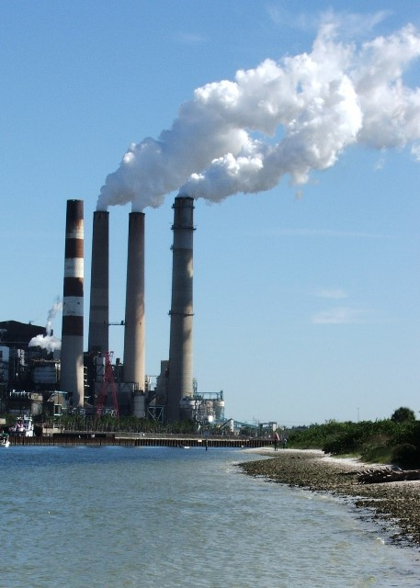

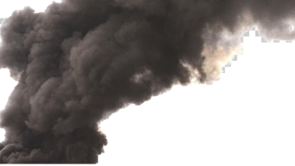

Global Climate Change
Flue Gas
Key contributors to global climate change.
Changing Environmental Life cycle
Global Warming
Emission of flue gas from a typical 600 MWE power plant could be more than 500 m3 every second.
Hazard to Human Life

Slide 3
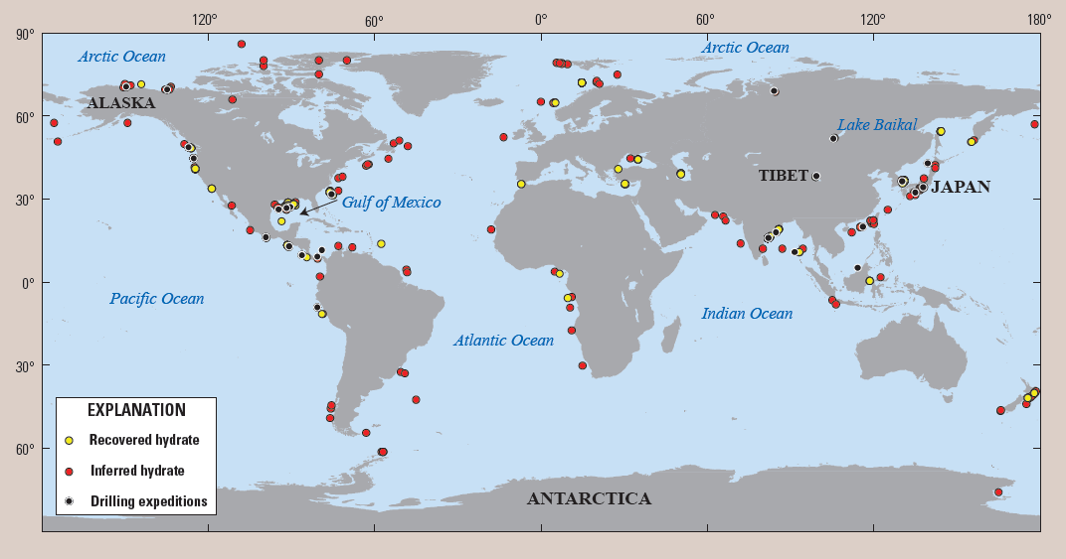
Gas Hydrates as a Potential Energy Resource
The global volume of Gas Hydrates may be 2–10 times greater than the global conventional gas endowment that includes undiscovered gas resources
How Big is the Resource?

Slide 4
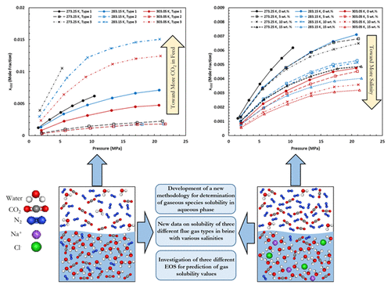
Solubility of Flue Gas or Carbon Dioxide-Nitrogen Gas Mixtures in Water and Aqueous Solutions of Salts
3
Different Flue Gas Types
Different Salinities
Different Temperatures
Different Equations of State

Slide 5
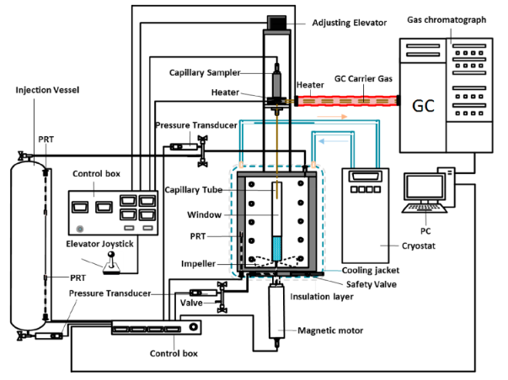
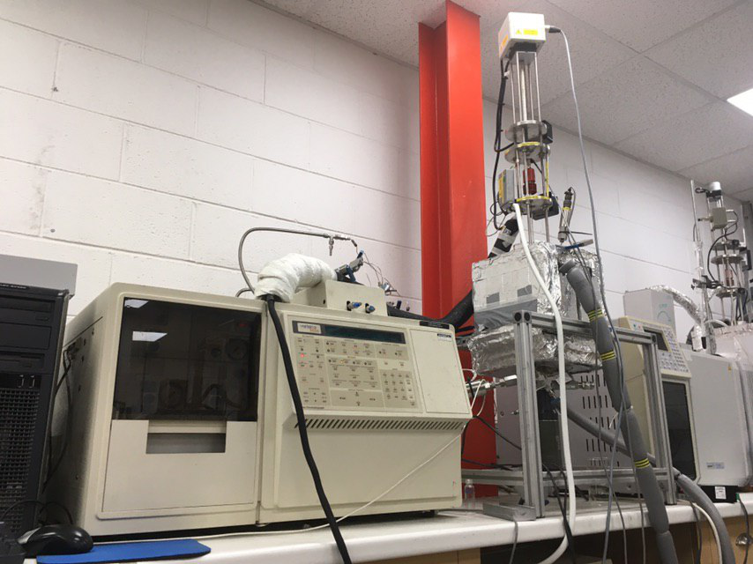
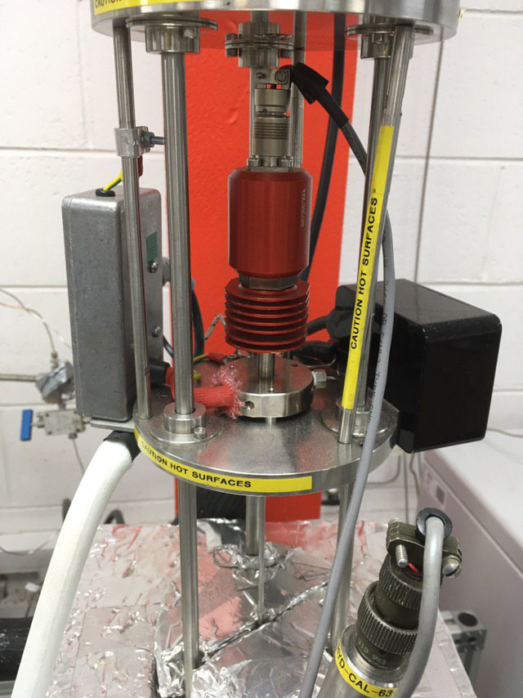
Our Methodology
Capillary Sampler
Hassanpouryouzband, A., Vasheghani Farahani, M., Yang, J., Tohidi, B., Chuvilin, E., Istomin, V. and Bukhanov, B.A., 2019. Solubility of Flue Gas or Carbon Dioxide-Nitrogen Gas Mixtures in Water and Aqueous Solutions of Salts: Experimental Measurement and Thermodynamic Modelling. Industrial & Engineering Chemistry Research.

Slide 6
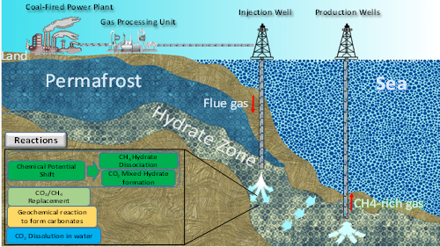
Methane Recovery from Gas Hydrate Reservoirs by Injection of Flue Gas
Overall objectives:
To develop a novel technology to recover methane from frozen gas hydrate reservoirs by flue gas.
Benefits:
Recovering methane from gas hydrates
Sequestrating CO₂ in marine sediments

Slide 7
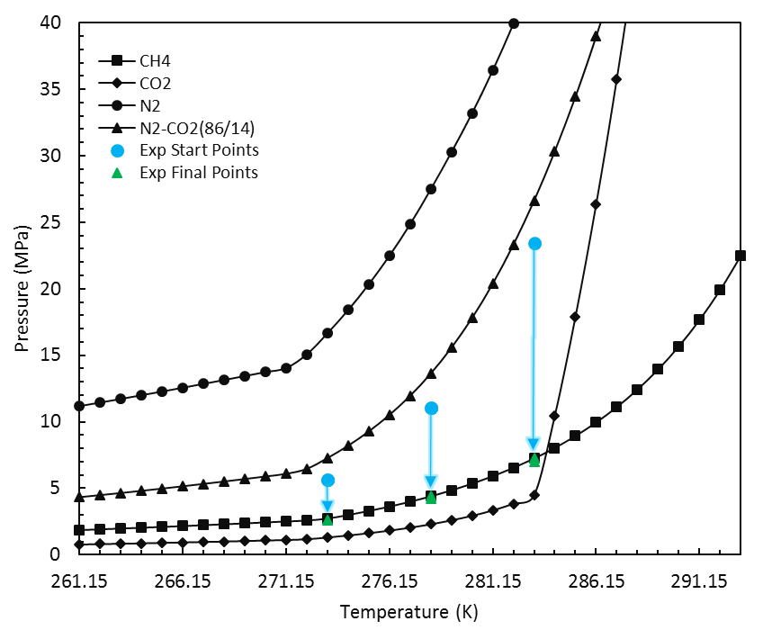
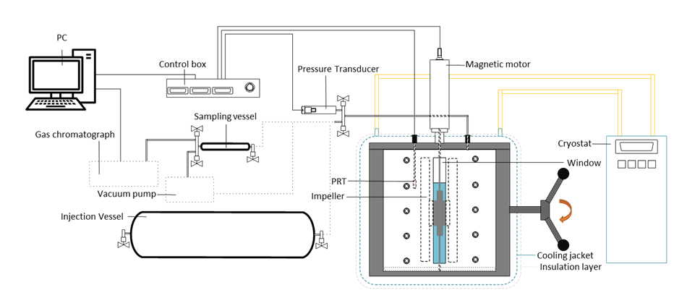
Methodology
Shifting gas hydrate stability zones by direct injection of flue gas into frozen gas hydrate reservoirs
Reactions:
Gas recovery
Fast dissociation of gas hydrates (no need of alcohol and heat, less requirement of depressurization)
Capture and sequestration of CO₂
Formation of CO₂ and CO₂-mixed hydrates
CO₂ dissolution into water
Geochemical reaction to form carbonates
Additional benefits:
Stabilizing of geological formation
Remaining formation energy
April 2017

Slide 8
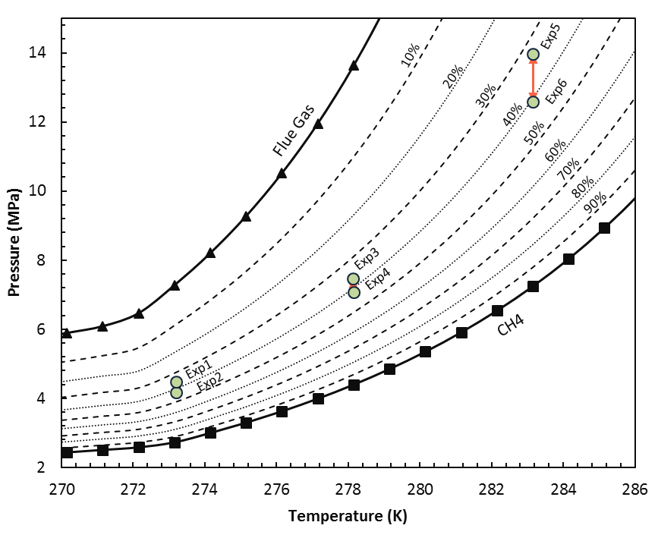
Dependence of CO2 Capture Efficiency on Gas Hydrate Reservoir Conditions
Location of the determined optimum conditions for CO2 capture for different gas hydrate reservoir conditions
Hassanpouryouzband, A., Yang, J., Tohidi, B., Chuvilin, E., Istomin, V., Bukhanov, B. and Cheremisin, A., 2018. CO2 capture by injection of flue gas or CO2–N2 mixtures into hydrate reservoirs: dependence of CO2 capture efficiency on gas hydrate reservoir conditions. Environmental science & technology, 52(7), pp.4324-4330.

Slide 9
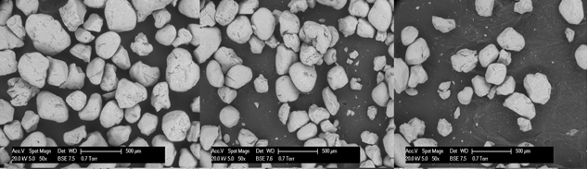
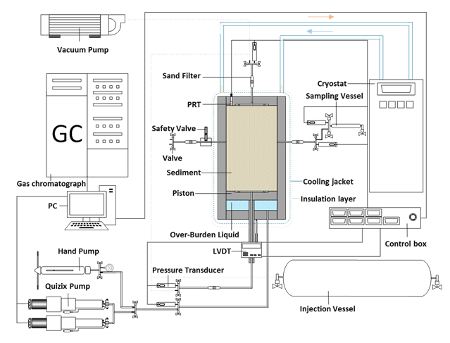
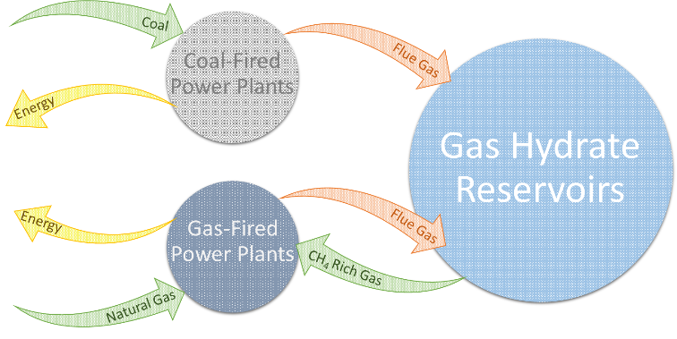
Integrated CO2 Sequestration and Methane Recovery by Injection of Flue Gas into Frozen Methane Hydrate Reservoirs
Hassanpouryouzband, A., Yang, J., Okwananke, A., Burgass, R., Tohidi, B., Chuvilin, E., Istomin, V. and Bukhanov, B., 2019. An Experimental Investigation on the Kinetics of Integrated Methane Recovery and CO 2 Sequestration by Injection of Flue Gas into Permafrost Methane Hydrate Reservoirs. Scientific reports, 9(1), pp.1-9.

Slide 10
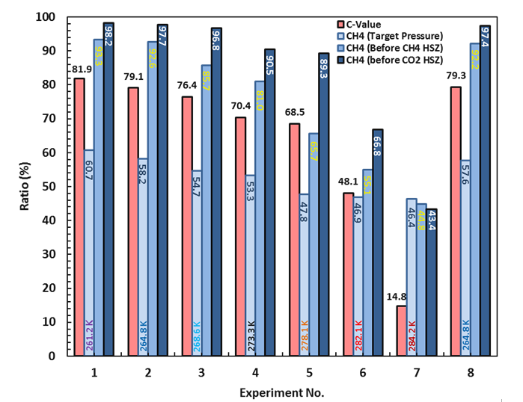
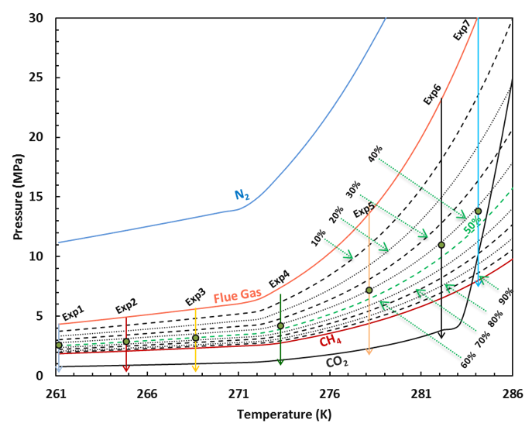
Methane recovery during depressurisation
At sub-zero temperatures CH4 concentration reached to >90% during depressurization.
81.9% of CO2 present in flue gas was captured and stored at 261.2 K.
Calculated C-value, and CH4 concentration
experimental conditions

Slide 11
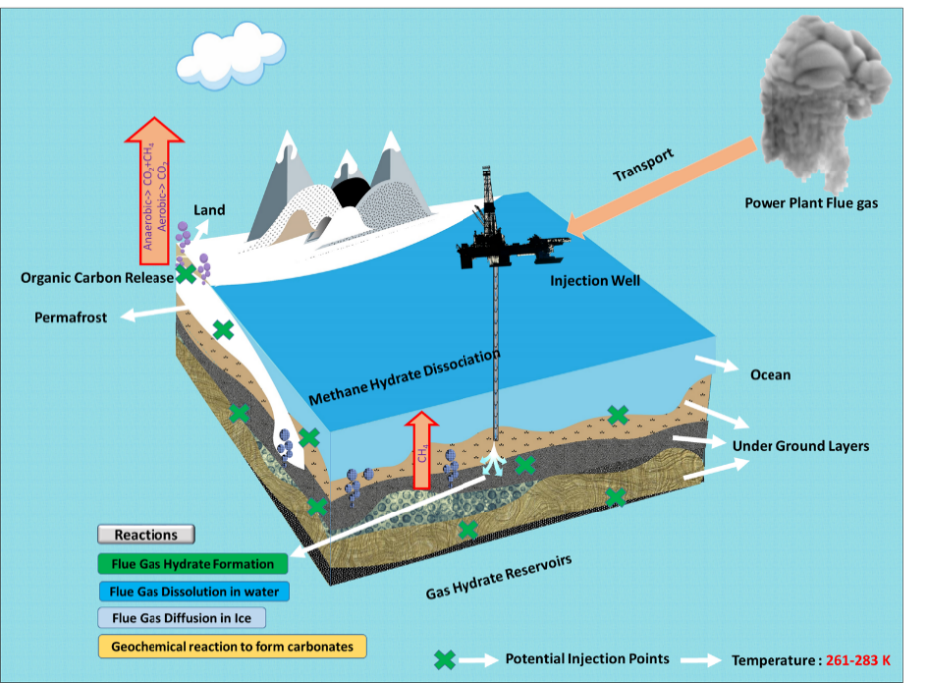
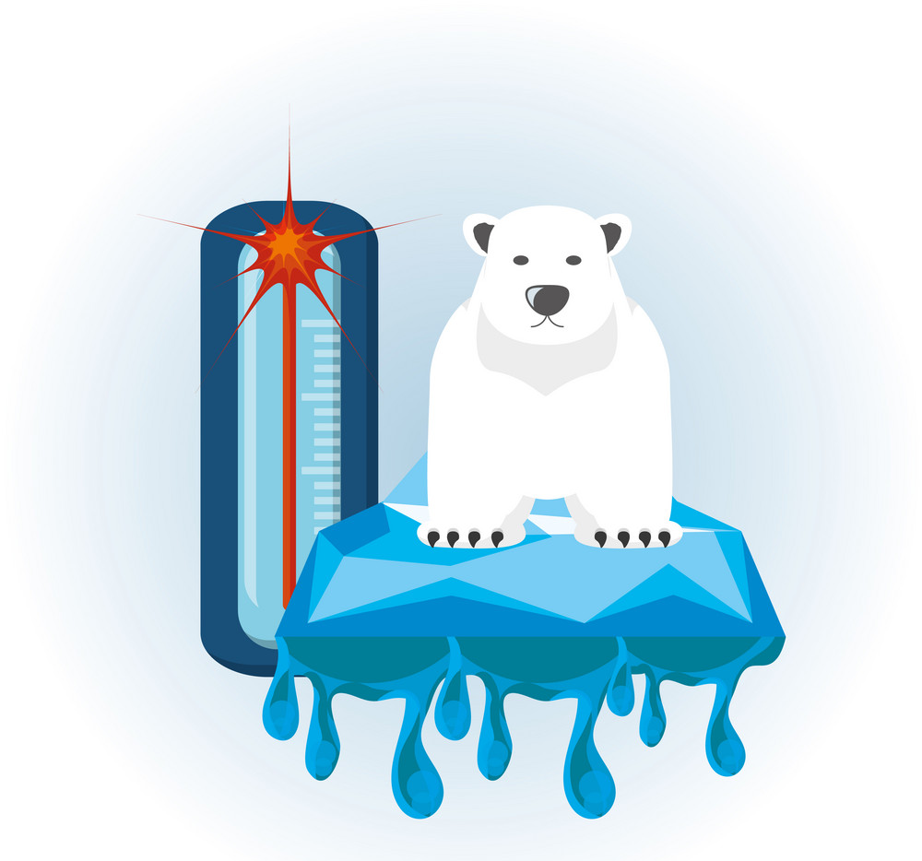
Geological CO2 Capture and Storage with Flue Gas Hydrate Formation in Frozen and Unfrozen Sediments
The increase in temperature in high-latitude regions of
the Earth appears to be occurring twice as fast as
the global average.
Hassanpouryouzband, A., Yang, J., Tohidi, B., Chuvilin, E.M., Istomin, V. and Bukhanov, B.A., 2019. Geological CO2 Capture and Storage with Flue Gas Hydrate Formation in Frozen and Unfrozen Sediments: Method Development, Real Time-Scale Kinetic Characteristics, Efficiency, and Clathrate Structural Transition. ACS Sustainable Chemistry & Engineering.

Slide 12
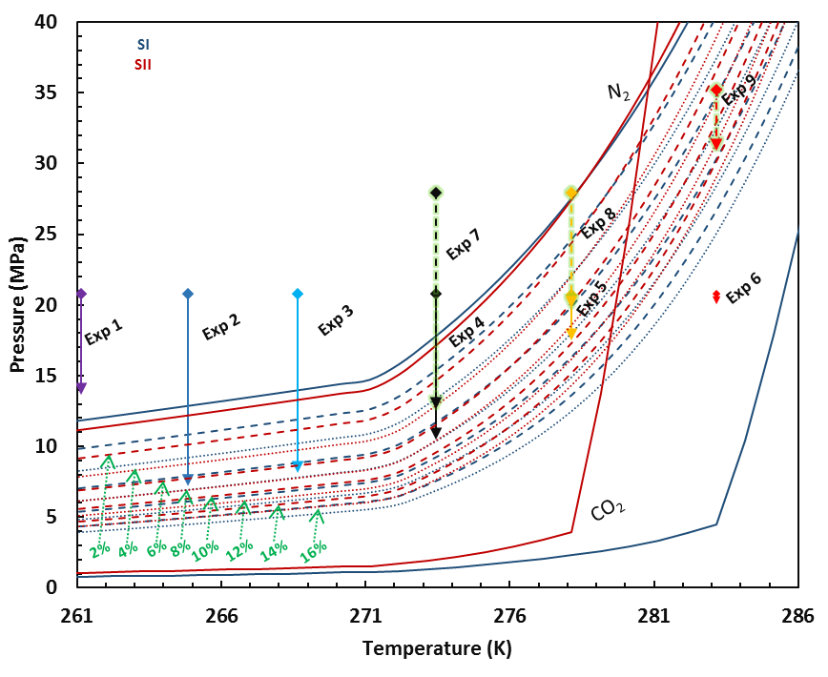
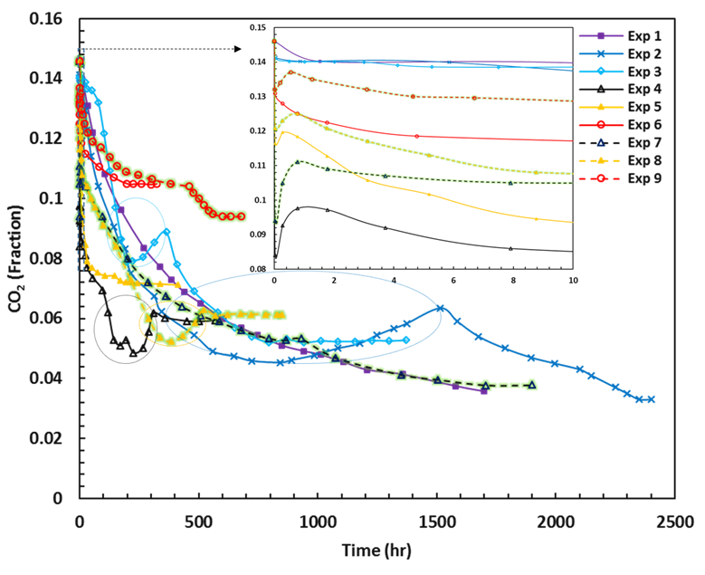
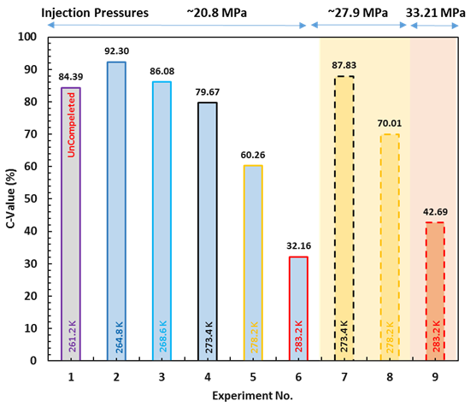
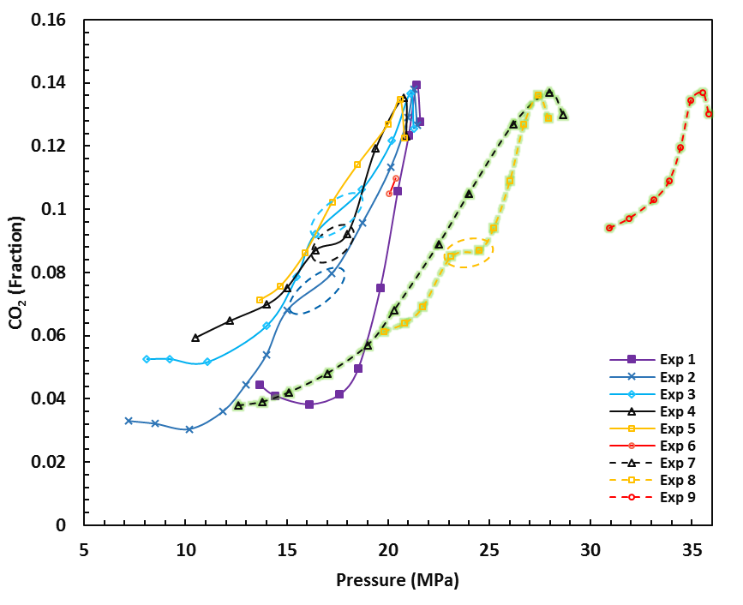
    Main Findings
    Structural change
    Quantitative analysis
    Dissociation of hydrates
Presence of N₂ provides a safety factor for thermal stability of the stored CO₂.

Slide 13
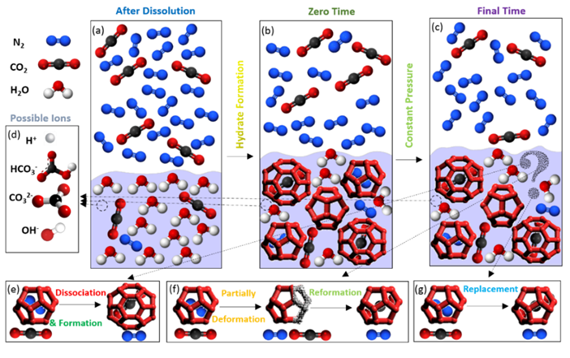
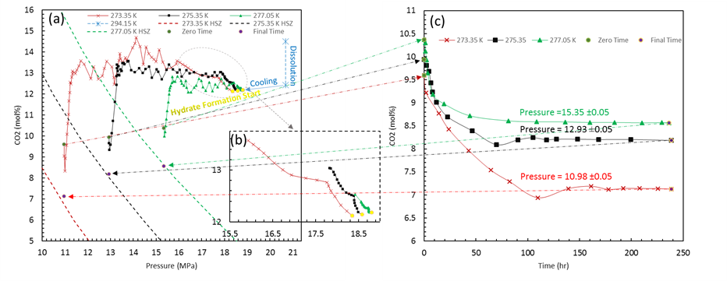
Insights into the CO₂ Capture by Flue Gas Hydrate Formation
(a) Variation in the CO₂ mole fraction in the gas phase versus pressure during experiments; (b) magnification of the selected part of the Fig. 3a; (c) Variation in the CO₂ mole fraction in the gas phase versus time after reaching equilibrium pressure.
Hassanpouryouzband, A., Yang, J., Tohidi, B., Chuvilin, E., Istomin, V., Bukhanov, B. and Cheremisin, A., 2018. Insights into CO2 Capture by Flue Gas Hydrate Formation: Gas Composition Evolution in Systems Containing Gas Hydrates and Gas Mixtures at Stable Pressures. ACS Sustainable Chemistry & Engineering, 6(5), pp.5732-5736

Slide 14
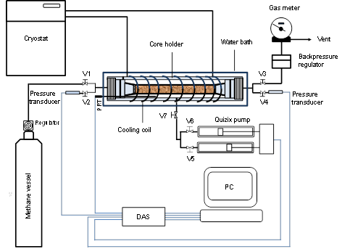
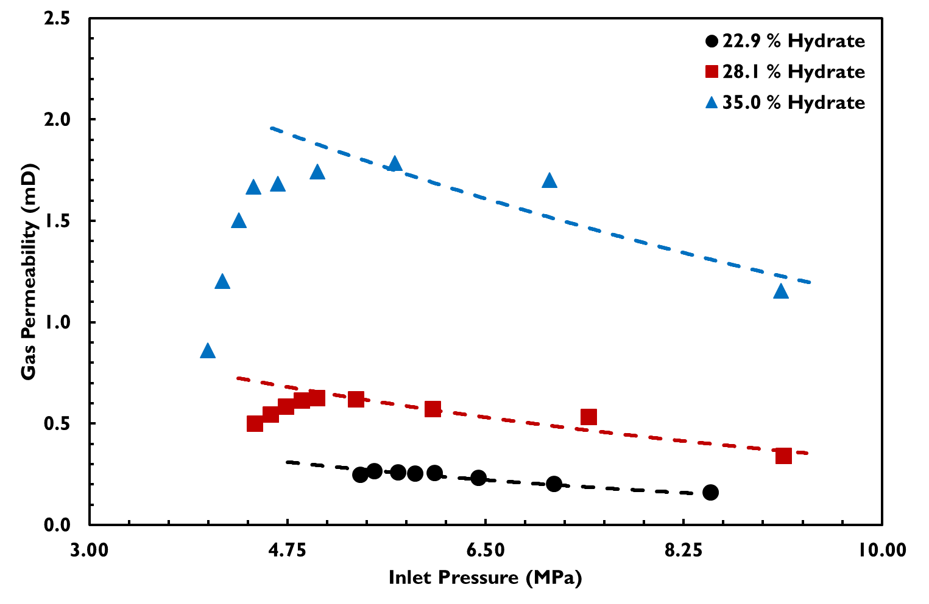
An Experimental Study on the Gas Permeation Characteristics under Varying Pressure
Gas permeability of sand-clay core sample against the inlet pressure
Okwananke, A., Hassanpouyouzband, A., Farahani, M. V., Yang, J., Tohidi, B., Chuvilin, E., ... & Bukhanov, B, 2019. Methane recovery from gas hydrate-bearing sediments: An experimental study on the gas permeation characteristics under varying pressure. Journal of Petroleum Science and Engineering.

Slide 15
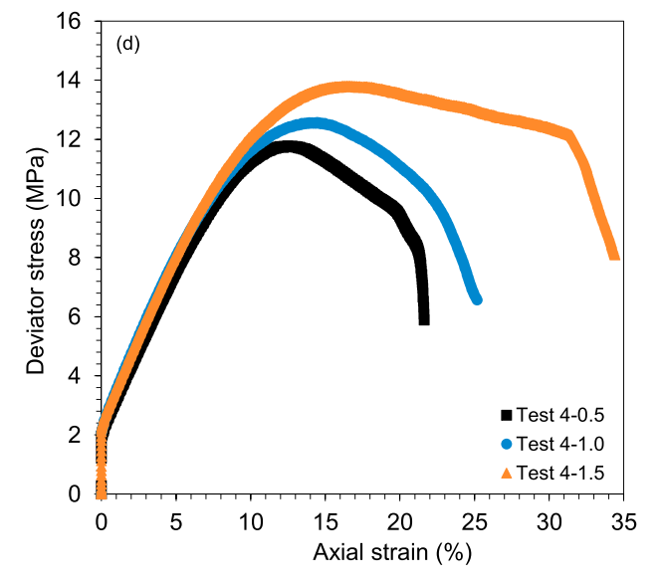
Distinctive Effect of Gas Hydrates and Ice on the Geomechanical Properties of Simulated Hydrate-Bearing Permafrost Sediments
Shear characteristics of hydrate-bearing frozen sediments
Yang, J., Hassanpouryouzband, A., Tohidi, B., Chuvilin, E., Istomin, V., Bukhanov, B. and Cheremisin, A., 2019. Gas Hydrates in Permafrost: Distinctive Effect of Gas Hydrates and Ice on the Geomechanical Properties of Simulated Hydrate-Bearing Permafrost Sediments. Journal of Geophysical Research: Solid Earth.

Slide 16
THANK YOU
For
YOUR
ATTENTION!

