Slide 1
Exploring North Atlantic and North Pacific Decadal Climate Prediction Using Self-Organizing Maps
Qinxue (Sharon) Gu ¹ and Melissa Gervais* ^{1,2,3}
¹ Department of Meteorology and Atmospheric Science , The Pennsylvania State University, University Park, Pennsylvania
² The Institute for Computational and Data Sciences, The Pennsylvania State University, University Park, Pennsylvania
³ Lamont-Doherty Earth Observatory, Columbia University, New York, New York

Slide 2
Motivation
Decadal climate prediction assesses the regional climate conditions and changes on a time scale of 10 to 30 years. It can provide important information to improve the decisions and policies.
Decadal variability is impacted by natural external forcing, anthropogenic external forcing, and internal climate variability.
Predicting internal variability remains a barrier to producing decadal climate predictions.
This study explores the potential use of the self-organizing map (SOM) to:
Identify the internal climate variability
Measure theoretical decadal predictability of internal climate variability
Conduct decadal prediction within a long control simulation.

Slide 3
Data
Community Earth System Model (CESM) 1
· Fully coupled version
· Pre-industrial (1850) radiative forcing conditions
December, January, and February (DJF) Sea Surface Temperature (SST)
· 11-year moving average
Data Length: ~1500 years
Resolution: ~1 degree
Kay et al. 2015

Slide 4
Self-organizing maps (SOM)
Features of the Method:
Unsupervised neural network method
Clusters high dimensional datasets
Handles nonlinear behavior
Not restricted by orthogonality or stationarity
Application of the Method:
Input Data: 1500-yr of CESM pre-industrial DJF SST
Region: North Atlantic (20ºN - 80ºN, 90ºW - 40ºE)
SOM size: 3x4 for total of 12 clusters
Kohonen, 1982
How does SOM work

Slide 5
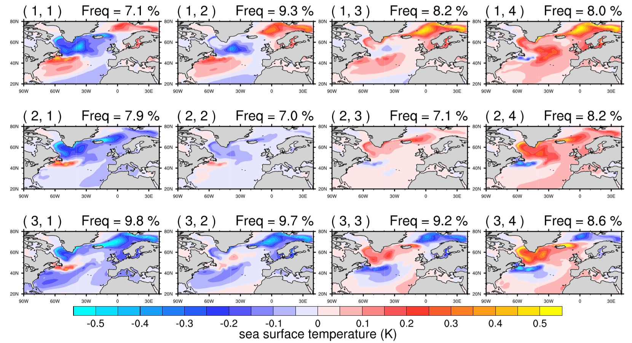
Use SOM to capture the decadal climate variability
Additional Pattern
3x4 SOM for the North Atlantic
AMO warm phase
SOM is organized so nearby (faraway) nodes have similar (different) patterns.
SOM nodes show AMO-like patterns, additional distinguishable patterns, and transition patterns.
Transition patterns
AMO cold phase
Additional Pattern
Gu and Gervais (In Review)

Slide 6
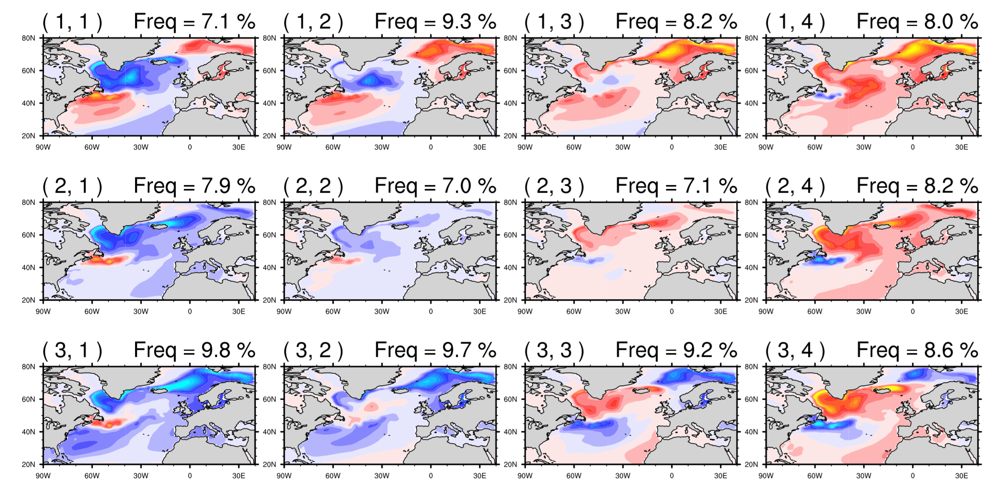
Use SOM to capture the decadal climate predictability
Step 1
Step 2
Determine the probability of being in each node at lag 1 given an initial node i at lag 0.
Apply step 1 to a given initial node i for lags 1 to 30.
Initial Node i
……
 | Lag 1 | Lag 2 | … | Lag 30
Transition probability table for initial node i at each lag. |  |  | …
Predictability of initial node i at each lag based on the number of significant probabilities (colored cells). | 10 | 9 | … | 4
Calculate
Probability
Transition probability table for initial node i at lag 1
%
Significantly lower
Significantly higher than normal
Gu and Gervais (In Review)
Not significant

Slide 7
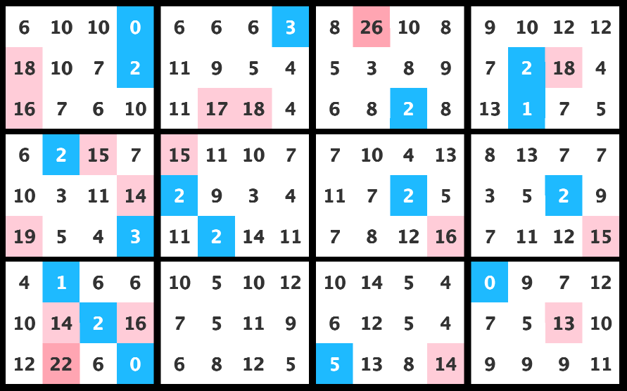
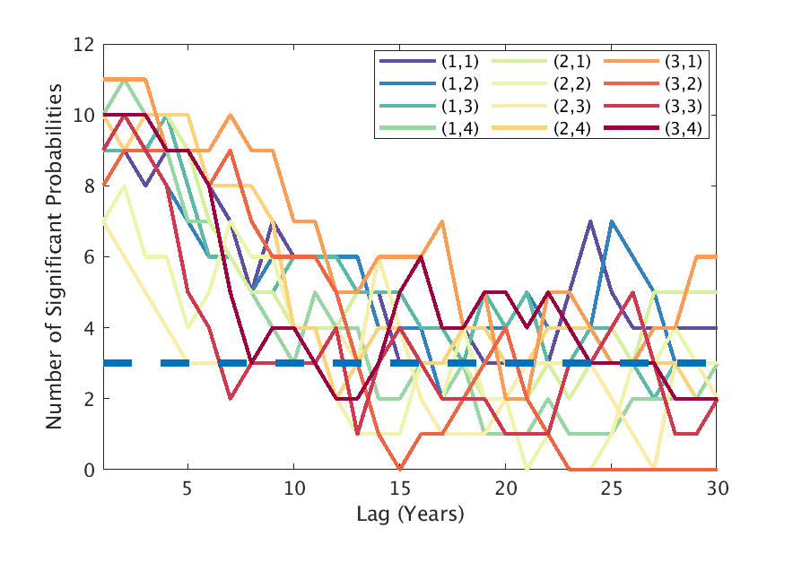
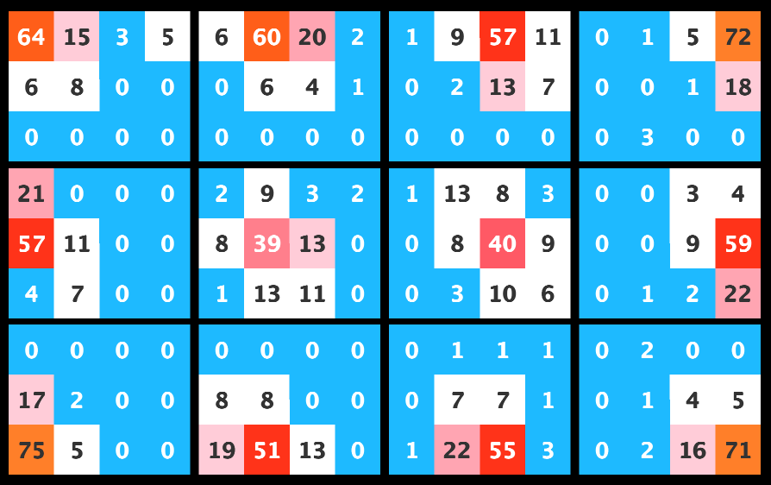
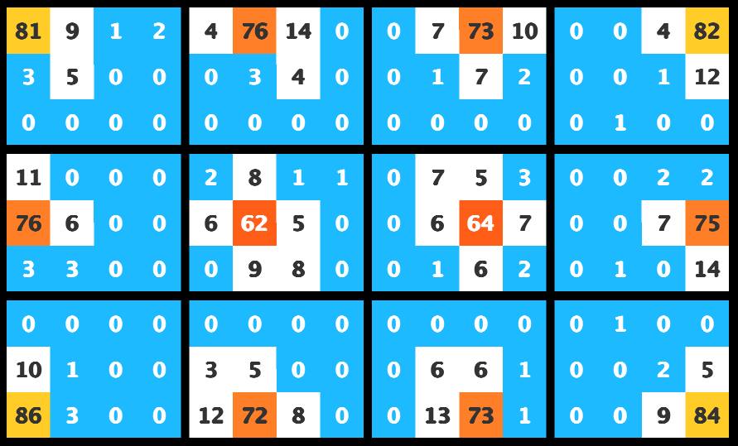
Use SOM to capture the decadal climate predictability
Step 3
Apply step 1 and step 2 to each node. Calculate transition probability tables for each initial node for lags 1 to 30.
Predictability of All Initial Nodes with Lag
Lag 30
……
Lag 3
Lag 2
Lag 1
(1,1)
(1,2)
(1,3)
(1,4)
Initial Node
(2,1)
(2,2)
(2,3)
(2,4)
(3,1)
(3,2)
(3,3)
(3,4)
A node is considered predictable at a given lag if it is globally significant.
Global significance level is achieved, according to Livezey and Chen (1982) field significance theory, if there are 3 or more significant probabilities
Gu and Gervais (In Review)

Slide 8
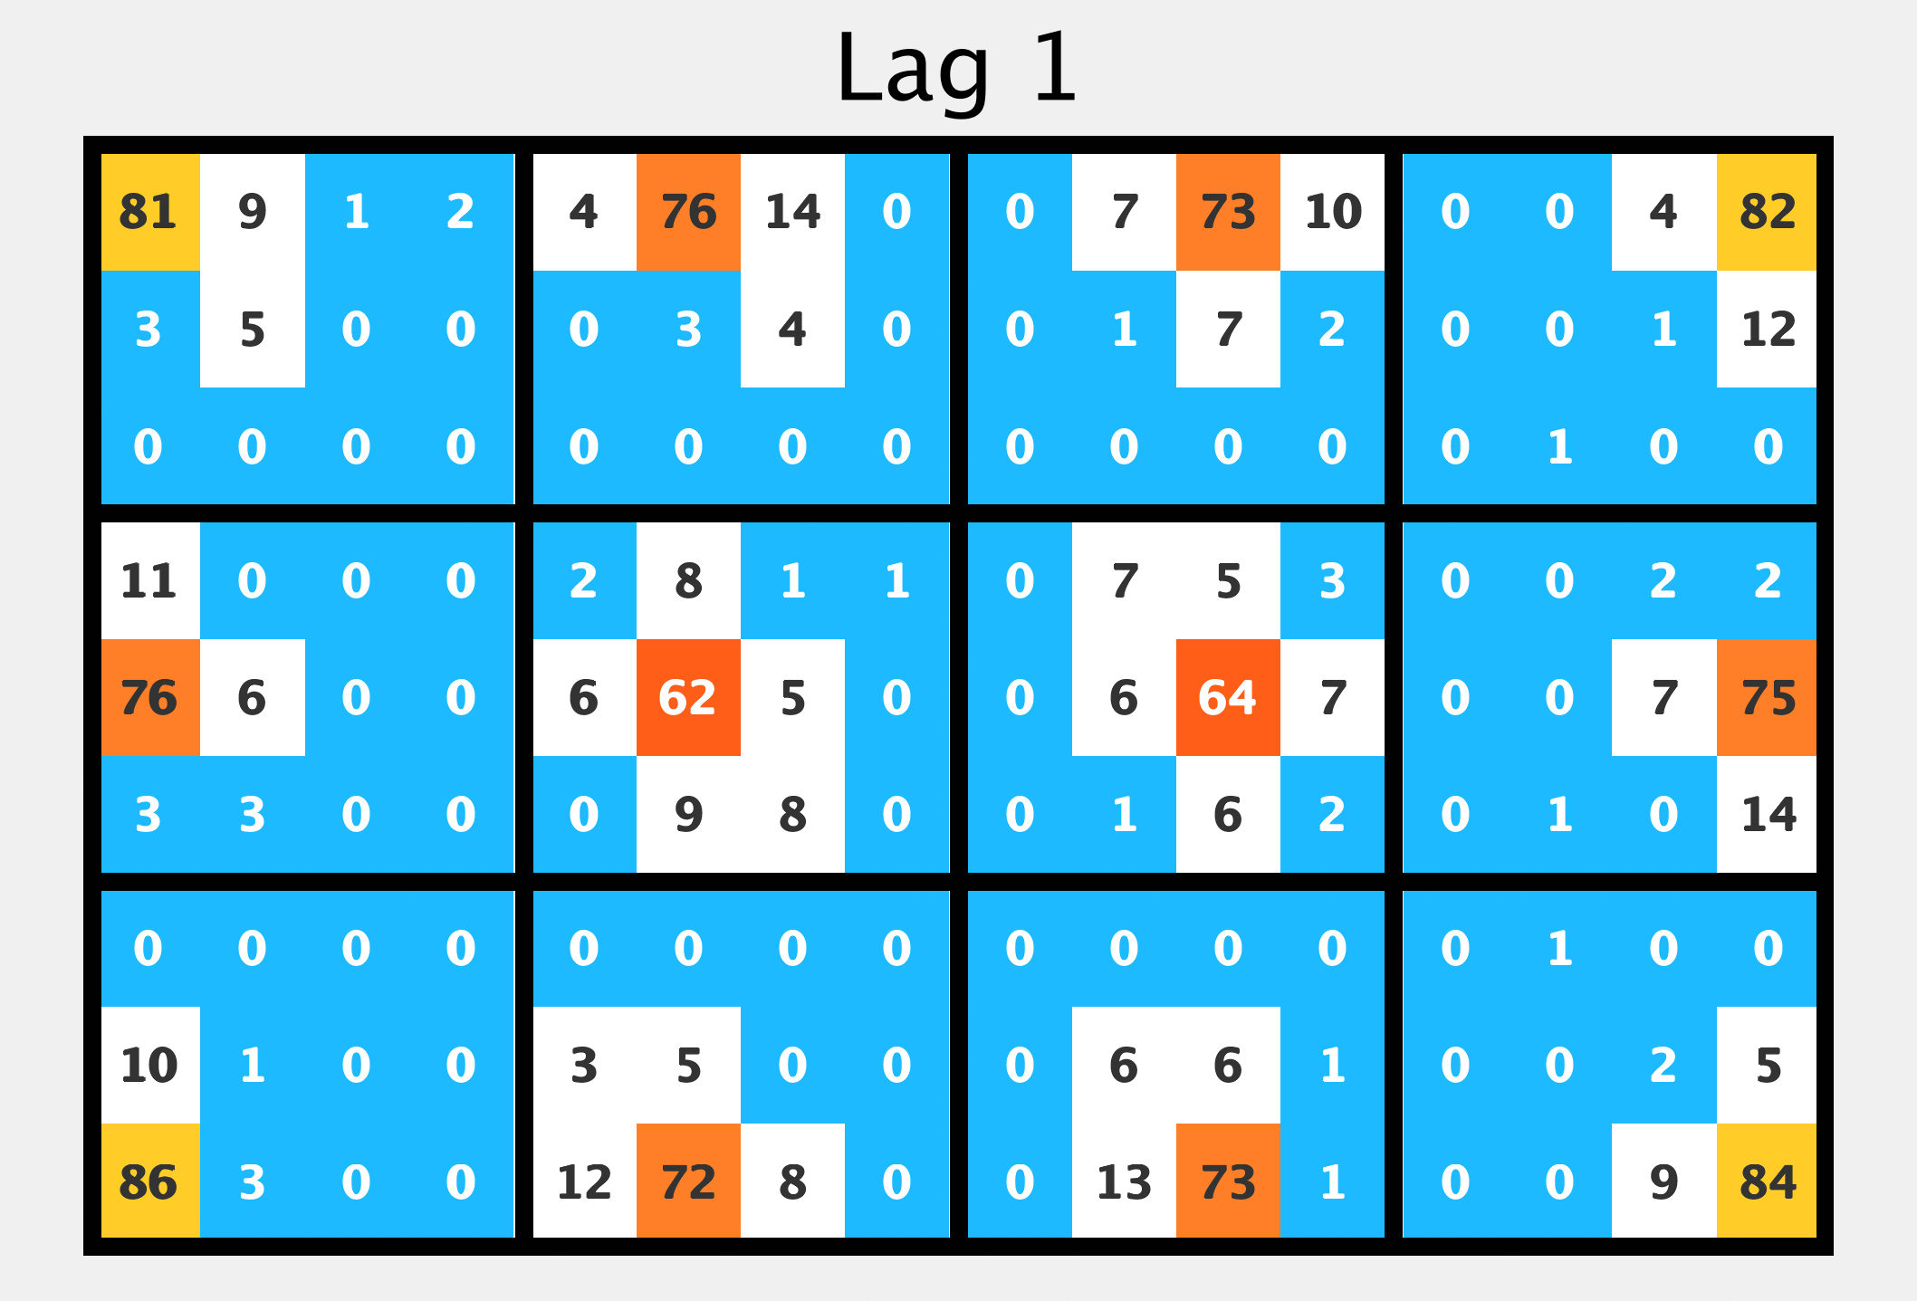
Transition probability tables show different predictability over time
North Atlantic
Click to Animate!
Node (2, 1)
Transitions occur in multiple directions
Persistence and directional transition are the sources of predictability.
Node (3, 1)
transitions occur in a preferred direction
Node (3, 4)
Begins with persistence
Gu and Gervais (In Review)

Slide 9
Transition probability tables show different predictability over time
North Atlantic
Take Home Messages:
SST patterns tend to remain in the initial node or transition to nearby nodes for several years.
Persistence and preferred directional evolution over time are the sources of predictability.
Transitions in multiple directions are less predictable.
Transition probabilities eventually become evenly distributed indicating loss of predictability.
Gu and Gervais (In Review)

Slide 10
Transition probability tables show different predictability over time
Number of significant probabilities of initial nodes show theoretical predictability with lag. Each line is associated with an initial node.
Theoretical predictability over the North Atlantic
Globally Significant level
Gu and Gervais (In Review)

Slide 11
SST pattern prediction using statistical methods
Persistence Forecast:
Predicted pattern is always the same as the initial SOM node.
Transition Probability Forecast:
Predicted pattern is the probability-weighted SOM pattern based on the transition probabilities at each lag.
Evaluation Metric: Anomaly correlation coefficient (ACC)
28 predictions using 300 years withheld data.
Prediction Length: 30 years
$$Predicted pattern=\frac{\sum{(SOM pattern ∗Conditional probability being in each SOM})}{Number of SOM nodes}$$
Gu and Gervais (In Review)

Slide 12
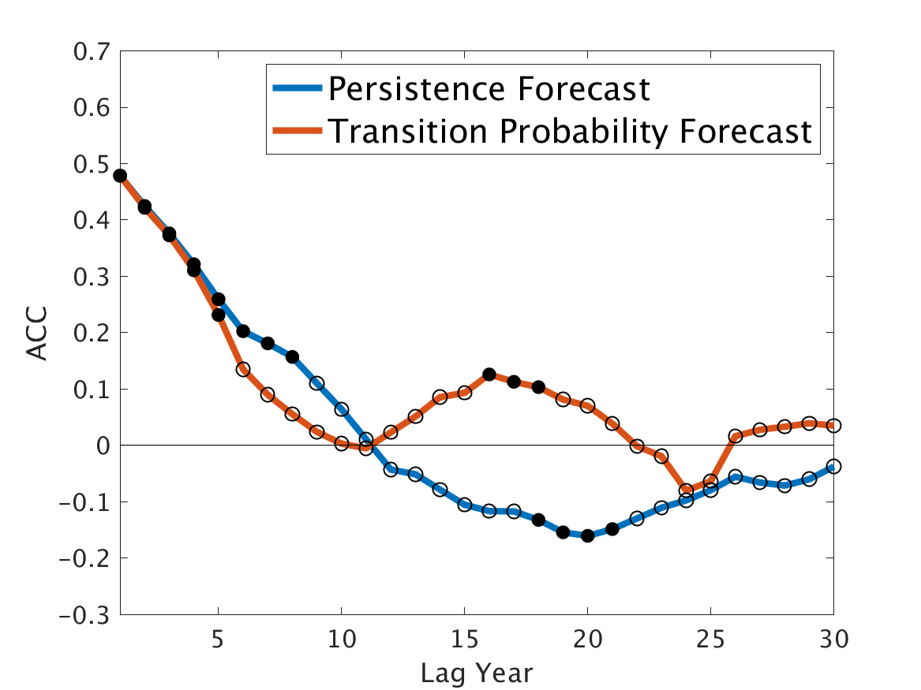
Actual prediction of North Atlantic SST using statistical methods
Reemergence of prediction skill
Persistence is a good predictor for the first 8 lags and then loses skill.
Transition probability prediction has similar skill to persistence at the beginning.
Transition probability has a re-emergence of prediction skill at lag 16, implying that it captures the true evolution in addition to the persistence.
Anomaly correlation coefficient (ACC) with lag, where higher ACC implies great prediction skill. Significant values at the 95% level are shown in filled circles.
Gu and Gervais (In Review)

Slide 13
Summary
SOM
Captures decadal SST variability
Tracks SST transitions
Measures decadal SST predictability
Predicts SST patterns

Slide 14
References
Gu, Q. & Gervais, M. Exploring north atlantic and north pacific decadal climate prediction using self-organizing maps (In Review)
Kay, J. E., Deser, C., Phillips, A., Mai, A., Hannay, C., Strand, G., et al. (2014). The Community Earth System Model (CESM) Large Ensemble Project: A Community Resource for Studying Climate Change in the Presence of Internal Climate Variability. Bulletin of the American Meteorological Society, 96(8), 1333–1349. https://doi.org/10.1175/BAMS-D-13-00255.1
Kohonen, T. (1982). Self-organized formation of topologically correct feature maps. Biological Cybernetics. https://doi.org/10.1007/BF00337288
Kosaka, Y., & Xie, S. P. (2013). Recent global-warming hiatus tied to equatorial Pacific surface cooling. Nature, 501(7467), 403–407. https://doi.org/10.1038/nature12534
Livezey, R. E., & Chen, W. Y. (1983). Statistical field significance and its determination by Monte Carlo techniques. Monthly Weather Review, 111(1), 46–59. https://doi.org/10.1175/1520-0493(1983)111<0046:SFSAID>2.0.CO;2
Newman, M., Alexander, M. A., Ault, T. R., Cobb, K. M., Deser, C., Di Lorenzo, E., et al. (2016). The Pacific decadal oscillation, revisited. Journal of Climate, 29(12), 4399–4427. https://doi.org/10.1175/JCLI-D-15-0508.1
Thank you for watching!
If you have any thoughts/comments/suggestions, please contact with us.
Qinxue (Sharon) Gu: qzg18@psu.edu
Melissa Gervais: mmg62@psu.edu

