Slide 1
On uncertainty in geoscience decision making
1
Cristina G. Wilson ^{1, 2} Thomas F. Shipley ¹
2
EGU Online
May 2020

Slide 2
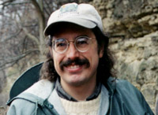
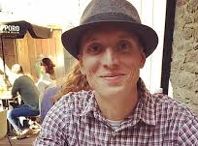
M. Ani Hsieh
Feifei Qian
Dan Koditschek
Basil Tikoff
Randy Williams
Alix Davatzes
Doug Jerolmack

Slide 3
Uncertainty is a feature of all science.
In uncertain conditions, humans constrain decision making using heuristics, i.e., rules of thumb.
Though satisfactory for many decisions, heuristics can lead to less-than-optimal decisions, known as biases.
Expertise does not protect against bias.
Our research in the growing field of metascience aims to better understand the cognitive processes underlying scientific decision making, with the aim of improving science by supporting scientists’ most important tool, their minds.
“whenever there is a simple error that most laymen fall for, there is always a slightly more sophisticated version of the same problem that experts fall for” -- Amos Tversky (Gardener, 1985, p. 360)

Slide 4
Geoscientists have long appreciated the influence of uncertainty on their cognition and the value of a metascience approach
Cognitive psychology, Geoscience, and Engineering
a Trading Zone (Galison, 1998)
“Evidently, if the investigator is to succeed in the discovery of veritable explanations of phenomena, he must be fertile in the invention of hypotheses and ingenious in the application of tests. The practical questions for the teacher are, whether it is possible by training to improve the guessing faculty, and if so, how it is to be done. To answer these, we must give attention to the nature of the scientific guess considered as a mental process. Like other mental processes, the framing of hypotheses is usually unconscious, but by attention it can be brought into consciousness and analyzed.”
--G.K. Gilbert (1886, pp. 286-287)

Slide 5
Wilson, C. G., Bond, C. E., and Shipley, T. F.: How can geologic decision-making under uncertainty be improved?, Solid Earth, 10, 1469–1488, https://doi.org/10.5194/se-10-1469-2019, 2019.
Wilson, C.G., Shipley, T. F., & Davatzes, A.:
Evidence of vulnerability to decision bias in expert field scientists,
Applied Cognitive Psychology, in-press, 2020.
Spatiotemporal data collection decisions
What heuristics do experts rely on when making data collection decisions?
Can heuristics be flexibly adapted by making real-time in-situ data available?
Workflow for mapping geologic uncertainty
How should experts represent and communicate uncertainty about data and interpretations during geologic mapping?

Slide 6
Spatiotemporal data collection decisions

Slide 7
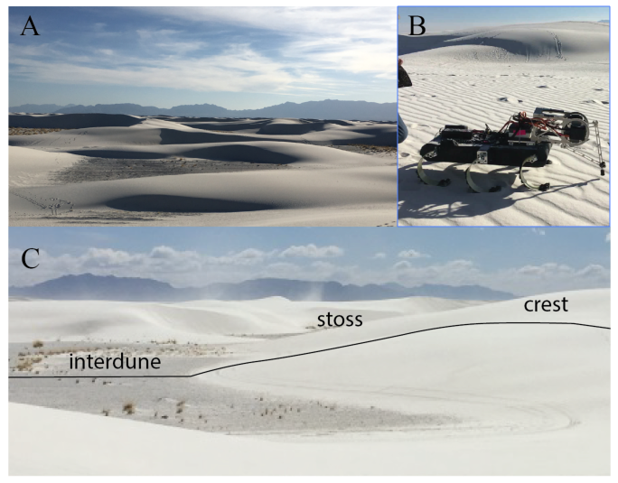

Slide 8
Step 1. Select an initial sampling strategy
Total Number of Locations
Order to Visit Locations
Number of Samples at Each Location
1
2
3
4
5

Slide 9
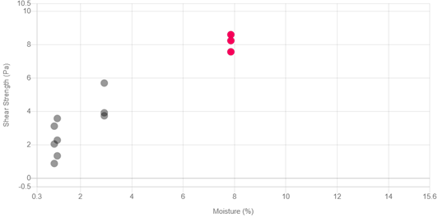
Step 2. RHex executes strategy with option to adapt based on in-situ data
1
2
3
4
5

Slide 10
Wilson, C.G., Qian, F., Jerolmack, D., Shipley, T., Roberts, S., Ham, J., & Koditschek, D.: Data foraging: Spatiotemporal data collection decisions in disciplinary field science,
Cognitive Science Society Virtual Meeting 2020
Participate in ongoing research:
Recruiting expert geologists and students (undergraduate, graduate)
https://www.seas.upenn.edu/~shenyuec/
username: rhex, passsword: rhex

Slide 11
Workflow for mapping geologic uncertainty

Slide 12
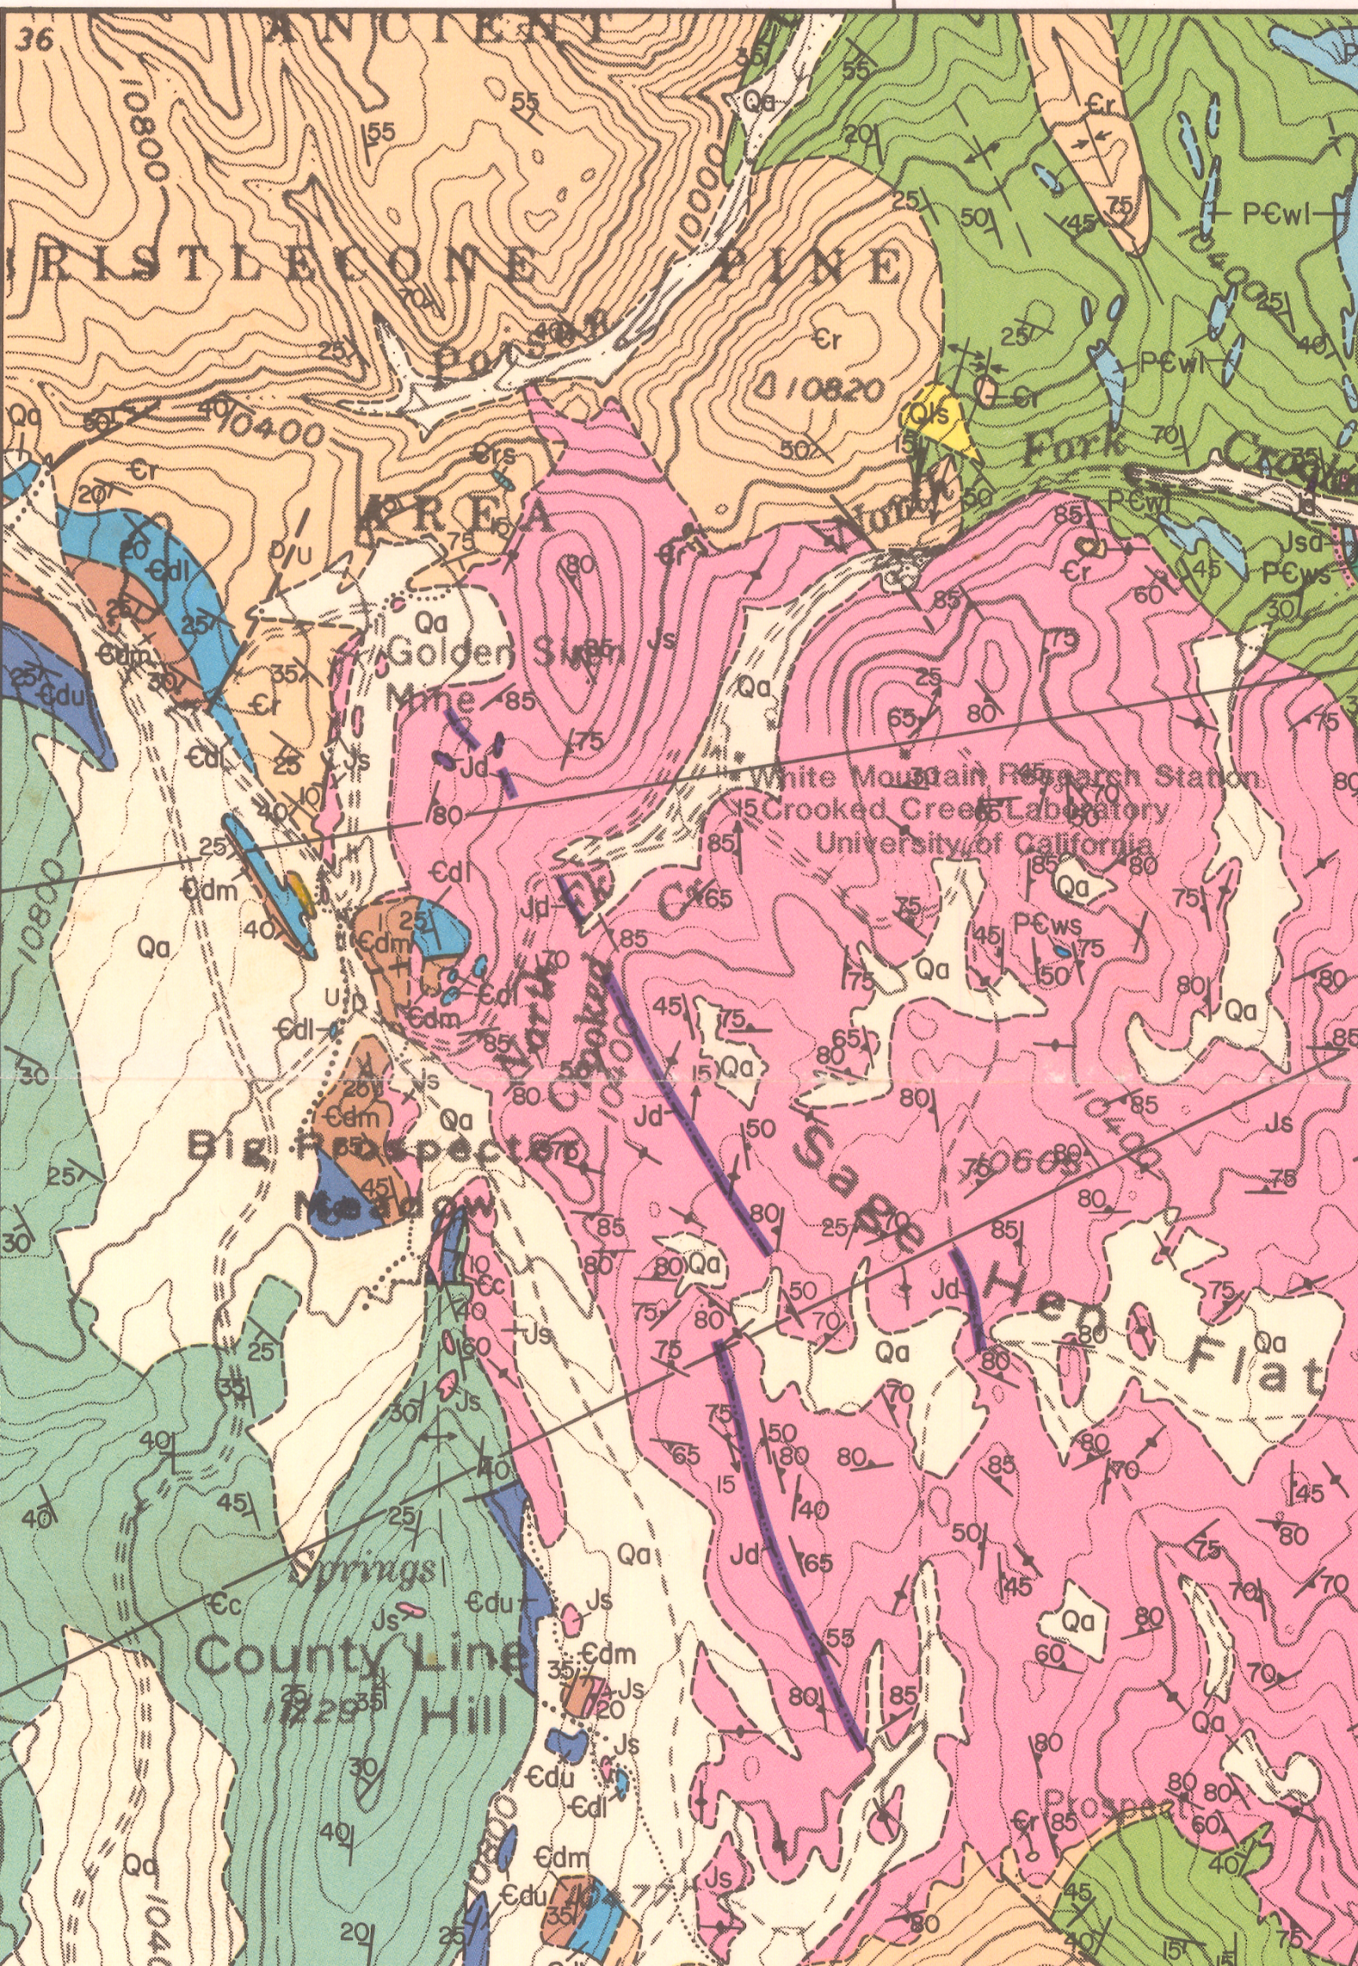
1993, Bilodeau & Nelson
1974 – 1986, Ernst & Hall

Slide 13
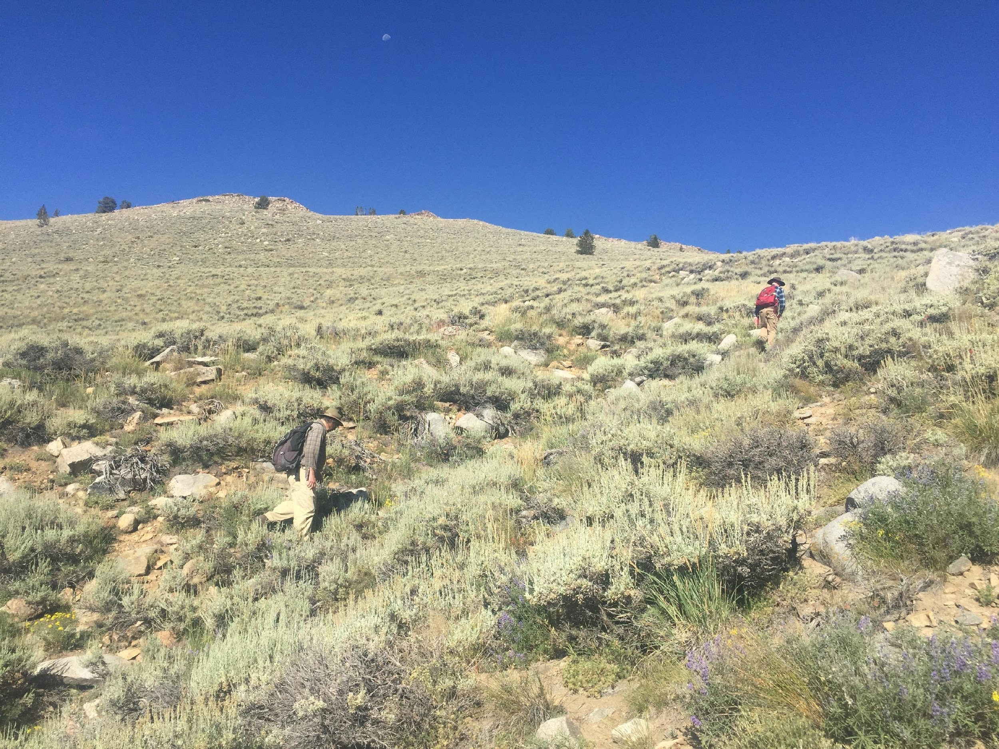
Reed Dolomite, Sage Hen contact– Sage Hen Flats, CA
Photo by Tim Shipley

Slide 14
1993, Bilodeau & Nelson
1974 – 1986, Ernst & Hall

Slide 15
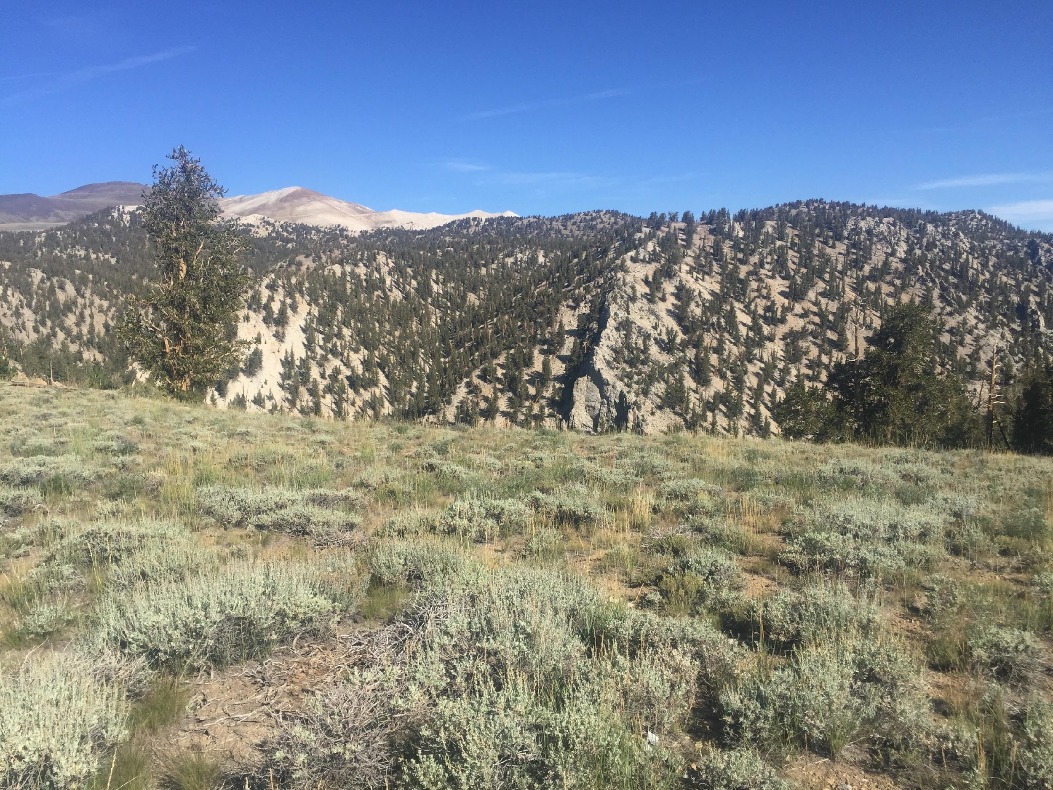
Reed Dolomite, Sage Hen contact– Sage Hen Flats, CA
Photo by Tim Shipley

Slide 16
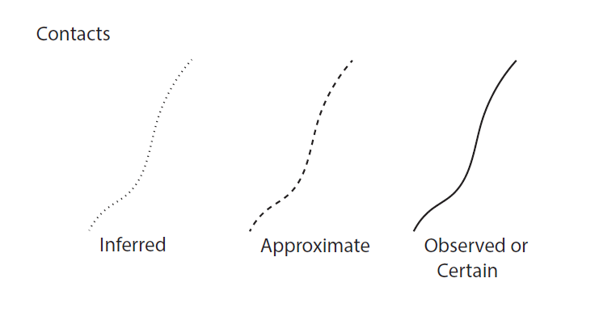

Slide 17
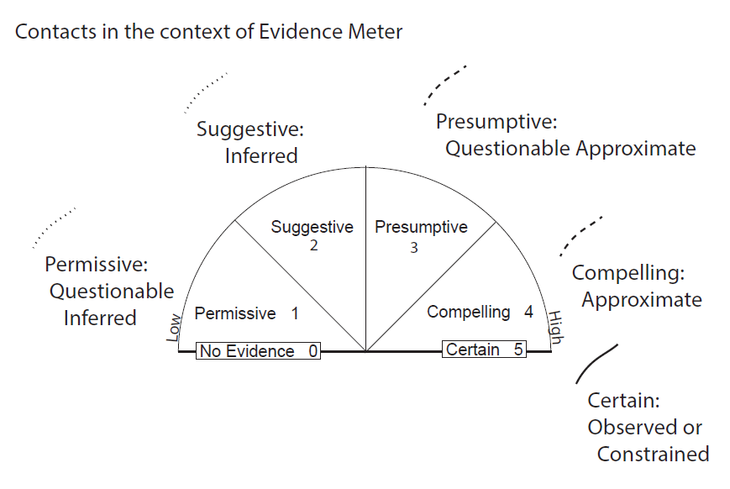

Slide 18
Suggestive indicates that there is positive evidence for a particular interpretation, but that the evidence also allows the possibility for other interpretations.
Presumptive – defined as “presumed in the absence of further information“– indicates that an interpretation is “more likely right than wrong”.
Permissive is the least certain form of evidence. Permissive suggests that a particular idea or interpretation cannot be ruled out, but it is also not the only available solution.
Compelling indicates that the evidence is strongly supportive of the interpretation. Compelling evidence for an interpretation is based on a preponderance of positive evidence.
Certain indicates that there is a direct and resolvable link between the evidence and a particular interpretation.

Slide 19
There are 4 features of an outcrop that a data uncertainty ranking system could be applied to:
1. Attachedness
The determination of whether the rock at the Earth’s surface is directly connected – and therefore is representative of – the rocks below the surface at that location.
2. Lithological Correlation
The determination of whether a particular rock belongs to a larger group of rocks. An expert geologist will be able to determine a rock type with high certainty at most outcrops – the bigger question is whether they can unambiguously decide what formation it belongs to.
3. Three-Dimensional Geometry
The determination of the internal features of an outcrop. An example of 3D Geometry is the determination of strike and dip of bedding. Again, most expert geologists in well understood field settings can do this with high certainty – but there are some cases where one is not certain.
4. Kinematics
The determination of the movement of the rock. In most cases, for sedimentary rocks, this is the determination of paleoflow based on sedimentological features. For deformed rocks, this is the determination of relative movement.

Slide 20
We are providing materials for a virtual field camp module for students participating in field camps during Summer 2020. The module is designed to help students think about geological uncertainty and how it manifests in data and models.
For more information:
Email cristina.wilson@temple.edu

Slide 21
M. Ani Hsieh
Feifei Qian
Dan Koditschek
Basil Tikoff
Randy Williams
Alix Davatzes
Doug Jerolmack

Slide 22
Thank You

