Slide 1
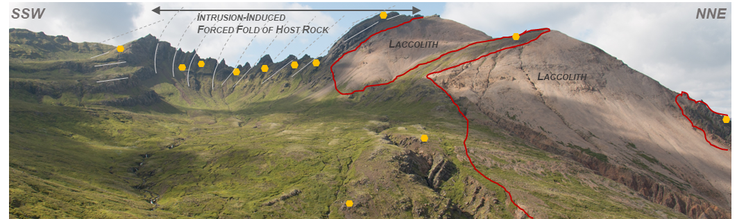
Unravelling magma emplacement through palaeomagnetic backstripping of an intrusion-induced forced fold:
A case study from the Sandfell Laccolith, SE Iceland
Vincent Twomey¹
William McCarthy¹, Craig Magee², Mike Petronis³
¹ School of Earth & Environmental Sciences, University of St Andrews, St Andrews, Fife, UK.
² School of Earth and Environment, University of Leeds, UK.
³ Department of Natural Resources Management New Mexico Highlands University, Las Vegas, NM, USA.

Slide 2



-Injection and inflation of intrusions in the shallow crust commonly produces overlying forced folds and surface deformation
-Dynamic interaction between progressive emplacement of hot magma, roof uplift, and any associated fracture/fault development remains poorly understood.
T0
Layered host rock
T1
Emplacement & initial inflation
Simple schematic diagram outlining possible elastic and inelastic deformation structures in layered host rock associated with incremental sheet emplacement during laccolith formation with inferred pmag vector deflections
Time (T)
Vertical inflation of sheet
T2
Emplacement of second sheet
Aim: Can Palaeomagnetism help:
record progressive host rock deflection during incremental laccolith construction;
Constrain the rate/duration of intrusion and/or cooling.
Vertical inflation of 2nd sheet
T3
Palaeomagnetic reference
Cooling and relaxation of intrusion
NRM
TRM

Slide 3
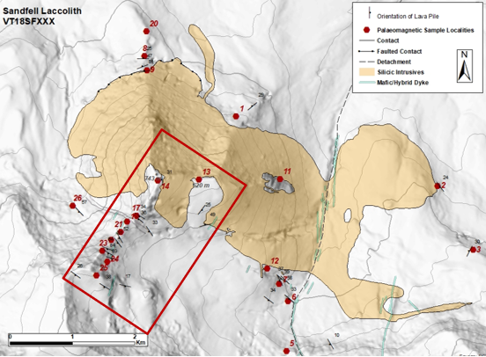
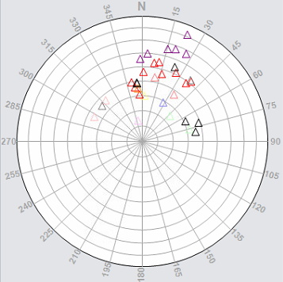
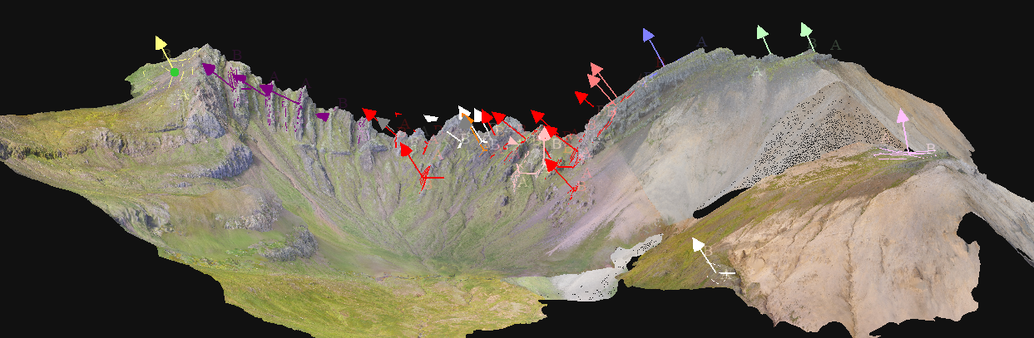
-We integrate palaeomagnetic techniques with semi-automated, UAV-based photogrammetric structural mapping
Test site is within the Neogene lava pile of the ~800 m wide structural aureole of the rhyolitic Sandfell Laccolith in SE Iceland,
-Intruded <1 Km below the palaeosurface at ~11.7 Ma.
3D model & interpretation of large-scale host-rock deformation at SW contact the of Upper Sandfell Laccolith
The dip of the layered host rock steepens away contact within the structural aureole
Rhyolitic,
Sandfell Lacolith
Poles to dip of lava piles
Pmag Locality
200 m

Slide 4
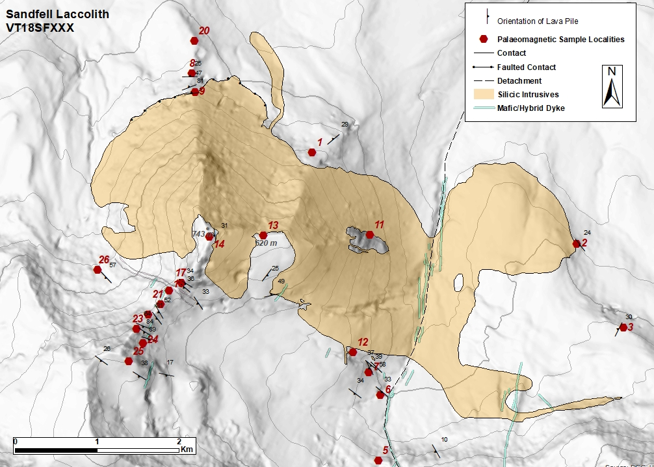

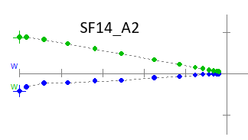
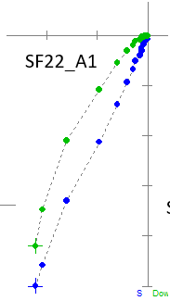
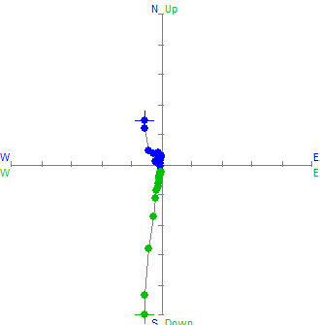
-09
-Aim to test a new hypothesis suggesting that thermoremanent magnetization (TRM) records progressive deflection of the host rock during incremental laccolith construction and that these measurements can be used to measure the rate of laccolith construction.
-Initial results rocks respond well to AF demagnetization

