Slide 1
SEARCHING FOR THE MISSING PLASTIC
A global surface mass budget for floating ocean plastics.
Laurent Lebreton & Matthias Egger - EGU2020

Slide 2
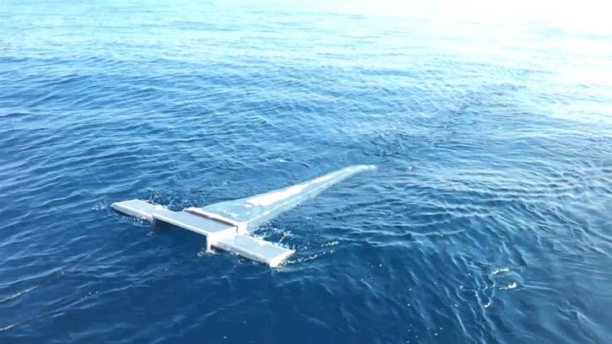
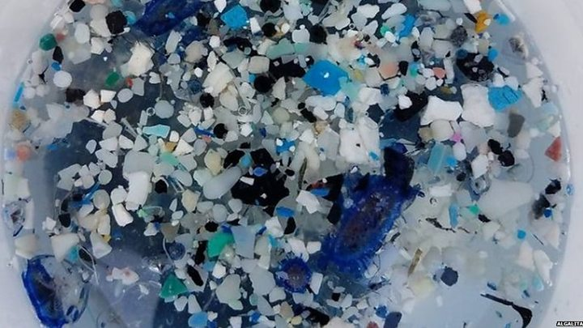
PLASTICS IN THE OCEAN
SURFACE SAMPLING
Floating plastic pollution samples are traditionally collected using surface trawls.
Satellite imagery, aerial, vessel-mounted photography or visual sightings have also been used to detect the presence of larger objects
Floating plastic pollution varies in shape and size with plastic particles ranging from nano- and micro-scale to several meters.

Slide 3
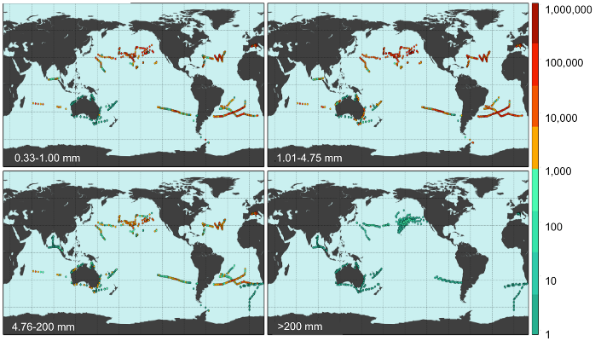
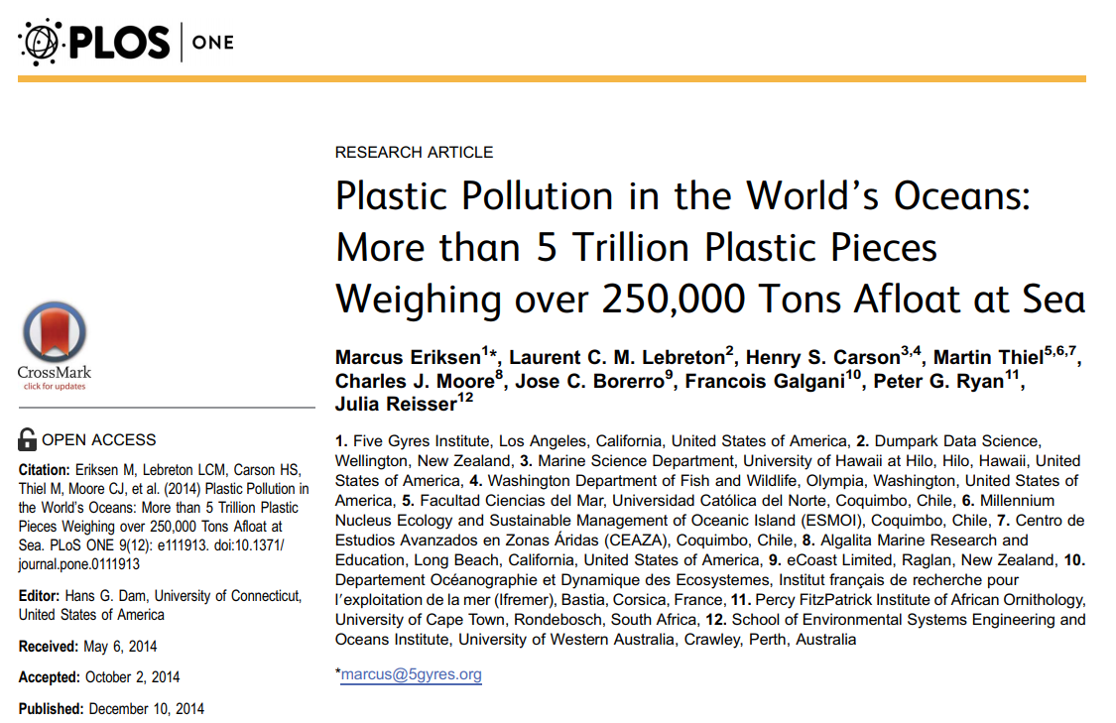
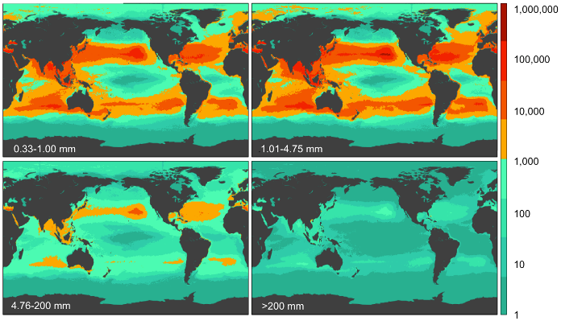
HOW MUCH PLASTIC IS FLOATING IN THE OCEAN?
PREVIOUS WORK
Calibrating numerical models with surface samples

Slide 4
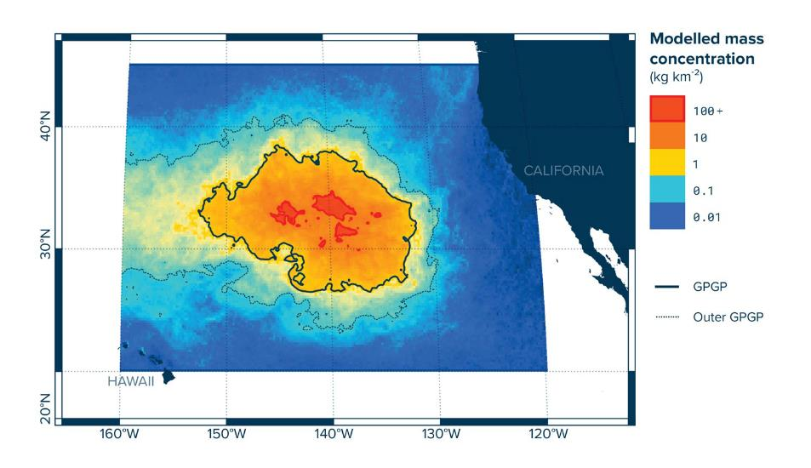
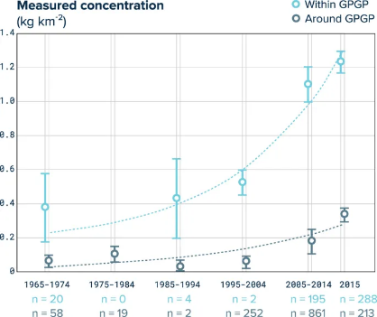
EVIDENCES OF ACCUMULATION
THE GREAT PACIFIC GARBAGE PATCH
A multi-vessel expedition and aerial reconnaissance mission revealed the extent of pollution.
Multi year sample analysis supported with numerical models suggest a rapid accumulation of microplastics in the region.

Slide 5
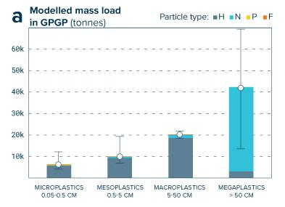
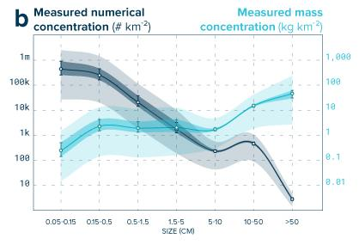
EVIDENCES OF ACCUMULATION
THE GREAT PACIFIC GARBAGE PATCH
We predicted at least 79 (45-129) thousand tonnes of ocean plastic were floating inside an area of 1.6 million km² in 2015.
Over three-quarters of the GPGP mass was carried by debris larger than 5 cm and at least 46% was comprised of fishing nets.
Microplastics accounted for 8% of the total mass but 94% of the estimated 1.8 (1.1-3.6) trillion pieces floating in the area.

Slide 6
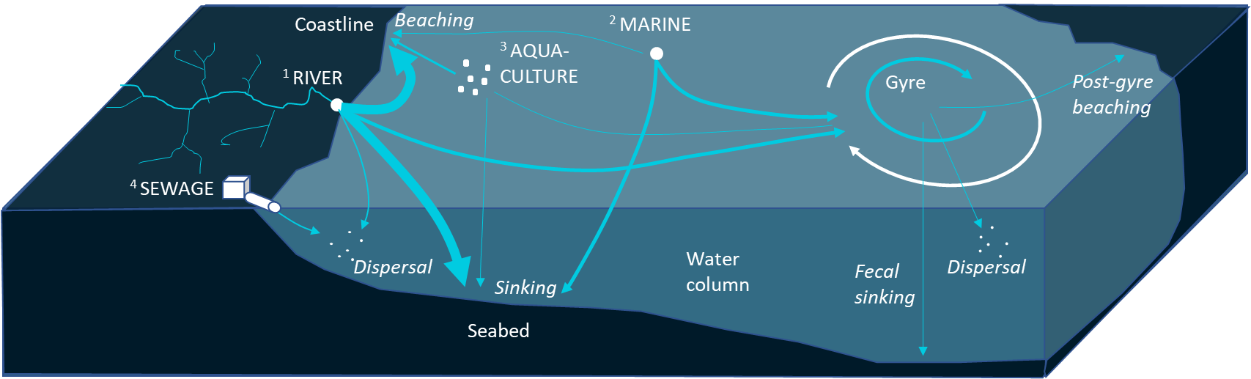
THE MISSING PLASTIC
The predicted mass of plastic floating at the surface of the ocean is one to two orders of magnitude smaller than the anticipated inputs. Where is all the rest?
<1 million tonnes accumulated
1-10 million tonnes
per year

Slide 7
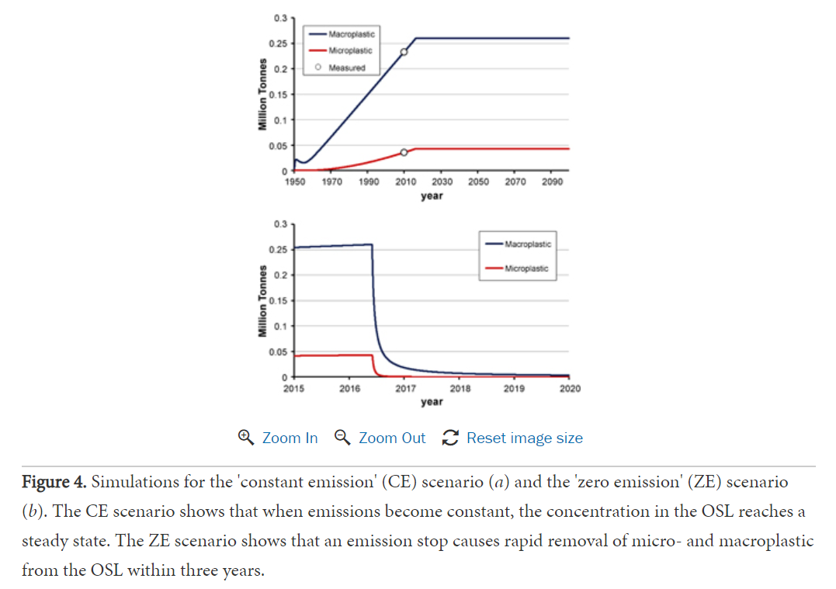
THE MISSING PLASTIC
SUGGESTING LOW SURFACE PERSISTENCY
Floating ocean plastic rapidly degrades and settles below the surface (>90% per year)
Emission stop causes rapid removal from the ocean surface layer within three years
All is not lost: deriving a top-down mass budget of plastic at sea. Koelmans et al. (2017)

Slide 8
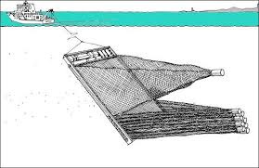
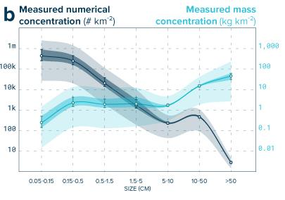
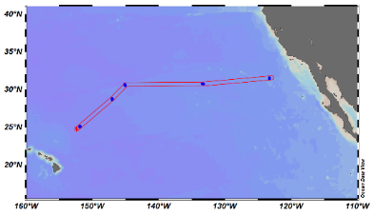

THE MISSING PLASTIC
SIZE SELECTIVE REMOVAL PROCESSEs
The smaller fraction of microplastics (0.5-1.5mm) is underrepresented in surface samples.
Possible explanation is a larger surface to volume ratio presented by these particles reducing their chance to maintain buoyancy when biofouled.
First evidence of plastic fallout from the Great Pacific Garbage Patch presented by Matthias Egger (Session D2191 | EGU2020-2387)

Slide 9
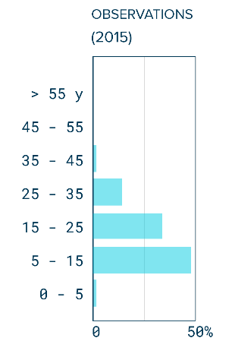
THE MISSING PLASTIC
LOW SURFACE PERSISTENCY - CONTRADICTIONS
Decades old plastic objects are commonly found floating in the Great Pacific Garbage Patch
Photo-oxidation of plastics is severely reduced when plastic is submerged at sea.
The formation of garbage patches predicted by numerical models requires several years of transport and accumulation of flotsam. If most plastic would survive less than 3 years at the surface, we would not see floating garbage patches forming.
Documenting evidences on ocean plastics
Age distribution of ocean plastics with an identifiable production date.
(Great Pacific Garbage Patch )
Production date labels

Slide 10
NATURAL SELECTION OF PLASTIC
Coastal plastic (Andres Cozar, UoC)
GPGP plastic (Mega Expedition)

Slide 11
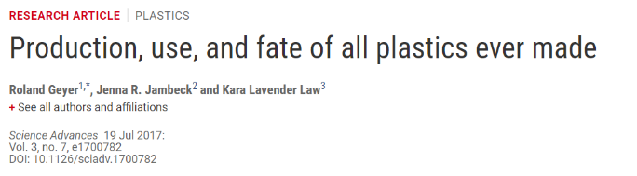
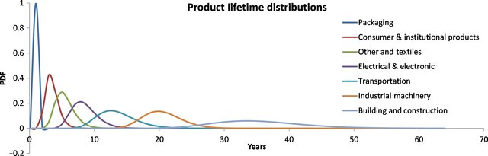
MODELLING THE AGE OF OCEAN PLASTIC
Lifetime of plastic objects from different market sectors
Share of polymer demand by market sector
Evolution of plastic demand from 1950 to present
Only floating plastic (HDPE,LDPE,PP)!

Slide 12
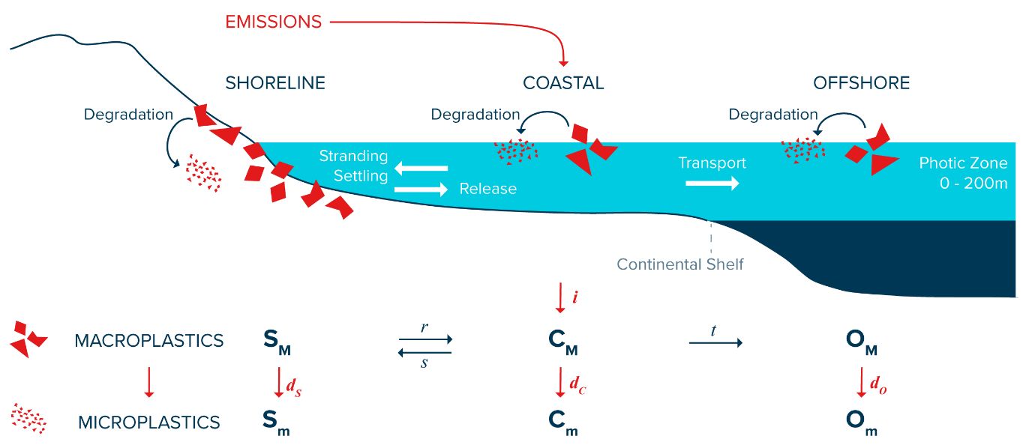
SURFACE MASS BUDGET FOR FLOATING MACROPLASTICS
Simple whole-ocean model representing the beach, coastal and offshore environment. Population age of plastic objects is tracked in each compartments from 1950 to present Degradation rate d from macro (>5mm) to microplastics (<5mm) is calibrated against our observations.

Slide 13
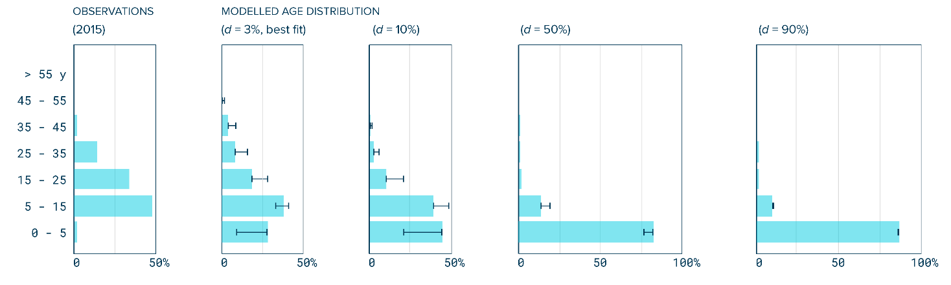
SURFACE MASS BUDGET FOR FLOATING MACROPLASTICS
Calibrated degradation rate: 3% of mass from macro (>5mm) to microplastics (<5mm) annually, in good agreement with material science research and laboratory experiment on degradability of polymers in seawater.

Slide 14
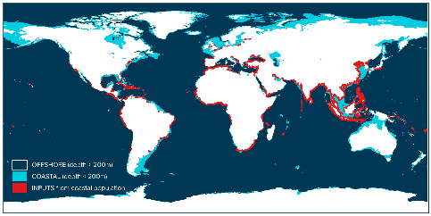
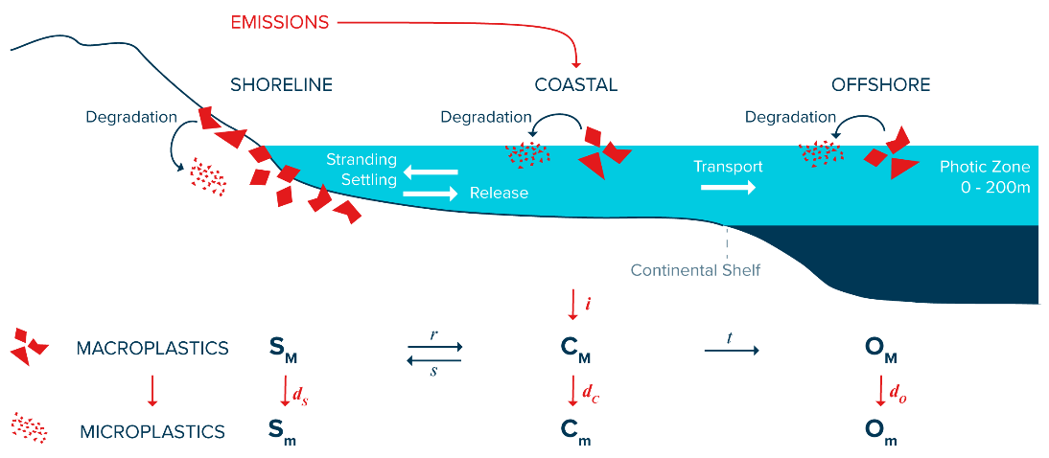
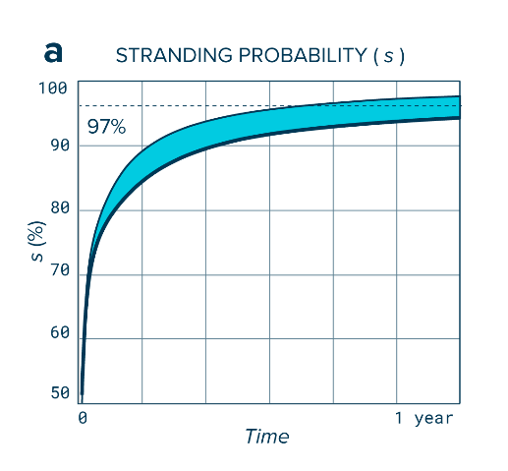
THE COASTAL ENVIRONMENT AS A NATURAL FILTER FOR OCEAN PLASTIC
97% of modelled floating plastic debris released from coastal sources is likely beached after one year.

Slide 15
IMPLICATIONS
PERSISTENCY OF FLOATING OCEAN PLASTICS
Beaching and stranding of debris just (or long) after release could better explain the differences between inputs and accumulated ocean plastics at the surface of the ocean.
Some plastic persist at the surface of the ocean and can accumulate in subtropical gyres. This pollution is likely highly persistent.
The formation of garbage patches with the accumulation of trillions of microscopic plastic particles could be mostly the result of the discard and degradation of plastics from decades ago as there could be a substantial time lag between discard in the environment and accumulation offshore.
Comparing estimated floating stock with current production (or discard) figures to draw a plastic pollution mass budget is misleading.
Researchers should consider timescales related to transport, degradation and accumulation when drawing a global mass budget for plastic in the ocean.

Slide 16
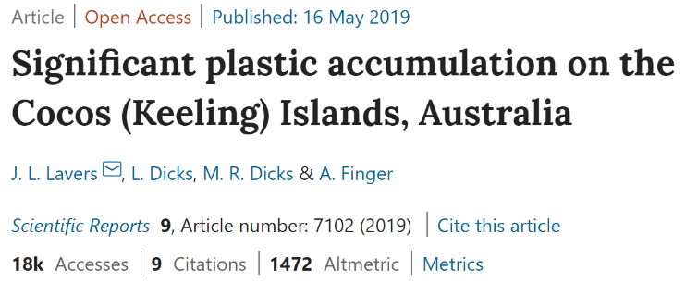
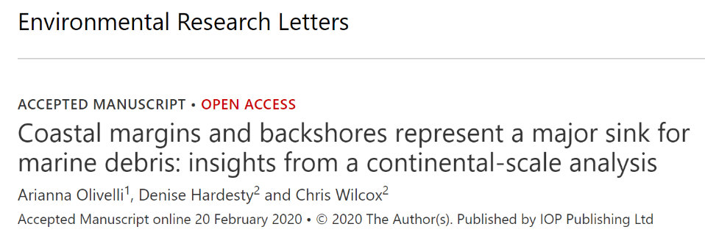
SUPPORTING EVIDENCES
Coastal margin as a major sink for ocean plastics, particularly evident in remote areas where debris are not collected.

Slide 17
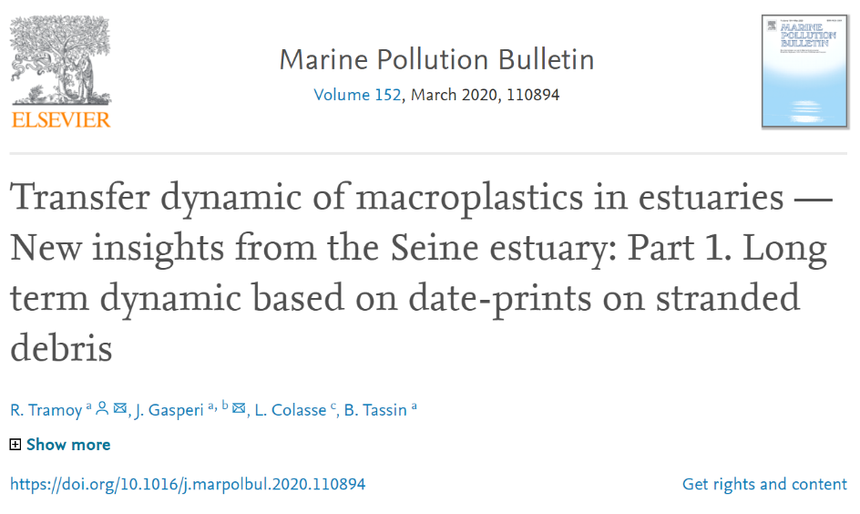
SUPPORTING EVIDENCES
Timescales from sources to sinks: the residence time of plastic waste may exceed decades in the Seine Estuary.

Slide 18
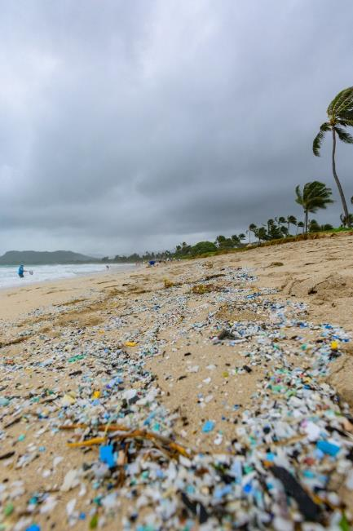
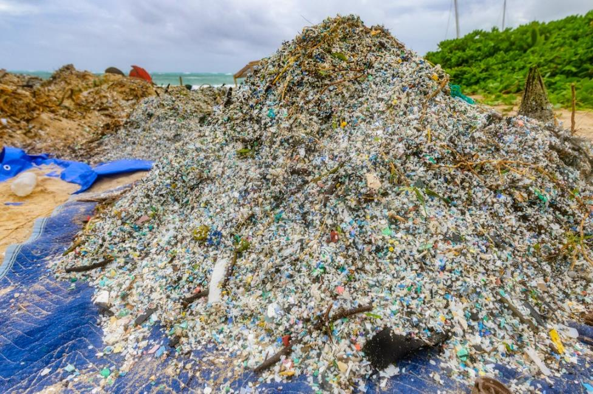
SUPPORTING EVIDENCES
Recent microplastic beaching event in Kailua, Oahu on the Hawai’i Archipelago

Slide 19
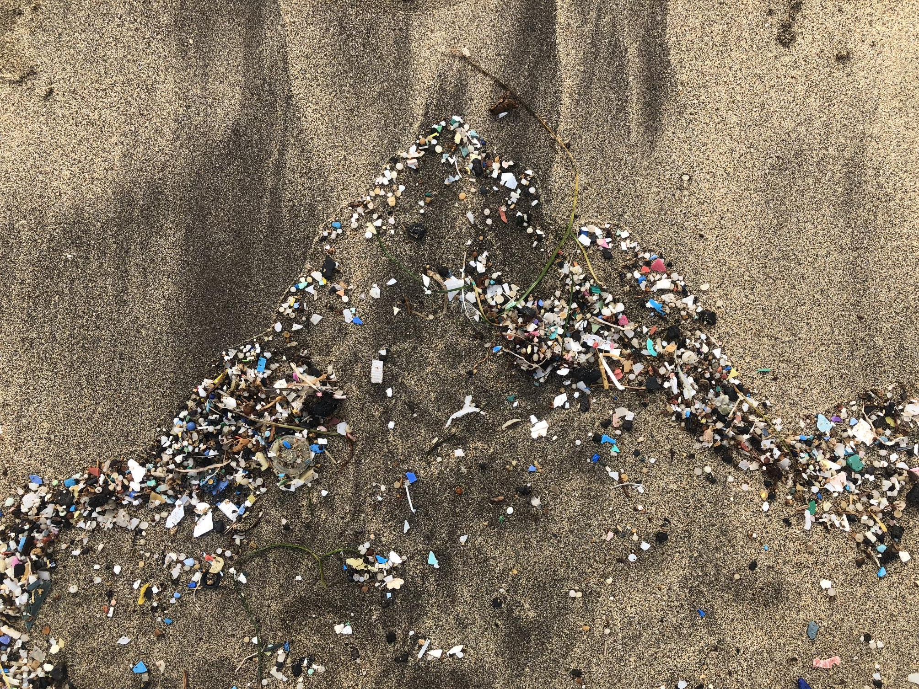
THANK YOU

