Slide 1

Characterization and Source Apportionment of Organic Aerosols in Delhi, India
V. Kumar¹, D. M. Bell¹,S. L. Haslett², D. Bhattu¹, Y. Tong^{1 ,}P. Rai¹,,, S. Giannoukos¹, S. mishra³, A. Singh⁴, P. Vats⁵ ,RV S. Kumar⁴, U. Baltensperger¹, D. Ganguly⁵, N. Rastogi⁴, C.Mohr², S.N. Tripathi³, A. S.H. Prévôt¹, J. G. Slowik¹
1 Laboratory of Atmospheric Chemistry, Paul Scherrer Institute, Switzerland
2 Department of Environmental Science and Analytical Chemistry, Stockholm University, Stockholm, Sweden
3 Department of Civil Engineering and Atmospheric Particle Research Lab, Indian Institute of Technology, Kanpur, India
4 Physical Research Laboratory, Ahmedabad, India
5 Center for Atmospheric Sciences, Indian Institute of Technology, Delhi, India
European Geosciences Union, General Assembly 2020(Online)
May 2020

Slide 2
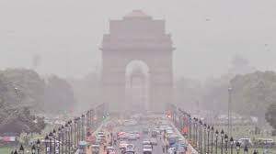
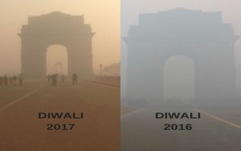
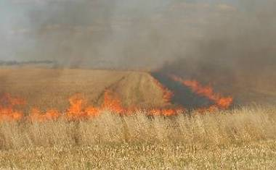


PM_{2.5} Pollution in Delhi
Persistent and severe particulate air pollution
National 24-hr standard (60 µg m⁻³) often exceeded by factor of 4-5… sometimes >10
www.outlookindia.com
www.outlookindia.com
Complex and chaotic emissions sources
>10 million registered vehicles Agricultural & biomass combustion
Local & regional industries Domestic heating & cooking
Open trash burning Transported pollution
www.southasiantimes.info
www.hindustanttimes.com
www.indianexpress.com

Slide 3
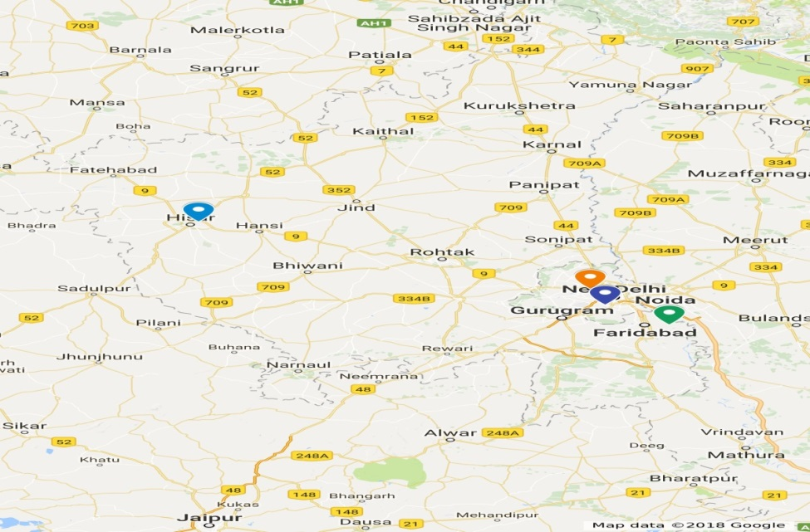
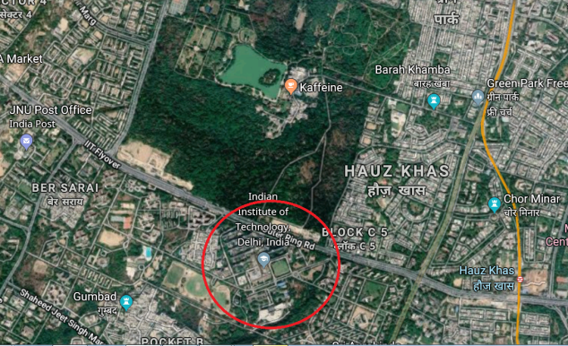
January 2019 Campaign
3 measurement sites
2 main sites within city
Third site with TOF-ACSM
Follow-up of winter 2019 campaign
Main site at IIT Delhi
EESI-LTOF, PM2.5 H-ToF-AMS
FIGAERO-I-CIMS, PTR-TOFMS
Xact 630i metals monitor
Aethalometer, online BrC
Gas monitors, filter collection
TOF-ACSM
HR-TOF-AMS
PTR-TOFMS

Slide 4
Non-refractory PM2.5 composition
Very high concentrations, with organics usually the largest fraction
Chloride routinely exceeds 100 µg m⁻³, peaks in early morning
Strong diurnal pattern for most species

Slide 5
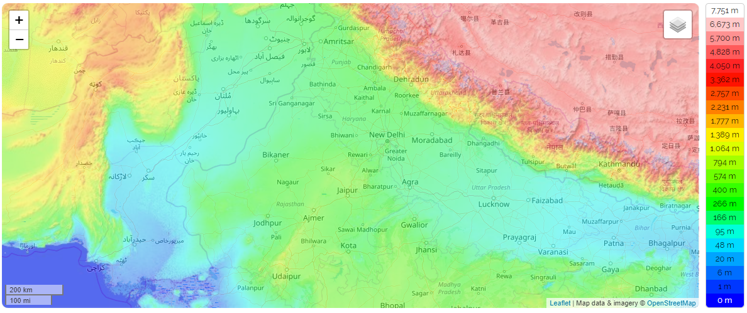
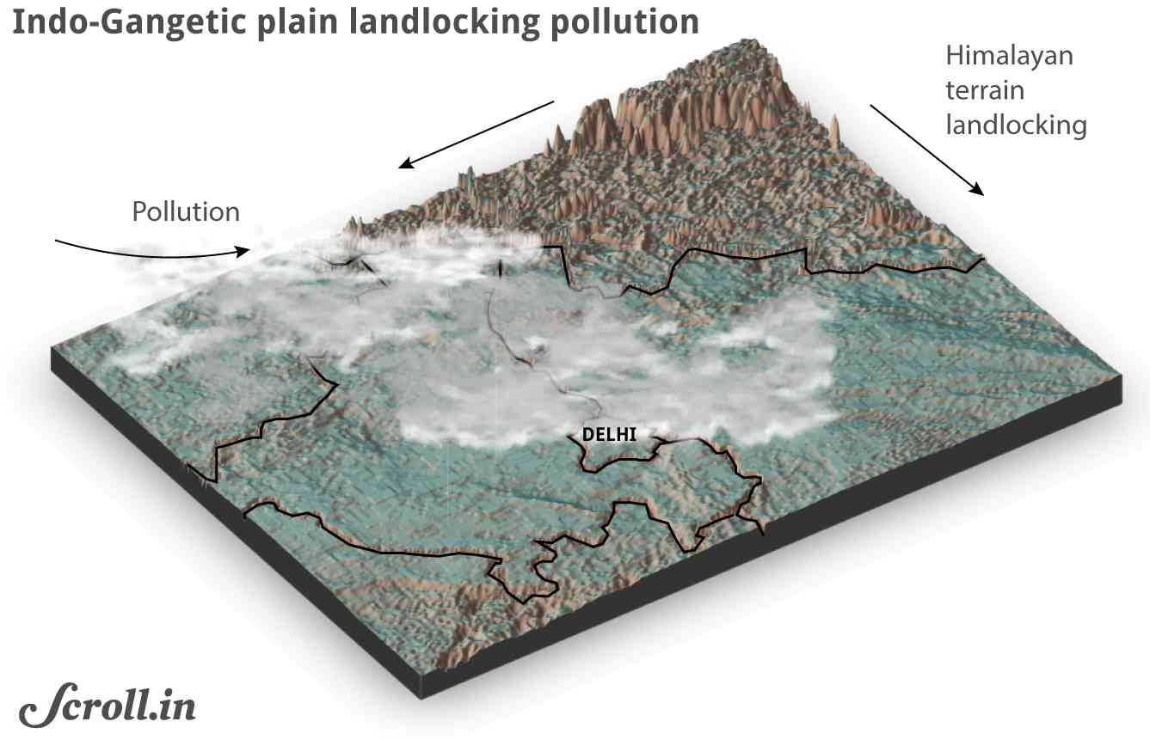
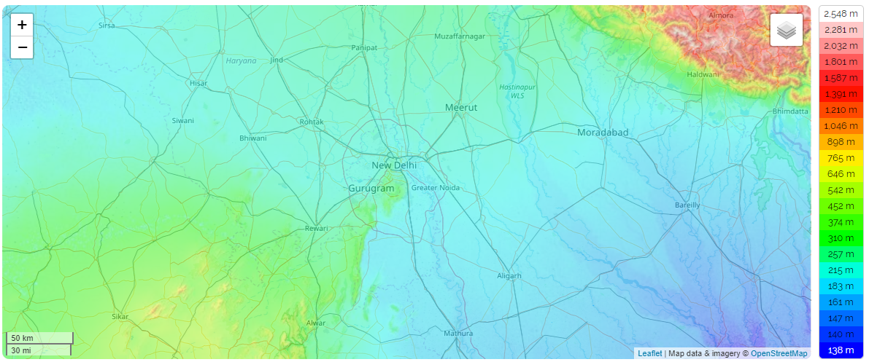
Diurnals – why so strong?
Source:Scroll.in
Boundary layer height in winter
https://ready.arl.noaa.gov/READYamet.php

Slide 6
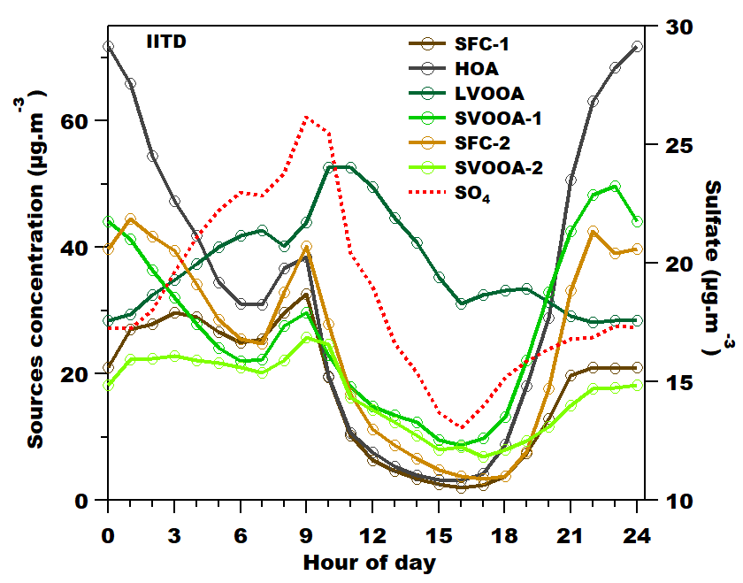
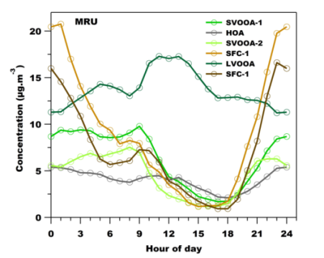
Diurnals – implications for chemistry
IITD (main site)
MRU
Daily cycle:
Accumulation → photochemistry → dilution/flushing
Each day relatively discrete
→ Compare SOA composition during photochemical burst

Slide 7
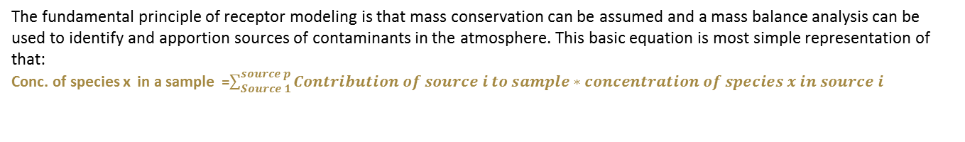
Positive matrix factorization as a tool for Source apportionment
The fundamental principle of receptor modeling is that mass conservation can be assumed and a mass balance analysis can be used to identify and apportion sources of contaminants in the atmosphere. This basic equation is most simple representation of that:
Conc. of species x in a sample =$\sum_{Source 1}^{source p}{Contribution of source i to sample∗concentration of species x in source i}$
Positive matrix factorization
X
Sample
(nxm)
X=GF+E
Source contribution
Source profile
F
(pxm)
G
(nxp)

Slide 8
Sources from AMS analysis :
10⁻³ *
HOA
10⁻³ *
BBOA-1
10⁻³ *
BBOA-2
LVOOA
10⁻³ *
SVOOA
Fig: Mass-spectra of 5 AMS factors identified by PMF
The primary factors consist of :
hydrocarbon-like organic aerosol(HOA) related to traffic and dominated by CH fragments. Prominent contributions of non-oxygenated species at m/z 43 (C3H7+ ), m/z 55 (C4H7+ ) and m/z 57 (C4H9+ ) can be observed.
2 biomass burning organic aerosol(BBOA) factors containing a high fraction C2H4O2+ at m/z 60 and C3H5O2+ at m/z 73(Tracers of Biomass burning).
The secondary factors:
They are separated by their oxygen content, which has been empirically related to volatility (Jimenez et al., 2009), and are classified here as less-volatile oxygenated organic aerosol (LVOOA) and Semi-volatile oxygenated organic aerosol (SVOOA) (Zhang et al., 2011).
LVOOA and SVOOA mass spectra are characterized by dominant peaks at m/z 28 (CO+) and 44 (CO2+ ). The main difference between the LVOOA and SVOOA mass spectra is the relative contribution of C2H3O+(m/z 43) compared to CO2+(m/z 44) , with C2H3O+ enhanced in SVOOA.
April 28, 2020
Varun kumar

Slide 9
Time series and Diurnal variation in AMS sources:
Fig: Stacked time-series of 5 AMS factors identified by PMF
Fig: Stacked diurnal plot of 5 AMS factors identified by PMF
A strong diurnal trend is evident in primary factors, with concentrations peaking overnight and decreasing during the day
A strong enhancement is seen in LVOOA during day-time.

Slide 10
EESI Source apportionment
PMF analysis of AMS data provides SOA components Segregation based on level of oxygenation but does not provide
any direct chemical information of SOA and different SOA precursor sources.
In contrast, PMF analysis of EESI-TOF-MS data Can yield several organic aerosol factors related to secondary
OA formation providing vital information on different SOA sources.
From a 10 factor solution from EESI TOF :
3 are classified as Biomass burning factors.
3 factors are classified as Aqueous influenced factors
4 remaining factors show diurnals similar to secondary sources and most likely are different SOA sources but still remain Unidentified.
Highest contribution from Biomass burning.
Around 4th of Jan, Aqueous factors dominate
EESI signal and AMS organics is substantially
lower.
Fig: Stacked time-series of EESI factors compared to AMS total OA concentration .Overall there is a good agreement between stacked EESI signal and AMS total OA concentration trends but during some events(e.g., 4th Jan),the agreement dramatically changes.

Slide 11
A set of Primary Biomass burning related factors:
BB-1 and 2 are dominated by C8H12O6.Previously been defined as tracer
of biomass burning (Stefenelli et al., 2019; Qi et al., 2019).
BB-3 is almost completely dominated by C6H10O5 with relative intensity of
0.92
These have high Contributions over-nights and decrease during the day.
Overall a good agreement with total AMS BBOA.
Fig: Mass spectra of 3 Biomass burning factors from EESI PMF
Fig: Stacked time-series of 3 Biomass burning factors from EESI PMF compared with total AMS BBOA concentration
Fig: Stacked diurnals of 3 Biomass burning factors from EESI PMF compared with total AMS BBOA diurnal

Slide 12
Aqueous influenced factors
influenced by high liquid water content of aerosols during a special event (around 4th January) and
dominated by high O:C and relatively low molecular weight compounds
Fig: Mass spectra of 3 Aqueous influenced factors from EESI PMF
Fig: Stacked time-series of 3 Aqueous factors from EESI PMF compared with NO and Liquid water content concentration

Slide 13
Other unidentified factors-Most likely SOA
1
2
3
4
Fig: Mass spectra of unidentified(likely SOA) factors from EESI PMF
These unidentified factors most likely represent different types of SOA.
Have contributions from cooking related fatty acids i.e., C13H22O4 as well as from Terpene Oxidation Products.

Slide 14
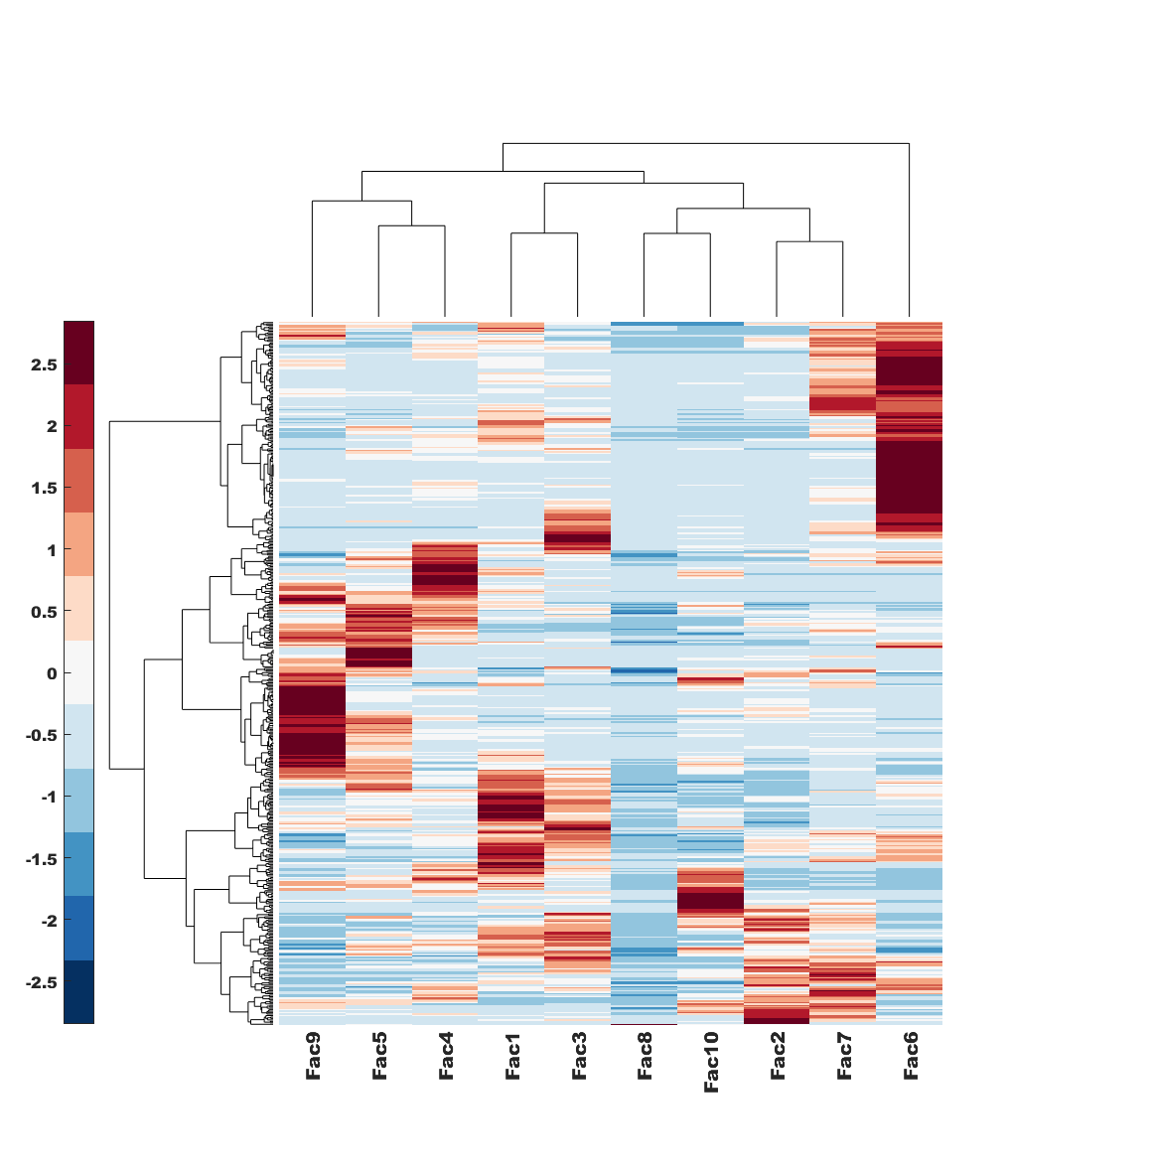
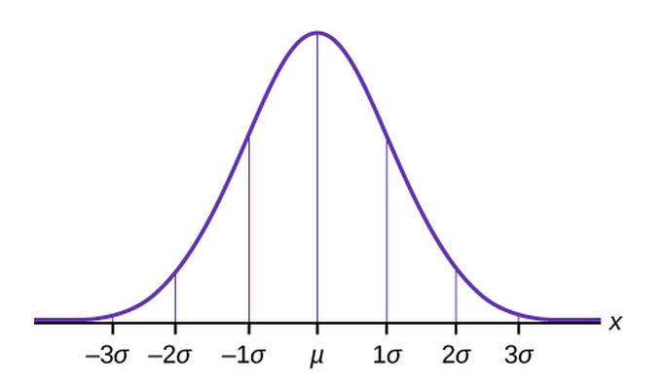

Key ion identification
Z-score – number of standard deviations of value from mean
Value: ion / factor profile
Distribution: across all profiles.
Aqueous
SOA
Biomass
burning
Kumar et al., in prep

Slide 15
Key ions: aqSOA vs. other SOA
Aqueous SOA
Unidentified factors
(SOA-dominated)
Kumar et al., in prep

Slide 16
Conclusions
High dominance of Secondary factors. Contributing almost 50% to total OA mass
Events where agreement between AMS and EESI is different than rest of the period need to be looked upon in detail.
Unique factors indicating aqueous chemistry coming into play during specific events.
-----------------------------------
Funding: Swiss National Science Foundation

Slide 17
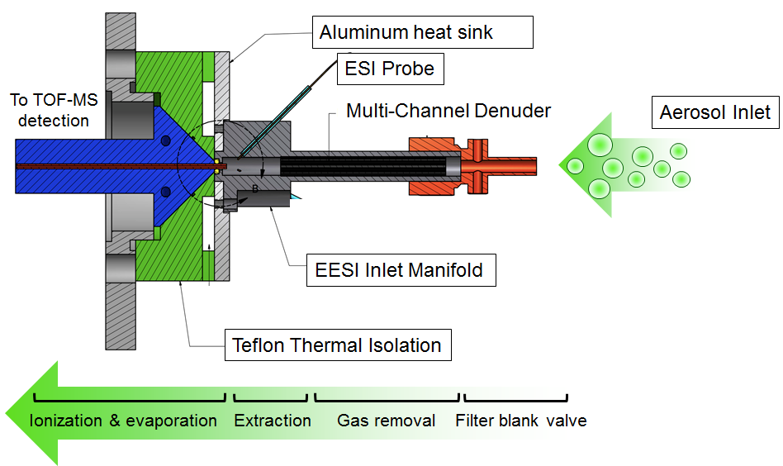
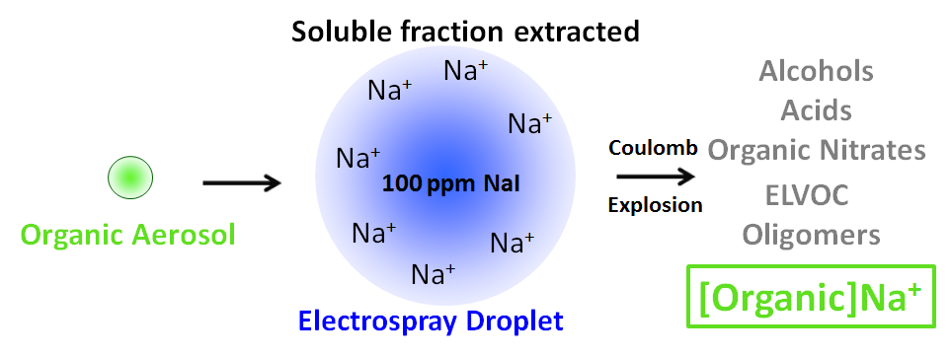
EESI-TOF
Extractive Electrospray Ionization Time-of-Flight Mass Spectrometer
Why EESI?
Online , real-time analysis
1 Hz time resolution
No thermal decomposition/fragmentation
1-10 ng m⁻³ detection limits in a few seconds
Linear with mass, no matrix effects
Quantification possible when chemical standard available

