Slide 1

Human Perception of and
Response to Wildfire Smoke
EGU 2020
Session NH7.2 - D2065 I EGU2020-21099
Mariah Fowler M.S. CE
Moji Sadegh Ph. D
May 4-8, 2020
Notes:
Photo: http://www.spokesman.com/stories/2018/jul/31/central-idaho-wildfire-enters-sawtooth-national-fo/
Yellow AQI in Boise.

Slide 2
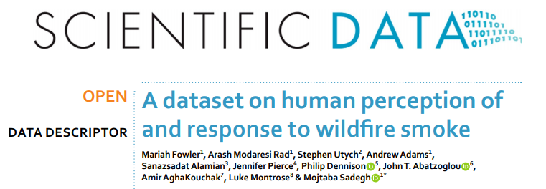
More information
The complete research has been published in Scientific Data and can be read in its entirety here: https://www.nature.com/articles/s41597-019-0251-y.

Slide 3
Introduction
Why are we here?
Impacts on human health, the human response and risk mitigation
Wildfires and wildfire smoke will continue to be a daunting hazard in the United States and across the globe
Social behavioral understanding of the human response to wildfire smoke hazard can help public health and safety administrators mitigate associated risks
What can we do?
Trans-disciplinary approach is required (All of you)
Lack of social behavioural understanding may render “well-intended policies” ineffective
The implementation of a risk management system for wildland fire policy and operations needs to account for smoke as well
Importance of social interactions, local knowledge of risk, financial support
Notes:
Policies may not be effective if we don’t look at how people will respond, do they listen to the warnings provided by reliable institutions?

Slide 4
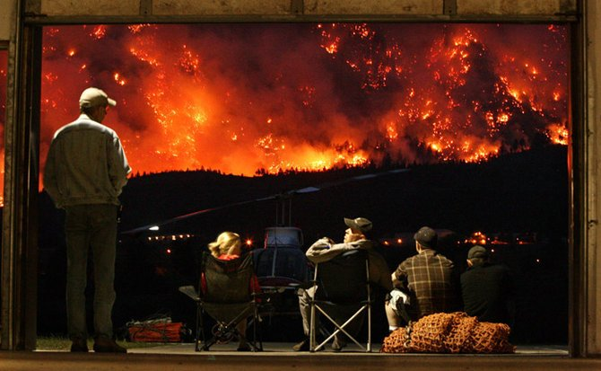
Human Response – Perception of Hazard
Peoples’ response to hazards depends on their interpretation of the risk
“shaped by their own experience, personal feelings and values, cultural beliefs and interpersonal and societal dynamics” (Eiser et al. 2012).
Importance of social interactions, local knowledge of risk, financial support
Notes:
Photo: “people sitting on back porch watching wildfire on Mount McLean in Canada https://buffetoblog.wordpress.com/2011/08/17/caption-contest-people-on-porch-watching-wildfire/people-watching-fire-on-mount-mclean-in-canada/
Human role in responding to the hazard (Raschky 2008).
Peoples’ response to any hazard is dependent on their interpretation of the risk, “shaped by their own experience, personal feelings and values, cultural beliefs and interpersonal and societal dynamics” (Eiser et al. 2012).
Blades – “Smoke from forest fires is a serious and increasing land management concern. However, a paucity of information exists that is specific to public perceptions of smoke. This study used conjoint analysis, a multivariate technique, to evaluate how four situational factors (i.e., smoke origin, smoke duration, health impact, and advanced warning) influence public tolerance of smoke in the northern Rocky Mountains and south-central United States. Separate analyses were performed for subgroups, based on community type, level of fire preparedness, demographics, and smoke experience, to explore potential differences among managerially relevant populations. Origin of the smoke and advanced public warning were commonly the most important factors influencing public tolerance of smoke. A comparison of our conjoint approach with a univariate rating technique is also discussed. Findings from this research will help fire managers understand public tolerance of smoke from forest fires, inform forest management, and enhance public communication strategies.”
Olsen - ”improving communication in both inter- and intra-agency situations as well as with members of the public. In particular, prioritizing fire and smoke-related communication within agencies, allocating agency resources specifically for training in communication and outreach endeavors, taking advantage of existing resources including informal social networks among the public, and building long-term relationships both between agencies and with the public were viewed as effective.”

Slide 5
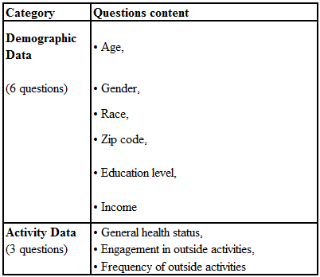
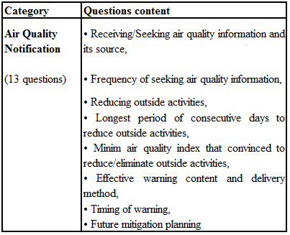
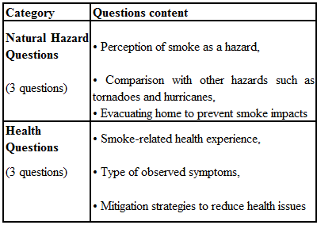
Method = Survey Questions
Notes:
The survey was designed into 5 categories.
The timing of survey collecting was after a major smoke wave came into the and passed through Idaho.

Slide 6
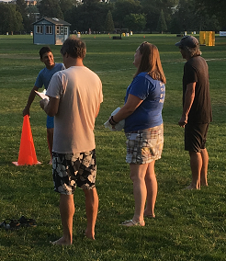
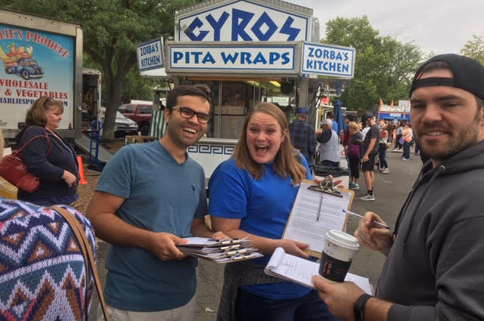
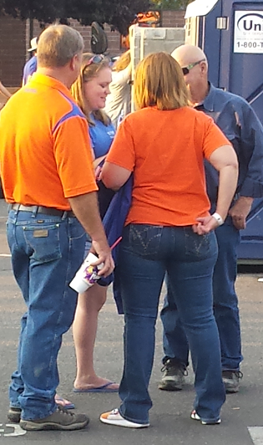
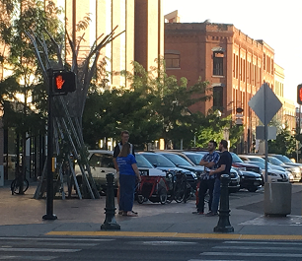
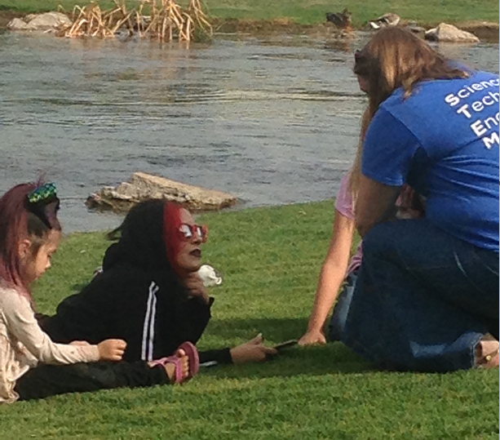
Survey Collection
Notes:
In-person August 28 – September 15 = 13 days with 16 locations and collected 614 public paper surveys.
Online was Sept. 25 – Oct. 16 = 21 days with 1,623 surveys completed.
Total of 2,237 combine.
In-person collections:
In Boise – Alive After-5, Julia Davis Park, Kristin Armstrong Park, Ann Morrison Park, Night Glow, Esther Simplot Park, Boise State University home football game, the Hyde Park Street Fair
Meridian – Farmer’s Market and Movie in the Park at Settlers Park
Kuna - downtown Kuna including Bernie Fisher Park and Kuna Middle School
Eagle – Guerber Park, downtown Eagle, and Eagle Island State Park
Nampa – Farmer’s Market and Lakeview Park
Caldwell – Farmer’s Market
Paper surveys were collected from August 28 – September 15 from which 13 days were used to collect data from 16 locations which ended in 614 public paper surveys collected. The amount of surveys collected in Kuna were 31, Nampa 34, Caldwell 37, Eagle 51, Meridian 54, and Boise 407. Collection successes – food truck lines, Alive-after-5, going to Farmer’s markets, Movie in the Park, Night Glow, and BSU home football game.
Challenges – not enough surveys and survey collectors at Night Glow. Also the time it took to input surveys into an electronic data base including quality checks.
Online from Sept. 25 – Oct. 16 and was downloaded from Qualtrics so that analysis can be completed. Nick Warcholak, the Associate Dean for Research at BSU was key to allowing the online data to be completed. His support with the IRB approval for this part of the research and providing emails was helpful. 8,768 emails in total were sent with 3,748 to all BSU faculty and staff and 5,020 to a randomized selection of BSU students. 1,745 online surveys were started with 1,623 completed.
Challenges with using technology include email limits within the Qualtrics program, email reminders, and the many bounce back emails that are sent to the survey sender.

Slide 7
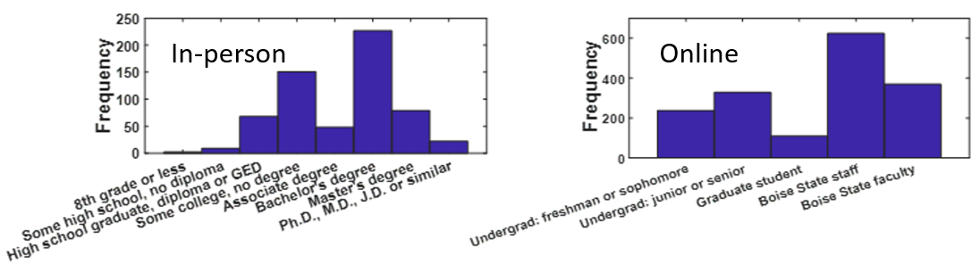
Demographic Results
Notes:
In-person = majority in their 20s-40s and Online = large portion 18-22 years old
Majority were female, In-person = 59% online = 65%
Most identified as White or Caucasian descent with a few Hispanic/Latino or Asian/Pacific Islander. Participants were able to select more than one answer for this question.
Figure above:
Q6 = Most of the public participants have at least a high school diploma or GED with 1.5% reported completing some high school and 11.2% stating that they were a high school graduate or obtained a GED. 25% have some college experience, 7.9% have an Associate’s degree and 37.5% hold a Bachelor’s degree, 12.9% have acquired a Master’s degree, and 3.6% achieved a Ph.D., M.D., J.D, or similar education level.
The online participants were able to provide their level of education as either: undergraduate freshman or sophomore, undergraduate junior or senior, graduate student, Boise State staff, or Boise State faculty. Fourteen percent stated they were undergraduate freshman or sophomores, 19.7% selected undergraduate junior or senior, and 6.6% were graduate students. Thirty-seven percent of online participants were Boise State staff and 22.1% selected faculty.

Slide 8
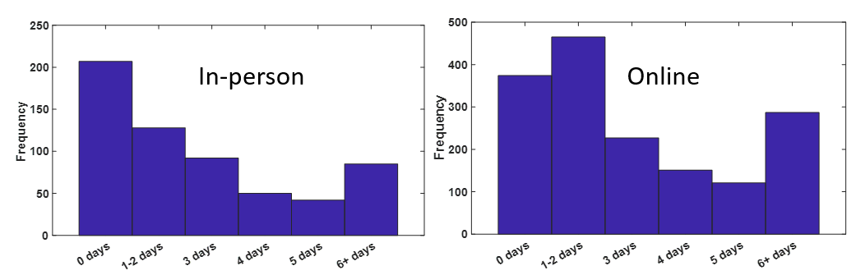
Reduced Daily Activities
During summer of 2018, think of the longest period of consecutive days you reduced or eliminated your outdoor activities due to a smoke event. How many consecutive days did you reduce or eliminate activity?
Notes:
95% of in-person and 92% of online participants reported that they had engaged in any outdoor activities, such as hiking, biking, fishing, gardening, running, or any other outdoor activity.
In-person = 62% and 75% of the online participants reported that they did reduce their outdoor activities.
Compared number of days reduced with age and education levels. Older are more prone to reduce more days. As education levels increase, so does the trend to reduce outdoor activities.
Slide figure: Q16 = in-person participants about 34% reported that they did not reduce their activities which aligns with Q15. Many verbally said that they could not reduce because of their jobs. Approximately 21% reduced 1-2 days while 14% reduced 6 or more consecutive days.
The online participants 23% said that they did not reduce their activities, 29% reduced 1-2 days, and 18% reduced more than 6 days.

Slide 9
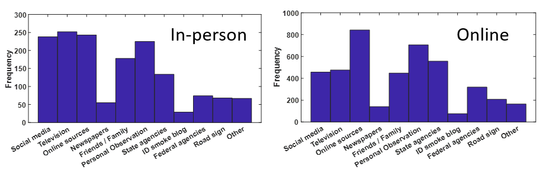
Source of Air Quality Notifications
Over 60% of both groups either received or looked for air quality notifications.
Which source do you use to find wildfire smoke notifications? [Check all that apply]
Notes:
Over 60% of both groups received or sought out air quality information. What about the other 40%? Where are we lacking????
Those who did get notifications, would look for 2-3 days and how they obtained their information…
Figure on this slide: Q13 = Participants were asked which sources they used to find wildfire smoke notifications and were allowed to check all that applied. The in-person participants mostly used television, online new sources, social media (like Facebook, Instagram, and Twitter), and personal observations.
Online participants heavily used online new sources, personal observations, and state agencies such as the Department of Environmental Quality website.
Those over 60 years old, more prominently use TV and newspapers.
Those under 30 use Social Media, online news, Family and Friends, and road signs.

Slide 10
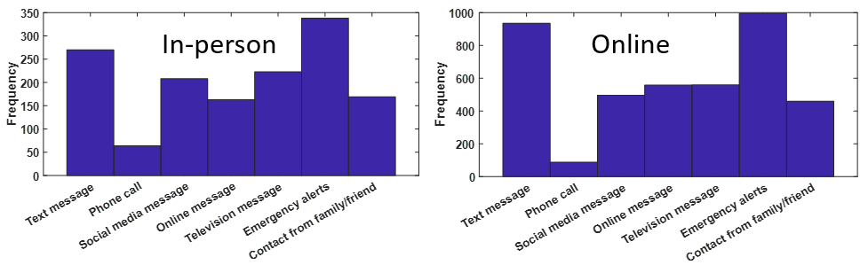
Messaging Preference
What type of message could motivate / motivated you to take action to mitigate the risk of issues related to wildfire smoke, such as staying indoors or leaving the area? [Check all that apply]
Notes:
How people WANT their messages. Emergency alerts, text messages.
In-person results, participants in their 50s and 60s prefer TV messages, a phone call, emergency alert, and social media messages, whereas the online group show only TV messages.
The median age for those who felt a social media message would motivate them to take action were 39 for the in-person group and 29 with the online
Know your demographics of the community for which you are providing services. The older population still expects a phone call or some kind of personal interaction if things are serious (evacuation).
Emergency median age 39/33 (In-person/Online)
Text median age 39/33
TV median age 45/42
Q22 = 50.5% of the in-person participants replied that a message before 9 a.m. and 35.4% of the in-person respondents expressed that messages even the day before would impact them the most.
52.1% of the online participants replied that a message before 9 a.m. and 36.3% expressed that messages even the day before would impact them the most.

Slide 11
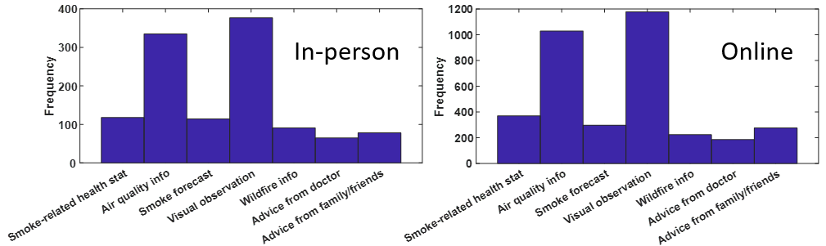
Info that Motivated to Reduce Outside Activities
If you decided to limit your outdoor activity during a smoke event, what type of information motivated your decision to do so? [Check all that apply]
Notes:
Q19 = Both groups reported that their own visual observations (seeing the smoke outside) and air quality information were most prominent in their decision making.
Min AQI to REDUCE over 38% orange
Min AQI to ELIMINATE over 87% red
since visual observation is more prominent answer, why not provide pictures that show what good (green AQI) to unhealthy (red AQI) and so on. Education of the public.

Slide 12
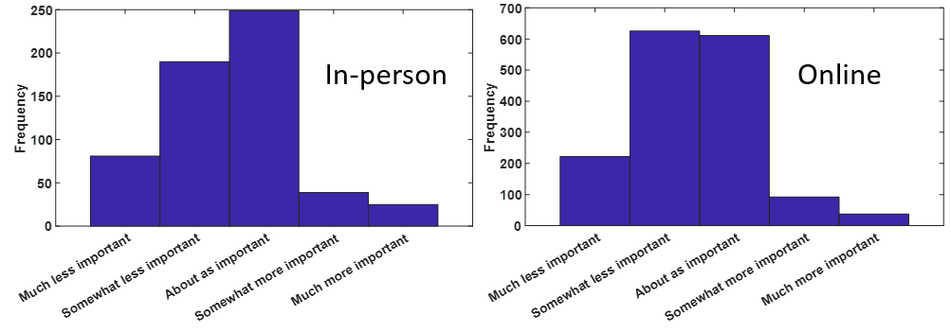
Compare Smoke to Other Hazards
80% of participants agreed that wildfire smoke is a natural hazard.
As a public health threat, are wildfire smoke events more important, less important, or about as important as other natural disasters, such as hurricanes or tornadoes?
Notes:
Q25 = the in-person results show that about 42.6% believe that smoke events are about as important and 32.5% believe that they are somewhat less important as other natural disasters.
The online group was split with 39.4% reporting somewhat less important and 38.5% reporting about as important comparing to other natural disasters.
Natural Hazard
81% and 80% of the in-person and online respectively, agreed that wildfire smoke is a natural hazard.
Hurricane Florence made landfall in North Carolina as a Category 1 hurricane on September 14, 2018 and Hurricane Michael made landfall in the Florida panhandle as a Category 4 hurricane on October 10, 2018 and was the strongest storm of the 2018 season (CNN Library 2018).

Slide 13
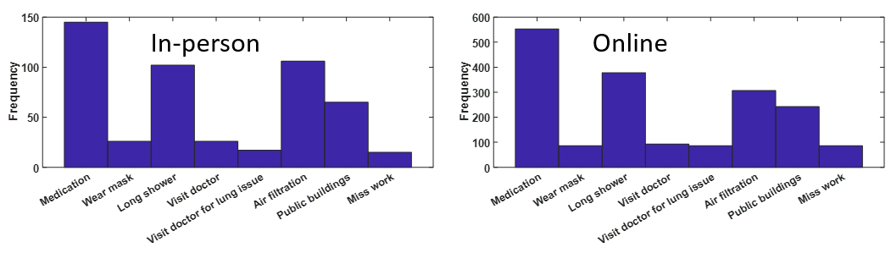
Mitigation Actions for Health
Did you use/do any of the following to help with any symptoms during the smoke event? [Check all that apply]
Notes:
Smoke symptoms: eyes, sinus, and irritated throats and headaches.
93% of In-person and 81% of online reported of having at least one symptom.
Q29 = 20% of in-person participants consumed medications, 14% reported they took longer showers, and 15% used personal air filtration systems in their homes or went to public buildings. The online group had similar results with 30% consumed medications, 21% reported they took longer showers, and 17% used personal air filtration systems in their homes or went to public buildings.
Are in home and public air filtration systems up to snuff? Are they really able to handle PM 2.5? Are we sending an incorrect message that staying inside is really what’s best for the public? What about those who must go outside to work?
Q23 = The in-person group reported 42% yes they would, whereas the online group reported 50%. An interesting point is that 44% of both groups were unsure if they would take any kind of preventative actions.
NOTE: some people have jobs that do not allow them to reduce their outdoor activities.

Slide 14
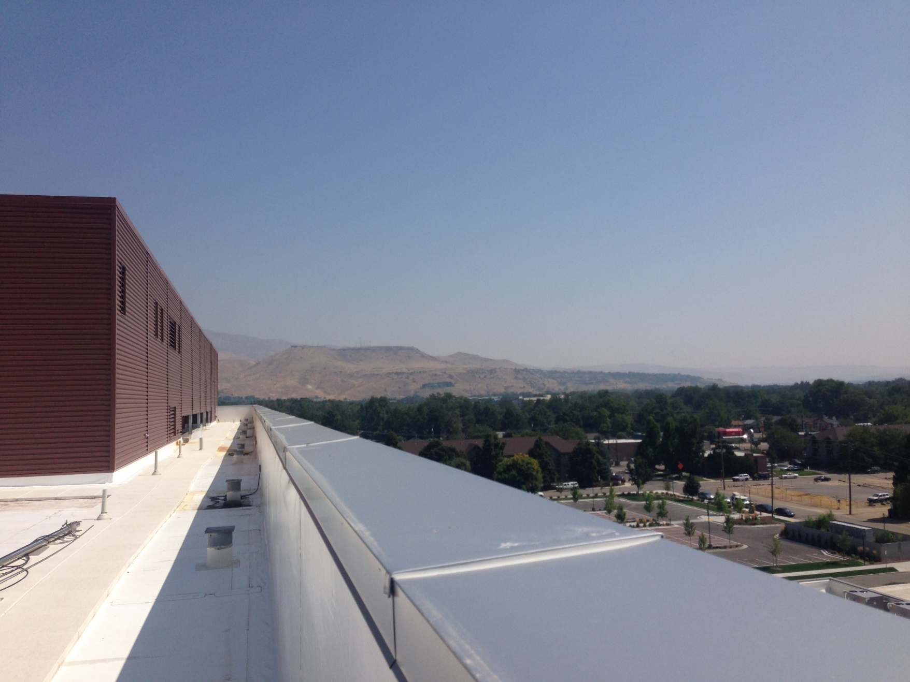
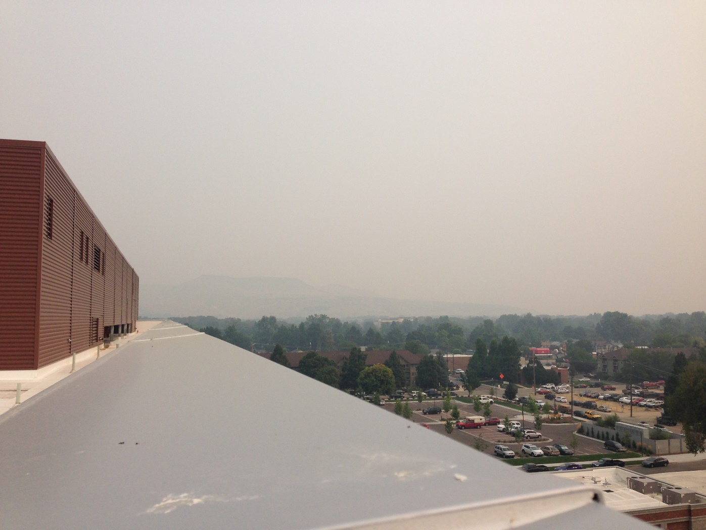
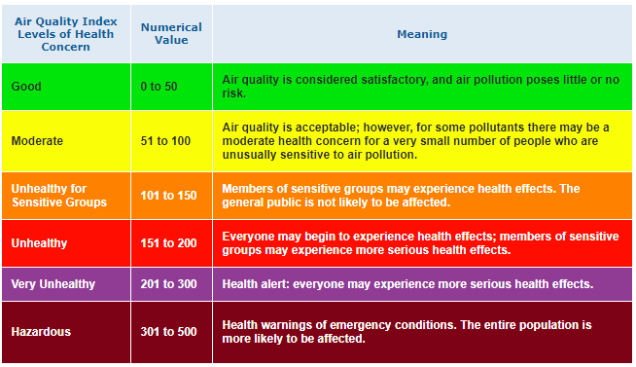
AQI Game….
August 27, 2017 at 1:59pm
Yellow AQI = Moderate
September 6, 2017 at 2:54pm
Red AQI = Unhealthy
Notes:
The AQI is a ranking system used to establish daily how clean or polluted ambient air is. The six criteria pollutants are monitored and reported with an AQI value that corresponds with their concentration level based on the national air quality standard for that pollutant. The pollutant with the highest value governs the AQI for that day (United States Environmental Protection Agency - 2 2019).
**Boise photos were taken by Mariah from the roof of the Environmental Research Building at BSU looking east at Table Rock.
August 27th = Yellow
September 6 = Red although purple and then Maroon was reported just north of Boise in Garden Valley about this same time of day.

Slide 15
Conclusion
80% of people do perceive smoke as a hazard
People will reduce their outdoor activities during a smoke event for 1-2 days
For messages to be most effective they should be delivered the night before and be short, direct messages through text, TV, online new sources, State Agencies, and social media depending on area demographics
Need a reference point for visual observations relating to the AQI index rating
Notes:
In ranking order, the in-person participants mostly used television, online new sources, social media (like Facebook, Instagram, and Twitter),and personal observations.
Online participants heavily used online new sources, personal observations, and state agencies such as the Department of Environmental Quality website, TV, and then social media.
As the age increases the willingness to reduce also increase
The higher the education level, the more prone to reduce

Slide 16

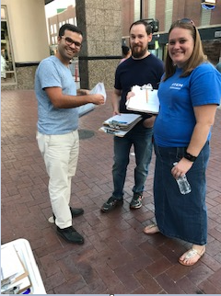
For any questions please reach out to either
Mariah Fowler at Mfowler@Forsgren.com
Dr. Moji Sadegh at mojtabasadegh@boisestate.edu

