Slide 1
Persistence and frequency of drought-relevant circulation types during temperature extremes in southern Central Europe
Revised and extended version!
Selina Thanheiser, Markus Homann, Christoph Beck, Andreas Philipp, Jucundus Jacobeit
Institute of Geography, University of Augsburg, Germany

Slide 2
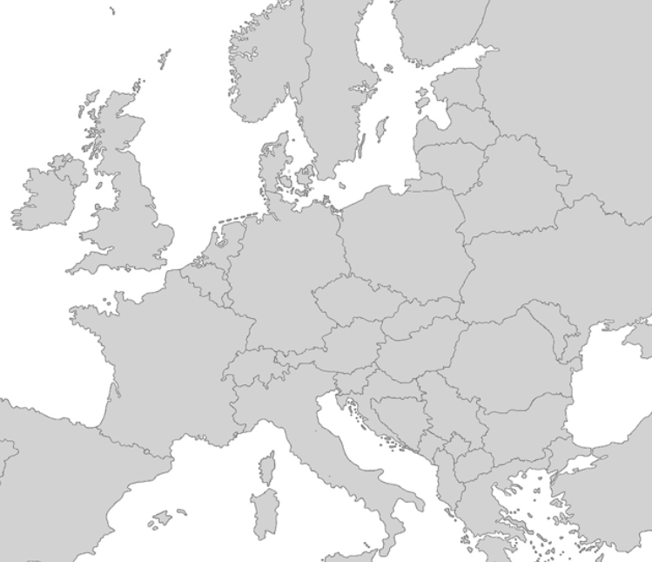
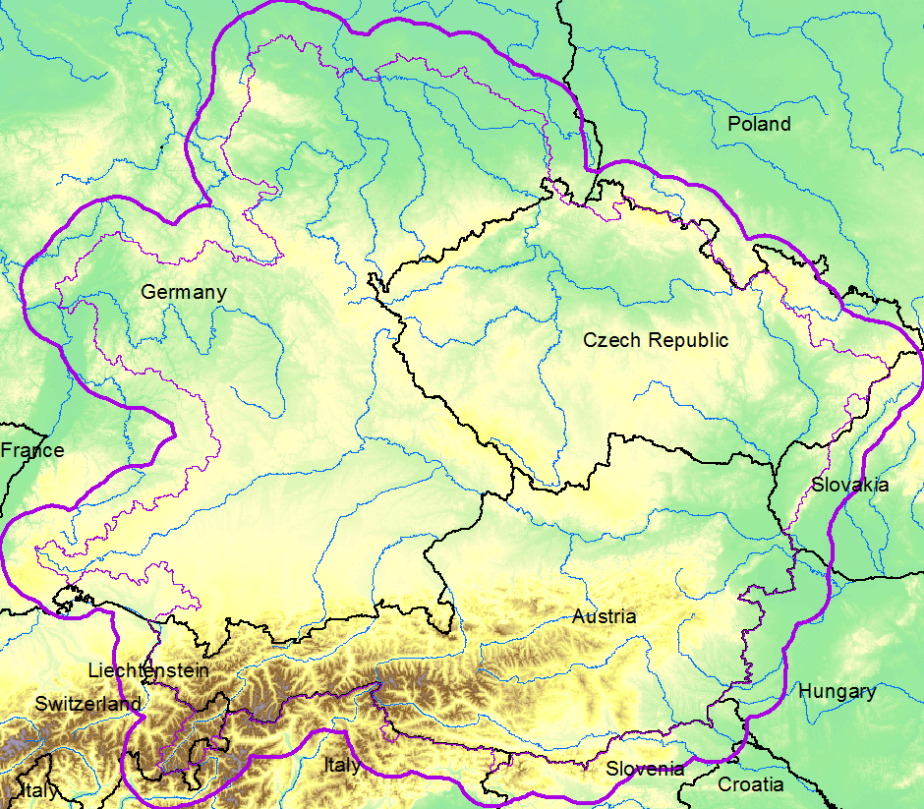
Data & Study Area
Table 1: Reanalysis & observation data
Variable | Unit | Level | Timeperiod | Resolution | Name
Mean sea level pressure | hPa | - | 1958-2017 | 6 hours / 1.25° | JRA55 – Japanese 55-year Reanalysis (Japan Meteorological Agency)
Relative humidity | % | 300 hPa, 500 hPa, 700 hPa, 850 hPa
U-component of wind | m/s | 300 hPa, 500 hPa, 700 hPa, 850 hPa
V-component of wind | m/s | 300 hPa, 500 hPa, 700 hPa, 850 hPa
Temperature | K | 2 m | 1918-2019 | daily / 147 Stations | European Climate Assessment and Dataset
Precipitation data – gridded | mm | - | 1961-2017 | 24 hours / 6x6km | Central Institute for Meteorology & Geodynamics (Austria)
Figure 1: Study Area – South of Central Europe
The study area is located in southern central Europe, including parts of Germany and Switzerland as well as Austria and Czech Republic.
© Authors

Slide 3
Method
1 Classification Process
Software
Method
Evaluation
Cost733class is a FORTRAN software package focused on creating and evaluating weather and circulation type classifications.
Non-hierarchical cluster analysis: SANDRA (simulated annealing and diversified randomization algorithm).
The Brier-Skill-Score (BSS) is based on the Brier Score (BS), a statistical index which can be used to validate probability forecasts.
The classification is conditioned to six precipitation time series as target variable, one for each region of similar precipitation variability within the study area. These time series result from a s-mod PCA that was applied to our data. The BSS is used as evaluation metric. There are two classifications with similar variable combination, one for summer (April – September) and one for winter (October – March).

Slide 4
Method
2 Persistence and frequency during temperature extremes
Persistence
Frequency
Method
Temperature extremes
Calculation of yearly maximum persistence in terms of consecutive days for each drought-relevant circulation type (1961-2017).
Calculation of the long term mean seasonal frequency for each drought-relevant circulation type (1961-2017).
Calculation of the persistence and the frequency of drought-relevant circulation types during temperature extremes.
Heat- and cold waves are defined as temperature difference from the long-term mean seasonal temperature (Summer, Apr-Sep) or (Winter, Oct-Mar) (1961-2017) on at least three consecutive days > 95th percentile for summer season and < 5th percentile for winter season at more than 50% of the available temperature stations in the study area (74 stations).

Slide 5
Results
Table 2: Percentage of circulation-type days associated with drought in precipitation regions (1961-2015) (Apr-Sep)
Table 3: Percentage of circulation-type days associated with drought in precipitation regions (1961-2015) (Oct-Mar)
CT | Nord-West | Ost | Nord-Ost | Nord-Stau | Süd | West
CT 1 | 0 | 2.17 | 1.21 | 0 | 0.48 | 0
CT 2 | 0.32 | 0.96 | 1.6 | 0.64 | 0.64 | 0.32
CT 3 | 8.89 | 21.85 | 18.61 | 21.76 | 13.98 | 5.74
CT 4 | 0 | 0 | 0 | 0 | 0 | 0
CT 5 | 0 | 0.2 | 0.2 | 0 | 0 | 0
CT 6 | 4.07 | 1.83 | 8.55 | 0 | 0 | 0.81
CT 7 | 0 | 0 | 0 | 0 | 0 | 0
CT 8 | 3.54 | 1.86 | 6.11 | 0 | 0.8 | 1.06
CT 9 | 0 | 0 | 0 | 0 | 1.03 | 0
CT 10 | 0 | 0 | 0 | 0 | 0 | 0
CT 11 | 0.69 | 0.69 | 3.45 | 0 | 0 | 0
CT 12 | 27.97 | 22.74 | 22.85 | 24.7 | 29.05 | 17.19
CT 13 | 0.32 | 0 | 0.95 | 0 | 0 | 0
CT 14 | 34.56 | 43.4 | 38.17 | 33.98 | 31.75 | 17.8
CT 15 | 0 | 6.41 | 0.67 | 2.53 | 6.58 | 0
CT 16 | 45.7 | 36.91 | 38.95 | 42.02 | 46.06 | 28.12
CT 17 | 0.82 | 0 | 0.82 | 0 | 1.23 | 0
CT 18 | 0 | 0 | 0 | 0 | 0 | 0
CT | Nord-West | Ost | Nord-Ost | Nord-Stau | Süd | West
CT 1 | 0 | 1.42 | 1.42 | 0 | 0.24 | 0
CT 2 | 0 | 0 | 0.4 | 0 | 0 | 0
CT 3 | 0 | 0 | 0 | 0 | 0 | 0
CT 4 | 0 | 0 | 0 | 0 | 0 | 0
CT 5 | 0 | 0 | 0.55 | 0 | 0 | 0
CT 6 | 10.11 | 15.31 | 17.58 | 14.18 | 1.51 | 12.95
CT 7 | 0 | 0.12 | 0.48 | 0 | 0 | 0
CT 8 | 0 | 3.24 | 0.17 | 2.73 | 7.5 | 1.02
CT 9 | 0 | 0 | 0 | 0.35 | 1.4 | 0.35
CT 10 | 37.9 | 40.06 | 38.14 | 33.81 | 25.64 | 23.24
CT 11 | 19.81 | 13.24 | 19.59 | 12.25 | 5.67 | 13.65
CT 12 | 0 | 0.75 | 1.49 | 0 | 0 | 0
CT 13 | 3.03 | 3.84 | 8.69 | 0.2 | 0 | 3.84
CT 14 | 33.42 | 34.28 | 32.43 | 33.09 | 30.24 | 29.32
CT 15 | 0 | 0 | 0 | 0 | 0 | 0
CT 16 | 0 | 0 | 0 | 0 | 0 | 0
CT 17 | 47.03 | 38.92 | 42.75 | 36.29 | 31.03 | 39.44
CT 18 | 0 | 3.85 | 4.4 | 0 | 0 | 1.65
CT = circulation type

Slide 6
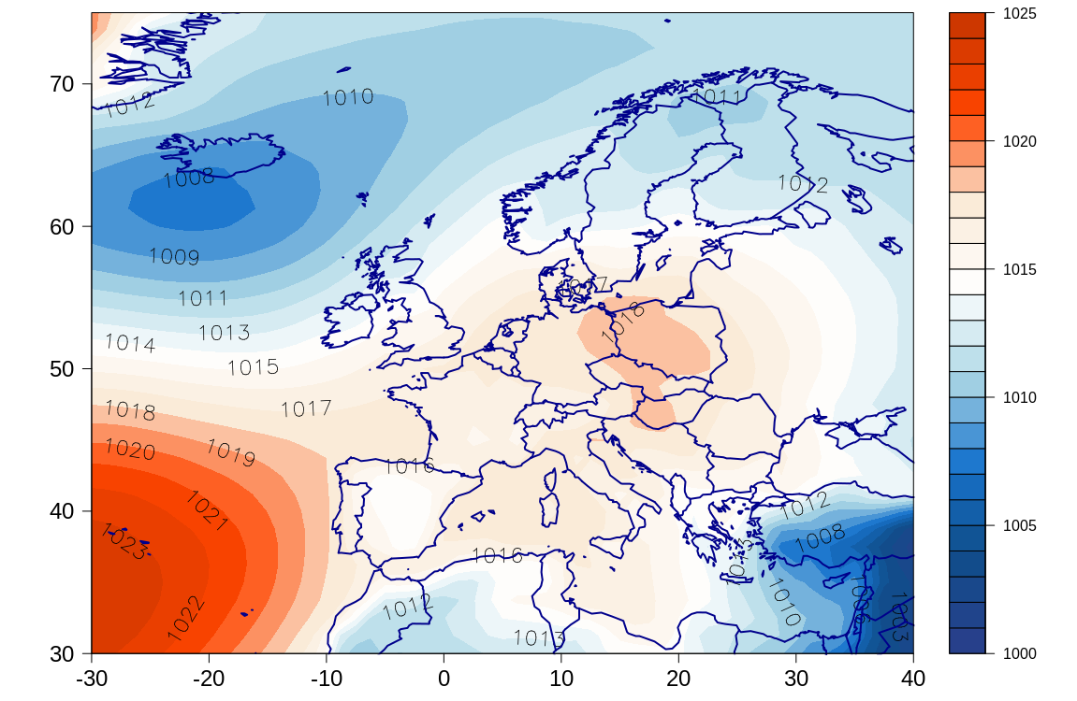
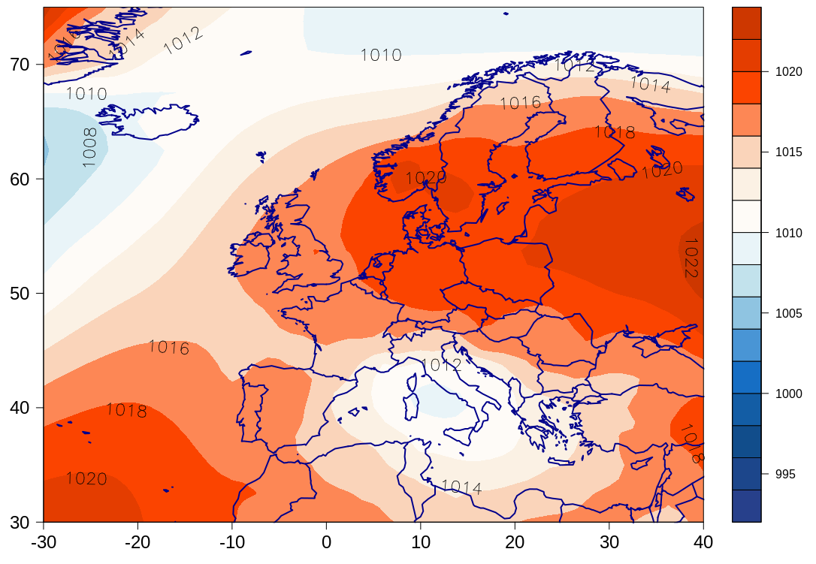
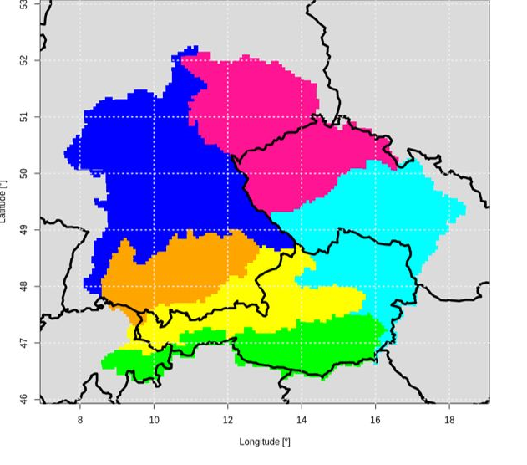
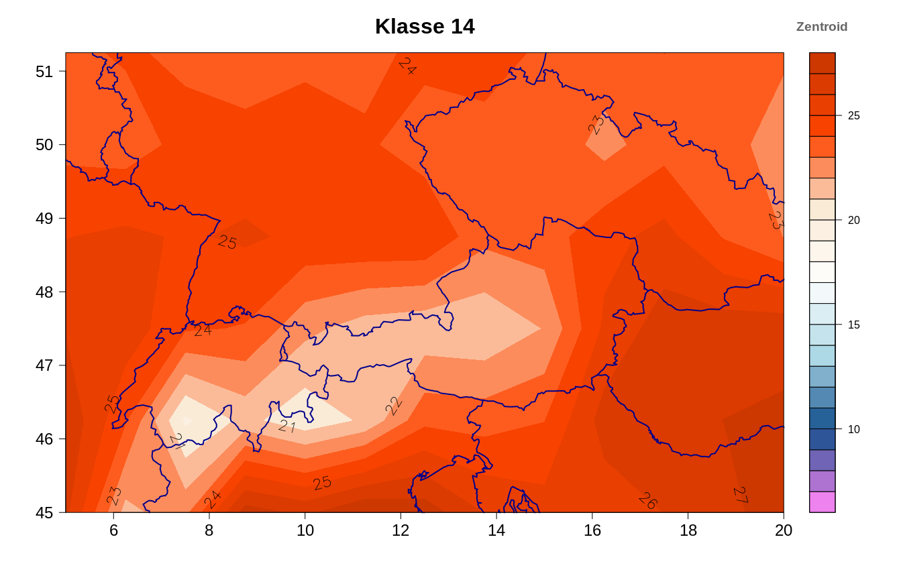
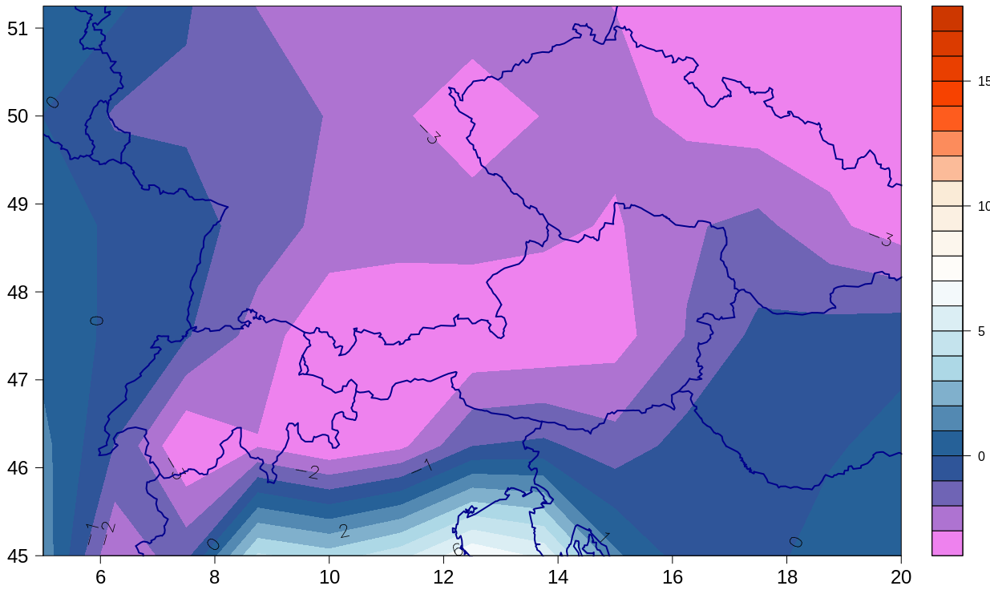
Results
Circulation Type 14 summer
Circulation Type 11 winter
Figure 2: Mean sea level pressure patterns [hPa] and Temperature [°C] of drought relevant circulation type 14 in summer and drought relevant circulation type 11 in winter
Fig 3: Regions of similar precipitation variability within the study area resulting from an s-mod PCA that was applied to our data.
Drought-relevant circulation types (CT) are determined according to relative frequencies of circulation type days, under the 20th percentile of precipitation. If at least 20 percent of the CT days are below the 20th percentile of precipitation, the CT is defined as drought-relevant.

Slide 7
Results
Do drought relevant CT become more frequent during temperature extremes?
Figure 4: Efficiency coefficient of the drought relevant circulation types during heat waves in summer and cold waves in winter
The efficiency coefficient is calculated as ratio between the relative frequency of a circulation type in a heat- or cold wave and its long term mean seasonal frequency (Kysely 2007). Drought relevant CT do not become more frequent during temperature extremes.

Slide 8
Results
Are drought relevant CT more persistent during temperature extremes?
Heat wave 1976 31°C
Heat wave 2003
33°C
Heat wave 1994 31,3°C
Cold wave 1985
-3,4°C
Cold wave 2012
-2°C
Cold wave 1963 -3,4°C
Figure 5: Relative maximum persistence of the drought relevant circulation types during heat waves in summer and cold waves in winter
Relative persistence is calculated as ration between the maximum persistence of drought relevant circulation types in a heat- or cold wave and the long term, yearly mean of maximum persistence of drought relevant circulation types. Drought relevant CT are more persistent during temperature extremes.

Slide 9
Results
Do drought relevant CT become more persistent during temperature extremes?
Figure 6: Relative maximum persistence of the drought relevant circulation types during heat waves in summer and cold waves in winter
Relative persistence is calculated as ratio between the maximum persistence of drought relevant circulation types in a heat- or cold wave and the long term, yearly mean of maximum persistence of drought relevant circulation types. Drought relevant CT do not become more persistent during temperature extremes.

Slide 10
Summary
Most days of temperature extremes are dominated by drought-relevant circulation types (not shown). Drought relevant CT are more persistent during temperature extremes. Drought relevant CT do not become more frequent or persistent during temperature extremes.
Heat waves
During heat waves in summer, only CT14 (high above Eastern Europe) occurs. Among the drought-relevant CT in summer, CT14 is the one that is associated with the highest temperatures and the lowest relative humidity in the study area. During the investigation of the type-internal changes (not shown), a significant increase of the mean temperature and a significant decrease of the relative humidity of this CT was found. That means, that if CT14 occurs it is getting warmer and drier. Since CT14 is the only CT which occurs during heat waves in summer, also heat waves become warmer and drier. There is still a change in circulation cause CT14 is getting less persistent in tis occurrence and less conductive to heat waves in summer.
Cold waves
CT17 (high pressure above central Europe) (not shown) become more conductive to cold waves in winter and CT11 (high pressure above Russia) become less conductive to cold waves in winter. Since CT17 is related to higher temperature than CT11, cold waves in winter become warmer. There is a significant decrease in the occurrence of CT11 and there was no cold wave in winter since 2012. Cold waves in winter become less frequent. There is a significant decrease in relative humidity of CT17. Since this type become more conductive to cold waves in winter, cold waves in winter become drier.

Slide 11
References
Beck, C., Philipp, A., (2010) Evaluation and comparison of circulation type classifications for the European domain. In: Physics and Chemistry of the Earth 35, pp 374–387
Hofstätter, M. (2015) Die „Vb“ Zugbahn. Bulletin Österreichische Gesellschaft für Meteorologie [Hrsg.], 2/15, Wien, pp. 21-28
Hofstätter, M., Jacobeit, J., Homann, M., Lexer, A., Chimani, B., Philipp, A., Beck, C., and Ganekind, M. (2015) Wetrax: Weather patterns, cyclone tracks and related precipitation extremes. Manuskripte Geographica Augustana, 19:240.
Homann, M., Beck, C., Philipp, A., Jacobeit, J. (2017) Regional precipitation extremes in Central Europe in the 21st century. Geophys. Res. Abs., 19, EGU 2017-8722
Homann, M. (2017) Auswirkungen des Klimawandels auf atmosphärische Zirkulationstyphäufigkeiten und starke Gebietsniederschläge im südlichen Mitteleuropa. Dissertation an der Fakultät für Angewandte Informatik der Universität Augsburg, Augsburg. S. 1-129
Jacobeit, J., Blöschl, G., Komma, J., Stahl, N., Hofstätter, M., Haslinger, K., Pistotnik, G. (2018) WETRAX+: Welche Wetterlagen führen zu Sturzfluten? In: Starkregen und Sturzfluten – Erfassen, Erforschen, Evaluieren. Disse, M., Kaiser, M., [Hrsg.]. Forum für Hydrologie und Wasserbewirtschaftung, München, 40.18. S. 5-10
Jacobeit, J., M. Homann, A. Philipp & Chr. Beck (2017) Atmospheric circulation types and extreme areal precipitation in southern central Europe. Adv. Sci. Res., 14, 71–75, doi:10.5194/asr-14-71-2017
Jacobeit, J., M. Homann, A. Philipp & Chr. Beck (2018) Großflächige Starkniederschläge im südlichen Mitteleuropa. In: Lozán, J. L., S.-W. Breckle, H. Graßl, D. Kasang & R. Weisse (Hrsg.). Warnsignal Klima: Extremereignisse. pp. 175-180. Online: www.klima-warnsignale.uni-hamburg.de. doi:10.2312/warnsignal.klima.extremereignisse.25.
Kyselý, Jan (2007): Implications of enhanced persistence of atmospheric circulation for the occurrence and severity of temperature extremes. In: Int. J. Climatol. 27 (5), S. 689–695. DOI: 10.1002/joc.1478.
Nissen, K., N., Ulbrich, U., Leckebusch, G., C. (2014) Vb cyclones and associated rainfall extremes over Central Europe under present day and climate change conditions. Meteorol Z, 22: 6, pp 649–660
Philipp A. (2008): The COST733 database of weather and circulation type classifications - conformance and differences between methods and their results. University of Augsburg
Spinoni, Jonathan; Naumann, Gustavo; Vogt, Jürgen; Barbosa, Paulo (2016): Meteorological Droughts in Europe. In: JRC Technical Reports (JRC100394). DOI: 10.2788/450449.
Notes:
Thank you very much for your attention. Are there any questions?

