Slide 1
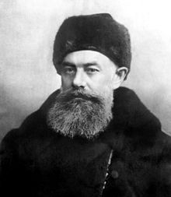
Standardized automated data collection for soil C model parametrization at the regional scale of Russia
Taras Vasiliev, Artem Vladimirov, Alexander Pashkov and Nadezda Vasilyeva
V. V. Dokuchaev Soil Science Institute, Interdisciplinary laboratory for mathematical modeling of soil systems,
Soil Data Center, Moscow, Russian Federation
© Authors. All rights reserved

Slide 2
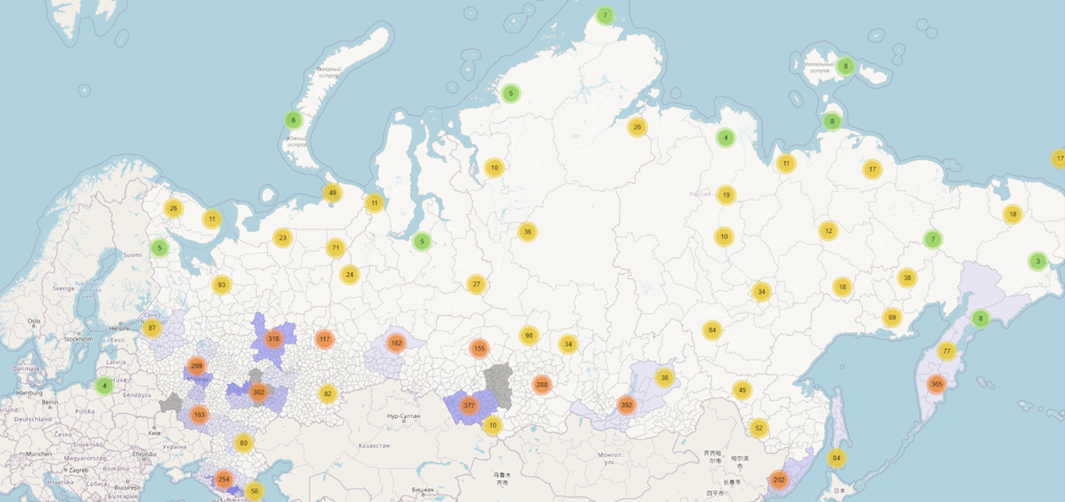
Aggregated map of soil profile locations in Russian national database
number of profiles in each region is shown in circles
Database contains descriptions for:
863 soil profiles with on average 5 horizons
195 soil types according to Russian soil classification
/94 soil types according to WRB
/62 soil types according to FAO
9 attributes of soil profile location
4 attributes of soil profile field description
12 attributes of each horizon field description
22 attributes of soil sample analysis from horizons

Slide 3
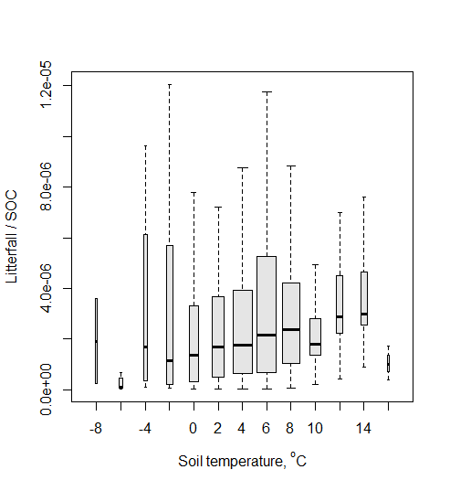
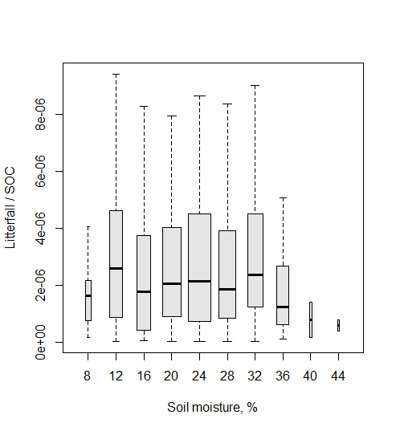
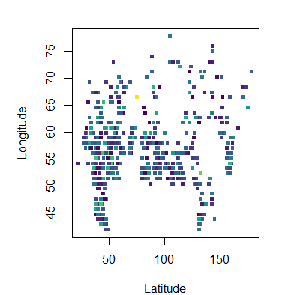
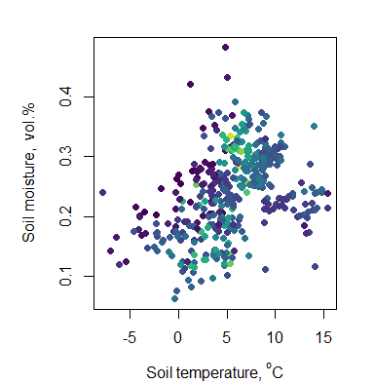
Estimating moisture and temperature sensitivity of soil carbon decomposition rates using Russian National Soil Database and ESM
The aim of the study is to perform a regional scale (Russia) soil type-specific soil C models calibration. To obtain temperature and moisture dependencies of soil C cycle reaction rates, the model can be fitted to soil profiles of the same soil type in different climatic conditions. For this aim historical climate data, carbon concentration profiles and soil profile descriptions (soil type, texture and other properties that can provide additional information to constrain model parameter values) in different spatial locations will be used.
863 soil profiles fit into 391 ESM grids
ESM result litter fall, soil temperature and soil moisture for these grids
Decomposition rates for carbon in surface soil layer 0-20 cm
as a function of soil temperature and moisture
Community Earth System Model (CESM 4.0) Scenario: 1deg_GSWP3v1_CMIP6_SSP3-7 Global Soil Wetness Project Phase 3 Grid 1.25 × 0.94°
Trends in decomposition rates with climatic conditions increasing with temperature and optimum with moisture are roughly seen even without soil-type specific grouping.

Slide 4
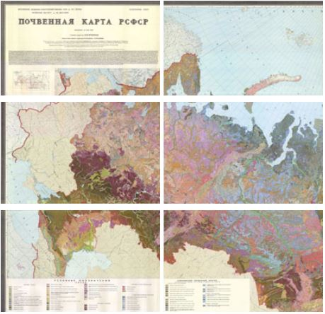
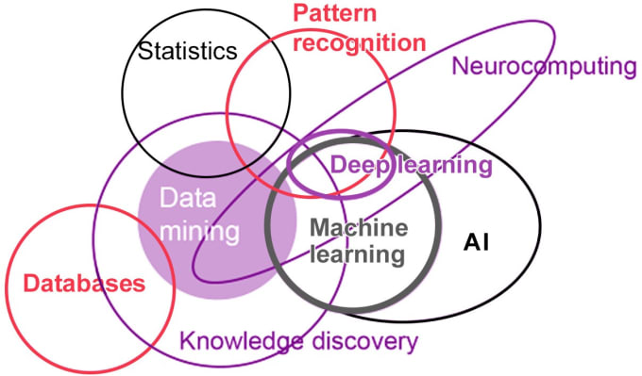
System functionality
Deployment of online application processing for internal documentation and data exchange between users, laboratories and administration
Online monitoring of research activities, instrumental throughput, optimization of time-consuming tasks
Data validation and cleaning
Data mining and automated data analysis using integration of new and archived data
Availability of the data in different formats, visualisation, interactive data analysis, reports
Statistical basis for soil classification improvements
Extension of national soil database

Slide 5
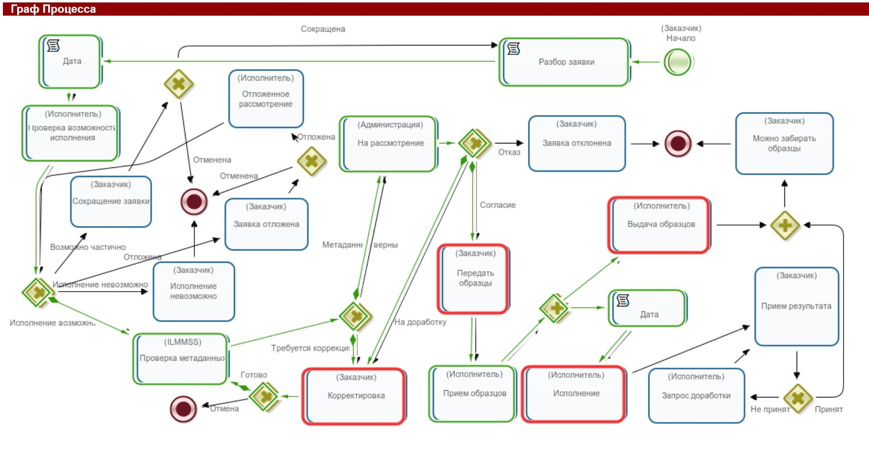
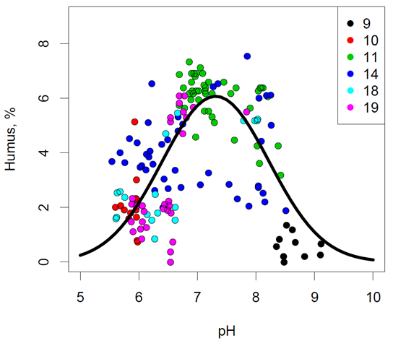
RunaWFE
System of process management, data collection and analysis

Slide 6
We develop a data collection system with a tool for field soil description according to the national soil database standard with a tool for soil determination which includes Kohonen algorithm to predict soil type based on the determined soil profile sequence of horizon indexes. Further the system allows automated RunaWFE based request for soil sample analysis (national method standards) which is obligatory accompanied with standard soil profile and samples descriptions.
V.V.Dokuchaev Soil science institute has 13 departments which are producing variety of soil analysis and are carrying out field work and sampling all around Russia:
Department of soil genesis, geography and classification
Laboratory of monitoring of the soil cover
Laboratory of soil digital mapping
Department of genesis and amelioration of saline and solonetz soils
Department of agro-ecological estimation of soils and designing of agro-landscapes
Inter-institute department of studying chernozem soils
Laboratory of soil erosion
Laboratory of hydrology of ameliorated soils
Laboratory of soil biology and biochemistry
Laboratory of soil chemistry and physico-chemistry
Analytical instrumental laboratory
Laboratory of soil mineralogy and micromorphology
Soil Data Center

