Slide 1

The ESA-funded Aeolus/Earthcare Aerosol Assimilation Study (A3S)
Julie Letertre-Danczak, Angela Benedetti, Alain Dabas, Thomas Flament and Samuel Quesada-Ruiz
Julie.Letertre-Danczak@ecmwf.int
EGU 05th May 2020

Slide 2
Aerosol Lidars/Ceilometers assimilation at ECMWF
ECMWF has participated on several project over the last few years related on the assimilation of LIDARS and Ceilometers:
Aeolus/EarthCARE Aerosol Assimilation Study (A3S) (ESA funded):
  The first phase was in 2016-2018
  The second phase started in October 2019
Aerosol Clouds Trace gases Research Infrastructure (ACTRIS-2) (EU H2020 funded)
  2015-2019
European Natural Airborne Disaster Information and Coordination System for Aviation (EUNADICS-AV) (EU H2020 funded)
  2016-2019
E-PROFILE (European ceilometer network) (unfunded)
  The collaboration started in 2017

Slide 3
What aerosol profile information can we assimilate?
Here is the list of improvements have been applied in order to assimilate the LIDAR/Ceilometers over the different projects in Integrated Forecast System (in the configuration of the Copernicus Atmosphere Monitoring Service, which is explained in the next slide):
Different instruments:
  Satellite lidars (CALIOP, Aeolus, Earthcare…)
  Ground-based (Lidar, Ceilometer).
Different Wavelengths:
  355, 532, 1064nm.
Different parameters:
  Aerosol backscattering (β), Aerosol attenuated backscattering (βatt), Aerosol extinction (σ).
Red: enabled in IFS and tests have been carried out.

Slide 4
IFS in CAMS configuration
CAMS NRT data assimilation system
Extra information:
Emissions (e.g. GFAS)
Fluxes
Chemistry solvers included in IFS
e.g. TM5 (CB05)
54 species, 126 reactions
photolysis, dry and wet deposition
(no TL + AD of chemistry)
IFS control variables
CHEM: O3, NO2, SO2, CO, HCHO
AER: single or dual control variables (total or fine & coarse mode aerosol mixing ratio)
GHG: CO2, CH4
Meteorological variables
Observations
Observation operators
Bias correction
Background error statistics
Aerosol model with 12 bins (no TL or AD)
GHG fields
Credit A. Inness

Slide 5
Historical perspective
The observation operator for lidar data was developed for inclusion in 4D-VAR under the ESA-funded project QuARL in 2010 (thanks to Jean-Jacques Morcrette, Olaf Stiller and Marta Janiskova)
Initial assimilation tests at ECMWF using CALIPSO data were started in 2011 (single orbit)
Several model changes (cycles) occurred over the years which resulted in a better agreement with the observations

Slide 6
Scientific motivation for the A3S project
Aeolus and EarthCARE are/will provide near-real-time (NRT) aerosol products from the ALADIN and ATLID lidars
Data are/will be delivered to operational centres with interest in aerosol prediction and forecasting such as ECMWF
ECMWF has been working on assimilation of profiling data from the CALIOP lidar on board of CALIPSO in the context of the Monitoring Atmospheric Composition and Climate projects (now the Copernicus Atmosphere Monitoring Service, CAMS).
Great interest in assessing the scientific relevance of aerosol data from Aeolus (prevalently a wind mission) and EarthCARE (a cloud&aerosol mission)

Slide 7
AEOLUS/EARTHCARE AEROSOL ASSIMILATION STUDIES (A3S)
ESA-funded project is a collaboration between ECMWF and MeteoFrance
The first phase ran from Feb 2016 to Feb 2018, the second phase started in October 2019
FIRST PHASE
Objectives:
- Create demonstration datasets from model data and CALIPSO observations to simulate
Aeolus lidar profiles using ESA’s End-to-End Simulator (E2S)
- Retrieve L2A data of aerosol extinction and backscatter from demonstration datasets
- Use retrieved L2A data in the ECMMWF/CAMS 4D-Var assimilation system to
demonstrate value of Aeolus (and EarthCARE) profile data for aerosol science applications
Highlights:
- First attempt to assimilate (simulated) particle backscatter data at 355nm from Aeolus platform
- Successful assimilation of simulated profile data into a 4D-Var system
- Valuable lessons learned in preparation of assimilation of (actual) Aeolus and EarthCARE profile data

Slide 8
AEOLUS/EARTHCARE AEROSOL ASSIMILATION STUDIES (A3S) continued…
Impact:
- assimilation of profile aerosol data can improve model performance in representing 3D-aerosol fields
- more skill in aerosol analysis/renalysis and forecasts
- improved aerosol climatologies from reanalysis for NWP and climate
SECOND PHASE:
Objectives:
- Assimilate real L2A data of aerosol extinction and backscatter in the operational cycle.
- Create a cloud filter based on the model.
- Develop the BUFR format for the L2A data.

Slide 9
MOCAGE/IFS simulation
10 days (10-20 June 2012): 1° horizontal resolution and 1-hour time resolution with the assimilation of MODIS observations by MOCAGE for the retrieval of aerosol properties
IFS cloud backscatter from the lidar/radar cloud forward operator ZmVAR (courtesy of Mark Fielding and Marta Janisková, ECMWF)
L2A prototype simulator version v3.07 was used.
Several assimilation experiments were run with the demonstration datasets.
Ground Track Tool (CFI)
+ Geoid Height
AUX_MET files
generation
+
adjustments of heights
(on the geoid)
E2S-segment XML-file generation
(+time/space interpolation)
E2S / L1B
simulators
L2A
simulator
Data
set
MOCAGE and IFS
simulations
Δx=90km
Δz=200m
Matlab routines
MOC4AEL
MOC4AEL_to_XML
aerosols
clouds

Slide 10
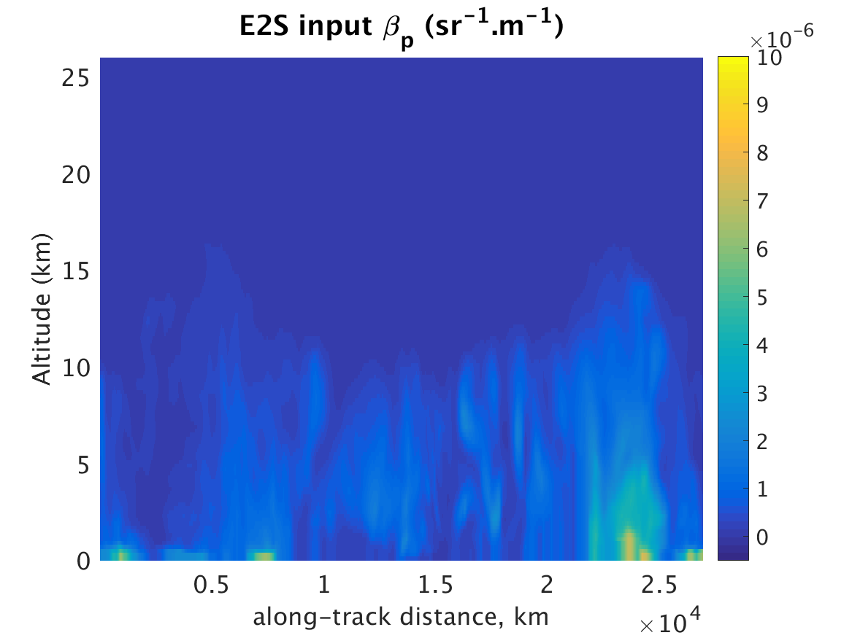
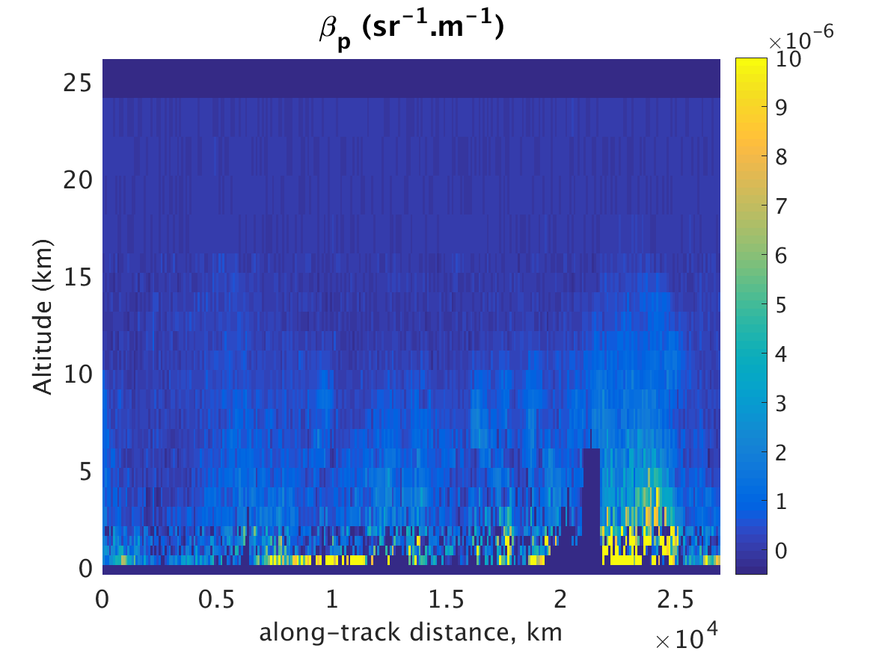
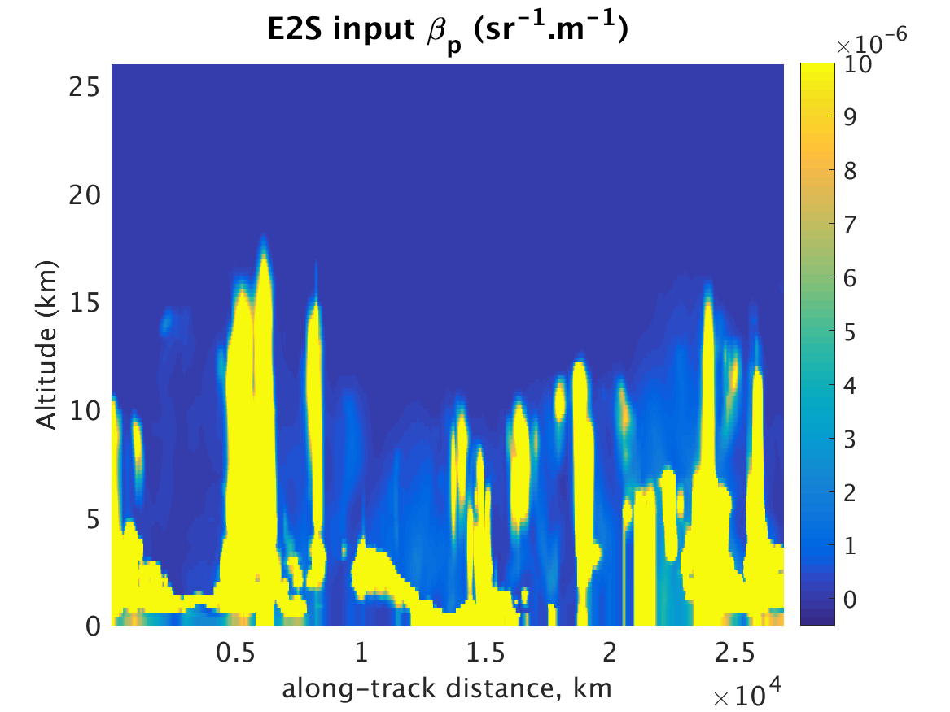
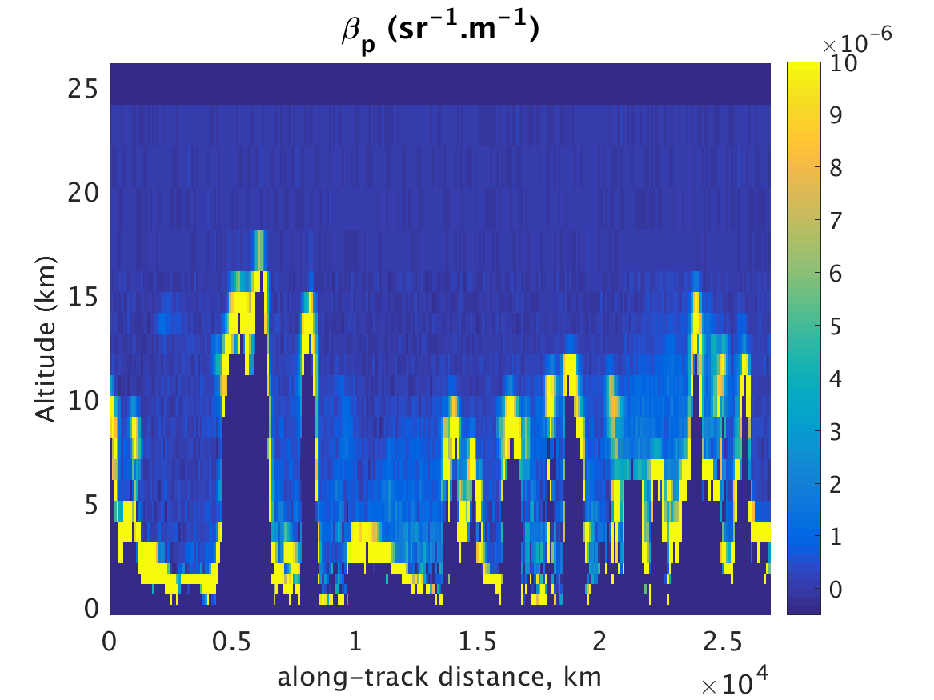
MOCAGE simulations
Backscatter, E2S input
Retrieved backscatter
MOCAGE aerosol only,
2012/06/12 at 00 hour
MOCAGE aerosol + IFS clouds,
2012/06/12 at 00 hour
Retrieved backscatter
Backscatter, E2S input

Slide 11
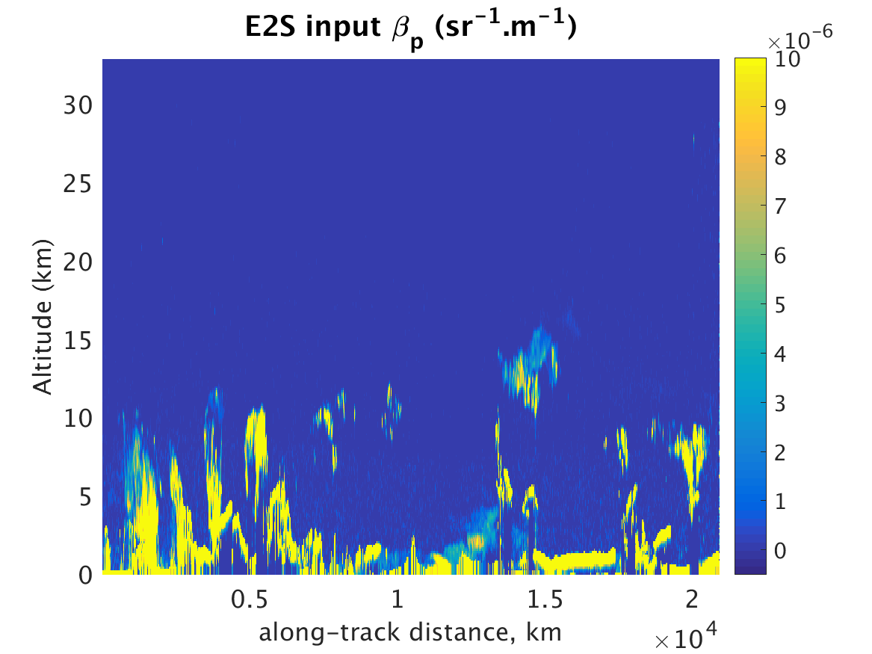
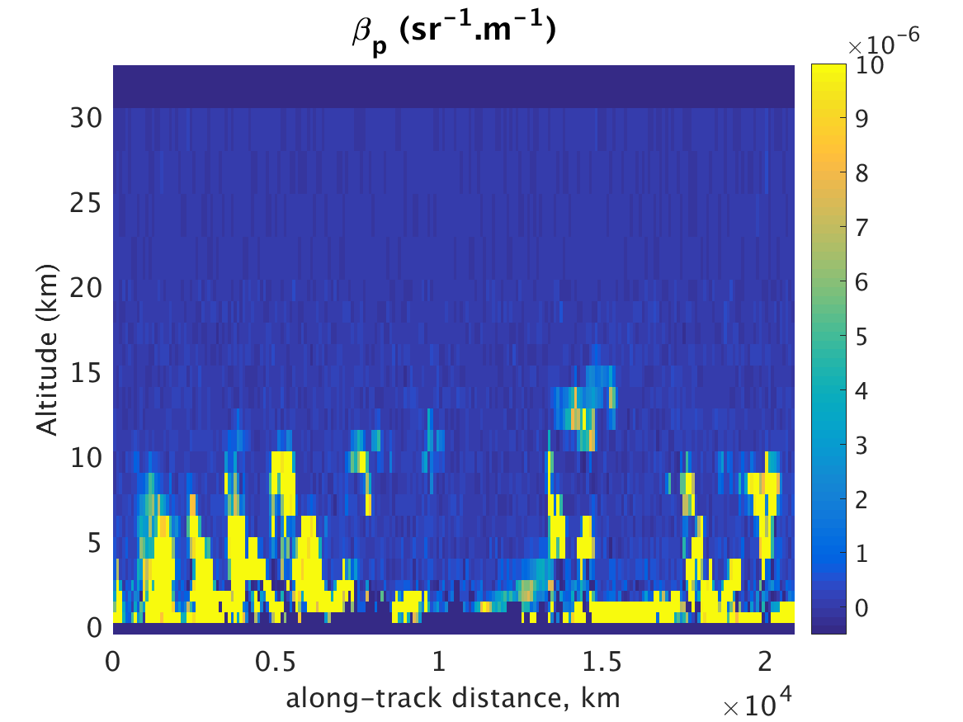
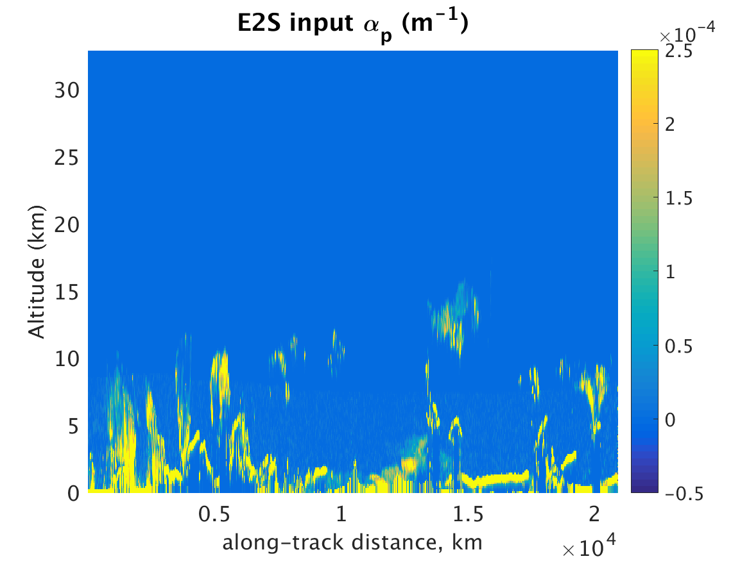
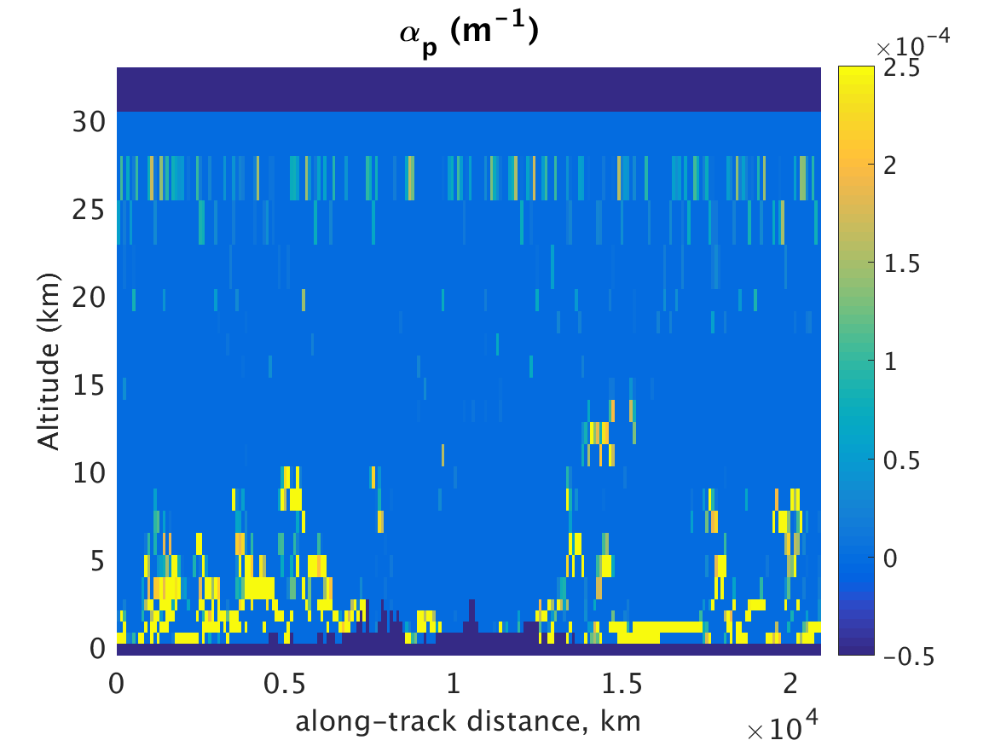
CALIPSO simulations
Backscatter, E2S input
Retrieved backscatter
CALIPSO 20070101
orbit 1,
Data rescaled at 355nm
on an Aeolus orbit
(courtesy of KNMI)
Extinction, E2S input
Retrieved extinction

Slide 12
ASSIMILATION EXPERIMENTS
Based on the ECMWF’s full 4DVAR system
L2A retrievals in EE format are transformed directly into Observation Data Base (ODB) files (ascii format) – this is a way to incorporate new observations into the assimilation system in absence of a proper BUFR format
A lidar backscatter operator is used to convert model fields from the Integrated Forecast System in CAMS configuration into profiles of backscatter at 355nm.
The operator only takes into account aerosol signal. Hence a cloud screening is applied to eliminate cloud signal.
The screening is based on height (only signal between 0.5 and 8km is considered) and backscatter threshold (thresh=20.E-06 sr-1 m-1)
Verification using AERONET

Slide 13
MOCAGE EXPERIMEnTS
MOCAGE aerosol only dataset
Period: 10-20 June 2012

Slide 14
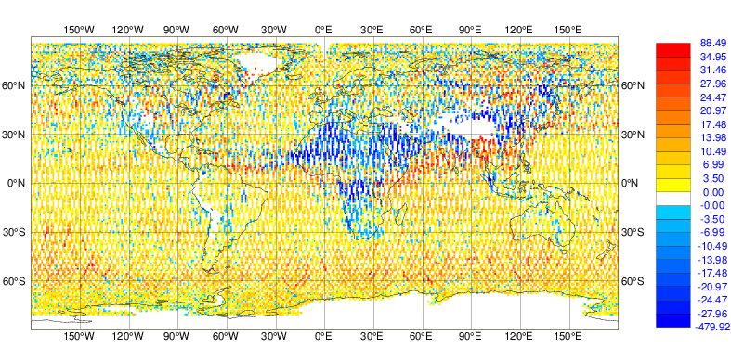
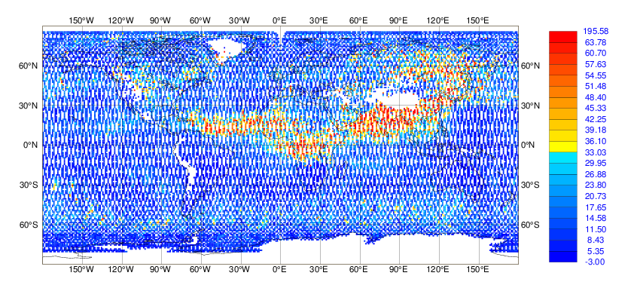
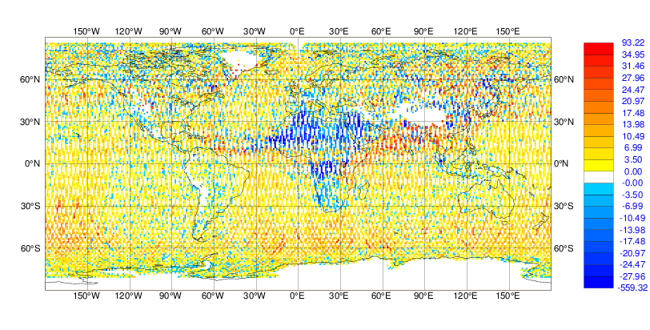
MEAN OBSERVATIONS and DEPARTURES
10-20 June 2012
700-1100hPa
Observations – first guess (mean=4.5)
Backscatter observations
Observations – analysis (mean=3.5)
Realistic backscatter aerosol fields from the MOCAGE model.
Realistic first guess and analysis departures
Units: 10-7 sr-1 m-1

Slide 15
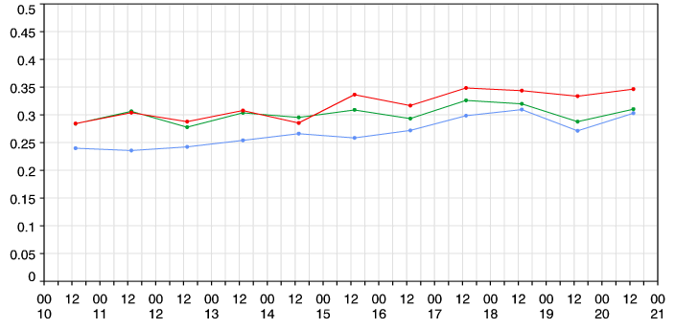
Verification using AERONET Aerosol Optical Depth
Due to the limitations of the full dataset (MOCAGE aerosols + IFS clouds) only
The experiment with the aerosol-only dataset was verified
Two experiments compared:
  only L2A aerosol backscatter data (no MODIS AOD assimilated)
  L2A aerosol backscatter data and MODIS AOD assimilated
AOD observations
L2A aerosol
backscatter
L2A aerosol
Backscatter
+ MODIS AOD
Main outcomes:
Lower bias of L2A-only experiment, but higher RMS error
Impact of L2A data non negligible

Slide 16
CALIPSO EXPERIMENTS

Slide 17
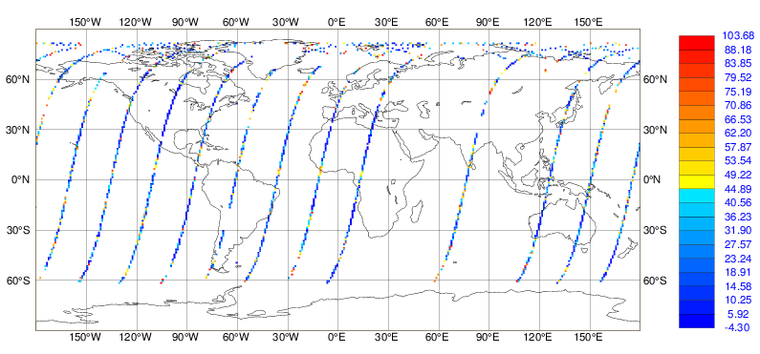
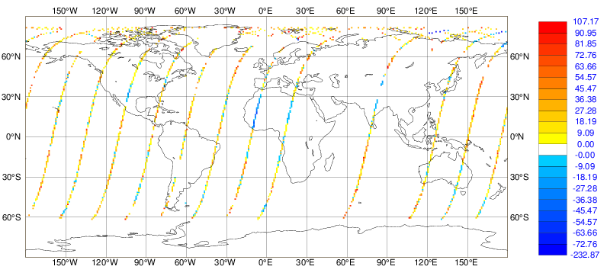
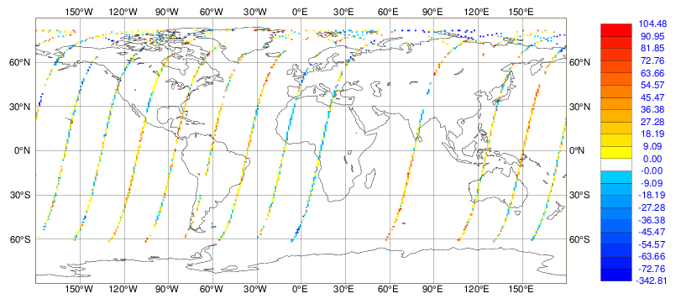
CALIPSO dataset
1 Jan 2007
700-1100hPa
Backscatter observations
Observations - First guess (mean=16.3)
Observations – Analysis (mean = 6.9)
Over the Sahara, negative first guess
departures (obs-fg) indicate that model
overestimates backscatter
Analysis departures are reduced by the
assimilation
Units: 10-7 sr-1 m-1

Slide 18
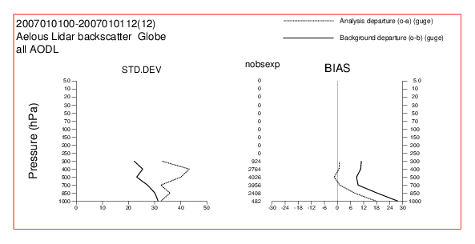

Average profiles: ERROR SENSITIVITY
CALIPSO-derived L2A with obs error/10
In the experiment with reduced error, the bias is reduced, but the standard deviation is increased in the assimilation. This is a sign that background and observation errors are not “balanced”
More balanced results when nominal error is used
Units: 10-7 sr-1 m-1
CALIPSO-derived L2A with nominal error
Units: 10-7 sr-1 m-1

Slide 19
AEOLUS DATA

Slide 20
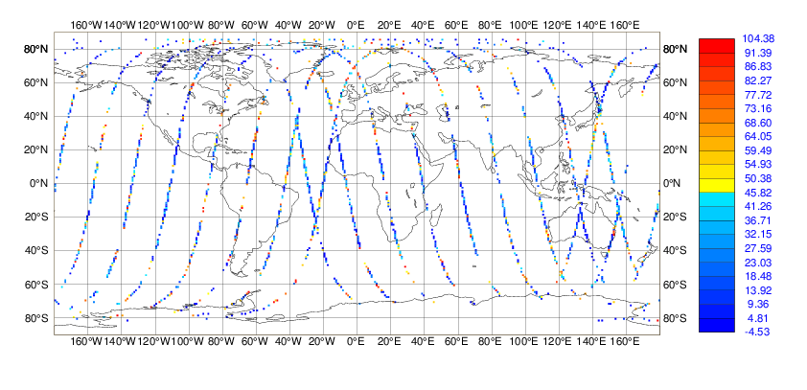
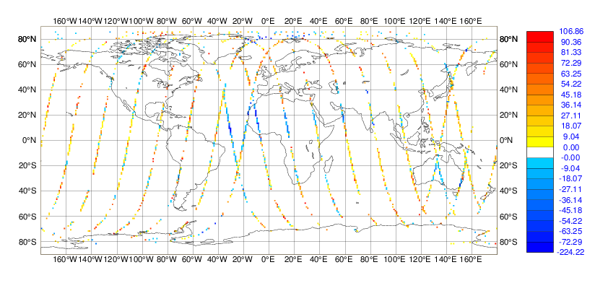

AEOLUS BACKSCATTER
13 Jan 2019(*)
700-1100hPa
Backscatter observations
Observations - First guess (mean=13.7)
Observations – Analysis (mean = 4.3)
(*) it was not technically possible to use
data for 2019 with the old model version used
in A3S, so the model was tricked into thinking
it was 2007
Lots of clouds present despite the screening,
especially at high latitudes
Analysis departures are reduced by the
assimilation with respect to first guess
Units: 10-7 sr-1 m-1

Slide 21
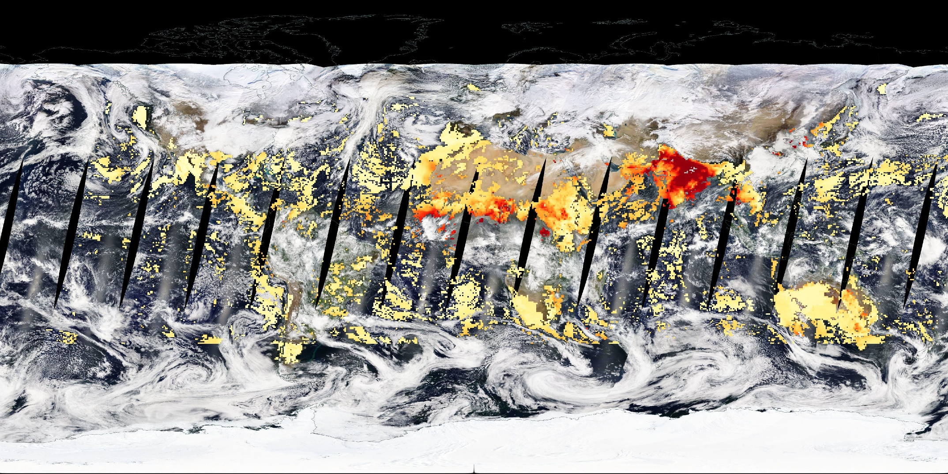
TRUE COLOR CORERECTED REFLECTANCE & MODIS AOD
13 Jan 2019
@NASA WORLDVIEW, https://go.nasa.gov/2YlYz26

Slide 22
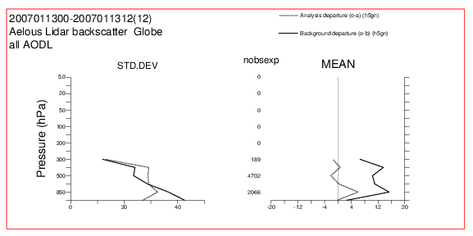
AVERAGE PROFILES
First guess profile clearly shows cloud contamination at upper levels
Height and backscatter screening need rethinking
Units: 10-7 sr-1 m-1

Slide 23
Summary and conclusions
4D-Var assimilation of simulated L2A datasets was demonstrated
MOCAGE aerosol + IFS cloud dataset proved challenging due to the presence of low-level low-backscatter clouds (cloud screening not successful)
Assimilation of aerosol-only dataset was successful
Verification with AERONET AOD showed a positive impact of the L2A aerosol-only dataset
CALIPSO dataset successfully assimilated
Initial tests with actual Aeolus L2A observations just started: successful technical test but cloud contamination is a problem
Needs to run more tests and work on the cloud screening – this will be addressed in Phase 2

Slide 24
Other studies with lidars or ceilometers

Slide 25
ACTRIS-2
ACTRIS is the European Research Infrastructure for the observation of Aerosol, Clouds and Trace Gases.
Development of tools for lidar profile assimilation from ground-based
Development of tools for verification of surface scattering and absorption coefficients from nephelometers observations
Extension of assimilation for multi-instruments, multi-parameters, multi-wavelength.

Slide 26
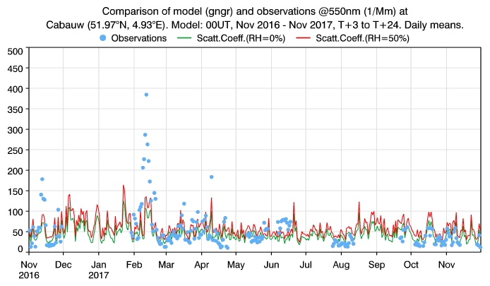
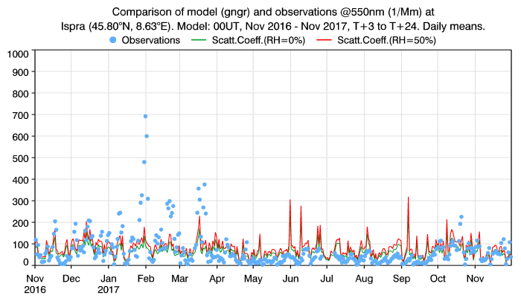
Aerosol light scattering verification
One year of verification of CAMS aerosol forecasts using ACTRIS2 nephelometer data has been implemented
This will be operationalized by CAMS
Comparisons between the model and the observation show good model skill with a tendency of the model to overestimate aerosol light scattering
Several aspects are still being investigated:
    Optimal comparison between point station & model grid point
    Influence of topography (particularly of mountain sites)
    Difference in relative humidity between model and obs (adjustments have to be done)
    observations are classified in function of the PM cut-off or full aerosol content, while the ECMWF model does not discriminate in function of the particle size.

Slide 27
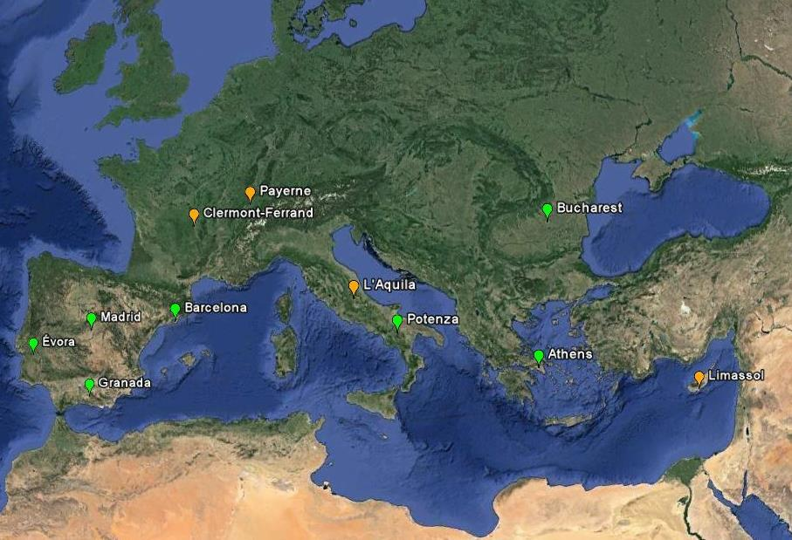
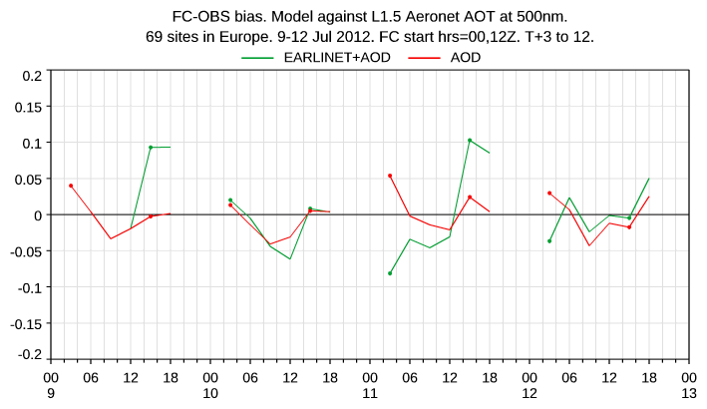
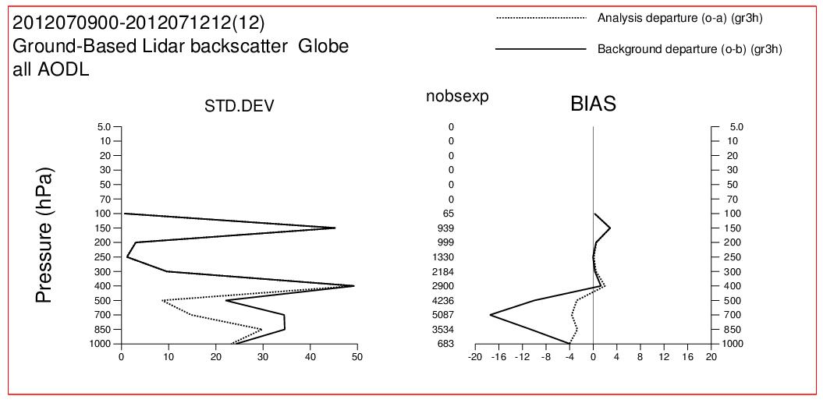
Assimilation of ground-based LIDAR data in CAMS
The assimilation of ground based LIDAR has been performed using ACTRIS2/EARLINET data for the 72-hour intensive observing period of July 2012.
The comparison with AERONET shows some degradation in skill (9 and 11 July) as well as some improvement (12 July) over EUROPE.
Monitoring capability developed

Slide 28
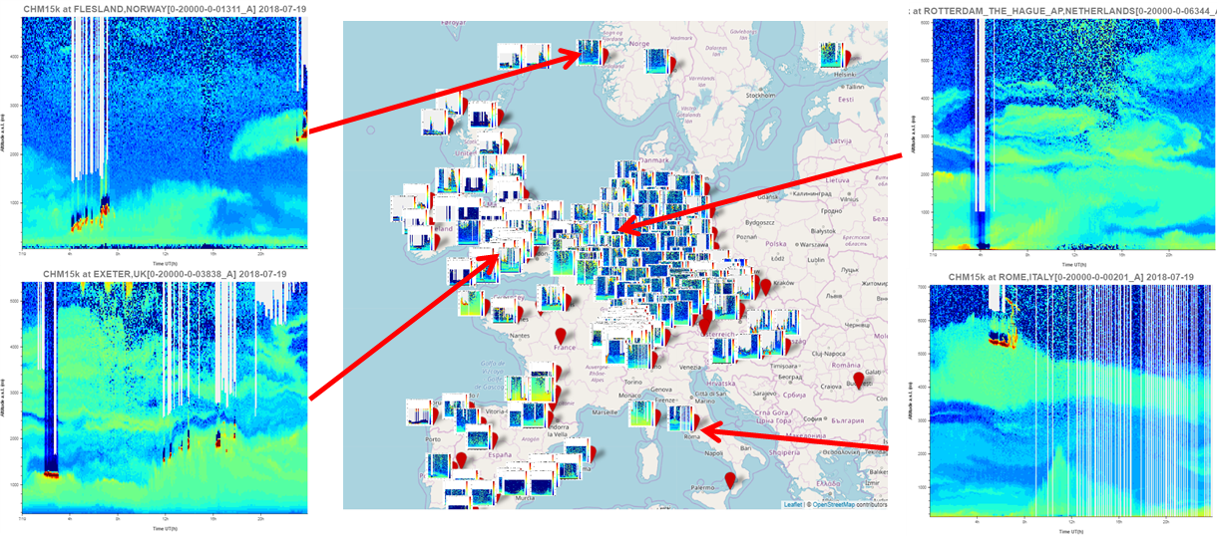
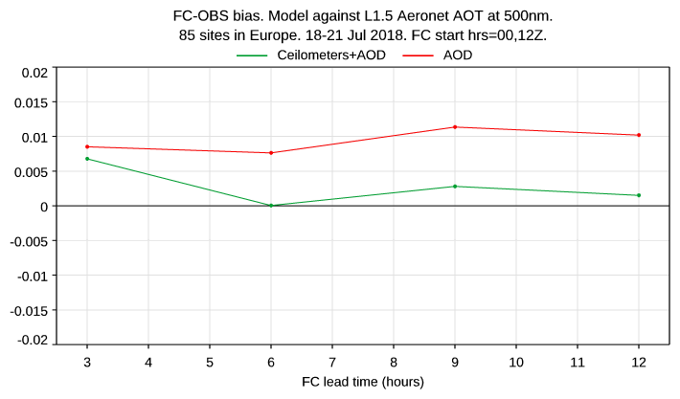
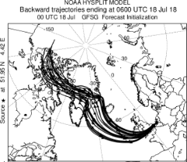
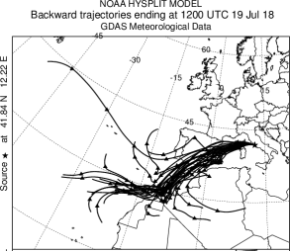
E-PROFILE Ceilometers network
Case study: 19th to 21st July 2018
Wild fires in northern America and saharan dust layer in southern europe.

Slide 29
Cases: Volcanic eruptions

Slide 30
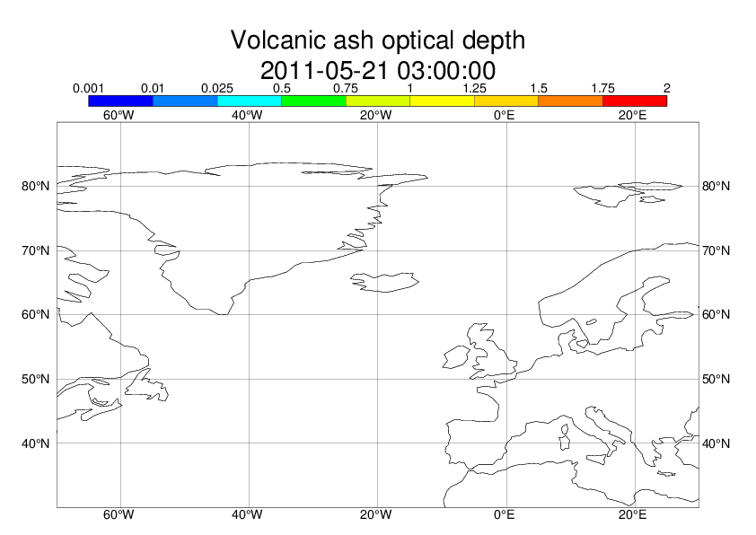
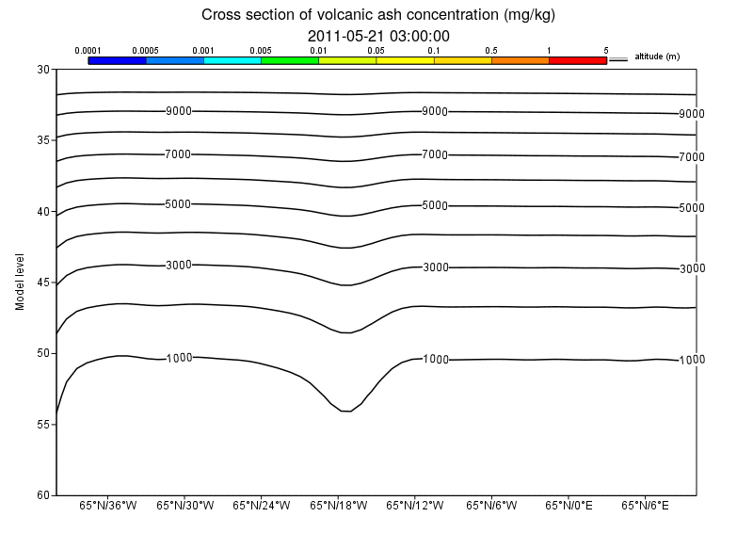
Case study : Grímsvötn eruption in IFS
The activation of source for volcanic eruption in IFS (COMPO configuration) shows a realistic evolution of the ash plume in 2D field (as shown by the AOD) but also in altitude (as shown by the concentration of ash in the cross field section).
AOD close to the reality because of the assimilation of MODIS data
Vertical profile driven by the assumption on altitude of the TOP plume at the time of eruption
Challenge : assimilation of LIDAR profile should optimized the plume vertical distribution
30

Slide 31
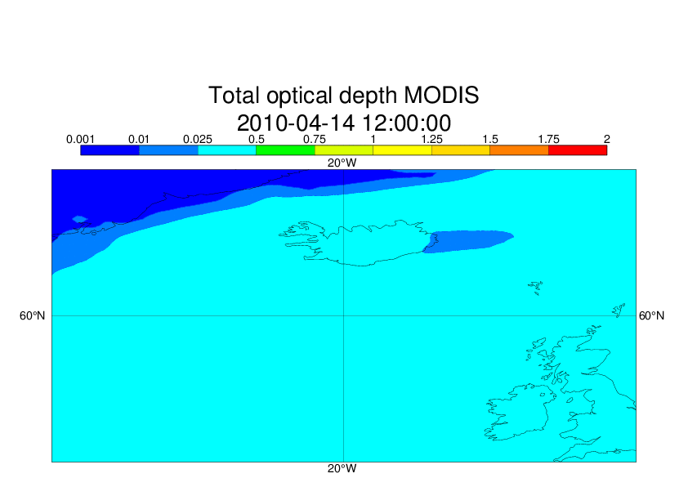
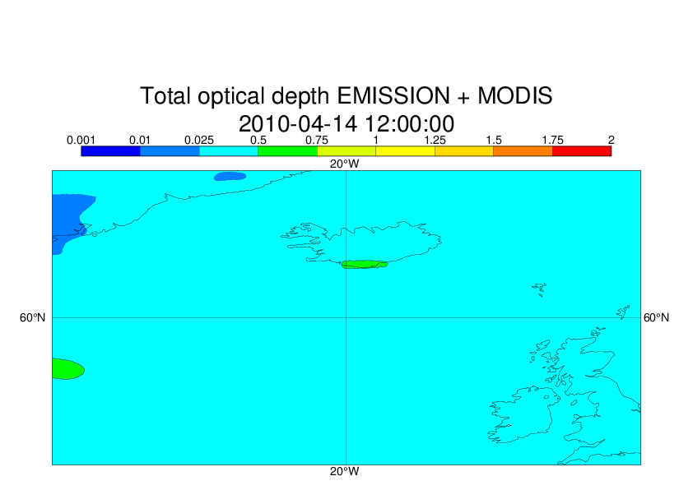
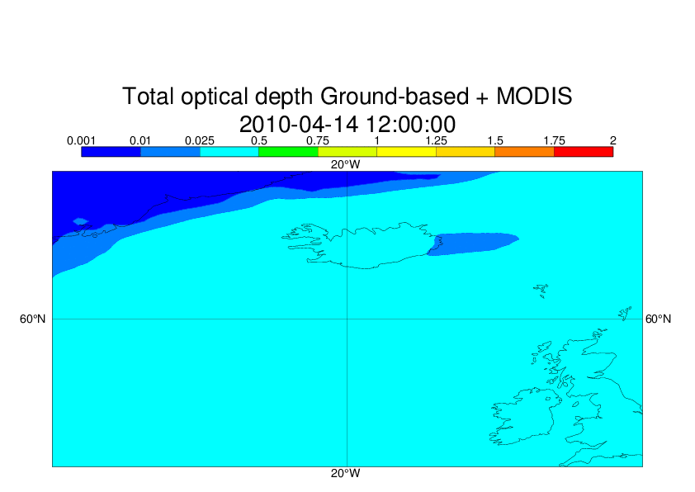
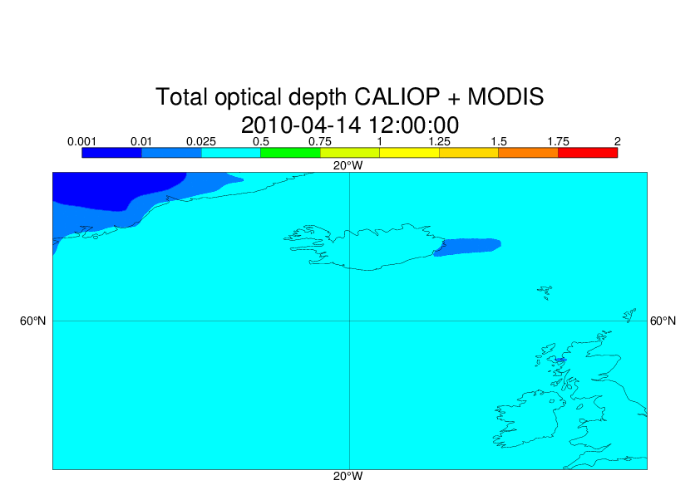
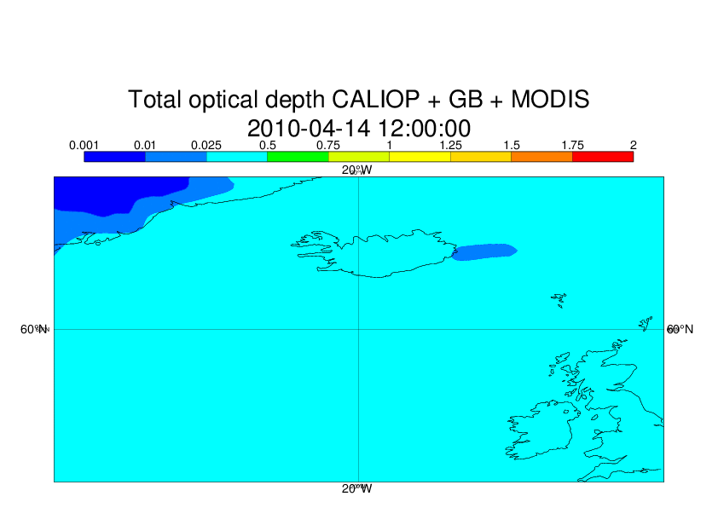
EUNADICS-AV
Case of the Eyjafjallajökull (April-May 2010): Impact of Lidars on IFS (AOD)

Slide 32
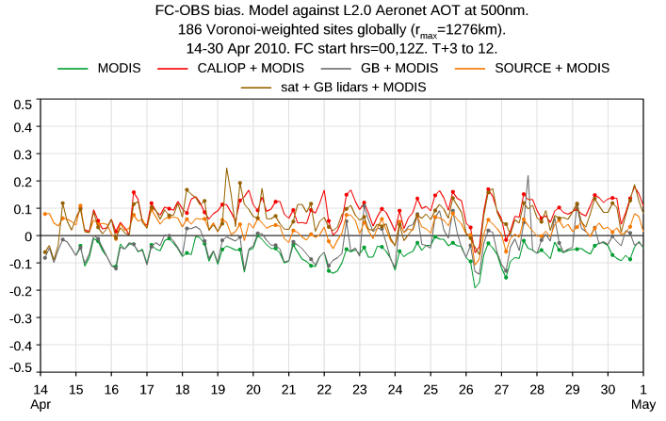
Impact of Lidars on IFS (AOD)

Slide 33
General conclusions and future works
The assimilation of aerosol lidar data as backscatter, attenuated backscatter and extinction profiles has demonstrated a positive impact on COMPO-IFS (CAMS/ECMWF).
Different platforms have be successfully used (satellite or ground-based) as the most recent ALADIN/AEOLUS instrument.
The importance of assimilation of profiling data have been demonstrated on specific cases as volcanic eruptions.
The assimilation will be improved by a cloud screening based on ECMWF model.
A monitoring of ACTRIS data should be operational in the coming months on CAMS/ECMWF.

