Slide 1



Biomass estimation based on hyperspectral and SAR data: an experimental study in South Tyrol, Italy
Eugenia Chiarito^{1, 2}, Francesca Cigna³, Giovanni Cuozzo¹, Ludovica De Gregorio¹, Giacomo Fontanelli², Simonetta Paloscia², Mattia Rossi¹, Emanuele Santi², Deodato Tapete³, Claudia Notarnicola¹
¹ Eurac Research, Institute for Earth Observation, Bolzano, Italy (Eugenia.Chiarito@eurac.edu)
^{2 I}institute of Applied Physics - National Research Council of Italy (IFAC–CNR)
³ Italian Space Agency (ASI)
PICO Presentation at European Geosciences Union General Assembly 2020, Vienna
04-08 May 2020

Slide 2
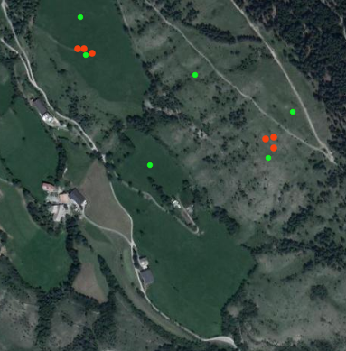
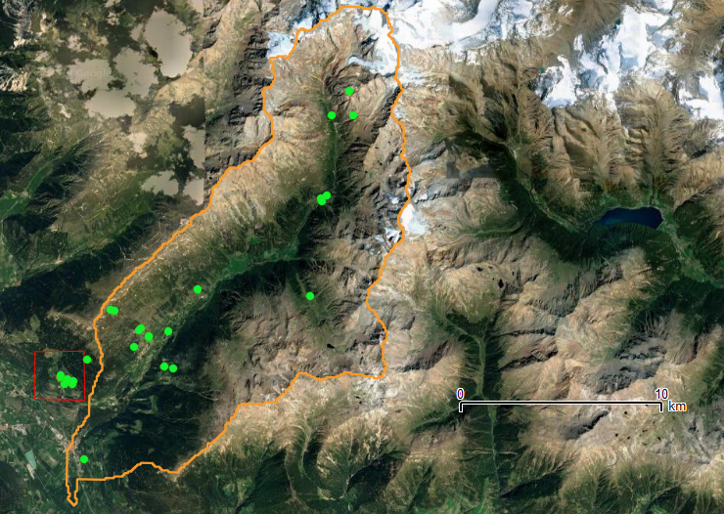
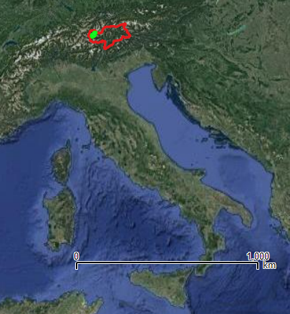
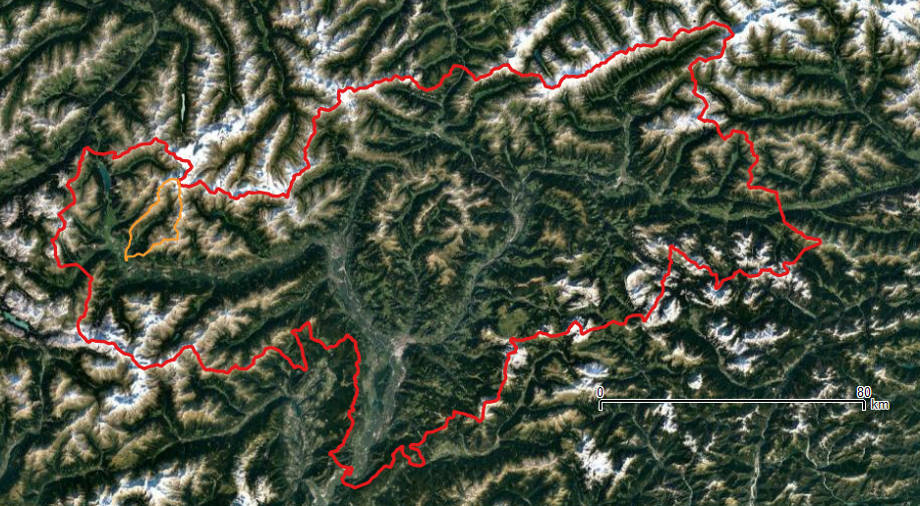
Two Minutes Presentation (I)
Objective:
  “To build an algorithm capable of biomass estimation using Support Vector Machine approach on hyperspectral and Synthetic Aperture Radar (SAR) data.”
Materials: 34 field campaigns (2017 & 2019)
Dataset 133 samples:
  Hyperspectral reflectance 1024 bands
  Sentinel 1 Backscattering coefficient HH and HV
  Biomass samples (plot 50x50cm)
Methods:
Spectral resampling: 1024 239 bands (PRISMA specifications)
Feature Selection: Genetic Algorithm to detect most sensitive bands
Machine Learning regression model: Support Vector Regression
Model improvements:
Data simulation: PROSPECT model for hyperspectral data simulation
Spectral resampling: 1024 13 bands (SENTINEL 2 specifications)

Slide 3
Two Minutes Presentation (II)
Feature Selection (case meadow)
Sentinel-2 Bands
B4
B5
B6
B8a
B11
Niter = 50
Pmut = 0.01
Ngenes (i=1) = 5
Time = 8.2 hs
Leaf pigments
Cell structure
Water content, Leaf biochemicals, Cellulose, Protein lignin

Slide 4
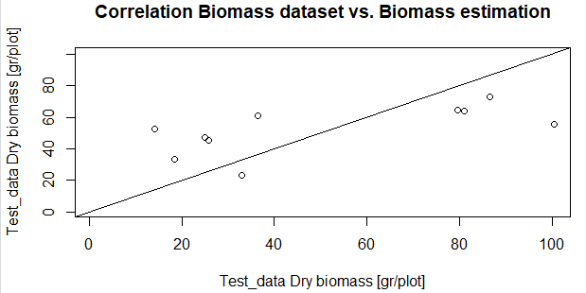
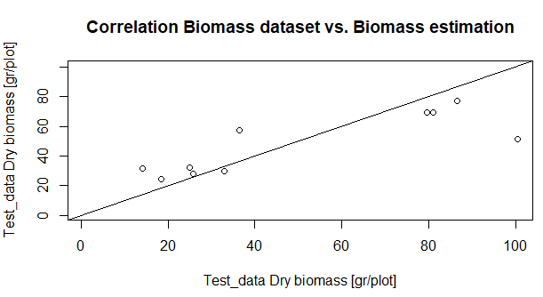
Two Minutes Presentation (III)
SVR regression (case meadow)
 | R2
Field Data 239 bands + σ_{VV} + σ_{VH} | 0.37
Field Data S2 13 bands + σ_{VV} + σ_{VH} | 0.71

Slide 5
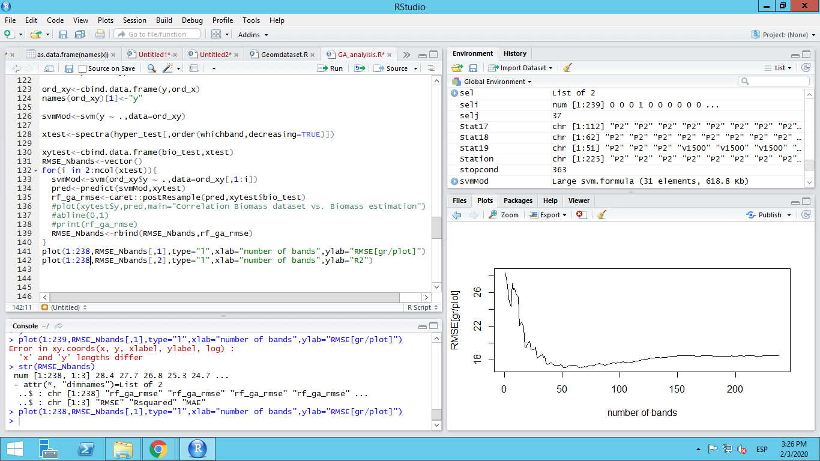
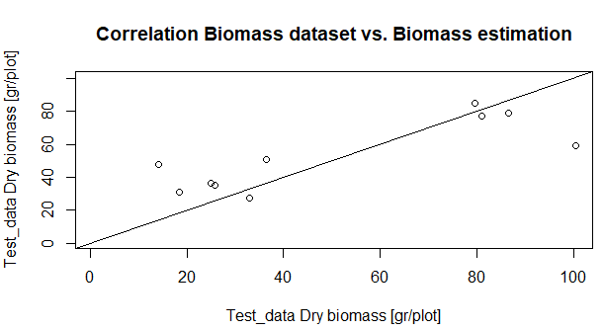
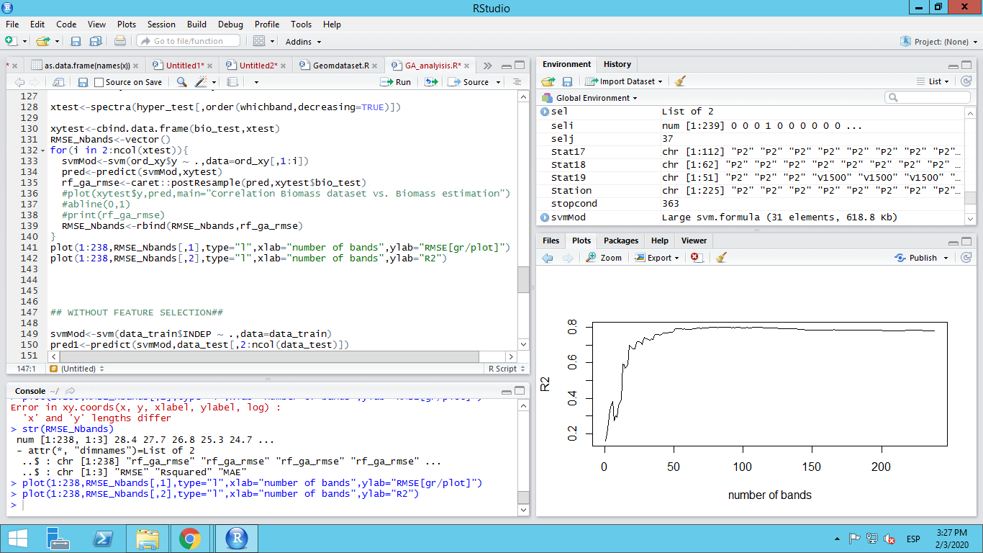
Two Minutes Presentation (IV)
SVR regression (case meadow)
 | R2
Field Data 239 bands + σ_{VV} + σ_{VH} | 0.37
Field Data 52 bands + σ_{VV} + σ_{VH} | 0.53

Slide 6
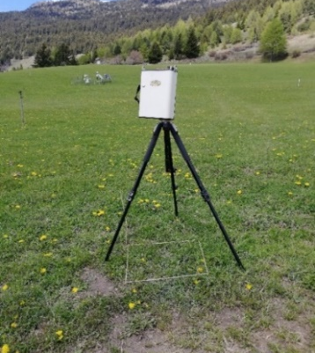
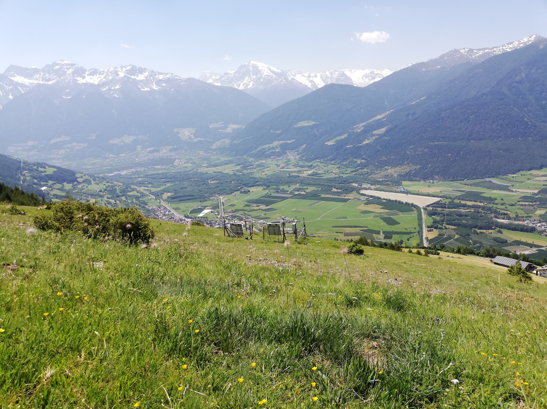
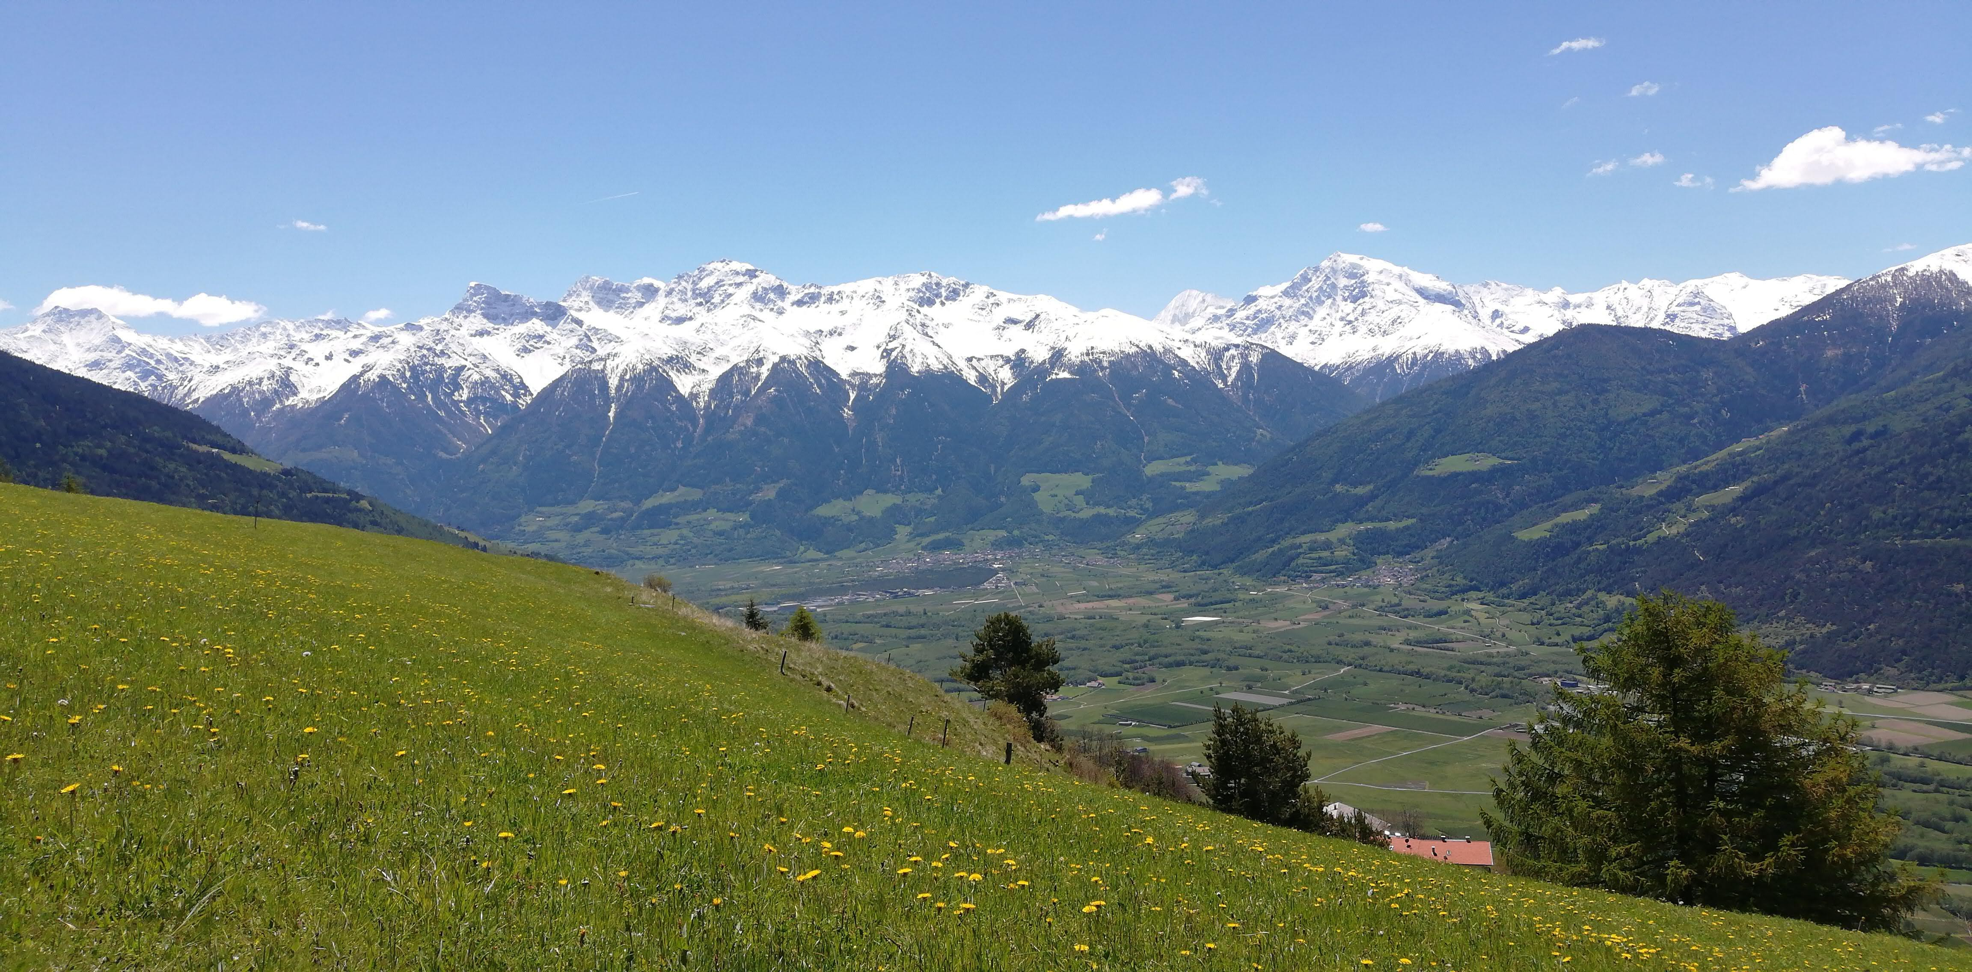
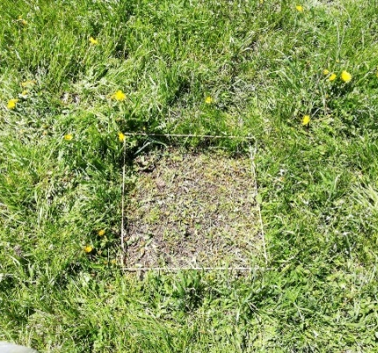
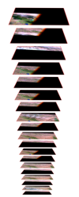
Field campaigns
Data sampling
Stations
Pasture
Meadow
Irrigation
Fertilization
2/3 cuts/season
Hyperspectral data collection SVC HR-1024i
1048 spectral bands
Range 338 nm to 2500 nm.
Dataset
133 samples
Meadow/ Pasture | Date | Lat/ Long | Hyperspectral Reflectance |  |  |  |  |  | SAR σ
 |  |  | B1 | B2 | (…) | Bi | (…) | B239 | VV | VH
Above Ground Biomass sampling
Destructive methodology
Plot 50x50cm

Slide 7
Two Minutes Presentation (V)
N_{i}
Cab_{i}
Car_{i}
Cbrown_{i}
Cm_{i}
Cw_{i}
Data simulation
Hyperspectral data
PROSPECT invert
N_{i+1}
Cab_{i+1}
Car_{i+1}
Cbrown_{i+1}
Cm_{i+1}
Cw_{i+1}
N_{i}, Cab_{i}, Car_{i}, Cbrown_{i}, Cw_{i},Cm_{i}
Simdata1:
  Parameter interpolation between i and (i+1)
Simdata 2:
  N, Cab, Car, Cbrown median
  Cm, Cw random within max-min ranges

Slide 8
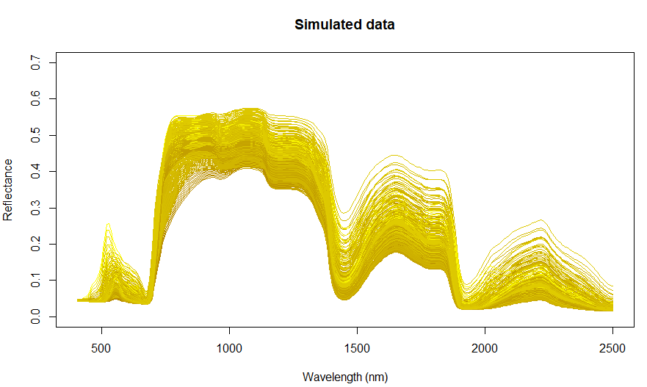
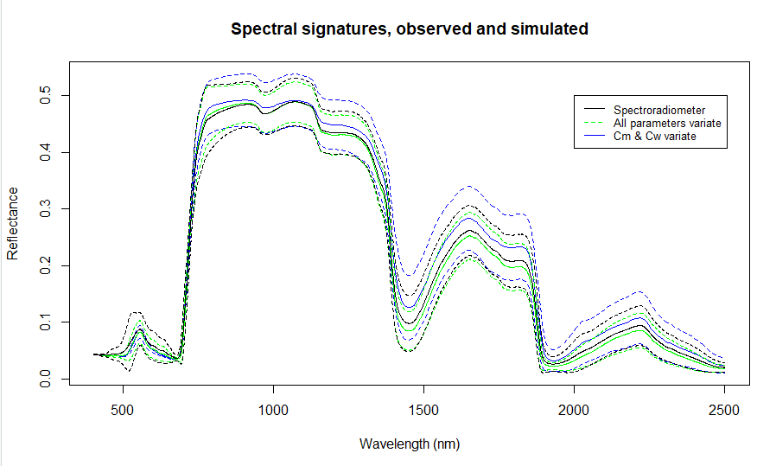
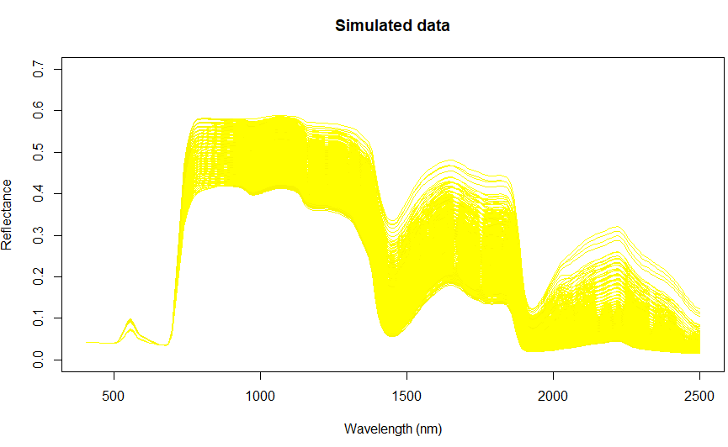
Two Minutes Presentation (VI)
SVR regression (case meadow)
(i)
(ii)

Slide 9
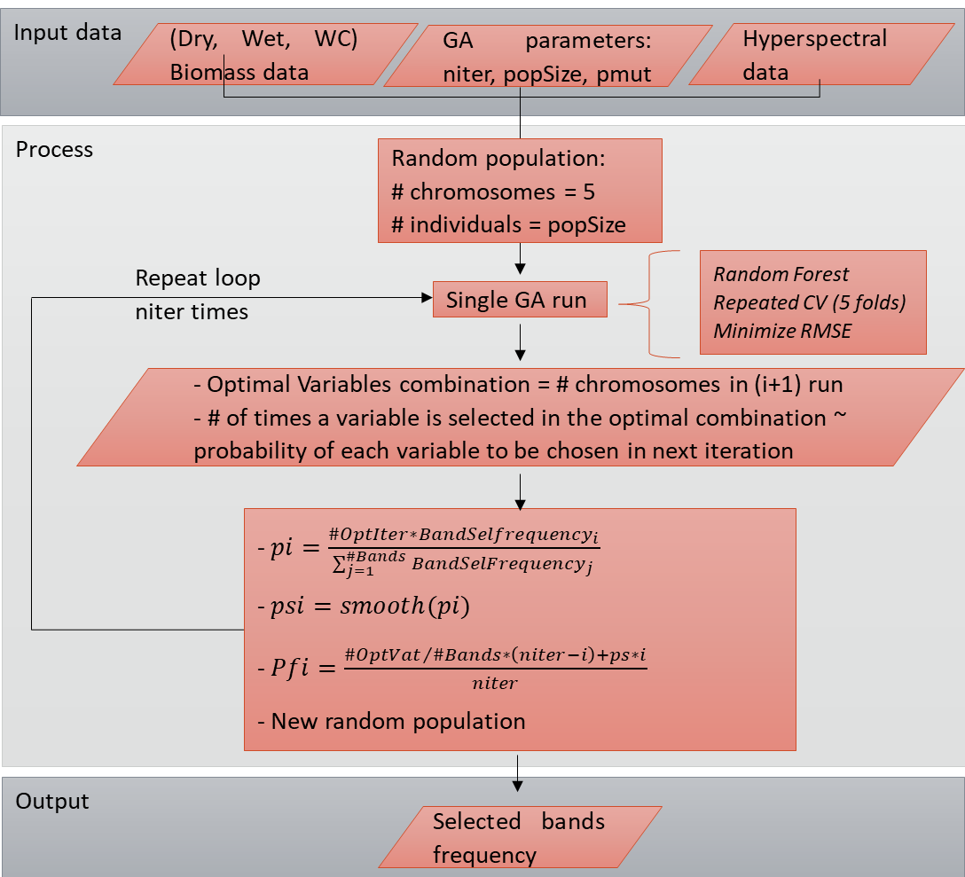
Feature Selection
Genetic Algorithm
resampling method: five-fold cross validation
population size: 30 chromosomes
Number of bands in the initial population: 5
model fitting function: Random Forest
response: Minimizing RMSE
probability of mutation: 1%
number of runs: 50
window size smoothing: 3 bands wide
See:
Leardi, R. (2000). Application of genetic algorithm–PLS for feature selection in spectral data sets. Journal of Chemometrics, 14(5‐6), 643-655.

Slide 10
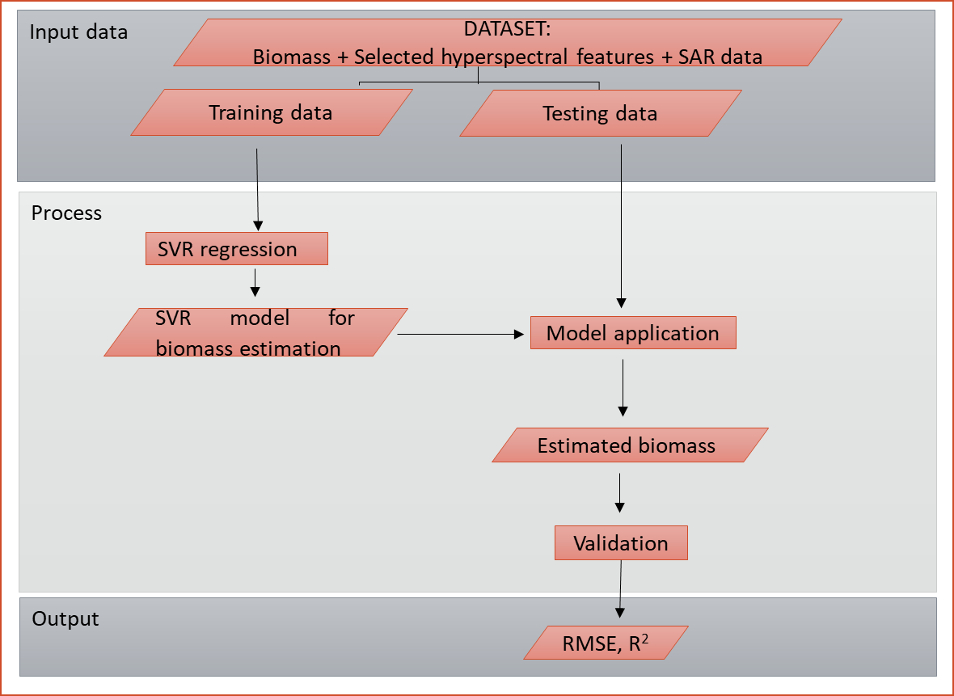
Machine Learning Assessment Model
Support Vector Regression
First model input:
Hyperspectral most sensitive band + σ_{VV} + σ_{VH}
Output:
RMSE₁; R²₁
i-st model input:
Hyperspectral i most sensitive bands + σ_{VV} + σ_{VH}
Output:
RMSE_{i}; R²_{i}
OPTIMAL SOLUTION: best compromise between performance and number of bands
See:
Chen, L., Ren, C., Zhang, B., Wang, Z., & Xi, Y. (2018). Estimation of forest above-ground biomass by geographically weighted regression and machine learning with Sentinel imagery. Forests, 9(10), 582.
Wang, C., Feng, M., Yang, W., Ding, G., Xiao, L., Li, G., & Liu, T. (2017). Extraction of sensitive bands for monitoring the winter wheat (Triticum aestivum) growth status and yields based on the spectral reflectance. PloS one, 12(1).

Slide 11
Results
Dry Biomass | N of bands | R²
Meadow | 52 | 0.53
Pasture | 6 | 0.24
Meadow
Pasture

Slide 12
Results
Fresh Biomass | N of bands | R²
Meadow | 127 | 0.51
Pasture | 67 | 0.41
Meadow
Pasture

Slide 13
Discussions
A multi sensors synergetic model is explored, in order to combine information about plant biochemical and structural properties, complemented with density/volumetric information.
An optimized genetic algorithm allowed to better understand the regions of the spectrum that contain most relevant information. The bands in the red-edge región, NIR plateau and SWIR water absorption bands were the most sensitive ones. Blue bands were also found to be relevant, especially in meadow.
The number of features were successfully and significantly reduced, with model performances similar to the model regression using all bands. However, the algorithm processing is still high consuming and needs further improvement.
The model performance improved when optical data number of bands was reduced to match Sentinel 2 bands, showing that a good compromise between the number of features and the dataset dimensions is required for optimal accuracy.

Slide 14
Conclusions
This study presents the preliminary results of an ongoing project that involves Agenzia Spaziale Italiana (ASI), IFAC-CNR and EURAC Research.
Narrow bands data combined with microwave data still remains as a partially explored field, and shows high potential.
Machine learning approach is highly dependent on the dataset dimensions, which is why future works are conducted to increase the number of available simples, not only by adding new field campaigns, but also by simulating hyperspectral and SAR data.
The general objective is to design algorithms capable of biomass retrieval using PRISMA hyperspectral data combined with Cosmo SkyMed Ping Pong SAR images. The authors expect to test the proposed methodology (with posible improvements) when PRISMA data will be released, and after some field data collection for proper validation.

