Slide 1
A global analysis of climate-relevant aerosol properties retrieved from the network of GAW near-surface observatories (SARGAN)
Serves as Fiducial Reference Measurement for the Ground-Based Aerosol GAW network of networks
→ Fully characterizes the suite of traceable aerosol ground-based measurements for climate monitoring
→ World map of operational stations, QA/QC procedures, Uncertainties, Data curation and access, gap analysis
→ First results of global distribution of Aerosol Essential Climate variable and Trends, comparison with models
→ Makes recommendations for user-requirements in GCOS and future developments

Slide 2
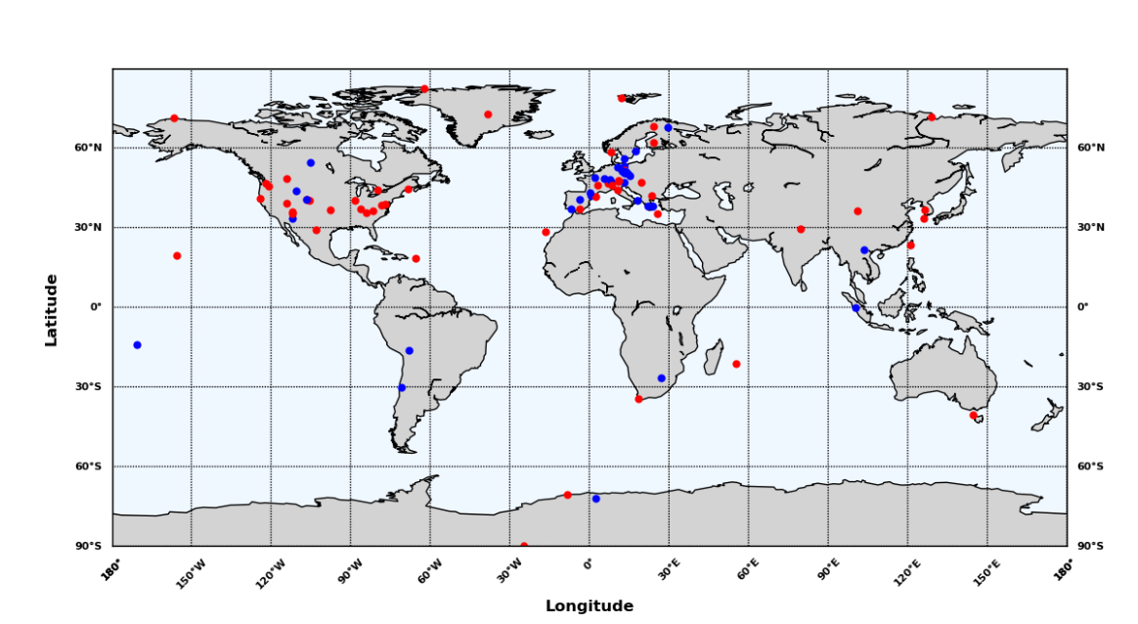
A global analysis of climate-relevant aerosol properties retrieved from the network of GAW near-surface observatories (SARGAN)
90 observation sites Worldwide providing fully traceable multi-year records of Aerosol Number concentration, Scattering and Absorption Coefficients

Slide 3
A global analysis of climate-relevant aerosol properties retrieved from the network of GAW near-surface observatories (SARGAN)
Laj et al.
AMTD
Collaud Coen et al
ACPD
Mortier et al
ACPD
Gliβ et al.
ACPD
Bigi et al.,
In prep
Rose et al.
In prep
Reference Measurement Network
Model/Observation of trends
Trend analysis
Analysis of variability (PNSD, Scatt. And Abs Coef, SSA, Ang. Exp.
Model/Observation of variability

Slide 4
A global analysis of climate-relevant aerosol properties retrieved from the network of GAW near-surface observatories (SARGAN)
→ General decreasing trends over the last decade for extensive properties where observations exist (Collaud Coen et al., ACPD)
→ Models tend to underestimate all variables when compared with the observations (Gliß et al., )
→ Models confirm negative trends where observations exists but indicate increasing trends in many World regions where observations simply do not exist (Mortier et al., )

Slide 5
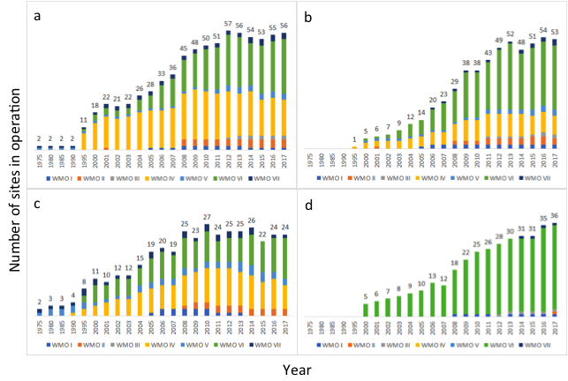
A global analysis of climate-relevant aerosol properties retrieved from the network of GAW near-surface observatories (SARGAN)
Abs. Coeff.
Scatt Coeff.
N
PNSD.

Slide 6
A global analysis of climate-relevant aerosol properties retrieved from the network of GAW near-surface observatories (SARGAN)

Slide 7
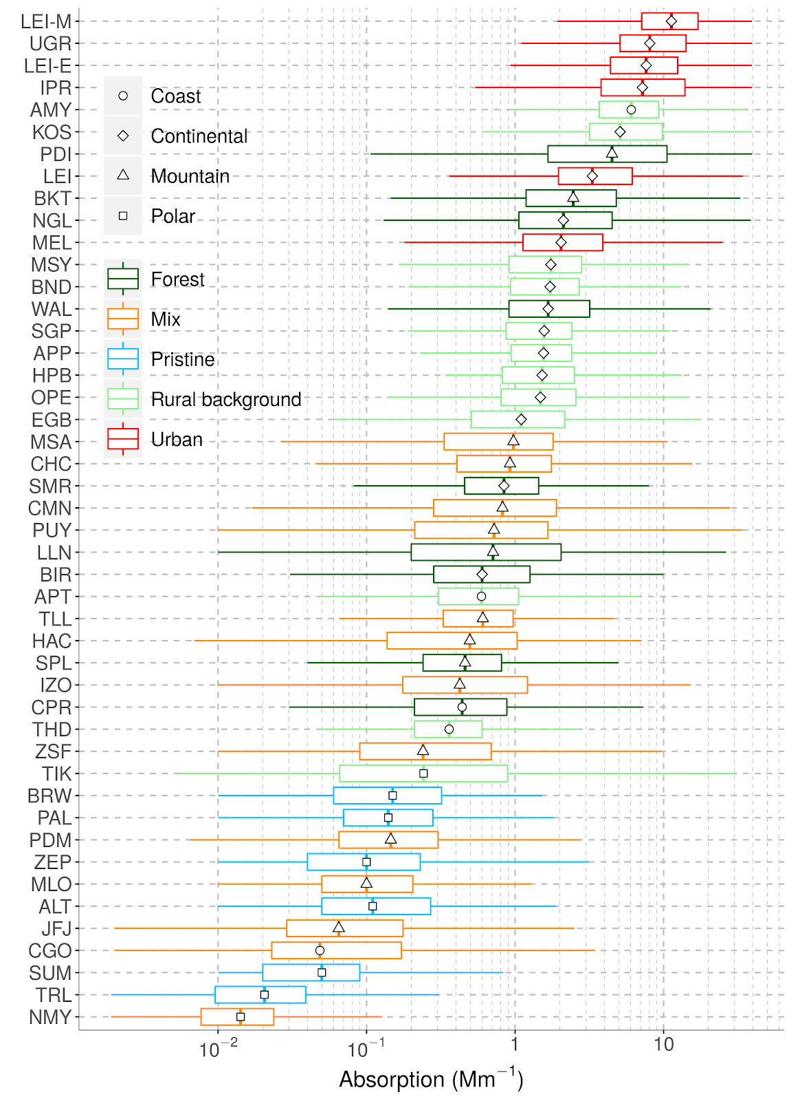
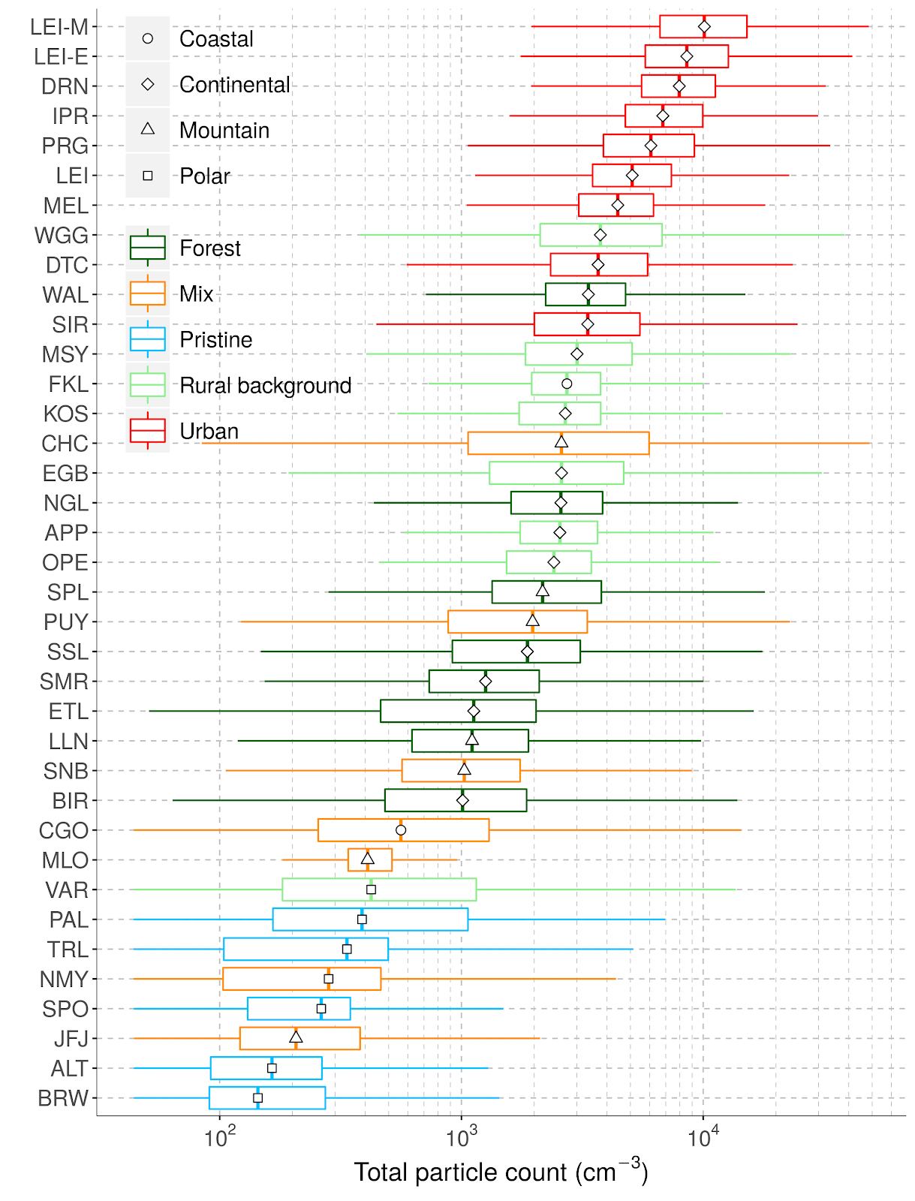
A global analysis of climate-relevant aerosol properties retrieved from the network of GAW near-surface observatories (SARGAN)
Bigi et al.,
Rose et al.,

