Slide 1
GIMO - a new geospatial tool for On-site Inspection data collection and techniques integration
Gustavo Haquin Gerade et al.
On-Site Inspection Division
Comprehensive Test Ban Treaty Organization

Slide 2
On Site Inspections
On-site inspections (OSI) are one of the elements of the CTBT verification regime.
An OSI is conducted to clarify whether a nuclear weapon test explosion or any other nuclear explosion has been carried out in violation of the Treaty, and, to the extent possible, to gather any facts, which might assist in identifying any possible violator.
The conduct of inspection activities requires an approach that takes into account the operational, technical and time constraints specified in the Treaty.
  Inspection area (IA) up to 1,000 km²;
  Inspection Team (IT) up to 40 inspectors;
  Inspection duration up to 130 days (60 days + 70 d extension);
  Use of approved inspection equipment and implementation of geophysical techniques

Slide 3
Signatures of underground nuclear test
Natural signatures caused by UNE
Radiation anomalies;
Cavity;
Damaged lithology and mass movement;
Aftershocks;
Craters;
Geophysical signatures.
Man-made signatures
Roads, tracks;
Mining or drilling equipment;
Drilling pads, mud pits;
Cables and cable runs, etc..

Slide 4
Inspection activities and techniques
Initial period
Position finding
Visual observations including overflights
Video and still photography
Multi-spectral imaging including MSIR
Measurements of level of radioactivity
Gamma energy resolution measurements
Environmental sampling
  Particulates (fission/activation products)
  Noble gases (Xe radioisotopes, radio Argon)
Passive seismological monitoring
Continuation period
Active seismic surveys
Resonance seismometry
Magnetic field mapping
Gravitational field mapping
Ground penetrating radar
Electrical conductivity measurements
After approval
Drilling

Slide 5
Data Flow during an OSI
The concept of OSI data flow and data protection implement Treaty provisions such as:
Use approved inspection techniques and collects data related to the purpose of inspection;
The IT respects the confidentiality of the Inspected State Party (ISP);
Data authenticity, integrity and confidentiality. Application of the need-to-know principle;
IT reports data collected by applying inspection techniques;
Systematic unbiased approach based on information-led search logic.
The core of the search logic is inspection data acquired.
The Inspection Team Functionality (ITF) having the most updated inspection data readily available to inspectors to facilitate the planning, processing and reporting.

Slide 6
Geospatial Information Management for OSI – GIMO
Map centric tool to support IT work
Facilitation of ITF concept
Planning tool for IT to conduct inspection activities
Management and repository of inspection data during an OSI
Integration of data acquired by implementation of techniques
Reporting
  Internal reports – Field team reports, technical mission reports and search zone summary reports
  External reports – progress inspection report and preliminary finding document.

Slide 8
Spatial information layers
Planning
Background information
  Geophysical
  Geology
  Radiation maps
  Routes, etc..
Search zones
Missions
Reports

Slide 9
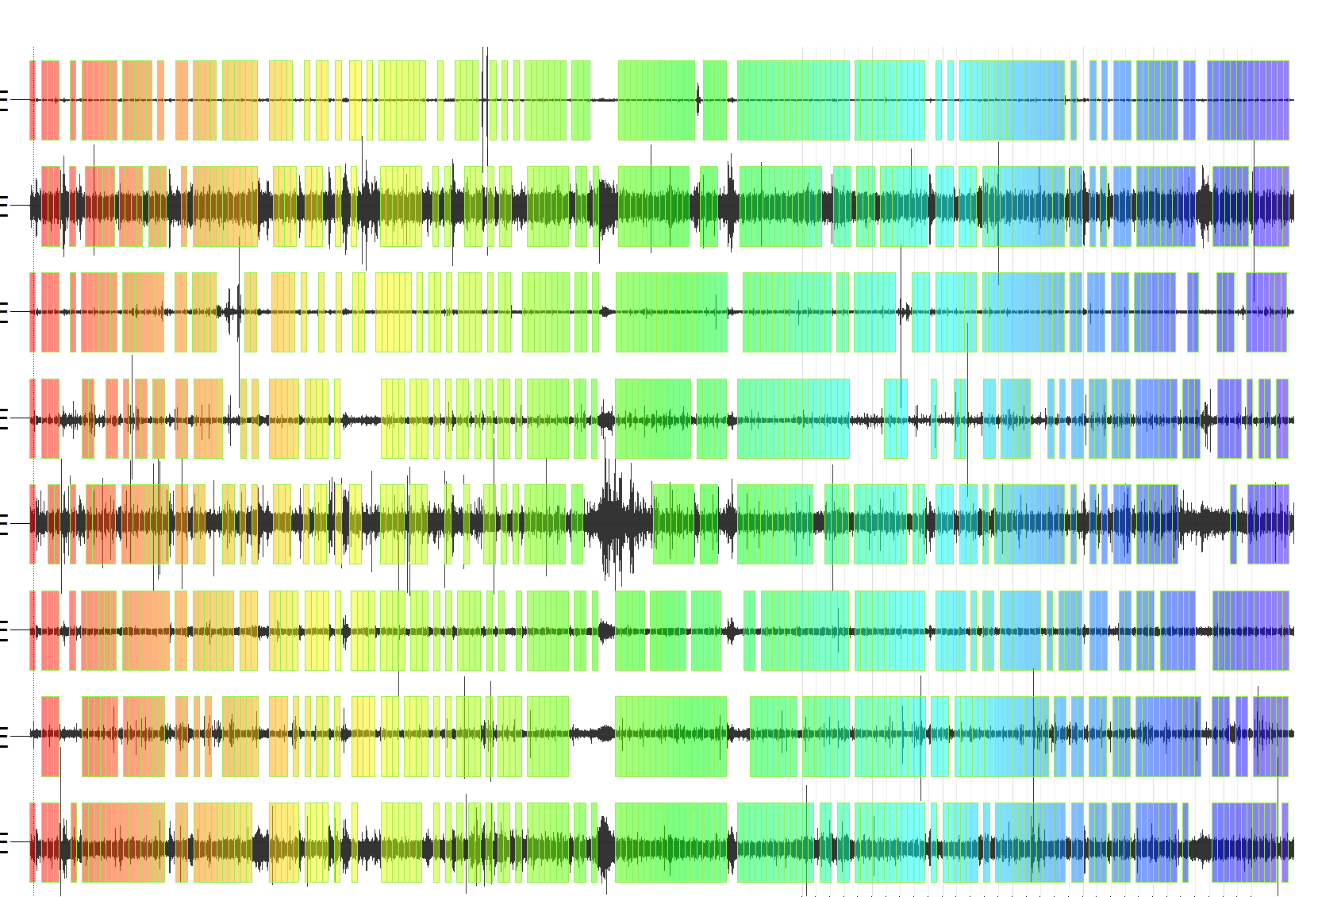
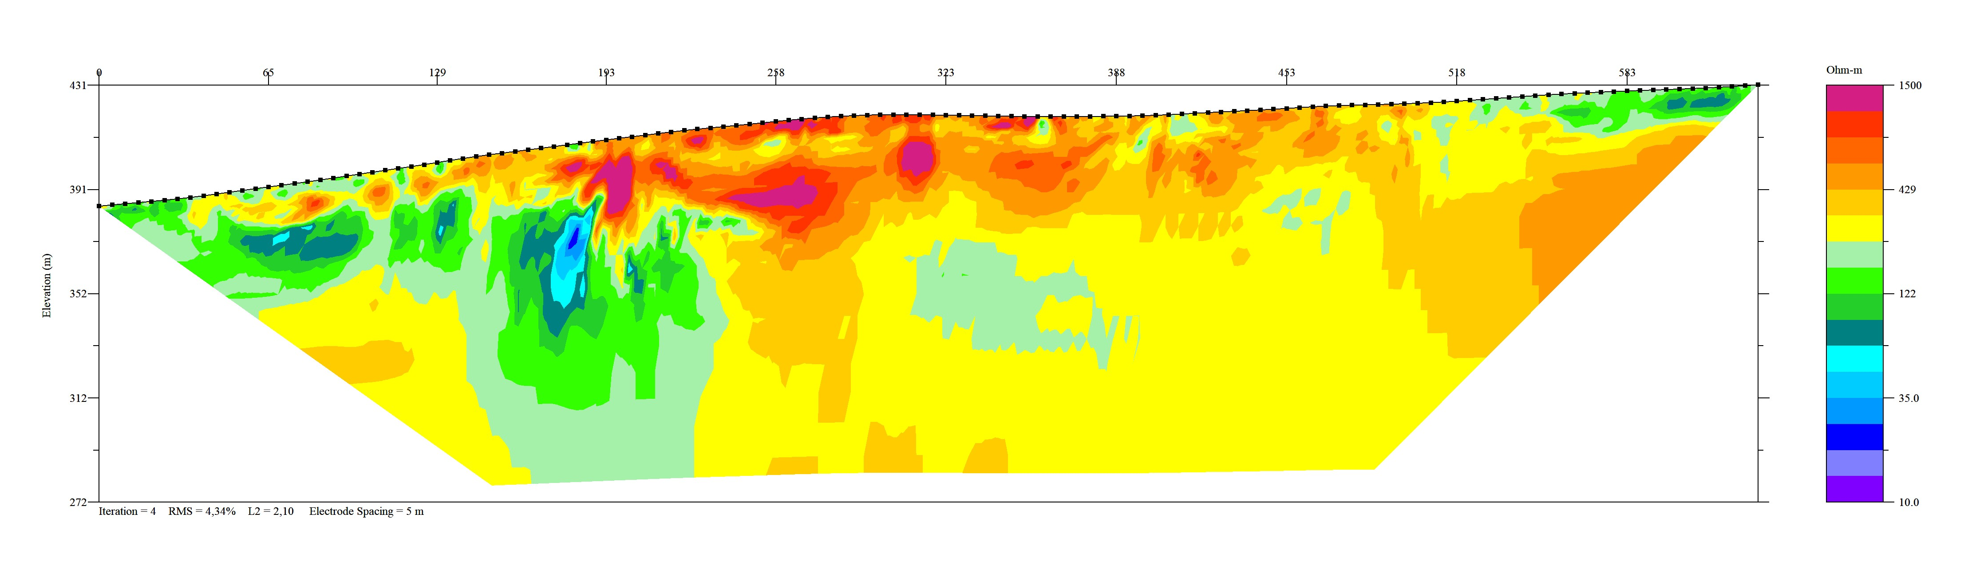
Inspection data integration
Missions
  Location
  Field team
  Tasks to perform
  Equipment to use
  Techniques to apply
Search zones
  Missions
  Technical reports
  Interest level

Slide 10
Conclusions
An OSI is one of the elements of the verification regime of the CTBT;
It is conducted under well defined constraints;
Use of approved scientific activities and techniques;
Information-led search-logic is used to have an efficient and unbiased inspection
GIMO – comprehensive tool for planning and conducting inspection activities, management of inspection data and reporting;
Integration of data acquired according to location, time and techniques;
Inspection team leadership have an integrative view any given time during the conduct of the inspection
GIMO tested in training and field exercises

