Slide 1
Incipient karst generation in natural fracture networks: influence of aperture variability
Xiaoguang Wang¹, Mohammed Aliouache¹, Qinghua Lei², Herve Jourde¹
1. HydroSciences Montpellier, UMR 5569 CNRS-IRD-UM, France
2. Department of Earth Sciences, ETH Zurich, Switzerland
8 May 2020
Vienna, Austria
Notes:
Hello everyone, I am Xiaoguang Wang from HydrocSiences Montpellier.
Today I am going to talk about the impact of in-situ stresses on incipient karst generation in natural fracture networks.

Slide 2
Research background
Karst development in limestone aquifers are often highly heterogenous
The high heterogeneity is caused by structural complexity in fracture network geometry and initial aperture distribution, which determined initial flow field.
Our recent paper (Aliouache et al., JoH 2019) shows:
The impact of fracture network topology on incipient karst generation
Fracture apertures are determined jointly by network geometry and in-situ stresses
Objective of this work:
The impact of in-situ stresses on incipient karst generation
Notes:
We all know that karsts are highly heterogeneous features, which are created by the chemical dissolution in fractured carbonate rocks.
The high heterogeneity of karst is largely caused by structural complexities in fracture geometries and heterogeneous distribution of fracture apertures.
In a recent paper, we have shown that the fracture network topology have a significant impact on the early-stage karst development.
Here we wish explore the effect of the other structural complexity, the fracture aperture distribution.
Under natural states, fracture apertures are jointly determined by the fracture network geometry and in-situ stresses.
So, here we extend our previous work to investigate the impact of in-situ stress on incipient karst generation in nature fracture networks.

Slide 3
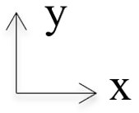
Natural joint network
Notes:
The fracture network that we have used in this work were mapped from an outcrop located in the Bristol channel area of UK.
The fracture network consists of two major fracture sets.
Along x direction, we have persistent fractures.
Along y direction, the fractures are short and abut the persistent fractures in the x direction.
The emergent ladder pattern represents a typical hierarchical morphology of natural joint networks in carbonate rocks

Slide 4
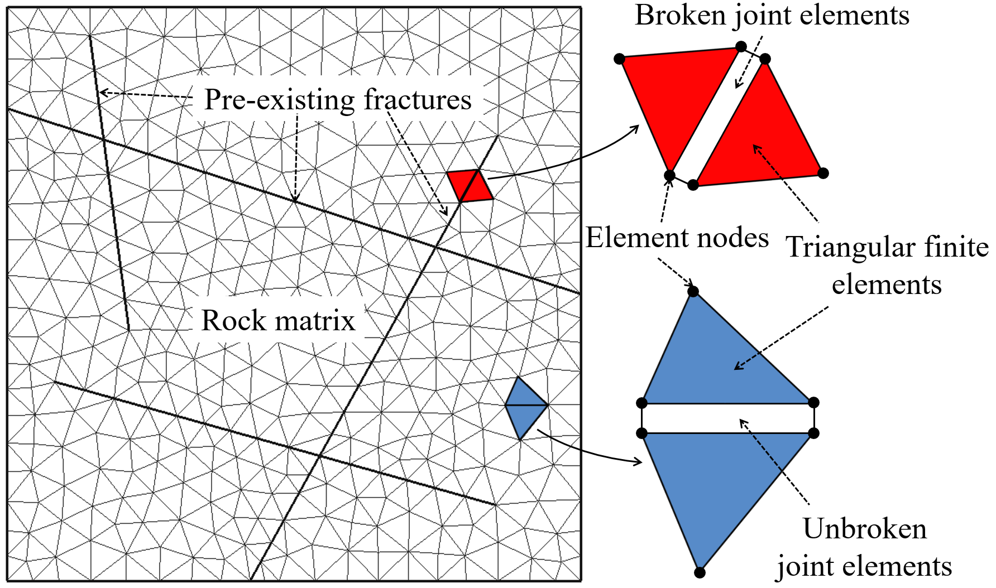
Geomechanical model
Lei et al., 2015, 2017
Hybrid finite-discrete element method (FDEM)
Deformation of intact rocks
Variability of local stresses
Displacement of pre-existing fractures
Propagation of new fractures
Joint constitutive model
Normal deformation:
Shear strength:
where
Shear dilation:
Fracture aperture:
(Goodman 1976; Saeb & Amadei, IJRMMS, 1992)
Notes:
We conduct geomechanical simulations to model the deformation of 2-D fracture networks in response to in-situ stress conditions.
The geomechanical model is formulated based on a hybrid finite-discrete element method (FDEM).
In the model, an empirical joint constitutive model has been implemented to capture the nonlinear displacement behavior of natural rough fractures in response to mixed normal and shear loadings.
Our geomechanical model can realistically mimic the deformation of intact rocks, variability of local stresses, displacement of pre-existing fractures, and propagation of new fractures.

Slide 5
Fluid flow and reactive transport models
$$k_{1−0}$$
$$p_{4}$$
$$k_{4−0}$$
$$\sum{k_{i−0}\left(p_{i}−p_{0}\right)=0}$$
Flow
$$k_{2−0}$$
$$p_{2}$$
$$k_{3−0}$$
$$p_{in}$$
$$p_{out}$$
$$p_{3}$$
$$C_{0}=\frac{\left(C_{3}+{∆C}_{3−0}\right)Q_{3−0}+\left(C_{4}+{∆C}_{4−0}\right)Q_{4−0}}{Q_{3−0}+Q_{4−0}}$$
Reactive transport
$$C_{1}$$
$$C_{4}$$
$${∆C}_{4−0}$$
Aliouache et al., 2019
$$C_{2}$$
$${∆C}_{i−0}=k (C_{sat}−C_{i})$$
$$inflow$$
$${∆C}_{3−0}$$
$$outflow$$
$$C_{3}$$
1. One dimensional discretization (segments) for flow and transport models
2. Mass conservation at nodes
$$∆a=\frac{R\left(c\right)Q∆t}{ρ_{r}l}$$
3. Model only advective flux in network; complete mixing of solute at nodes
Notes:
The flow and reactive transport processes are simulated using a finite difference method.
Fluid flow is assumed to only occur on fractures with the fracture-matrix interaction omitted.
The flow and transport problems in the fracture network are solved by assuming mass conservation at fracture intersections.
The flux-weighted formula is adopted in deriving the concentration field.
The aperture growths are calculated based on the linear reaction kinetics.

Slide 6
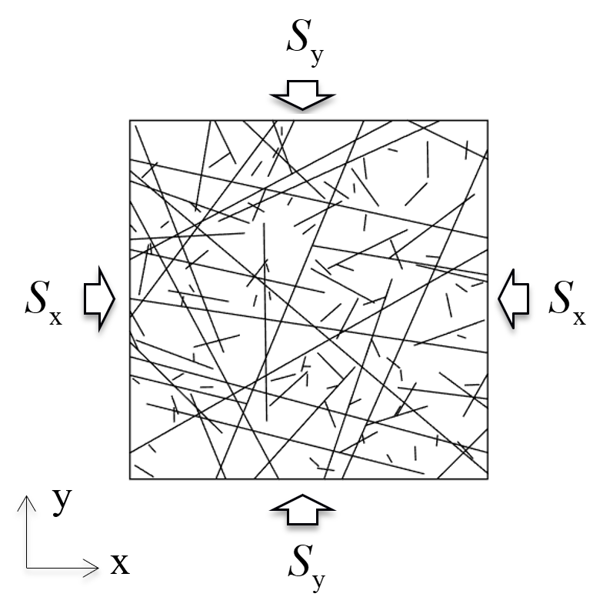
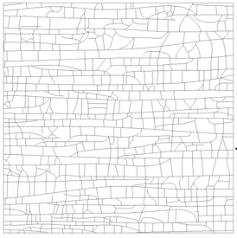
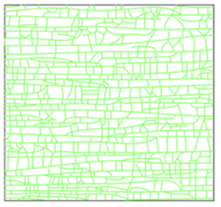
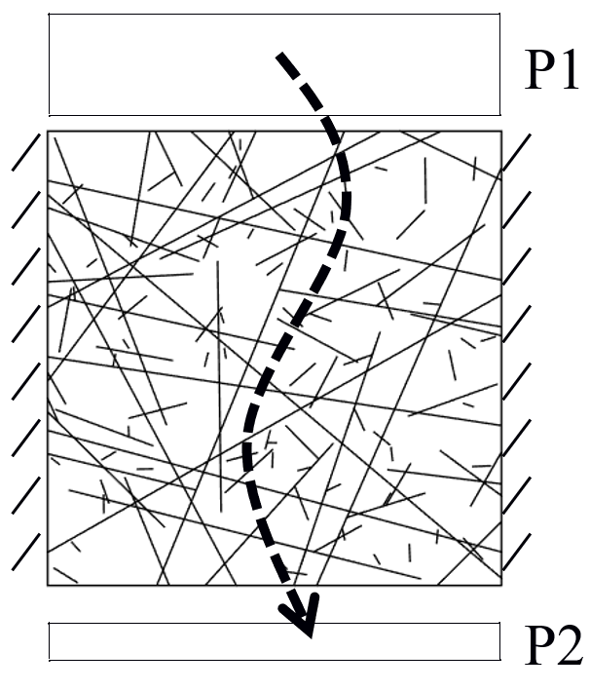
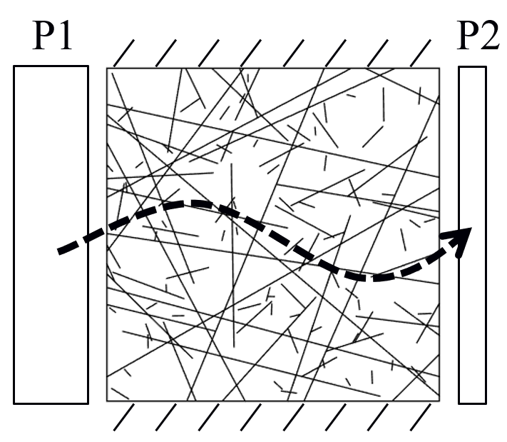
Model set-up
two far-field stress loading scenarios
15 MPa
5 MPa
Geomechanical modelling:
5 MPa
15 MPa
Lognormal distributions
Initial aperture field:
Mean: 1 mm
Variance: 0 or 1
Single-phase flow simulation:
Constant head boundaries
Notes:
In geomechanical modelling, we apply effective far-field stresses orthogonally to the domain and we consider two anisotropic stress conditions: (i) S_{x} = 5.0 MPa, S_{y} = 15.0 MPa, and (ii) S_{x} = 15.0 MPa, S_{y} = 5.0 MPa.
We assume that the initial aperture field of the fracture network follows a lognormal distribution with a mean value of 1 mm and a variance of 0 (i.e., constant initial aperture scenario) or 1 (i.e., variable initial aperture scenario).
In the variable initial aperture case, lognormally-distributed aperture values are assigned to fracture segments randomly.
We used constant head boundary conditions for solving single-phase flow simulations. We simulate flow along x and y directions.

Slide 7
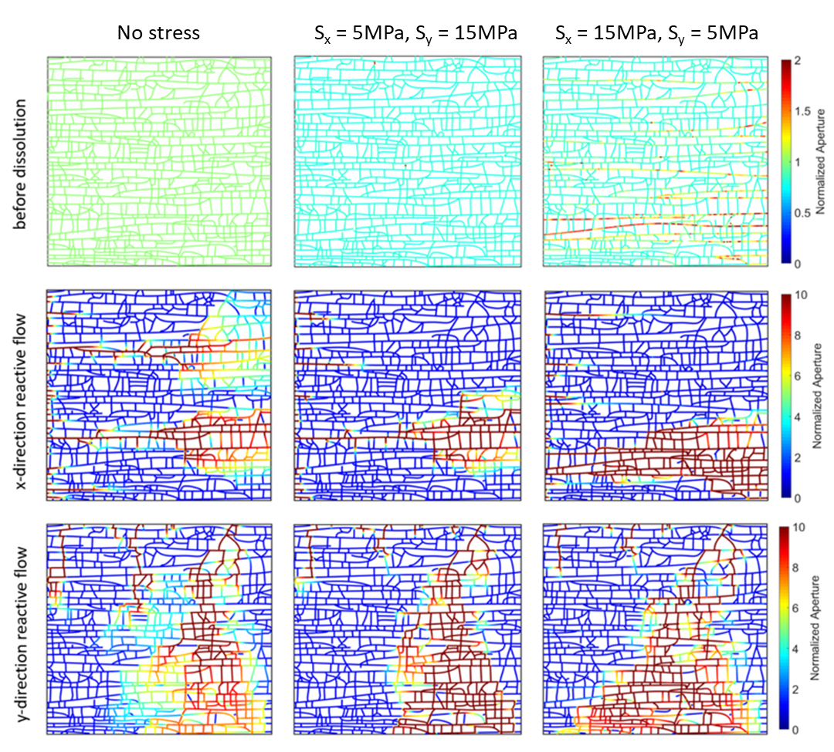
Results: aperture fields
Case 1 – constant initial apertures
Different main conduits
Similar main conduit
Notes:
Now we analyses the results. We will start with the constant initial aperture case and then move on to the variable initial aperture case.
Here, we show the aperture fields for different far-field stress conditions before dissolution and at breakthrough time.
For better comparison, the fracture apertures are normalized by the no stress case.
Ok before dissolution, we can see here, in the case of S_{x} = 5MPa and S_{y} = 15MPa, there is a global reduction in aperture distribution and the resulting aperture field is fairly uniform.
In contrast, in the case of S_{x} = 15MPa and S_{y} = 5MPa, several through-going fractures exhibit enhanced openings due to the shear dilation effect.
When reactive flow occurs in the x direction,
for the no stress case,
two main conduit networks develop toward the outlet for the no stress case.
For the two anisotropic stress loading cases,
only one conduit pathway develops,
and location and the shape of the evolved conduit structure are different in the two cases.
The conduit pattern of in the stress case is similar to the no-stress case.
While it is different in the case for S_{x} = 15 MPa and S_{y} = 5 MPa.
The extent of the developed conduit network is much larger.
In this case, the location of the developed conduits matches that of the shear-induced preferential path with large openings.
When reactive flow occurs in the y direction, if no stress is applied, multiple conduit networks develop in the middle of the model domain and the one with larger lateral extent reaches the outlet.
When S_{x} = 5 MPa and S_{y} = 15 MPa, the geometry of the most developed conduit network is similar to that in the no-stress case with only slight differences observed in the downstream side.
In the stress case of S_{x} = 15 MPa and S_{y} = 5 MPa, we observe a much larger extent of highly dissolved fractures, particularly near the outlet, due to the presence of the curved long fractures, which are highly dilated.
However, the trajectory of the most developed conduits in the three stress cases is rather similar in the upstream region.

Slide 8
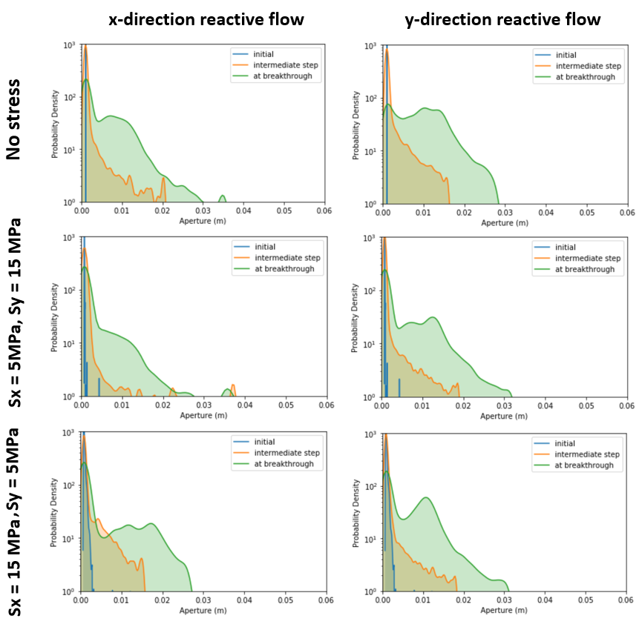
Results: aperture fields
Case 1 – constant initial apertures
Evolution of aperture PDFs
Notes:
Now we analyses the results. We will start with the constant initial aperture case and then move on to the variable initial aperture case.
Here, we show the aperture fields for different far-field stress conditions before dissolution and at breakthrough time.
For better comparison, the fracture apertures are normalized by the no stress case.
Ok before dissolution, we can see here, in the case of S_{x} = 5MPa and S_{y} = 15MPa, there is a global reduction in aperture distribution and the resulting aperture field is fairly uniform.
In contrast, in the case of S_{x} = 15MPa and S_{y} = 5MPa, several through-going fractures exhibit enhanced openings due to the shear dilation effect.
When reactive flow occurs in the x direction,
for the no stress case,
two main conduit networks develop toward the outlet for the no stress case.
For the two anisotropic stress loading cases,
only one conduit pathway develops,
and location and the shape of the evolved conduit structure are different in the two cases.
The conduit pattern of in the stress case is similar to the no-stress case.
While it is different in the case for S_{x} = 15 MPa and S_{y} = 5 MPa.
The extent of the developed conduit network is much larger.
In this case, the location of the developed conduits matches that of the shear-induced preferential path with large openings.
When reactive flow occurs in the y direction, if no stress is applied, multiple conduit networks develop in the middle of the model domain and the one with larger lateral extent reaches the outlet.
When S_{x} = 5 MPa and S_{y} = 15 MPa, the geometry of the most developed conduit network is similar to that in the no-stress case with only slight differences observed in the downstream side.
In the stress case of S_{x} = 15 MPa and S_{y} = 5 MPa, we observe a much larger extent of highly dissolved fractures, particularly near the outlet, due to the presence of the curved long fractures, which are highly dilated.
However, the trajectory of the most developed conduits in the three stress cases is rather similar in the upstream region.

Slide 9
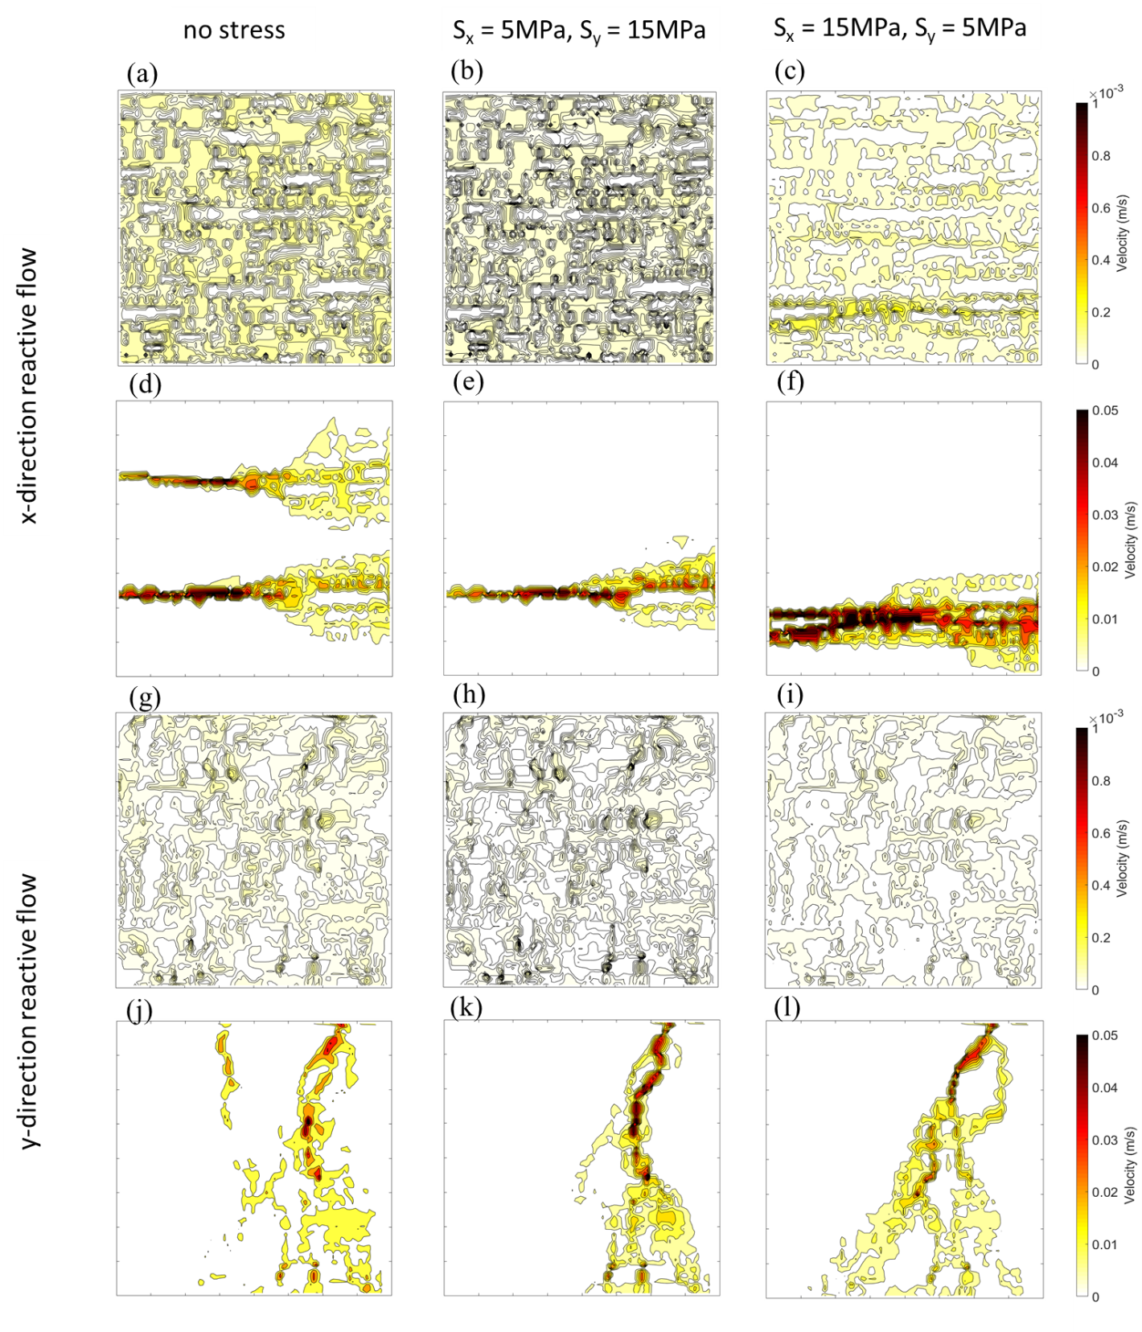
Results: flow fields
Case 1 – constant initial apertures
Different main conduits
Similar main conduit
Notes:
Here, we present the velocity fields at the initial and breakthrough times for different stress cases.
If reactive flow occurs along the x direction, the initial flow field is quite homogeneous under no stress loading.
When S_{x} = 5 MPa and S_{y} = 15 MPa, the flow field is still fairly homogeneous; however, the flow magnitude is reduced due to compression-induced aperture reduction.
Also, flow channelization with correlated velocities emerges due to shear-induced dilations along the two through-going fractures.
At the breakthrough, flow channelization occurs in all cases as a result of dissolution.
For the no-stress case and the case of S_{x} = 5 MPa and S_{y} = 15 MPa, no obvious correlation between the flow fields before dissolution and at the breakthrough time can be found.
While for the stress case of S_{x} = 5 MPa and S_{y} = 15 MPa, the emergent high-flow paths at breakthrough clearly correlate to the channelized flow structure before dissolution.
When reactive flow occurs along the y direction, a different flow evolution behavior is observed. At the initial time, the flow field is similar among the three stress conditions. The flow field of the case of S_{x} = 5 MPa and S_{y} = 15 MPa has a slightly higher heterogeneity.
At the breakthrough time, the emergent flow structures for the no-stress case and the case of S_{x} = 5 MPa and S_{y} = 15 MPa are similar
While, in the case of S_{x} = 15 MPa and S_{y} = 5 MPa, the flow paths are slightly different in the downstream side, due to the presence of the highly dilated fractures that promote the lateral spreading of the dissolution.
In all the cases, the location of emergent main flow paths seems to match the location of channels with high initial flow velocities.

Slide 10
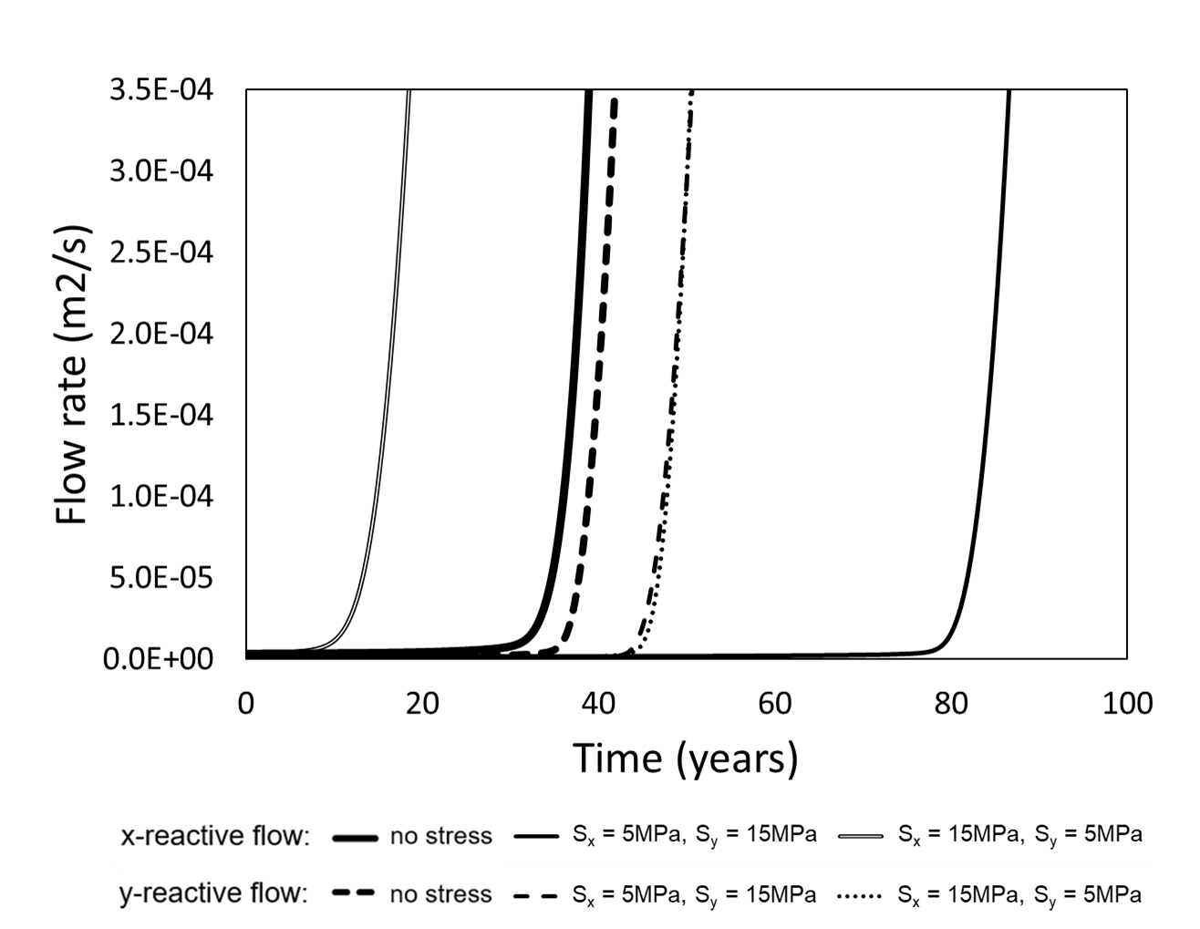
Results: breakthrough curves
Case 1 – constant initial apertures
Notes:
We further analyze stress effects on the breakthrough times.
When the reactive flow occurs in the x direction, the breakthrough time is quite different for different stress loadings.
The breakthrough onsets several tens of years earlier in the case of S_{x} = 15 MPa and S_{y} = 5 MPa than the no-stress case.
In contrast, in the case of S_{x} = 5 MPa and S_{y} = 15 MPa, breakthrough occurs several tens of years later.
If the reactive flow is along the y direction, the breakthrough of the two stressed cases occurs at a similar time, which is later than that of the zero stress case.

Slide 11
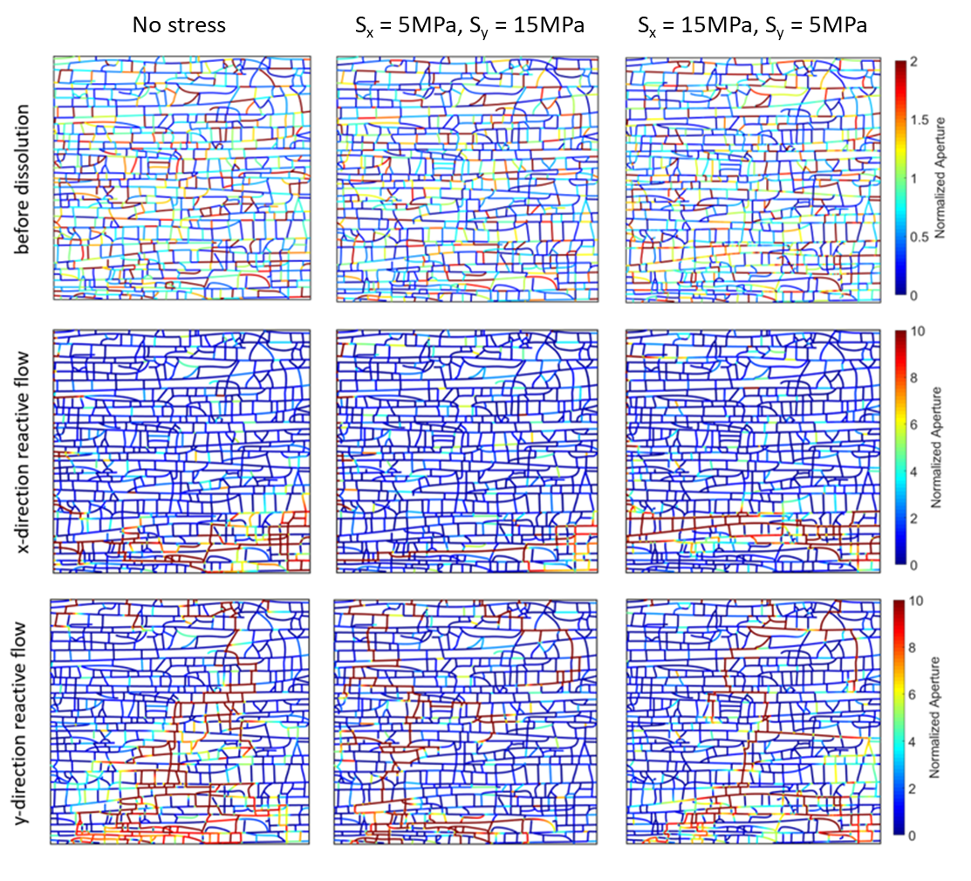
Results: aperture fields
Case 2 – lognormal initial apertures
Different main conduits
Different main conduits
Notes:
Now we discuss the results for the variable initial aperture cases.
Before dissolution, the preferential paths with correlated apertures are difficult to observe even for the anisotropic stress scenario, comparing to the constant initial aperture case.
When reactive flow occurs in the x direction, only one conduit network develops in the case of zero stress loading, which is different from the constant initial aperture case.
The anisotropic stress loading conditions lead to an alternation in the location of main karst conduits, comparing to the zero stress case.
When reactive flow occurs in the y direction and no stress loading is applied, the location of the most developed conduit network near the inlet is similar to the respective case with a constant initial aperture, but becomes different close to the outlet.
For the two anisotropic stress cases, the developed conduit networks are very tortuous and located in different areas of the model domain.

Slide 12
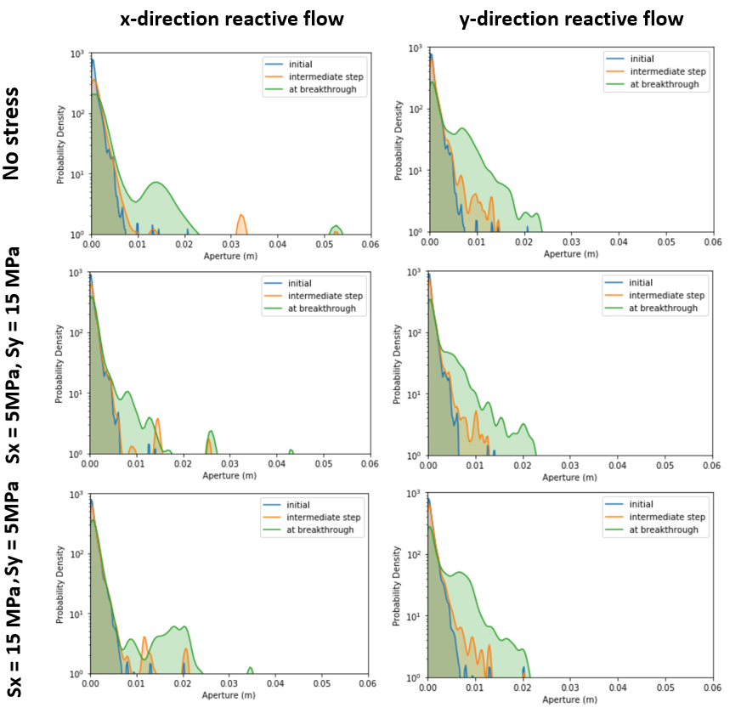
Results: aperture fields
Case 2 – lognormal initial apertures
Evolution of aperture PDFs
Notes:
Now we discuss the results for the variable initial aperture cases.
Before dissolution, the preferential paths with correlated apertures are difficult to observe even for the anisotropic stress scenario, comparing to the constant initial aperture case.
When reactive flow occurs in the x direction, only one conduit network develops in the case of zero stress loading, which is different from the constant initial aperture case.
The anisotropic stress loading conditions lead to an alternation in the location of main karst conduits, comparing to the zero stress case.
When reactive flow occurs in the y direction and no stress loading is applied, the location of the most developed conduit network near the inlet is similar to the respective case with a constant initial aperture, but becomes different close to the outlet.
For the two anisotropic stress cases, the developed conduit networks are very tortuous and located in different areas of the model domain.

Slide 13
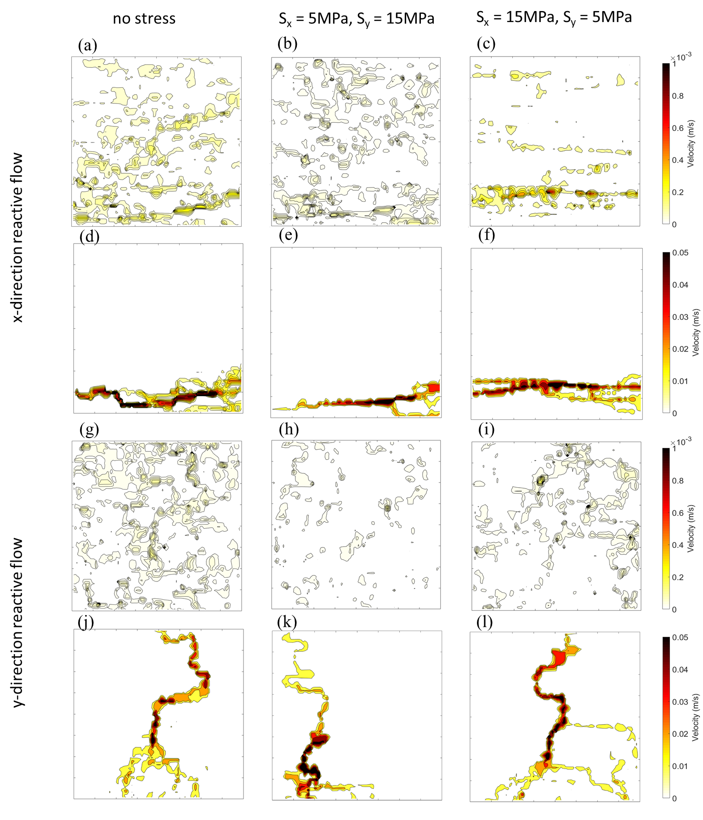
Results: flow fields
Case 2 – lognormal initial apertures
Different main conduits
Different main conduits
Very different paths
Notes:
Here are the flow fields for the variable initial aperture cases.
When reactive flow occurs in the x direction, a very heterogeneous flow pattern emerges under zero stress loading due to the presence of initial aperture variability.
The anisotropic stress loading of S_{x} = 5 MPa and S_{y} = 15 MPa decreases flow magnitude but increases velocity correlation.
A highly heterogeneous flow field characterized by profound flow channelization occurs in the network when S_{x} = 15 MPa and S_{y} = 5 MPa.
At the breakthrough, in general, the developed flow conduits correspond to the portion of the fracture network that shows correlated spatial flow organization.
When reactive flow occurs in the y direction, the initial flow field under no stress loading is also more heterogeneous compared to that of the corresponding constant initial aperture case.
The application of anisotropic stress loading leads to a higher flow heterogeneity and a stronger correlation of large velocities.
In the evolved conduit networks, the location of the high velocity paths seems to match well to the initially correlated high velocity regions.
Moreover, the location of the most developed conduit network in the variable initial aperture case is different from the constant initial aperture case.
This indicates that the karst genesis is not only regularized by the network geometry but by the interplay among fracture network, aperture variability and in-situ stress strongly impacts karst genesis.

Slide 14
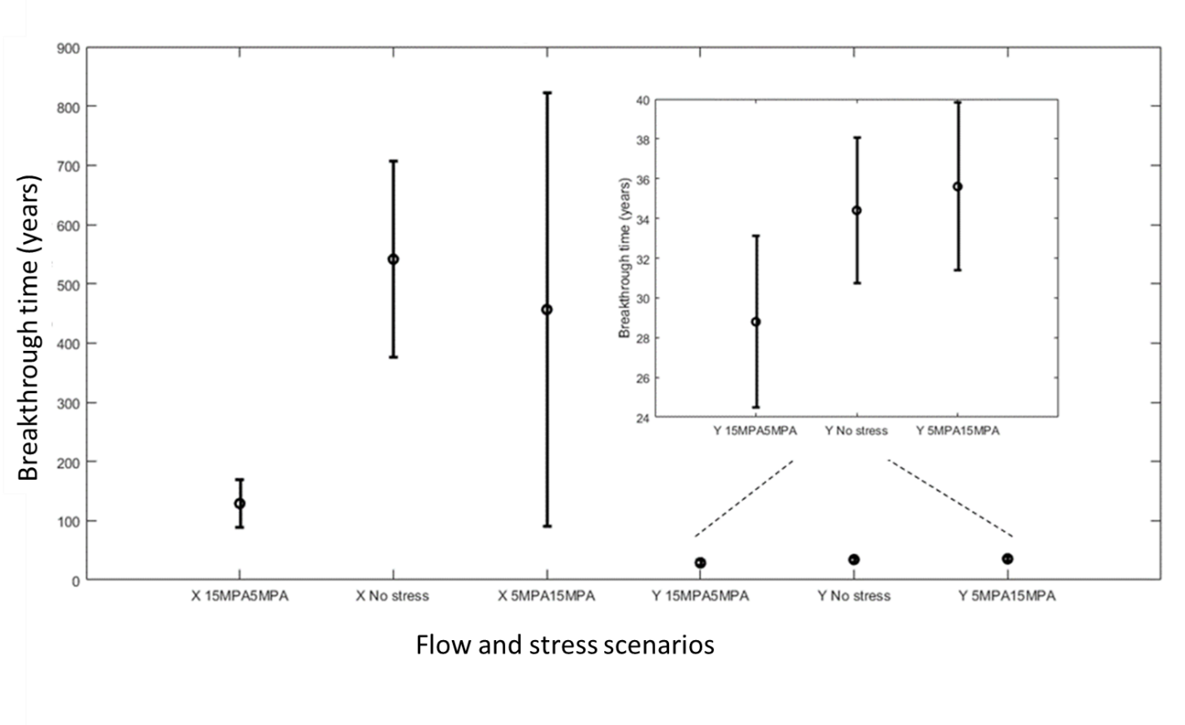
Results: breakthrough curves
Case 2 – lognormal initial apertures
Notes:
The impact of stress loading on karst genesis is further analyzed based on the breakthrough curves.
When reactive flow occurs in the x direction, the anisotropic stress loading with S_{x} = 15 MPa and S_{y} = 5 MPa leads to an earlier breakthrough due to the presence of dilated fractures.
In contrast, the breakthrough time of the stress case of S_{x} = 5 MPa and S_{y} = 15 MPa is severely delayed due to the closure of the through-going fractures.
When the reactive flow is along the y direction, both anisotropic stress loading conditions lead to delayed breakthrough.
The breakthrough occurs much later in the stress case of S_{x} = 5 MPa and S_{y} = 15 MPa compared to that of the case with S_{x} = 15 MPa and S_{y} = 5 MPa, which is different from what we observe for the constant initial aperture case.

Slide 15
Conclusions
We use numerical simulations to investigate in-situ stress effects on incipient karstification in a 2-D natural joint network.
We found that:
How stress affects karstification is controlled by the stress orientation, flow direction and initial aperture variability
Reactive flow in direction of dominant fracture set
stress loading may alter dissolution pattern and breakthrough time significantly
stress loading reduce the karstification extent
Reactive flow in direction of secondary fracture set
stress loading has a negligible impact on the emergent dissolution pattern
some impacts on the onset time of breakthrough
Initial aperture variability enhances the stress impact
significant change in the dissolution pattern
significant change in the breakthrough time
Wang et al., under review
Tunneling and Underground Space Technology
Notes:
In summary, we report that the in-situ stress plays a critical role in the early-stage karstification processes in fractured carbonate rocks.
The extent of the stress impact depends on the relative relationship between flow and structural anisotropies as well as aperture variability.
When the reactive flow direction is aligned with the set of persistent fractures, stress loading direction may alter the dissolution pattern significantly and reduce the karstification extent.
In contrast, when the reactive flow direction is along the set of short fractures, the evolved karst patterns are insensitive to stress loading.
Aperture variability may enhance the stress effects in both flow conditions such that more profound effects are observed when the maximum stress is oriented normal to the long fractures.
Our results highlight the critical importance of incorporating realistic fracture network geometry and stress-dependent fracture aperture in karst genesis modeling.
The conventional approaches that neglect these effects may lead to biased prediction of karst pattern and breakthrough time.

Slide 16
Thank you!

