Slide 1
Key aspects for the definition of OSI Challenging Environments
Feihong Kuang, Gustavo Haquin Gerade
EGU2020, Vienna, May 2020

Slide 2
Background
On-site inspection (OSI) is one of the elements of the verification regime of the Comprehensive Nuclear Test Ban Treaty (CTBT).
Its sole purpose is to clarify whether a nuclear weapon test explosion or any other nuclear explosion has been carried out in violation of Article I and, to the extent possible, to gather any facts which might assist in identifying any possible violator.
In regard to nuclear test explosion (NTE), historically it happened in different kinds of scenarios dominated by several key environmental factors. These environmental factors could impact the conduct of an OSI.
Thus, understanding and well defining the environment where an OSI is happened is an important way to develop and improve the comprehensive OSI capabilities.

Slide 3
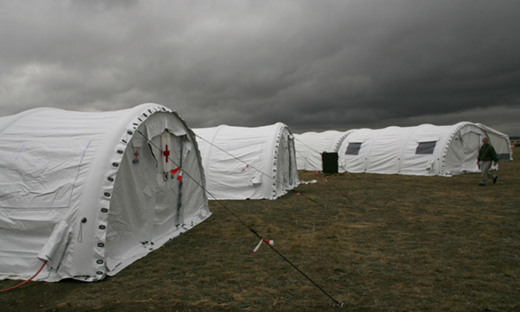
Examples of Environmental impacts on OSI
Extreme climate conditions could jeopardize the whole inspection.
The 2008 Integrated Field Exercise (IFE08) , Kazakhstan, 2008

Slide 4
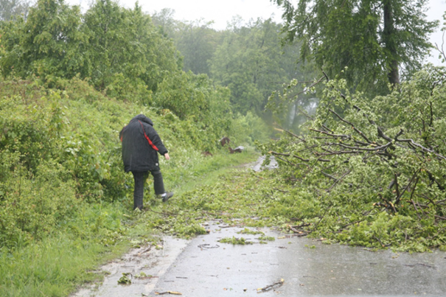
Examples of Environmental impacts on OSI
High and dense vegetation could cause problems to the IT.
The introductory course of the second training cycle (IC-2TC), Hungary, 2010

Slide 5
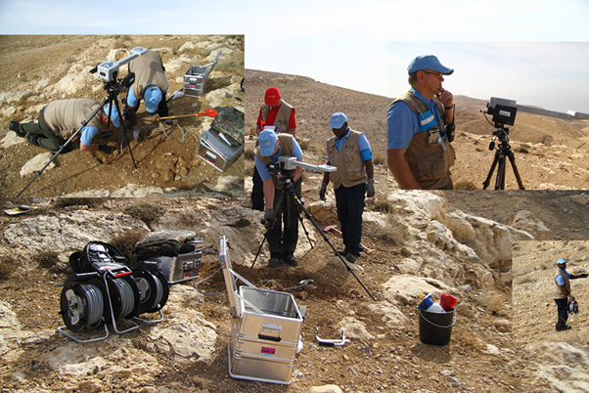
Examples of Environmental impacts on OSI
Extreme relief could significantly affect the deployment of the IT.
The 2014 Integrated Field Exercise (IFE14), Jordan, 2014

Slide 6
A Definition of OSI Environment
From the perspective of how physical environmental conditions impact the IT’s ability, an OSI environment can be simply defined as follows:
When an OSI occurs in a specific NTE scenario, a combination of key natural or artificial environmental factors that could constrain and impact on OSI actions and capabilities of the IT is called the OSI environment.
For underground NTE scenario, among the environmental factors, three key natural environmental factors could impact an OSI the most:
Climatic condition
Vegetation coverage, and
Topographic relief

Slide 7
Challenge and Prospective
The Treaty bans all NTEs in all environments, and the purpose of OSI is to collect facts from these explosions, while these facts are of highly environmental dependent.
As a very preliminary stage, this research is served as a start to motivate the development of OSI capability with regard to operationalization of OSIs in different environments. There are still significant challenges ahead.
With the great supports from the States Signatories and the involvements of the international scientific communities, a comprehensive OSI capability with strong climatized and environmental adaptability will be established in the near future.

Slide 8
Thank you,
For your attention!

