Slide 1
The science-policy interface – in need for "society" as a third component
J. Thielen-del Pozo¹, L. Autogena², J. Portway³ and F. Pappenberger⁴
Joint Research Centre, European Commission, 2. Sheffield Hallam University, 3. Freelance,
4. European Centre for Medium-Range Weather Forecast
EGU, Session HS1.2.3/EOS4.11 , Online, 4-8 May 2020
Notes:
Some of my background

Slide 2
Two questions to guide this presentation
If science is important for policy makers, should we not see more impact of our science in policy making?
If policy making is about shaping our future, who decides what our future should look like?

Slide 3
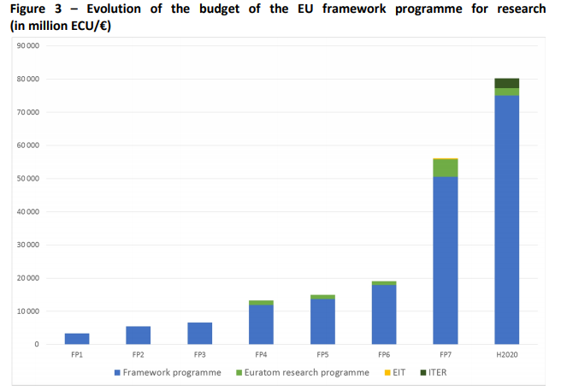
Impactful Science – or is it?
EU funding for science in different domains has continuously increased since the first Framework Programme in 1983
The value of science for policy making has been recognised increasingly over the past decades, ….
7.5% of EU budget
2% of EU budget

Slide 4
… should we not see more impact of science in policy making ?
I have the feeling nobody listens to me…

Slide 5
From experience at the EC Joint Research Centre
One of many: Policy makers are open to scientific advice, but it is one of many inputs. The scientific voice must be heard
Timing: Different phases of the policy cycle require different types of input. Understanding when what input is needed is essential
Context: Policy makers are knowledgeable but have little time to digest a lot of detailed information. A picture of a flooded town may influence the reader more than a report on water management.
Uptake: Policies are made to shape and frame our societies. If societies do not adhere to the policies, they have little impact.

Slide 6
Society
a huge reservoir of tacit and formal knowledge
a source of data
driving research and policy agendas
Science
consult
knowledge
driver
Policy
Society
data

Slide 7
JRC Resonances – Art, Science and Society
Since 2015 the JRC is engaging with artists in an experimental setting, to
stimulate transdisciplinary thinking and cross-thematic research
Approach research from different angles
Engage with the public during so-called Resonances Festivals
(Contact: adriaan.eeckels@ec.europa.eu)

Slide 8
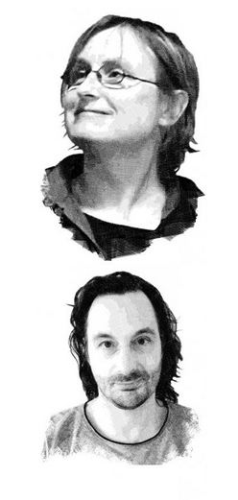
Lise Autogena and Joshua Portway
Lise Autogena and Joshua Portway have worked together since the early 1990s, developing largescale multimedia installations, site-specific works and performances.
They use video, new technologies and large-scale data visualisations of global real-time data, to explore what impact human-made social, geographic and economic systems have on our human experience.
3rd Resonances edition Datami on Big Data, Digital Transformation and Artificial Intelligence (2018-2020)

Slide 9
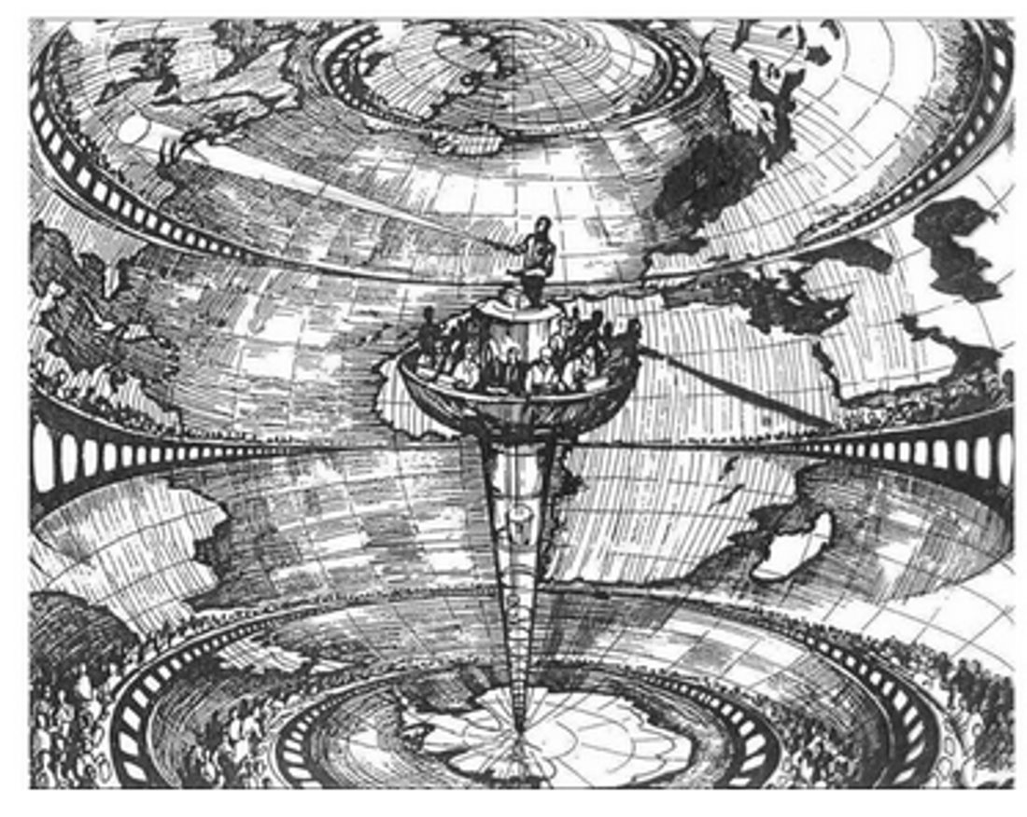
Weather Prediction by Numerical Processes
Inspired by Lewis Fry Richardson’s first numerical
code and his vision of a human computing force ​
JRCs European Crisis Management Laboratory and the idea of a Slow Crisis Room​
Forecasting the weather through the act of public collaborative participation​

Slide 10
…
One society / many Cultures

Slide 11
…
Culture is a framework that creates meaning

Slide 12
…
Science is a culture

Slide 13
…
Artists can help negotiate between science and culture

Slide 14
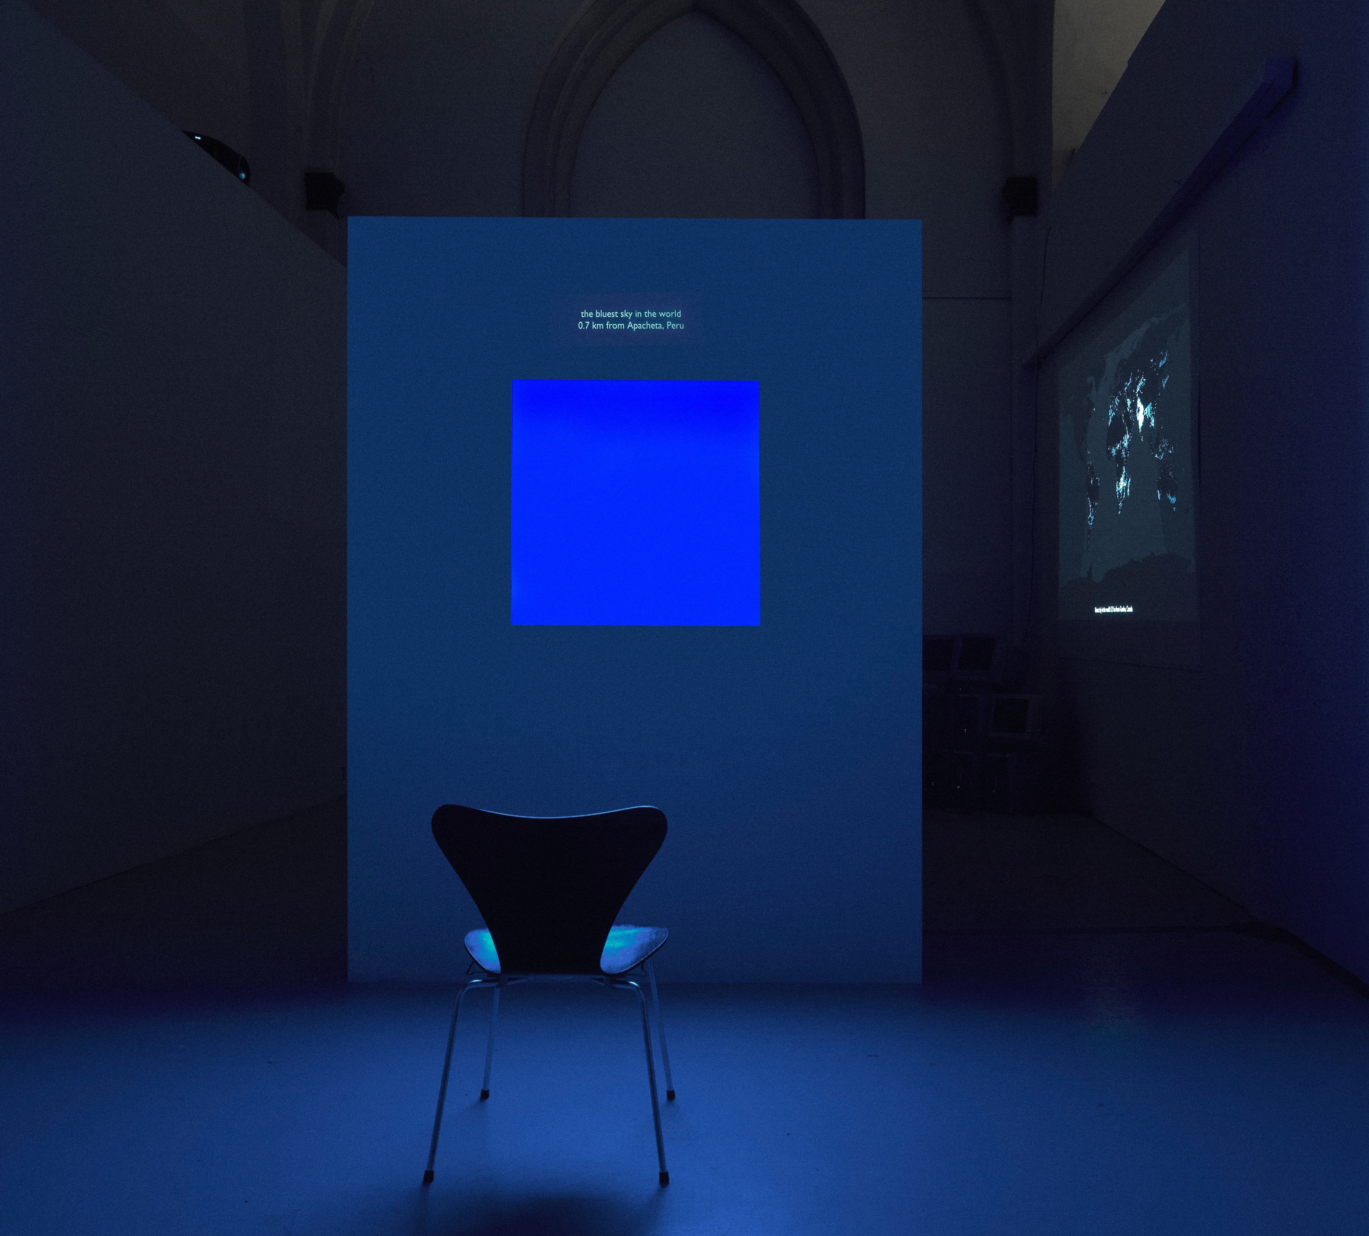
…

Slide 15
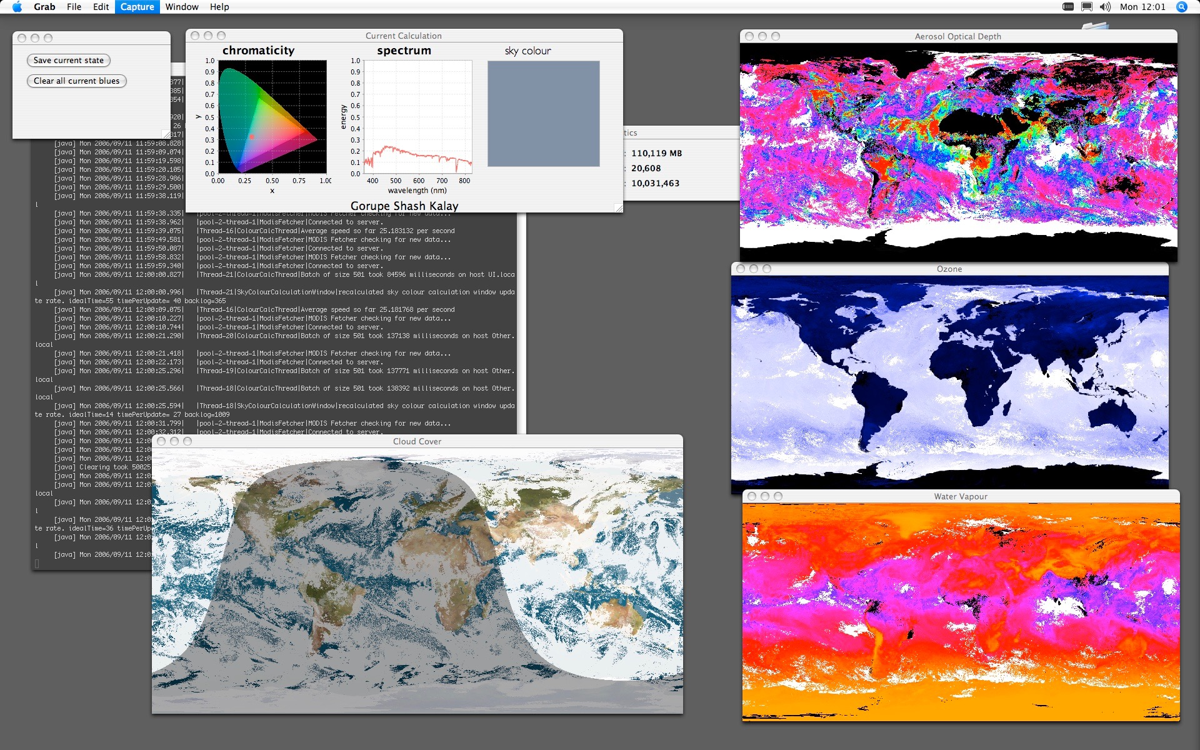
…

Slide 16
…
Nature is a problematic construction

Slide 17
…
We have no myths about exponential problems

Slide 18
…
Climate change is a cultural problem

Slide 19
…
Science needs to talk to culture

Slide 20
Our future is decided together!
Science
Policy
Society/Culture

