Slide 1
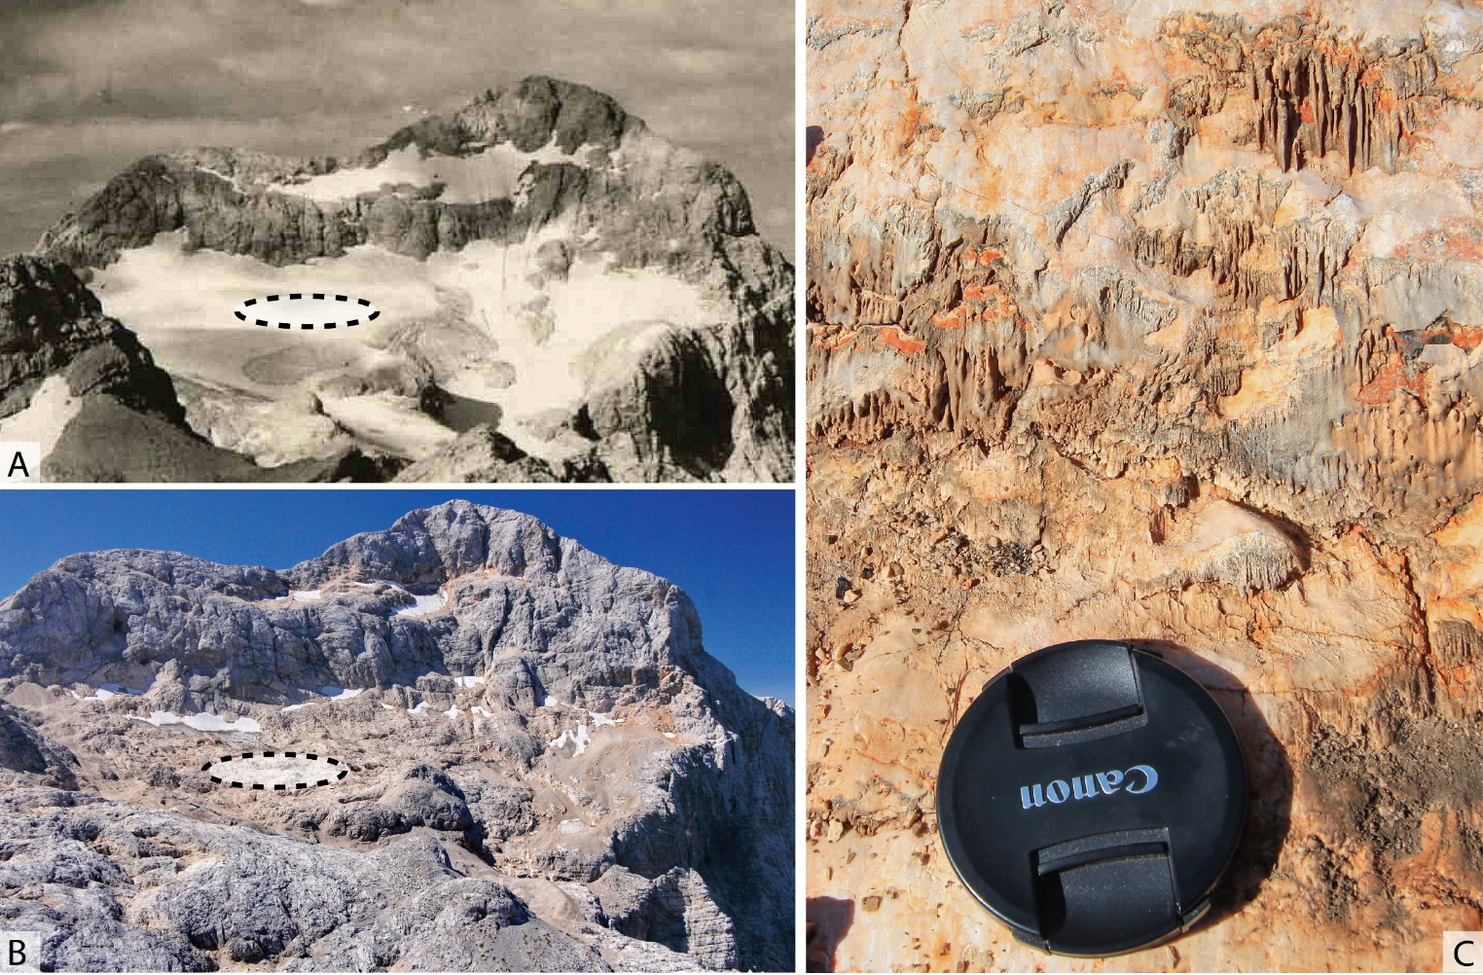
Recently exposed subglacial carbonate deposits at the retreating Triglav Glacier, Slovenia
Matej Lipar¹ , Andrea Martín Pérez² , Jure Tičar¹ , Miha Pavšek¹ , Matej Gabrovec¹ , Mauro Hrvatin¹ , Blaž Komac¹ , Matija Zorn¹ , Nadja Zupan Hajna³ , Jian-xin Zhao⁴ , Russell Drysdale⁵ , and Mateja Ferk¹
¹ The Slovenian Academy of Sciences and Arts, Anton Melik Geographical Institute ZRC SAZU, Slovenia
² The Slovenian Academy of Sciences and Arts, Ivan Rakovec Institute of Palaeontology ZRC SAZU, Slovenia
³ The Slovenian Academy of Sciences and Arts, Karst Research Institute ZRC SAZU, Slovenia
⁴ Radiogenic Isotope Facility, School of Earth and Environmental Sciences, The University of Queensland, Australia
⁵ School of Geography, The University of Melbourne, Australia & EDYTEM, UMR CNRS 5204, Université de Savoie-Mont Blanc, France
Mount Triglav, the Triglav Glacier and the sampling location of subglacial carbonates relative to the years 1932 (A) and 2017 (B).
Close up of an exposure of subglacial carbonate (C).
Photo curtesy of (A) Janko Skerlep (ZRC SAZU Anton Melik Geographical Institute archive), (B) Miha Pavšek and (C) Matej Lipar.

Slide 2
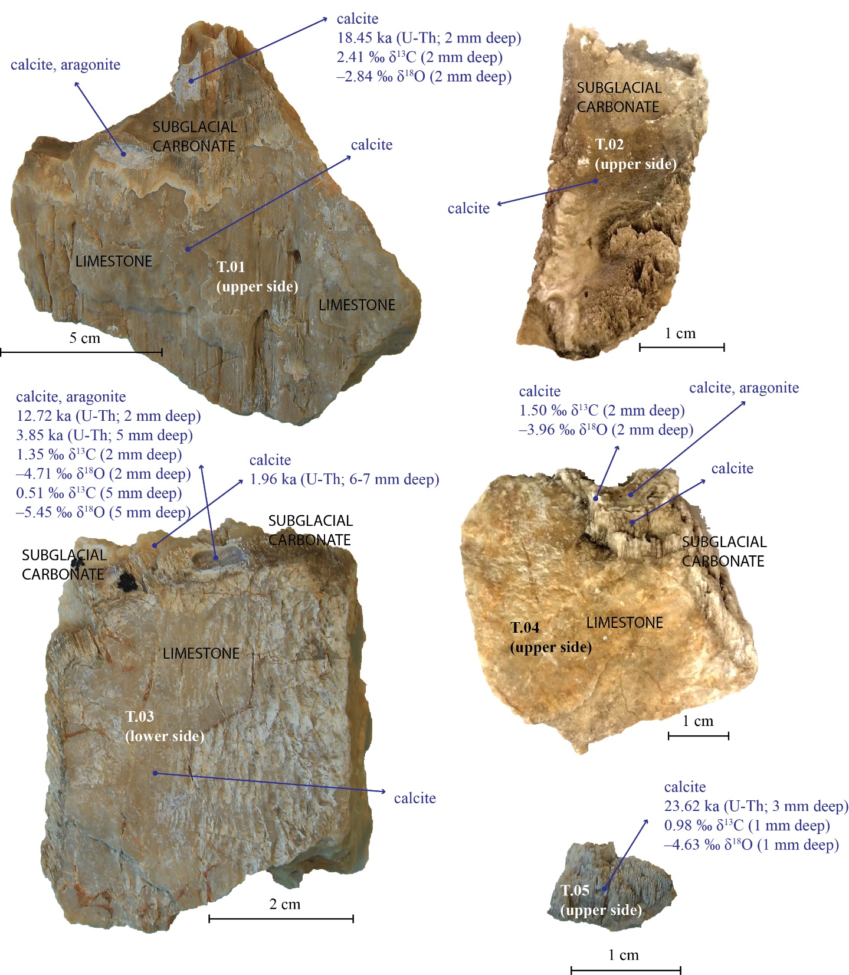
Oldest obtained U-Th ages of Last Glacial Maximum.
However, aragonite-to-calcite replacement fabrics pose a challenge.
Currently, these dates should be regarded as “maximum ages”.

Slide 3
Subglacial carbonates are fragile and exposed to:
(1) Chemical weathering (up to 0.14 mm/year),
(2) Frost weathering,
(3) Abrasion.
Further work:
High-resolution U-Th dating with a combination of ³⁶Cl nuclide dating,
Frost weathering rate.
If they were exposed during the Holocene Climactic Optimum, they should have been eroded.
Their presence today may suggest the continuous glacier-cover since their deposition throughout all but the most recent part of the Holocene.

