Slide 1
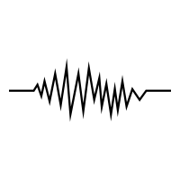
Considerations on Parameter and State Estimation with Ensemble Data Assimilation Methods - A Case Study with a Nonlinear Oscillator
2020 EGU GENERAL ASSEMBLY
Vienna, 3th - 8th May 2020
Dr. Arundhuti Banerjee, Dr. Ir. Femke Vossepoel
A.Banerjee@tudelft.nl
Petroleum Engineering Department, Faculty of Civil and Geoscience Engineering,
TU Delft
4th May 2020

Slide 2
Table of Contents
Introduction
Problem Statement
Model under Study
Data Assimilation
Numerical Experiment: State Parameter Estimation
Results and Discussion
Conclusion

Slide 3
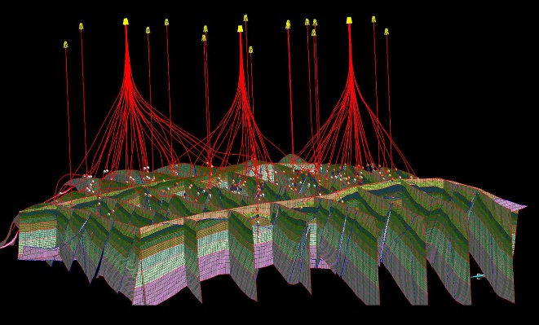
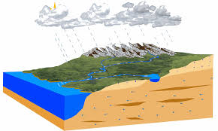
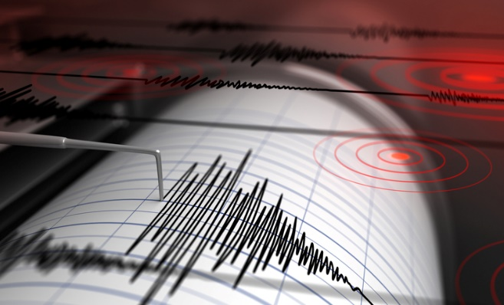
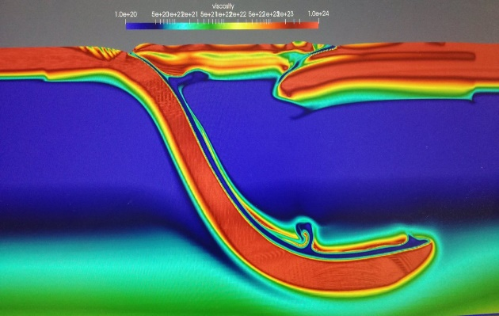
Introduction: State and Parameter Estimation
Primarily Interested in Estimating the State or Parameter of the system.

Slide 4
Problem Statement
Earthquake !!
noise
Seismicity Model
noise
Forecast/ Estimate
Measurement Process
noise
Model Parameters
How sure are we ??
noise
Earthquake Catalog
Uncertainty is the only certainty there is, and knowing how to live with insecurity is the only security. - John Allen Paulos

Slide 5
State of the Art: Seismic Model
Numerical Models:
Dynamic rupture propagation using boundary integral method by Okubo P.G. (1989)
Modelling of rupture propagations in integrated numerical scheme proposed by Lapusta et al. (2000)
Seismic cycle modeling by allowing rupture nucleation and propagation by Lapusta and Barbot (2002)
Earthquake nucleation and early seismic propagation for a strike-slip fault model by Lapusta and Rice (2003)
Spectral element method for the simulation of of long‐term fault slip by Kaneko et al. (2011)
Modeling seismic cycle on spontaneously evolving subduction faults by Van Dinther et al. (2012)
Analogue Model:
Earthquake cycle modeling using spring-block system (Burridge Knopoff Model) by Burridge and Knopoff (1967),
Earthquake cycles modeled using stochastic point process by Werner et al. (2011).
Complex
Model Complexity
Seismic
Models
Simple

Slide 6
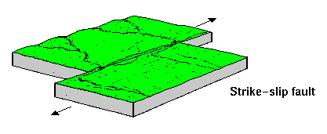
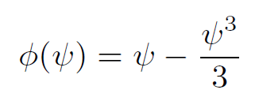
Model under Study: B. K. Analogue Model Van der Pol Oscillator
m
x
X(x,t)……
State Variables ψ and η
V = slip velocity
kp, kc = spring stiffness
µ = friction coefficient
c = longitudinal cpeed of sound
ν = slip rate
ψ = friction law
m = mass of block
Spatial
Derivative
X (x,t) = represents the time-dependent local longitudinal
deformation of the surface of the upper plate in the static reference frame of the lower plate
Van der Pol Oscillator ignoring spatial derivative

Slide 7
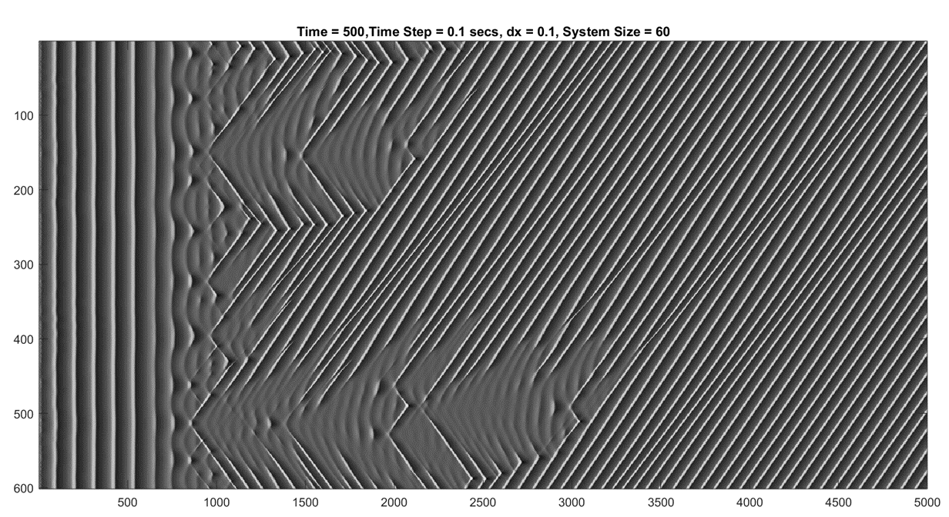
Model under Study: BK Model Solution
Spatiotemporal plot of plate velocity ψ (x, t)
Global Oscillations
Period Doubling
Propagating Front
x
Global Oscillations
Period doubling
Propagating Front
Cartwright et al. 1999
Time (sec)

Slide 8
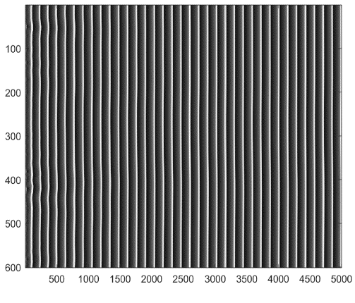
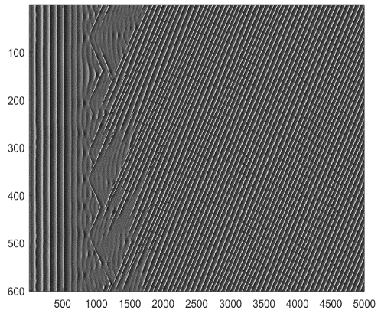
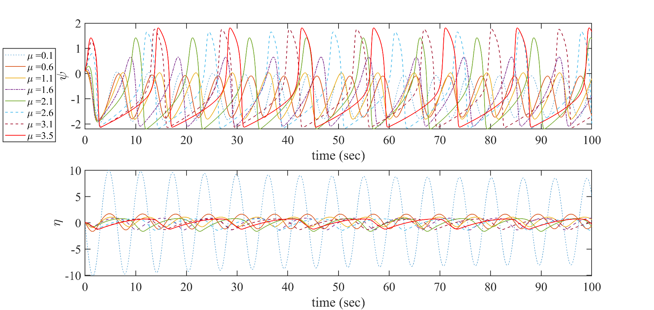
Model under Study: BK Model
Spatiotemporal Plots of ψ (x,t) [Includes spatial derivative term]
µ = 1.30
µ = 1.50
µ = 1.85
µ = 3.00
x
x
x
x
Time (sec)
Time (sec)
Time (sec)
Time (sec)
ψ (t) plots of Van der Pol Oscillator
Without Spatial Correlation (Forced Van der Pol Os
High Correlation of µ with state variable ψ and η

Slide 9
Data Assimilation: Framework
Estimation of State or Parameter
µ
µ
µ
µ_{t}

Slide 10
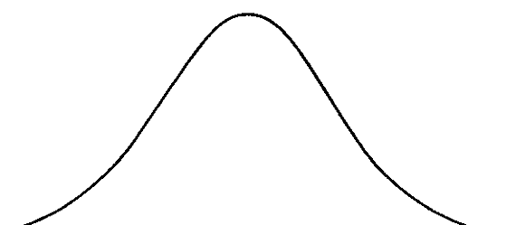
Data Assimilation: Particle Filter
State Space
Prior Distribution p(x)
Monte Carlo N Samples
Bayes Rule
Sampling
Sampling
Posterior
P(x/y)
Weights (w) proportional to
Observation (y) likelihood
p(y/x)
Weighting
Resampling

Slide 11
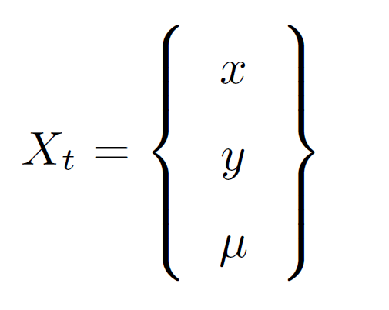
Numerical Experiment: Parameter Error
Generate Observations from model with true parameter (µ_{t} ) [Twin Experiment].
Use incorrect parameter (µ) in the model for assimilation.
Accordingly update states and parameter by:
Augmenting parameter in state vector (X_{t}) and updating both state and parameter (SPU)
Updating state variables only (SU)
Updating parameter only (PU)
SPU
SU
PU
ψ
ψ
ψ
η
η
η
Augmented

Slide 12
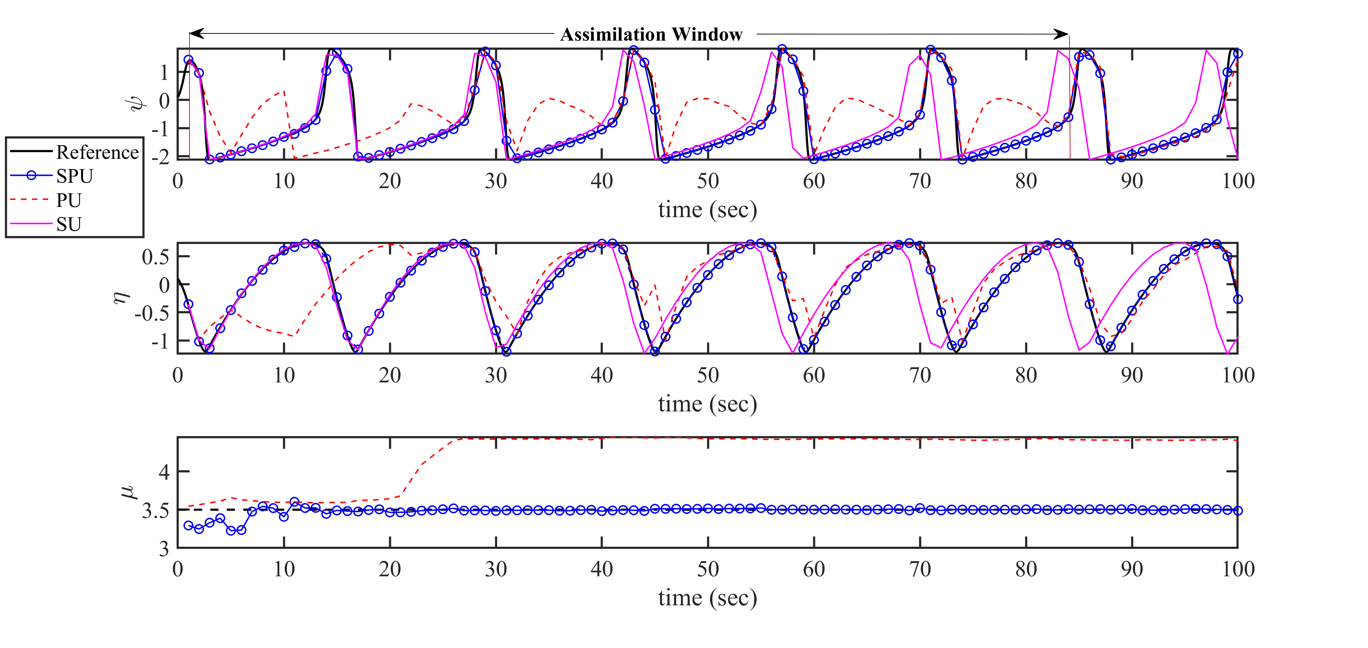
Results and Discussion (Analysis/Posterior)
SPU gives better state estimates than PU and SU
Analysis Mean for 1000 ensemble members and no model error ( µ = 3.3, µ_{t} = 3.5)

Slide 13
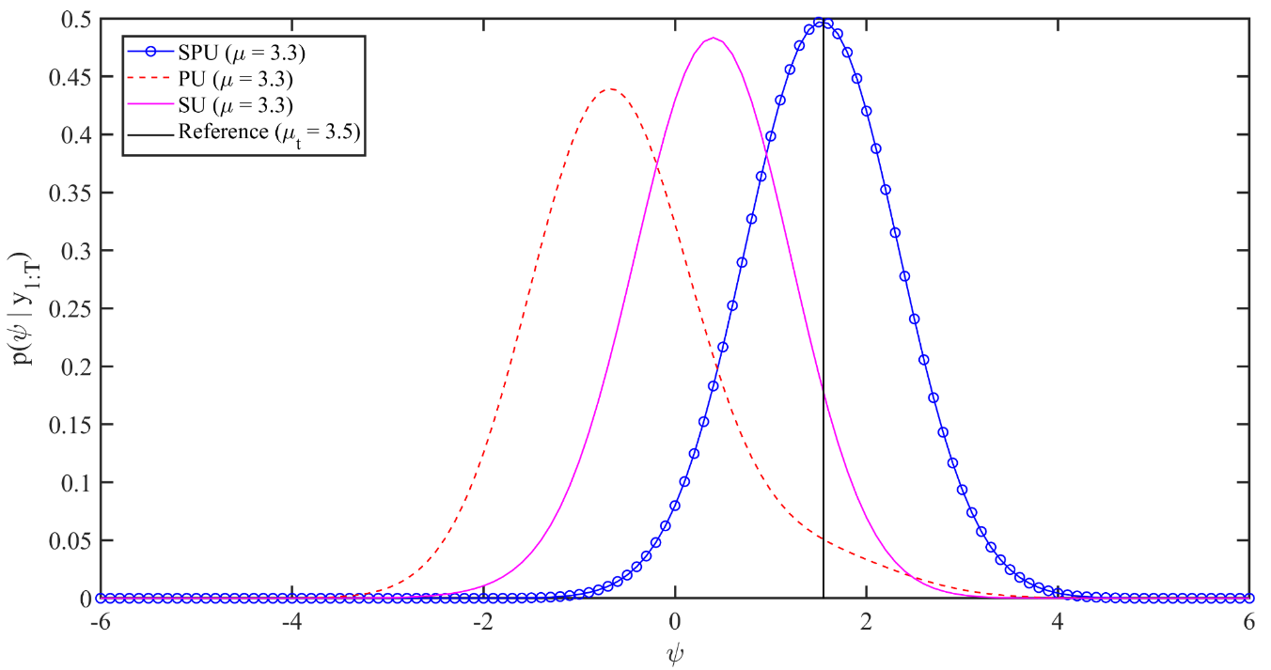
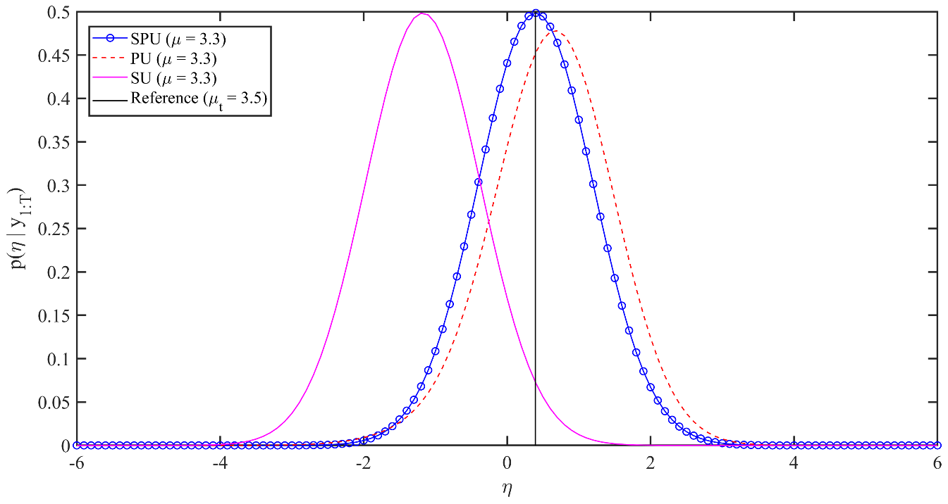
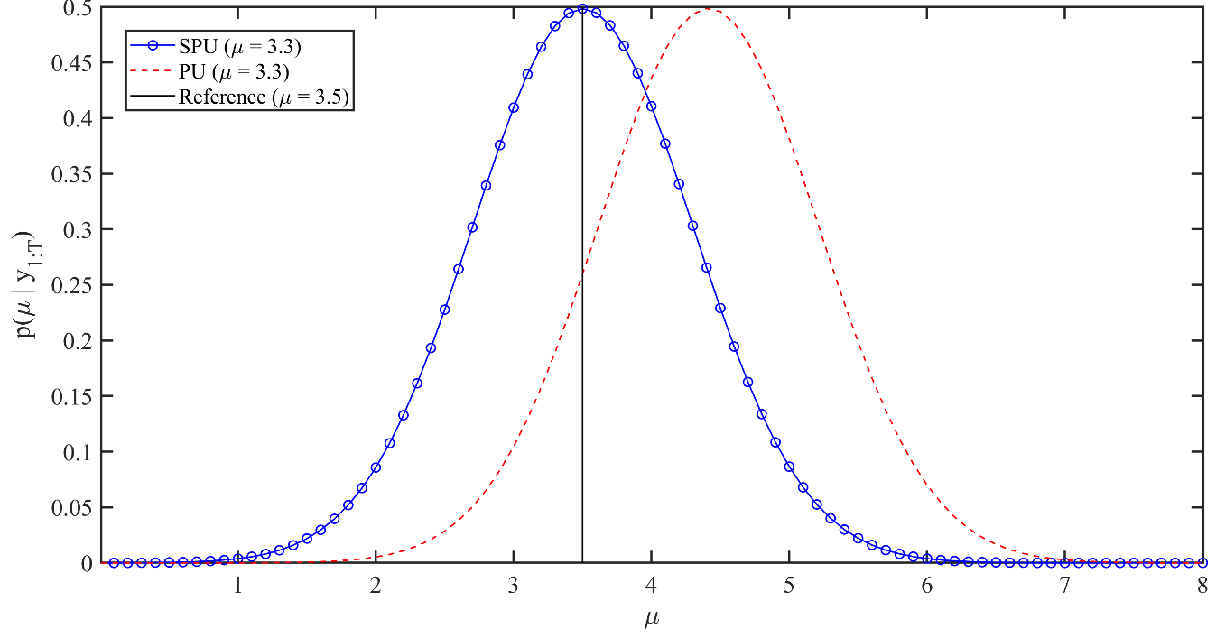
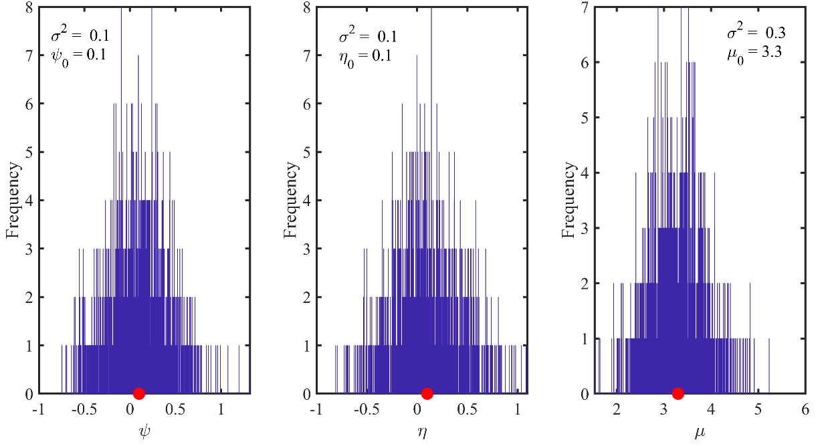
Results and Discussion (Analysis/Posterior)
Initial Ensemble with mean value

Slide 14
Conclusion
It is necessary to update the parameter in the model to get an accurate state estimate for a highly correlated parameter in a nonlinear model.
Depending on how precise or close the assumed parameter value is to the true value, the accuracy of the state estimate will vary.
There is a need for study to understand the correlation between the model dynamics with the time required to update the estimates i.e. assimilation time duration.

Slide 15
THANK YOU

Slide 16
References
Burridge, R., and L. Knopoff. (1967) Model and theoretical seismicity, Bulletin of the Seismological Society of America, 57 (3), 341-371.
Cartwright, J. H., V. M. Eguíluz, E. Hernández-García, and O. Piro. (1999) Dynamics of elastic excitable media. International Journal of Bifurcation and Chaos in Applied Sciences and Engineering, 9 (11), 2197-2202.
Lapusta, N., Rice, J. R., Ben‐Zion, Y., and Zheng, G. (2000) Elastodynamic analysis for slow tectonic loading with spontaneous rupture episodes on faults with rate- and state-dependent friction. Journal of Geophysical Research, 105, 23765-23789..
Lapusta, N. & Barbot, S. (2002) Models of earthquakes and aseismic slip based on laboratory-derived rate-and-state friction laws, in The Mechanics of Faulting: From Laboratory to Real Earthquakes, edited by A. Bizzarri and H. S. Bhat, 153–207, Research Signpost, Trivandrum, Kerala, India
Lapusta, N, and Rice, J. R. (2003) Nucleation and early seismic propagation of small and large events in a crustal earthquake model. Journal of Geophysical Research: Solid Earth 108.B4
Kaneko, Y., Ampuero, J. P., Lapusta, N. (2011) Spectral-element simulations of long-term fault slip: effect of low-rigidity layers on earthquake-cycle dynamics. Journal of Geophysical Research :Solid Earth, 1.16 (10).
Okubo, P. G. (1989) Dynamic rupture modeling with laboratory-derivated constitutive relations, Journal of Geophysical Research, 94, 12,321-12,335.
Werner, M. J., Ide, K., and Sornette, D. (2009). Earthquake forecasting based on data assimilation: Sequential Monte Carlo methods for renewal processes. Nonlinear Processes in Geophysics, 18(1) .

