Slide 1

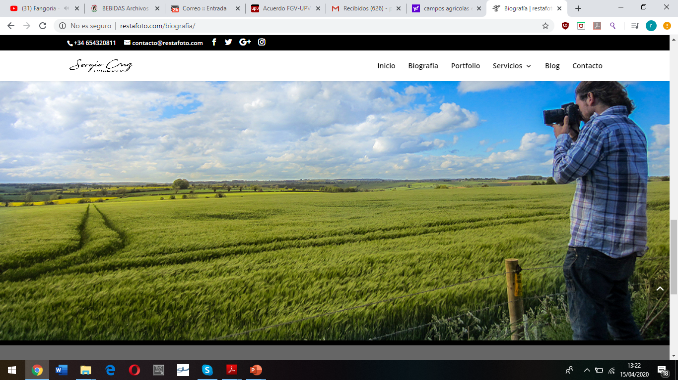

Modelling fate and transport of pesticides: the case study of the contamination in Valencia aquifers
Ricardo Pérez Indoval - Eduardo Cassiraga - Javier Rodrigo-Ilarri
Instituto de Ingeniería del Agua y Medio Ambiente (IIAMA)
Universitat Politècnica de València (UPV)

Slide 2
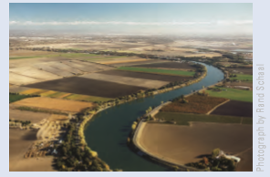
Overview
Background
PWC (GW) Conceptual model
Sensitivity of the interaction of parameters and PWC (GW) model assumptions
          Single dose application
          Annual application
        Layer thickness (dispersion)
        Simulation for the types of soil
        Application timing (rainfall timing)
        Conclusions
Photograph by Rand Schaal

Slide 3
Pesticide classification
Pesticide
Insecticides
Fungicides
“Substances or organisms used to eliminate, incapacitate, modify, inhibit growth of or repel pests. They can be natural or synthetic chemicals, mixtures of these, or living organisms that act as biological control agents” - EPA (2005)
Organochlorines
Organophosphates
Carbamates
Synthetic pyrethroids
Systemic: parts not directly treated
Non systemic (preventive): inhibit spore germination
Herbicides
Organic acids
Phenoxyacids
Carbamates
Derivates of urea
Triazines

Slide 4
USEPA model evolution
SCI-GROW, EXAMS
1997
Under development
HYDRUS
Heat and solute transport
Advection, dispersion, and reactions between phases
1980
2000
2015
1990
2010
PESTAN
1982
Advection, dispersión and reactions
Pearl and Geo Pearl
2000
Pesticide leaching in groundwater, infiltration and persistence
PRZM5.0
SWCC and VVWM
Pesticides in soil and GW
Advection, dispersion, reactions and plant interactions
PWC
Pesticides in soil, SW and GW
Diagram by Young 2004

Slide 5
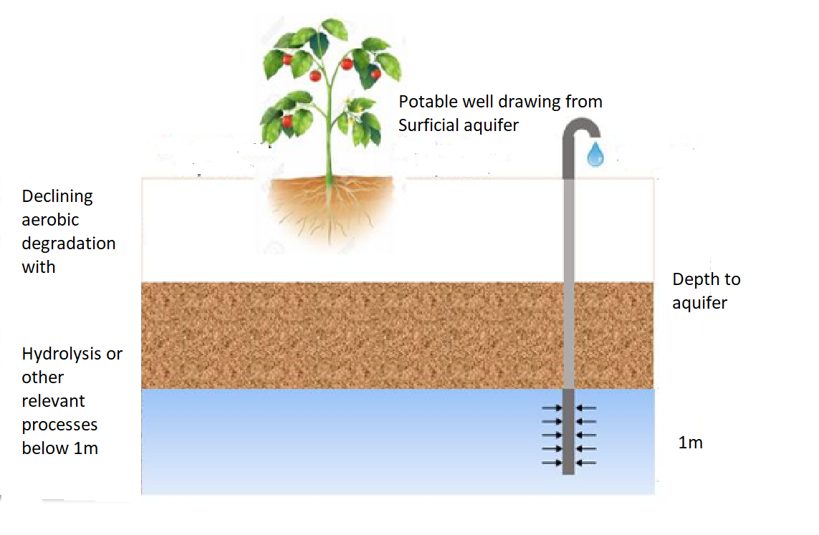
PWC: Groundwater conceptual model
A drinking water well beneath an agricultural field which draws water from a shallow unconfined, high water-table aquifer with a well screen.
Processes include water flow, chemical degradation and sorption, rain, irrigation and crop specific factors including transpiration, pesticide interception and management practices
Soil temperature
Slower aerobic soil degradation at depth up to 1m.
1m
Photograph by Young 2004

Slide 6
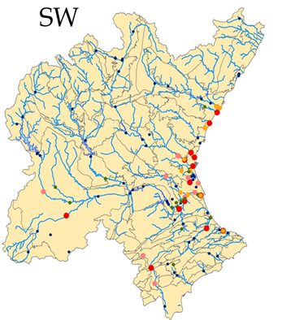
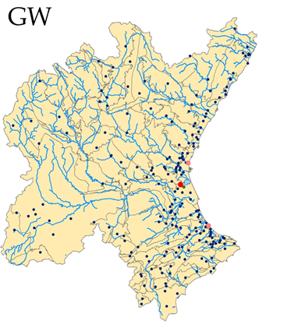
Current situation in Valencia Region (Spain)
The organophosphate insecticide chlorpyrifos is widely detected in the final stretches of the rivers (Mijares, Turia, Júcar) and in other areas of the Júcar Basin
Surface water quality control net
Groundwater quality control net
> 0.10
0.050-0.10
0.025-0.050

Slide 7
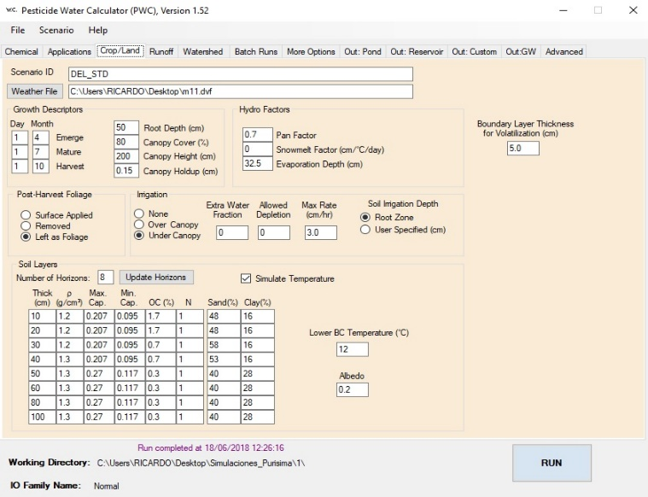


Software tools
Software PWC (Groundwater).
Meteorological archive
Crop information
Chemical characteristics of the pesticide
Geographic information systems
Q gis 3.1
Calculation sheets
Microsoft Excel
Photograph by www.epa.com
Photograph by gisgeography.com
Photograph by Microsoft office.com

Slide 8
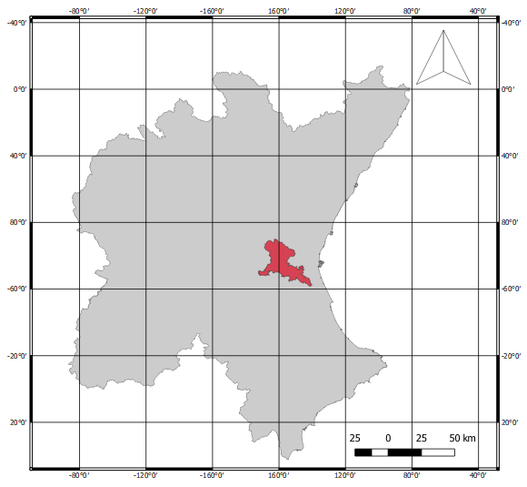
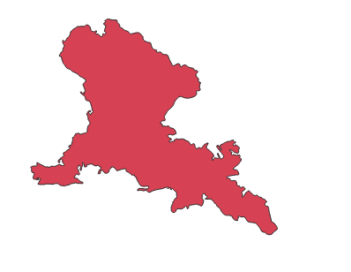
Case study: Buñol-Cheste aquifer
Underground Masses Buñol-Cheste
Underground Masses NOT ANALYSED

Slide 9
Hydrometeorological data
Mediterranean climate
Semi-arid climate
Increase of temperature
Decrease in rainfall
Climate change
Extreme periods

Slide 10
Case study 1
Single dose
5kg
3kg
2kg
1kg
 | Chlorpyrifos concentration
Case 1. Single dose | 1kg/ha | 2kg/ha | 3kg/ha | 5kg/ha
Peak concentration ppb | 0.1774 | 0.3548 | 0.5149 | 0.8005
Average concentration ppb | 0.0125 | 0.0249 | 0.0361 | 0.0562
Days > 0.10 ppb | 198 | 416 | 489 | 562
Disappear date | 08/12/2008 | 28/03/2009 | 21/05/2009 | 18/07/2009
Duration (days) | 982 | 1091 | 1144 | 1201

Slide 11
Case study 2
Annual application
5kg
3kg
2kg
1kg
2006
2007
2008
Case 2 | 1kg/ha | 2kg/ha | 3kg/ha | 5kg/ha
Peak concentration | 1.4617 | 2.9234 | 4.3851 | 7.3085
Average concentration | 0.1871 | 0.3742 | 0.5614 | 0.9356
Days > 0.10 | 2236 | 2745 | 2941 | 3145

Slide 12
Case study 3
Distribute single dose
5kg
3kg
2kg
1kg
2006
 | Chlorpyrifos concentration
Case 3 | 1kg/ha | 2kg/ha | 3kg/ha | 5kg/ha
Peak concentration ppb | 0.1871 | 0.3743 | 0.5614 | 0.9357
Average concentration ppb | 0.0092 | 0.0185 | 0.0277 | 0.0462
Duration (days) | 3218 | 3348 | 3404 | 3913

Slide 13
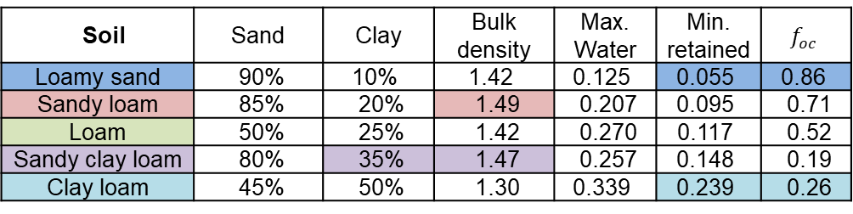
Case study 4
Simulation for different soil types
Soil | Sand | Clay | Bulk density | Max. Water | Min. retained | $$f_{oc}$$
Loamy sand | 90% | 10% | 1.42 | 0.125 | 0.055 | 0.86
Sandy loam | 85% | 20% | 1.49 | 0.207 | 0.095 | 0.71
Loam | 50% | 25% | 1.42 | 0.270 | 0.117 | 0.52
Sandy clay loam | 80% | 35% | 1.47 | 0.257 | 0.148 | 0.19
Clay loam | 45% | 50% | 1.30 | 0.339 | 0.239 | 0.26

Slide 14
Case study 5
Impact of compartment thickness in the model
10@ 1cm
1 @ 10 cm
1 @ 20 cm
1 @ 20 cm
1 @ 20 cm
1 @ 20 cm
10@ 1cm
1 @ 10 cm
2 @ 10 cm
2 @ 10 cm
2 @ 10 cm
2 @ 10 cm
6 horizonts in 1m
5m
4m
16@25cm
16@25cm
Water table
16@12.5cm
1m well screen

Slide 15
Case study 5
Impact of compartment thickness in the model

Slide 16
Case study 6
Impact of heavy rain on application day
Rain moved from
11/22 to 11/29
Rain moved from 11/22 to 12/22
15.5 cm to 10.5 cm
16.8 cm to 10.5 cm

Slide 17
Case study 6

Slide 18
Conclusions
The daily and maximum concentrations of the pesticide chlorpyrifos have been estimated in an groundwater mass of Valencia Region
The sensitivity analysis show a proportionality between the application dose and the concentrations.
Modelling application on heavy rainfall day on has a multi-fold impact on groundwater concentrations of low persistence compounds compared to persistent compounds.
Of the 6 cases, the degradation factor profile on depth = 0-1 m down to GW is the most sensitive. This approach may be appropriate but given the high sensitivity on model predictions further investigation may be performed to demontrate whether the result are not extremely conservative for some chemicals.
These concentrations are highly dependent on the soil characteristics (being 4 times higher on sandy clay than in loamy sand).

Slide 19
References
Custodio, E., & Llamas, M. R. (1996). Hidología Subterránea. Ediciones Omega.
Fetter, C. W. (2001). Applied Hydrogeology. Prentice Hall.
Freeze, R. A., & Cherry, J. A. (1979). Groundwater. Prentice Hall.
Guymon, G. L. (1994). Unsaturated zone Hydrology. Prentice Hall.
Pepper, I. L., Gerba, C. P., & Brusseau, M. L. (2006). Environmental and Pollution Science. Academic Press.
The British Crop Protection Council. (1997). The Pesticide Manual (Undécima ed.). (C. Tomlin, Ed.) The British Crop Protection Council.
Tindall, J. A., & Kunkel, J. R. (1999). Unsaturated Zone Hydrology for Scientists and Engineers. Prentice Hall.
Varadhan, R., & Johnson, J. A. (1982). PESTAN Pesticide Analytical Model Version 4.0. U.S Environmental Protection Agency (EPA).
Young, D. F. (2014). PRZM GW User Manual. U.S Environmental Protection.

