Slide 1
Towards a seamless approach for photovoltaic forecasting
Thomas Carriere, George Kariniotakis
Data & Decision Science for Energy Transition
EGU2020 Sharing Geosciences Online

Slide 2
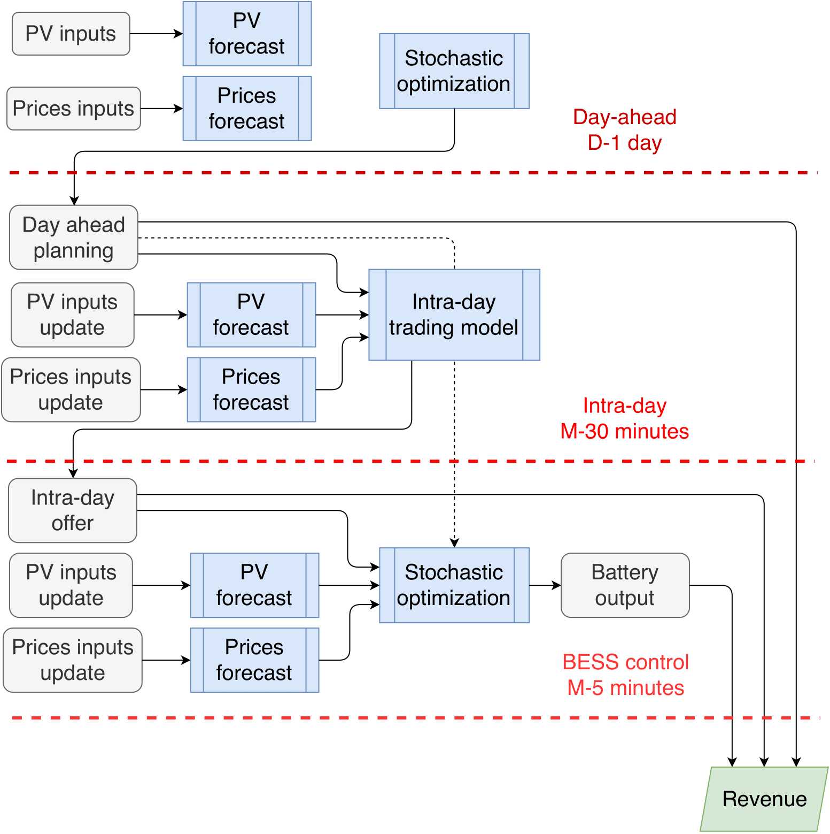
Motivation
Large variety of forecasting products required for electricity markets:
Day-ahead schedule:
Horizon +12 to +36 hours
Resolution ~1 hour
Intra-day market:
Horizon +30 minutes
Resolution ~30 minutes
Storage planning:
Horizon as close to real-time as possible
Resolution as high as possible

Slide 3
Motivation
PV power forecasting models are often designed for one specific horizon/resolution
In this work we propose a single model to cover all PV forecasting products
This effectively simplifies the usage of PV power forecasts in several decision-making processes

Slide 4
Motivation
Proposition based on the Analog Ensemble (AnEn) method
Combine heterogenous sources of input
Forecasts adapted to market time frames:
Provide both intra-day and day-ahead accurate forecasts
Provide forecasts with both high (i.e. 5 minutes) and low (i.e. 30 minutes) temporal resolutions
Provide forecasts starting at any time of the day
As fast as possible
Probabilistic forecasts for decision under uncertainty
Already present in the state-of-the-art
To implement
To check after implementation

Slide 5
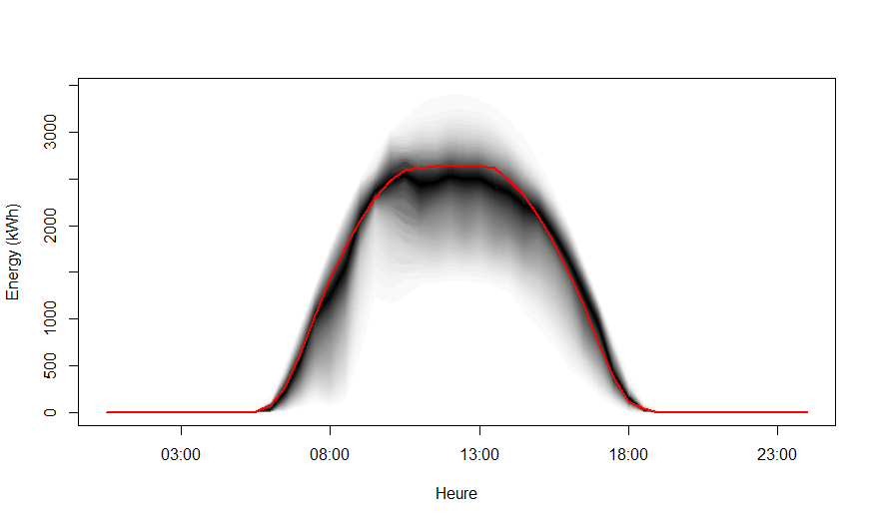
Methodology
NWP, Clear-sky
Past observations
Past productions
2. Select k most similar past inputs
3. Obtain the k corresponding past productions =
Analog Ensemble
1. Compute similarity between current and past inputs
4. Derive PDF from the Analog Ensemble using a KDE approach
$$f\left(p\right)=\frac{1}{\sum_{i=1}^{N_{A_{n}}}{s_{i}}}\sum_{i=1}^{N_{A_{n}}}{\frac{s_{i}}{bw}\left[K\left(\frac{p−e_{i}}{bw}\right)+K\left(\frac{p+e_{i}}{bw}\right)+K\left(\frac{p+e_{i}−2E_{n}}{bw}\right)\right]}$$
Predictive inputs (NWP, Clear-sky)
Observation inputs (Measurements, Satellite)
Production Forecast
?

Slide 6
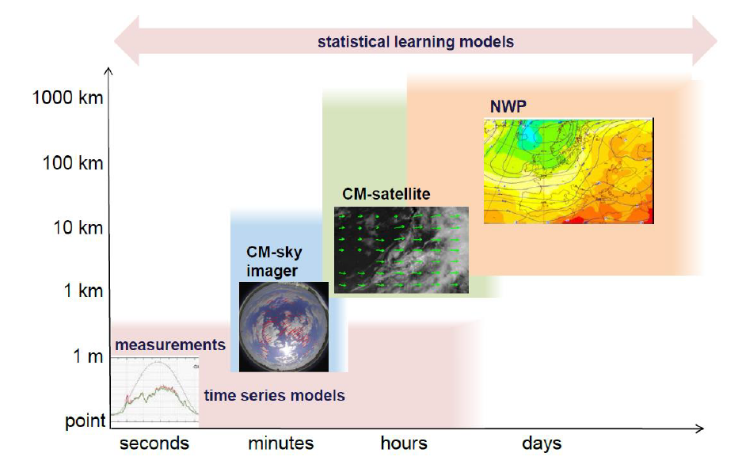
Methodology
To achieve short-term forecasts:
Measurements for very short-term
Satellite data for short-term
Source: Solar Training 2016, OIE- Transvalor

Slide 7
Methodology
Standard AnEn model:
$$\left|\left|F_{t}, A_{t}\right|\right|= \sum_{i=1}^{N_{v}}{\frac{w_{i}}{σ_{f_{i}}}\sqrt{\sum_{j=−k}^{k}{{\left(F_{i, t−j}−A_{i, t−j}\right)}^{2}}}}$$
The weights $w_{i}$ are optimized on a training set (“wrapper”)
We propose a “filter” approach to compute the weights directly from the history without an optimization loop

Slide 8
Methodology
When $h$ is the forecast horizon:
$$\left|\left|F_{t}, A_{t}^{h}\right|\right|= \sum_{i=1}^{N_{v}}{w_{i}^{h}\sqrt{\sum_{j=−k}^{k}{{\left(F_{i, t−j}−A_{i, t−j}^{h}\right)}^{2}}}}$$
The weights $w_{i}^{h}$ are dependent on the forecast horizon.
Compute the weight of each feature based on its Mutual Information (MI) with the measurements
Normalize the weight so that the sum of all the weights coming from a same data source is not higher than a set limit.

Slide 9
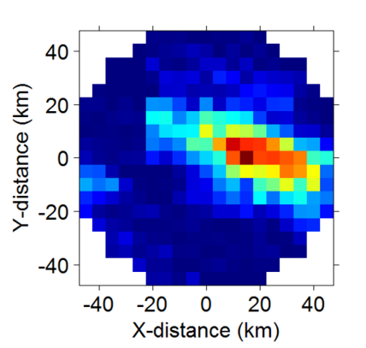
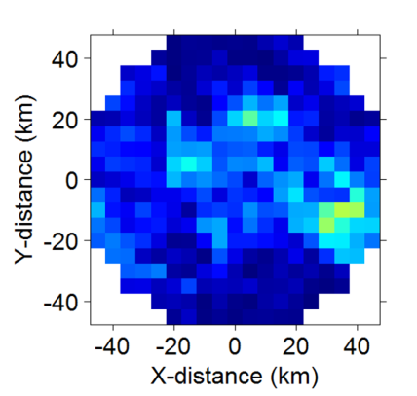
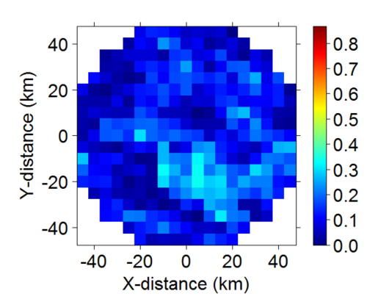
Methodology
Satellite data: Estimation of GHI time series for each pixel from geostationary satellite images following [Blanc2011]
Very large number of redundant features
Selection of representative pixels based on MI with the measurements
T + 30 minutes
T + 90 minutes
T + 250 minutes
[Blanc2011]: Philippe Blanc et al., The HelioClim project : Surface solar irradiance data for climate applications, In: Remote Sensing 3.2 (2011)

Slide 10
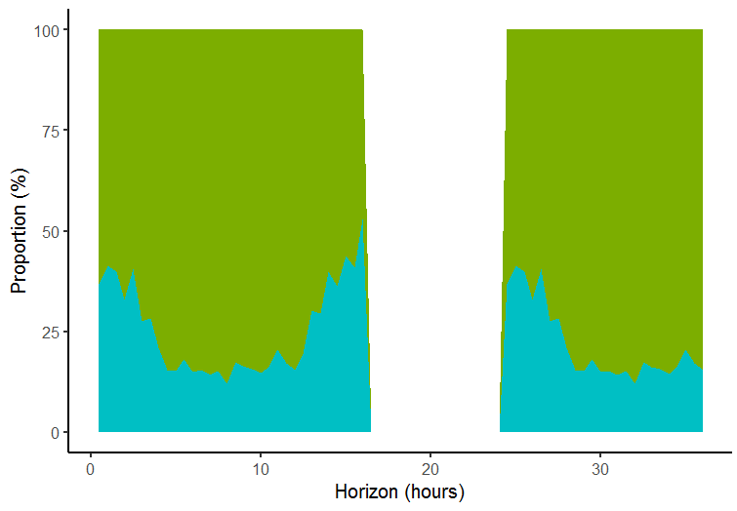
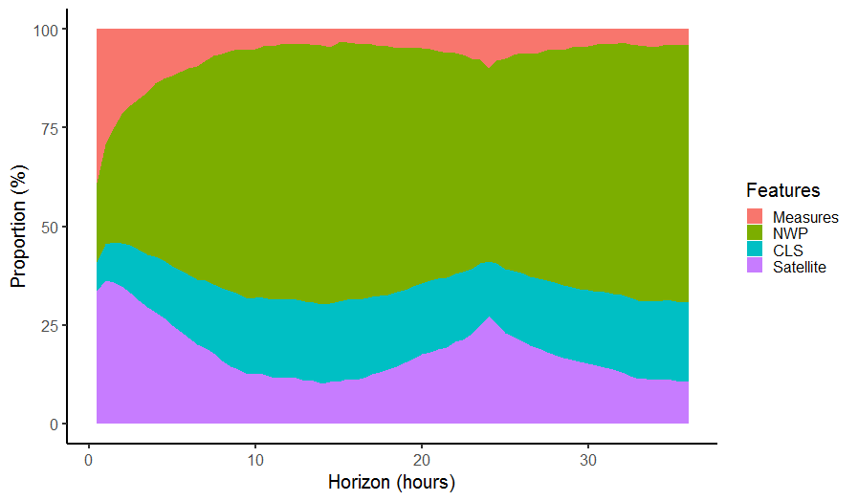
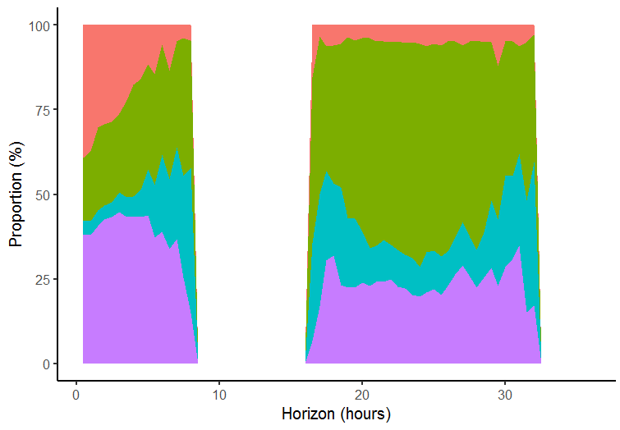
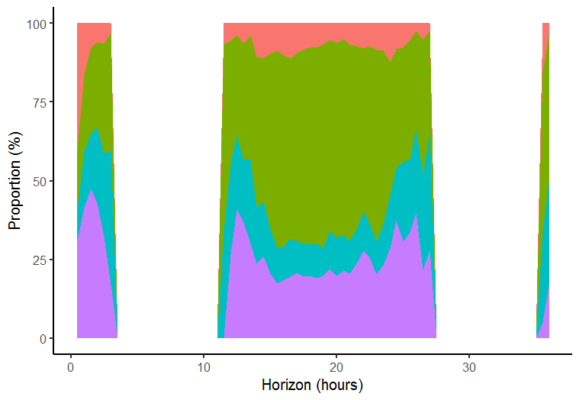
Methodology
Average over all starting times
3 AM
12 AM
17 PM

Slide 11
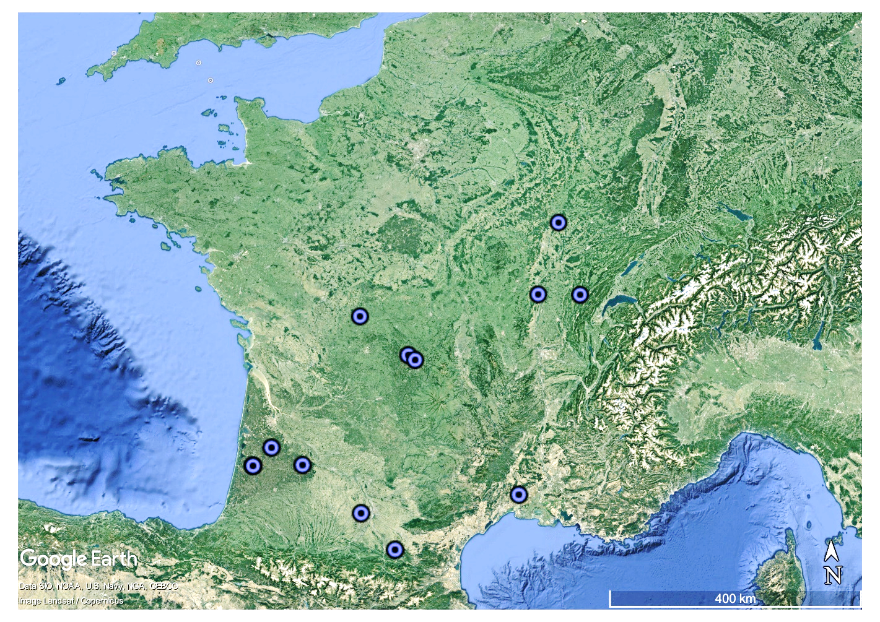
Evaluation of the AnEn model
Evaluation of the AnEn model on a portfolio composed of 12 PV plants ranging from 2 to 10 MW.
Measurements with 5- and 30-minute resolutions are used
Benchmark models are implemented:
Day-ahead forecasts: Quantile Random Forest (QRF) and Bayesian Automatic Relevance Determination (ARD)
Intra-day forecasts: Clear-sky index persistence and integrated auto-regressive (ARIMA) model

Slide 12
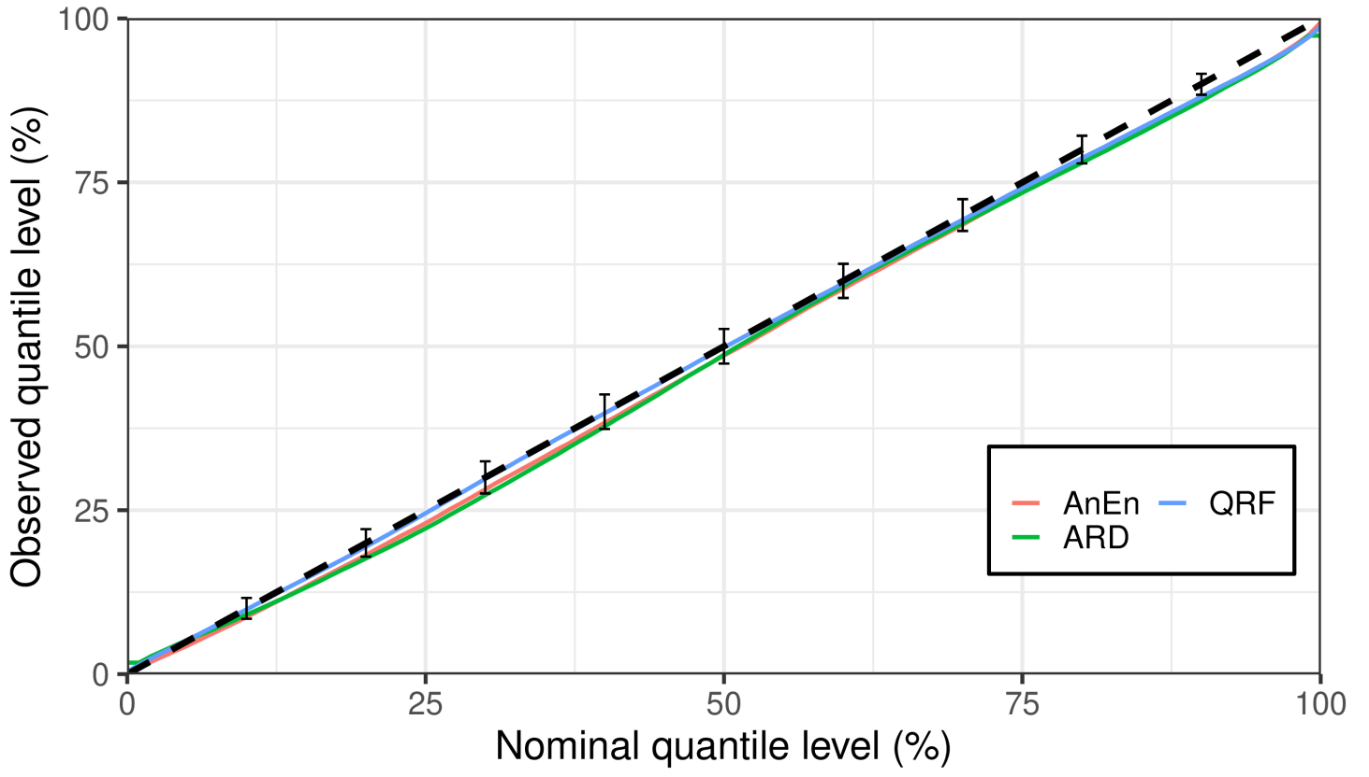
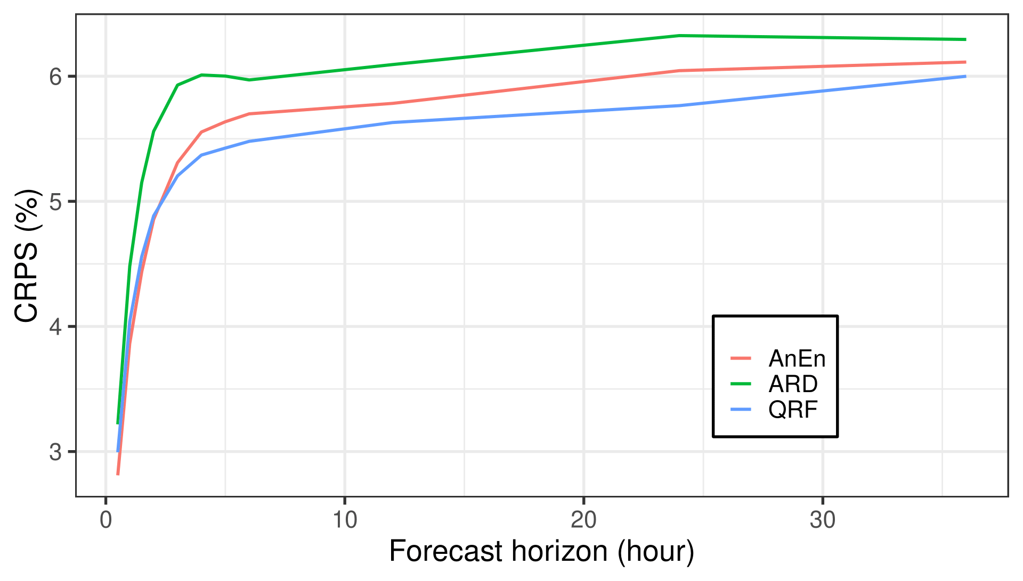
Result – 30 minute resolution
Forecast performance for day-ahead forecasts (30-minute resolution, plant n°4):
Possible range for a perfectly reliable model
CRPS: Continuous Ranked Probability Score, normalized by installed PV capacity
Reliability diagram: nominal vs. observed quantiles

Slide 13
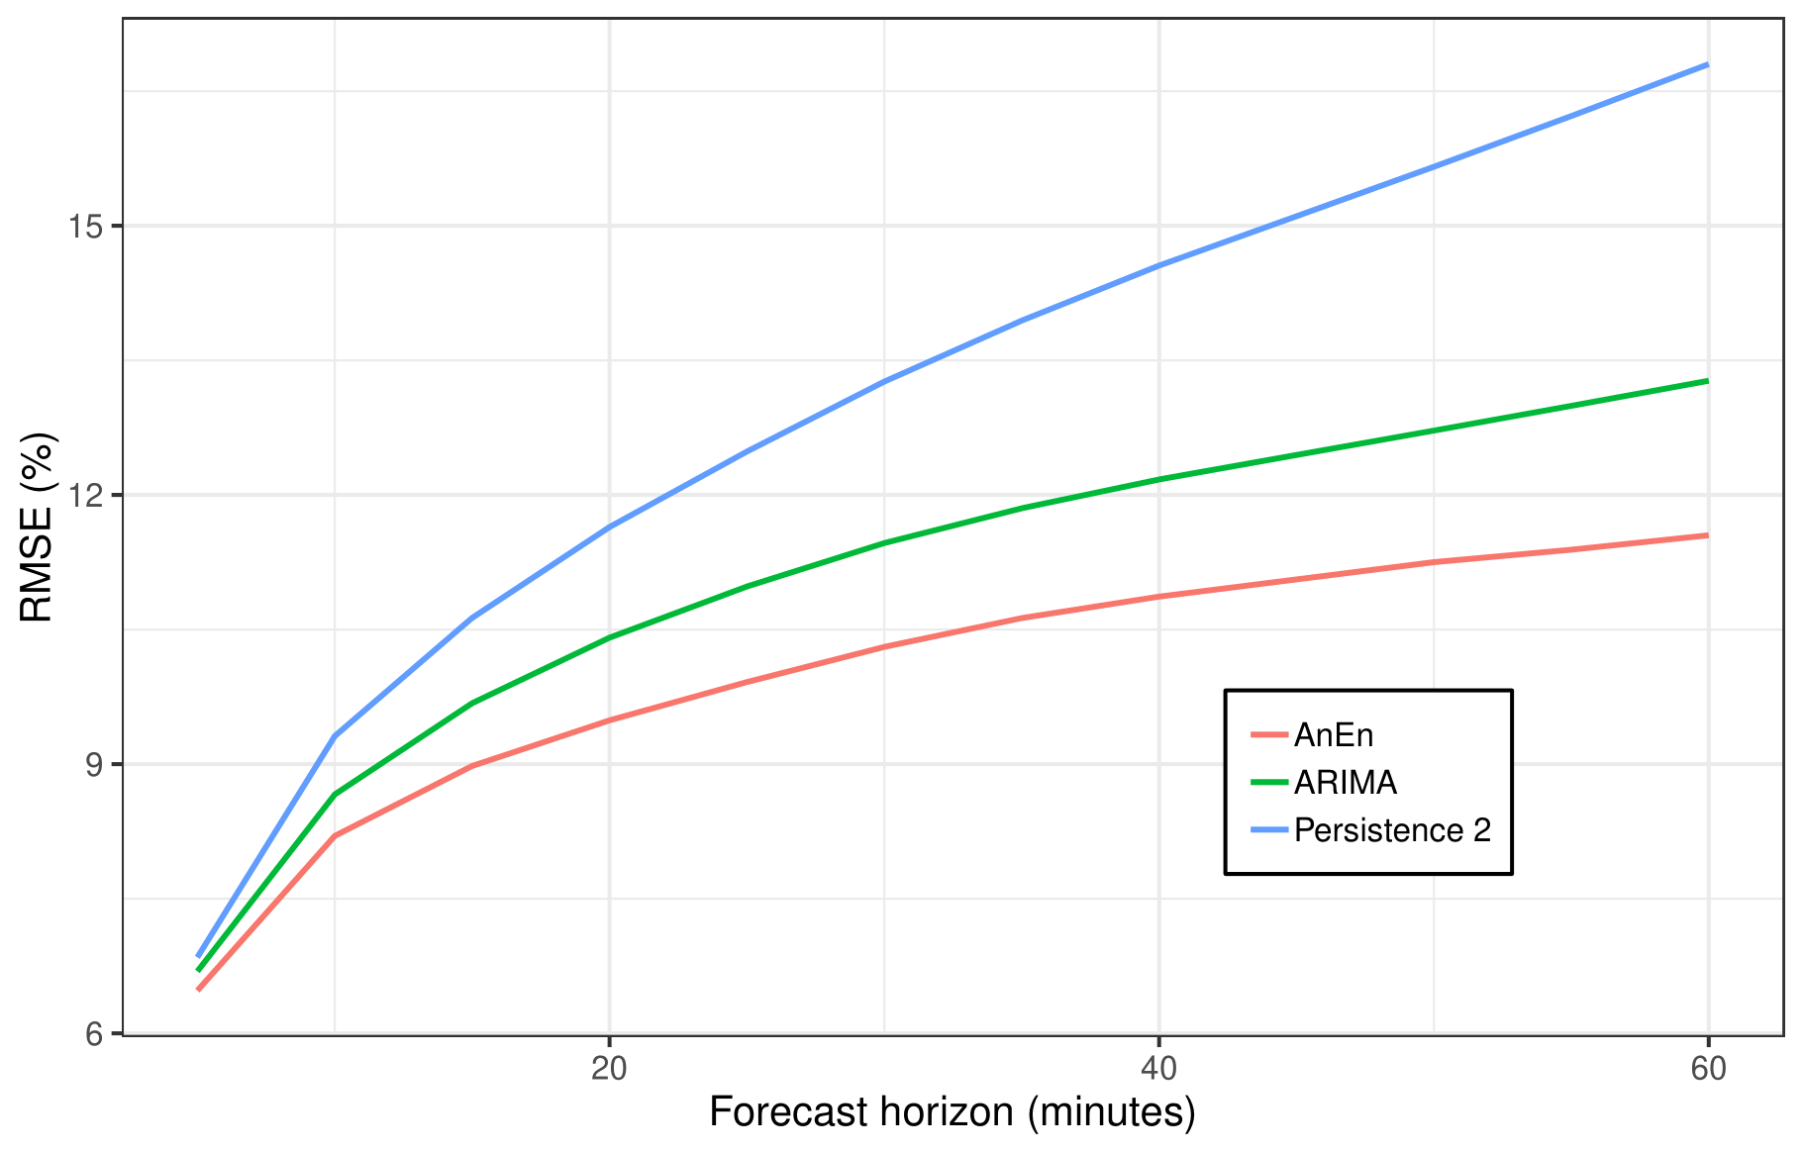
Result – 5 minute resolution
Forecast performance for intra-day 5-minute forecasts. QRF and ARD models are discarded due to computational cost:
RMSE: Root Mean Square Error, normalized by installed power

Slide 14
Computing time
Computing time required for providing a forecast for a given horizon in seconds
 | 30-minute resolution |  | 5-minute resolution
 | Training | Forecasting | Training | Forecasting
AnEn | - | 1.87 | - | 8.77
Persistence 1 | - | 5e-3 | - | 6e-3
Persistence 2 | - | 5e-3 | - | 6e-3
ARIMA | 9.2e-2 | 2.5e-7 | 10e-2 | 3.7e-3
QRF | 4.26 | 1.3e-2 | 68.0 | 4e-2
ARD | 10.75 | 10e-3 | 154 | 1e-3

Slide 15
Conclusions and perspectives
A single forecasting model that can quickly provide accurate forecast for temporal resolutions from 5-minute to 1-hour, and horizon from 5 minutes to 3 hours
Additional types of data could be used:
All-sky imagers
Neighboring plants or weather stations
Infra-red satellite data
Commercial forecasts from third entities
More details in: T. Carriere, C. Vernay, S. Pitaval, F.P. Neirac, G. Kariniotakis, A Novel Approach for Probabilistic Photovoltaic Power Forecasting Covering Multiple Time Frames, IEEE Transactions on Smart Grid

