Slide 1
Efficient POD-Kriging Surrogate Models for Rainfall Forecasting
Citlali Cabrera Gutiérrez, Jean-Christophe Jouhaud

Slide 2
Introduction
Nowcasting (or short-term weather forecasting) is particularly important in the case of extreme events as it helps prevent human losses
Currently, immediate rainfall forecasts in France are calculated using the Arome-NWC model developed by Météo-France, which is a complex physical model.
Arome-NWC gives rainfall forecasts with a temporal resolution of 1 minute, but, due to storage reasons, they are only saved every 15 minutes. Making rainfall forecasts with a higher time resolution available would be useful for operational applications in nowcasting.
Surrogate models produce results which are very close to the ones obtained using a complex model, but with largely reduced calculation times.
Goal: build surrogate models (based on Arome-NWC) to make rainfall forecasts with a higher time resolution available and reduce the calculation time

Slide 3
Outline
AROME-NWC
Dimensionality reduction using POD
Kriging
Results
Discussion and conclusion

Slide 4
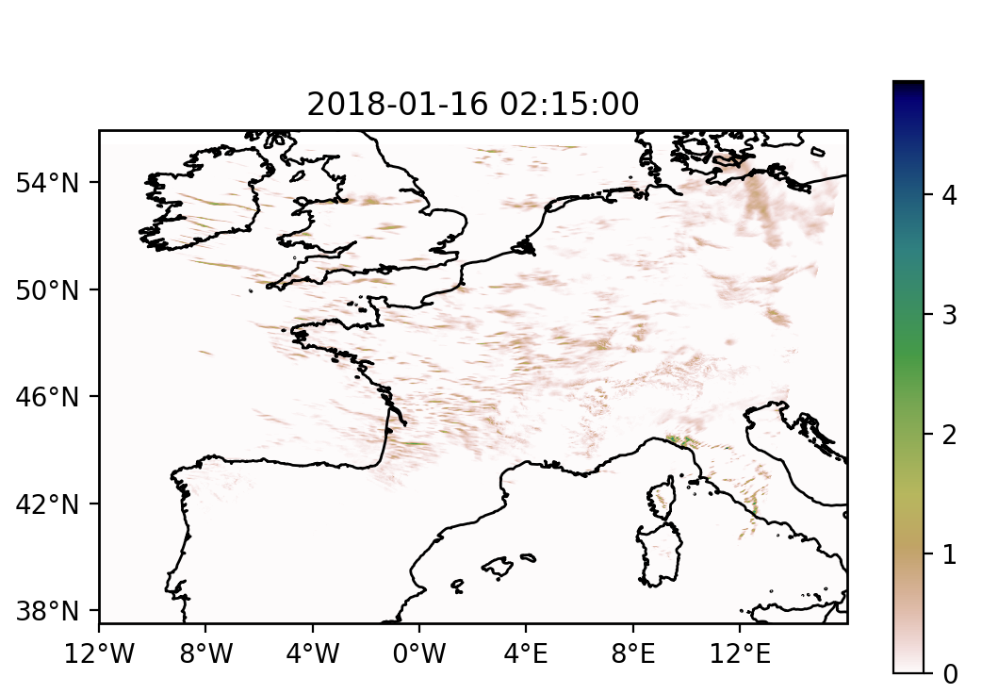
AROME-NWC
Rainfall
Arome-NWC is a fine grid (1.3 km) physical nowcasting system that is based on an existing Arome mesoscale model, from which background and lateral boundary conditions are taken.
Every hour H, the last available Arome-NWC forecast and observations in the interval [H-10,H+10[ are used to give rainfall forecasts
Maximum forecast range: 6 hours.
Resolution of calculations: 1 minute
Resolution of stored calculations: 15 minutes (due to storage reasons)
Available rainfall forecasts:
[H+15 min, H+30 min , …, H+6 hours ]
Output available at: H+30 min
In the following, we refer to Arome-NWC as simply Arome

Slide 5
Dimensionality reduction using POD (also known as PCA or EOF)
POD is a wide-spead technique used for dimensionality reduction that keeps physical information
A variable can be projected on an orthogonal basis
$$\hat{Y_{0}}=\hat{Y}\left(x_{0}\right)=\sum_{i=1}^{n}{a_{i}∙φ_{i}}$$
$$φ_{1}$$
: 1st mode
where
($φ_{i} ∙φ_{j})=δ_{ij}$
: 2nd mode
$δ_{ij}=1$ if $i=j$
$$φ_{2}$$
$δ_{ij}=0$ otherwise
$$φ_{3}$$
: 3rd mode
Keeping the main modes, we get a good approximation of it
Methods:
Eigendecompositon
Singular Value Decomposition (SVD)
$k$
$$\hat{Y_{0}}≈\sum_{i=1}^{k}{a_{i}∙φ_{i}}$$
with $k<n$
Image taken from: https://www.math.u-bordeaux.fr/~mbergman/Images/graphs/ModesGMRES.jpg

Slide 6
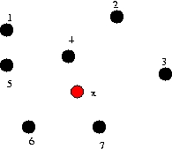
Kriging
Kriging uses known values of a variable to build a surrogate model and estimate unknown values of this variable at other positions (in time and/or space)
$$\hat{Y_{0}}=\hat{Y}\left(x_{0}\right)=\sum_{i=1}^{n}{ω_{i}Y_{i}}$$
*Examples are shown in space, but the same applies for time
$$x_{0}$$
$$\sum_{i=1}^{n}{ω_{i}=1}$$
In the case of ordinary kriging the unbiasedness condition is fulfilled:
The weight values are estimated using the covariance between the points (which depends on the distance between them)
$$ω_{i}$$
When POD is used, Kriging is done on the POD basis and it estimates the coefficients :
$$a_{i}$$
where
$$c$$
: the variance-covariance matrix of the known values of the variable
$$\hat{Y_{0}}≈\sum_{i=1}^{k}{a_{i}∙φ_{i}}$$
$$a_{i}=c^{−1}c_{0}$$
$$c_{0}$$
: a vector of covariances between the known and the predicted value of the variable

Slide 7
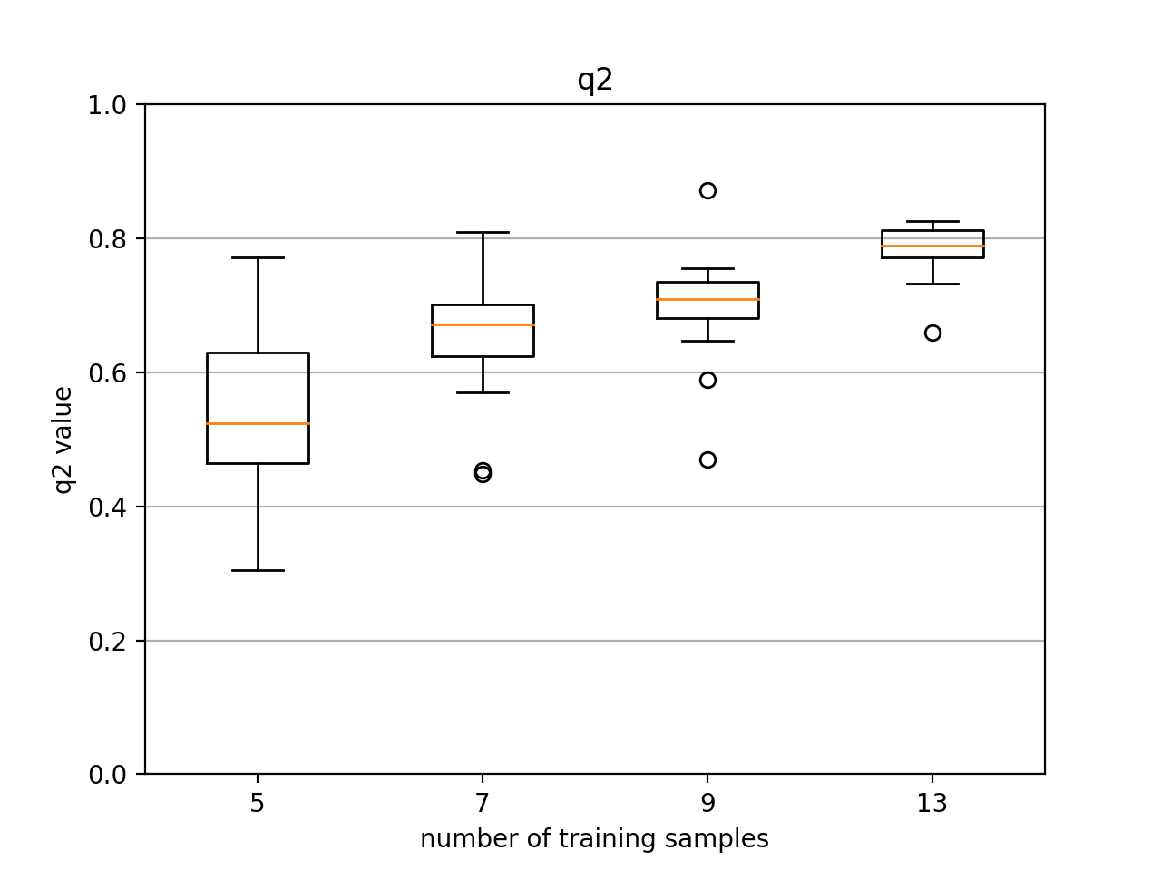
Results
We used batman, a tool developed in python at Cerfacs based on the scikit learn library, to build our surrogate models
Rainfall
Every hour, Arome gives rainfall forecasts for the following 6 h(1 forecast every 15 minutes)
→ 24 samples
We built a surrogate model for different numbers of training samples
Samples that are not used to build the surrogate model are compared to the results given by the surrogate model
q2
Pourcentage of variance explained by the model
q2 ~0.8
Surrogate model is a good approximation of the complex model
Rainfall data from 04/01/2018 at 0h

Slide 8
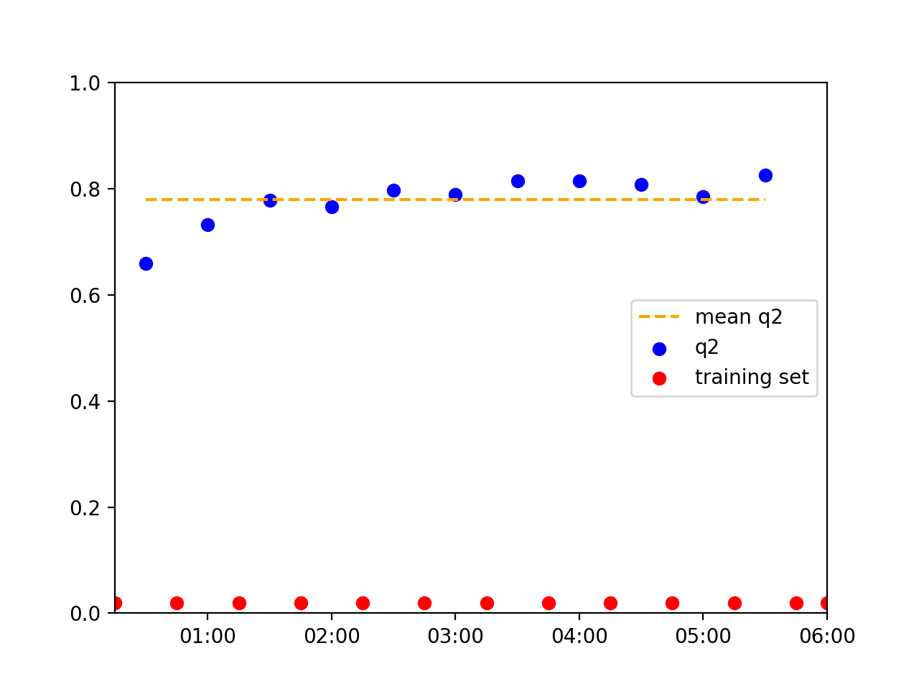
Results
5 training samples
13 training samples
The value of q2 increases when one goes further in time, as more training samples from the past are available
Rainfall data from 04/01/2018 at 0h

Slide 9
Results
Example of results:
Arome
Surrogate model prediction
mm
mm
Predictions given by our surrogate model are good
Video : click on play to watch
Rainfall data from 04/01/2018

Slide 10
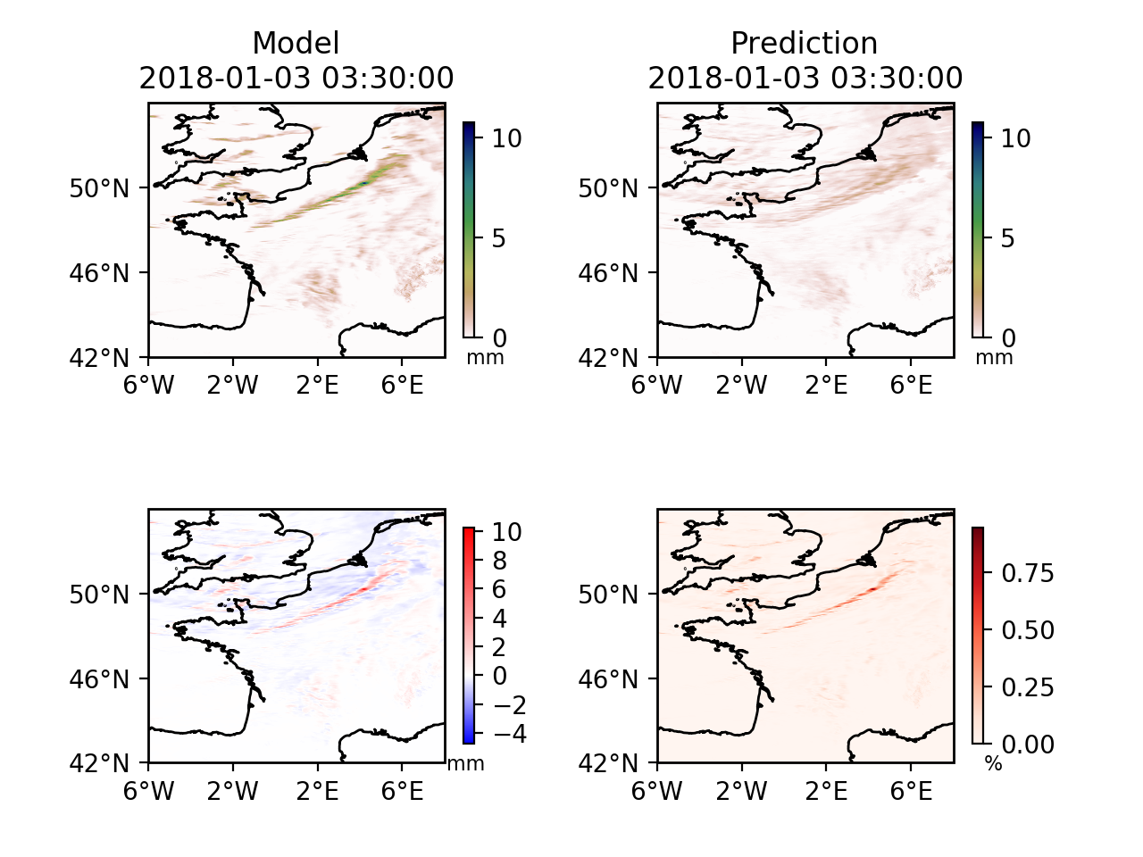
Results
However, in some cases, results can be less accurate…
Model - Prediction
(Model – Prediction)/Max(Model)

Slide 11
Results: Using extra data
Solution: use more data to build the surrogate model in order to improve our surrogate model
Possible choices:
Arome data
Radar data (data every 5 minutes)
Antilope data (reanalysis calculated in 9 minutes, data every 15 minutes )

Slide 12
Results: Arome data
Limitation: data is not continuous as the intial conditions are reset every hour
Approach: Use multiple Arome simulation sets, but leaving an « empty » interval of one hour
main
simulation set
extra simulation sets
H-14
H-8
H-7
H-1
H
H+6
Data from 16/01/2018

Slide 13
Results: Radar/antilope data
Better results are obtained when using Antilope data, but it is a reanalysis
The q2 value obtained when using 10h of Antilope data is close to the one obtained when using 2 more Arome data sets.
Data from 16/01/2018, 13 Arome samples

Slide 14
Results
Here we take a maximum of 13 samples from the main Arome data set. If we use all 24 available samples, the value of q2 will increase (but it can’t be calculated)
Using 2 extra Arome simulation sets perfoms slightly better than using extra radar or Antilope data, hence this solution has been chosen.
Data from 16/01/2018, 6 h of radar/antilope data

Slide 15
Results
Here we show some examples of the surrogate models that we built. They correspond to different meteorological situations
Arome
Surrogate model
24 samples
Video : click on play to watch

Slide 16
Results
Arome
Surrogate model
24 samples
Video : click on play to watch

Slide 17
Results
Arome
Surrogate model
24 samples
Video : click on play to watch

Slide 18
Results
Arome
Surrogate model
24 samples
Video : click on play to watch

Slide 19
Results
Arome
Surrogate model
24 samples
Video : click on play to watch

Slide 20
Discussion and conclusion
We showed that POD and Kriging can be used to build surrogate models for rainfall forecasts, which allow to do reasonably good time interpolations.
In practice, all 24 samples must be used to build the surrogate model (left out samples were only used as reference to evaluate the model)
It should be kept in mind, that the q2 value will change from one case to another.
Predicting rain fronts is particularly challenging as the fronts tend to be widened in the predictions

Slide 21
Discussion and conclusion
Be aware of the fact that building a surrogate model in this way has the drawback of working only for the given parameters. Therefore, for each set of Arome-NWC outputs (24 in total: a prediction every 15 minutes for 6 hours), a new surrogate model will have to be built.
All calculations were run on a CPU with 64 GB and 2.5 GHz and took about 20 minutes (24 samples and 2 extra simulation sets).
Our calculation time with a surrogate model is largely reduced (we made predictions with an interval of 1 minute, which makes a total of 346) compared to Arome-NWC (a forecast for 24 different times takes 30 minutes to be calculated).

Slide 22
Discussion and conclusion
The calculation time changes with the size of the region that is being considered and the number of samples used.
It is important to notice that once the surrogate model has been built, making a new prediction is very quick. We chose here to do a prediction for every minute,but the time interval can be easily reduced.

Slide 23
Deep4Cast team
This work is part of the Deep4Cast project* funded by the STAE Fundation
Members of the Deep4Cast team :
Mohamed Chafik Bakkay¹, Naty Citlali Cabrera Gutiérrez¹ , Florian Dupuy¹, Jean-Christophe Jouhaud², Valentin Kivachuk¹, Maud-Alix Mader¹, Olivier Mestre ³, Guillaume Oller¹, Mathieu Serrurier⁴, Laurent Terray⁵, Michaël Zamo^{3`}
¹Institut de Recherche Technologique Saint-Exupéry, Toulouse, France
²CERFACS, 42 Avenue Gaspard Coriolis, 31057 Toulouse Cedex 1, France
³CNRM – Météo-France – CNRS, GMAP, Toulouse, France
⁴IRIT, université Paul Sabatier, Toulouse, France
⁵CECI, Université de Toulouse, CERFACS/CNRS, Toulouse, France
*https://www.researchgate.net/project/Deep4Cast

