Slide 1



Landslide and Rockfall failures Characterization with Object-Based 3D Analysis
Stratis Karantanellis, PhD researcher
Co-authors: Vasilis Marinos, Emannuel Vassilakis
Aristotle University of Thessaloniki, Department of Geology, Laboratory of Engineering Geology & Hydrogeology

Slide 2

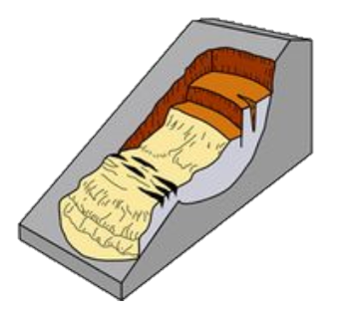
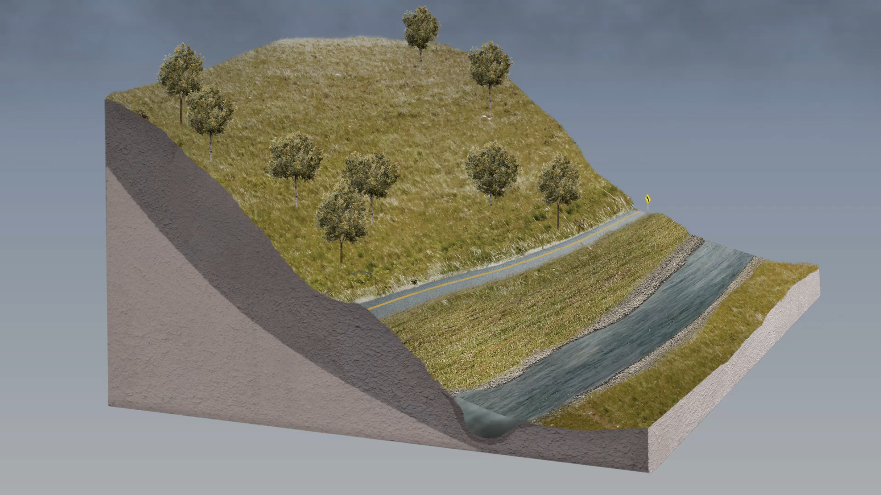
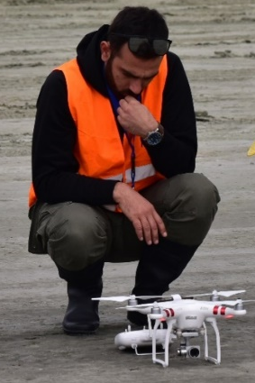
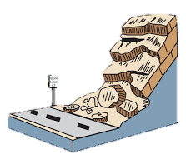
Motivation
Landslides → widespread phenomena → disastrous events worldwide
Remote sensing imagery constitutes a valuable and cost-effective source for mapping landslides and identifying topographic changes.
UAV (RPAS) → Powerful tool for landslide research
Urgent need → Automated & objective geohazard identification (site-specific cases)
Objective → Methodology for landslide risk management tool
✅ Object-based approach to mimic experts’ perception into machines!

Slide 3
Landslide analysis
Hazard
Susceptibility
Elements at Risk
Urgent Need: Unique framework for holistic Landslide Risk Analysis
Necessary
Automation - Accuracy
Completeness - Precision
Transferability – Adaptability
~ Object-Based Image Analysis
Goal → Bring life to models
Exposure
Risk
Automation – Completeness –
Transferability
Capacity
Vulnerability
Consequences

Slide 4
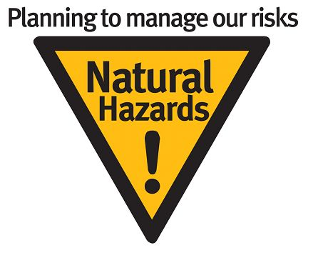
Effective & Efficient data acquisition
- Flight operation consist of 2 sub-flight plans (perpendicular)
1st: 80º degrees & 2nd: 60º degrees (20° at most)
→ Avoid occlusion due to vegetation or undesired assets

Slide 5
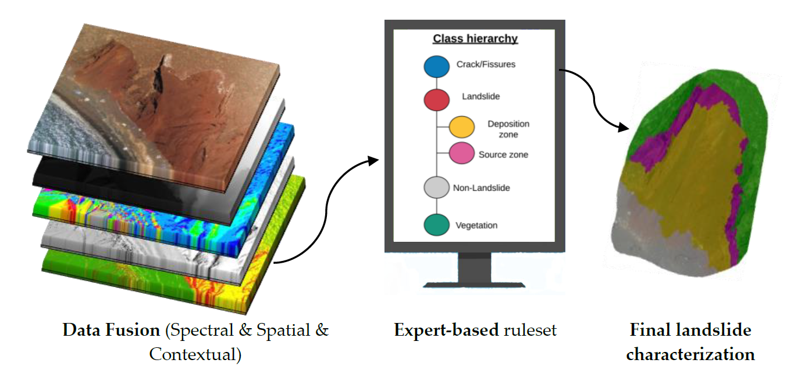

Slide 6


Slide 7
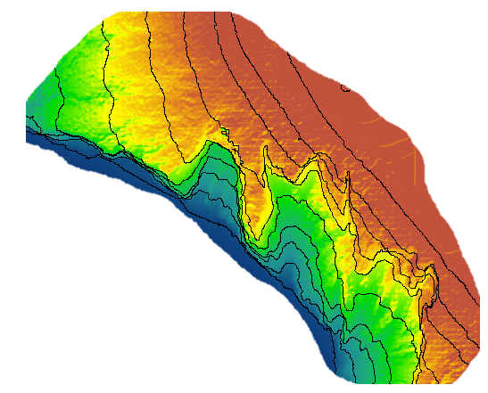
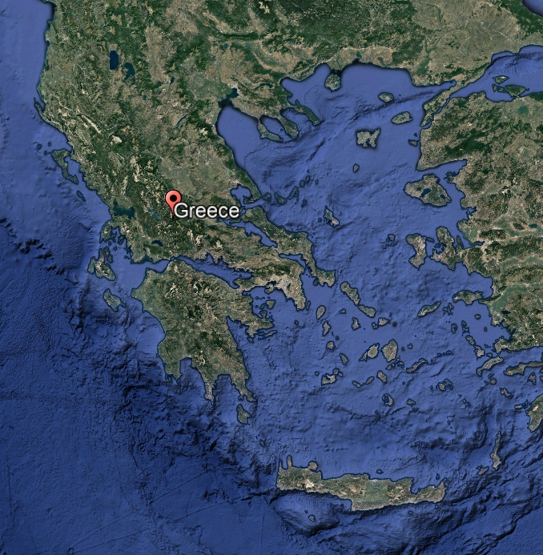
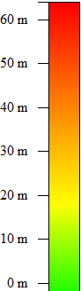
Case site – Red Beach, Santorini, Greece
Active landslide area
Steep slopes (60m) - Unfavorable conditions
Susceptible to landslide due to weathering/erosion
High touristic activity – High Risk
- Seasonal (6-months) monitoring
70
60
50
40
30
20
10

Slide 8
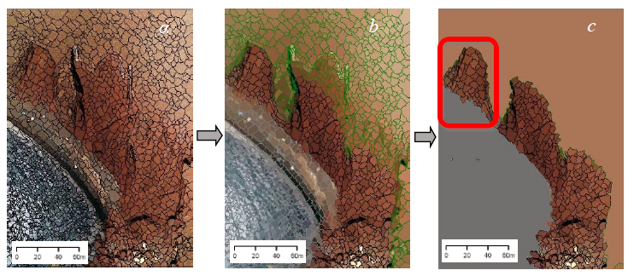
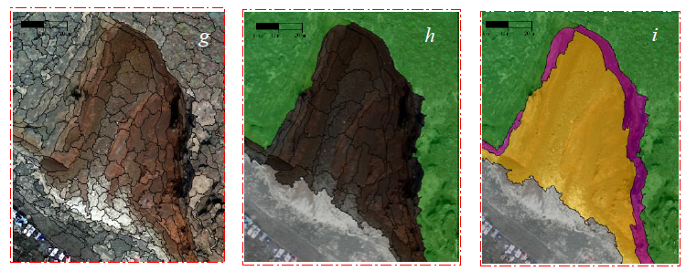
Methodology

Slide 9

Conclusions
Remote sensing technology and UAVs provides the ability to obtain information from the entire area of interest in effective and efficient way.
OBIA methodology proved effective for landslide semantic labelling which can lead to better characterization and monitoring results.
Automation is the next thing in Engineering Geology by transferring geological knowledge from experts to computer vision. To make sense of all this information, we need machine learning to automate some of the working steps in Engineering Geology.
UAVs are just tools of landslide research, post-processing requires further advance Engineering Geological knowledge.
«Geology is passion, Engineering Geology is unconditional love»

Slide 10
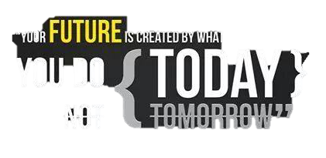





Stratis Karantanellis
Aristotle University of Thessaloniki, Dept of Geology, Lab of Engineering Geology & Hydrogeology, Greece
Contact info:
skarantanellis@gmail.com – karantan@geo.auth.gr
www.stratiskarantanellis.eu
Stratis Karantanellis
Stratis Karantanellis
«This research is co-financed by Greece and the European Union (European Social Fund- ESF) through the Operational Programme «Human Resources Development, Education and Lifelong Learning» in the context of the project “Strengthening Human Resources Research Potential via Doctorate Research” (MIS-5000432), implemented by the State Scholarships Foundation (ΙΚΥ)»

