Slide 1
Diurnal and seasonal variations in carbon ﬂuxes in bamboo forests during the growing season
in Zhejiang province, China
Liang Chen^{1,2,3} • Yuli Liu^{2,3,4} • Guomo Zhou^{2,3,4} • Fangjie Mao^{2,3,4}
Huaqiang Du^{2,3,4} • Xiaojun Xu^{2,3,4} • Pingheng Li^{2,3,4} • Xuejian Li^{2,3,4}
1 Faculty of Science and Forestry, Department of Environmental and Biological Science, University of Eastern Finland, Finland
2 State Key Laboratory of Subtropical Silviculture, Zhejiang A & F University, Lin’an 311300, Zhejiang, China
3 Key Laboratory of Carbon Cycling in Forest Ecosystems and Carbon Sequestration of Zhejiang Province, Zhejiang A & F University, Lin’an
311300, People’s Republic of China
4 School of Environmental and Resources Science, Zhejiang A & F University, Lin’an 311300, People’s Republic of China
https://liangchen3519.github.io/

Slide 2
Introduction Materials & Methods Results Conclusions
Contents
Contents
① Introduction
Background
Aims
② Materials & Methods
Site description
Measurements and data acquisition
Data processing and gap ﬁlling
③ Results
Daily and monthly variations in C ﬂuxes at LB site and MB site
Response of carbon ﬂuxes to environmental variables
④ Conclusions

Slide 3
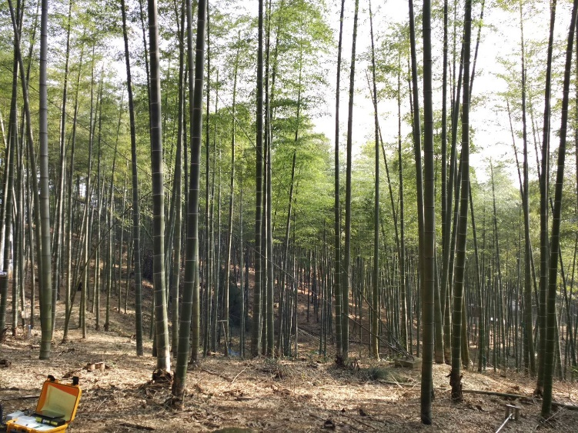
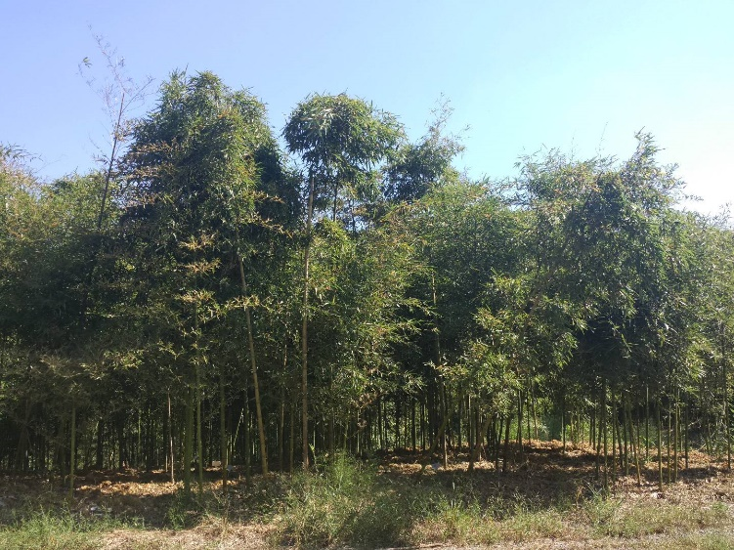
Introduction Materials & Methods Results Conclusions
Background
Background
Zhejiang province
Has the largest area of bamboo forest with 0.83 million ha in China
Moso bamboo
(Phyllostachys heterocycla)
Lei bamboo
(Phyllostachys praecox)

Slide 4
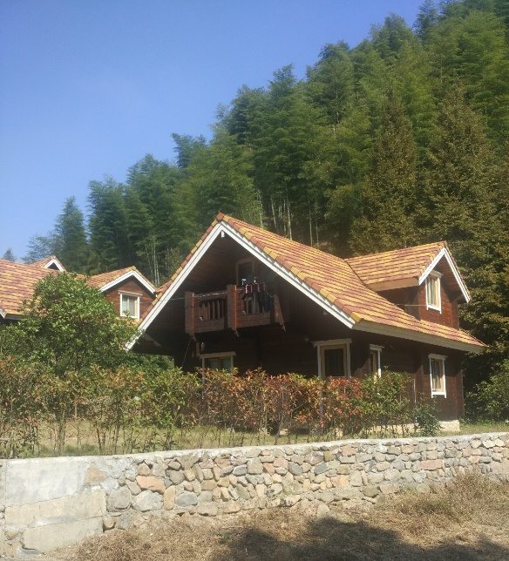
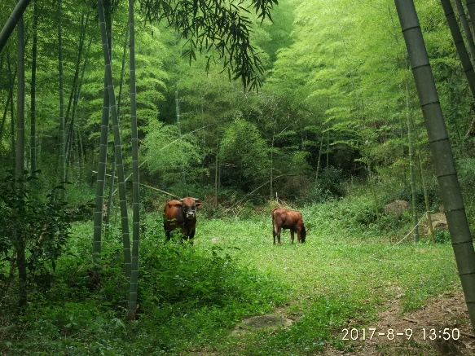
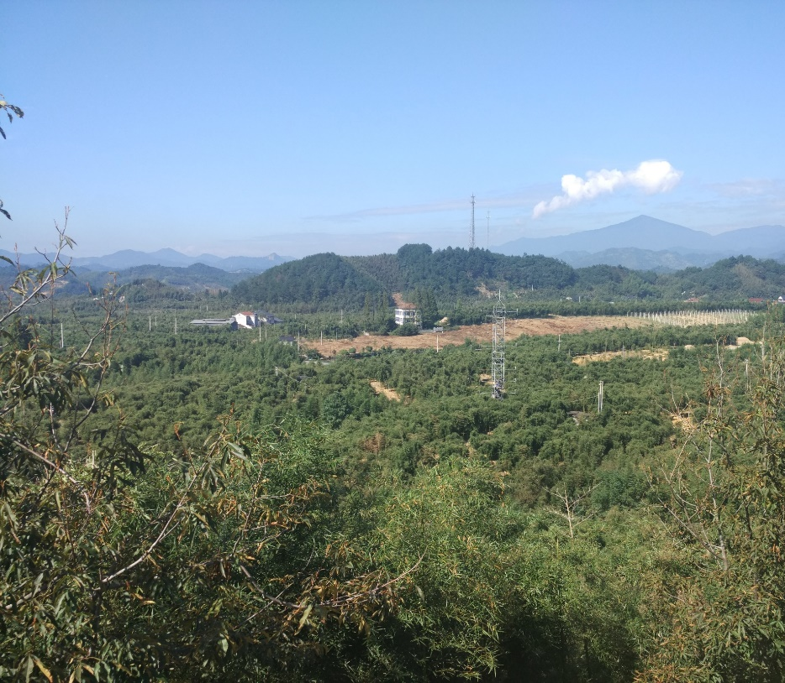
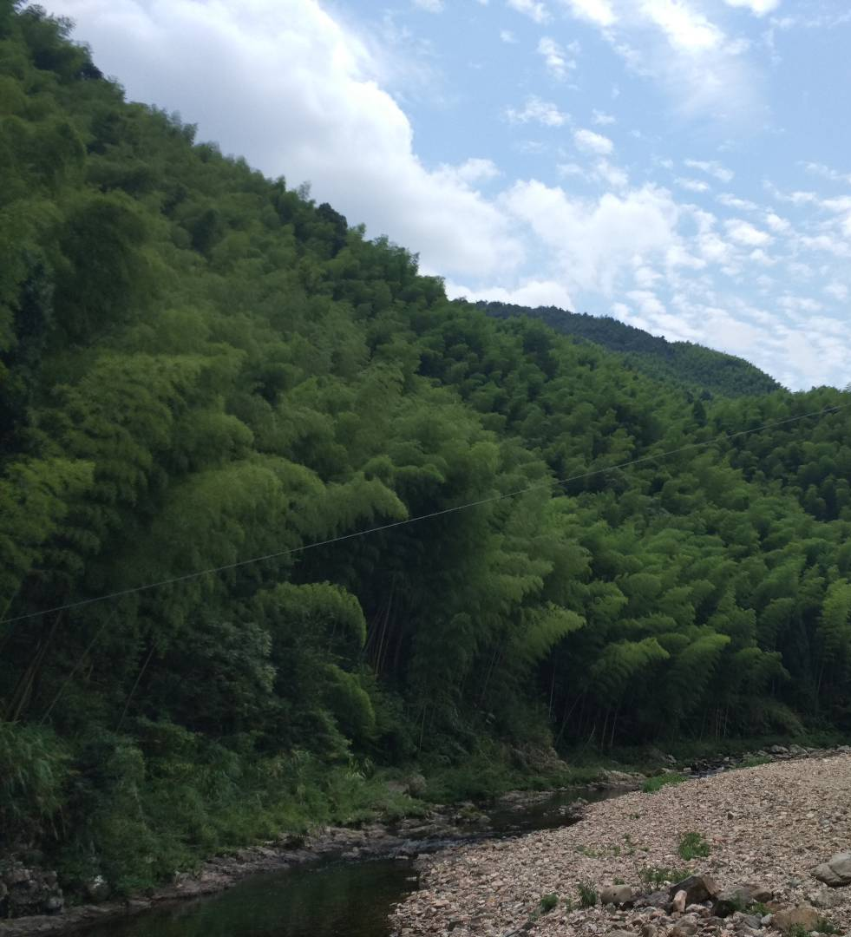
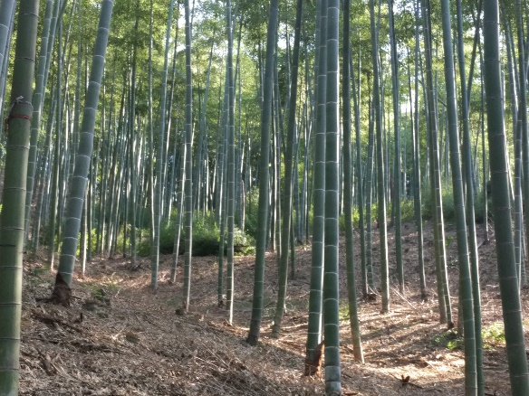
Introduction Materials & Methods Results Conclusions
Background
Background
Moso bamboo
(Phyllostachys heterocycla)
Lei bamboo
(Phyllostachys praecox)

Slide 5
Introduction Materials & Methods Results Conclusions
Background
Background
Moso bamboo
(Phyllostachys heterocycla)
Canopy height
July to September
Growth rate
Two months
On-year
Off-year
Lei bamboo
(Phyllostachys praecox)
September to October
February
Bamboo shoots
Growth rate

Slide 6
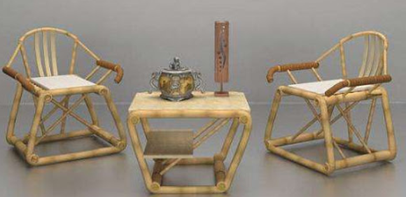
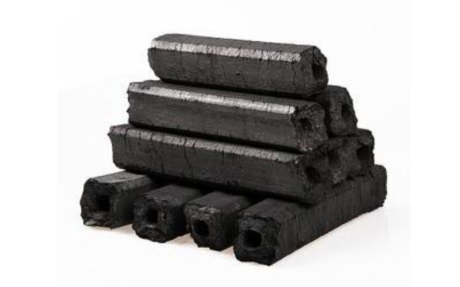
Introduction Materials & Methods Results Conclusions
Background
Background
Bamboo forest
Economic value (6 billion €)
Furniture
Bamboo board
Carbon
http://www.ytjinjiang.com/a/xinwenzhongxin/2018/0814/372.html
https://m.haiwainet.cn/middle/3543295/2019/1205/content_31677118_1.html

Slide 7
Introduction Materials & Methods Results Conclusions
Background
Background
Bamboo forest
Carbon sequestration potential
Forest type | Yearly Carbon Fixation (gC∙m⁻²∙year) | Ref.
Lei bamboo | 126.3 | Chen et al. 2013
Moso bamboo | 668.4 | Sun et al. 2013
ENF | 360.9 | Zhang et al. 2006
EBF | 536.2 | Zhang et al. 2006
ENF | 495-765 | Ziemblińska et al. 2016
MF | 70 | Speckman et al. 2014
ENF | 553-645 | Liu et al. 2004
ENF: evergreen needle-leaf forest; EBF: evergreen broadleaf forest; MF: mixed forest;

Slide 8
Introduction Materials & Methods Results Conclusions
Background
Background
Although, Many studies of forest carbon allocation and carbon sequestration have been conducted in bamboo forests.
However
dynamics of carbon ﬂuxes during the fast-growth period of bamboo shoots, and the corresponding correlation with environment factors are poorly understood.

Slide 9
Introduction Materials & Methods Results Conclusions
Aims
Aims
To investigate differences in diurnal and monthly variations in net ecosystem exchange (NEE), gross ecosystem exchange (GEE), and total ecosystem respiration (RE) between the two bamboo forests;
to use the EC technology to characterize how environmental factors in each of these two forests affect C ﬂuxes during the growing season (April to October).

Slide 10
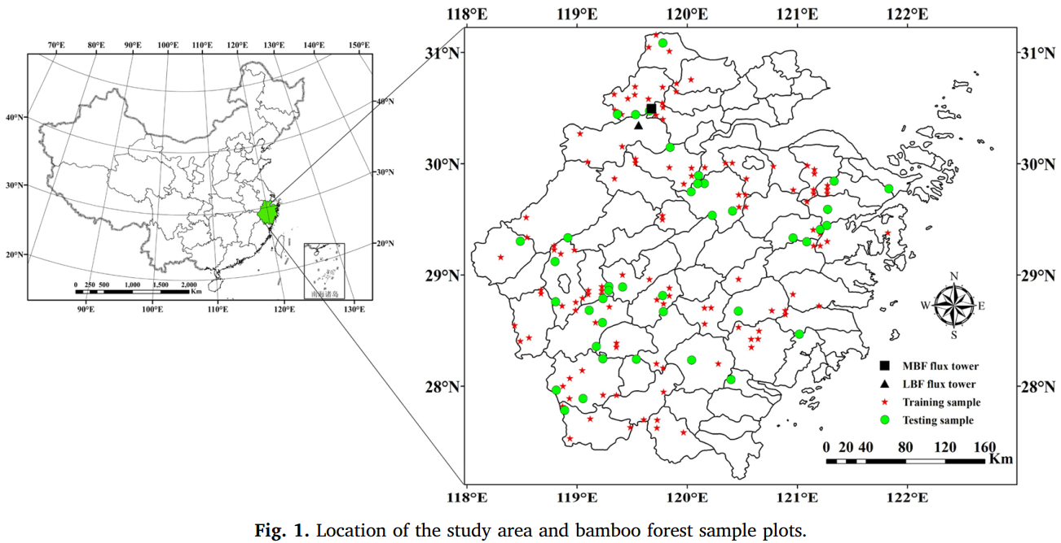
Introduction Materials & Methods Results Conclusions
Site description
Site description
MB flux tower
LB flux tower
(Li et al. 2018)

Slide 11
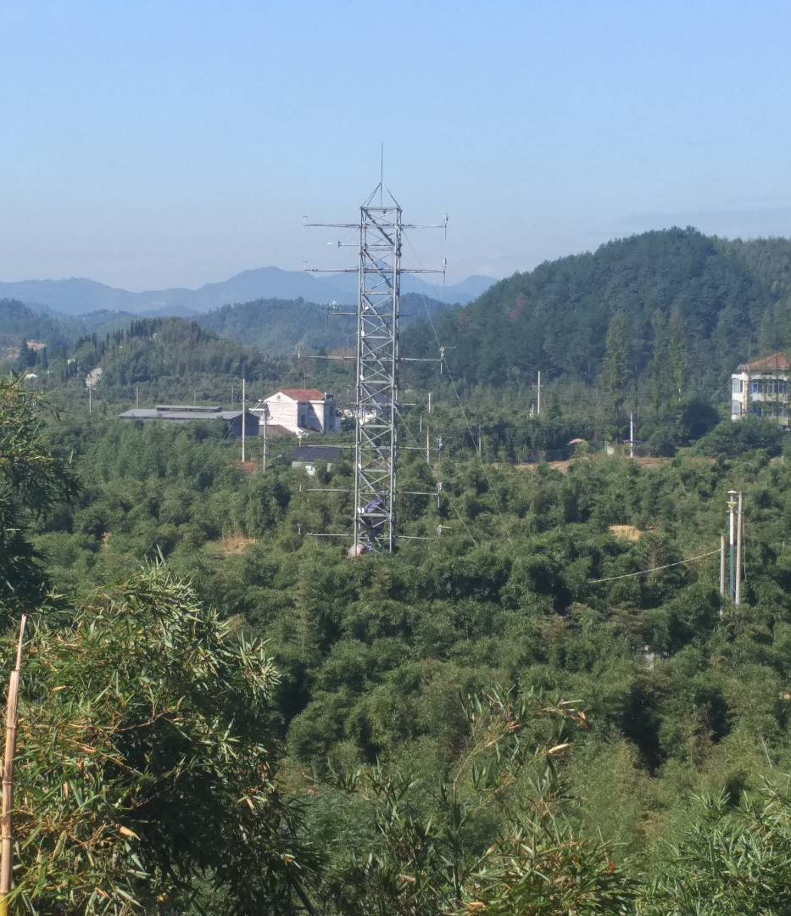
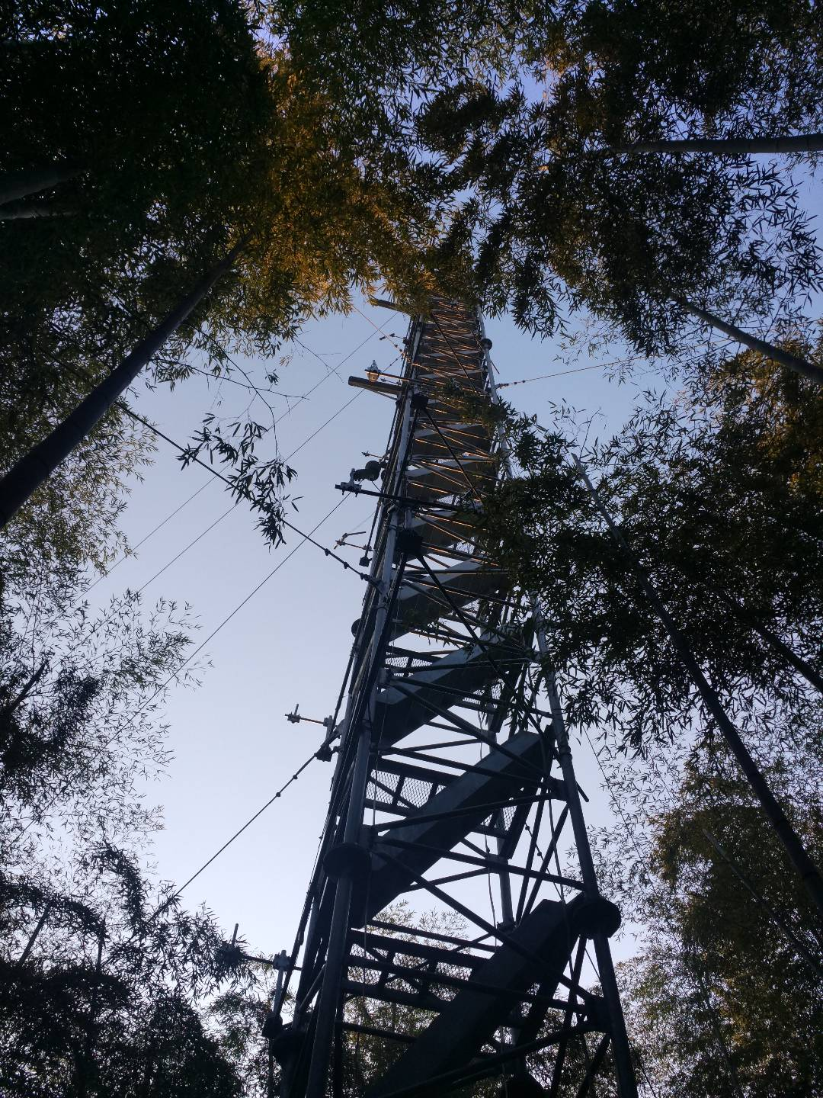
Introduction Materials & Methods Results Conclusions
Site description
Site description
LB flux tower
MB flux tower

Slide 12
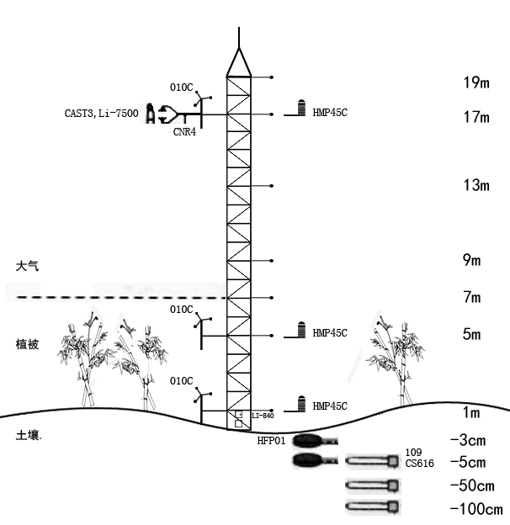
Introduction Materials & Methods Results Conclusions
Site description
Site description
 | MB site (40 m) | LB site (20 m)
three-dimensional sonic anemometer | 38 | 17
Co₂/H₂0 analyzer | 38 | 17
Net radiation | 38 | 17
Wind speed, Air temperature | 1、7、38 | 1、5、17
Canopy temperature | 2、23 | 1.5、5
Soil heat flux | Below ground 3、5 | Below ground 3、5
Soil water content | Below ground 0.05、0.5、1 | Below ground 0.05、0.5、1
Atmosphere
Vegetation
Soil profile

Slide 13
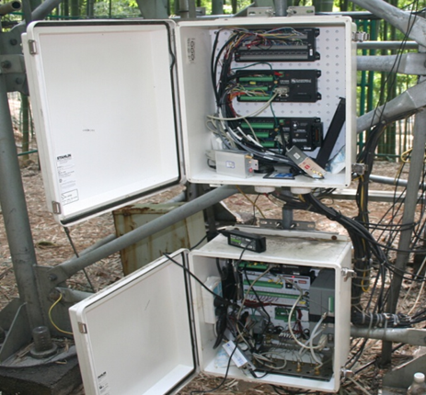
Introduction Materials & Methods Results Conclusions
Data processing and gap ﬁlling
Data processing and gap ﬁlling
Flux data
Flux observation system data
Meteorological
data
Gradient data

Slide 14
Introduction Materials & Methods Results Conclusions
Data processing and gap ﬁlling
Data processing and gap ﬁlling
EdiRe software package
(http://www.geos.ed.ac.uk/abs/research/micromet/EdiRe)
Raw data
Outlier ﬁltering
Lag
correction
+
WPL
+
Coordinate rotation
+
Linear detrending
Sonic virtual temperature
+
Pre-processed data

Slide 15
Further processing：
Pre-processed data
Friction velocity (U*)
MB site = 0.2 m ∙s⁻¹ ; LB site = 0.15 m ∙s⁻¹
Exclude data during precipitation
Exclude CO2 concentration out of 500 ppm
Exclude water vapor concentration out of range 40g · m⁻³.
Missing data

Slide 16
Finally：
Missing data
Day time NEE were gap filled using Michaelis-Menten equation（ Falge et al 2001） :
Night time NEE were gap filled using Exponential equation (Nakai et al 2008):
Complete time series data

Slide 17
Introduction Materials & Methods Results Conclusions
Daily and monthly variations in C ﬂuxes at LB site and MB site
Daily and monthly variations in C ﬂuxes at LB site and MB site
Both MB and LB were acting as C sink during day time
Diurnal NEE moved from positive to negative between 5:30 and 7:00 am

Slide 18
Introduction Materials & Methods Results Conclusions
Daily and monthly variations in C ﬂuxes at LB site and MB site
Daily and monthly variations in C ﬂuxes at LB site and MB site
The diurnal pattern of GEE was similar at the two sites
GEE turned negative at around 5:00–6:00 am Beijing Standard Time (BST), then increased continuously until reaching maximum values at noon.

Slide 19
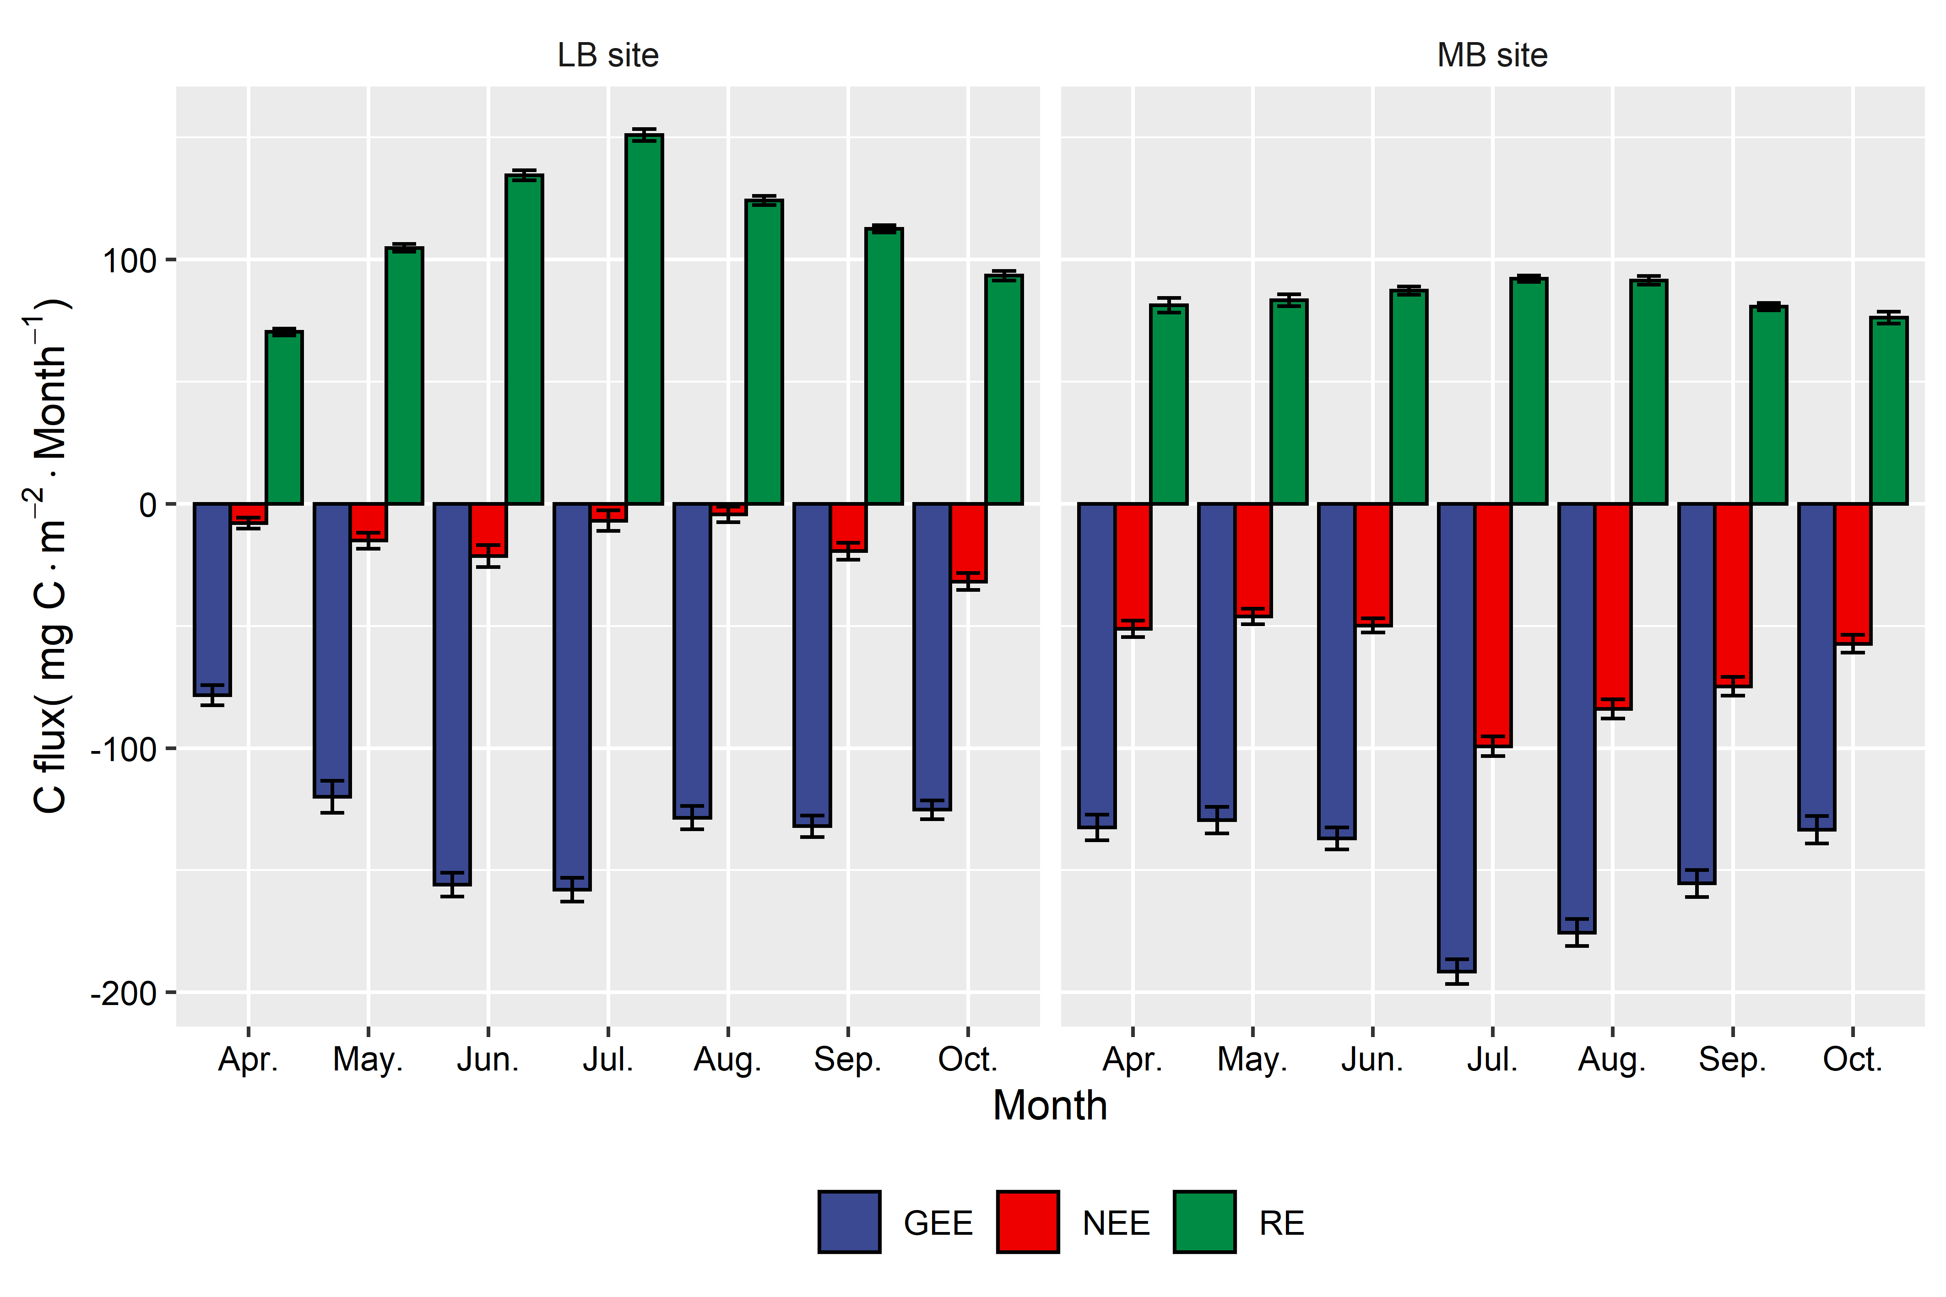
Introduction Materials & Methods Results Conclusions
Daily and monthly variations in C ﬂuxes at LB site and MB site
Daily and monthly variations in C ﬂuxes at LB site and MB site
RE at LB site was stronger than MB site which leads to similar GEE at two sites, despite, NEE at MB site was higher than LB site.

Slide 20
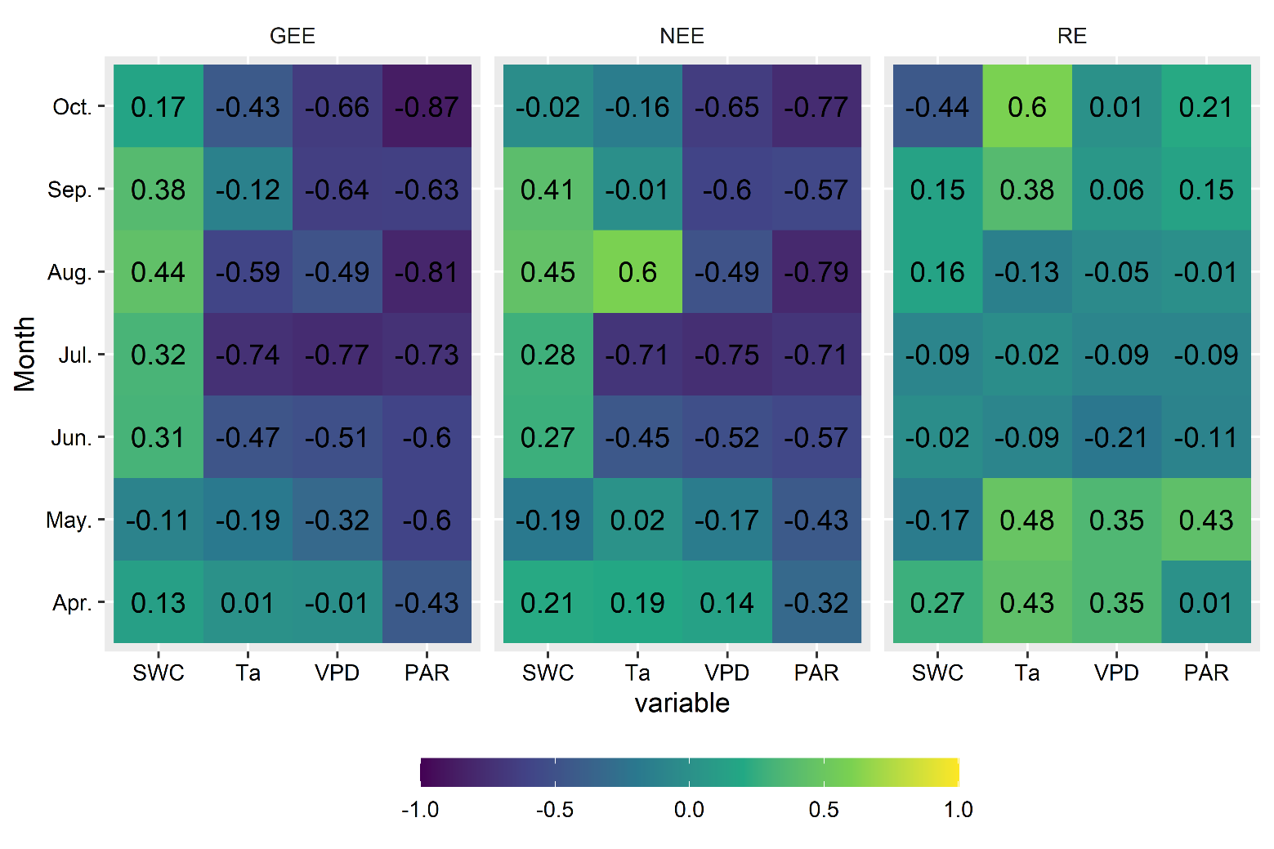
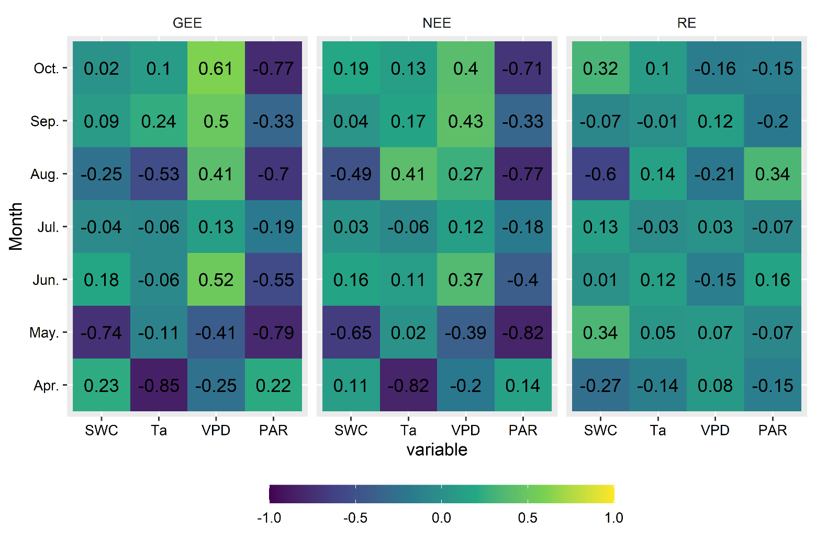
Introduction Materials & Methods Results Conclusions
Response of carbon ﬂuxes to environmental variables
Response of carbon ﬂuxes to environmental variables
GEE and NEE were mainly controlled by PAR and VPD at both sites.
At LB site, only SWC showed significant correlation with RE.
MB site
LB site
*
***
***
***
***
*
***
***
***
***
*
***
***
*
***
***
*
**
*
**
***
**
***
**
***
**
***
**
**
***
*
***
**
*
***
***
***
***
***
***
**
**
***
*
**
***
**
**
*
*
***
*
**
*
*
*
***
**
*
***
***
*
*
*
***
***

Slide 21
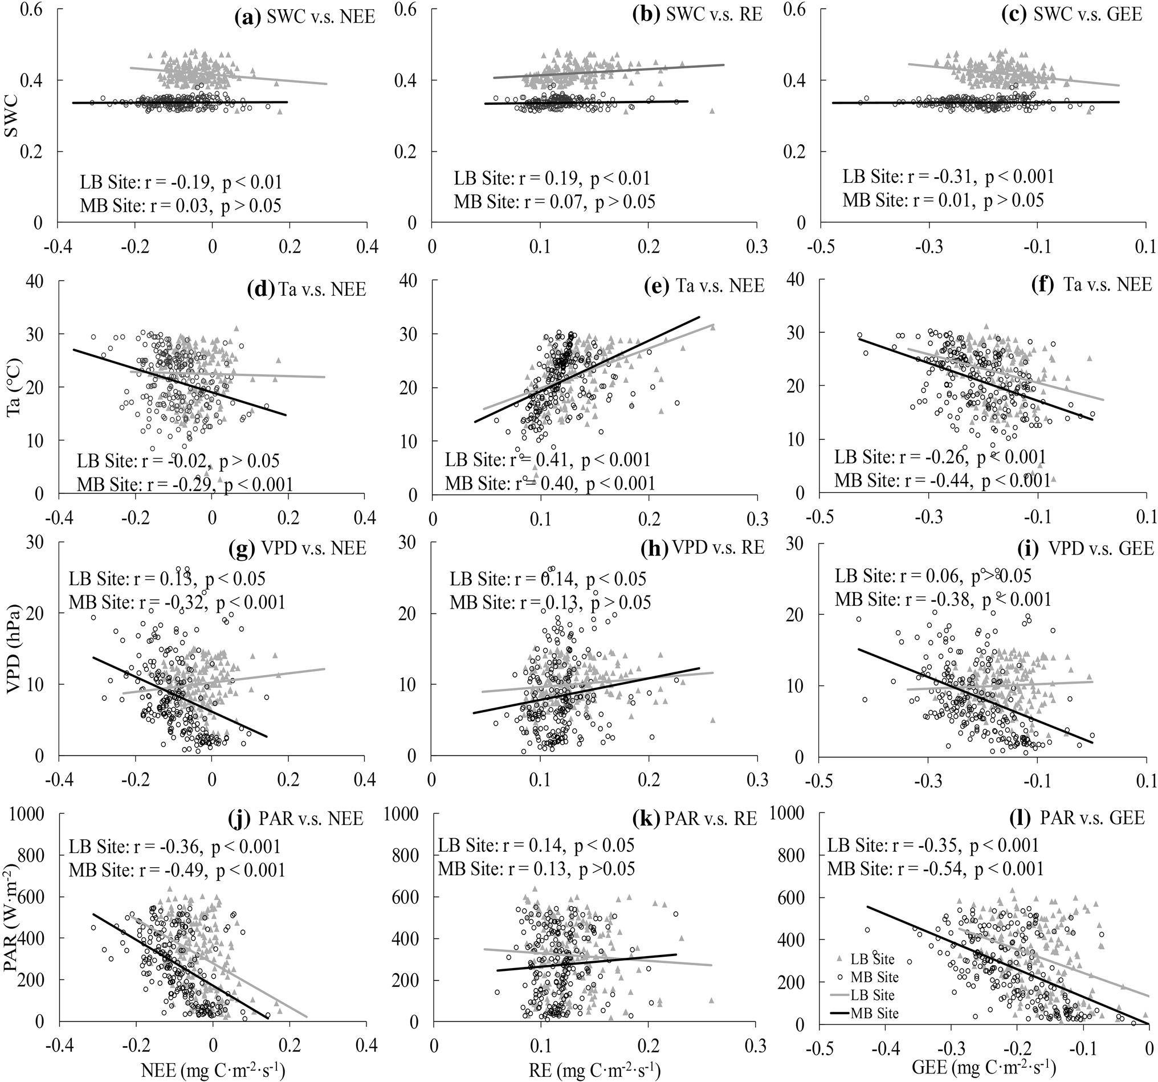
Introduction Materials & Methods Results Conclusions
Response of carbon ﬂuxes to environmental variables
Response of carbon ﬂuxes to environmental variables
The relationships between NEE ,GEE and environmental factors showed similar across the entire growing season.
SWC was more important in LB site than MB site.
RE
GEE

Slide 22
Introduction Materials & Methods Results Conclusions
Conclusions
Conclusions
MB site and LB site were both characterized as carbon sinks during the study period;
Environmental factors affect bamboo forest ecosystem C ﬂuxes by determining heat and water availability;
To better understand the role of bamboo forests regional C cycling, the variations of C ﬂuxes should also be evaluated over long time periods;
liang.chen@uef.fi

