Slide 1
Science Upgrades to the World Area Forecast System
Piers Buchanan, Teil Howard, Ed Steele, Graeme Anderson, Claire Bartholomew, Katie Bennett, Mark Canning, Jacob Cheung, Debi Turp, Andre Lanyon (Met Office, UK)
Brian Pettegrew and Matt Strahan (Aviation Weather Center, USA)
EGU General Assembly 2020

Slide 2
Overview
Introduction – what WAFS is.
High resolution upgrades to deterministic turbulence and airframe icing diagnostics
Probabilistic prototype for Cb diagnostic
Note that this presentation has presenter notes that can be read alongside the slide content

Slide 3
Introduction
The World Area Forecast System (WAFS) provides seamless global forecasting of upper air winds, temperatures and significant weather hazards to enhance safety and identify potential for delays.
Provided by WAFC London (Met Office) and WAFC Washington (NOAA)
Forecasts currently produced both by forecasters – Significant Weather Chart (SIGWX) and from gridded model output.
In the period from 2020 to 2024 and beyond there are several stages of major upgrades to the service to make sure it’s ready for the next generation of aviation.
Notes:
These major upgrades require significant science effort years ahead of the implementation deadlines.
Several upgrades are planned including higher resolution (0.25 degree) hazard data.

Slide 4
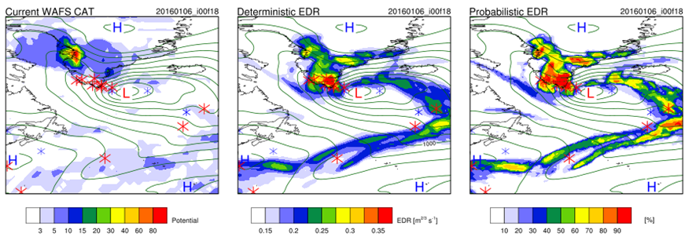
WAFS hazard forecasts for GTG turbulence at 0.25 degree resolution
Kim, J., R. Sharman, M. Strahan, J.W. Scheck, C. Bartholomew, J.C. Cheung, P. Buchanan, and N. Gait, 2018: Improvements in Nonconvective Aviation Turbulence Prediction for the World Area Forecast System. Bull. Amer. Meteor. Soc., 99, 2295–2311
Notes:
This slide demonstrates the new WAFS turbulence capability due to be implemented in November 2020
The panels show a mountain wave turbulence incident in the Greenland area with pilot reports of turbulence indicated by red crosses
The left panel shows the current WAFS blended CAT forecast. The higher the number the more likely turbulence is. The diagnostic has not captured the event over Greenland. This is likely due to the simplicity of the diagnostic as it uses only one wind shear and one mountain wave diagnostic.
The middle panel shows the high resolution (0.25 degrees) (Eddy dissipation rate) EDR forecast from the Met Office implementation of the Graphical Turbulence Guidance System from NCAR.
With GTG the turbulence event better captured than the existing WAFS capability (likely due to its sophisticated multi-diagnostic nature. Additionally the industry standard EDR output is aircraft independent and measures the likely severity of the turbulence.
The right panels shows a glimpse into the world of the probabilistic forecast

Slide 5
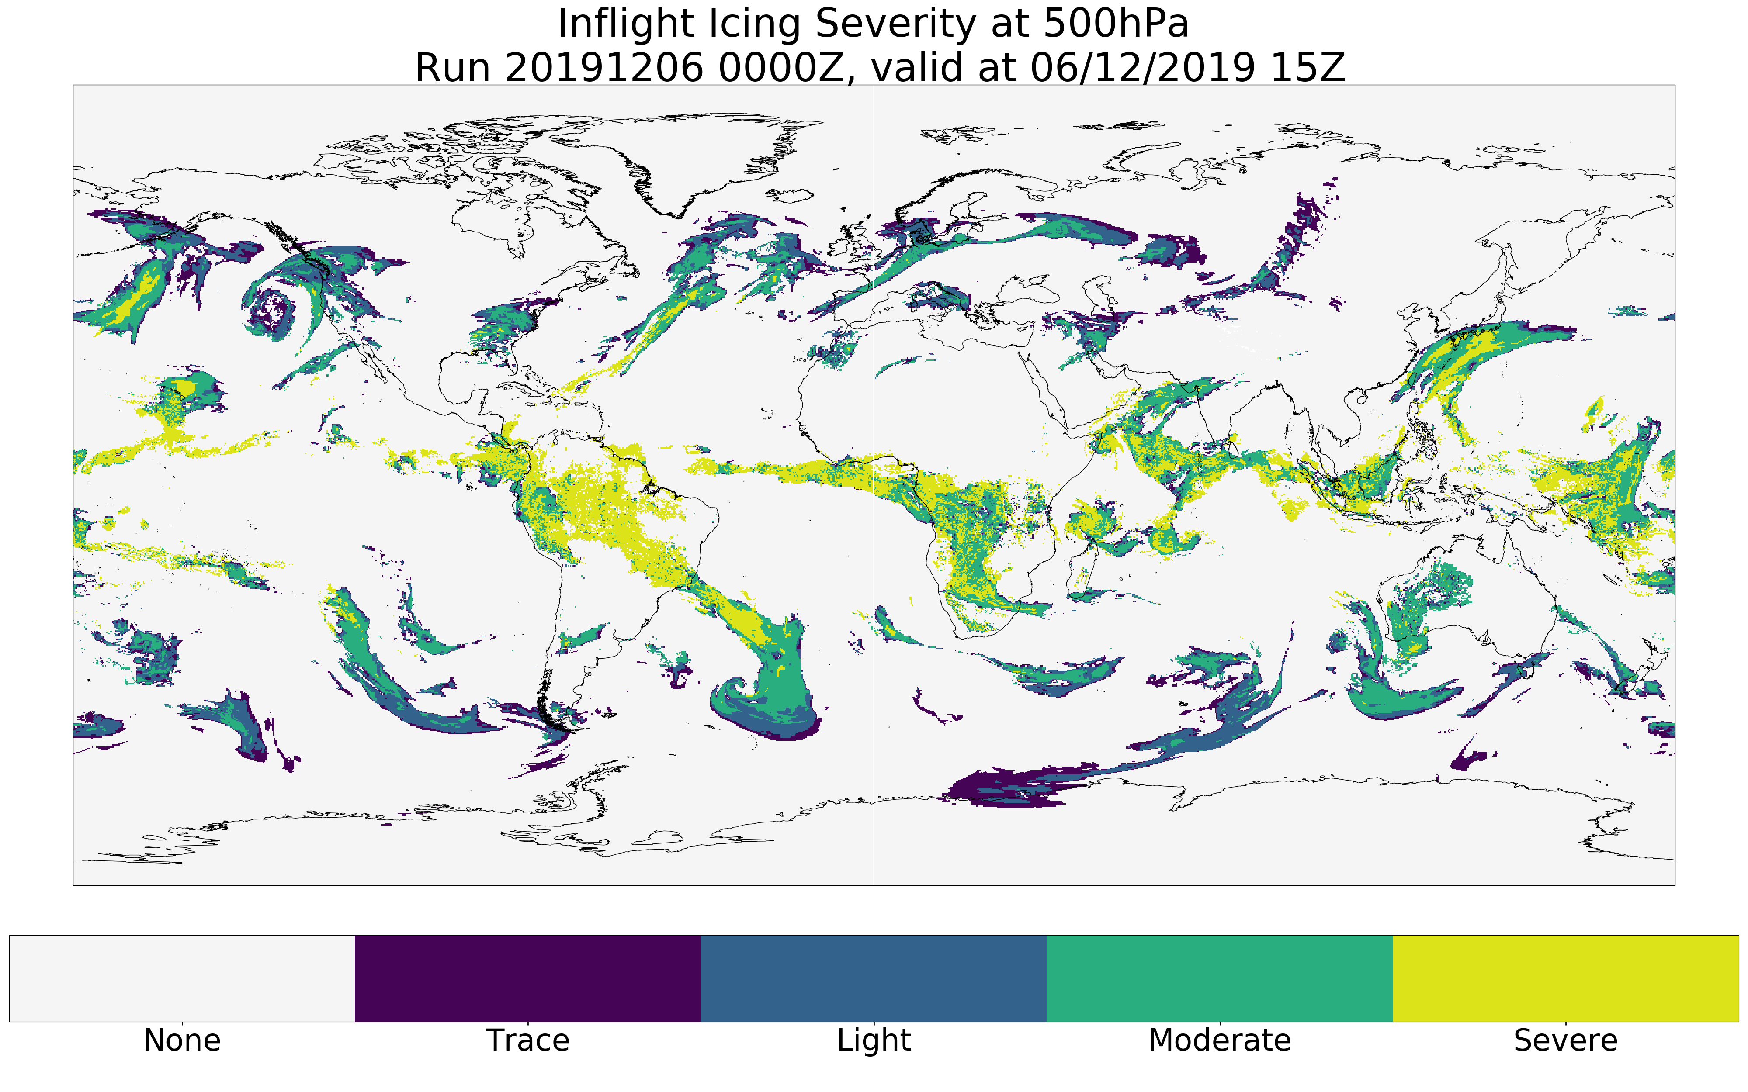
WAFS Airframe Icing Severity at 0.25 degrees.
New icing severity diagnostic significantly more sophisticated than the current WAFS diagnostic
Icing severity categorised as either trace, light, moderate or severe.
Notes:
The new airframe icing diagnostic is not only much higher resolution but also more sophisticated.
It assesses the likelihood of icing based on an algorithm assessing several different meteorological causal factors.

Slide 6
WAFS Hazard Update
Turbulence, airframe icing and Cb data example forecast files from WAFC London available to customers at 0.25 degrees
Have worked with WAFC Washington to harmonize and propose blend strategy for new icing and turbulence.
Now finalising the production of blended turbulence, icing and Cb forecasts.

Slide 7
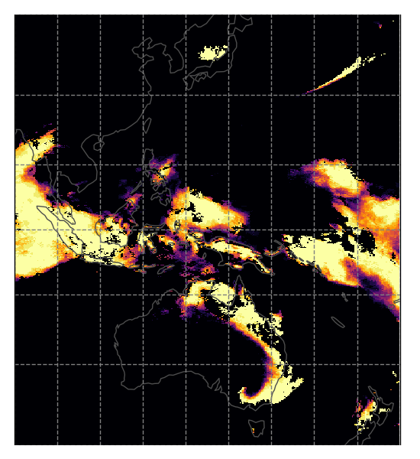
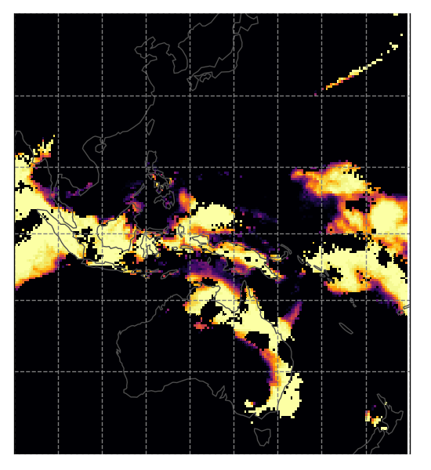
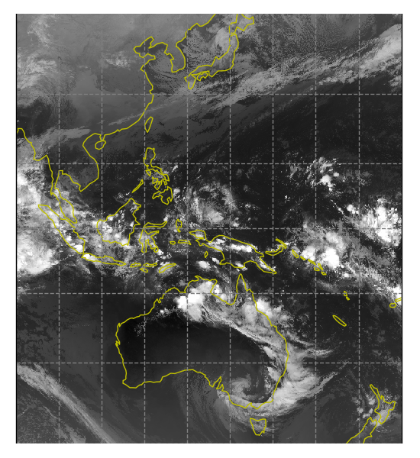
Probabilistic Cb Forecast Update
Example: Validity time = 12:00UTC, 13/12/2018
Model Timestep = T+12
Probability of convective cloud exceeding 35,000ft
1
Probability
0
MOGREPS-G
ECMWF
IR satellite
Thanks to Ken Stone at NCAR for advice / assistance setting up this algorithm
Notes:
The probabilistic Cb forecast diagnostic has been developed using an algorithm very similar to what was produced by WAFC Washington partners at NCAR.
This slide shows example output of EPOCH from mid-December 2018.
Output using MOGREPS-G data is on the left and ECMWF data in the middle, alongside a geostationary IR satellite image for the validity time of the forecast.
The EPOCH output shown is from the middle EPOCH height threshold of 35,000ft.
Broad regions of convection are qualitatively well represented.

Slide 8
Probabilistic Cb Forecast Update
Initial verification results reflect well on EPOCH* using either MOGREPS-G or ECMWF data.
Archive is now back to November 2018 so more comprehensive verification results due early 2020.
*EPOCH standards for Ensemble Prediction of Convective Oceanic Hazards
www.metoffice.gov.uk © Crown Copyright 2020, Met Office
Notes:
Verification results show that EPOCH seems to compare well with current deterministic WAFC Cb forecasts.
We have an archive of the EPOCH output using MOGREPS-G and ECMWF data going back to November 2018.

Slide 9
WAFS Science Plans Timeline
Now: Example 0.25 degrees high res hazard files available to customers.
November 2020: 0.25 degrees high res hazard files available in real time to customers.
2024: Fully probabilistic WAFS hazard output available

Slide 10
Any Questions?
Piers Buchanan
Aviation Applications Scientific Manager
https://www.metoffice.gov.uk/services/transport/aviation/regulated
piers.buchanan@metoffice.gov.uk

