Slide 1
Short-term effects of biochar on soil CO₂ efflux in boreal Scots pine forests
Xudan Zhu *, Tingting Zhu, Jukka Pumpanen, Marjo Palviainen, Xuan Zhou, Liisa Kulmala, Viktor J. Bruckman, Egle Köster, Kajar Köster, Heidi Aaltonen, Naoki Makita, Yixiang Wang, Frank Berninger
Department of Environmental and Biological Sciences, University of Eastern Finland, Finland

Slide 3
http://cprsx.com/blog/climate-change-action-plan/soil-fertilization/

Slide 4
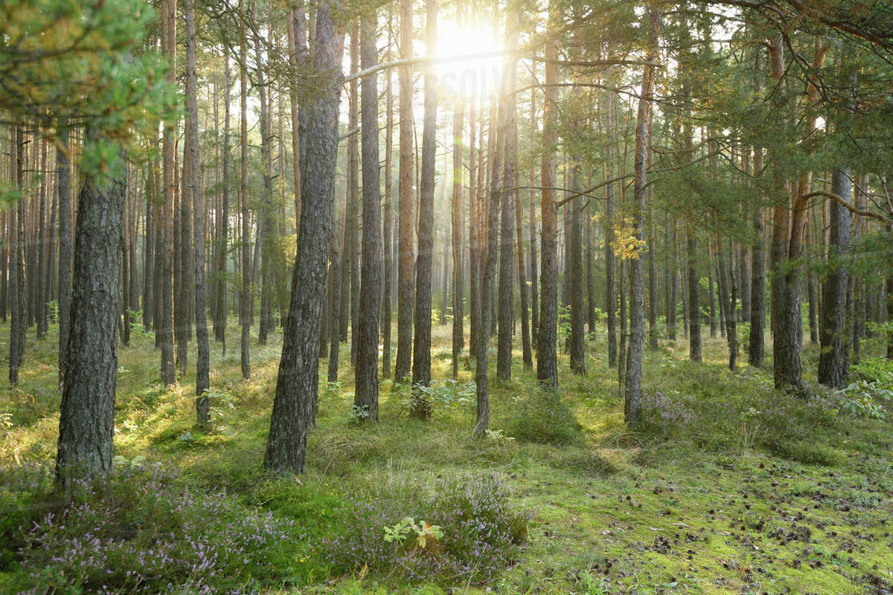
Introduction
Biochar restore soil fertility ecosystem productivity
Biochar sequester C atmospheric CO₂
Biochar soil CO₂ effluxes ?
Subtropical & temperate forests inconsistent
Boreal forests rare

Slide 5
How does biochar affect short-term soil CO₂ ?
Soil moisture
Soil temperature
Soil CO₂
Soil organic content
pH
Others
Soil organism

Slide 6
Hypothesis
Biochar will increase soil CO₂ efflux by changing the soil physiochemical and biological properties at the initial stage.
The pyrolysis temperature and amount of biochar will affect these factors.

Slide 7
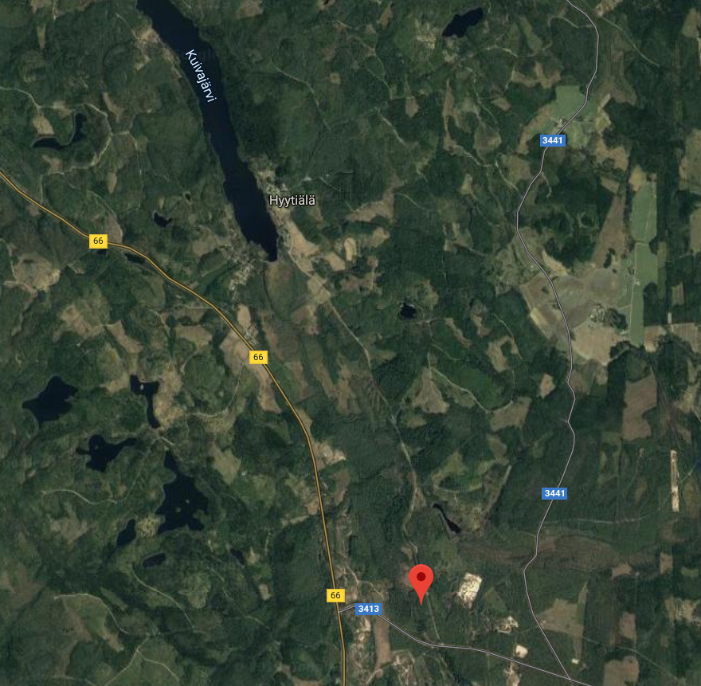
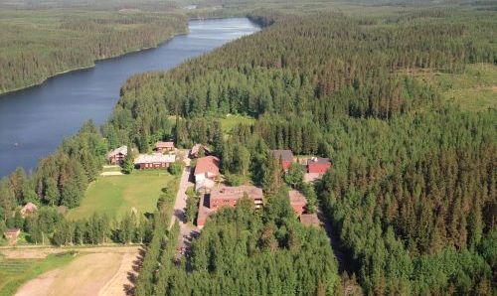
Site Description Hyytiälä stataion (61ﹾ 48׳ N, 24ﹾ 18׳ E )
Flat terrain
Low-fertility xeric site types
20-year-old Scots pine forest
Mean annual air temperature 3.5 ℃
Mean annual precipitation 700 mm
Snow cover duration 145-160 days

Slide 8
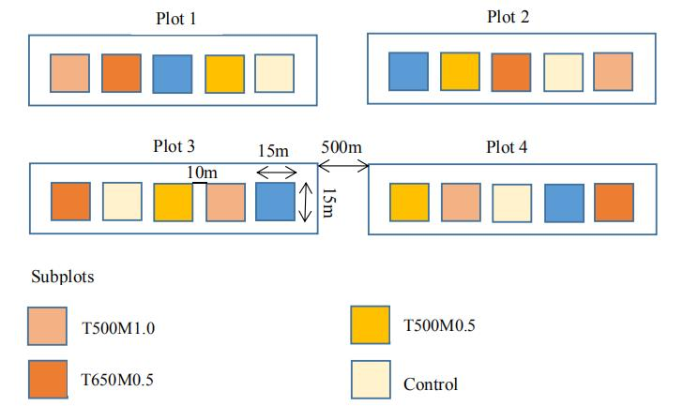
Schematic
T650M1.0
Biochar types: 500 ℃, 650 ℃
Amounts : 0.5 kg m⁻², 1.0 kg m⁻²
Experimental set-up: randomized-block design
Sampling during May-Sep 2015
Notes:
The biochar 134 was spread manually on top of the humus layer (0.5–2.0 cm) in May 2015 to avoid soil disturbance and damage to roots. 135 During our experimental period, biochar remained on the surface of soil, but the moss-dominated vegetation did not 136 suffer from biochar addition and remained stable. The mosses did not cover the biochar until the second summer after 137 treatment .

Slide 9
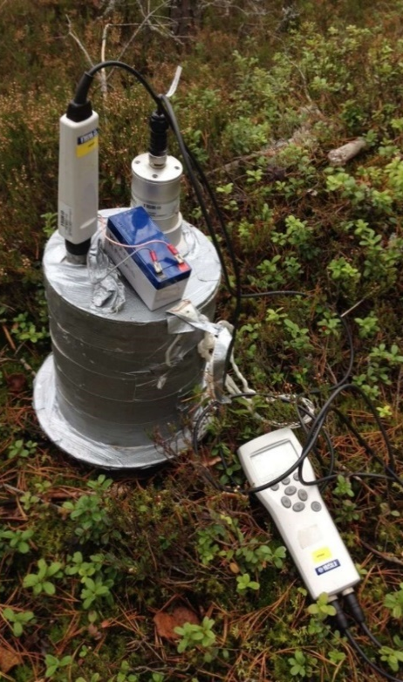
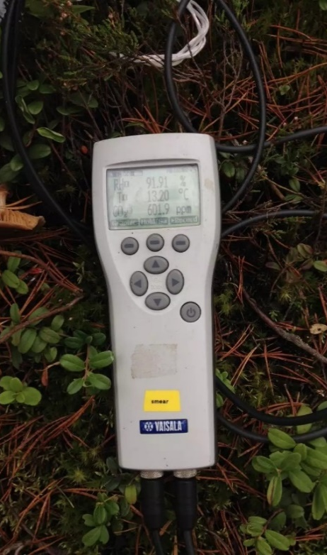
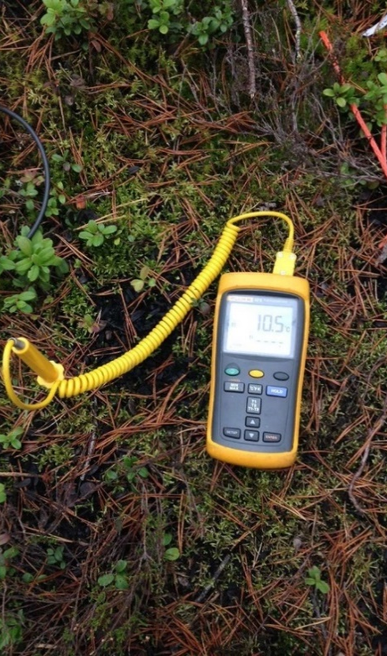
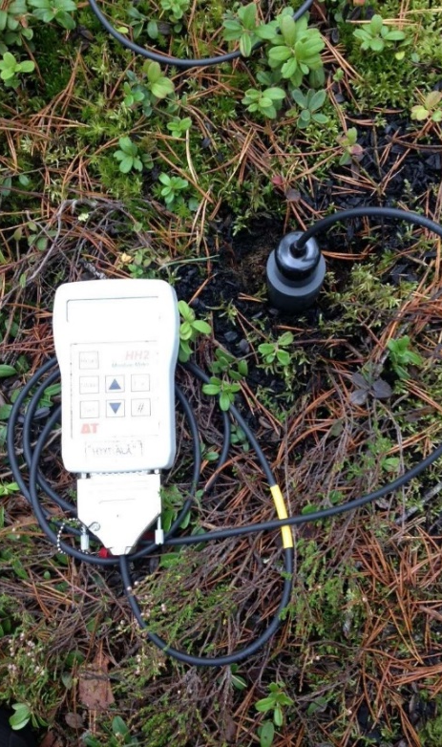
Measurements
Chamber system
Data recorder
Soil hygrometer
Soil thermometer

Slide 10
Statistical analysis
Linear mixed model
Fixed factors: treatment and month
Random factors: block and collar
Covariate: soil CO₂ efflux in May
Notes:
Fisher’s least significant difference test(LSD)

Slide 11
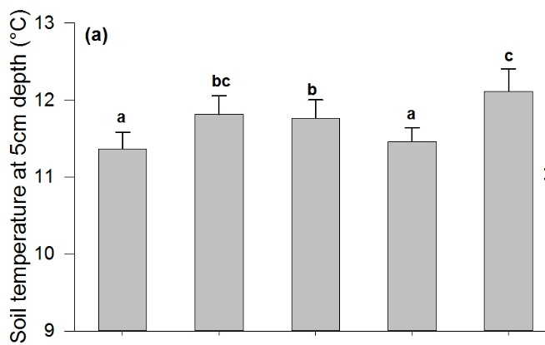
Dynamic of soil temperature
0.57 °C
Compared to control, soil temperature was 0.57 °C higher in the 1.0 kg m⁻² treatments (P<0.05).
Fig.1. Mean (±SE) soil temperature at 5-cm depth in different treatments from June to September. Different letters indicate statistically significant differences (P<0.05) between treatments.

Slide 12
Dynamic of soil moisture
Significant changes (P<0.05) of soil moisture only emerged in BC500 treatments, but are inconsistent.
Fig.2. Mean (±SE) soil moisture in different treatments from June to September.

Slide 13
Dynamic of soil CO₂
14.3%
The increase of soil CO₂ was 14.3% (P<0.05) for an application of 1.0 kg m⁻² biochar treatments and 4.6% (P>0.05) for 0.5 kg m⁻² biochar.
Fig.3. Mean (±SE) soil CO₂ efflux in different treatments from June to September.

Slide 14
Comparison using linear mixed models
T - treatment
M - month
B - block
C - collar in plot
Ln(R) - natural logarithm of soil CO₂
Moi – soil moisture
Tem – soil temperature
a - coefficients of fixed effects
α - coefficients of random factors
Ɛ - the error term

Slide 15
Significance of the fixed factors in each linear mixed model
Biochar Soil temperature & moisture soil CO₂ efflux

Slide 16
Soil CO₂ responds to soil temperature at different soil moisture condition
Soil CO₂ efflux was more sensitive to soil temperature at higher soil moisture condition.

Slide 17
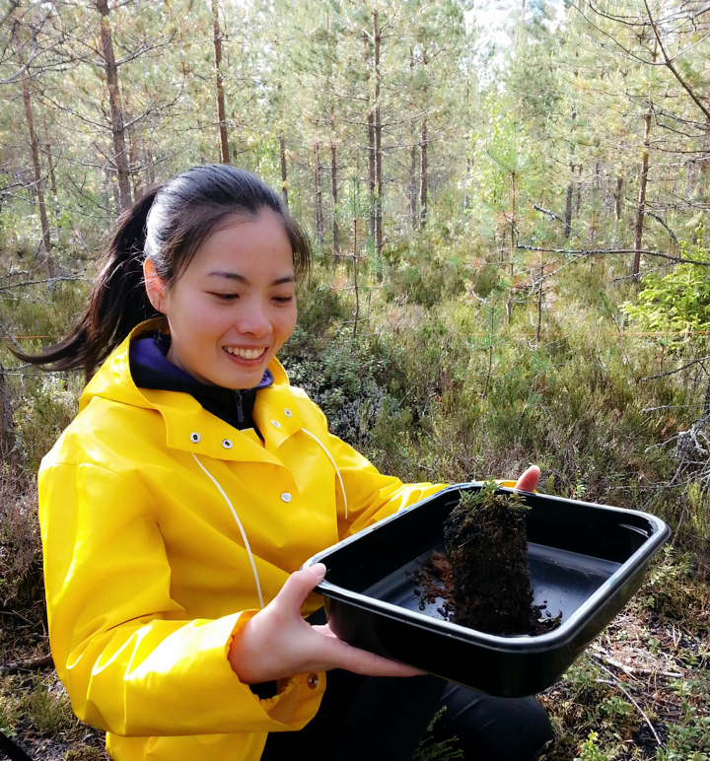
Take Away
In boreal forests, the initial soil CO₂ efflux responses were dominated by physical effects of biochar on soil temperature.
Higher amount of biochar leads to higher soil CO₂ efflux.
The increase in soil temperature and CO₂ efflux are probably transient.
xudanzhu@uef.fi

