Slide 1



Improving drought stress parametrization in a crop growth model with SIF
Simon De Cannière, Michael Herbst, François Jonard

Slide 2
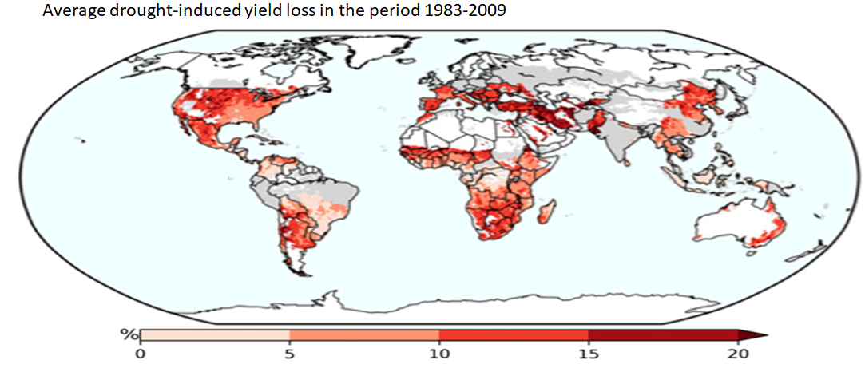
Drought stress, major problem in agriculture
Average drought-induced yield loss between 1983 and 2006
75% of global cropland affected
10% crop yield loss on average
Percentage of yield loss
Information needed to mitigate effects
Kim et al., 2019

Slide 3
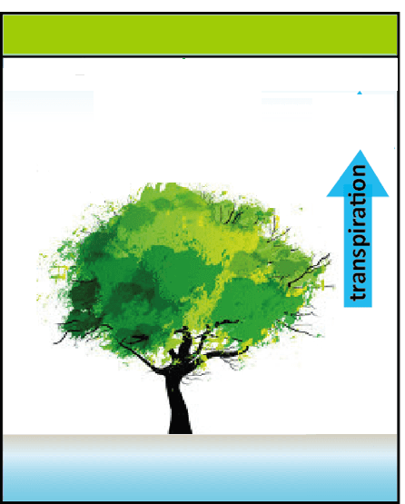
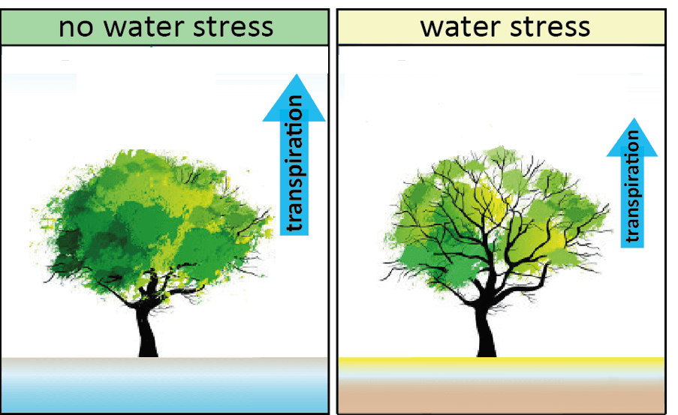
Need for early drought detection systems
No drought stress
Short-term drought stress
Drought stress
Mild drought stress
Photosynthesis
Photosynthesis
Photosynthesis
Transpiration
Transpiration
Transpiration
Healthy plant
Healthy plant
Damaged plant
Chlorophyll Fluorescence (F)
Classical remote sensing
methods

Slide 4
Linking water availability to SIF
Soil drier than h3
Photosynthesis
SIF changes
Drought stress
Optimal zone
Waterlogging
1
Stress factor
0
Wilting point
h3
h2
Water saturation
Water availability (Pressure heads)

Slide 5
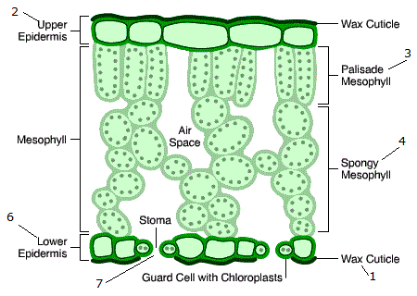

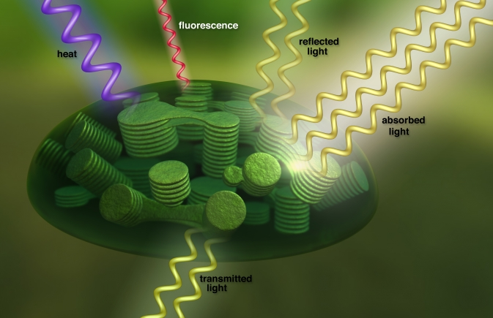
Link SIF and stress at different scales
Photosystem Leaf Canopy
Increase in NPQ
Loss in turgor pressure
Changes in canopy structure
Drought stress changes photosystem-level F
SIF is measured at canopy scale

Slide 6
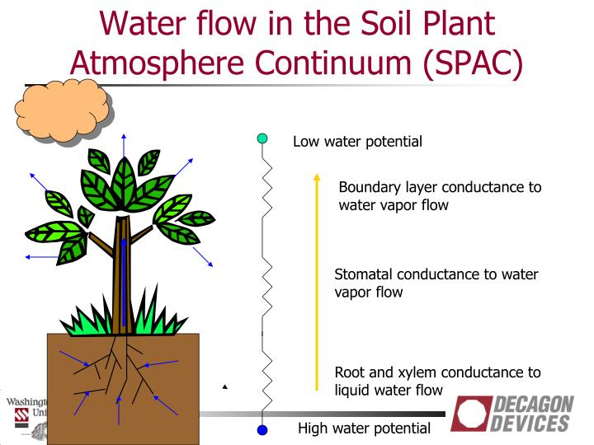
AgroC: State of the art crop growth model
Stress factor
Photosynthesis Transpiration
water & carbon fluxes
Meteorological variables
Soil water dynamics
Plant and soil parameters
Soil carbon turnover

Slide 7
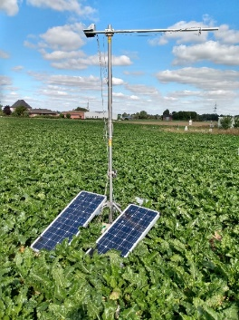
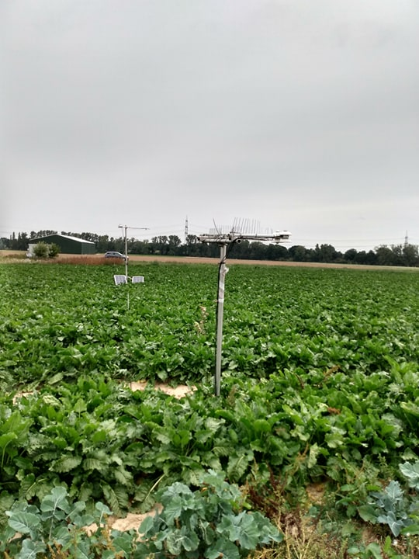
Crop models estimate field-scale photosynthesis
SIF
observations
Modeled
canopy-scale SIF
RTM
SCOPE
Error
Fluorescence
Stress factor
Photosynthesis Transpiration
VALIDATION
EC TOWER
water & carbon fluxes
Meteorological variables
Soil water dynamics
Plant and soil parameters
Soil carbon turnover

Slide 8
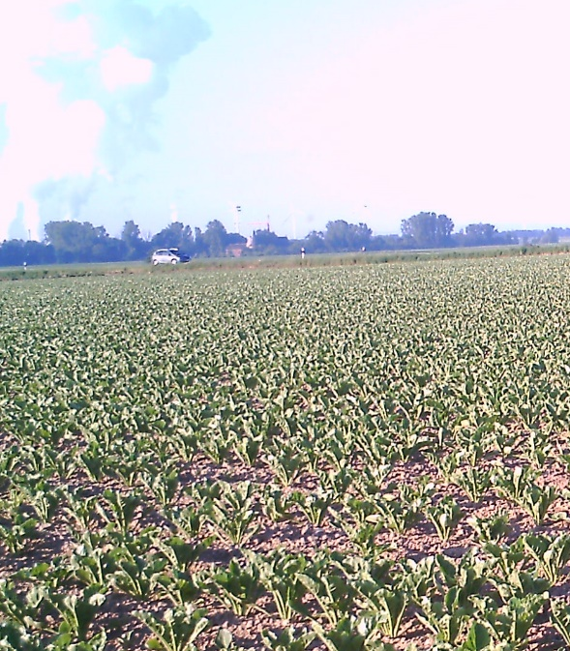
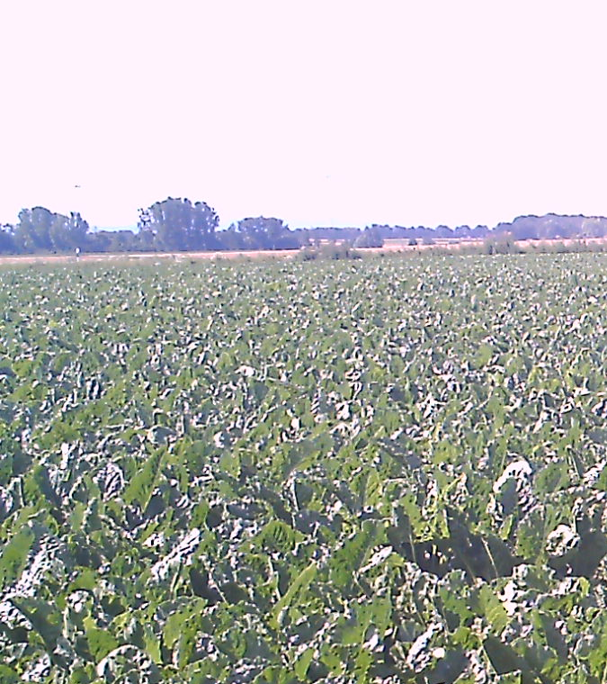
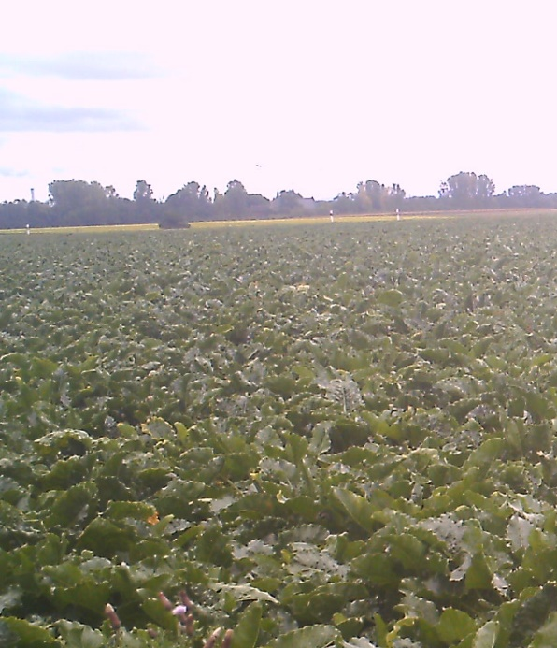
Field laboratory in Merzenhausen, Germany
ICOS Station
Fluorescence Box (FloX)
2019: DOY 214-279
Reflectance & fluorescence
Only SIFA is used
2019: DOY 32-330
Net Ecosystem Exchange
Evapotranspiration
Soil/Air Temp./Moisture
DOY 150: leaf development
DOY 204: heatwave
DOY 269: Late season

Slide 9
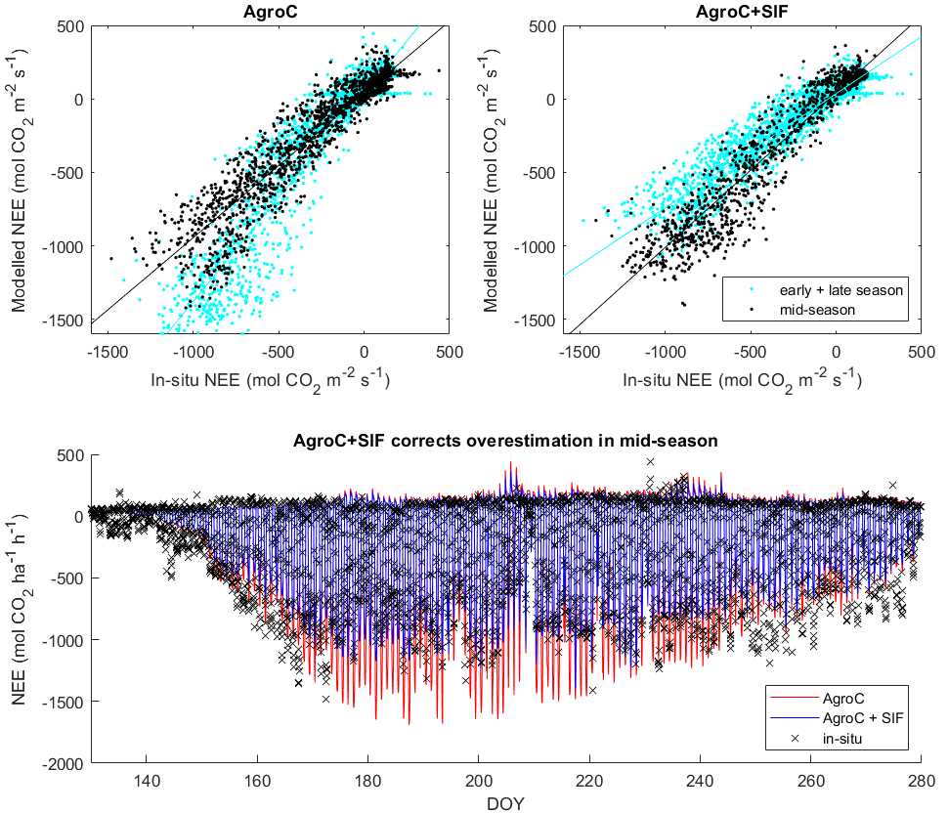
Early+Late-season
 | AgroC | AgroC+SIF
R² | 0.89 | 0.90
slope | 0.98 | 0.78
RMSE | 134 | 154
Mid-season (DOY 175-230)
 | AgroC | AgroC+SIF
R² | 0.91 | 0.91
slope | 1.40 | 1.05
RMSE | 267 | 140

Slide 10
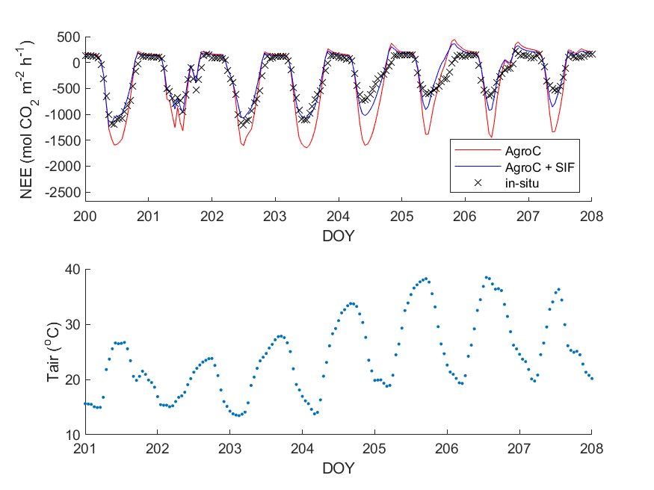
AgroC-SIF detects stress during heat wave

Slide 11
Take-home message
SIF indicates photosynthesis during growing season
Feddes function links water availability to photosynthesis
SIF has the potential to calibrate Feddes function
Better performance of crop models in stressed conditions

Slide 12
ADDITIONAL SLIDES

Slide 13
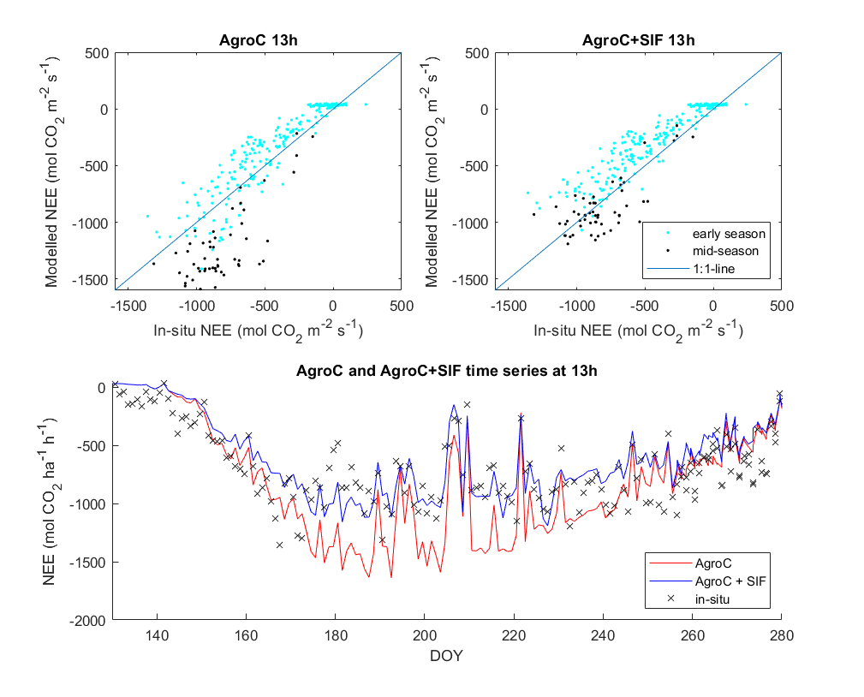

Slide 14
Statistical analysis of NEE comparison
Early+Late-season
Mid-season (DOY 175-230)
 | AgroC | AgroC+SIF
R² | 0.89 | 0.90
slope | 0.98 | 0.78
RMSE | 134 | 154
Intercept | 39 | 42
NSE | 0.87 | 0.83
 | AgroC | AgroC+SIF
R² | 0.91 | 0.91
slope | 1.40 | 1.05
RMSE | 267 | 140
Intercept | 38 | 36
NSE | 0.59 | 0.89

