Slide 1



Relationship Between Aerosol Concentration, Relative Humidity And Atmospheric Electric Potential Gradient In Cities
Matthew D Wright¹, James C Matthews¹,*, Hugo G Silva², Panida Navasumrit³, Mathuros Ruchirawat³ and Dudley E Shallcross¹
¹ School of Chemistry, University of Bristol, Bristol, U.K.
² Laboratory of Environmental Toxicology, Chulabhorn Research Institute, Bangkok, Thailand.
³ Physics Department, Institute of Earth Sciences, University of Évora, Évora, Portugal.

Slide 2
The vertical atmospheric potential gradient is particularly affected by high aerosol loading in cities as the air’s conductivity is reduced through aerosol attachment of free ions.
The reduction of ion concentrations decreases the conductivity (λ) and, as the air-earth current (J) remains constant, the potential gradient (PG) increases
PG = J / λ
This relationship has been shown to relate pollutants to atmospheric PG (Silva et al 2016).
Silva H G, Conceiçao R, Khan M A H, Matthews J C, Wright M D, Collares-Pereira M and Shallcross D E. 2016. J. Electrostat. 84 32-41.

Slide 3
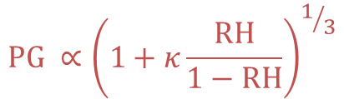
Aerosol size distributions can be affected by the relative humidity (RH) dependent on the aerosol hygroscopicity (к) , if an aerosol is sufficiently hygroscopic, it will grow as humidity increases
As larger aerosol are more prone to effectively scavenge ions, an increase in RH may increase the size of hygroscopic aerosol, decrease ion concentrations and hence increased measured PG.
Measurements of atmospheric potential gradient in Lisbon, Portugal, demonstrated an increase in potential gradient associated with increasing RH (Silva et al 2015).
$$PG ∝{\left(1+κ\frac{RH}{1−RH}\right)}^{1/3}$$
Silva H G, Conceiçao R, Wright M D, Matthews J C, Pereira S N and Shallcross D E. 2015. J. Aerosol Sci. 85 42-51.

Slide 4
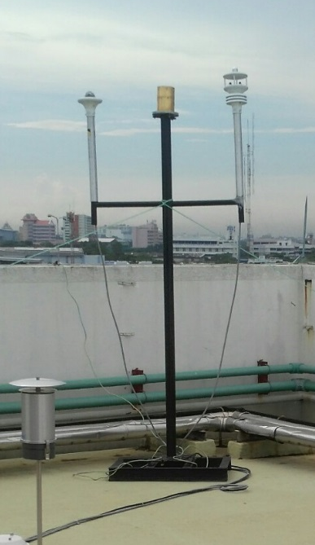
Bristol (urban background, PG, met + CPC)
  19th May 2016 – 11th August 2016
  School of Chemistry rooftop
  PG measured by JCI 131 electric field mill at 1 s intervals
  Temperature, Humidity, Pressure, wind speed and wind direction measured by Gill GMX500 at 1 s intervals
  Rainfall measured by Gill GMX100 at We the Curious site
Bangkok (urban roadside, PG, met + CPC)
  8th March 2018 – 17th November 2018
  Chulabhorn Research Institute rooftop
  PG measured by JCI 131 electric field mill at 1 s intervals
  Temperature, Humidity, Pressure, wind speed and wind direction measured by GMX500 at 1 s intervals
  Rainfall measured by Gill GMX100 at 1 s intervals
  PG and Met data averaged to 1 minute. PG normalised to mean value across all measurements to enable comparison between sites.

Slide 5
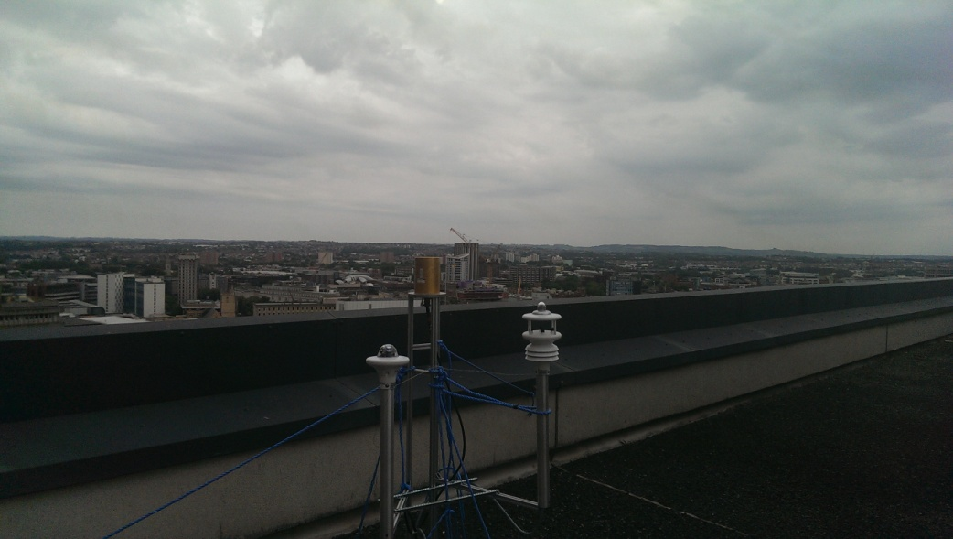
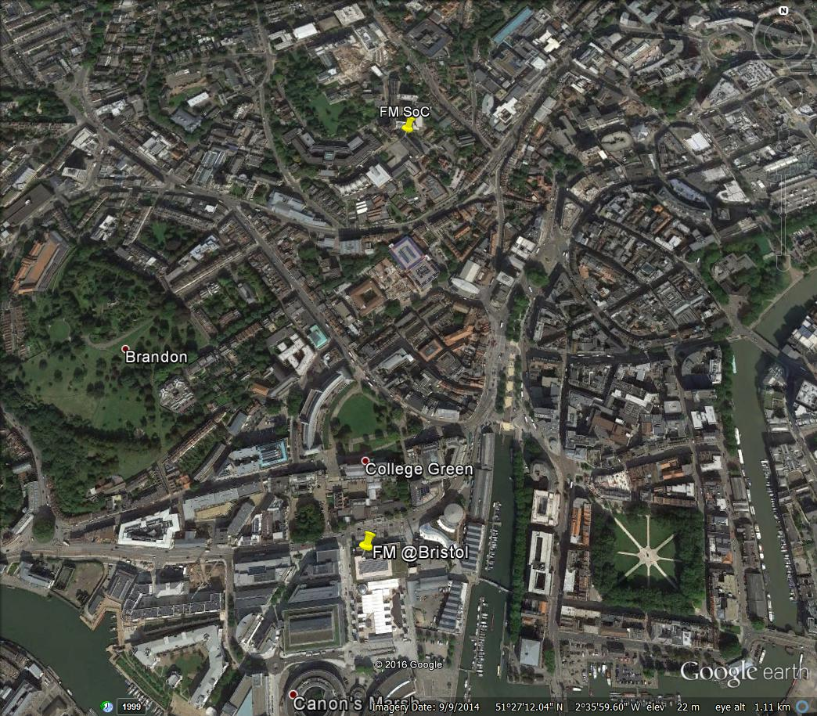
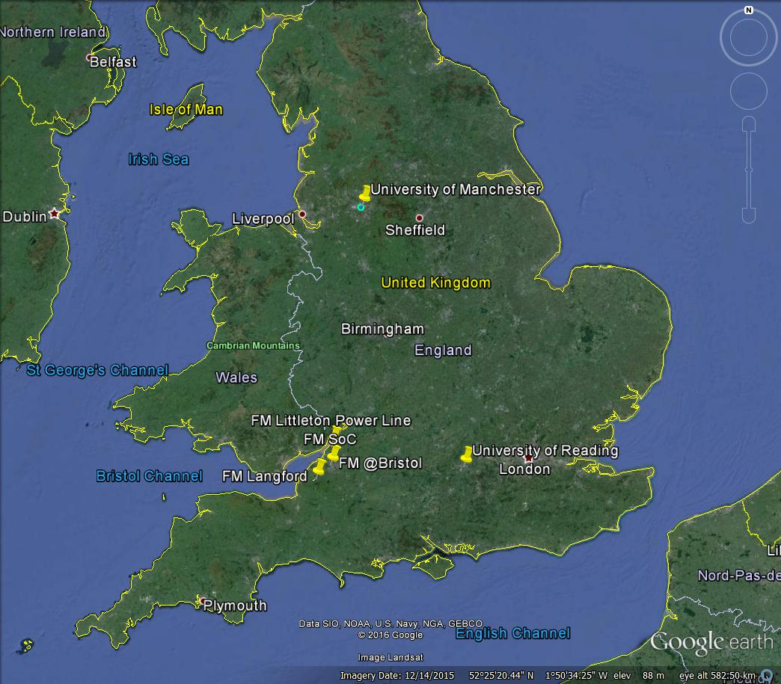
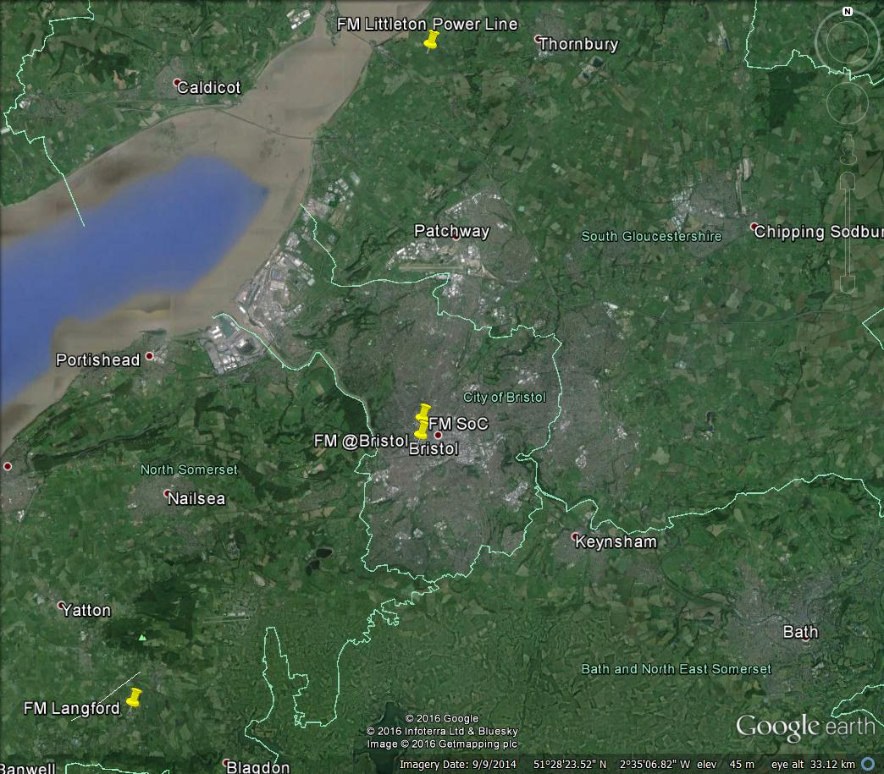
PG
Met
Rain
Figure 1: The location of the Bristol, UK measurement site. Images from Google Earth.

Slide 6

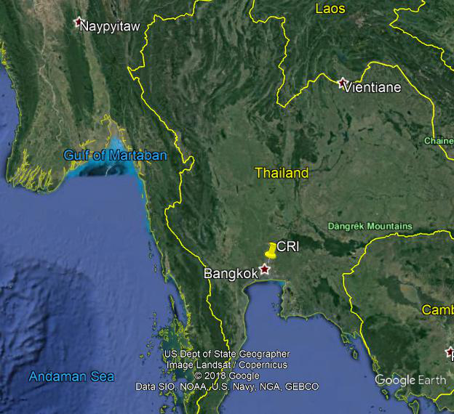
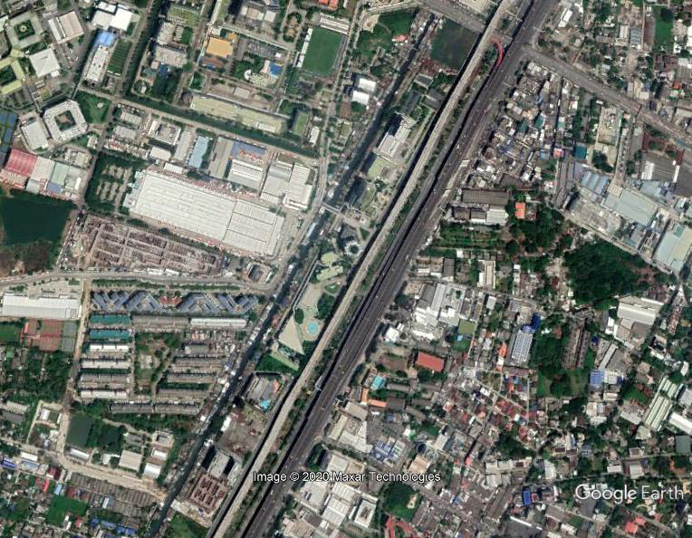
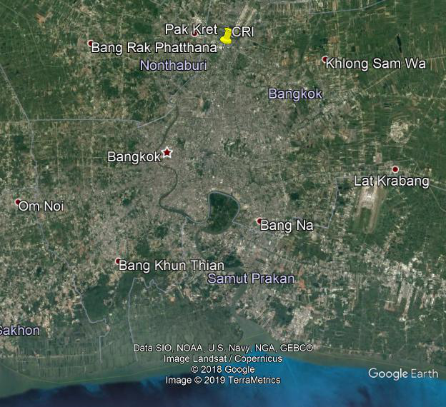
PG
Met
Figure 2: The location of the Bangkok, Thailand measurement site. Images from Google Earth.

Slide 7
(a) Bristol
(b) Bangkok
Figure 3: Box plots of PG with increasing RH in (a) Bristol and (b) Bangkok showing days when rainfall was detected, and days when rainfall was not detected.
Distributions of PG are similar in Bristol and Bangkok, though values are difference. Rainy days broaden the Bristol distribution, but do not broaden the Bangkok distribution.

Slide 8
(a) Bristol all days
(b) Bristol dry days
Figure 4: Box plots of PG with increasing RH in Bristol showing (a) all data and (b) days when rainfall was not detected.
In Bristol, removing days with rainfall shows an increase of PG with increasing RH, which may be due to hygroscopic growth.
Wright M D, Matthews J C, Silva H G, Bacak A, Percival C and Shallcross D E. 2020. Sci. Total Environ. 76 134959

Slide 9
(a) Bangkok all days
(b) Bangkok dry days
Figure 5: Box plots of PG with increasing RH in Bangkok showing (a) all data and (b) days when rainfall was not detected.
In Bangkok, where particle concentrations are higher, removing days with rain does not affect the relationship between RH and PG.
Matthews J C, Wright M D, Navasumrit P, Ruchirawat M and Shallcross D E. 2019. J. Phys: Conf. Ser.1322 (1), 012029.

Slide 10
Conclusions
An increase in PG with high RH is shown in Bristol data when days including rain have been removed.
No increase in PG with RH was observed in Bangkok data with or with days including rain.
The Bangkok site has higher aerosol concentrations than Bristol (Wright et al 2020, Matthews et al 2019), and more stormy weather, which may be more important for atmospheric PG that RH.
Wright M D, Matthews J C, Silva H G, Bacak A, Percival C and Shallcross D E. 2020. Sci. Total Environ. 76 134959
Matthews J C, Wright M D, Navasumrit P, Ruchirawat M and Shallcross D E. 2019. J. Phys: Conf. Ser.1322 (1), 012029.

Slide 11




James Matthews
Matthew Wright
Dudley Shallcross
Hugo Silva
Panida Navasumrit
Mathuros Ruchirawat
This work was funded by Leverhulme Trust grant RPG-2014-102, NERC Grant number NE/K01501X Newton Fund NERC grant number NE/P014674/1 and Thailand Research Fund grant RDG6030008.

