Slide 1
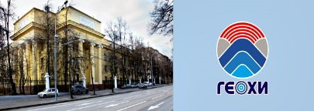
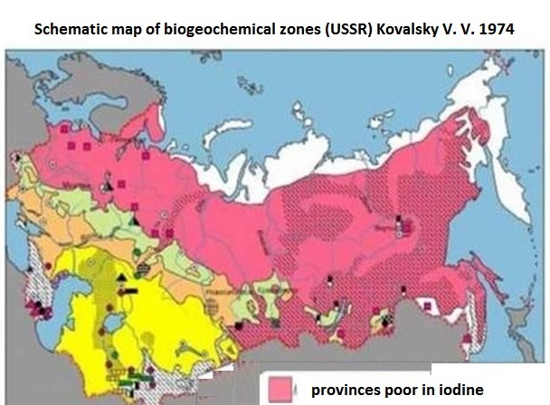
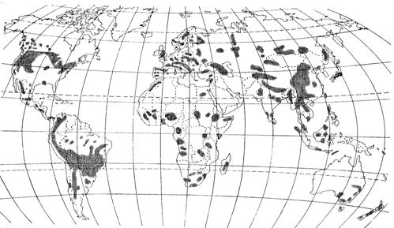
A study of iodine concentration in drinking waters of Bryansk and Oryol regions
Berezkin V.Yu., Kolmykova L.I., Korobova E.M., Kulieva G.A.
Vernadsky Institute of Geochemistry and Analytical Chemistry, Rus. Ac. of Sci., Peoples’ Friendship University of Russia
The aim of the research was iodine in natural waters of different age aquifers of the Bryansk and Oryol regions (Russia), primarily in the waters used by local residents of these regions for drinking purposes.
Areas of endemic goiter (WHO, 1973)
Bryansk and Oryol regions
Iodine-deficient diseases are one of the most common non-communicable human diseases

Slide 2
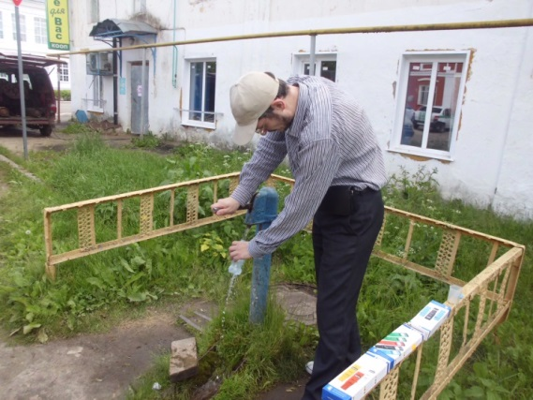
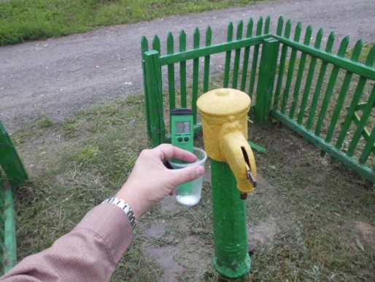
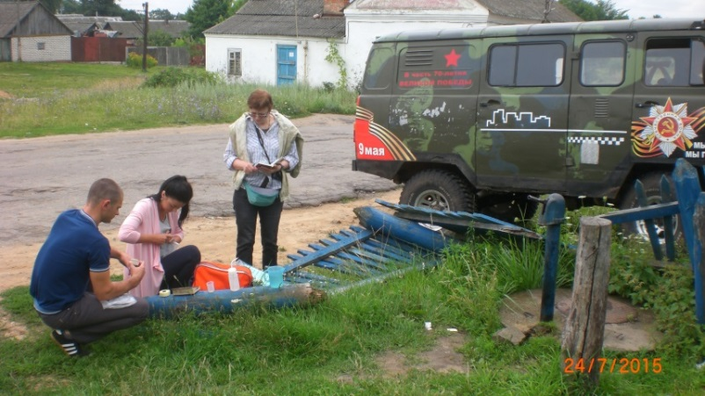
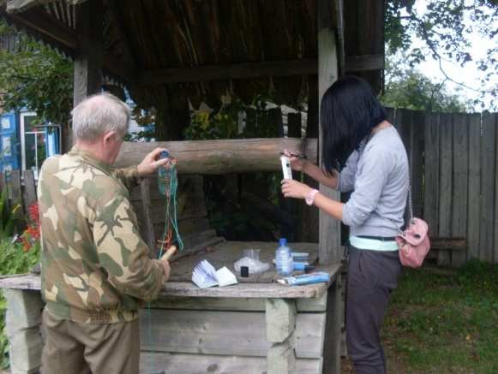
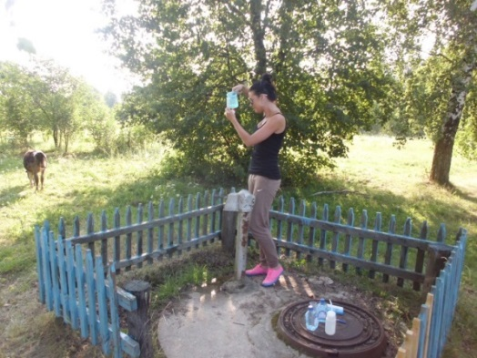
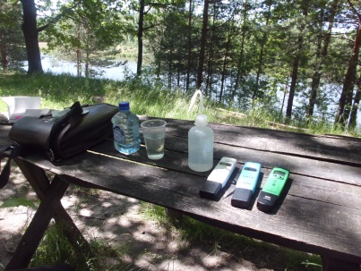
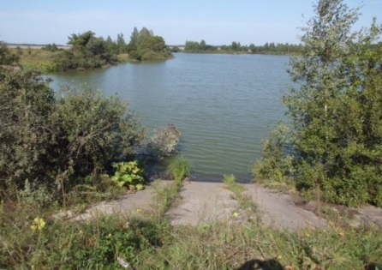
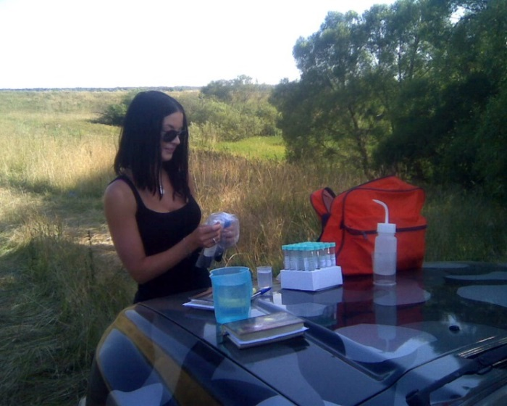
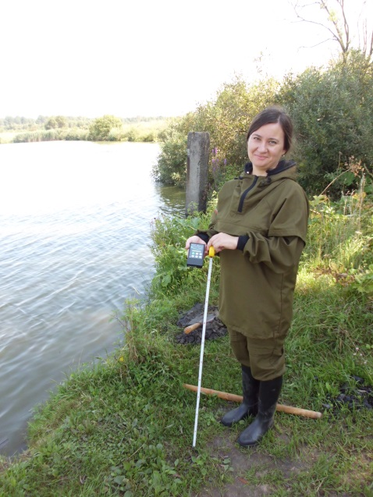
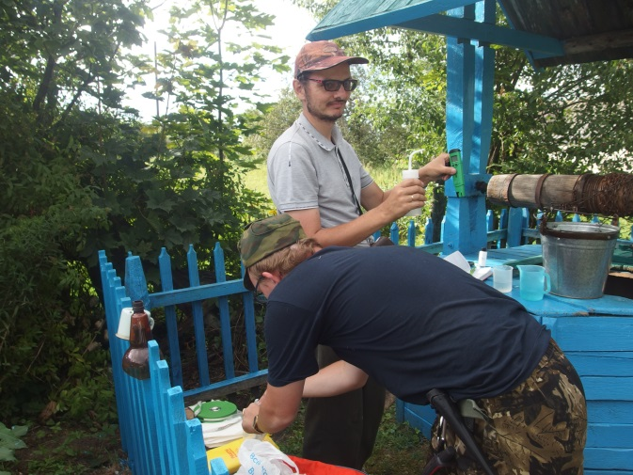
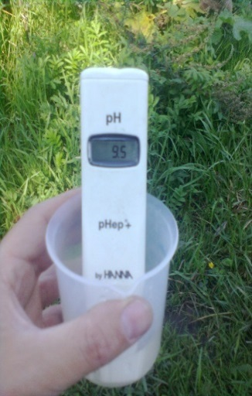
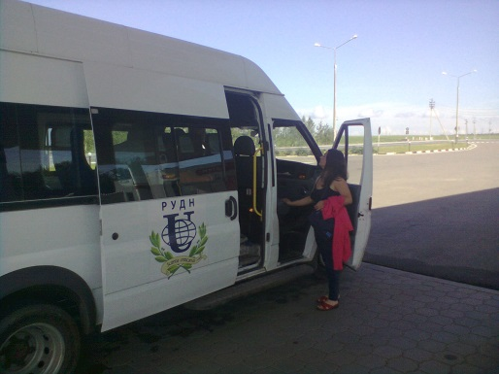
A study of iodine concentration in drinking waters of Bryansk and Oryol regions
The presentation is based on the original data on water samples collected during the field works carried out in the Bryansk region (2007-2015) and the Oryol region (2016-2017).
Expeditions to the Oryol region (2016-2017)
Water sampling, filtration, salinity and pH measurement
In the Bryansk region (2007-2015)

Slide 3
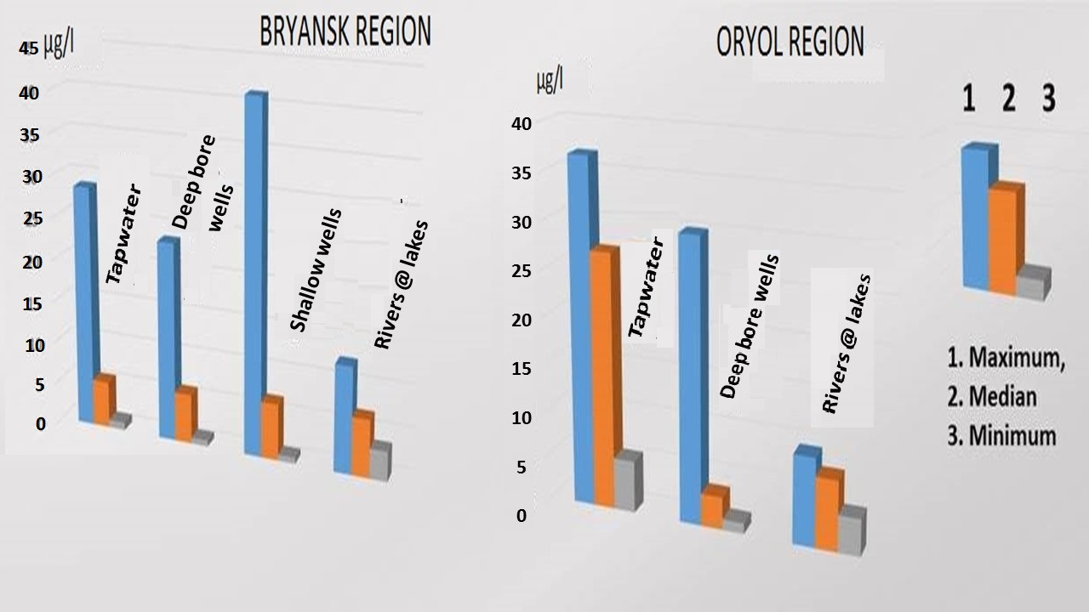
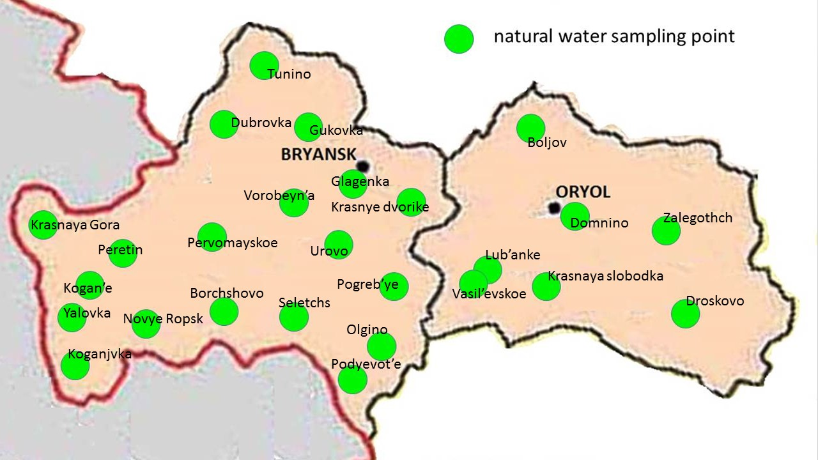
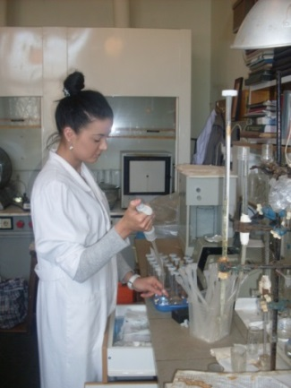
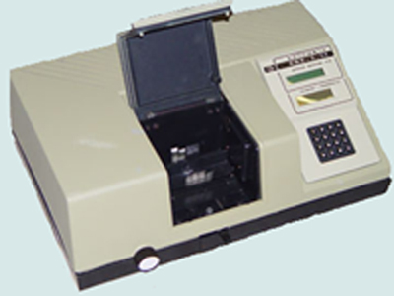
A study of iodine concentration in drinking waters of Bryansk and Oryol regions
Iodine was determined by kinetic rodanide-nitrite
method (Proskuryakova, Nikitina, 1976)
in the laboratory
of environmental biogeochemistry
at the Vernadsky Institute of geochemistry and analytical chemistry
of the Russian Academy of Sciences
Schematic map of the Bryansk and Oryol regions (with indication of sampling location), 2013 – 2017.

Slide 4
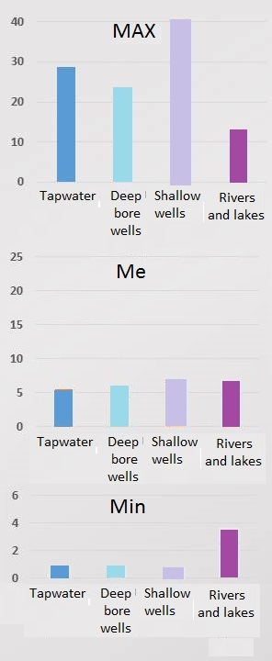
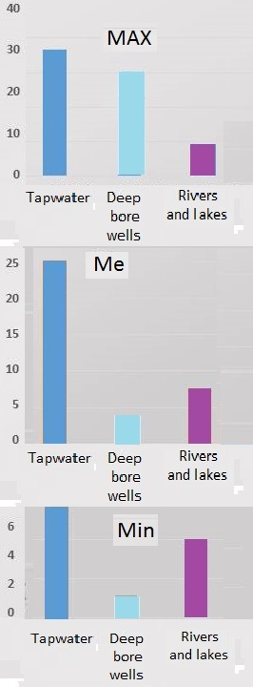
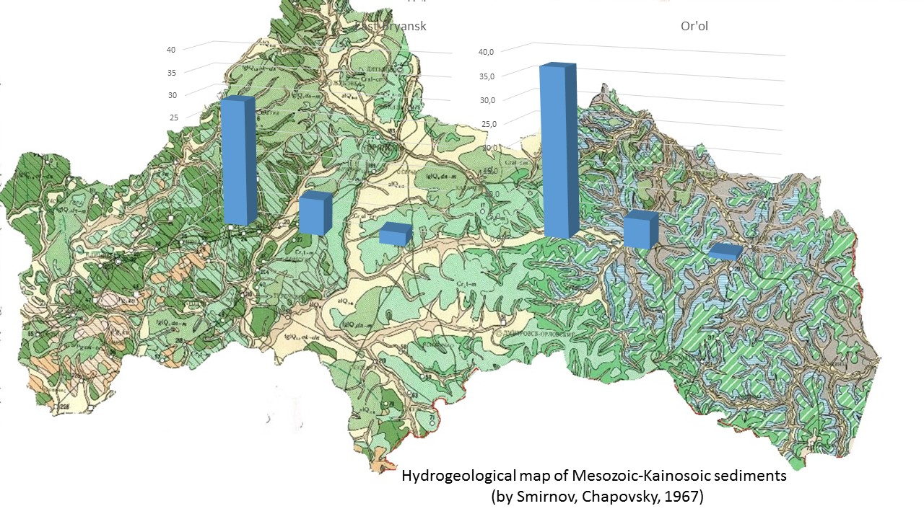
A study of iodine concentration in drinking waters of Bryansk and Oryol regions
Statistical parameters of iodine concentration in water
of Bryansk region
statistical parameters of iodine in water
of Oryol region
µg/l
µg/l
The most contrasting values of iodine content are found in water samples originating from upper Devonian and Cretaceous aquifers.
The range and median values of I
in drinking waters of two regions
µg/l
µg/l
µg/l
µg/l

Slide 5
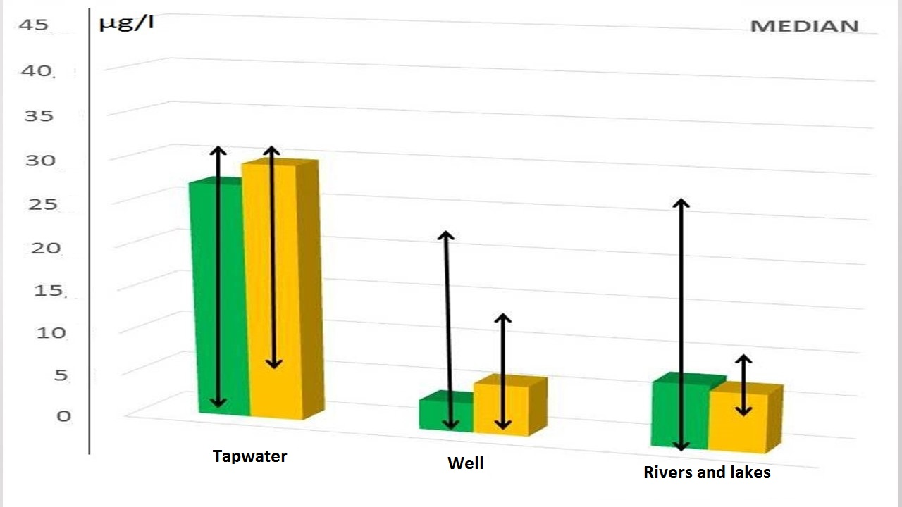
A study of iodine concentration in drinking waters of Bryansk and Oryol regions
Significant relation of iodine concentration in water samples to their salinity was confirmed in both regions (in the Bryansk region r=0.39, n=267; in the Oryol region r=0.32, n=23.
The results confirmed the previously established significant variation of iodine concentration in the Bryansk region (0.7 - 41.19 µg/l, n=267 (Kolmykova L., Korobova E., Korsakova N., et al, 2014)) and in the Oryol region (1.12 - 36.8 µg/l, n=23). The dependence of iodine concentration in the waters of the Bryansk region on salinity (r=0.39, n=267), as well as on the content of Ca (r=0.38, n=119, wells) and Mg (r=0.33, n=110, water supply), was shown earlier. The relationship of iodine concentration in waters to water salinity appeared to be also significant in the samples collected in the Oryol region (r=0.32, n=23).
Surface waters of the Oryol region were characterized by low iodine level (Me=7.40 µg/l, n=8). Even the maximum value (9.32 µg/l) does not exceed the lower limit of the hygienic standard, equal to 10 µg/l. But the obtained value is rather close to median I content found in the Bryansk region (6.76 µg/l, n=267). In the Oryol region the iodine lowest median concentration was registered in borehole waters (2.96 µg/l, n=9), which is likely to be due to the aquifer features. In the Bryansk region, iodine concentration in borehole waters appeared also lower than in surface and well waters (5.82 µg/l, n=30). This seems to be due to similar water bearing Quaternary alluvial and fluvioglacial deposits which are used for decentralized water supply in both areas.
A relatively high iodine level was registered in the tap water (Me_{I}=27.16 µg/l, n=6). Similar level of iodine concentration was found in deep-lying groundwater studied in the North-Eastern part of the Bryansk region. This fact was explained by higher salinity and specific composition of the water-bearing Devonian sediments.
Median values and variation of iodine content in water
of the Oryol (green) and North-Eastern Bryansk (orange)
regions
THANKS FOR YOUR ATTENTION!
The study was carried out with partial financial support by RFBR grant
No. 13-05-00823.

