Slide 1
Fast cooling of normal-fault footwalls: rapid fault slip or thermal relaxation?
Reinhard Wolff (1), Ralf Hetzel (1), István Dunkl (2),
Aneta A. Anczkiewicz (3), Hannah Pomella (4)
1: WWU Münster
2: Universität Göttingen
3: Polish Academy of Sciences, Kraków
4: Universität Innsbruck

Slide 2
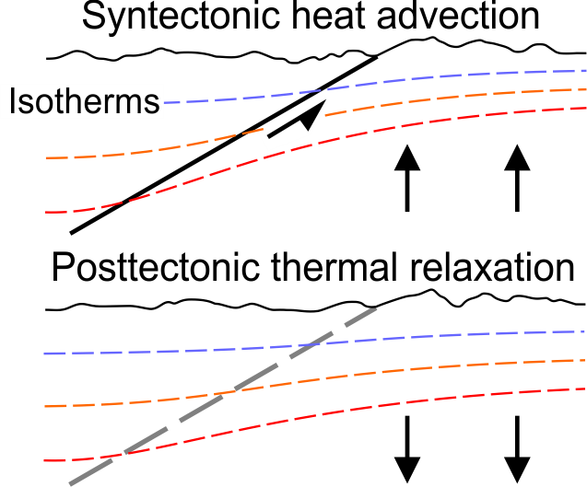
Thermochronology
Normal faulting advects hot footwall rocks
→ shifts the isotherms upwards
→ the geothermal gradient increases
When faulting stops, this process is reversed
isotherms move downwards during thermal relaxation
the geothermal gradient decreases
Geothermal gradient
increases
Geothermal gradient
decreases

Slide 3
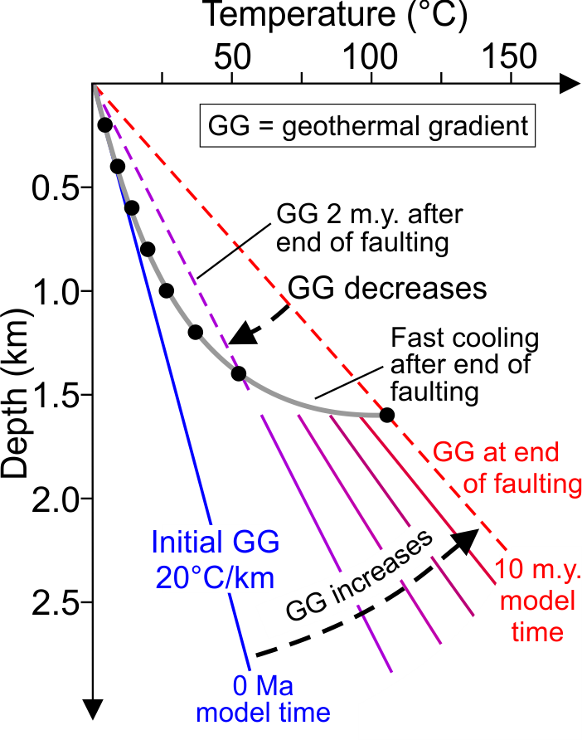
Thermochronology
PECUBE model (Braun et al. 2012)
Initial geothermal gradient: 20°C/km
10 m.y. duration of faulting
Rate of faulting 3 km/m.y.
After end of faulting:
Geothermal gradient decreases
→ Fast cooling after end of faulting
Wolff et al. 2020, Geology

Slide 4
Thermochronology
PECUBE model (Braun et al. 2012)
Initial geothermal gradient: 20°C/km
10 m.y. duration of faulting
Rate of faulting 3 km/m.y.
After end of faulting:
Geothermal gradient decreases
→ Fast cooling after end of faulting
Modeling of thermochronological data
is required to determine fault slip histories
Wolff et al. 2020, Geology

Slide 5
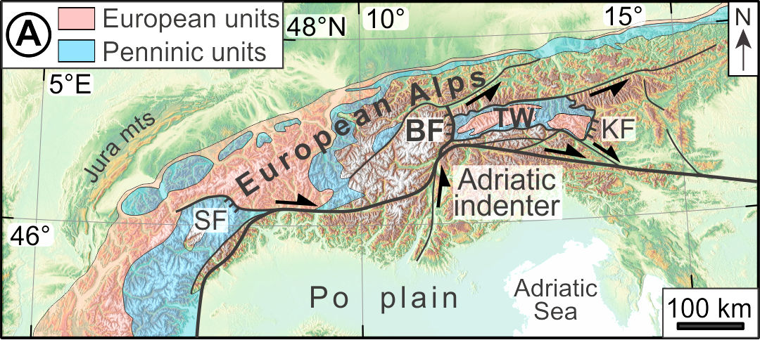
European Alps formed during the collision between Europe and Adria
(modified after Schmid et al. 2013)
Collision between Europe and Adria since late Eocene
Breakoff of European slab in the Oligocene led to intrusion of large plutons along the Periadriatic Line at 34 – 28 Ma (Rosenberg et al. 2004)

Slide 6
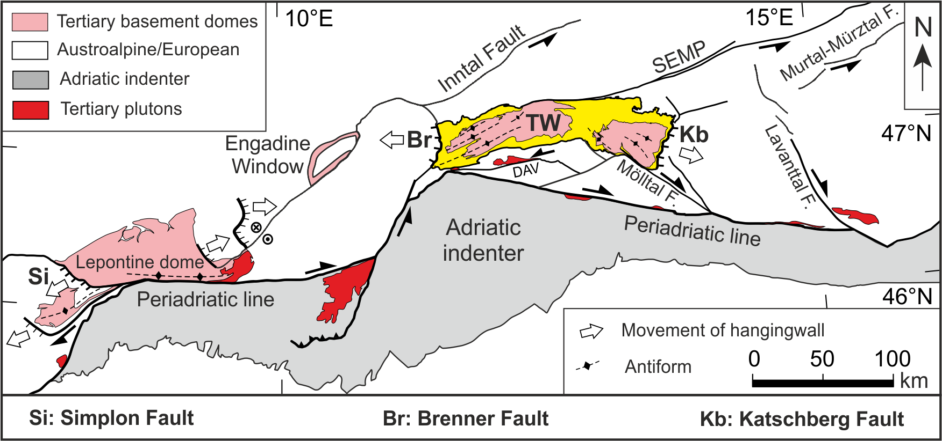
Normal faulting during late-orogenic extension
Simplon normal fault
Tauern Window is bounded by Brenner and Katschberg fault
Study area is located in the footwall of the Brenner fault
(modified after Handy et al. 2005)

Slide 7
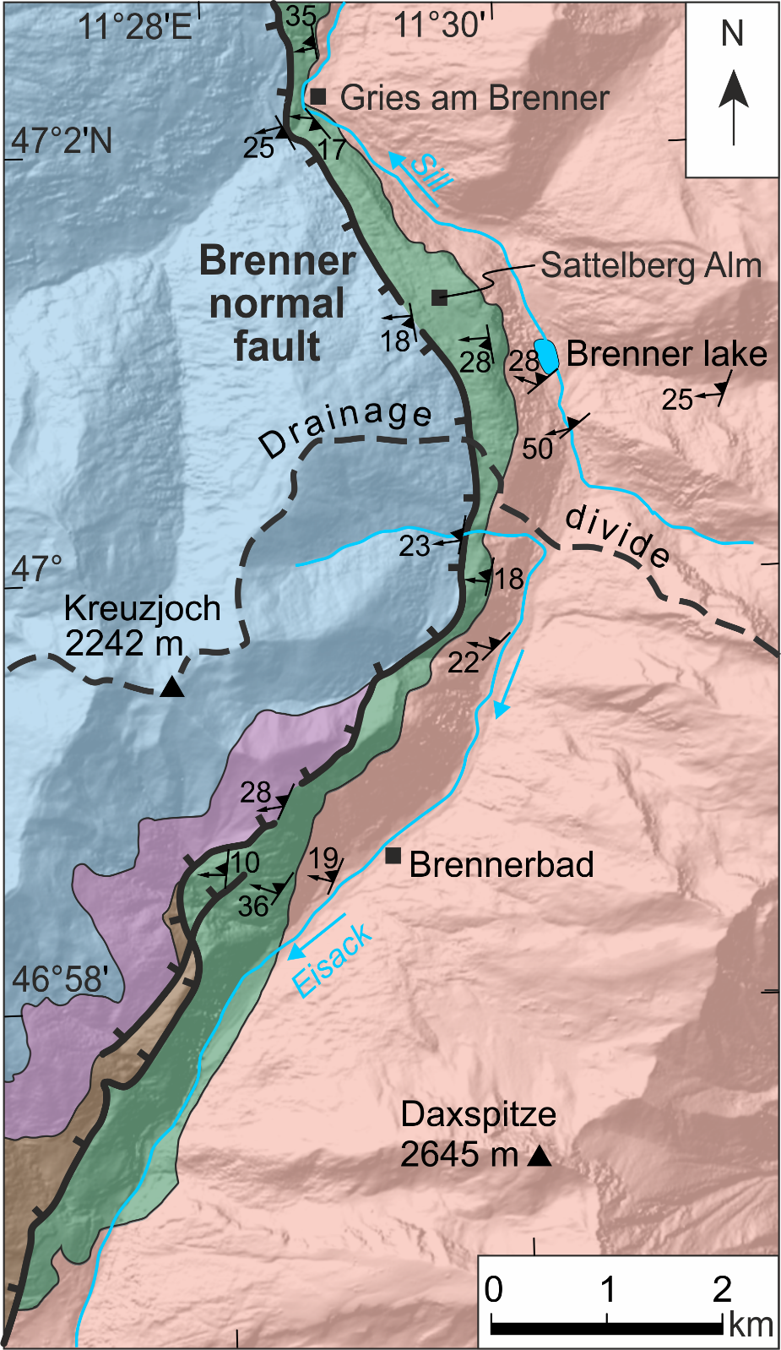
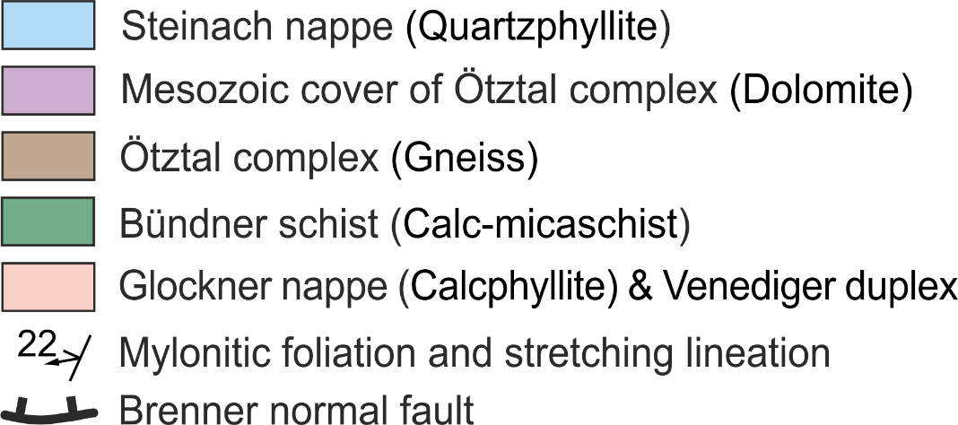
Brenner normal fault system
Mylonites at least 400 m thick (Behrmann 1988, Selverstone et al. 1988)
W-dipping mylonitic foliation (10° – 36°)
Stretching lineation plunges gently to WSW – WNW
Shear bands, oblique grain shapes, and asymmetric quartz-c-axis fabrics indicate top-to-the-W shear sense (Behrmann, 1988)
Brittle fault at the top of the mylonites (fault dip: 30° – 50°)

Slide 8
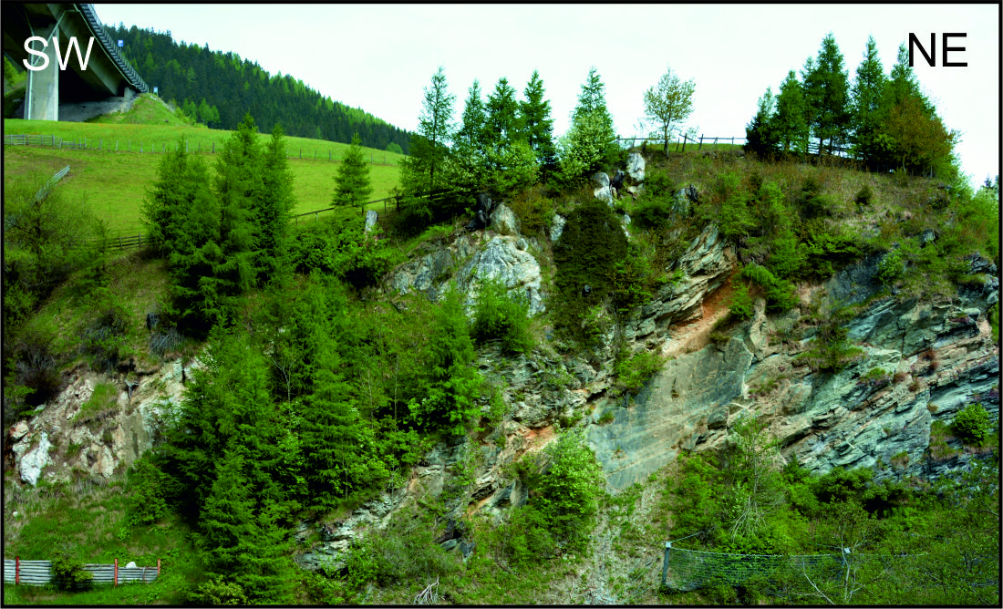
Fault gouges near the top of the mylonites
Example of brittle fault slightly steeper than the mylonitic foliation
fault gouge
mylonite

Slide 9
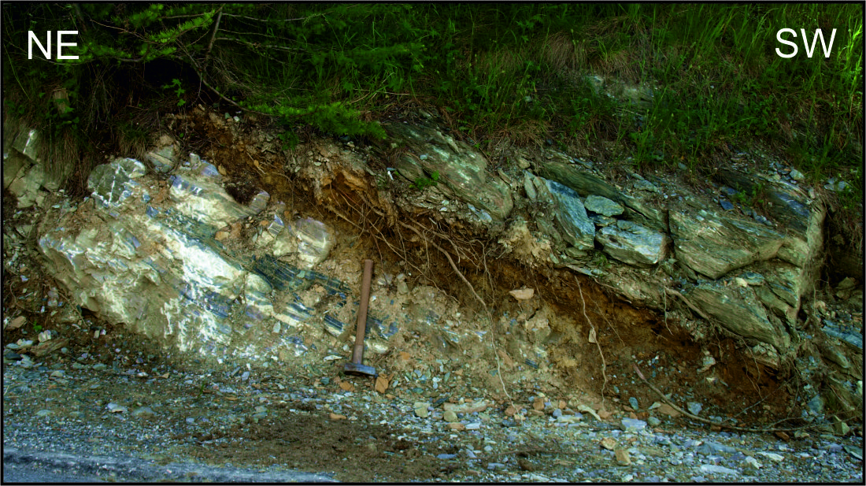
Fault gouges near the top of the mylonites
Example of brittle fault parallel to the mylonitic foliation
mylonite
fault gouge
mylonite

Slide 10
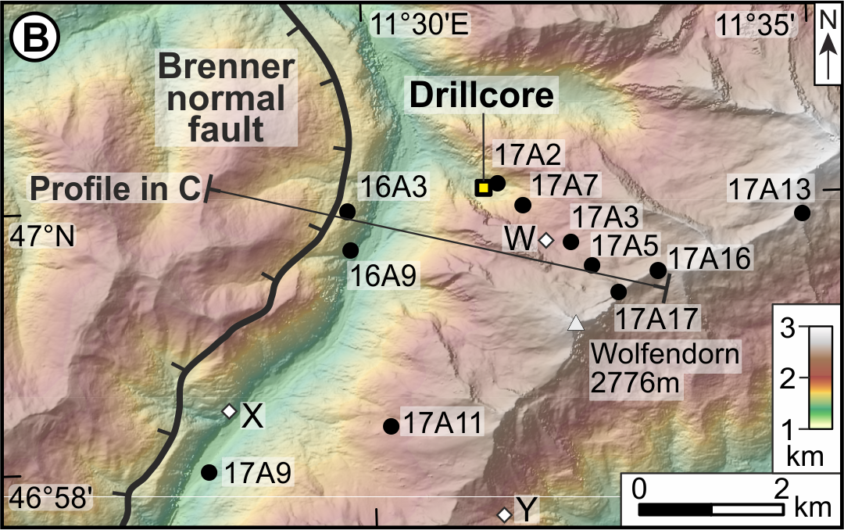
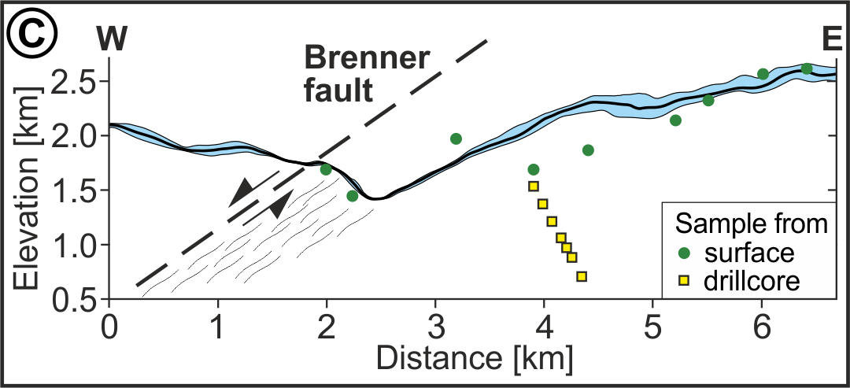
Sampling & Methods
Samples from a 2-km-thick crustal section, including a 1000-m-long drillcore (mostly from Variscan gneiss)
Zircon and apatite (U-Th)/He thermochronology and apatite fission track dating

Slide 11
Thermochronology
Wolff et al. 2020, Geology
Ages increase with increasing elevation
ZHe and AHe ages differ by only ~1 Myr in individual samples
Rapid cooling of footwall and/or thermal relaxation?
Thermokinematic modeling

Slide 12
Parameters of PECUBE model
Fault dip 35°
Initial geothermal gradient (30°C/km)
Thermal diffusivity, radiogenic heat production
Free parameters during modeling
Fault slip rate
Initiation of faulting
End of faulting
10,000 model runs
Data inversion
Red circles: best fit model
Wolff et al. 2020, Geology

Slide 13
Results of model inversion
Normal faulting stopped 8.8±0.4 Ma
Total slip rate 4.2±0.9 km/Myr
Exhumation 25±7 km
Normal faulting started 19±2 Ma
Crustal extension 35±10 km
Wolff et al. 2020, Geology

Slide 14
Results of model inversion
Best-fit model
Normal faulting stopped 8.8±0.4 Ma
Total slip rate 4.2±0.9 km/Myr
Exhumation 25±7 km
Normal faulting started 19±2 Ma
Crustal extension 35±10 km
Wolff et al. 2020, Geology

Slide 15
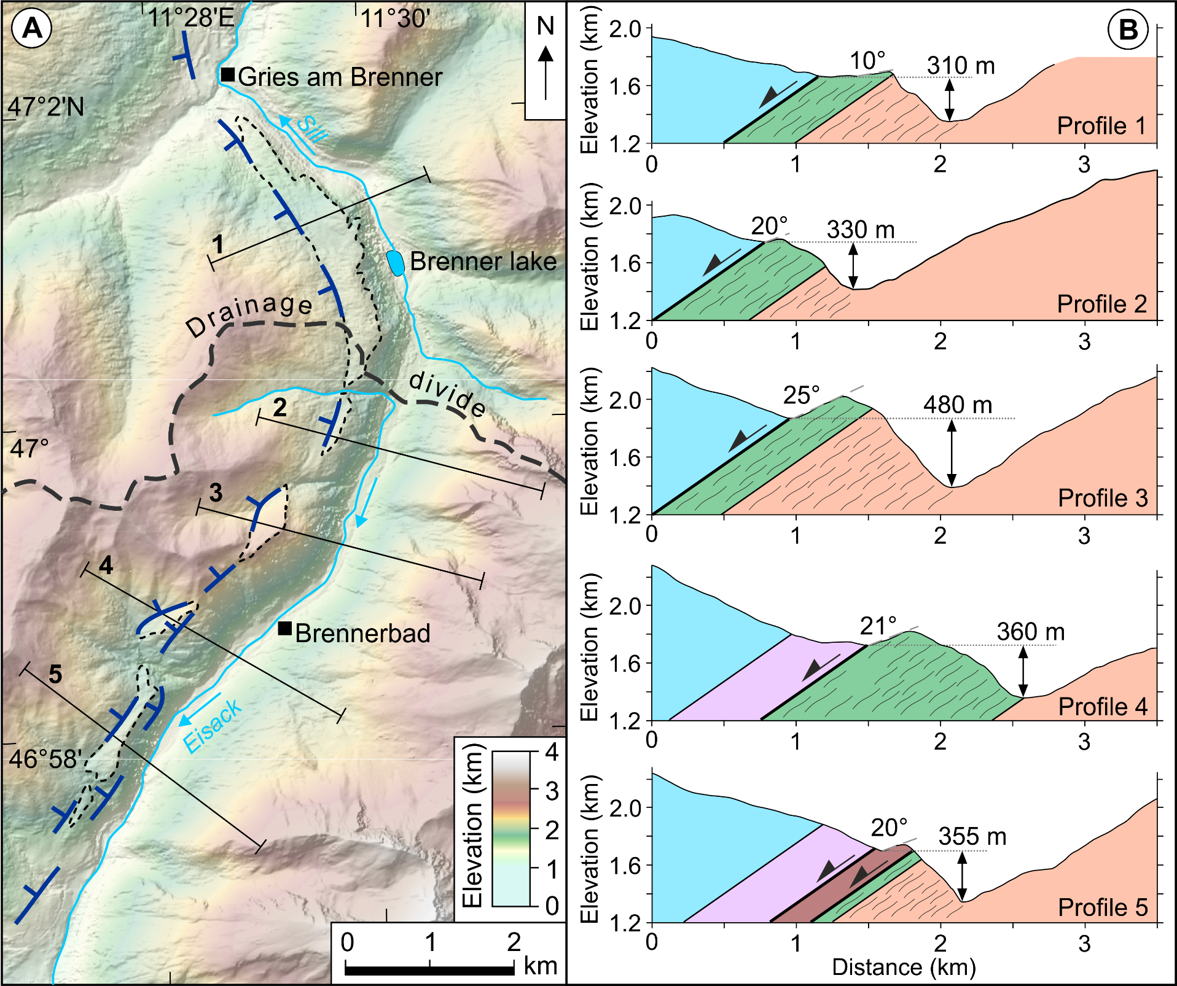
Geomorphology
Brenner fault-trace several hundred meters above valley floor
→ Faulting ceased before incision of valley which is consistent with model results

Slide 16
Normal faulting during late-orogenic extension
Brenner fault:
Initiated 19±2 Ma
Stopped 8.8±0.4 Ma
Extension 35±10 km
(Wolff et al. 2020)
Simplon fault
Initiated 18.5±2.5 Ma
Extension 21±5 km
(Campani et al. 2010)
Katschberg fault
Initiated ~23 Ma
Extension 23–29 km
(Scharf et al. 2013)
(modified after Handy et al. 2005)

Slide 17
Conclusions
Brenner fault footwall is exhumed from a depth of 25±7 km
Brenner fault caused 35±10 km of crustal extension
Our findings demonstrate that both syntectonic heat advection and posttectonic thermal relaxation are responsible for the cooling pattern in the Brenner normal-fault footwall.
In general, it may be difficult to distinguish cooling ages reflecting faulting from those reflecting thermal relaxation
→ Use several thermochronometers is recommended
→ Sampling a local relief of >1 km is the key for determining fault-slip histories

