Slide 1
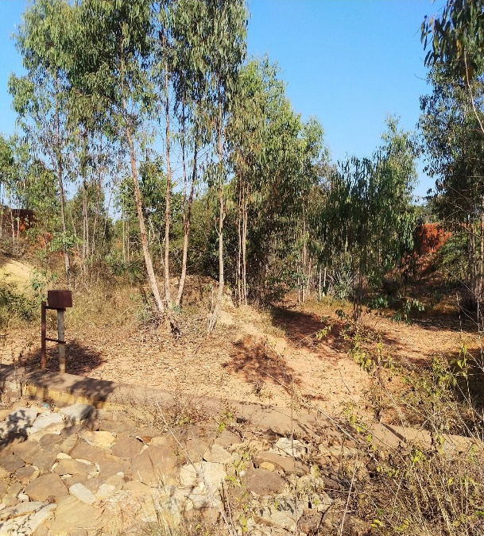
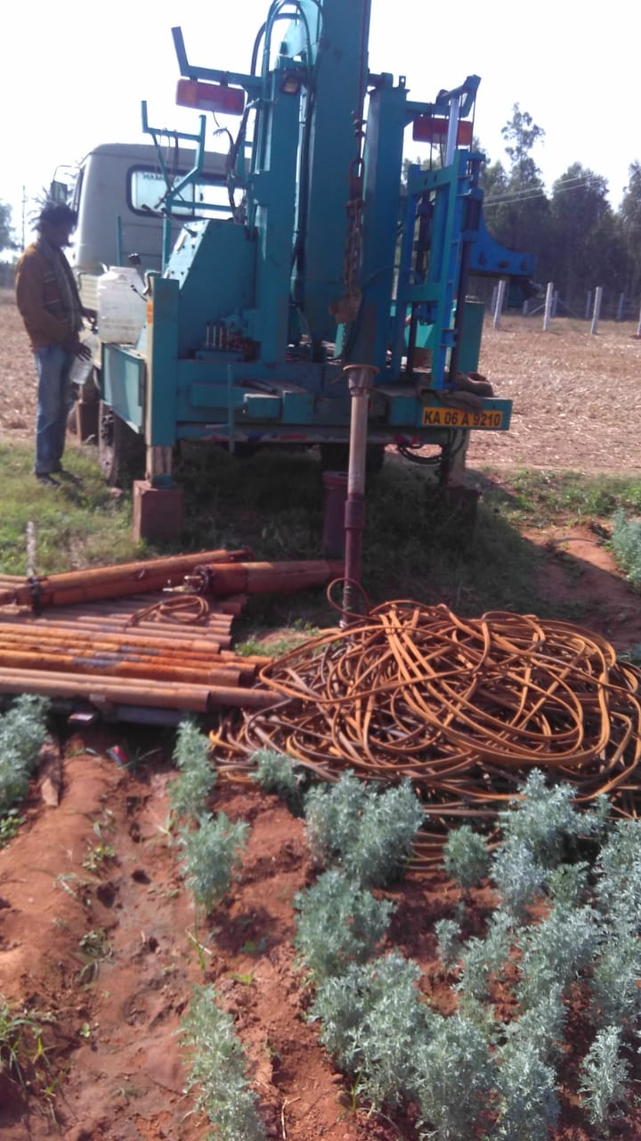
On the difficulties of estimating water-balance components from remote-sensing in anthropogenically modified catchment in southern India Kulkarni, T.¹, Gassmann, M.¹, Vajedian, S.²
¹ University of Kassel (tejas.kulkarni@uni-kassel.de), ² Leibniz Universität, Hannover
Introduction
Navigate to each sub-heading. Click on pictures to enlarge. Click return to previous page. Press home-page button to access this slide. Watch as !
Study Area
Data & Methods
Results
Discussions

Slide 2
On the difficulties of estimating water-balance components from remote-sensing in anthropogenically modified catchment in southern India Kulkarni, T.¹, Gassmann, M.¹, Vajedian, S.²
¹ University of Kassel (tejas.kulkarni@uni-kassel.de), ² Leibniz Universität, Hannover
Introduction
Especially in India, climatic-driven groundwater (GW) drought and human-induced GW stress has to be explored in all scales as it is the worlds largest GW user.
Regionalization and down-scaling of global models using remote sensing (RS) data assimilation is an effective tool, but they have largely underestimated decadal declines in the southern Indian studies. This is primarily due to the following factors
Coarse resolution of products + smaller basins + inter-basin transfers/leakages
Exclusion of deeper GW extraction in modelling
Impertinence of GW data, in terms of rightly estimating “true levels“ in the hard-rock aquifers.
Therefore, it becomes important to assess GW storage changes (GWSC) using the continuously & newly generated global models with their RS products and examine their
pitfalls - incongruity to accommodate GW extraction and
potential benefits to probe into GW sustainability in the region.

Slide 3
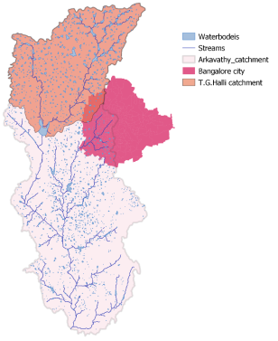
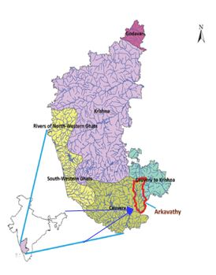
On the difficulties of estimating water-balance components from remote-sensing in anthropogenically modified catchment in southern India Kulkarni, T.¹, Gassmann, M.¹, Vajedian, S.²
¹ University of Kassel (tejas.kulkarni@uni-kassel.de), ² Leibniz Universität, Hannover
Study Area
The Arkavathy river catchment overlaps Bangalore city, the fastest growing metropolis in South India.
However, most of the city‘s water demands are met by other inter-basin transfers and the return flows through the Vrishbhavathy river. Hence, it makes sense to do water accounting only for the Upper Arkavathy Catchment (UAC)
Hydrological literature have indicated intensive GW pumping as the main driver leading to the drying up of the reservoir.
It is reported that private borewells are being drilled to depths of 400m, since the upper aquifers are only seasonal.

Slide 4
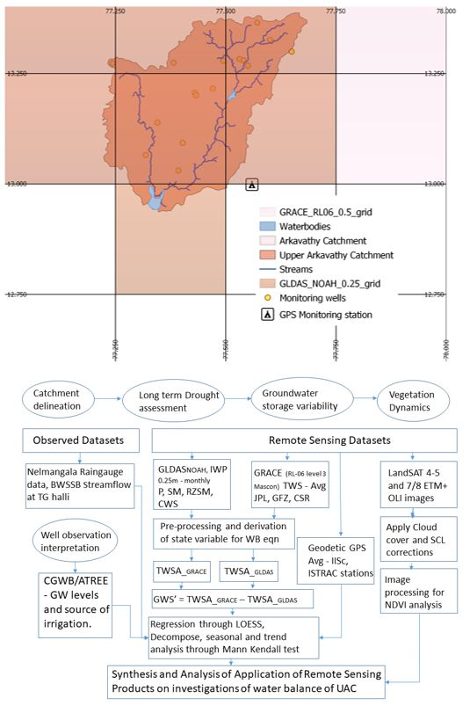
On the difficulties of estimating water-balance components from remote-sensing in anthropogenically modified catchment in southern India Kulkarni, T.¹, Gassmann, M.¹, Vajedian, S.²
¹ University of Kassel (tejas.kulkarni@uni-kassel.de), ² Leibniz Universität, Hannover
Data and Methods
We assessed long term precipitation datasets from GLDAS and two rain gauges in the catchment to understand climatic drought.
We used the following data to assess GWS change.
GRACE total water storage (TWS) from the JPL,GFZ and CSR RL-06 mascon data and applied scaling factors.
GLDAS_NOAH land surface model (LSM) hydrological outputs.
To assess land deformation linked to GW, we used GPS geodetic data.
Monthly sampled GW levels from 20 governmental monitoring wells.
in the following equation to compute GWS change:
ΔGWS = ΔTWS_{GRACE} – (ΔSM + ΔCWS)_{GLDAS} – ΔSW_{TGHalli} – ΔGWsampled
TWS from the GRACE RL-06 Mascons data
Soil Moisture (SM) and Canopy Water Storage (CWS) values from the GLDAS2.1_NOAH output
Surface water (SW) gauged data at T.G.Halli
Change in irrigated area is noted pixel wise derived from 272 Landsat images
NDVImonth i > NDVIall previous months ; SCL and cloud-cover corrected

Slide 5
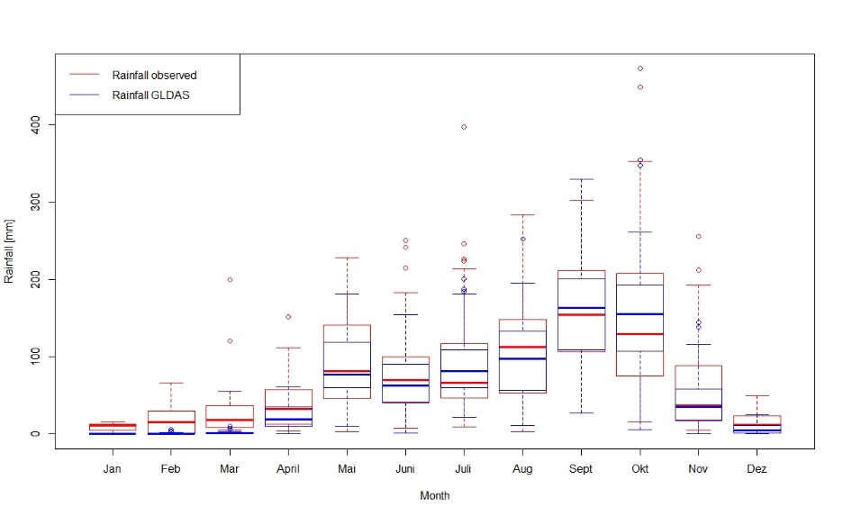
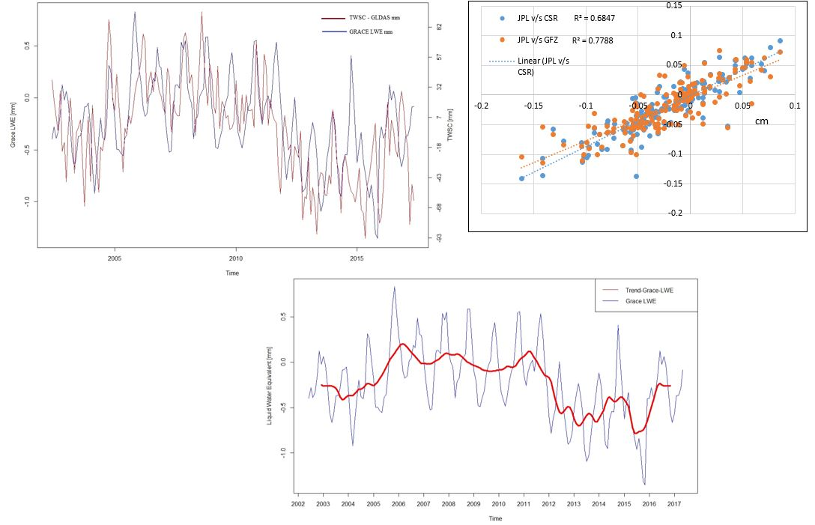
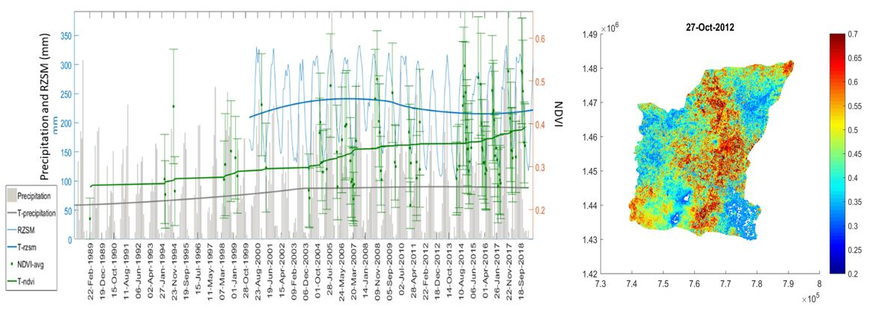
On the difficulties of estimating water-balance components from remote-sensing in anthropogenically modified catchment in southern India Kulkarni, T.¹, Gassmann, M.¹, Vajedian, S.²
¹ University of Kassel (tejas.kulkarni@uni-kassel.de), ² Leibniz Universität, Hannover
Results and Discussion
GLDAS precipitation data correlates well with the rain gauge data (1948-2019), but shows no long-term deficit or climatic drought.
GRACE Mascon TWS (2002-2017) from JPL,CSR & GFZ are compared and the average shows meagre declining trends of -0.03mm/year.
Seasonal GRACE trends correspond to GLDAS-SM, which shows a time delay accounting for biomass to get wet.
Landsat-NDVI (1972-2018) show an increasing irrigated agriculture trend of 31%, especially from 2014 ; however there is intermittency in data due to cloud coverage during crucial cropping seasons.

Slide 6
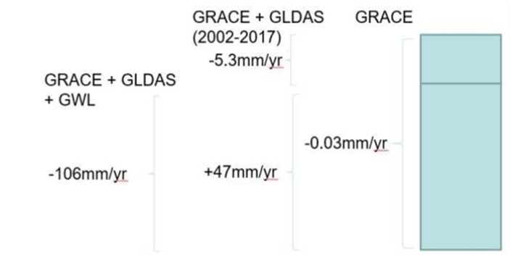
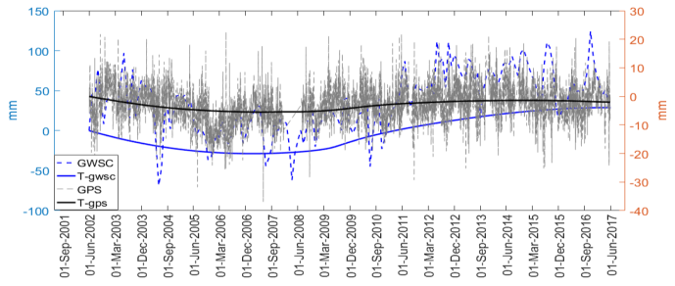
On the difficulties of estimating water-balance components from remote-sensing in anthropogenically modified catchment in southern India Kulkarni, T.¹, Gassmann, M.¹, Vajedian, S.²
¹ University of Kassel (tejas.kulkarni@uni-kassel.de), ² Leibniz Universität, Hannover
Results and Discussion
GWSC derived from RS-only assimilation seems like a converse trend of SM change. This is because TWS-GRACE trend only is considerably flat compared to soil moisture change magnitude (by ~10²).
GPS data shows similar patterns but since GWSC has only assigned shallow storage fluxes, land deformation cannot indicate changes in fractured aquifer below.
Sampled GW levels show a trend of -153mm/year, but still very less compared to the hundreds of metres of decline in the social narrative.

Slide 7
On the difficulties of estimating water-balance components from remote-sensing in anthropogenically modified catchment in southern India Kulkarni, T.¹, Gassmann, M.¹, Vajedian, S.²
¹ University of Kassel (tejas.kulkarni@uni-kassel.de), ² Leibniz Universität, Hannover
Conclusions
Lack of evidence in climatic-driven drought was correctly quantified for the UAC long-term satellite precipitation trend analysis.
However, RS products like did not seem very useful in terms of capturing human-induced GW stress.
In parallel, absence of sensible “hard” GW variation data through well logs, camera inspections inhibits the prospects of numerical GW model data inputs to simulate variations.
Outlook
Neither satellite nor field data can correctly model GWS in highly exploited fractured aquifers.
What magnitude of increase in scaling factors for GRACE data can be used in such areas ?
What are the possibilities of further assimilations of anthropogenic use using PCR-GLOB outputs or other datasets developed for highly stressed aquifers?
How to incorporate auxiliary socio-hydro metrics (for eg.well depths, pumping hours), in the absence of sensible GW variation data, to quantify extraction in deep fractured aquifers?
Can a higher temporal resolution LSM (for eg. GLDAS2.2) improve accommodating anthropogenic GWSC assimilations?

Slide 8
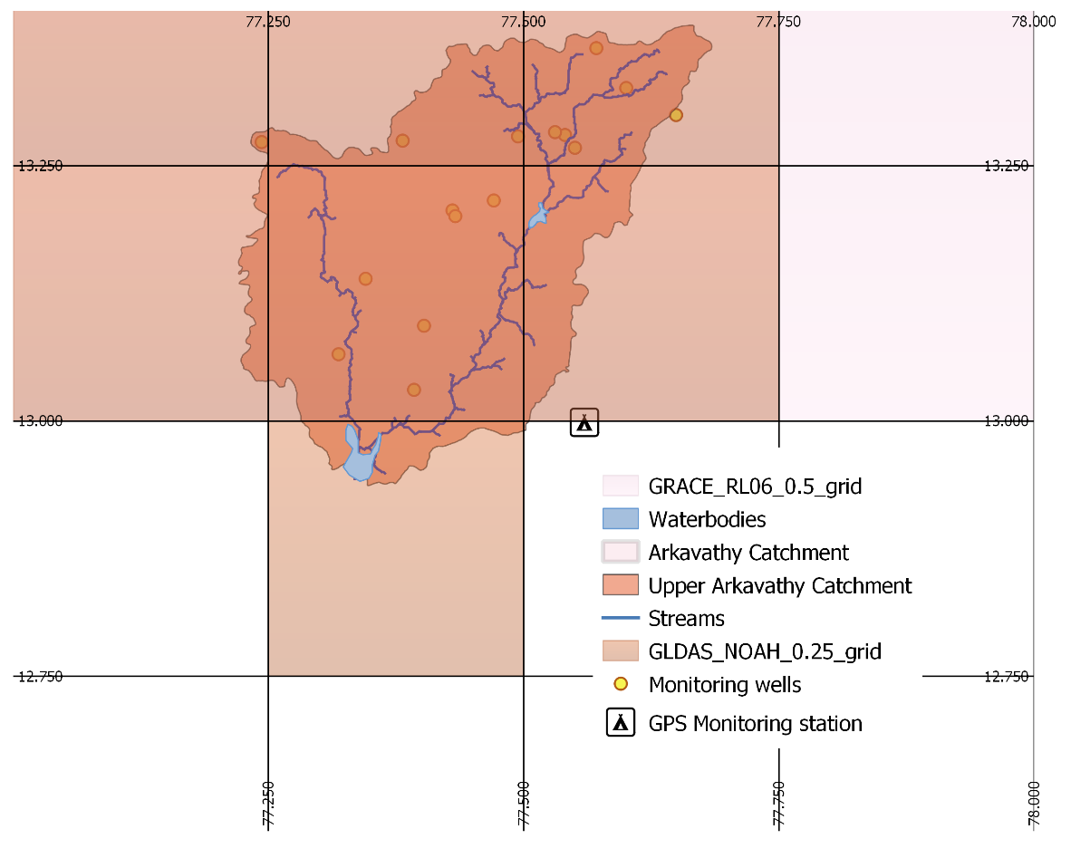
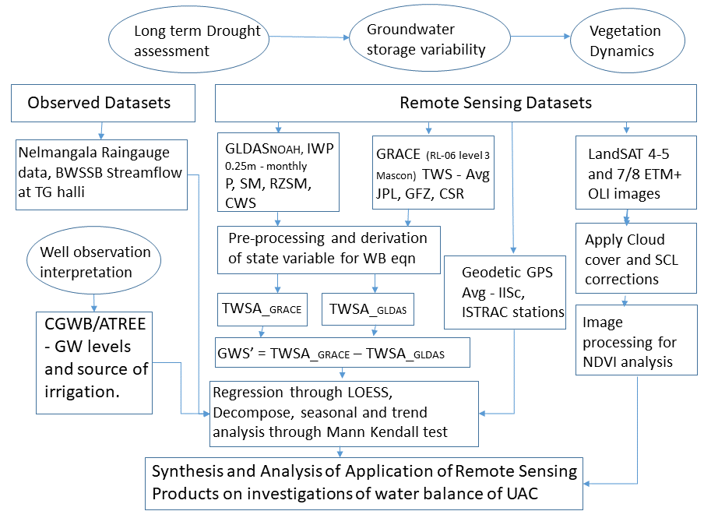
On the difficulties of estimating water-balance components from remote-sensing in anthropogenically modified catchment in southern India Kulkarni, T.¹, Gassmann, M.¹, Vajedian, S.²
¹ University of Kassel (tejas.kulkarni@uni-kassel.de), ² Leibniz Universität, Hannover
Data and Methods
Figure.1 Catchment overlay on grided RS datasets with their spatial resolutions. All catchment estimations are done by areally averaging values from the grid centres. Locations of monitoring wells and GPS station depicted in the picture.
Figure.2 Data framework in methodology to assess climatic-driven drought and human-induced water stress using RS products for the UAC.

Slide 9
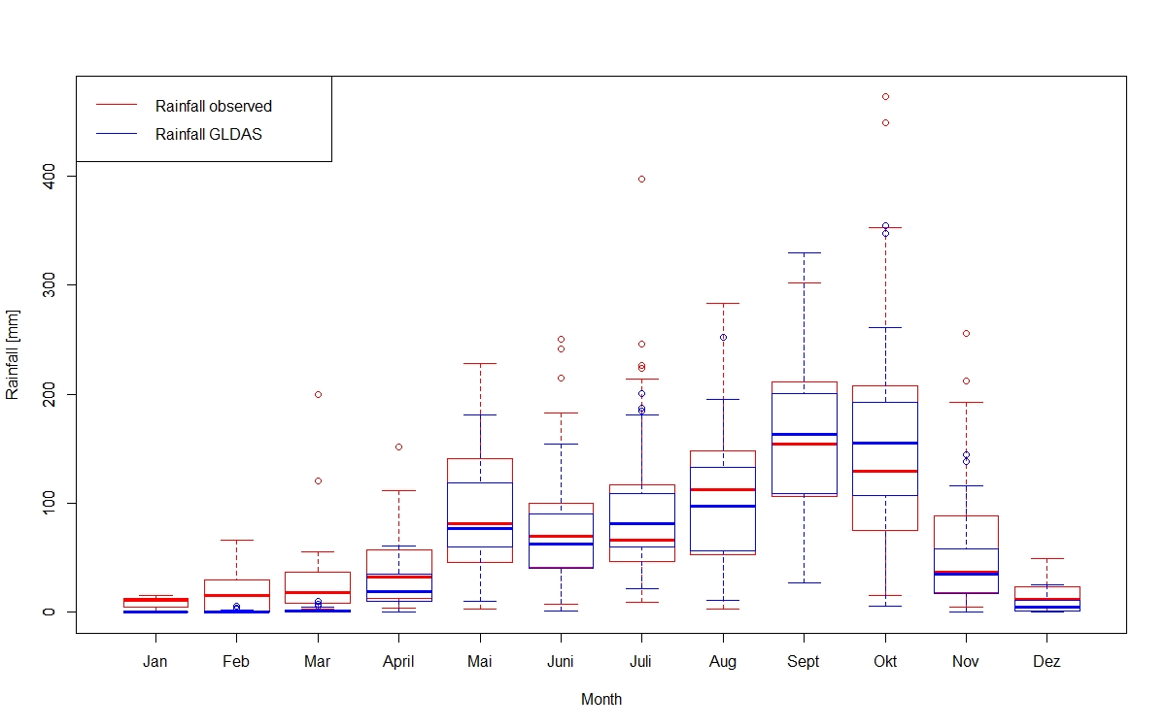
On the difficulties of estimating water-balance components from remote-sensing in anthropogenically modified catchment in southern India Kulkarni, T.¹, Gassmann, M.¹, Vajedian, S.²
¹ University of Kassel (tejas.kulkarni@uni-kassel.de), ² Leibniz Universität, Hannover
Results and Discussion
Rainfall Decade | Average Yearly rainfall in mm
1980 – 1990 | 667.7
1990 – 2000 | 769.5
2000 – 2010 | 1063.1
2010 – 2019 | 990.7
Figure.3 The box plot shows monthly statistical variation of precipitation from GLDAS and at Nelmangala and Devenahalli rain gauges (1948-2019). Although, high r² of 0.87 is observed, there are high monthly variations particularly during the over two spells - the south-west monsoon (Jun-Sept) the shorter north-east (Oct-Nov) rains, re-indicating the lower performance of GLDAS over the complex southern pensinsular region. We assessed rainfall using mann-Kendal statistics for JJASO and NDJF and MAM months. The months of July, Aug and Oct had the highest variances. We noted that the substantial increase in rainfall in two decades post-2000 along with the increase in frequency RS datasets being produced could possibly oversight the statistics further in the study as well.

Slide 10
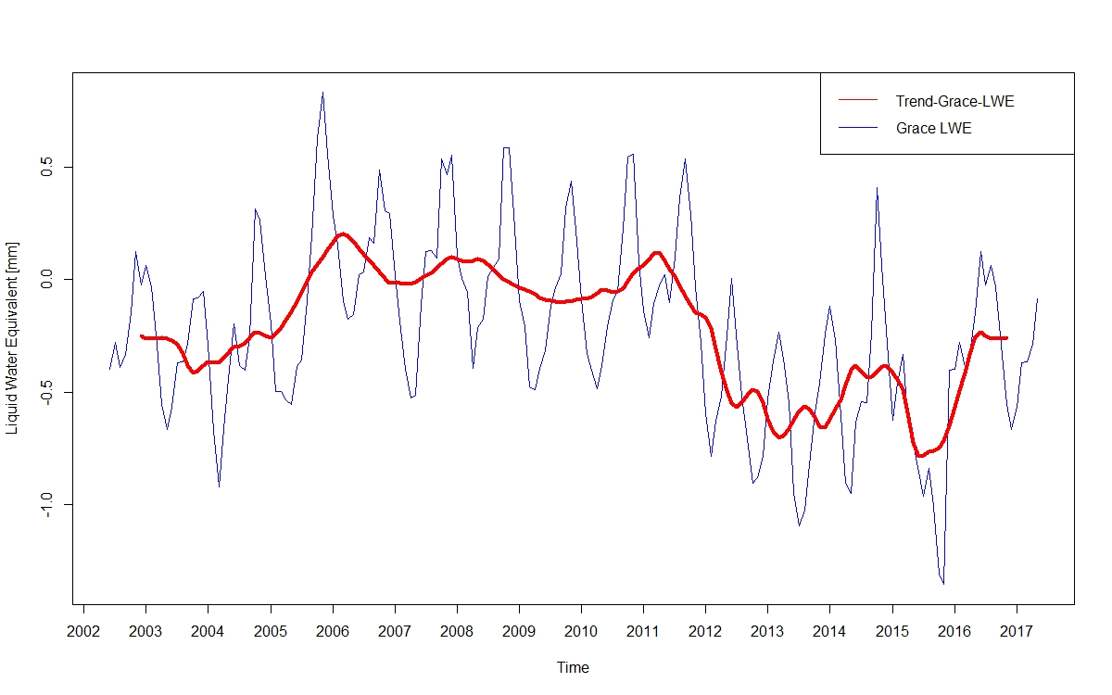
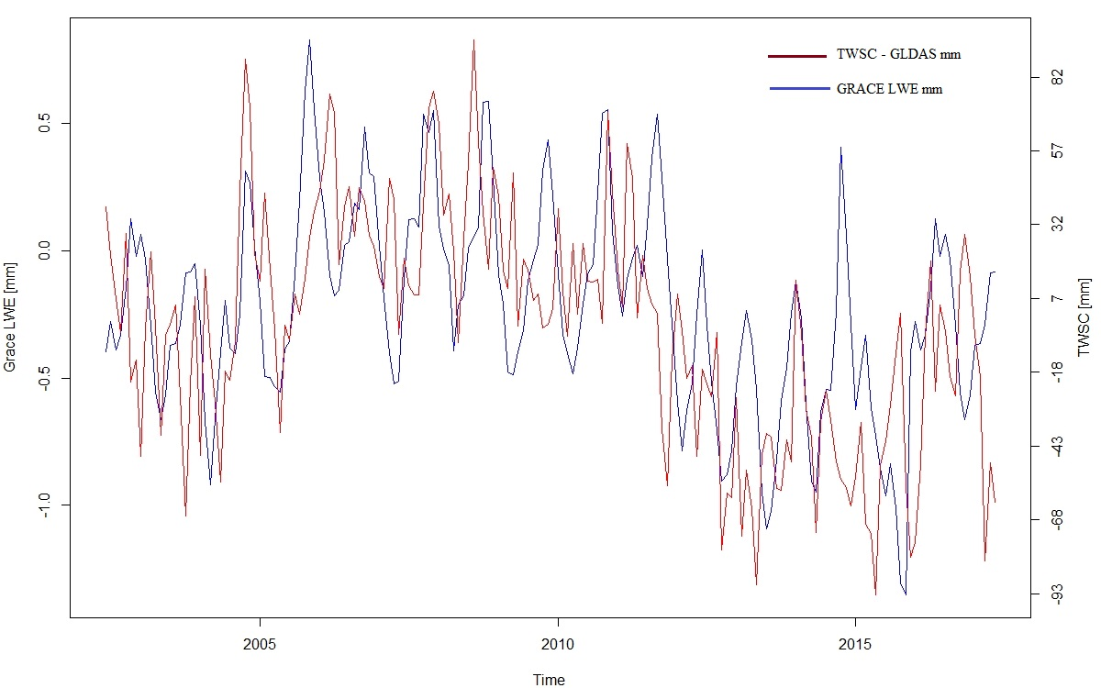
On the difficulties of estimating water-balance components from remote-sensing in anthropogenically modified catchment in southern India Kulkarni, T.¹, Gassmann, M.¹, Vajedian, S.²
¹ University of Kassel (tejas.kulkarni@uni-kassel.de), ² Leibniz Universität, Hannover
Results and Discussion
Figure.4 . The comparison of the GRACE TWS data from GFZ, CSR and JPL with applied scaling factors is shown in the scatter plot. The average of the three solutions was chosen as the optimal use of GRACE Mascon data as suggested by Sakumura et al,. (2014). A net decrease in the basin storage of the 0.7Mm³ is calculated for the catchment in entire time period.
Figure.6 TS of GRACE_LWE corresponds well seasonally with GLDAS_SM+CWS change, but is much lower by in magnitude. A simple regression between the GRACE derived and GLDAS TWSC gives an r² of 0.29 which is within the acceptable range of 0.2-0.5 as noted by Rowlands et al. (2010).

Slide 11
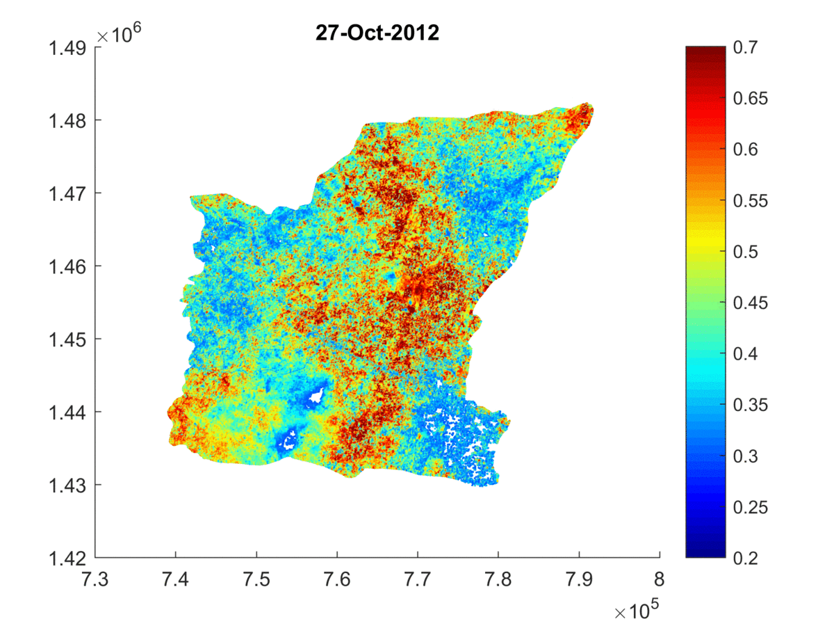
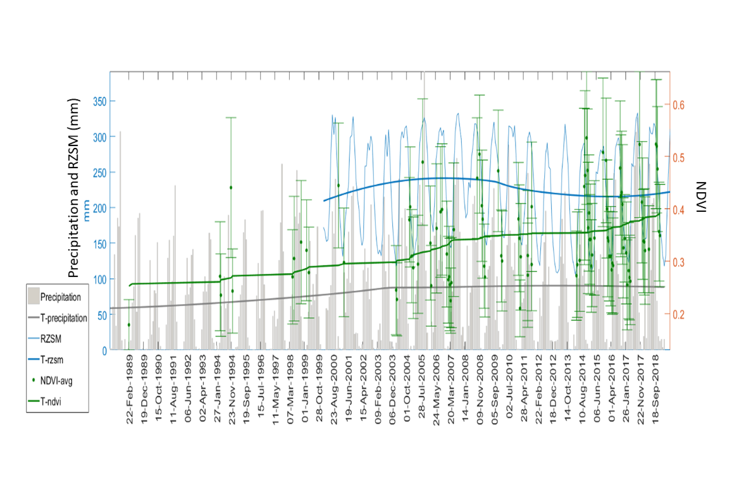
On the difficulties of estimating water-balance components from remote-sensing in anthropogenically modified catchment in southern India Kulkarni, T.¹, Gassmann, M.¹, Vajedian, S.²
¹ University of Kassel (tejas.kulkarni@uni-kassel.de), ² Leibniz Universität, Hannover
Results and Discussion
NDVI
Figure.7 Mean and standard deviations of NDVI depicted spatio-temporally show increase in irrigated agriculture especially after 2013. However, there is also increased statistical recording considering higher frequency of Landsat and increased rainfall in the same period. The root zone soil moisture (RZSM) values from GLDAS corresponded well with the rainfall patterns.

Slide 12
On the difficulties of estimating water-balance components from remote-sensing in anthropogenically modified catchment in southern India Kulkarni, T.¹, Gassmann, M.¹, Vajedian, S.²
¹ University of Kassel (tejas.kulkarni@uni-kassel.de), ² Leibniz Universität, Hannover
Results and Discussion
Figure.8 The GPS data corroborates well with the GWSC. This implies that the deduced GWSC is reliable, but applicable only to the surficial aquifer. The peak to peak amplitude of the GPS and GWSC annual variation is about 3mm and 6mm respectively. The similarity of the drop in the curves upto 2009 and a gradual increase after 2009 confirms that seasonal vertical displacements are driven by groundwater mass loading variations.
Figure.9 There seems to be groundwater abstraction before the year 2009 and a recharge period after 2009. The GWSC tends to decrease even though there are higher rainfall years during this period. The years of 2003-2009 received higher rainfall (1131.2mm/year), but the GWSC still showed a declining trend. Only at the end of 2009, there is a rising curve in the GWSC despite comparatively lower rainfall (940.1mm/year- 2010-2016). This observed lag in the rising slope can be justified, as the state variable in the surface water must change, in order to impact the GWSC.

Slide 13
On the difficulties of estimating water-balance components from remote-sensing in anthropogenically modified catchment in southern India Kulkarni, T.¹, Gassmann, M.¹, Vajedian, S.²
¹ University of Kassel (tejas.kulkarni@uni-kassel.de), ² Leibniz Universität, Hannover
Results and Discussion
Srinivasan et.al, (2015)
Figure.10 The top layer includes flux changes in soil moisture and CWS in three layers – 0-10cm, 10-40cm and 40cm-100cm and 100-200cm from NOAHs outputs. The change in fluxes below as the GWSC. Sampled GW level variations accounts for all the value of information in these assimilation methods. Simple addition of trends is further incorrect considering the data used are of shallower wells (depth<70m) as compared to the private well census (>300m) as seen in the graph. Although the study area ignores the minimum GRACE area recommendations, we argue that this misappropriation in scaling of GRACE data and such assimilation techniques for the UAC could be highly sensitive in such cases. Hence, for the down-scaling procedures of global models, intensive-GW exploitation in hard rock aquifers could be better captured by other socio-hydrological metrics.

Slide 14
On the difficulties of estimating water-balance components from remote-sensing in anthropogenically modified catchment in southern India Kulkarni, T.¹, Gassmann, M.¹, Vajedian, S.²
¹ University of Kassel (tejas.kulkarni@uni-kassel.de), ² Leibniz Universität, Hannover
Study Area
Figure.11 The location of the Arkavathy catchment is shown adjacent to Bangalore cities boundaries in southern India. The stream gauge data at the TG Halli reservoir encompassing the UAC showed a decrease of 96% in inflow from 3.85x10⁵ m³/day during pre-1975 to 1.5x10⁴ m³/day in 2013. The upper catchment covers an area of 1443 km² (89%- rural ; 11%-urban).

Slide 15
On the difficulties of estimating water-balance components from remote-sensing in anthropogenically modified catchment in southern India Kulkarni, T.¹, Gassmann, M.¹, Vajedian, S.²
¹ University of Kassel (tejas.kulkarni@uni-kassel.de), ² Leibniz Universität, Hannover
Study Area
References
Srinivasan, V.; Thompson, S.; Madhyastha, K.; Penny, G.; Jeremiah, K.; Lele, S. (2015): Why is the Arkavathy River drying? A multiple-hypothesis approach in a data-scarce region. In Hydrol. Earth Syst. Sci. 19 (4), pp. 1905–1917. DOI: 10.5194/hess-19-1905-2015.
Thank you !
Figure.12 Intensive GW pumping has led to the drying up of the Arakavathy river bed in Southern India.

