Slide 1








Using multi-temporal Sentinel-2 data to predict chemical properties of the organic surface layer of forest soils
[1]
Carina Becker^{1,5}, David Frantz², Rainer Petzold¹, Karsten Schmidt^{3,6}, Thorsten Behrens^{4,6}, Thomas Scholten^{5,6}
Funded by
1 Public Enterprise Sachsenforst, Unit site survey / soil monitoring / laboratory, Pirna, OT Graupa, Germany;
2 Humboldt-Universität zu Berlin, Geography Department, Earth Observation Lab, Berlin, Germany;
3 Eberhard Karls Universität Tübingen, eScience-Center, Tübingen, Germany;
4 Soilution GbR, Heusweiler, Germany;
5 Eberhard Karls Universität Tübingen, Department of Geoscience, Chair of Soil Science and Geomorphology, Tübingen, Germany;
6 DFG Cluster of Excellence “Machine Learning”, Eberhard Karls Universität Tübingen, Germany

Slide 2





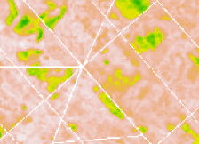
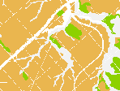
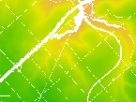


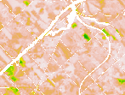
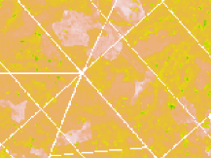
Motivation
+

Slide 3
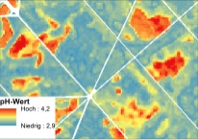
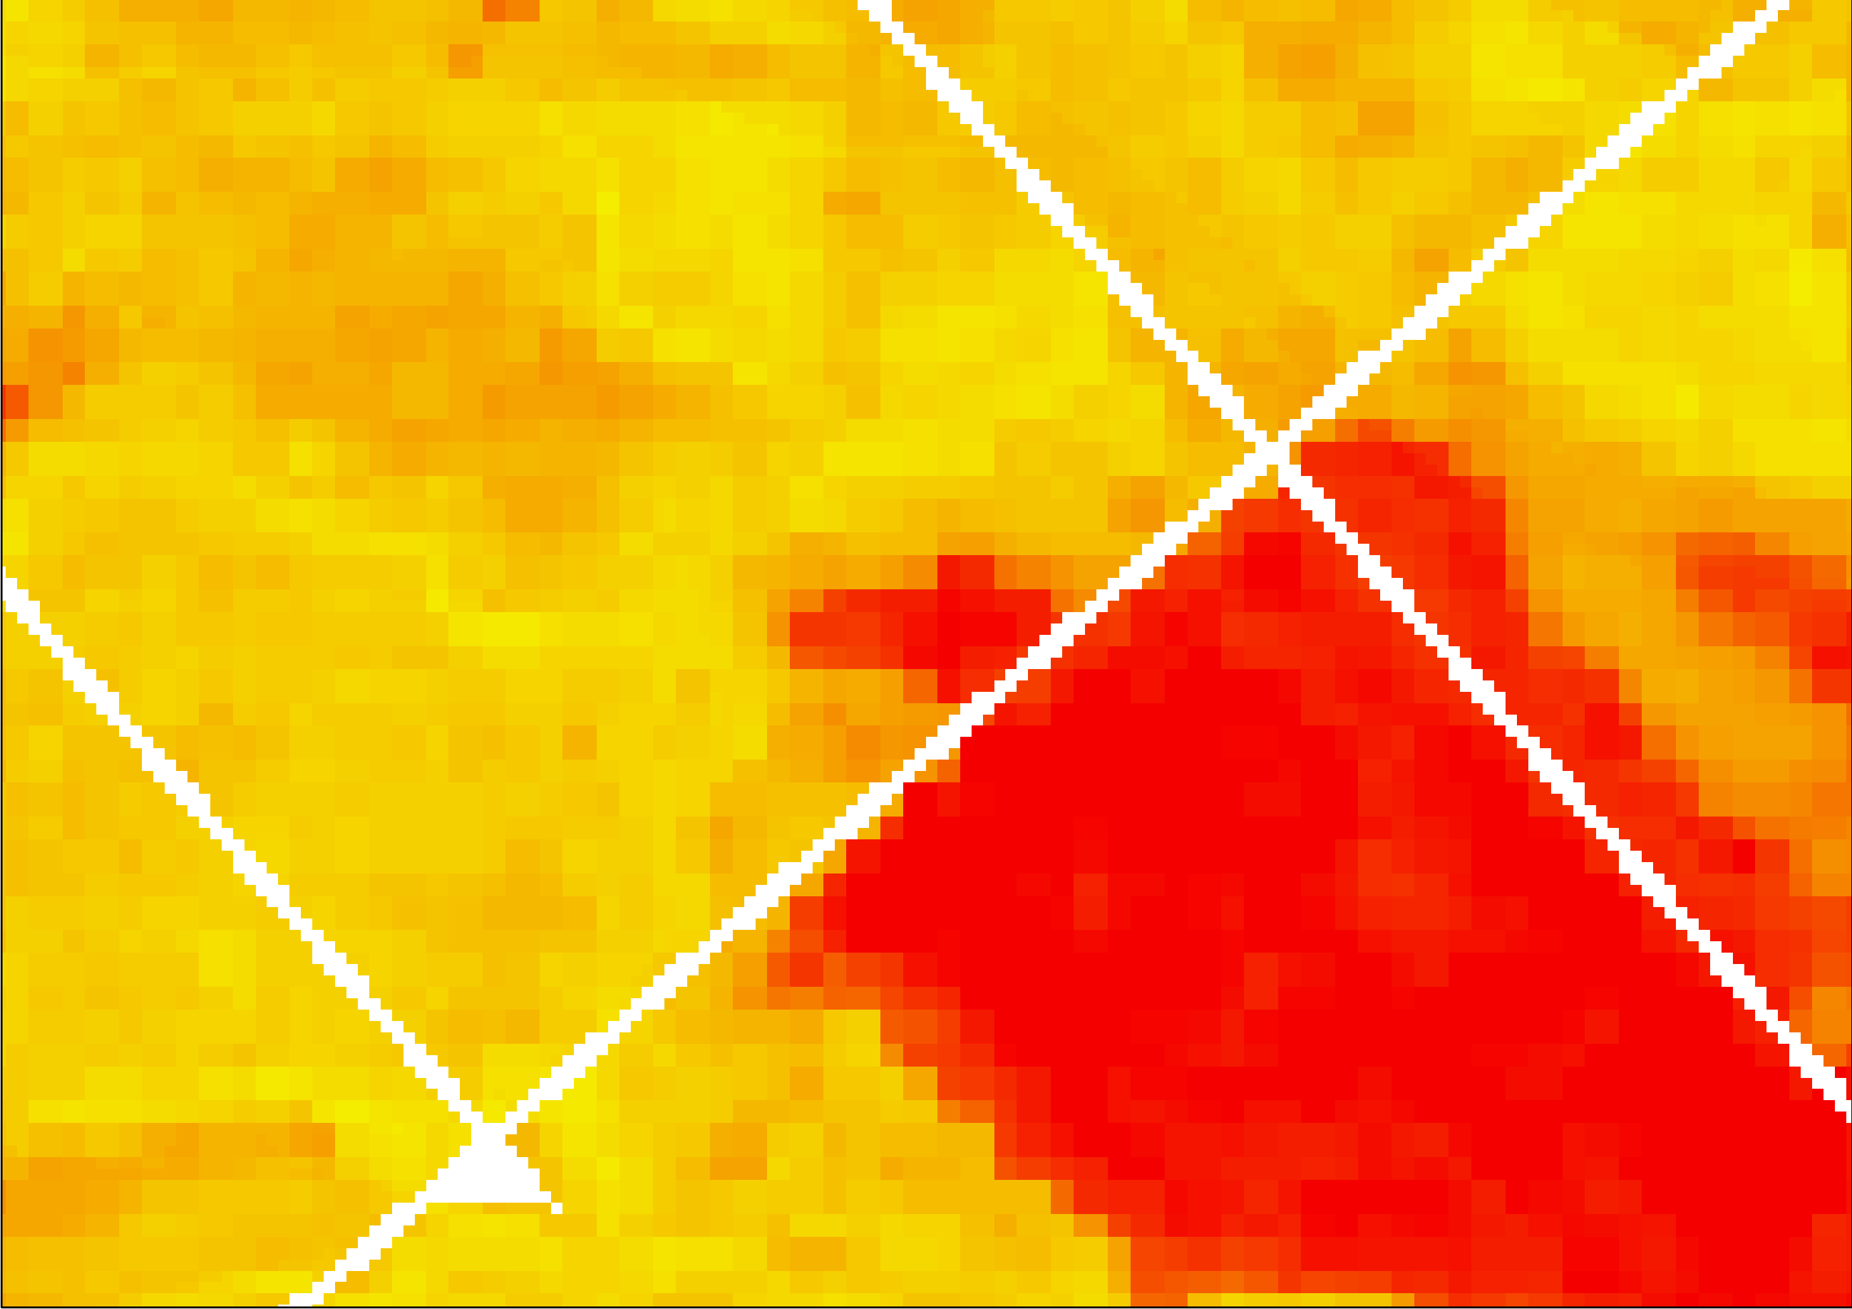
Materials and methods - Overview
Chemical properties - points
Predictors
pH
Base saturation
C/N ratio
CEC
Model
Chemical properties - area wide
Uncertainty
Information for forest management

Slide 4
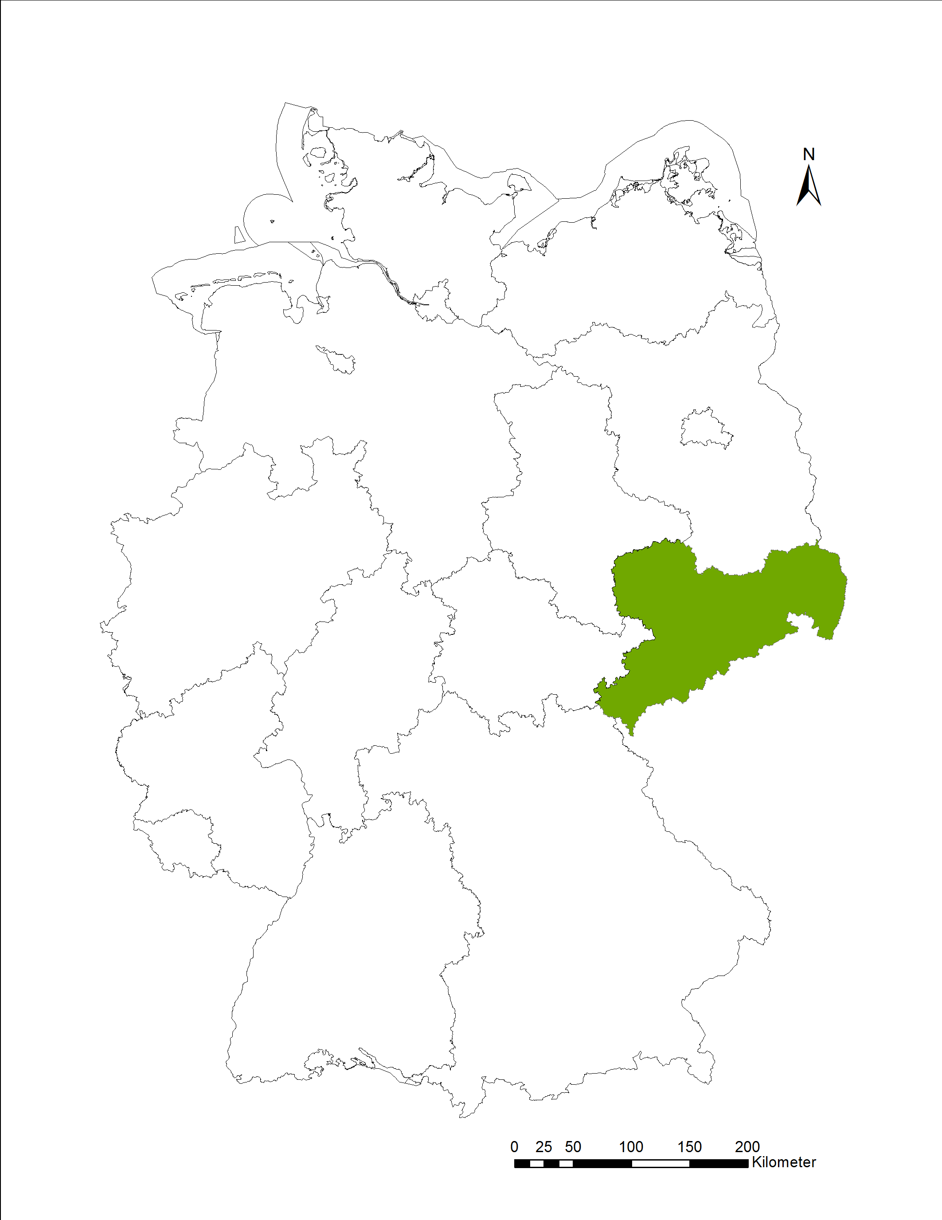
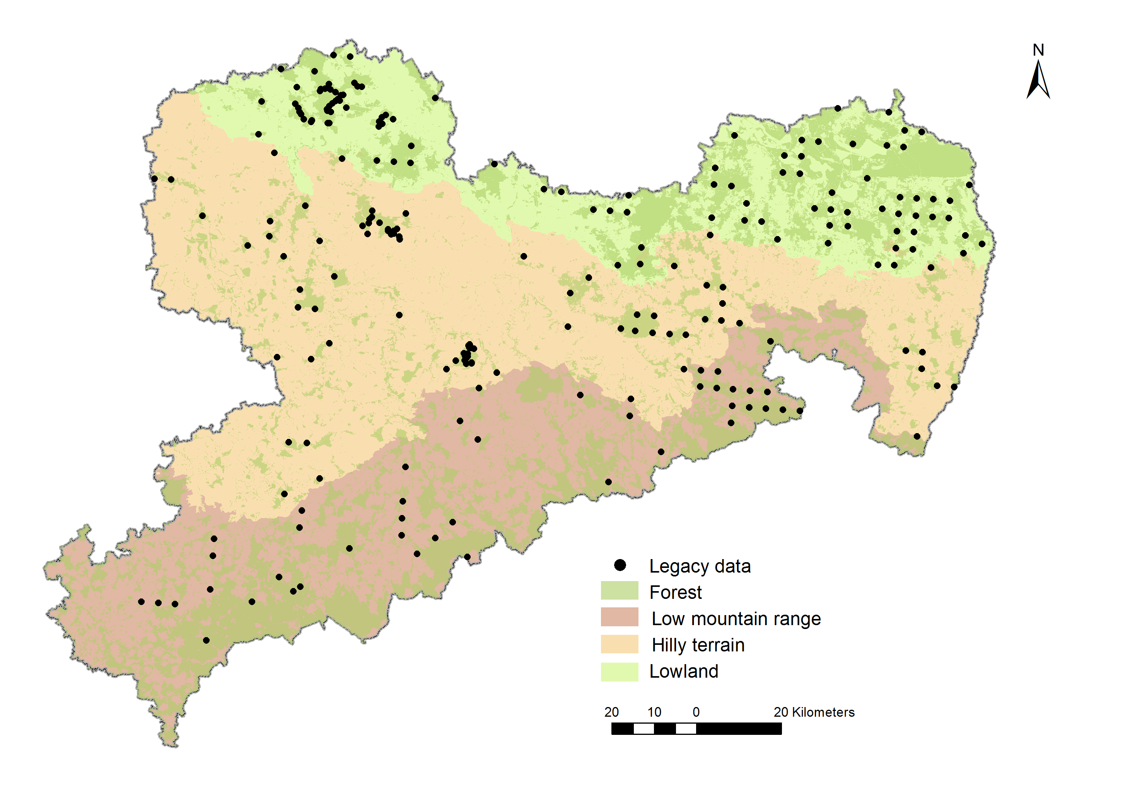
Materials and methods – study area
Samples
O | A
222 | 244
O = Organic layer
A = 0-5 cm of the mineral soil

Slide 5
Materials and methods – study area
Samples
O | A
222 | 244
O = Organic layer
A = 0-5 cm of the mineral soil

Slide 6
Materials and methods – predictors
Ancillary
predictors
Predictor |  | Information
Soil | Soil form class | 23 categories, categorical
Climate | Temperature, evapotranspiration, precipitation, climatic water balance | Raster data, 1x1 km resolution, metric
Organisms (Vegetation) | Tree species groups from a field survey (TERR), Sentinel-2 (S2) | TERR: point information, categorical S2: Raster data 10 m resolution, metric
Relief (Terrain parameters) | Height above sea level, slope | Raster data from DEM, 4 m resolution, metric
 | Aspect (northness, eastness)
 | Curvature (crosssectional, longitudinal, general)
 | SAGA wetness index | Raster data from DEM, 10 m resolution, metric
Parent material | Geological information from forest soil map 1:10.000 | 33 categories, categorical
N (Geographic Coordinates) | Easting (x), Northing (y) | UTM, metric
Vegetation
Ancillary predictors

Slide 7
Materials and methods – predictors
Ancillary
predictors
Predictor |  | Information
Soil | Soil form class | 23 categories, categorical
Climate | Temperature, Evapotranspiration, precipitation, climatic water balance | Raster data, 1x1 km resolution, metric
Organisms (Vegetation) | Tree species groups from a field survey (TERR), Sentinel-2 (S2) | TERR: point information, categorical S2: Raster data 10 m resolution, metric
Relief (Terrain parameters) | Height above sea level, slope | Raster data from DEM, 4 m resolution, metric
 | Aspect (northness, eastness)
 | Curvature (crosssectional, longitudinal, general)
 | SAGA wetness index | Raster data from DEM, 10 m resolution, metric
Parent material | Geological information from forest soil map 1:10.000 | 33 categories, categorical
N (Geographic Coordinates) | Easting (x), Northing (y) | UTM, metric
Vegetation
Ancillary predictors

Slide 8
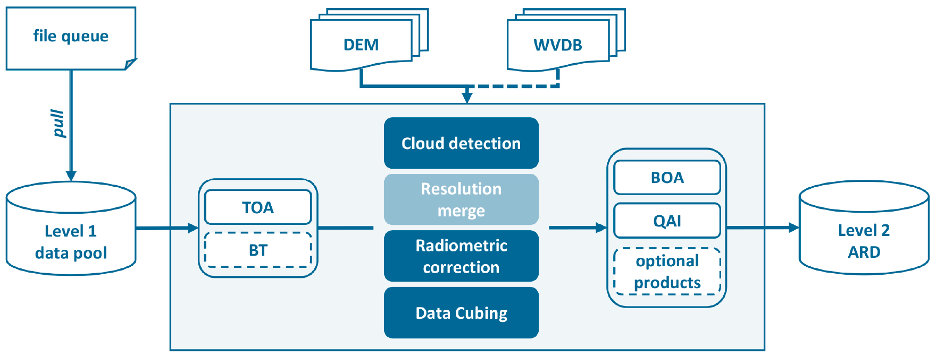
Materials and methods – predictors
Vegetation predictors
Tree species groups from a field survey: only point information, not suitable for spatial prediction with Random Forest model
Sentinel-2 data
FORCE = Framework for Operational Radiometric Correction for Environmental monitoring
[2]
[1]
TOA - top-of-atmosphere; BT - brightness temperature; BOA - bottom-of-atmosphere; QAI - quality assurance information

Slide 9
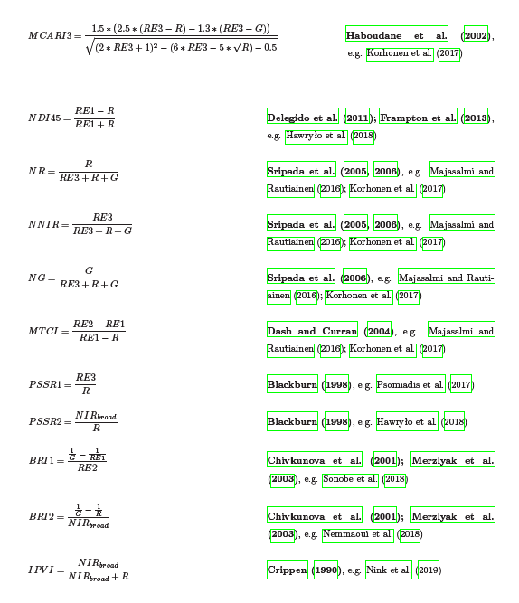
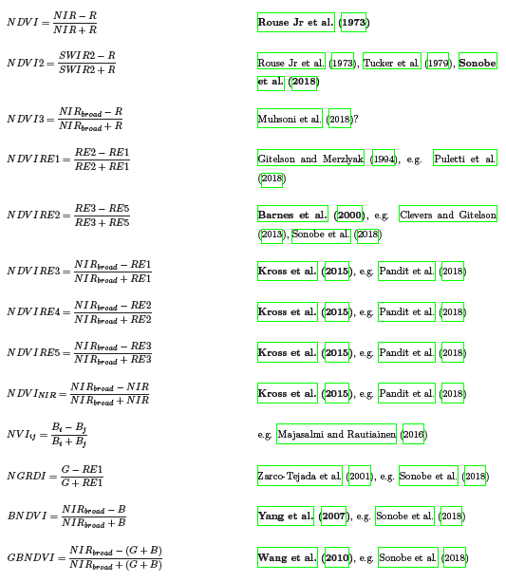

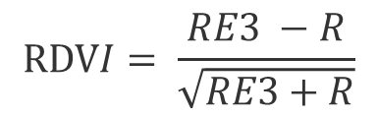
Materials and methods – predictors
Spectral indices
Spectral indices | number
Multiple combination | 11
Unique | 107
Total | 118
~ 175,000 spectral indices
RE3
R
= red edge 3 (0.769 - 0.797 µm)
= red (0.646 - 0.684 µm)

Slide 10
Materials and methods – predictors
Scenarios vegetation predictors
 | TERR | S2 | NDVI | NDVI AVG | NOV | S2IND
Info | Categorical tree species groups from a field survey | Sentinel-2 multi-temporal statistical metrics and best-available-pixel | NDVI of S2 | NDVI of S2-AVG | No vegetation predictor | S2 + S2-derived spectral indices
Quantity | 1 | 504 | 37 | 4 | 0 | ~ 175,000

Slide 11
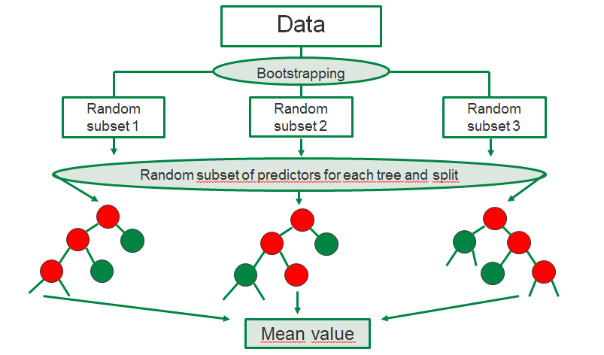
Materials and methods – model
Feature selection using recursive feature elimination (RFE)
Random Forest Regression with repeated k-fold cross-validation

Slide 12
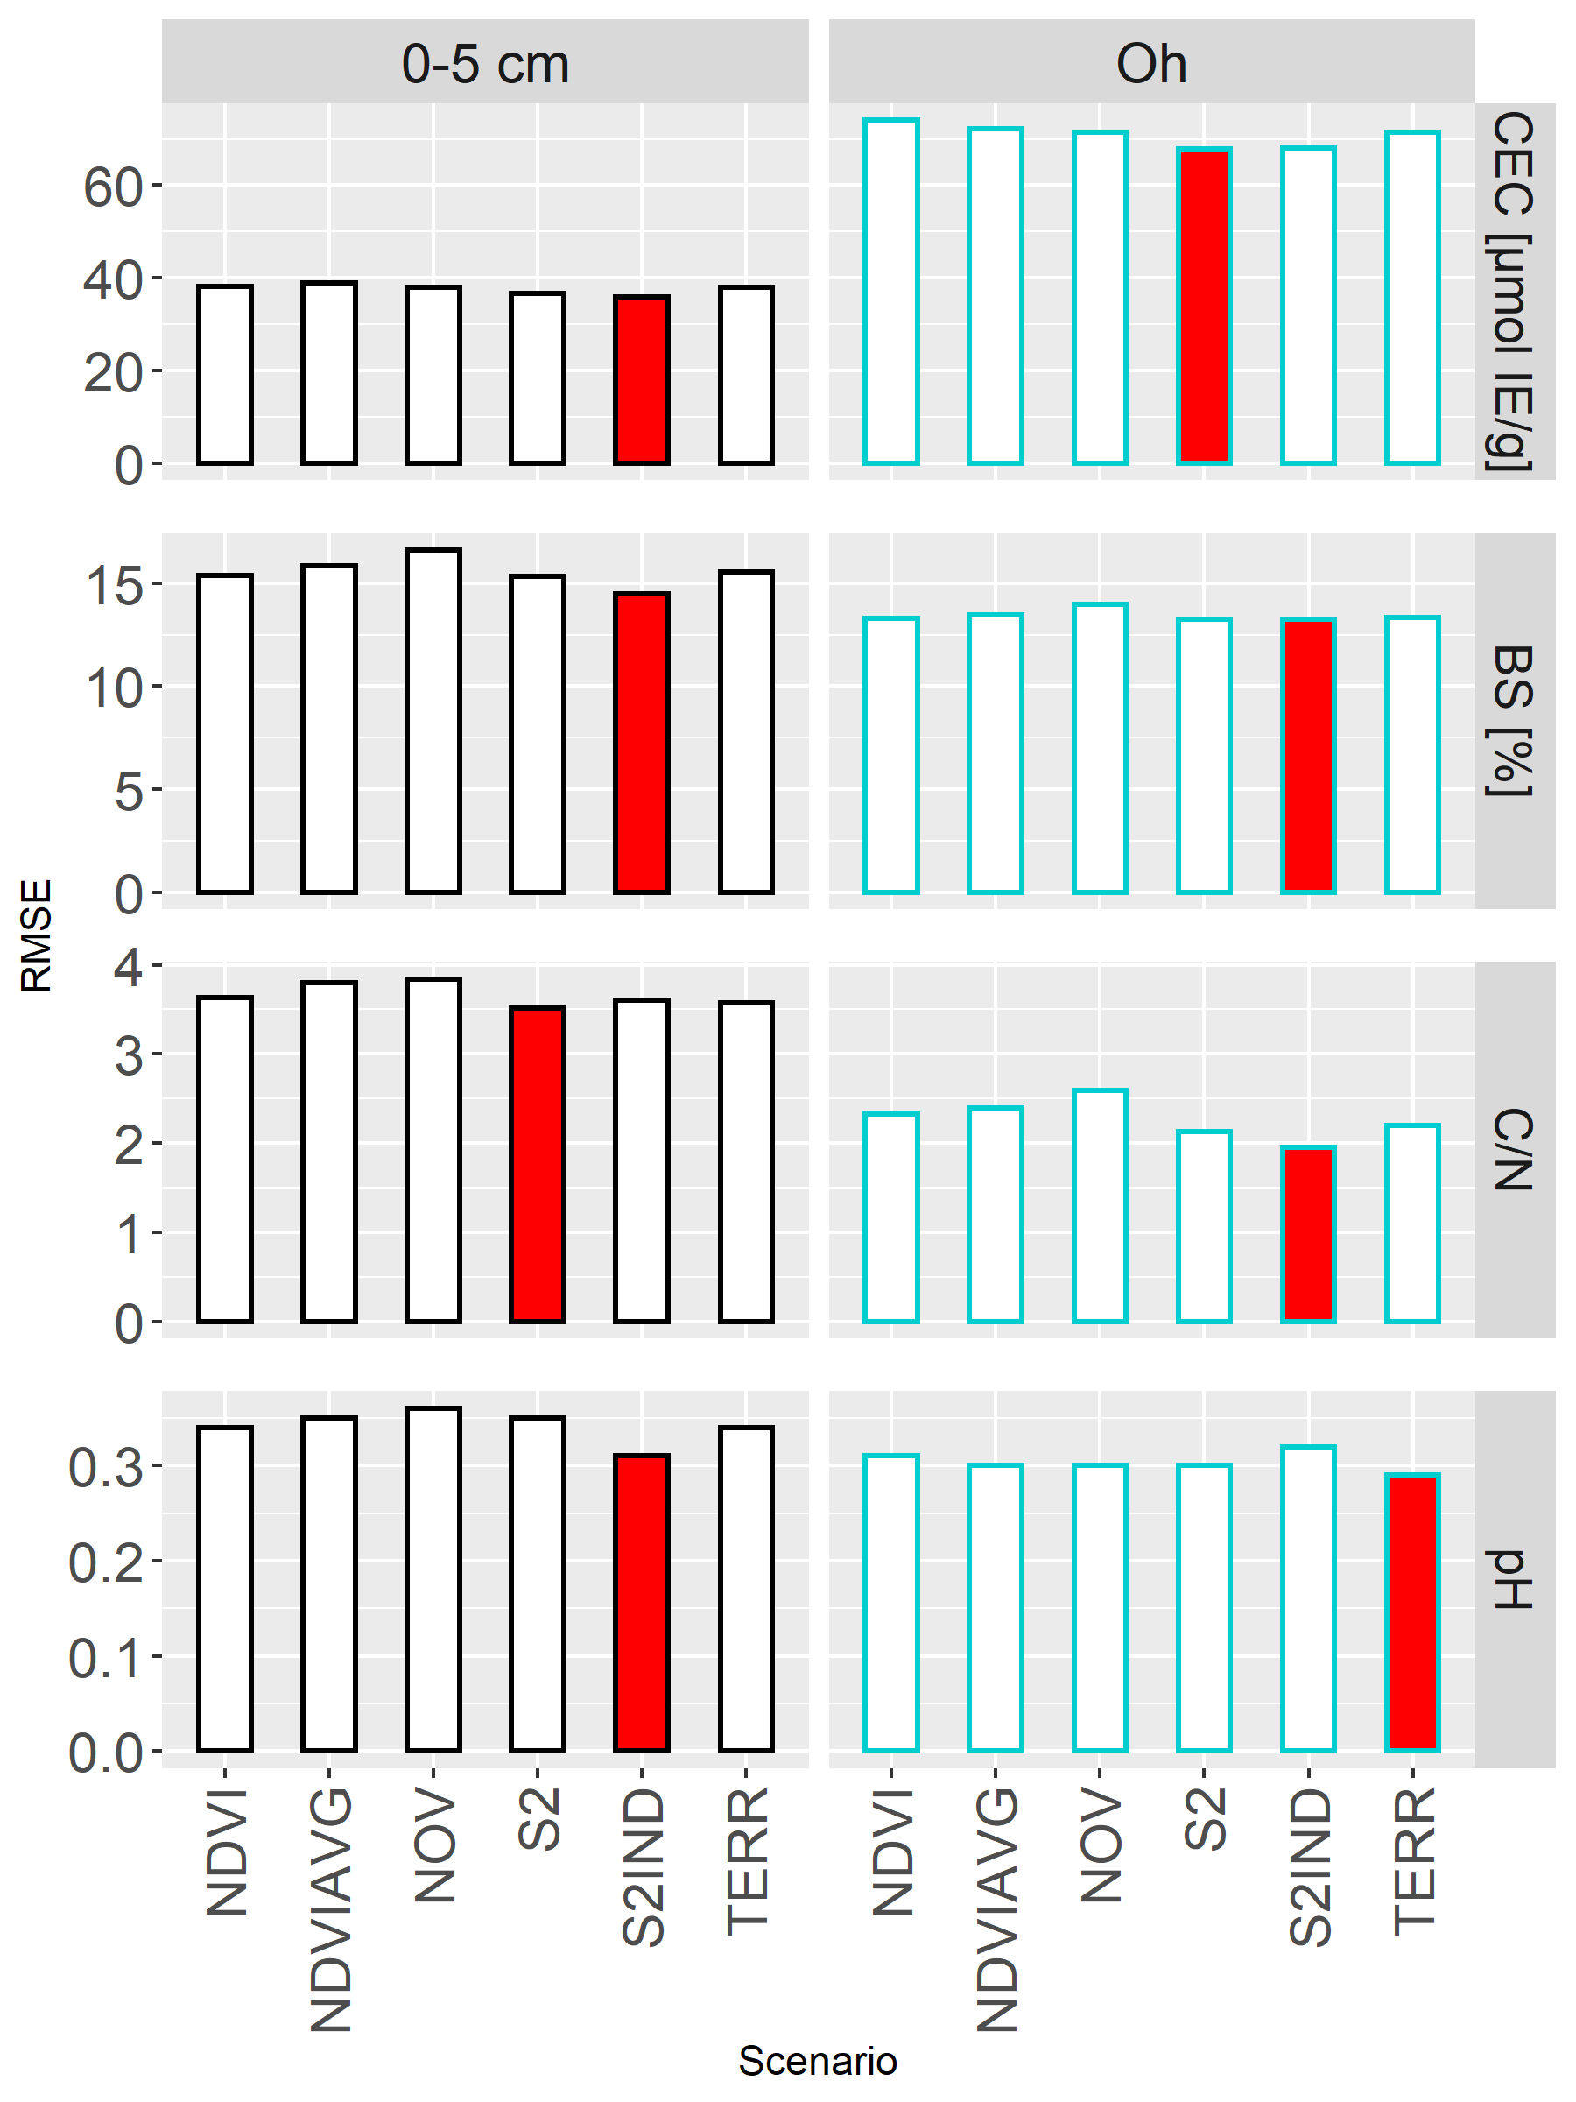
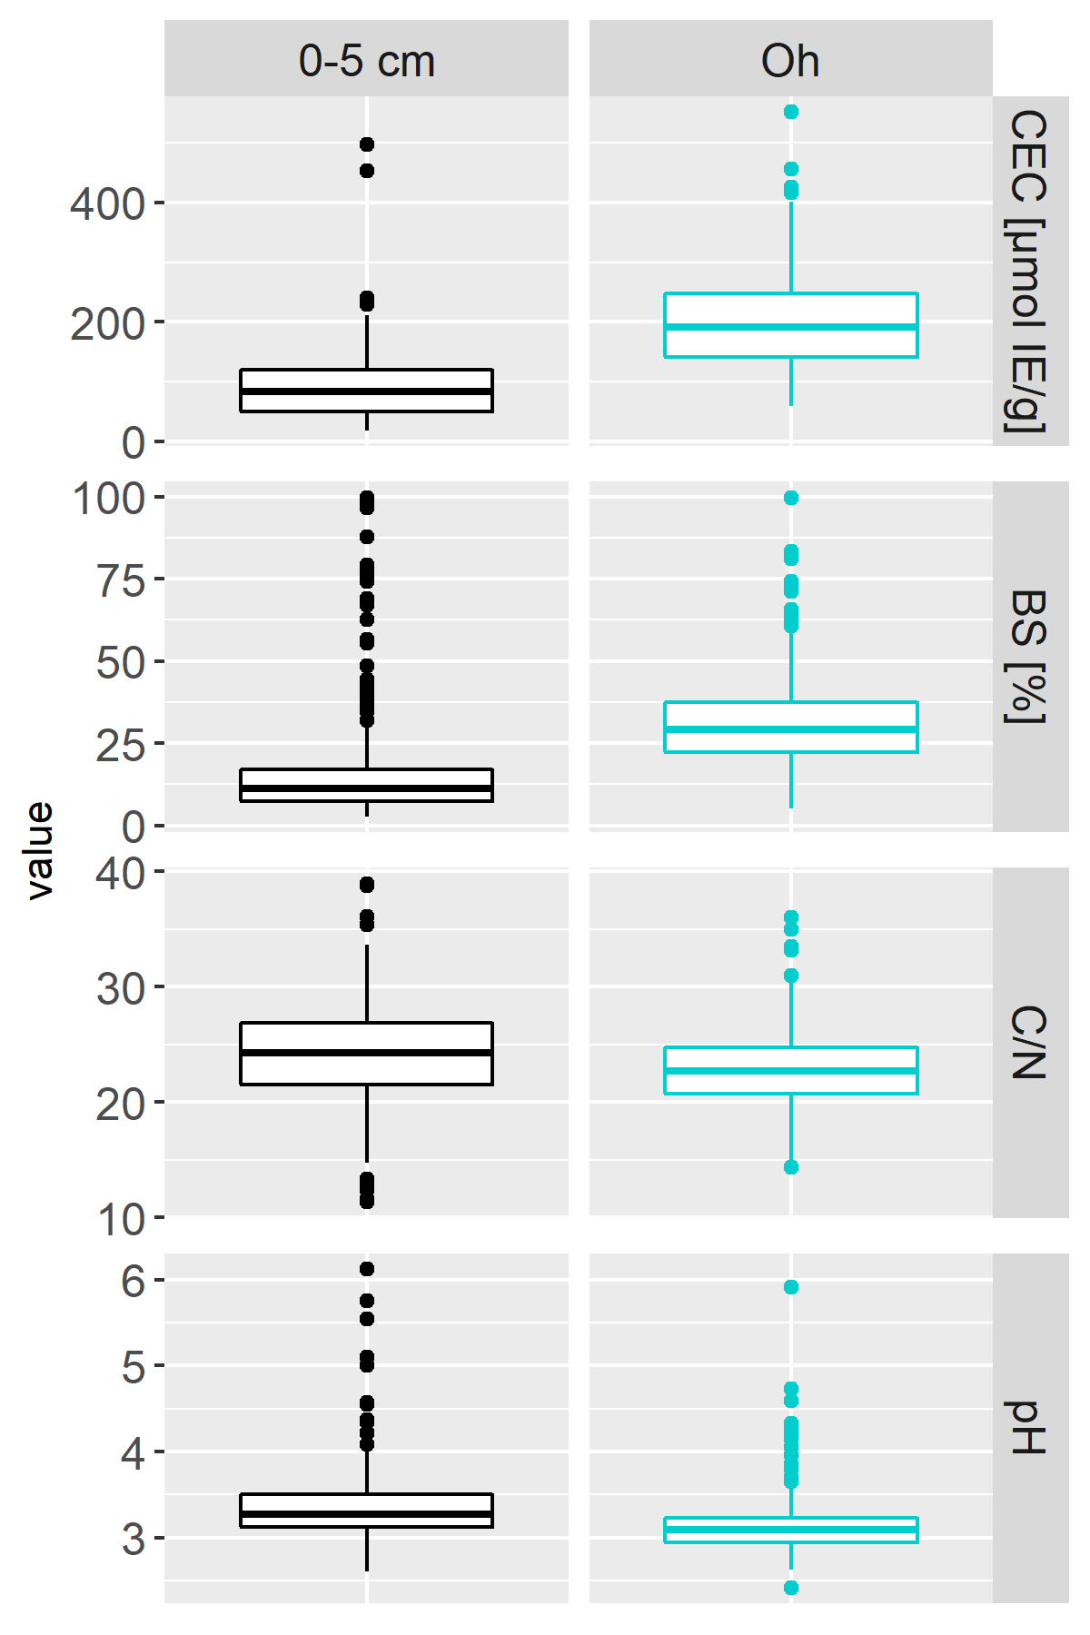
Results and discussion – RMSE and observations
A
O
A
O

Slide 13
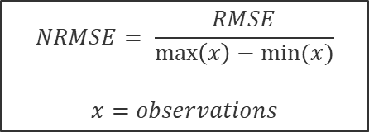
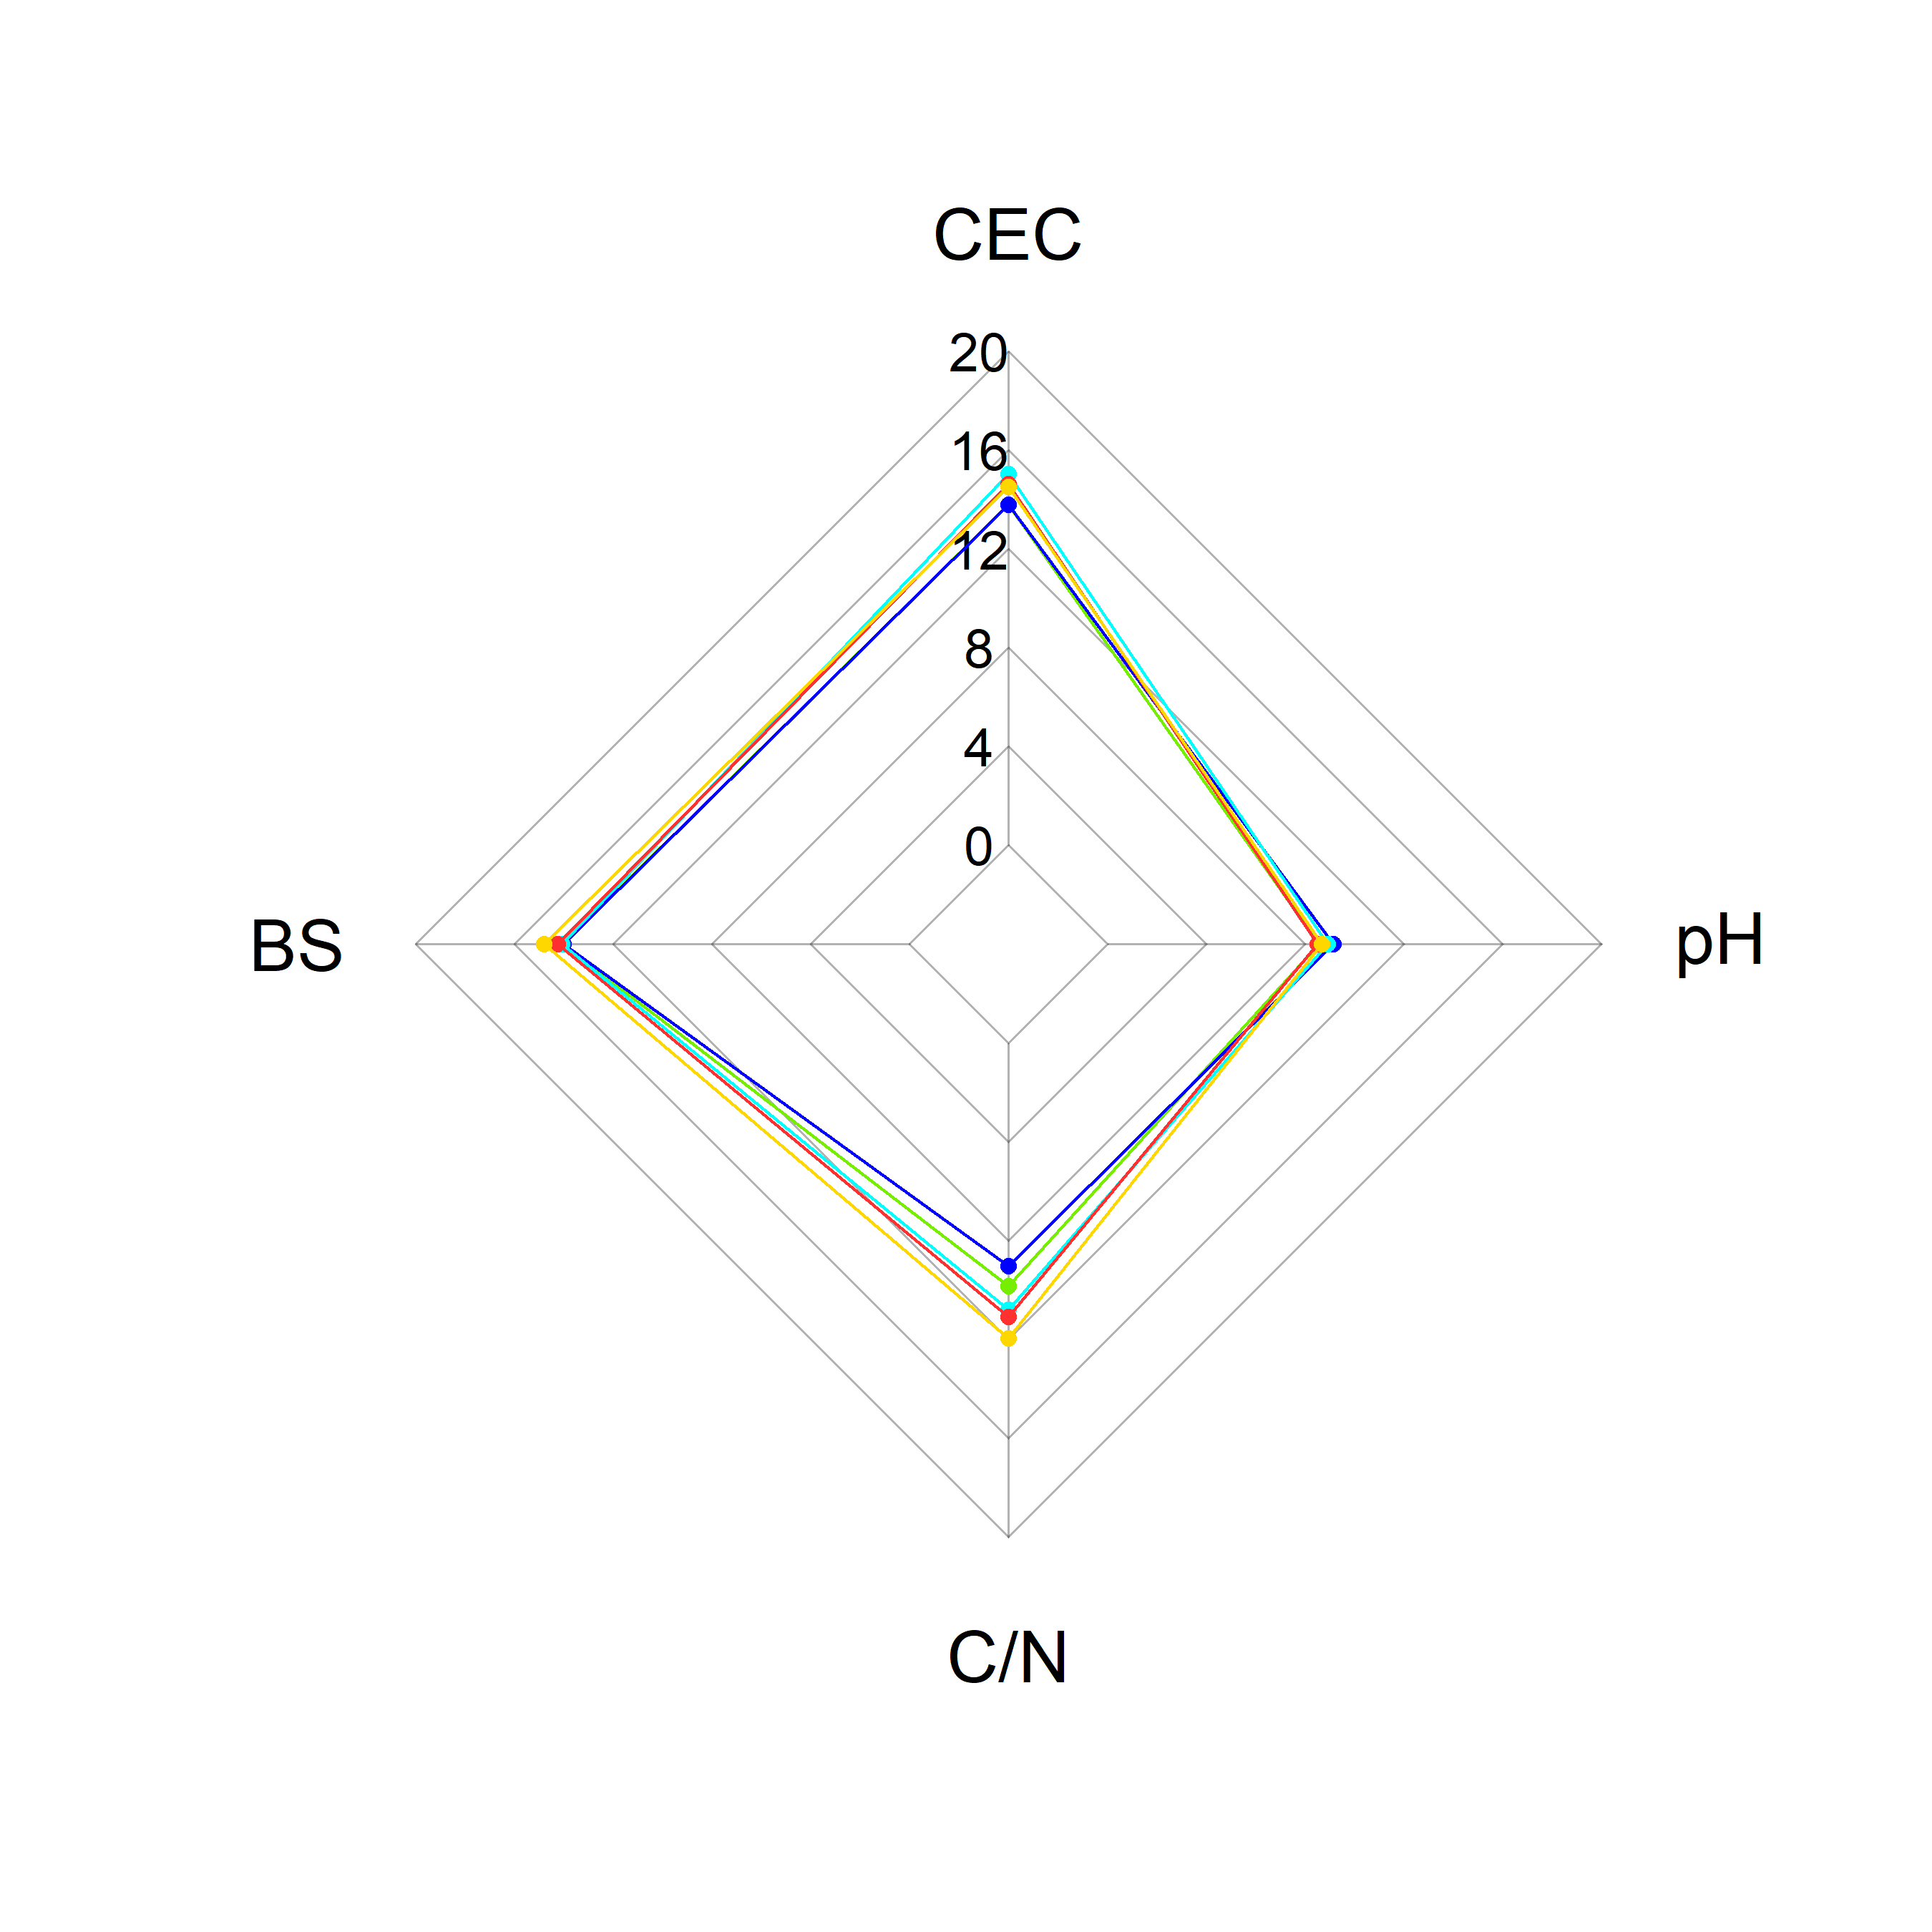
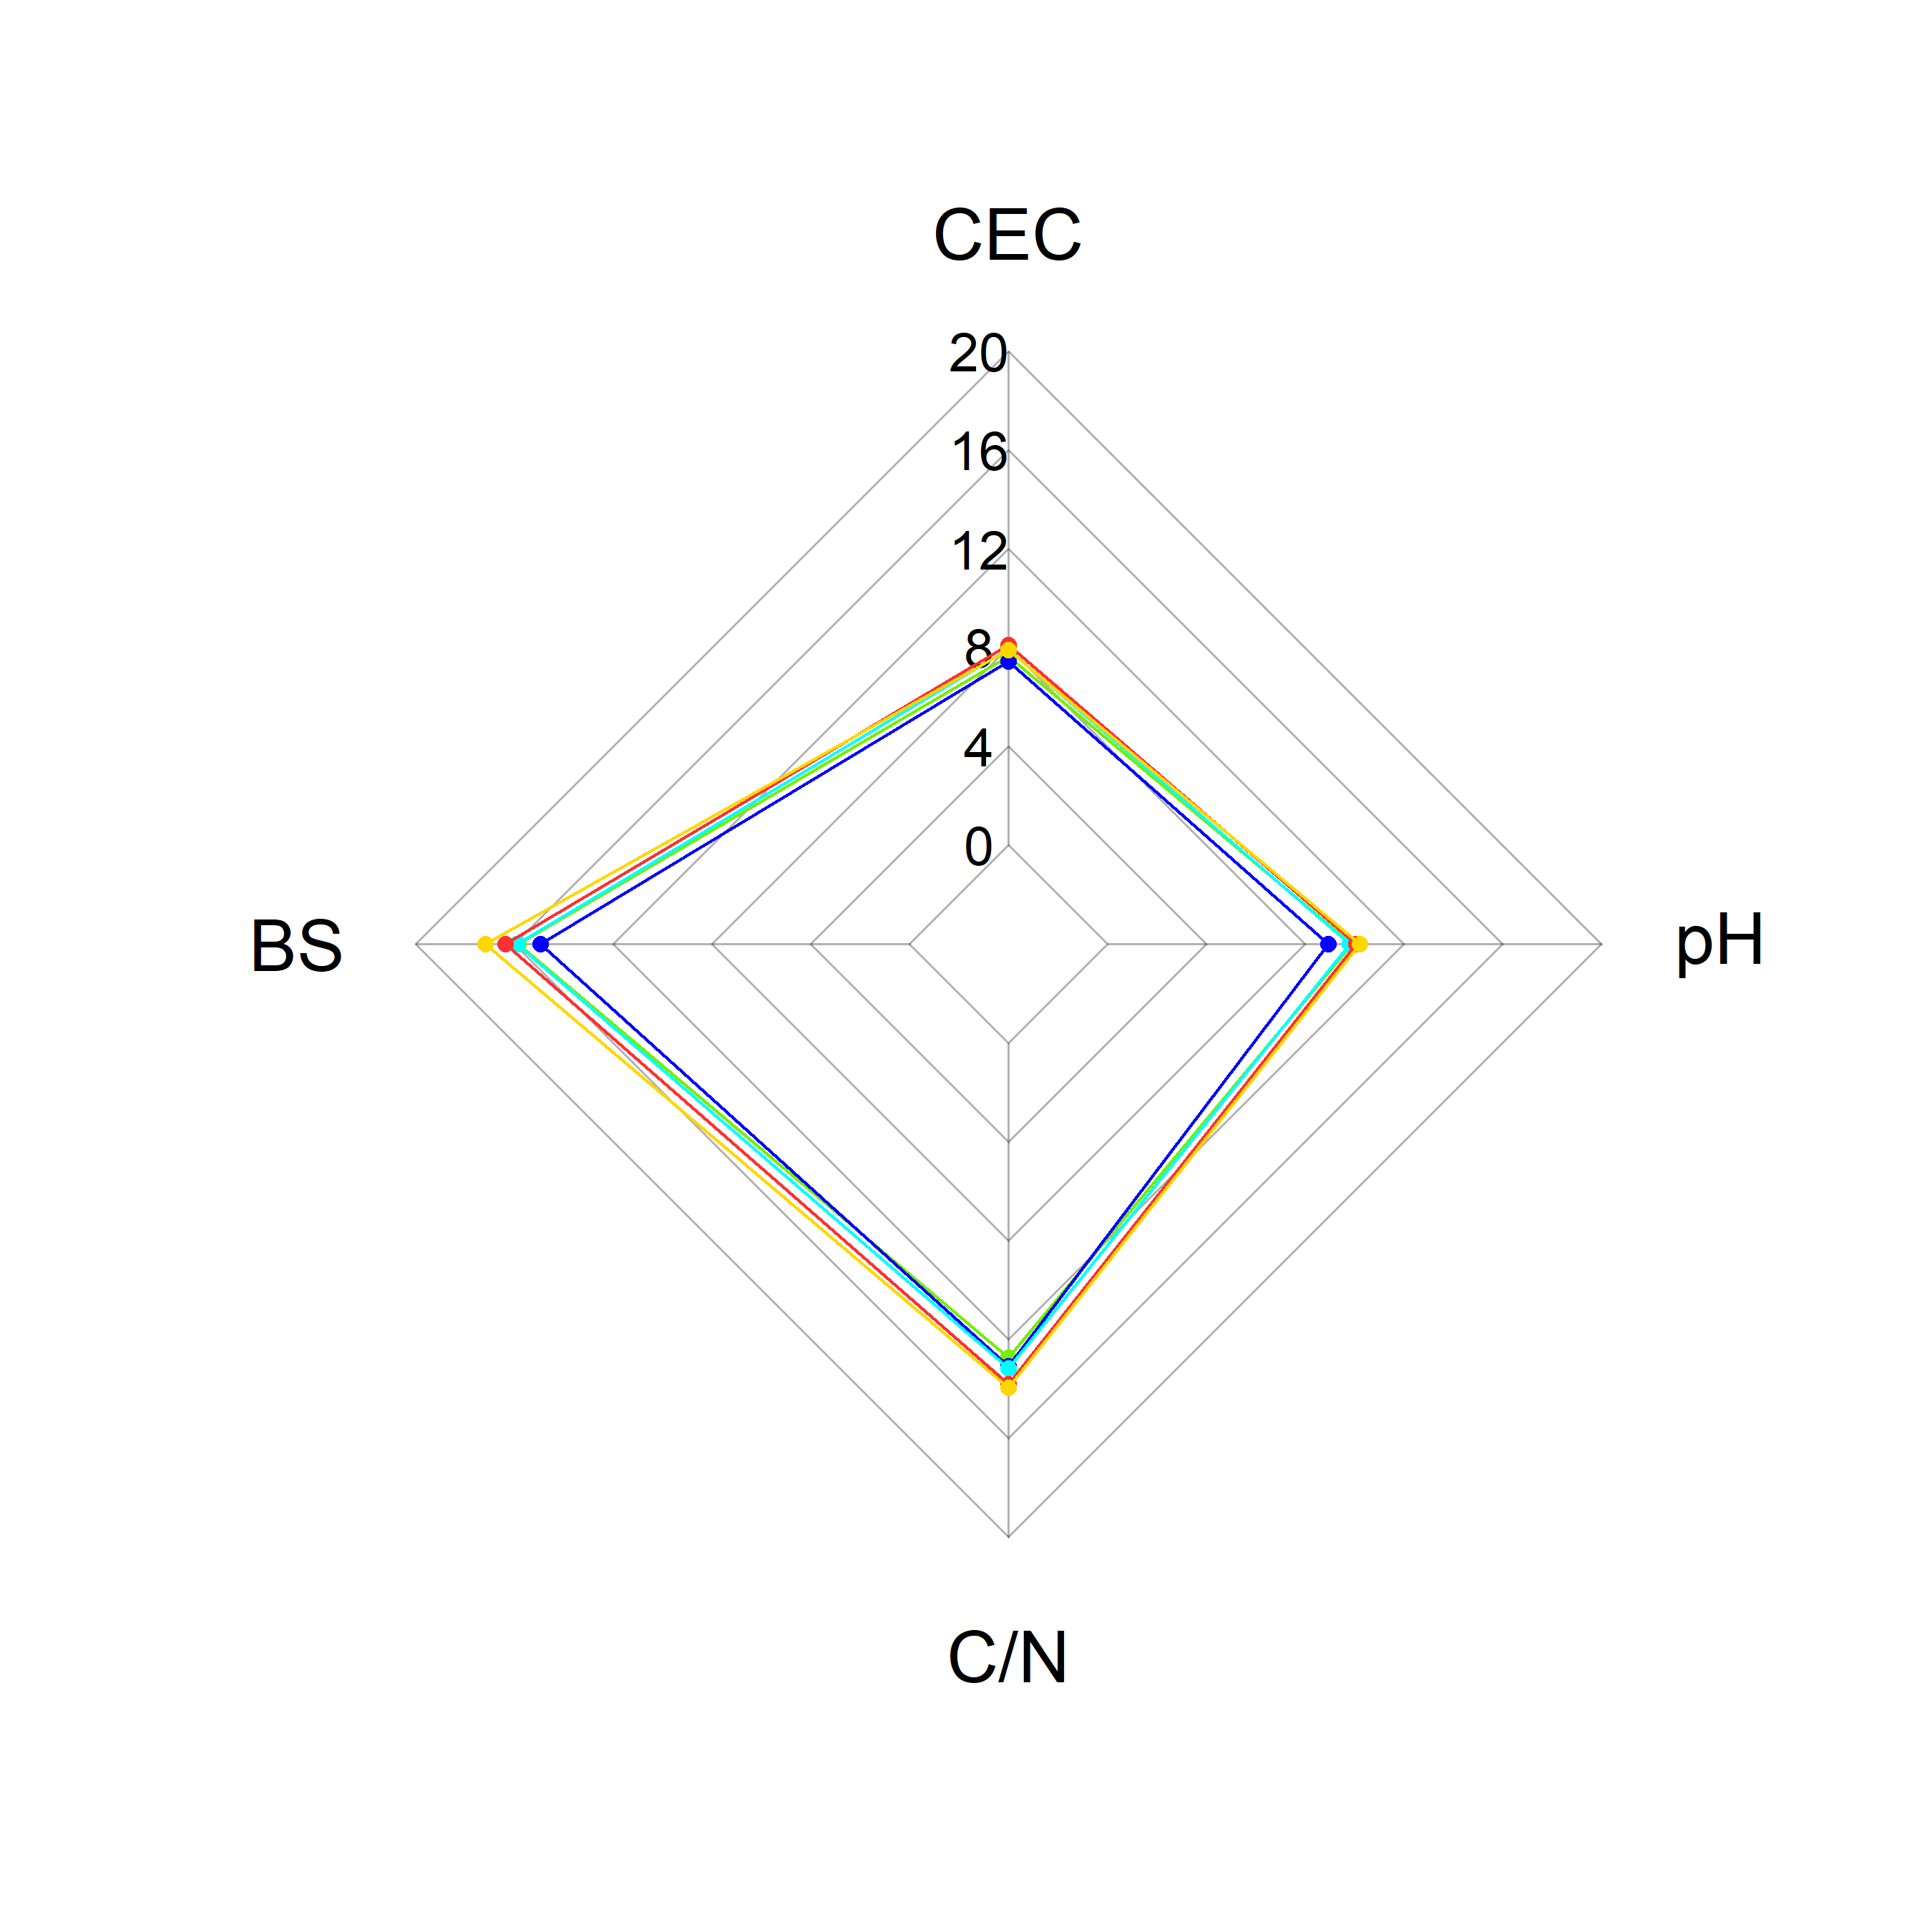
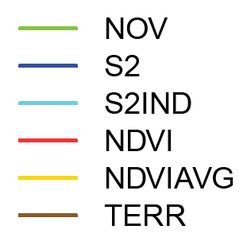
Results and discussion – Normalized RMSE (NRMSE) in %
O
A

Slide 14
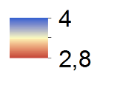
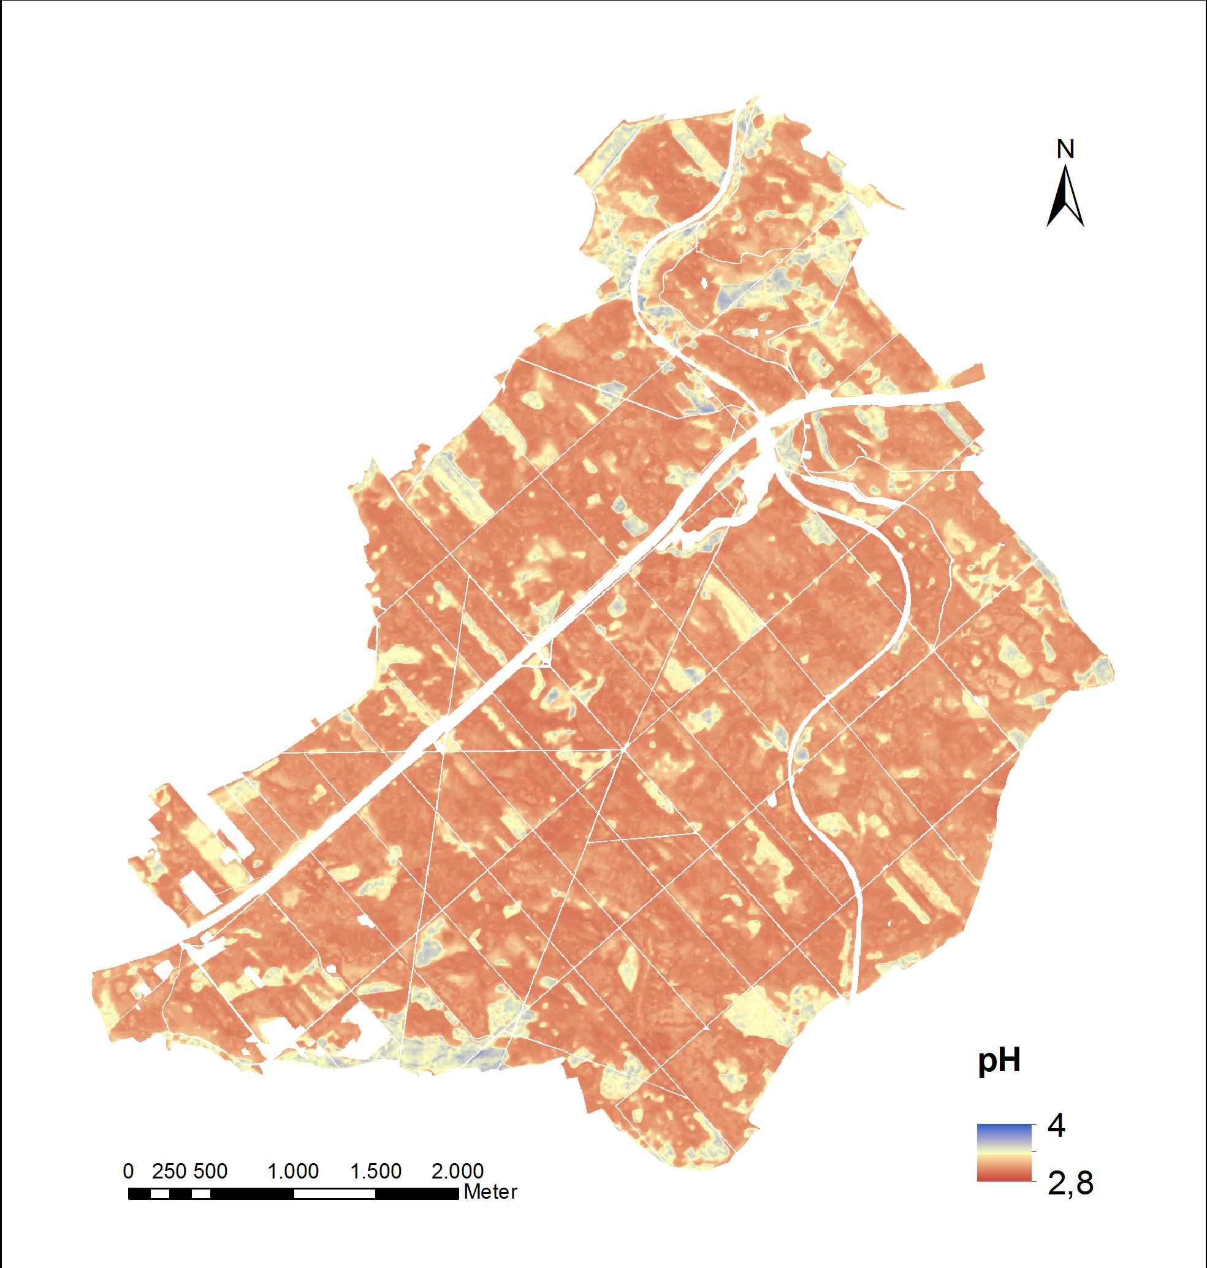
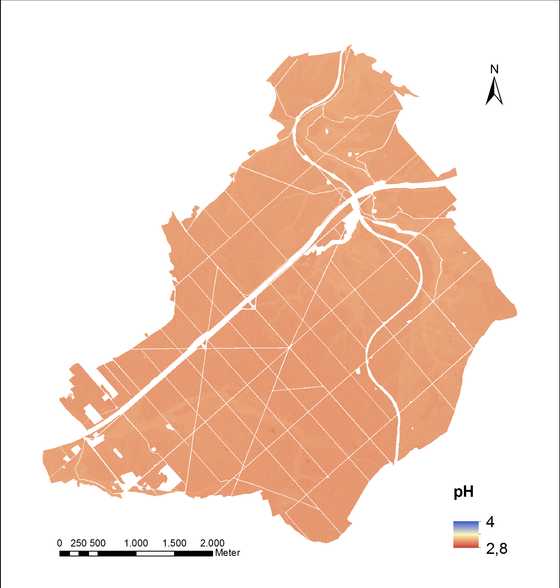
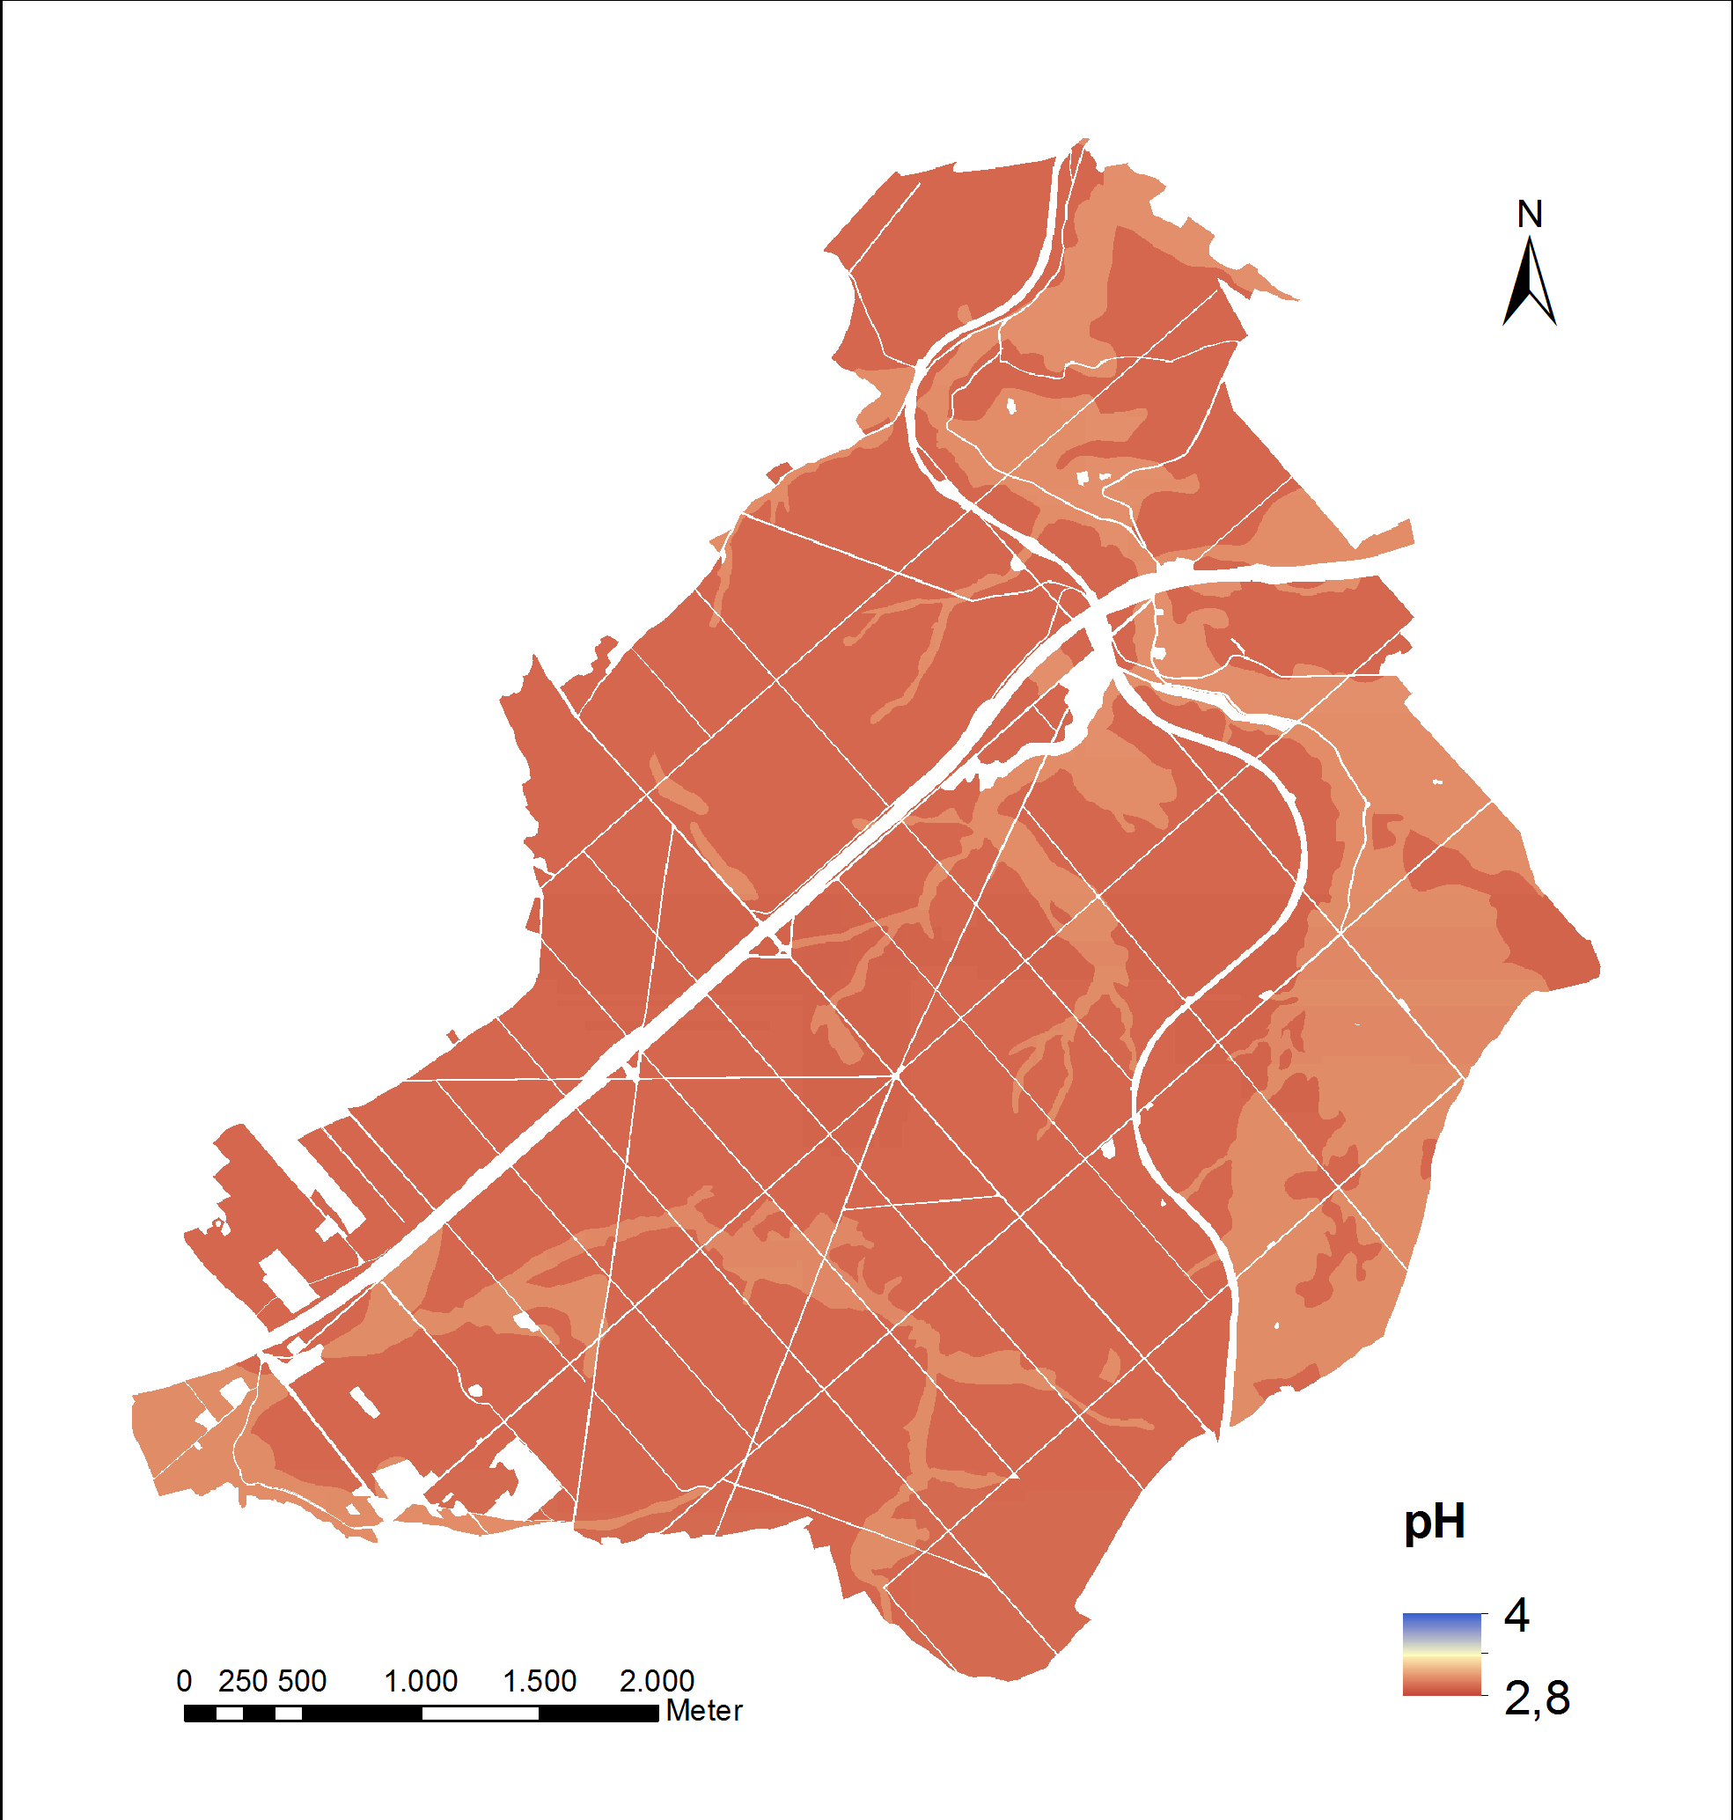
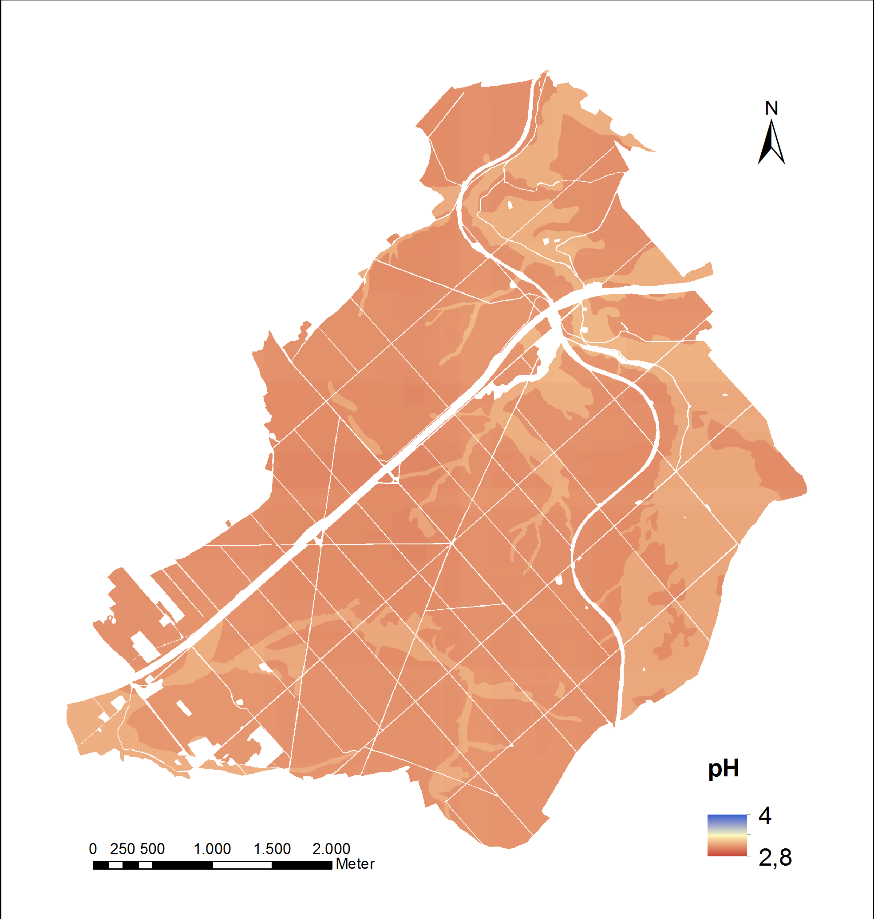
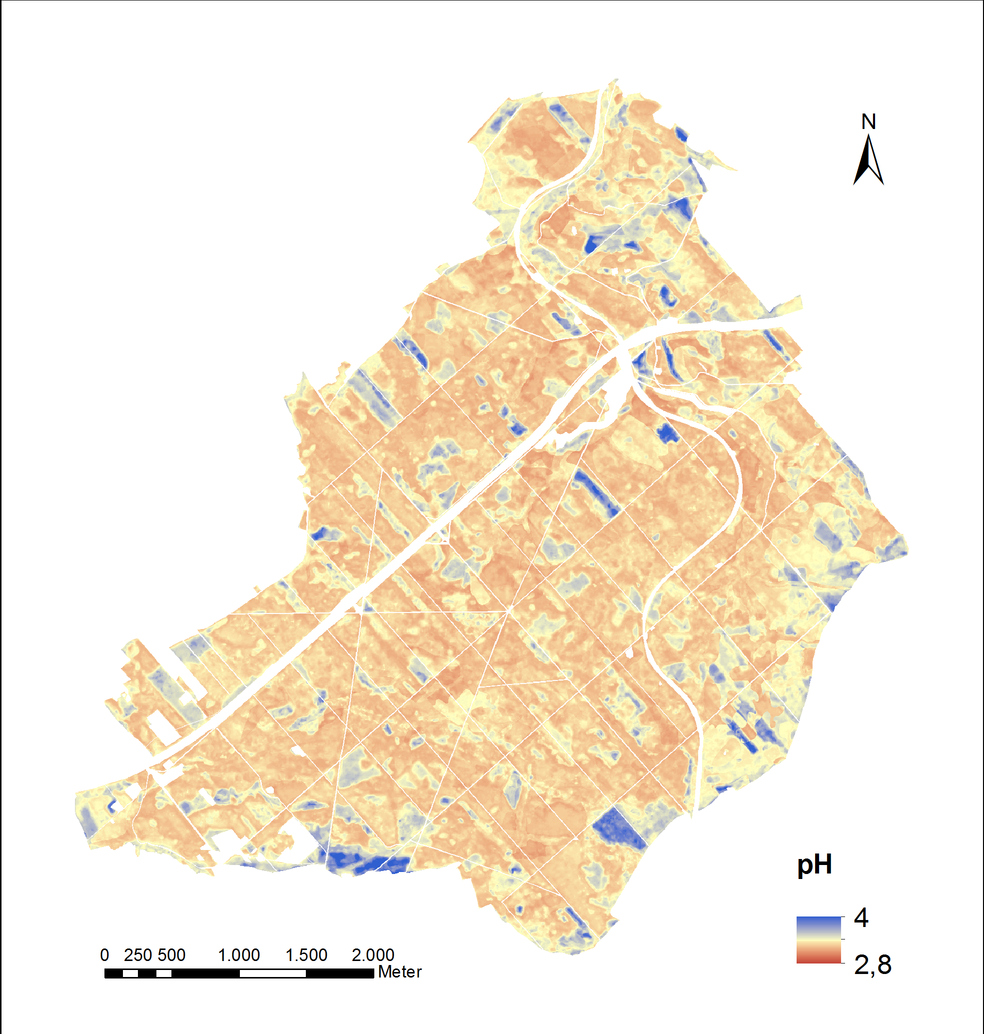
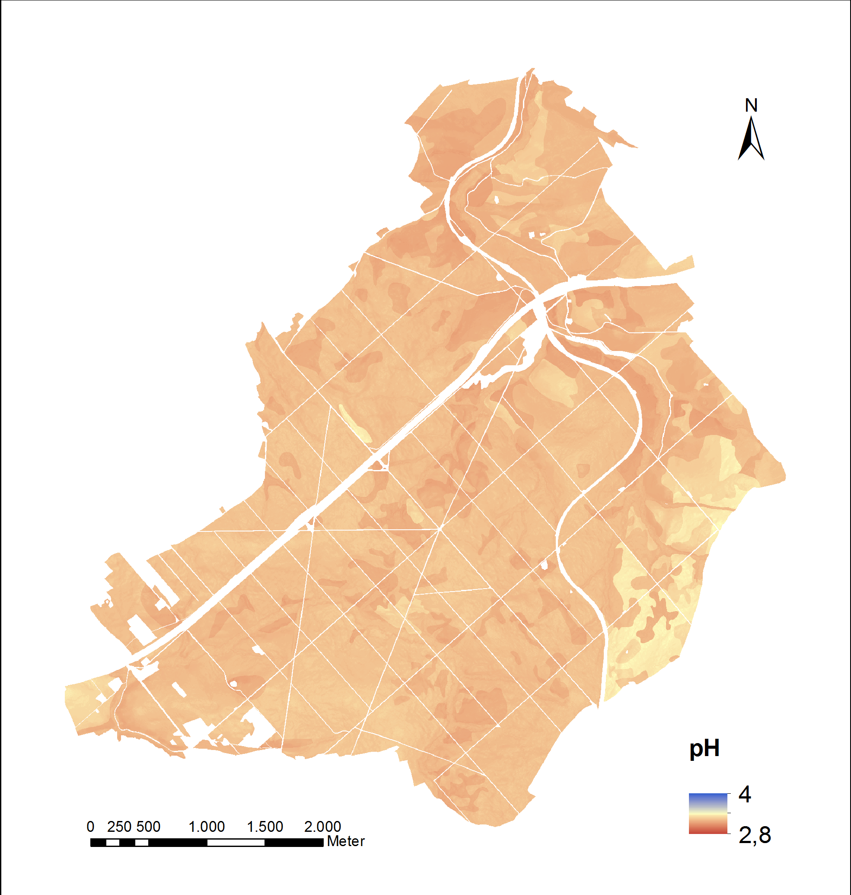
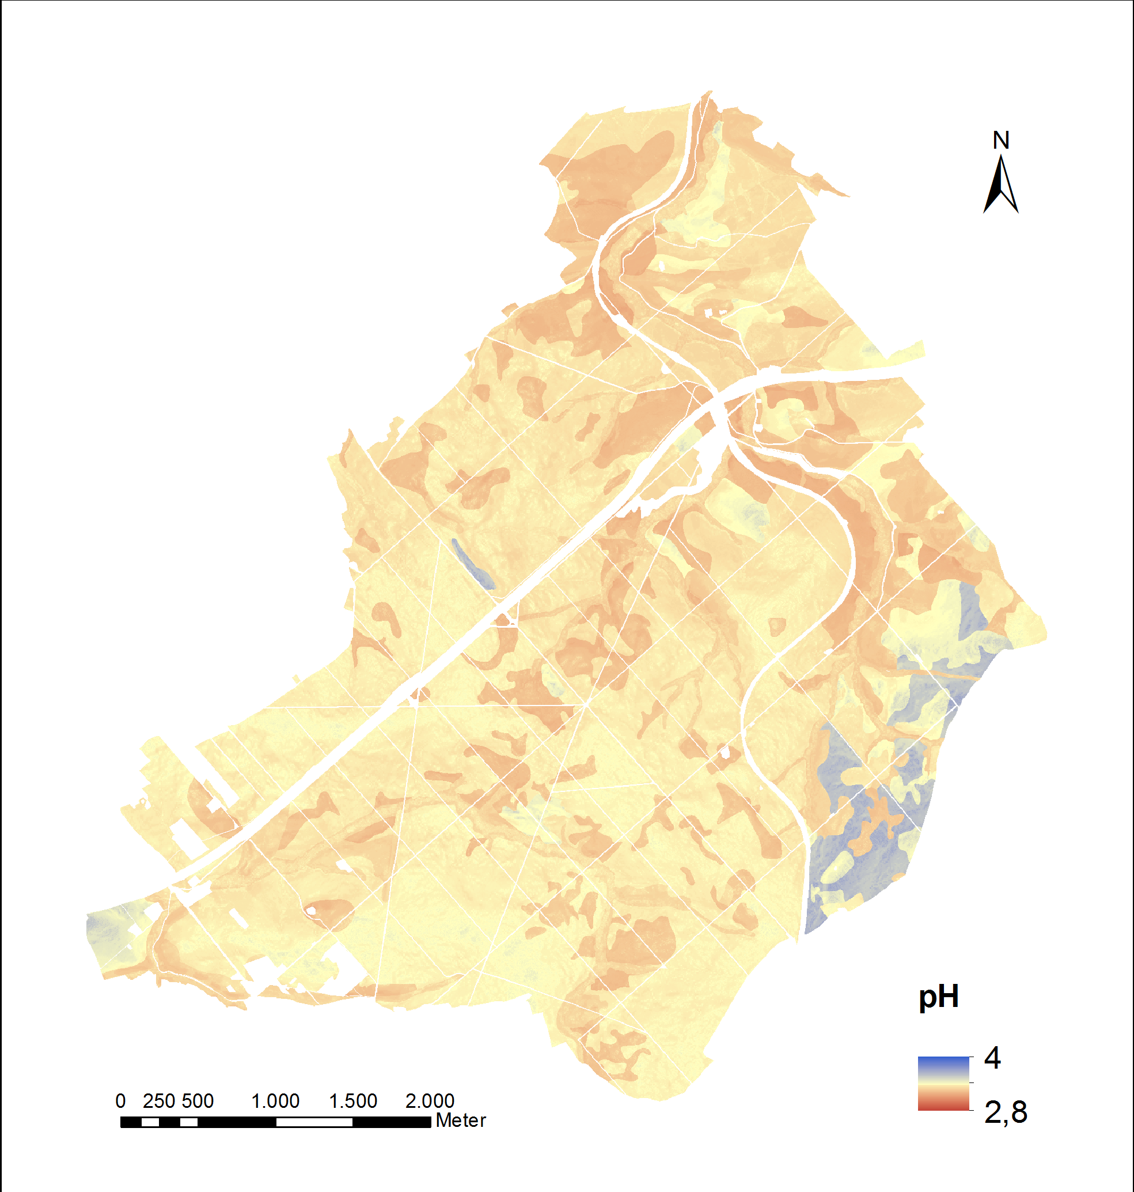
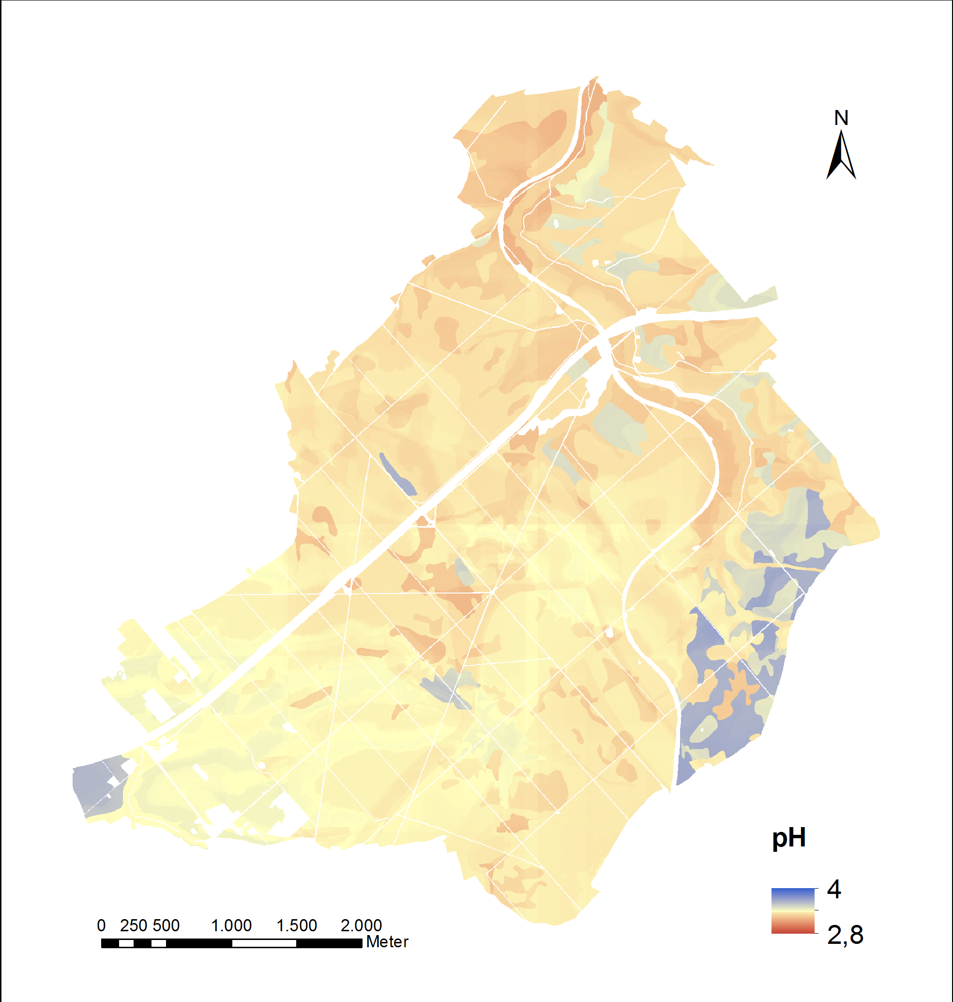
Results and discussion – prediction maps pH
pH
S2
NDVI
NDVI AVG
NOV
Var expl:
22.15 %
Var expl:
17.02 %
Var expl:
25.49 %
Var expl:
22.89 %
O
Var expl:
34.18 %
Var expl:
34.11 %
Var expl:
31.95 %
Var expl:
28.65 %
A

Slide 15
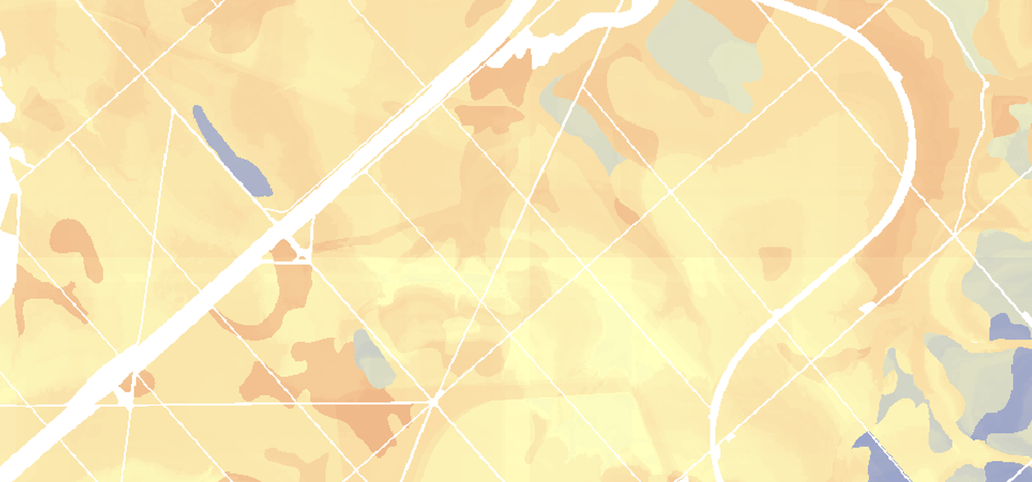


Results and discussion – prediction maps
x
y
Striping because of ancillary predictors x, y
No quality assessment of prediction maps during feature selection and tuning hyperparameters

Slide 16
Conclusions
The feature selection algorithm is especially useful when trying to separate many noisy predictors from important ones as in scenario S2IND.

Slide 17
Conclusions
The feature selection algorithm is especially useful when trying to separate many noisy predictors from important ones as in scenario S2IND.
Multi-temporal S2 data can replace categorical tree species groups from a field survey as vegetation predictors to predict chemical properties of the organic surface layer of forest soils.

Slide 18
Conclusions
The feature selection algorithm is especially useful when trying to separate many noisy predictors from important ones as in scenario S2IND.
Multi-temporal S2 data can replace categorical tree species groups from a field survey as vegetation predictors to predict chemical properties of the organic surface layer of forest soils.
We can use multi-temporal S2 data as vegetation predictors to create prediction maps with Random Forest models.

Slide 19
Conclusions
The feature selection algorithm is especially useful when trying to separate many noisy predictors from important ones as in scenario S2IND.
Multi-temporal S2 data can replace categorical tree species groups from a field survey as vegetation predictors to predict chemical properties of the organic surface layer of forest soils.
We can use multi-temporal S2 data as vegetation predictors to create prediction maps with Random Forest models.
  Error measures alone are not sufficient. Finally, the resulting prediction maps should be discussed with the user. Uncertainty maps could help to evaluate the reliability of the map.

Slide 20
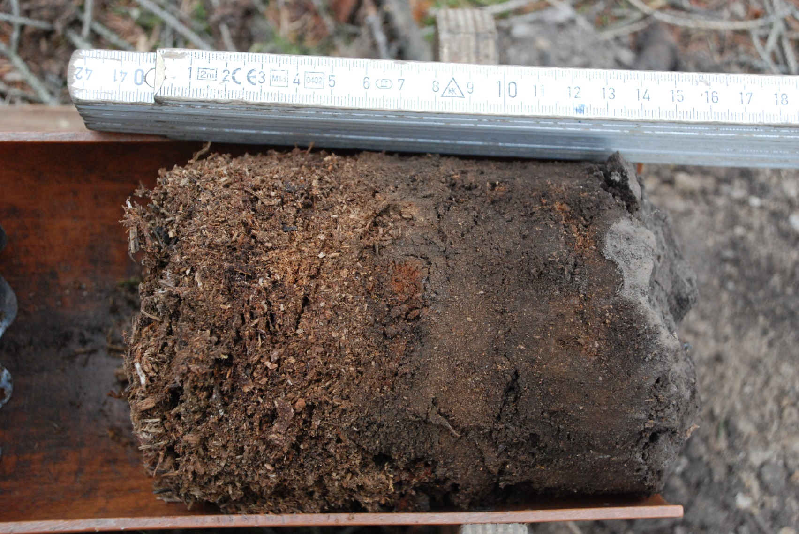



Das diesem Bericht zugrundeliegende Vorhaben wurde mit Mitteln des Bundesministeriums für Ernährung und Landwirtschaft unter dem Förderkennzeichen 22001316 gefördert. Die Verantwortung für den Inhalt dieser Veröffentlichung liegt beim Autor.
Notes:
I want to finish the presentation with a picture of the sampling campaign.
Thank you for your attention.

Slide 21
References figures
[1] https://sentinel.esa.int/web/sentinel/user-guides/sentinel-2-msi/overview
[2] Frantz, David. "FORCE - Landsat+ Sentinel-2 analysis ready data and beyond." Remote Sensing 11.9 (2019): 1124.

Slide 22
Supplementary information – predictors
Vegetation predictors S2 scenario
Sentinel-2 data of 2018, Coverage of the full area in 10 m resolution, 10 spectral bands
  Spectral temporal metrics
Using every high quality observation within temporal range
Band wise computation of multi-temporal statistical metrics per Pixel: AVG, IQR, KRT, MAX, MIN, Q25, Q50, Q75, RNG, SKW, STD
  Best-available-pixel composite (BAP)
Using only highest quality observations, which lie closest to target date
No computation of metrics
March 15
May 1
June 15
dt
Clear sky observations (cloud and haze free)
dt = time between observations
Notes:
From 10 spectral bands spectral temporal metrics and a best-available-pixel composite were computed. The spectral temporal metrics use every high quality observation within a temporal range. High quality means cloud and haze free. An example of a temporal range is shown here. The black dots are the clear sky observations and this is the target date. I used metrics of 3 temporal ranges (spring, summer, autumn). Multiple clear sky observations were used to compute multi-temporal statistical metrics of each pixel and band for every season. The best-available-pixel composite is composed of the highest quality observation that lies closest to the target date (in this case May 1) for each pixel. For every single pixel the best observation is chosen, therefore the composite may consist of observations from different dates.
From this pool we used 251 different predictors of the year 2018.

