Slide 1
Evaluation of the spatio-temporal development of hydrological droughts and its sensitivity to the choice of different parameters of the hydrological model. Case study: Magdalena-Cauca River basin - Colombia
Fabio Aguilar Carrillo | fabio.Aguilar@mail.escuelaing.edu.co
Juan M. Cotrino Palma | juan.Cotrino-p@mail.escuelaing.edu.co
Germán R. Santos Granados | german.santos@escuelaing.edu.co
Gerald A. Corzo Pérez | g.corzo@un-ihe.org
Mostafa Farrag | mostafa.farrag@gfz-potsdam.de

Slide 2
Sustainable Hydropower and Multipurpose Storage to meet Water, Food, and Energy Development Goals: A Program for Collaborative Research and Innovation
(S-MultiStor), project 106472
2017

Slide 3
MOTIVATION
How can the parameters of hydrological models determine variations in the characteristics of droughts and their spatio-temporal development?
High global consumption of fossil fuels (Zamora, Huerta, & Maqueo, 2016).
Cost of droughts has generated losses of over 100 billion euros in the EU (Strosser et al., 2012).
Between 2010 and 2011, severe droughts killed more than 250,000 people in East Africa (Carty, 2017).
In Colombia (1991) there was a drought that triggered a serious energy crisis (González, Daza, & Urueña, 2008).
Difficulty objectively characterizing droughts (Vicente-Serrano, Beguería, & López-Moreno, 2010).
Reasearch question:

Slide 4
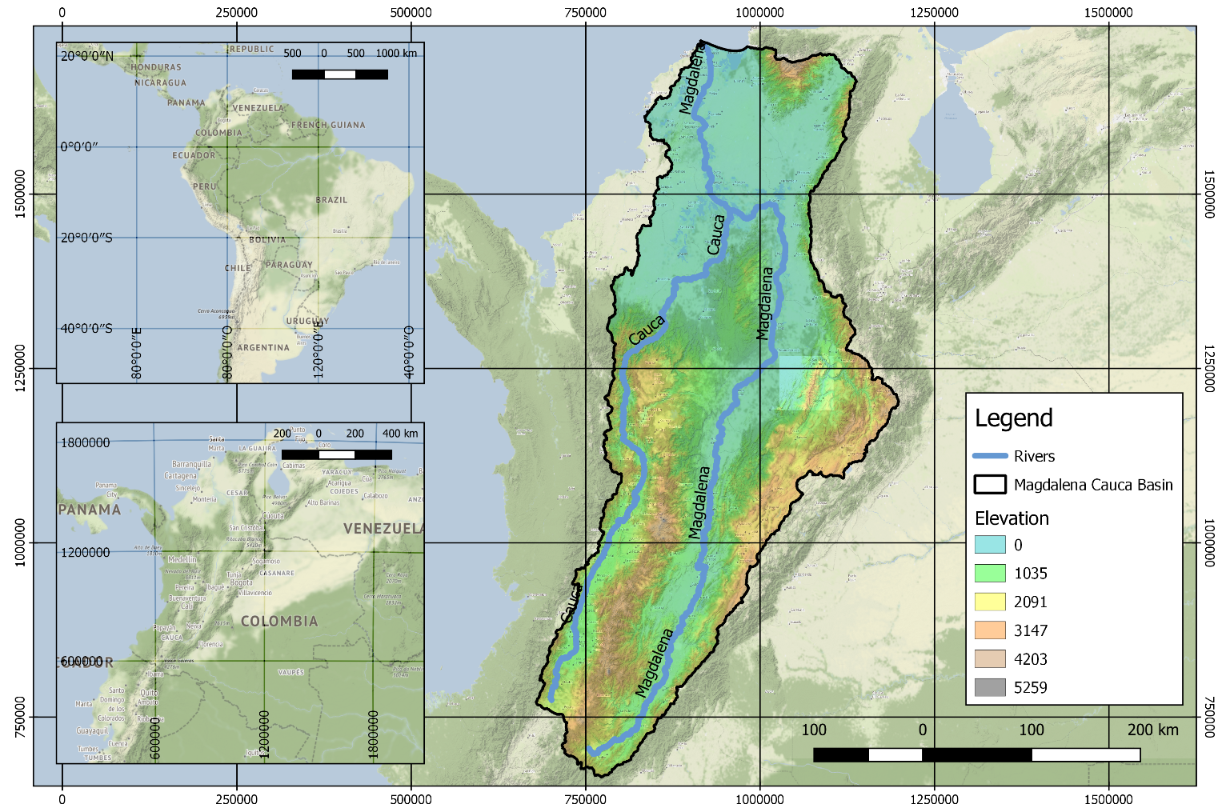
STUDY CASE
Magdalena – Cauca Basin in Colombia
According to the Ministry of housing and territorial development (2015):
Basin area of 273.459 km².
24% of the Colombian territory.
77% of the country’s total population.
Length of the Magdalena river 1.528 km.
Average flow of the Magdalena river 7.100 m³/s.
Length of the Cauca river 1.180 km.
Average flow of the Cauca river 2.275 m³/s.
Source: Authors

Slide 5
METHODOLOGY
II. HYDROLOGIC CHARACTERIZATION
Hydrological modeling
III. SPATIOTEMPORAL ANALYSIS
Non-contiguous drought area analysis (NCDA)
Contiguous drought area analysis (CDA)
IV. ANALYSIS AND RESULTS
I. DATA COLLECTION
Satellite meteorological data (CHIRPS and ERA-INTERIM)
Lake data
Drought index calculation
Drought characterization in duration and severity
To come
In process
Done

Slide 6
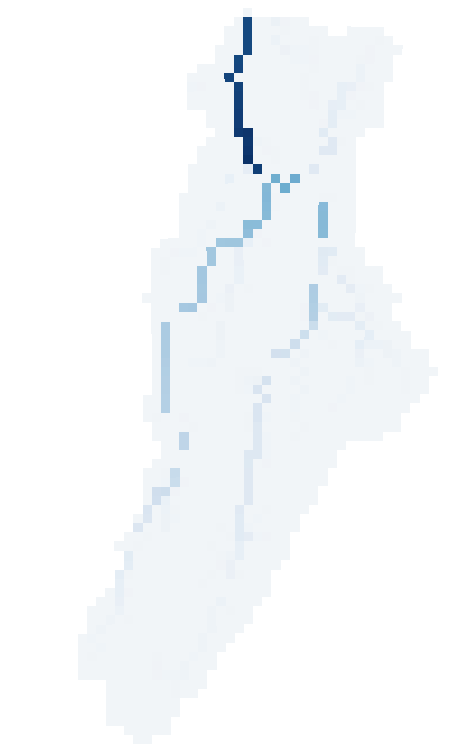
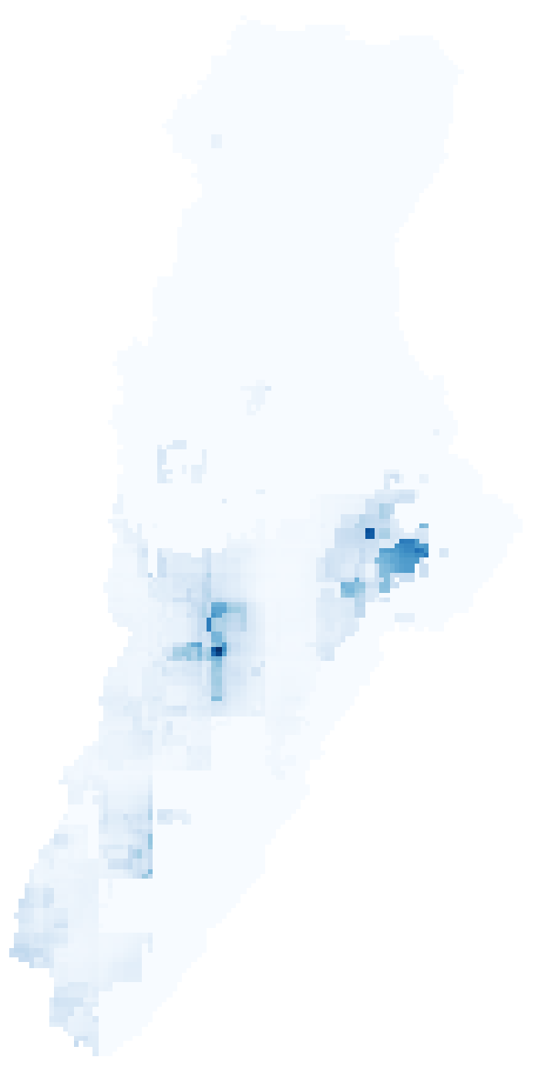
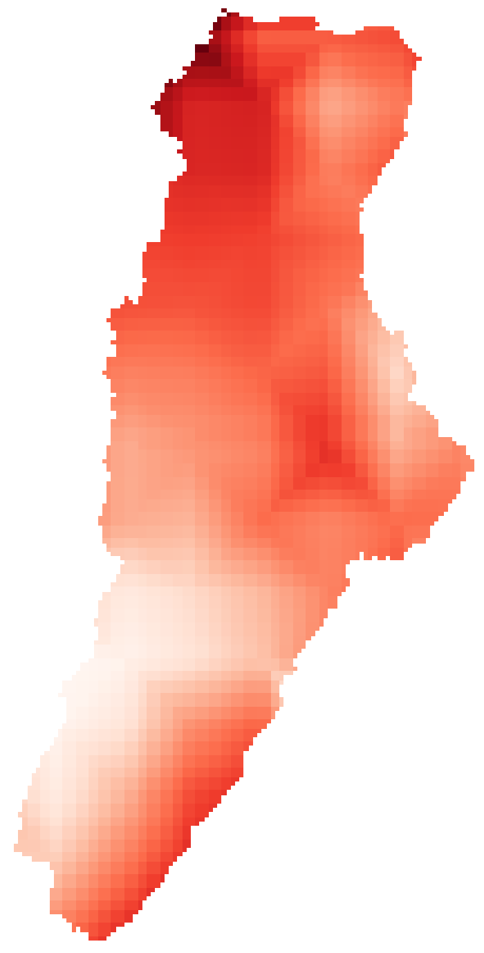
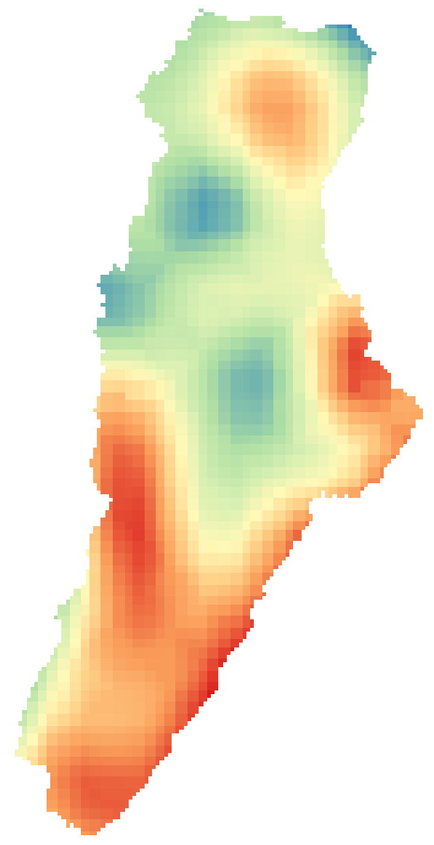
DATA COLLECTION
Daily rasters downloaded from CHIRPS and ERA-INTERIM servers using WAToolbox python package, and lake data from reservoir operators
Runoff
(ERA-INTERIM)
Precipitation
(CHIRPS)
Potential Evapotranspiration
(ERA-INTERIM)
Temperature
(ERA-INTERIM)
Lake data
Source: Authors

Slide 7
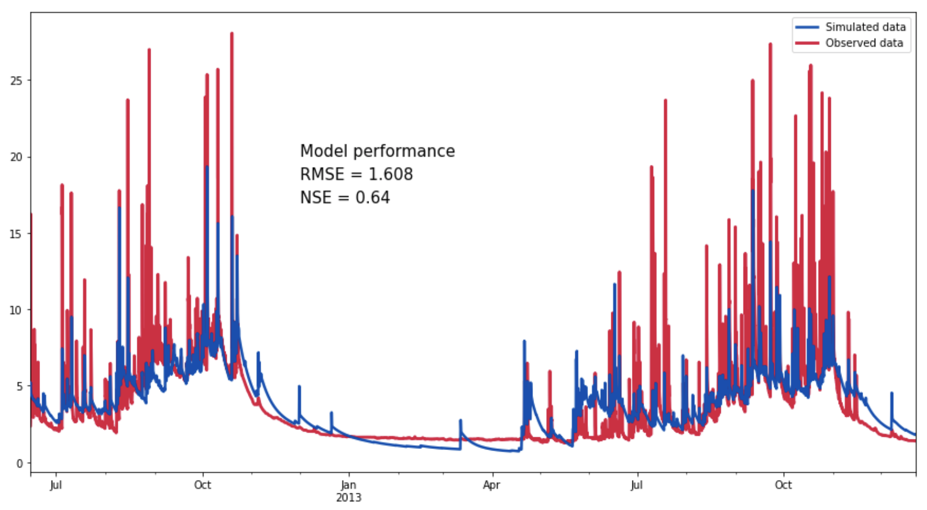
HYDROLOGICAL MODELING
HBV Model (HAPI python package)
Precipitation
Potential Evapotranspiration
Temperature
Flow Accumulation
Flow Direction
Lake data
Comparison between observed and simulated data. Retreive from https://github.com/MAfarrag/HAPI/blob/master/Examples/03Jiboa.ipynb

Slide 8
DROUGHT DEFINITION
Binary representation of a drought event
$$D_{s}\left(t\right)=\left\{\begin{aligned}1 if X_{t}< T_{t} \\ 0 if X_{t}≥ T_{t}\end{aligned}\right.$$
$D_{s} :Drought state per cell$
$X_{t} :Hydrologic variable considered$
$T_{t} :Threshold$
Percentage drought area relative to the total study area
$$PDA \left(t\right)=100/A_{tot} .\sum_{c=1}^{N}{(D_{s}\left(t\right). A)}$$
$PDA :Percentage drought area$
$D_{s} :Drought state per cell$
$A :Cell area$
$A_{tot} :Total study area$
(Corzo Perez, Van Huijgevoort, Voß, & Van Lanen, 2011)

Slide 9
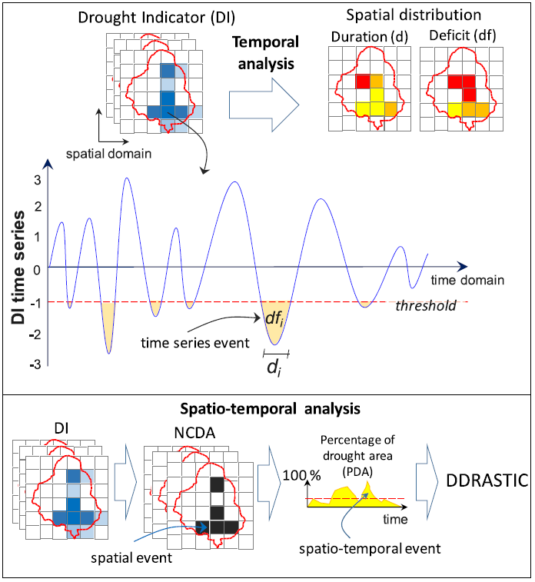
SPATIO-TEMPORAL ANALYSIS
DROUGHT INDICATOR
NCDA/CDA ANALYSIS
Standardized Runoff Index (SRI)
Standardized Soil Moisture Index (SSI)
Standardized Evapotranspiration Deficit Index (SEDI)
Source: Diaz, V., Corzo, G., Van Lanen, H. A. J., & Solomatine, D. P. (2019)

Slide 10
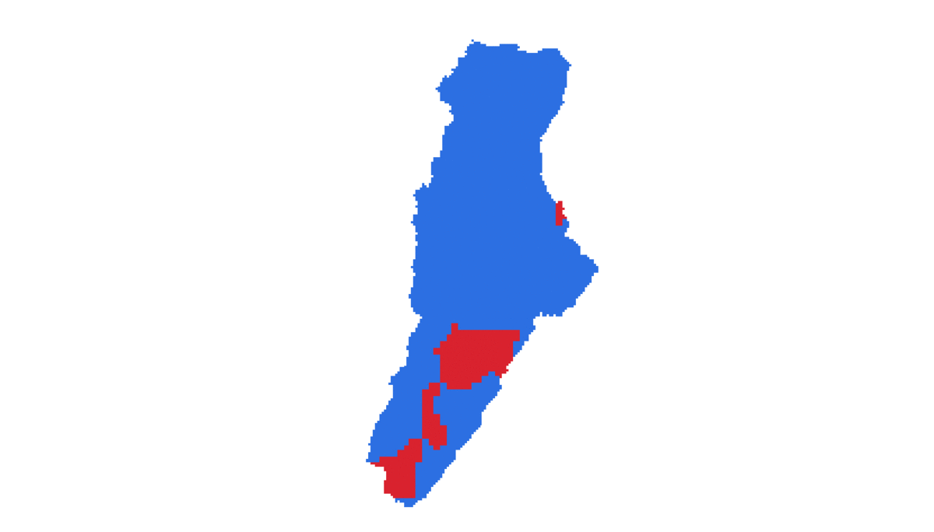
PRELIMINARY RESULTS
Drought development in space and time for random period
Blue cells: No drought
Red cells: Drought
Note: To watch the animated gif please switch to presentation mode

Slide 11
DISCUSSIONS
This research aims to be a tool for decision making of government institutions, as it allows to analyze the development of hydrological droughts an its meteorological conditions associated.
This study can be used as a starting point for future investigations on the hydrological droughts forecasting

Slide 12
REFERENCES
Carty, T. (2017). El clima, en crisis: Cómo el cambio climático está agravando la sequía y el desastre humanitario en África Oriental. Recuperado de https://oxfamilibrary.openrepository.com/bitstream/handle/10546/620263/mb-climate-crisis-east-africa drought-270417- es.pdf;jsessionid=593F679EAC1885CD9E3BFEE3B8B4CAC4?sequence=5
Diaz, V., Corzo, G., Van Lanen, H. A. J., & Solomatine, D. P. (2019). Spatiotemporal Drought Analysis at Country Scale Through the Application of the STAND Toolbox. In Spatiotemporal Analysis of Extreme Hydrological Events. https://doi.org/10.1016/b978-0-12-811689- 0.00004-5
González, J., Daza, C., & Urueña, C. (2008). esquema de generación distribuida como una opción para el Sistema eléctrico colombiano Distributed generation scheme analysis as an option for colombian. En Ingenieria.Udea.Edu.Co (Vol. 44).
M. Farrag, HAPI, (2018), GitHub repository, https://github.com/MAfarrag/HAPI/blob/master/Examples/03Jiboa.ipynb
Strosser, P., Dworak, T., Garzón Delvaux, P. A., Berglund, M., Schmidt, G., Mysiak, J., … Ashton, V. (2012). Gap Analysis of the Water Scarcity and Droughts Policy in the EU. En SWD (2012) 380 final. Recuperado de http://ec.europa.eu/environment/water/quantity/pdf/WSDGapAnalysis.pdf
Vicente-Serrano, S. M., Beguería, S., & López-Moreno, J. I. (2010). A multiscalar drought index sensitive to global warming: The standardized precipitation evapotranspiration index. Journal of Climate. https://doi.org/10.1175/2009JCLI2909.1
Zamora, M. E., Huerta, A. H., & Maqueo, O. P. (2016). Cambio global : el Antropoceno. 67–75

Slide 13
Thank you

