Slide 1
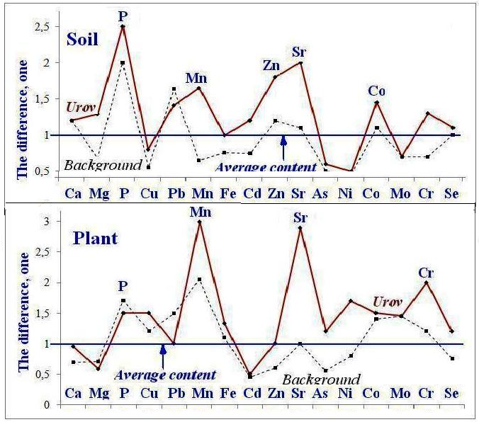
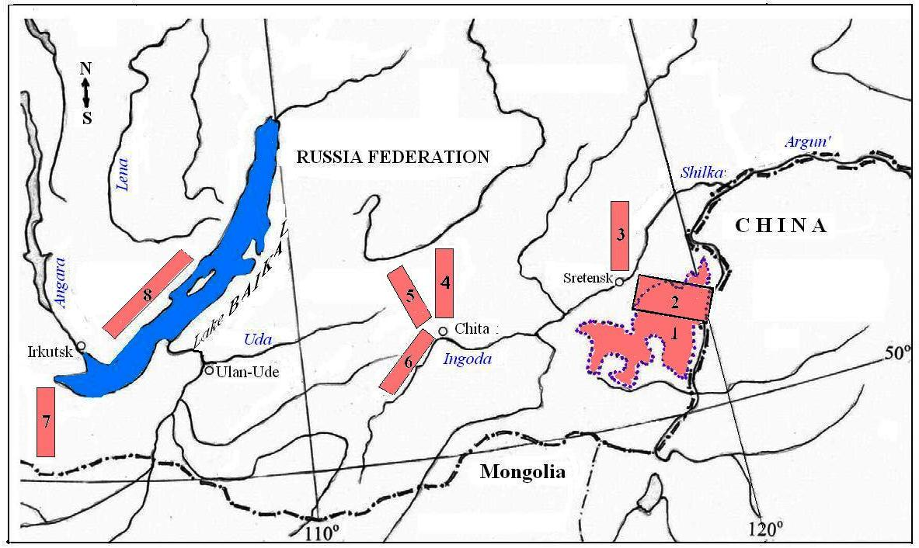
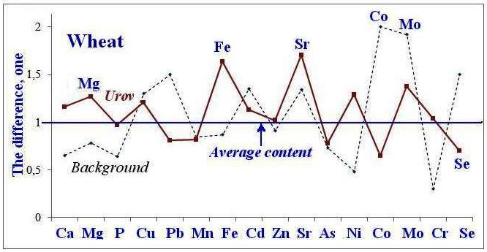
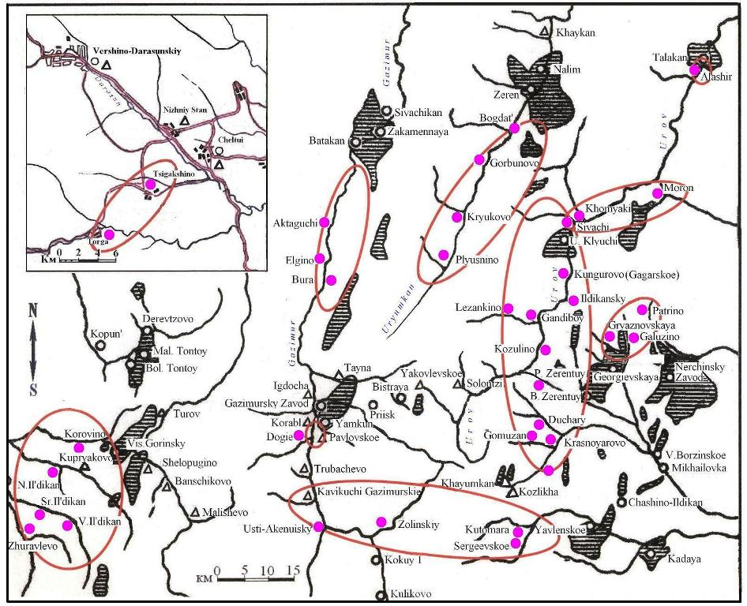
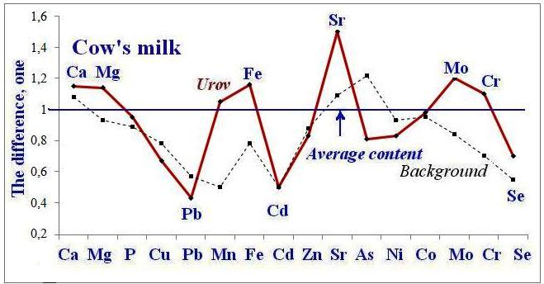
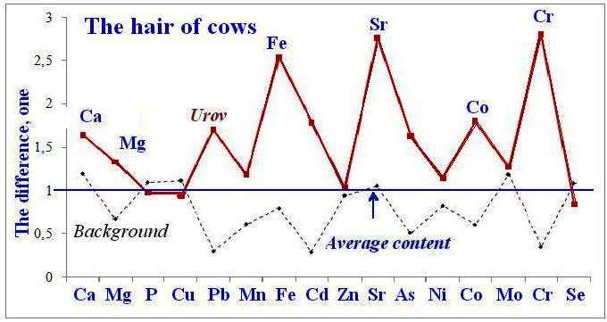
Urov endemic disease: peculiarities of biogeochemical food chains
Vadim Ermakov, Ul’yana Gulyaeva, Danilova Valentina, Tyutikov Sergey and Degtyarev Alexander
Vernadsky Institute of Geochemistry and Analytical Chemistry of RAS, Moscow, Russia
E-mail: vad-ermak@yandex.ru
INTRODUCTION
Urov Kashin-Beck disease is a non-infection endemic osteoarthrose. It is combined with the endemic goiter sometimes (Beck 1906; Kravchenko, 1955). The disease is localized in Russia in some areas of the Chita and Amur regions), in China and Northern Korea (Fig. 1). Aetiology of this disease is still one of the unsolved problems. Alimentary factor as the main one in the disease pathogenesis is probably of a complex nature. Among a complex of geochemical and nutritional factors the special role belongs to fungus factor and Se-deficiency (Li et al., 1989; Peng et al 1992).
CONCLUSION
1. The increased content of P, Mn, Sr, Zn and Co in floodplain meadow-alluvial and sod-meadow soils on the territory of the manifestation of the Urov disease in Eastern Transbaikalia was found.
2. Meadow plants in these areas intensively accumulate Mn, Sr and Cr. The absorption of P by plants is reduced.
3. Wheat grain contain more Mg, Fe and Sr in endemic areas compared to background territories. At the same time, the concentration of selenium in wheat grain is significantly lower than in the control areas.
4. The range of variation in concentrations of macro-and trace elements in milk drops sharply, as does the content of toxic chemical elements (Pb, Cd, As). Selenium content is also reduced.
5. The hair cover of cattle from endemic areas is characterized by increased accumulation of Fe, Sr, Co, and Cr, as well as Ca and Pb, which reflects the chemical composition of soils, with the exception of Fe.
6. There is a noticeable accumulation of strontium in objects of endemic territories In all links of the biogeochemical food chain.
7. Thus, The Siberian biogeochemical provinces of Eastern Transbaikalia are characterized by polyelement microelementhosies with an excess of strontium. The source of this imbalance is soil-forming rocks. specific conditions of soil formation (accumulation of organic matter in frozen soils of narrow valleys with a high degree of moisture and low flow. and selective concentration by plants).
The data obtained are consistent with the results of the research by Chinese scientists on the assessment of the chemical element composition of hair in healthy children and with Urov pathology. In the latter case, an increased content of Ca, Fe, Mn, Cr, Sr, and p was detected in the hair.
Wang X.. Ning Y.. Zhang P.. Li C.. Zhou R.. Guo X. Hair multi-bioelement profile of Kashin-Beck disease in the endemic regions of China// J Trace Elem Med Biol.. 2019. Vol. 54 July 2019. Pages 79-97. https://rareomics.healx.io/disease/kashin-beck-disease.
Aim of investigation:Assessment of the biogeochemical peculiarities (risk factors) of the endemic (Urov) disease in Eastern Zabaikalje.
MATERIALS AND METHODS
Sampling Area. The main sites for experimental studies and biogeochemical sampling of the material located on the territory of Eastern Transbaikalia in the area between the rivers Argun and Shilka, where observed manifestations Urov Kashin-Beck disease. . The study territory belongs to the forest-steppe areas of the High-Amur Midlands. The control sites within the same areas and in other regions of Russia (western territories of Eastern Transbaikalia, Baikal, Republic of Buryatia (Fig 1), free from Urov endemic, were sampled. Soil samples (mainly meadow were taken from the uppermost soil horizons: layer of 0–20 cm. The sample of the hair of cow and milk, plants (harvests) and wheat were taken too in the same places.
Analytical Methods. Chemical elements were determined in soils by means of X-ray fluorescence, NAA, and trace elements in soils and plants - by atomic absorption spectrometry. The selenium content was measured by spectrofluorimetric method. The data were processed by methods of variation statistics.
Fig. 1. The areas of biogeochemical researches of Urov endemic territories of East Siberia. 1,2 – endemic territory, 3-8 – background areas.
Endemic villages, conventionally the "healthy" villages.
RESULTS
The data on the content of macro- and trace elements in soils, plants, wheat, hair and milk cows in some areas of Eastern Transbaikalia and the Baikal region are presented in Fig. 2.
KEYWORDS: biogeochemistry, trace elements, strontium, soil, plants, wheat, milk,
hair of animals, Urov endemic
Vadim Ermakov – vad-ermak@yandex.ru
Tyutikov Sergey - tyutikov-sergey@rambler.ru
CONTACT
Gulyaeva Ul’yana – milia-nova@mail.ru
Danilova Valentina - val1910@mail.ruUliana
Fig. 2. The level of macronutrients and microelements in soils (n = 111/106), meadow plant mowing (64/32), wheat grains (5/5), hair (72/102) and milk of cows (7/10).
Alexander Degtyarev - degtyarev_a@mail.ru

