Slide 1

1
Pliocene evolution of ocean & climate dynamics
in the eastern Indian Ocean,
and its implications for the global climate state.
David De Vleeschouwer
Angelina Füllberg
Rebecca Smith
Gerald Auer
Benjamin Petrick
Isla S. Castañeda
Beth A. Christensen
ddevleeschouwer@marum.de
EGU2020: Sharing Geoscience Online, 5th of May 2020
Austral
winter
[NASA Earth Observatory]

Slide 2
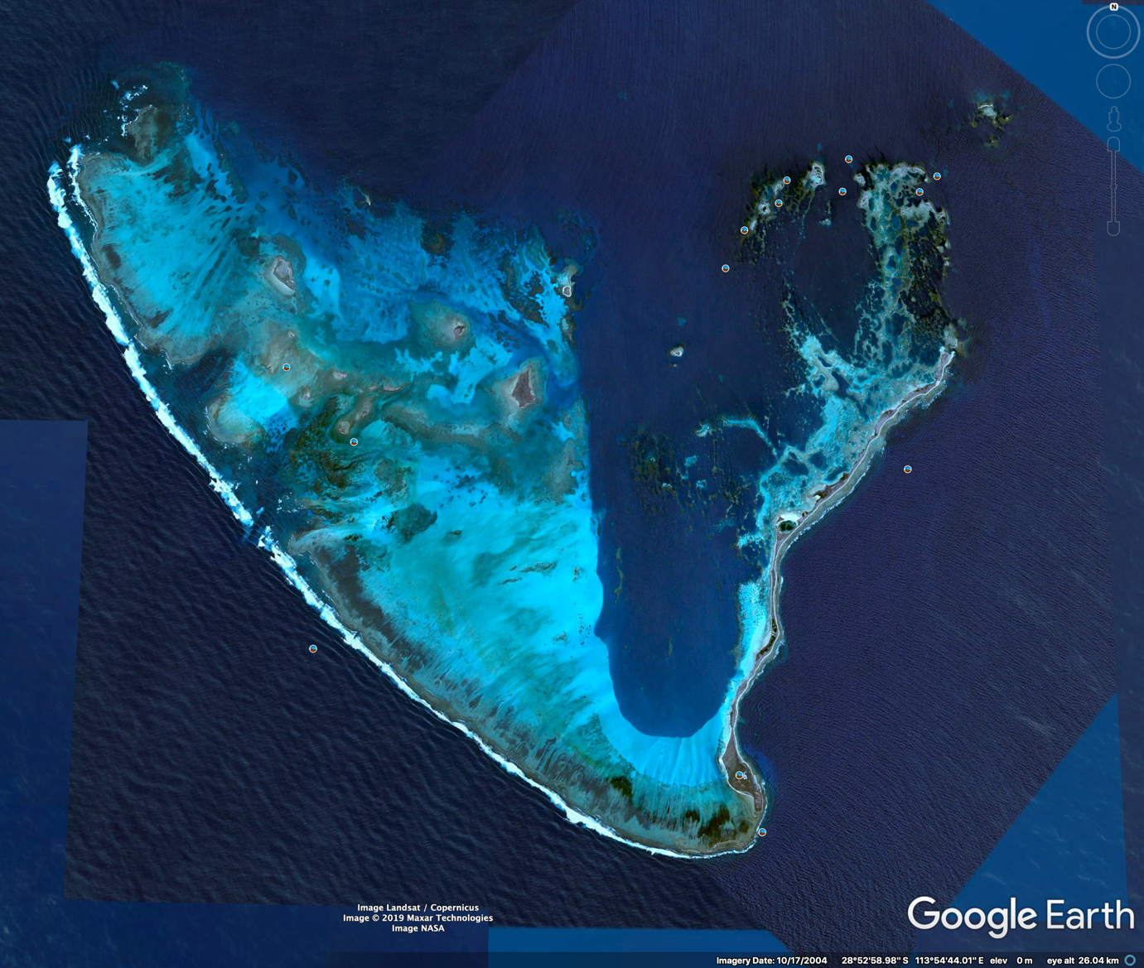
2
Without the Leeuwin Current,
there wouldn’t be coral reefs at 29°S.
[Google Earth]
Austral
winter
[NASA Earth Observatory]
[Chris Spiker on Google Earth]
Notes:
Before we dive into the Pliocene history of the Leeuwin Current, a few fun facts from the present day.
Thanks to the warm waters of the Leeuwin Current we have the Houtman Abrolhos coral reef in the Perth Basin. At 29°S this is the most southerly coral reef system in the SH.

Slide 3
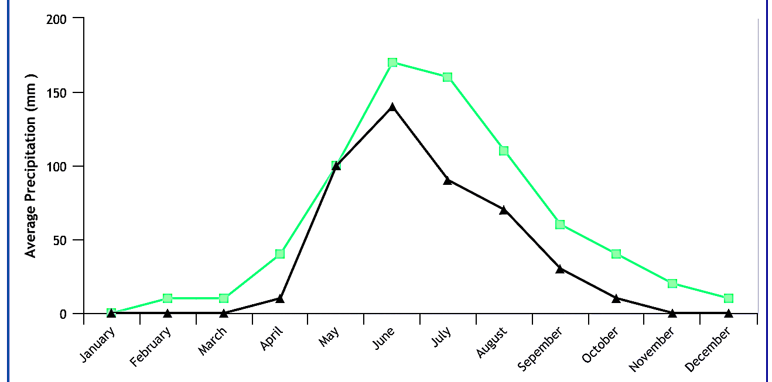
3
Without the Leeuwin Current,
western Australia would resemble the Atacama or Namib desert.
Perth, Australia
800 mm / year
Austral
winter
Average Precipitation (mm)
Valparaiso, Chile
500 mm / year
[NASA Earth Observatory]
[weatherbase.com]
Notes:
It makes that Perth has a Mediterranean climate regime, rather than a desert climate.

Slide 4
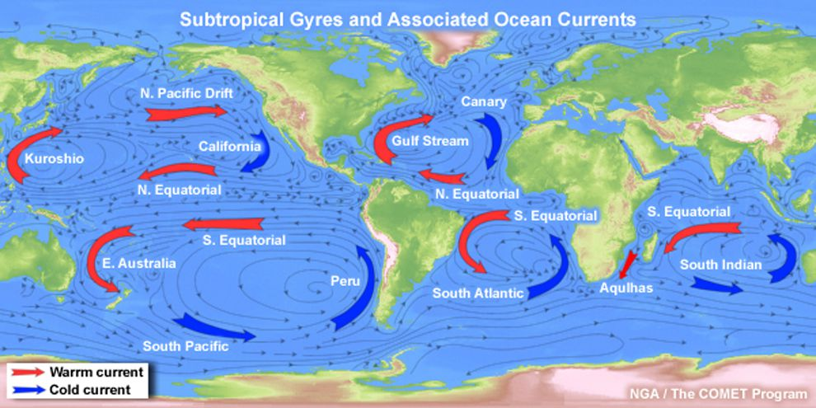
4
Eastern boundary currents usually flow equatorward,
but the Leeuwin Current flows poleward.
Leeuwin
Current
[NASA Earth Observatory]
[http://meted.ucar.edu/]
Notes:
The Leeuwin Current is the only poleward flowing eastern boundary current in the Southern Hemisphere. Therewith, it counteracts the West Australian Current in the Indian Ocean.

Slide 5
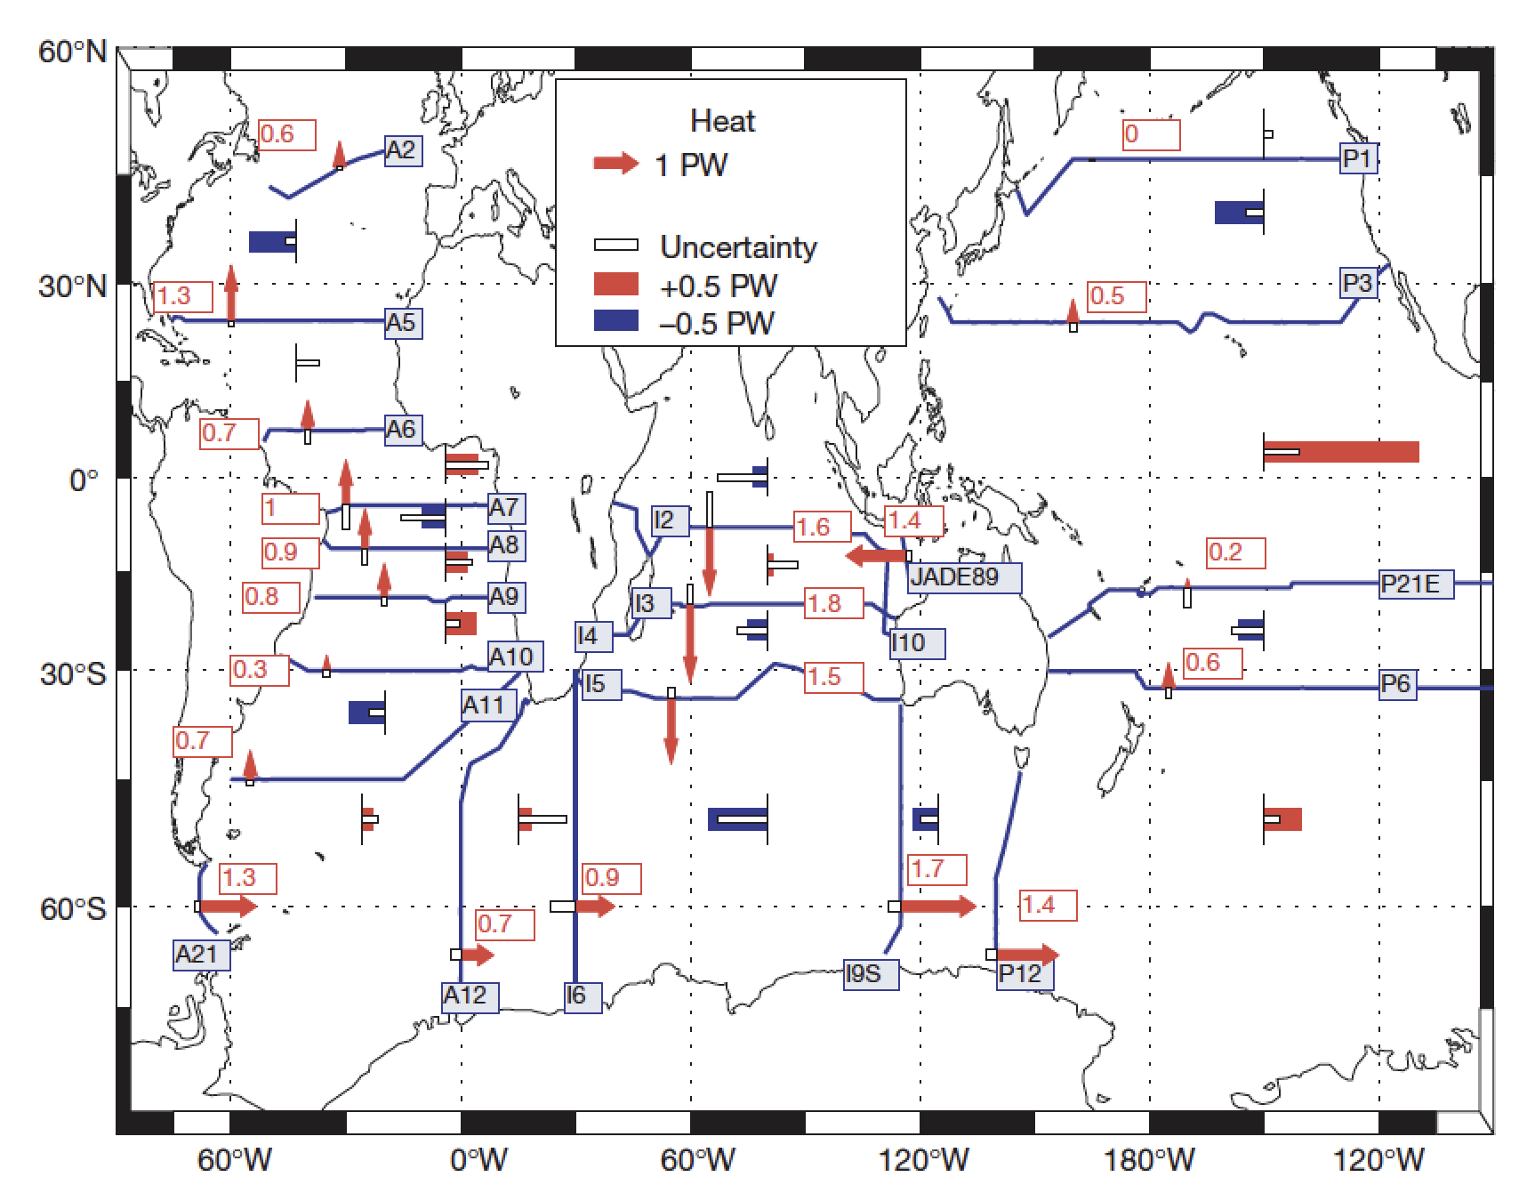
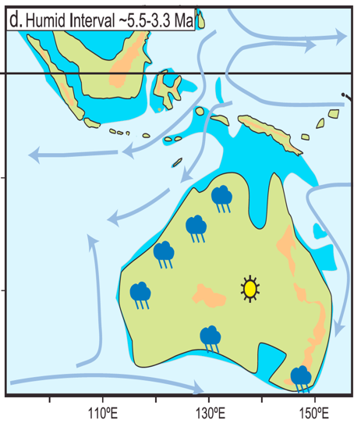
5
To scrutinize the effect of ITF on oceanographic change south of Northwest Cape, we present a multiproxy study from the Perth Basin (U1459).
Humid Interval ~5.5 – 3.3 Ma
(sensu Christensen et al., 2017)
U1459
[Ganachaud & Wunsch, 2000, Nature]
Notes:
After the introduction to the Leeuwin Current by means of a few fun facts,
This slide is here to tell you WHY is it important to evaluate the Pliocene history of the Leeuwin Current.
The reason is equator-to-pole heat transport! …
Let‘s consider the simple Stefan-Boltzman equation, using the mean annual insolation at the equator and 60°S:
At 0°S → 417 W/m2, albedo 0.2 → 42°C
At 60°S → 237 W/m2 albedo 0.4 → -19°C
That is a huge latitudinal temperature gradient! By means of atmospheric and oceanographic EQUATOR TO POLE HEAT TRANSPORT, this gradient is smoothened out. With more heat transport resulting in smoother temperature gradients.

Slide 6
A Pliocene history of poleward heat transport
through the Leeuwin Current.
U1459 TEX₈₆ & δ¹⁸O paleothermometry suggests that a Pliocene Leeuwin Current was active, albeit with fluctuations in intensity.
U1459 XRF records provides insight in Pliocene hydroclimate changes in southwest Australia.
Intersite-comparisons reveal three main factors in control of Leeuwin Current strength.

Slide 7
Warm Pliocene SST’s can only be explained
by means of an active (proto-)Leeuwin current
Glaciation events
in both hemispheres
[De Schepper et al., 2014]
Today's mean annual SST
at Site U1459:
22.8°C

Slide 8
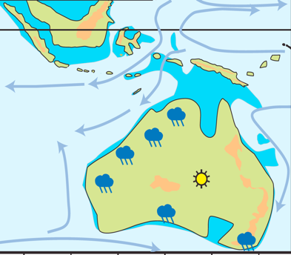
A Pliocene numerical climate model tells a similar story:
A warm poleward-flowing Leeuwin Current causes ~24°C SST in the Perth Basin.
PRISM3 Pliocene simulation
405 ppm CO₂
warm orbit @ 3.06 Ma
[Prescott et al., 2014]
Humid Interval ~5.5 – 3.3 Ma
(sensu Christensen et al., 2017)

Slide 9
A Pliocene history of poleward heat transport
through the Leeuwin Current.
U1459 TEX₈₆ & δ¹⁸O paleothermometry suggests that a Pliocene Leeuwin Current was active, albeit with fluctuations in intensity.
U1459 XRF records provides insight in Pliocene hydroclimate changes in southwest Australia.
Intersite-comparisons reveal three main factors in control of Leeuwin Current strength.

Slide 10

Low‐seasonality & glacial orbits negatively impact the amount of winter precipitation, and therefore annual precipitation.
Less detrital, but more eolian transport from the Yilgarn Craton
Cold & dry glacials
in SW Australia
~
Obliquity minima
~
Attenuated seasonality.
SST minima
Ca/Fe maxima
(low detrital input)
Vegetation
cover
decreases
K/Al minima
(high eolian flux)
Fluvial transport
decreases
Eolian flux increases.
Kaolinite-enriched material
from the deeply-weathered
residuum of the Yilgarn Craton

Slide 11
A Pliocene history of poleward heat transport
through the Leeuwin Current.
U1459 TEX₈₆ & δ¹⁸O paleothermometry suggests that a Pliocene Leeuwin Current was active, albeit with fluctuations in intensity.
U1459 XRF records provides insight in Pliocene hydroclimate changes in southwest Australia.
Intersite-comparisons reveal three main factors in control of Leeuwin Current strength.

Slide 12
Only ~3°C difference in SST between U1463 and U1459
But U1459 TEX₈₆ record of insufficient resolution to make any more detailed interpretations
U1463
[U1463 data from Castañeda et al., in review]
U1459
Austral
winter

Slide 13
Orbital-scale variability around the M2 glacial very similar between U1463 & U1459
But only ~400 kyr of overlap...
U1463
U1459
Austral
winter

Slide 14
Small isotopic difference between two Sites implies a strong Leeuwin Current.
Stepwise increase in Δδ¹⁸O around 3.7 Ma interpreted as a tectonic reorganization in the ITF region
763
[763 data from Karas et al., 2011.]
U1459
Austral
winter

Slide 15
Isotopic offset between U1463 and U1459 is approximated by a composite of only two driving factors: Inter-tropical insolation gradient & eustatic sea level
U1463
U1459
Austral
winter

Slide 16
A Pliocene history of poleward heat transport
through the Leeuwin Current.
“cold” orbit
Conclusions
Further
sea-level fall
Orbitally-forced Pliocene hydroclimate in southwest Australia, with similar dynamics as in the Quaternary.
Pliocene Leeuwin Current stronger than today,
as implied by the high U1459 TEX₈₆ SSTs: 23.8 – 28.9°C
Pliocene Leeuwin Current dynamics on glacial – interglacial timescales constitute a positive feedback mechanism.
Polar
amplification
Sea-level
Fall
&
weaker winter
Hadley cell
+
Less poleward
heat transport
Weaker
Leeuwin
Current

Slide 17
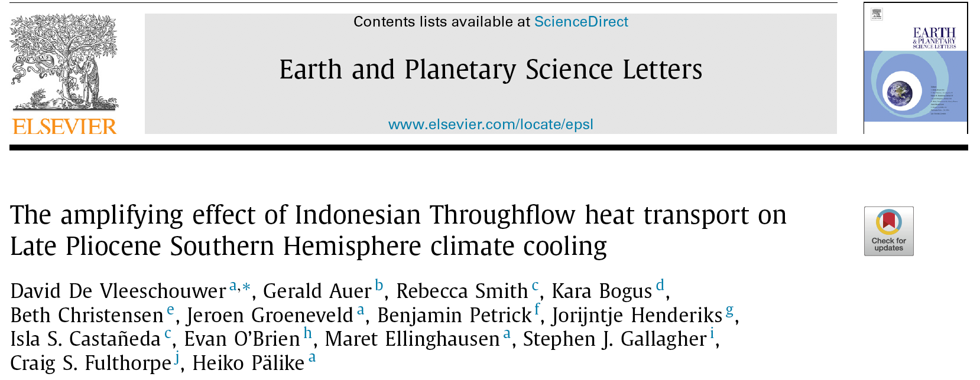
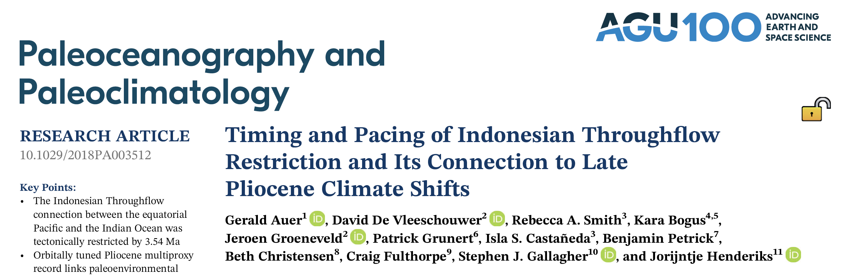
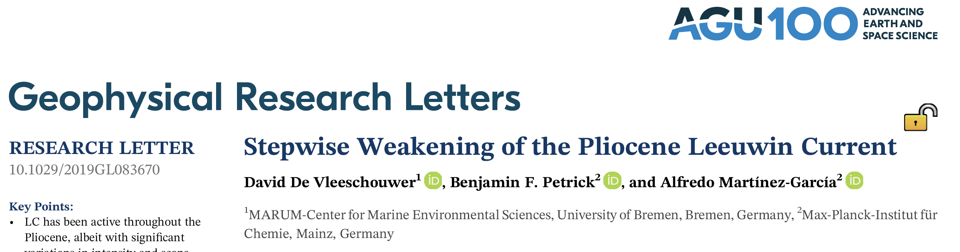
[De Vleeschouwer et al. (2018), EPSL]
[Auer et al. (2019), PP]
[De Vleeschouwer et al. (2019), GRL]
Questions?

