Slide 1







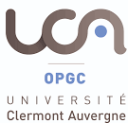




Strategies to define best practices for geochemical gas monitoring across Volcano Observatories
Fausto Grassa* and the Work Package 5 (WP5) Team "Consolidation of geochemical gas monitoring across Volcano Observatories“
EUROVOLC project.
*INGV- Sezione di Palermo; fausto.grassa@ingv.it

Slide 2
Overview of the project
I3 Project: Innovative Integration of Infrastructure
  Integrating activity for Research Infrastructures
  Submitted to the INFRAIA-02-2016-2017 Horizon2020 call to integrate starting communities
    Budget is € 6 million – EC grant is € 5 million
    Duration – 3 years
    Connected to EPOS project
    Collaboration between 9 Countries, Co-ordinated by IMO
    18 Partners, 2 linked, third parties, 2 subcontractors

Slide 3
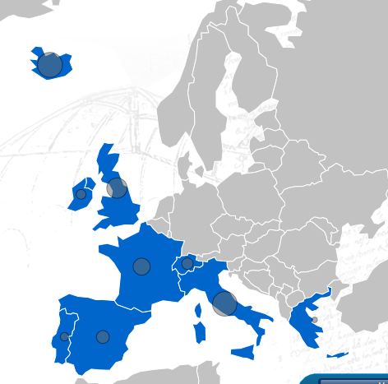
Partners and share
Country Institutions a
Iceland IMO (Samsýn), UI, NCIP. LV
Italy INGV (CNR), UNIFI (ITEM)
Terradue
France IPGP, UCA
UK BGS, ULeeds, UMan, Met Office
Spain CSIC [IGN]
Switzerland UniGe (Uni Rome)
Ireland DIAS
Portugal (Azores Is.) CIVISA
Greece IGME
Stakeholders: London and Toulouse VAACS,
ICAO, ISAVIA, Univ. Bergen
Industrial stakeholders: Rolls Royce, TAMDAR
SME: Terradue, ITEM
Organizations: ICDP, WOVO, IAVCEI
ESFRI projects: EPOS, ARISE2
Other projects: ARISTOTLE, ECLIPSE

Slide 4
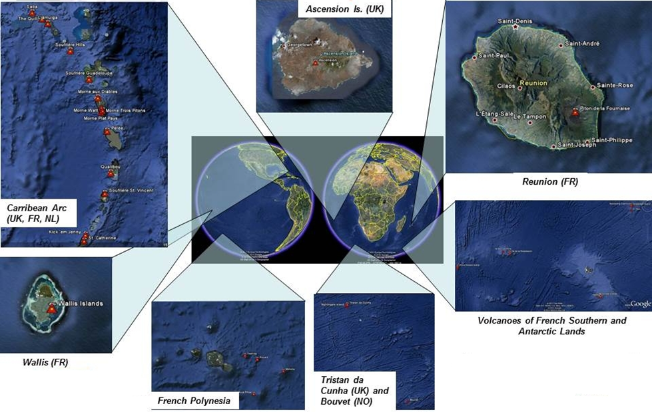
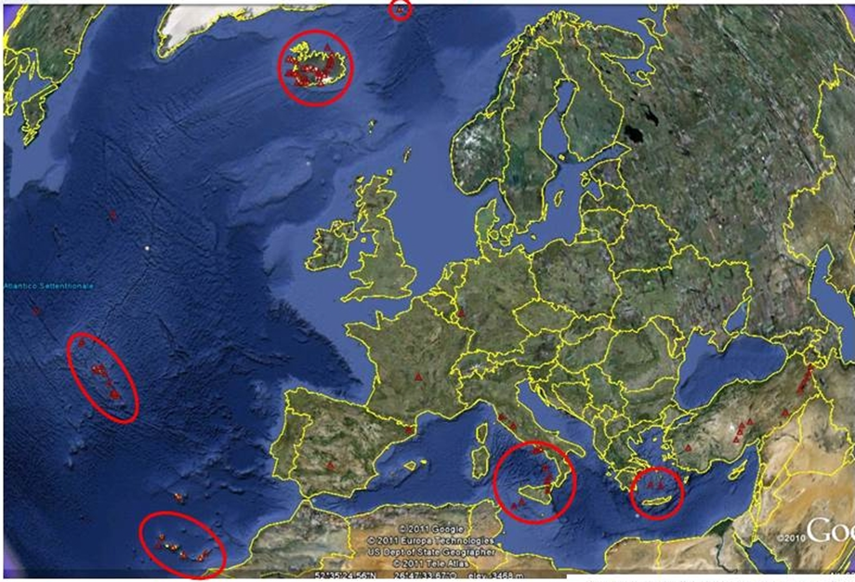
“European” Volcano Observatories
Widely distributed
Volcano Observatories
Volcanoes in overseas territories

Slide 5

Project goals
  To harmonize volcanological infrastructures with the wider scientific community
  To optimise research activities to assure the best possible European response before, during and after volcanic crises
  To improve European competitiveness in Earth Science researches

Slide 6
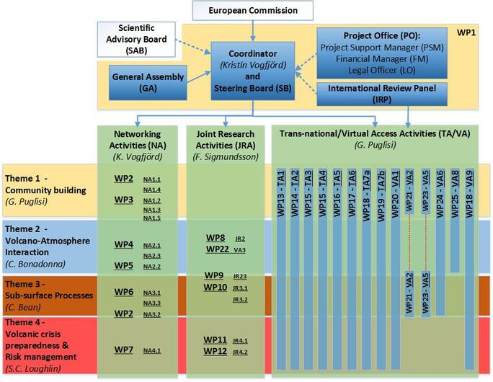

Management organization

Slide 7
Management organization

Slide 8
WP5: Consolidation of geochemical gas monitoring across VOs
Theme 2 Volcano-Atmosphere interaction
Specific objectives are:
• Definition of the best practices in geochemical sampling and monitoring of fluxes and compositions of volcanic gas emissions in the atmosphere.
Integration data of volcanic gases in the atmosphere in agreement with EPOS guidelines.
Knowledge transfer and skill building between RIs and VOs on state-of-the-art of the geochemical gas monitoring.

Slide 9
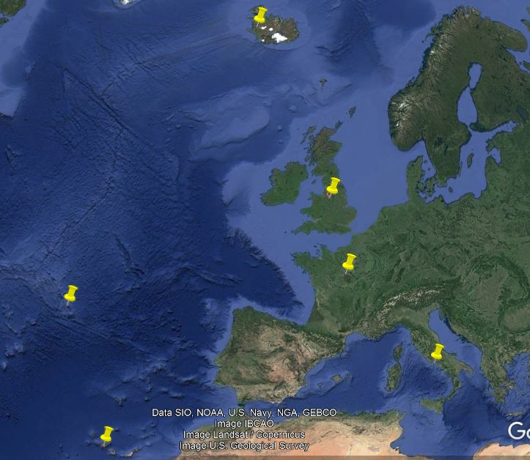
WP5: Consolidation of geochemical gas monitoring across VOs
8 PARTNERS INVOLVED
FROM 6 COUNTRIES
IMO (IS)
UNILEEDS (GB)
UMAN (GB)
IPGP (FR)
UCA-OPGC (FR)
CIVISA (P)
INGV(IT)
CSIC (ES)
IMO
UNILEEDS
UMAN
IPGP
CIVISA
UCA
INGV
CSIC

Slide 10
WP5: Consolidation of geochemical gas monitoring across VOs
Task 5.1: Best practices for direct sampling (DS) techniques and analysis of fumarolic gases.
Task 5.2: Best practices for ground-based remote sensing (RS) techniques and in-situ measurements of volcanic plumes
Task 5.3: Integration of geochemical dataset of volcanic gases in atmosphere not implemented in EPOS-IP

Slide 11
WP5: Consolidation of geochemical gas monitoring across VOs
Task 5.1: Best practices for direct sampling (DS) techniques and analysis of fumarolic gases.
Task 5.2: Best practices for ground-based remote sensing (RS) techniques and in-situ measurements of volcanic plumes
Task 5.3: Integration of geochemical dataset of volcanic gases in atmosphere not implemented in EPOS-IP
WP5 Deliverables
D5.1 Best practices -fumarolic gases
D5.2 Best practices - groundbased measurements volcanic plumes
D5.3 EPOS geochemical database participation

Slide 12
WP5: Consolidation of geochemical gas monitoring across VOs
Task 5.1: Best practices for direct sampling (DS) techniques and analysis of fumarolic gases.
Task 5.2: Best practices for ground-based remote sensing (RS) techniques and in-situ measurements of volcanic plumes
Task 5.3: Integration of geochemical dataset of volcanic gases in atmosphere not implemented in EPOS-IP
WP5 Deliverables
D5.1 Best practices -fumarolic gases
D5.2 Best practices - groundbased measurements volcanic plumes
D5.3 EPOS geochemical database participation
WP5 Milestone
At least one collective field survey will provide the opportunity for partners to perform concurrent sampling and measurements of volcanic plumes
Building of a data repository. To organize and to define common standards thus making data accessible to the whole community. To implement the already planned activities in EPOS.

Slide 13
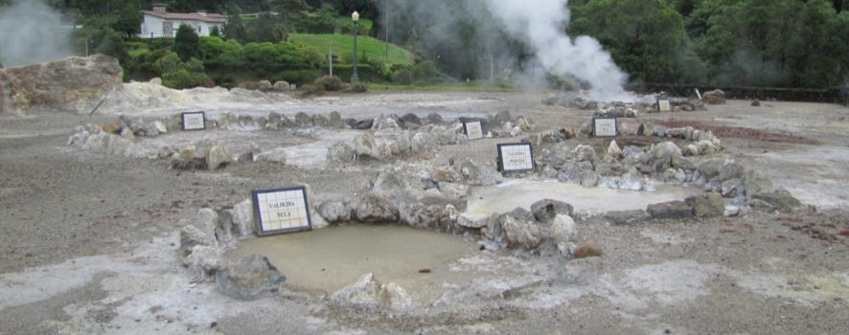
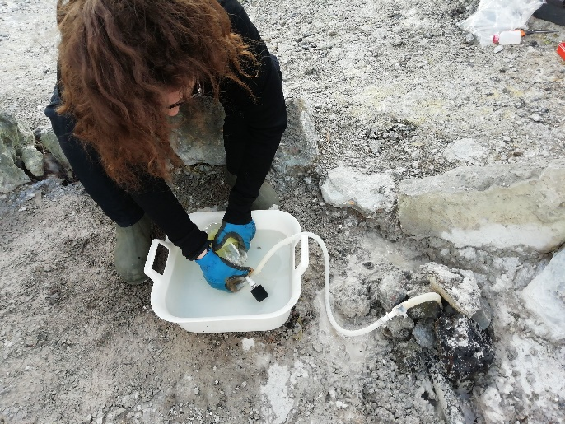
WP5: Consolidation of geochemical gas monitoring across VOs
Task 5.1: Best practices for direct sampling techniques and analysis of fumarolic gases – Field survey
Joined field survey at Furnas Volcano (Azores) in February 2019
5 teams actively sampled the gas using the Giggenbach methodology (7 partners involved: INGV, IPGP, CSIC, IMO, CIVISA, UNIVLEEDS, OPGC);
4 samples collected by each team and sent to 4 laboratories (INGV Palermo, INGV Naples, IPGP, CIVISA);
Gas analyses were shared by the different laboratories during last EGU meeting; verification of the data proceeded until January 2020

Slide 14
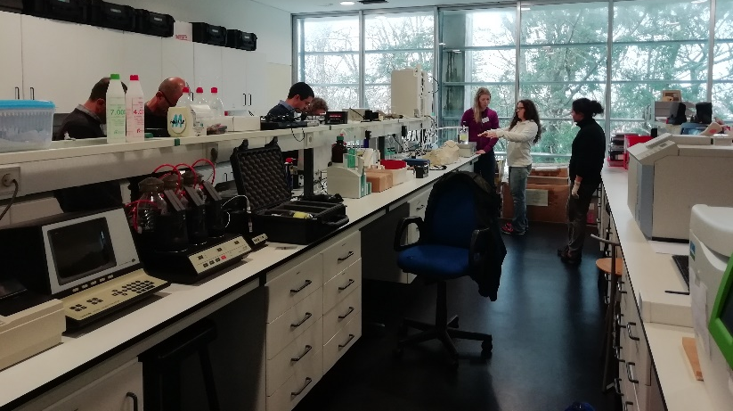
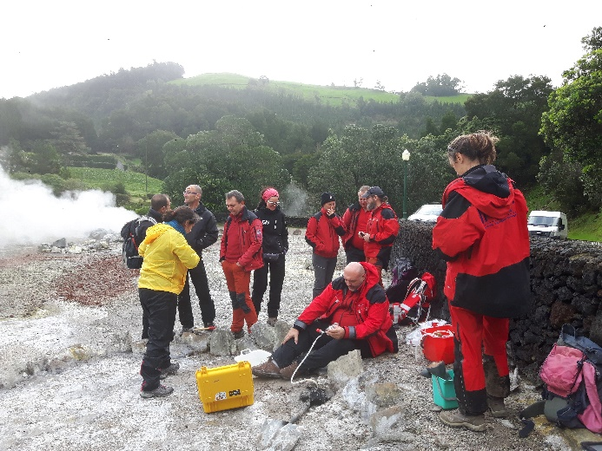
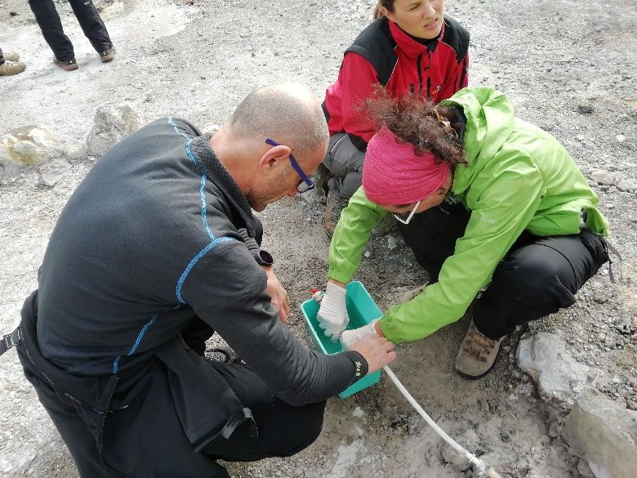
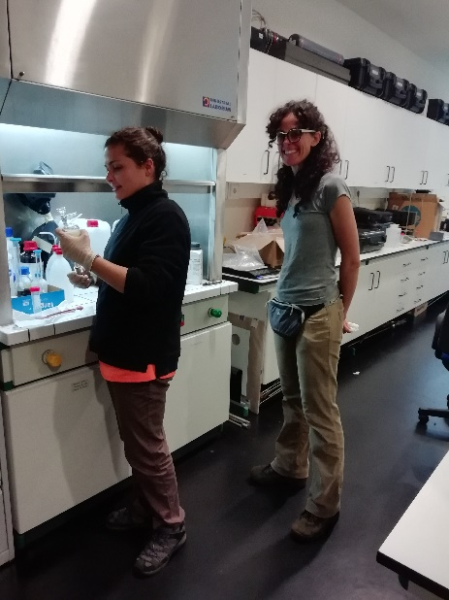
WP5: Consolidation of geochemical gas monitoring across VOs
Task 5.1: Best practices for direct sampling techniques and analysis of fumarolic gases – Field survey
  Training on the laboratorial and field sampling procedures (sharing of experience between the teams involved)

Slide 15
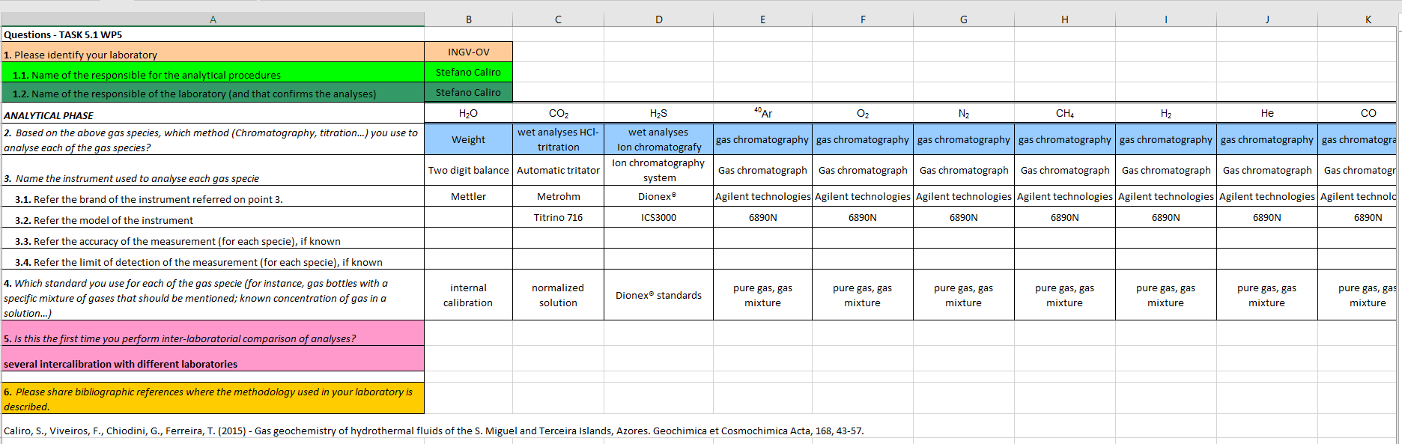
WP5: Consolidation of geochemical gas monitoring across VOs
Task 5.1: Best practices for direct sampling techniques and analysis of fumarolic gases – Results
  Comparison of results considering:
  SAMPLING: materials used, preparation of the bottles for sampling, operators, maintenance,…
  ANALYTICAL PROCEDURES on the different laboratories
Excel form shared beween the 4 laboratories that carried out the analyses to fill with the methodologies (ongoing)

Slide 16
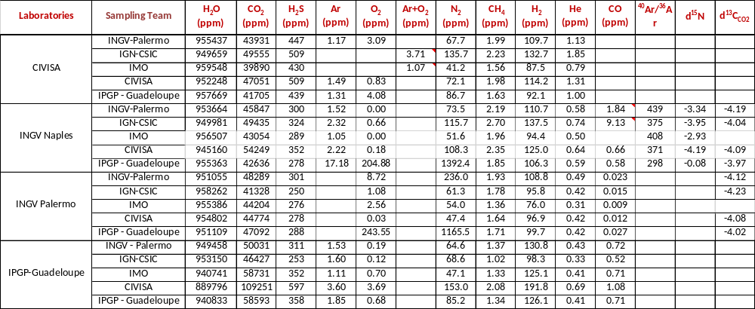
WP5: Consolidation of geochemical gas monitoring across VOs
Task 5.1: Best practices for direct sampling techniques and analysis of fumarolic gases – Results
  Results and preliminary analyses:
  20 gas analyses from the same sampling site (in the same day)

Slide 17
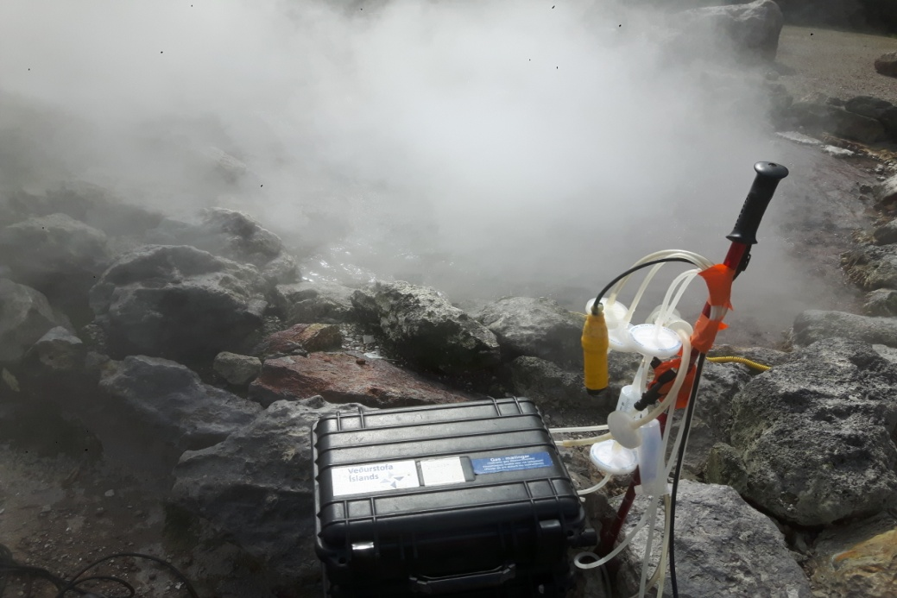
WP5: Consolidation of geochemical gas monitoring across VOs
Task 5.2: Best practices for ground-based remote sensing (RS) techniques and in-situ measurements of volcanic plumes- Field survey
Joined field survey aimed at simultaneous measurements of selected points at Furnas Volcano Caldera and at Furnas Lake fumarolic fields (Azores Islands) in February 2019
4 multigas equipments
Gas composition (H₂O, CO₂, H₂S and H₂)
The inter-comparison of results is still ongoing.
The key point for the best practices is not only the comparison of final results but rather to identify the corrected procedure to acquire and to reprocess the data.

Slide 18
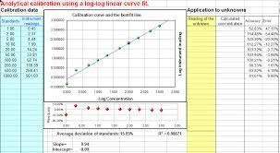
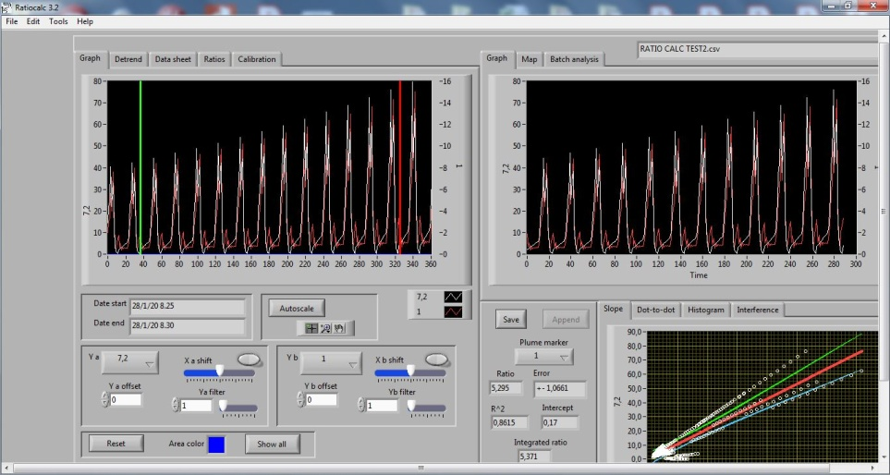

WP5: Consolidation of geochemical gas monitoring across VOs
Task 5.2: Best practices for ground-based remote sensing (RS) techniques and in-situ measurements of volcanic plumes- Results
Sensors calibration procedure, data filtering and applicability and limitations in the use of software (e.g. ratio calc) or macros.

Slide 19
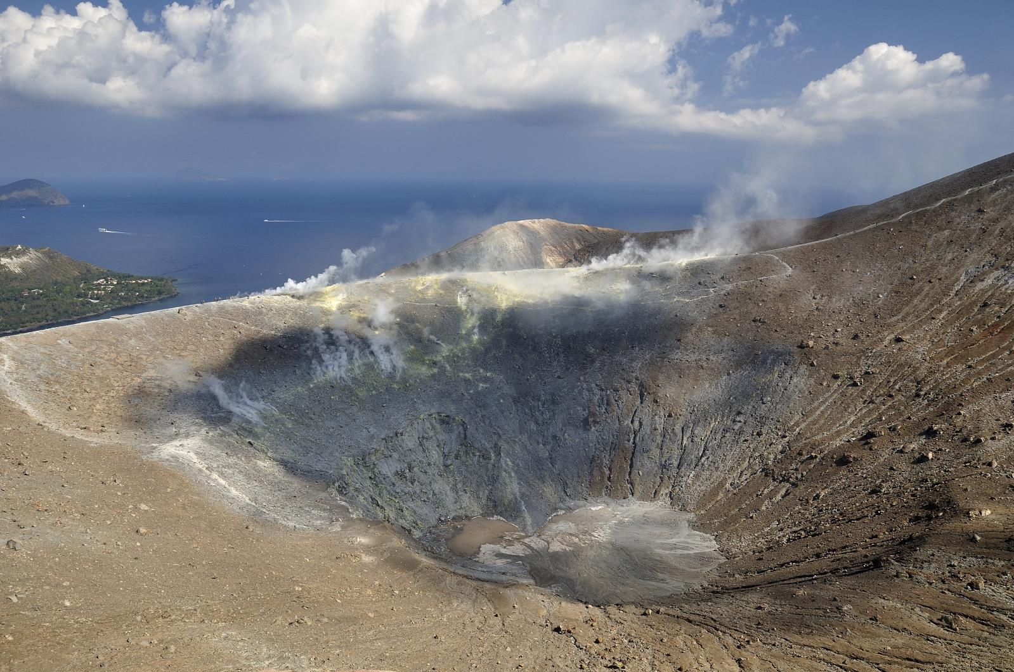

WP5: Consolidation of geochemical gas monitoring across VOs
Task 5.2: Best practices for ground-based remote sensing (RS) techniques and in-situ measurements of volcanic plumes- Future plans
A second field survey was scheduled in May (11-15), at Vulcano Island (Italy) where a high-temperature (T>300°C) fumarolic fields is present.
Plume composition
- in-situ measurements by multiple MultiGAS (on ground and by drone)
- co-located filter packs at target fumarole(s)
- remote sensing by FTIR
Emission rates (fluxes)
- remote sensing for SO₂ flux
- UV cameras and scanning DOAS
- integration of plume X/SO₂ ratios with SO₂ flux for emission rates of other species

Slide 20
WP5: Consolidation of geochemical gas monitoring across VOs
Task 5.2: Best practices for ground-based remote sensing (RS) techniques and in-situ measurements of volcanic plumes- Future plans
To compare the calibration procedures of the sensors before the measurements
To evaluate the time to make representative measurements
To compare procedure used by different groups to evaluate the final ratios thus affecting the estimation of the X/SO2 ratios from their composition measurements;
How do different groups quantify and report uncertainty or error? (e.g. sensor delays, light dilution, uncertain wind speeds);
- To confront lab techniques used in filter pack preparation;

Slide 21
WP5: Consolidation of geochemical gas monitoring across VOs
Task 5.3: Integration of geochemical dataset of volcanic gases in atmosphere not implemented in EPOS-IP
A structure for metadata, as already developed in EPOS project, has been proposed for the geochemical data.
The first data used were those acquired during the field survey performed at Furnas volcano.
All information on sampling and analytical procedures has been gathered to implement the metadata related to chemical analyses of fumarolic gases and in-plume measurements.

Slide 22
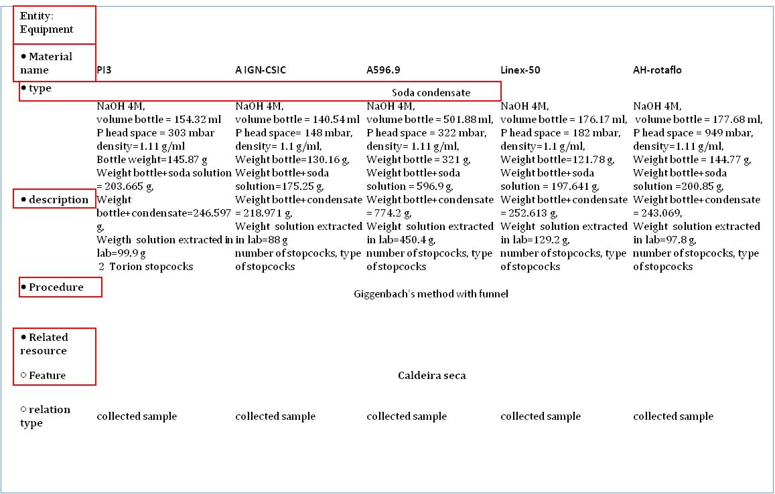
WP5: Consolidation of geochemical gas monitoring across VOs
Task 5.3: Integration of geochemical dataset of volcanic gases in atmosphere not implemented in EPOS-IP

Slide 23
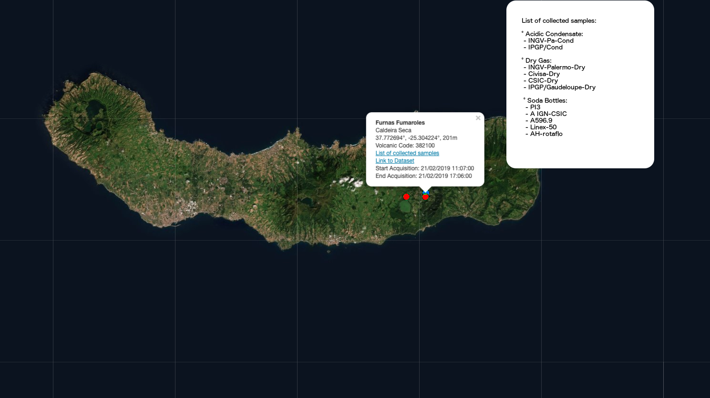
WP5: Consolidation of geochemical gas monitoring across VOs
Task 5.3: Integration of geochemical dataset of volcanic gases in atmosphere not implemented in EPOS-IP
Service for data management at INGV-PA: under construction

Slide 24

WP5: Consolidation of geochemical gas monitoring across VOs
Conclusive remarks
  Comparison/discussion of the results – trying to be quantitative
  Preparation of the best practices (sampling and analytical procedures, calibration protocol(s), data filtering, guidelines, recommendations, checklist)
  Submission of scientific publications with the results obtained and “best practices” from the EUROVOLC community:
  for low temperature fumaroles (based at least on the Furnas Volcano case)
  for remote sensing measurements (based at least on the field surveys).
  Completion of the data repository, population of the DB thus making it accessible to the whole scientific community.

