Slide 1
Tide-Surge Interaction in Ensemble Total Water Level Forecasts
Natacha B. Bernier,
O. Huziy, P. Wang,
K.R. Thompson, B. Pouliot, Y. Liu
© Her Majesty the Queen in Right of Canada, as represented by the Minister of Environment and Climate Change Canada, 2020.

Slide 2
Motivation
Public and private sectors require more accurate forecasts with longer lead times (e.g., for activation of emergency measures including evacuations).
Strong storms are an ongoing threat to Canadian coastlines (e.g., hours roads, cars, and land) including most recently Hurricane Dorian in 2019.
Can we provide better guidance, including realistic estimates of uncertainty?

Slide 3
Study And surge model REGION
Domain of the storm surge model
Twice daily (00Z and 12Z) ensemble runs (20+1 members) on surge grid of 1/12° driven with the 10m winds and surface air pressure from the GEPS (~39km grid spacing)
5 Flather type open radiation boundary conditions (N, E and S edge of the model plus GSL and BoF
Tide gauges

Slide 4
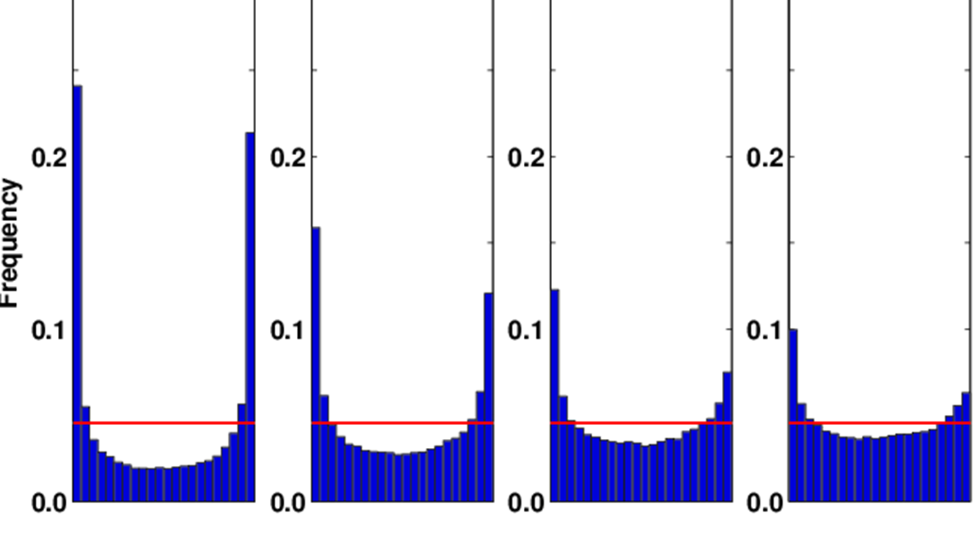
What we know
Ensemble surge forecasts are typically the result of forced simulations using perturbed winds and air pressure
Resulting surge predictions spread follows that of the atmospheric system.
Day 3
Day 5
Day 7
Day 9
For each obs, ensemble members are sorted from lowest to highest.
The “bin” for each obs is noted, and tallied into frequency of hits per bin.
Desired outcome: Flat histogram.
The U-shape implies that the spread is too small

Slide 5
What we Know
Tide-surge interaction (TSI) can “focus” surges on particular phase of the tides.
TSI is present in the study region
Experiment performed with idealized wind forcing

Slide 6
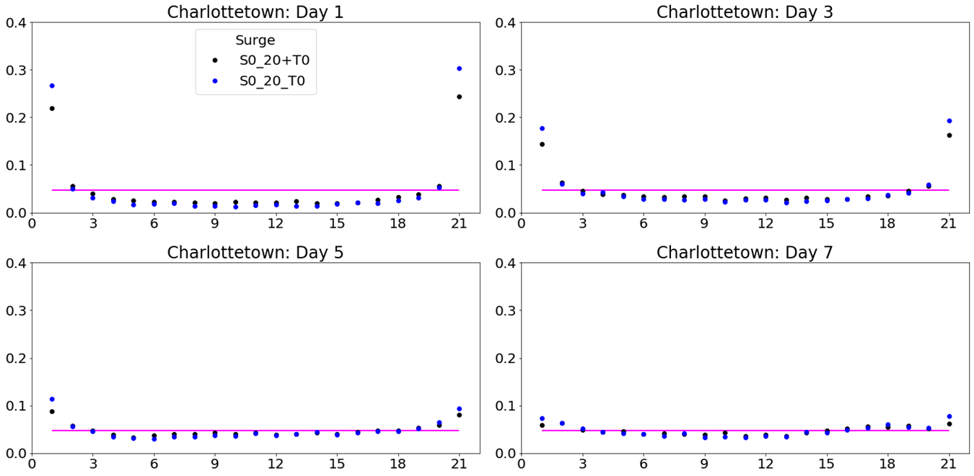
What happens IF we ALLOW TSI in TWL Ensemble forecast system
Spread in surges is reduced particularly in regions with strong tsi

Slide 7
Sampling the Uncertainty
Given the governing equations, perturbations of the drag coefficient, bathymetry, etc, further modify the spread already resulting from the perturbed atmospheric winds and air pressures.
How else can we sample uncertainty? We know tides are affected by density structures hence they have a stochastic component. Can we usefully perturb the tides?

Slide 8
What we know from Sea Level Observation records
22 tide gauges recording total sea level, η_{obs}
To a first approximation
η_{obs} = η_{S} + η_{T} + η_{E} η_{s} : storm surge
η_{T} : tides
η_{E} : error
Errors can result from observation errors, seiches, baroclinic changes driven by freshwater input and surface heating, etc
Tides are not purely deterministic (e.g. can vary with environmental conditions such as baroclinicity) so we separate the deterministic and remnant component and rewrite
η_{T} = η_{TD} + η_{TR}
And it follows that
η_{obs} - η_{TD} = η_{S} + η_{TR} + η_{E}

Slide 9
Perturbing the tides can be important: A post-processing example
Bernier and Thompson, OM, 2015

Slide 10
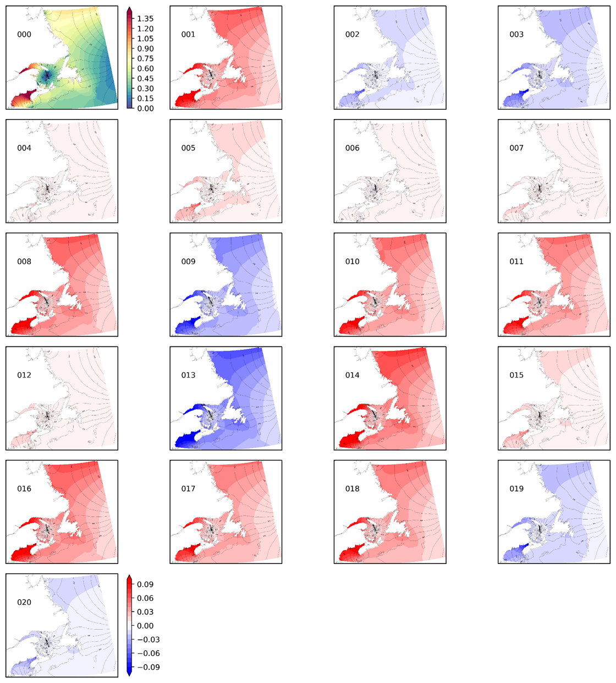
perturbations of the M2 open boundary
O1 is perturbed similarly

Slide 11
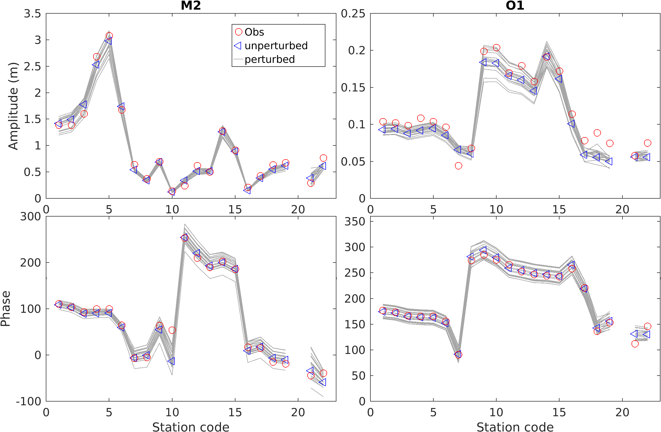
Impact of perturbed obc at coastal tide gauges

Slide 12
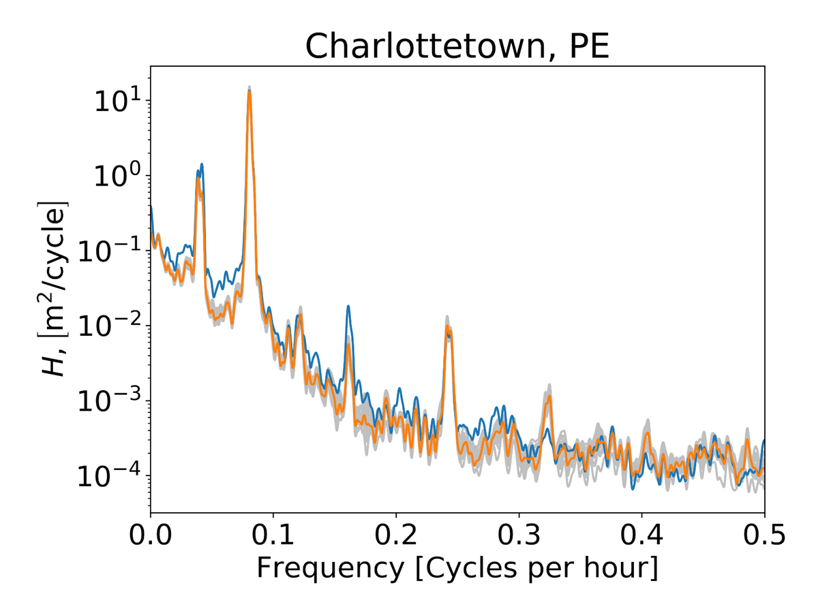
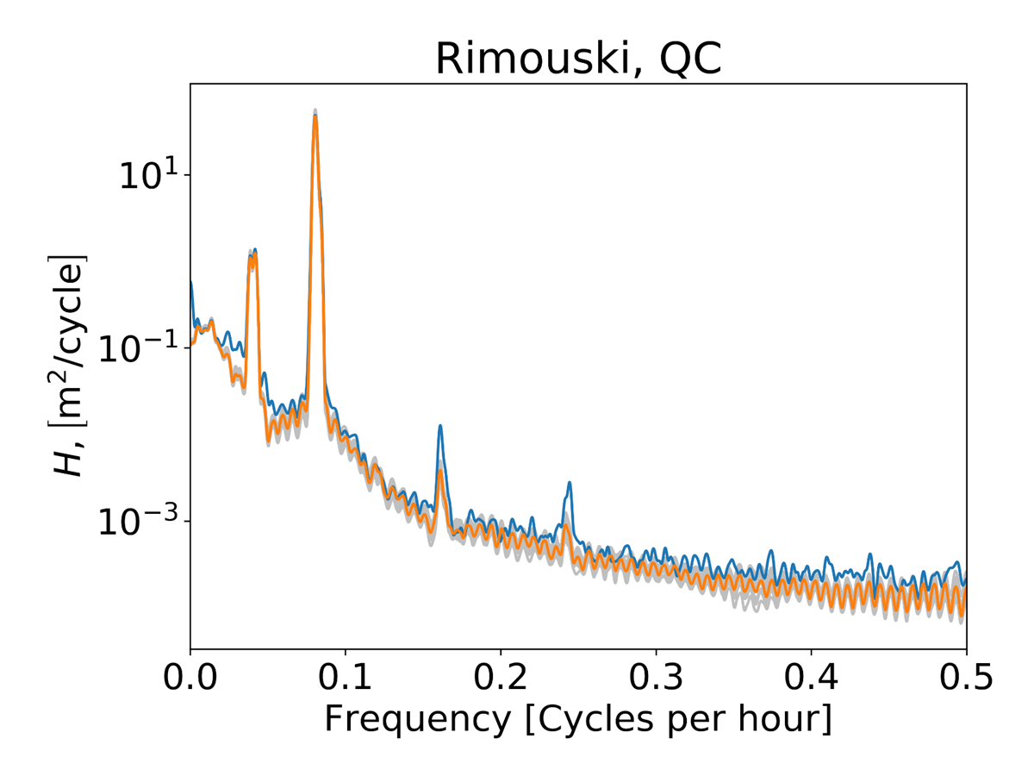
TWL spectra for Perturbed surge and tides
Grey lines show the power spectra of the perturbed members.

Slide 13
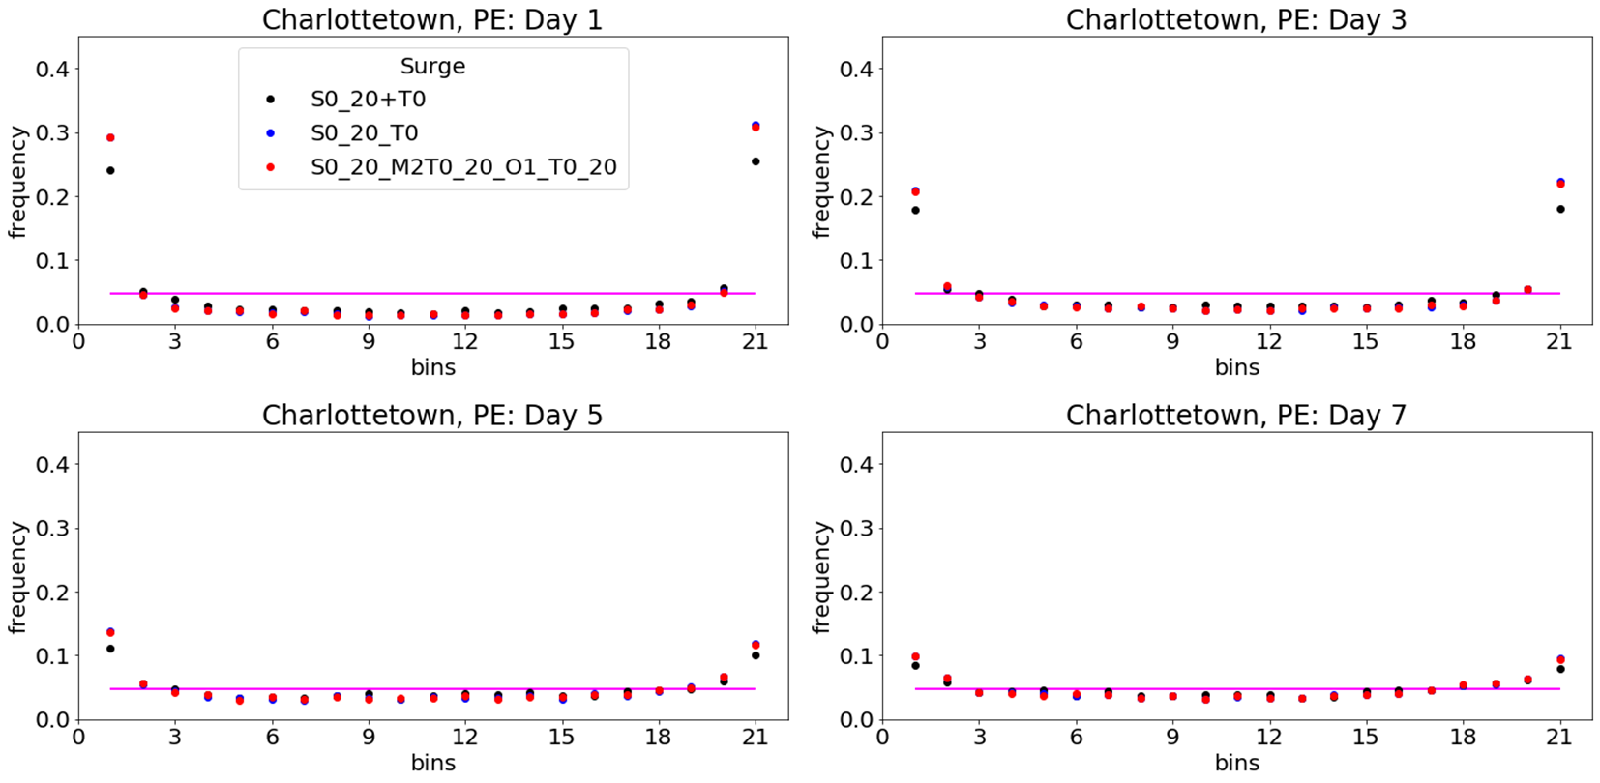
surge only spread: TSI acts to focus the surges

Slide 14
Preliminary results: tidal perturbations improve spread of twl forecasts

Slide 15
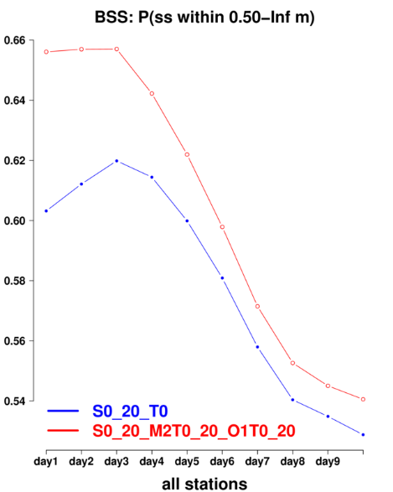
Overall improvement in other skill scores when tides are perturbed

Slide 16
Conclusions
Uncertainty is not a sign of bad models or science.
Surge predictions are improving. Expect rapid progress over next 5 years at ECCC with (i) better atmospheric forcing, (ii) global, higher resolution models of TWL (iii) improved perturbation methodology (iv) coupling to wave models. But uncertainty will remain.
An outstanding problem is the communication of risk of flooding to individuals and organizations.
Notes:
16

