Slide 1

PhD Project:
Evaluating phosphorus availability from sewage sludge derived pyrochar and hydrochar in European agriculture
Maria Pimenta da Costa Ocampo
5th – May - 2020

Slide 2
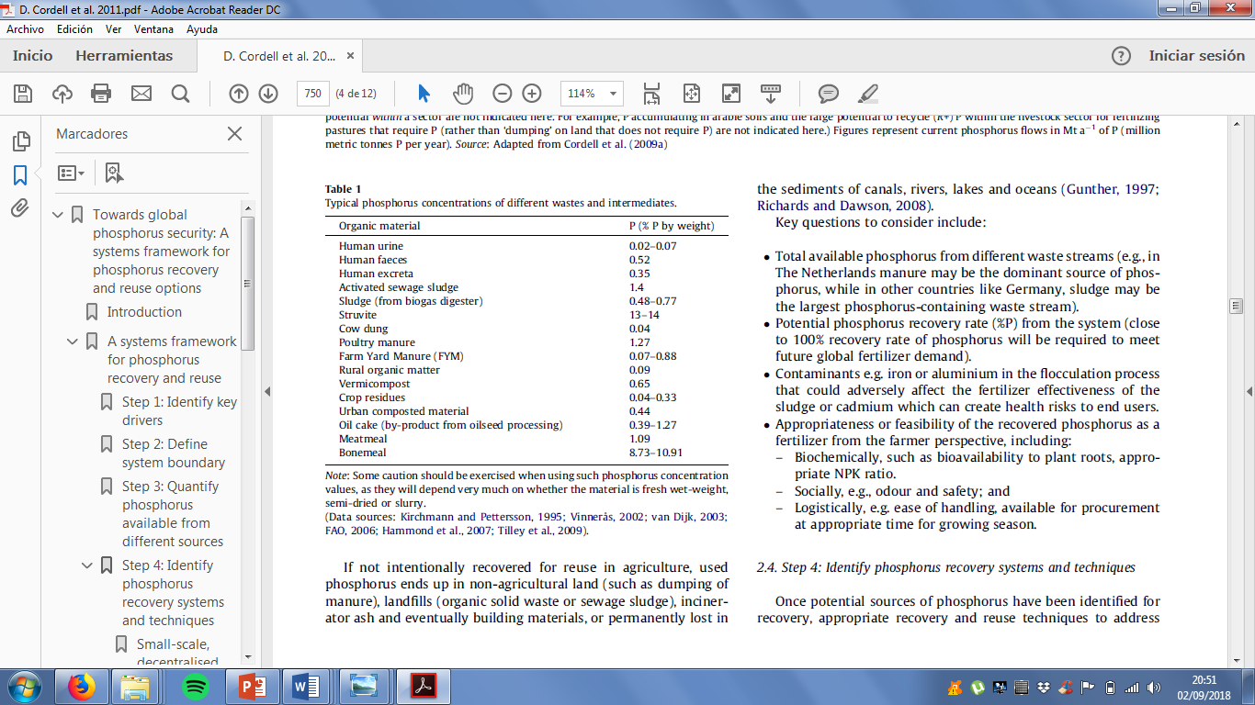

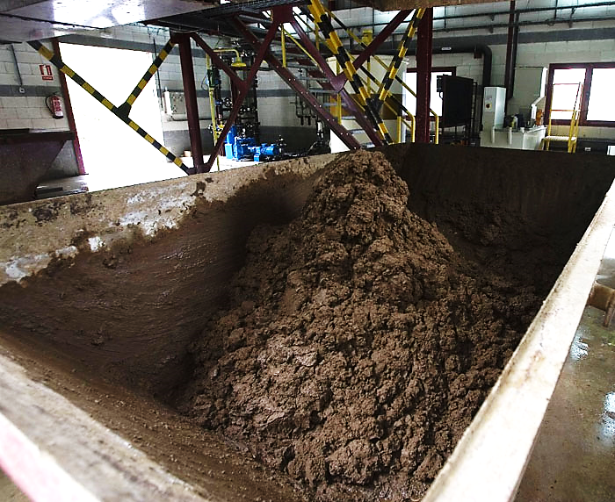
Context
Everyday contribution to
Sewage Sludge (SS) over production
Phosphorus crisis (Pmineral critical raw material)
Alternative P fertilizer?
A common solution?
Cordell et al., 2011
Water Treatment Plant
P
P
P
P
P
Sewage sludge
https://www.shutterstock.com/search/standout+man

Slide 3

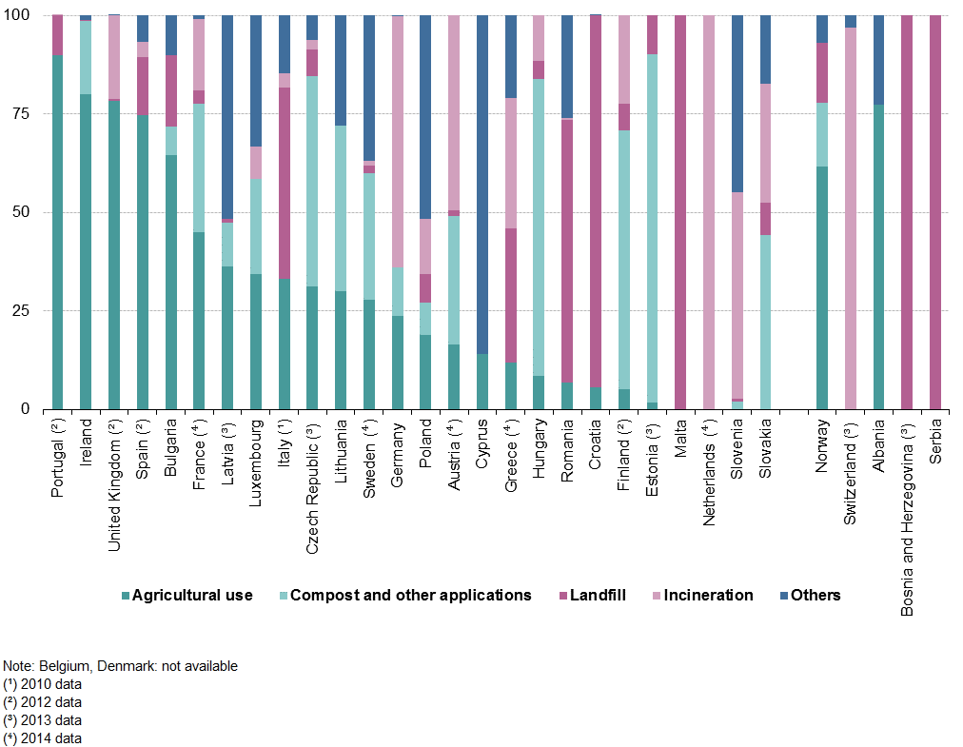
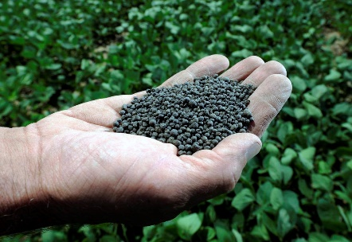
Context
Agricultural use of sewage sludge (SS)
Table 1. Final destination objectives of the treated sewage sludge by 2020
Final destination objectives of the treated sewage sludge | Year 2020 (*)
Valorization in soils and other types of valorization excluding the energetic route | 85% minimum
Energetic Valorisation (Valorisation/Co-incineration) | 8% minimum
Disposal | 7% minimum
Directive 2008/98/CE
To ensure the environmental protection
a pretreatment must be done
(*) Percentages calculated on the total amount of sludge produced (PEMAR).
https://www.thestar.com/life/health_wellness/2008/07/12/is_sewage_fertilizer_safe
https://www.123rf.com/photo_70899250_3d-white-man-looking-through-the-magnifying-glass-3d-rendering-.html
Composting
Thermal treatments
Figure 2. Sewage Sludge Management, 2012 for UK and Spain. EUROSTAT Source. (Access date: 23-Dec-2017)

Slide 4
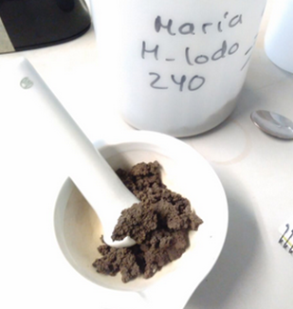
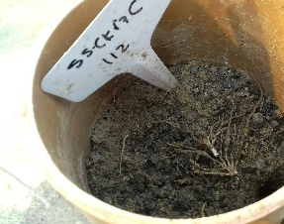
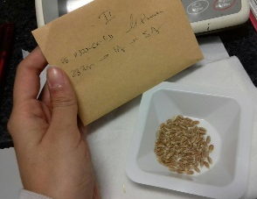

Project
AIM
To evaluate interactions in phosphorus availability of spring wheat from sewage sludge and its thermally treated derivatives, pyrochar and hydrochar, when added on its own and in combination with sewage sludge cake as soil amendment
To answer the following questions:
How did the thermal treatments affect the sludge? Are the material significantly different?
Do these materials change the properties of the soil amended with them?
Would this change over time?
Do these amendments improve yield production?
And grain quality?

Slide 5
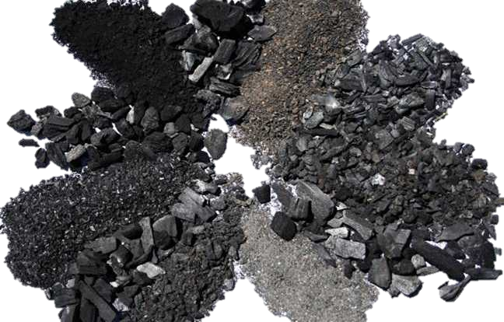
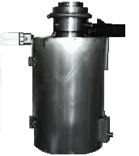
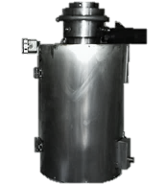

Thermal Treatments selected
Sewage sludge
Solid product “Biochar”
Reactor
Table 2. Types of thermal treatments (Sohi et al., 2009); (H. J. Huang & Yuan, 2016).
Process | Temperature (°C) | Retention time | Principal product
Gasification | 800 | Long time rates | Syngas
Fast Pyrolysis | >500 | Short time (2 s) | Bio-oil
Slow Pyrolysis at high or moderate temperatures | 300-700 | Long-time rates | Biochar
Slow Pyrolysis at low temperatures (Torrefaction) | 200- 300 | Long-time rates | Biochar
Hydrothermal Gasification | >400 | Long-time rates | Syngas
Hydrothermal Liquefaction | 250-400 | Long-time rates | Bio-oil
Hydrothermal Carbonization (HTC) | 180-250 | Long-time rates | Hydrochar
If low class biochar (IBI)
= pyrochar
Reactor 1
Reactor 2
https://ethz.ch/en/news-and-events/eth-news/news/2014/04/biochar-is-there-a-dark-side/_jcr_content/news_content/fullwidthimage/image.imageformat.lightbox.2060475423.jpg

Slide 6
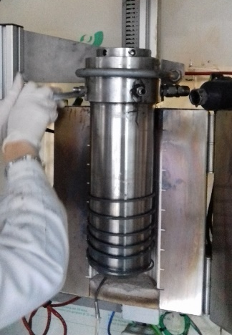
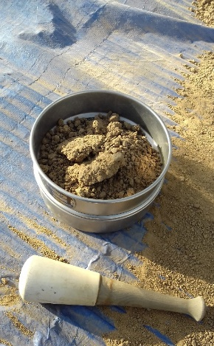
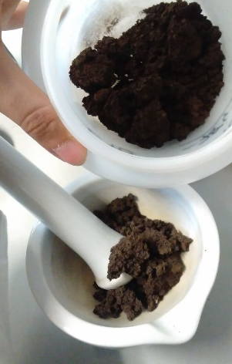
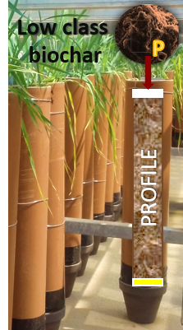
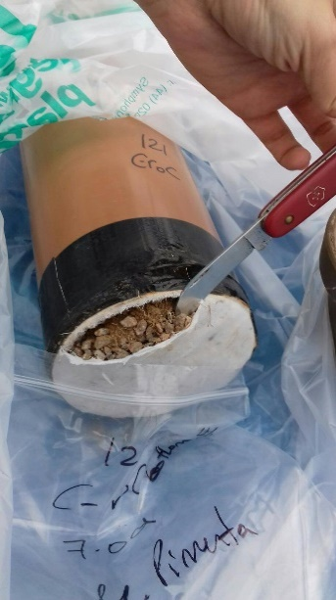
Approach
Glasshouse Experiment
(2 years)
Thermal
Treatments
Characterization
Materials & Soil
Sewage Sludge (SS1) Feedstock
Hydrochar 180◦C 4h (H180-4)
Hydrochar 240◦C 4h (H240-4)
Pyrochar 300◦C 1h (P300-1)
Pyrochar 400◦C 1h (P400-1)
pH, EC, LOI, Olsen-P
C stability, structure,
phytoxicity & heavy metals concentration
5/10/20 t/ha own
10/20/40 t/ha combined
Soil mixtures
Top layer (2cm) 0→ 1→ 2
Initial Conditions
After first harvest
After second harvest
Bottom layer (2cm) → 2
After second harvest
(+) SEWAGE SLUDGE SS2
(COMBINED AMENDMENT 50:50)
Grain quality

Slide 7
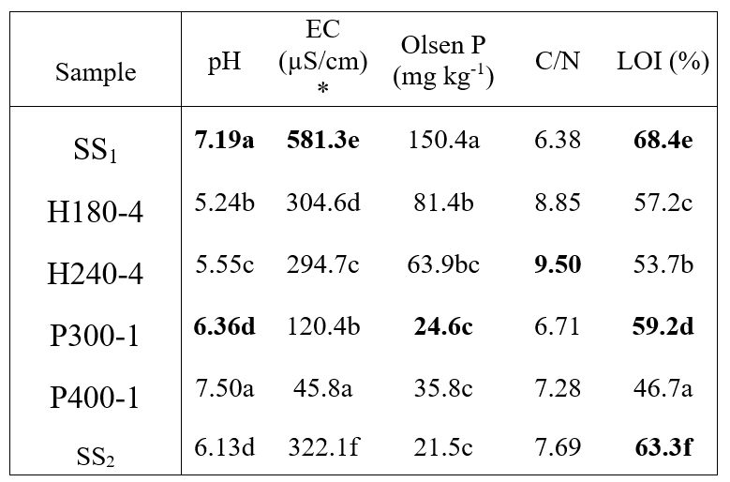
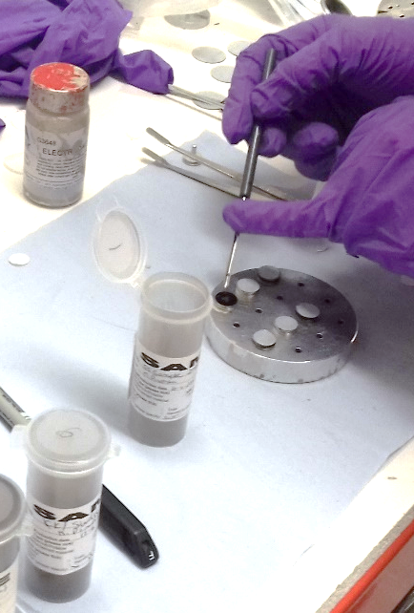
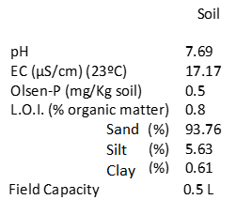
Physical-chemical Characterization
How did the thermal treatments affect the sludge? Are the materials significantly different? Yes, hydrochars are acidic & hold more available-P, P300 has more Organic matter (LOI) & P400 is more stable
Sewage Sludge (SS1) Feedstock
Hydrochar 180◦C 4h (H180-4)
Hydrochar 240◦C 4h (H240-4)
Pyrochar 300◦C 1h (P300-1)
Pyrochar 400◦C 1h (P400-1)
The higher the temperature needed to drop the weight, the more stable. Here: P400-1.
200°C-300°C, is the range of oxidation of the most labile organic matter:
Sewage Sludge for combined (SS2)
Table 2a. Materials of study characterization
Table 2b. Soil Initial conditions
Poor sandy loam soil
} 1:10 (23◦C)
*(EC) Limit between a normal and a saline soil is 400 µS/cm.

Slide 8
Physical-chemical Characterization
The type of thermal process and the temperature selected had a direct impact on the carbonization of the sewage sludge samples (SS1)
Ratios closer to “low quality” coals
Figure-1. Van Krevelen Graph.
Table 2. BET and Mesoporous Analysis (BJH) of SS₁, thermal derivatives (H180-4, H240-4, P300-1 and P400-1) and SS₂ used for the combination treatments.
*Total pore volume filled at a relative pressure p/po equal to 0.99 A.Bsgreev 2001
Data in Table 2 was kindly provided by Dr Ali Navabi, Cranfield’s Centre for Climate and Environmental Protection, Whittle Building, Cranfield University, Cranfield, Bedfordshire MK43 0AL, UK
Sample | BET surface area (m2/g) | Adsorption average pore width (A) (nm) | MicroPore 2-10 Percentage(%) | MesoPore 10-20 Percentage(%) | MesoPore 20-50 Percentage(%) | MacroPore >50 Percentage(%)
SS2 | 1.726 | 33.752 | 28.52 | 13.72 | 21.9 | 35.86
SS1 | 2.043 | 24.907 | 35.8 | 11.47 | 6.26 | 46.47
H180-4 | 20.131 | 33.571 | 9.09 | 10.47 | 36.54 | 43.9
H240-4 | 19.998 | 30.896 | 10.41 | 6.95 | 33.86 | 48.78
P300-1 | 4.964 | 36.745 | 18.96 | 17.57 | 28.02 | 35.45
P400-1 | 16.941 | 25.316 | 11.37 | 11.05 | 30.27 | 47.3
SS derivatives are mainly mesoporous
Pore size is grater at higher temperature in both treatments
Surface area 10 times higher !

Slide 9
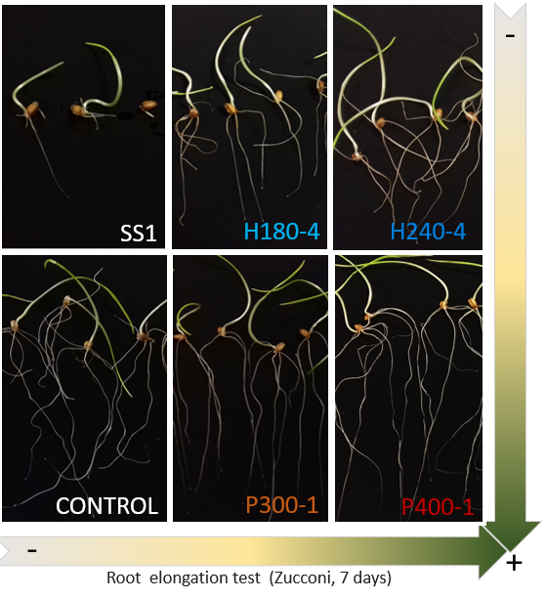

Phytotoxicity
$$Spring Wheat (KWS WILOW)$$
Response of the seeds
Would the materials be toxic and reduce the germination of the seeds?
Zucconi Test (worst case scenario)
Toxicity reduced after all thermal treatments
Phytotoxicity minimal only through pyrolysis
Seed germination test (2 days)
Phytotoxicity is said to be minimal if Germination Index is > 60% (Alisa Jane Savage)
Germination considered if radicle is > or = 0.2 cm
Sewage Sludge (SS1) Feedstock
Hydrochar 180◦C 4h (H180-4)
Hydrochar 240◦C 4h (H240-4)
Pyrochar 300◦C 1h (P300-1)
Pyrochar 400◦C 1h (P400-1)
Figure-2.

Slide 10
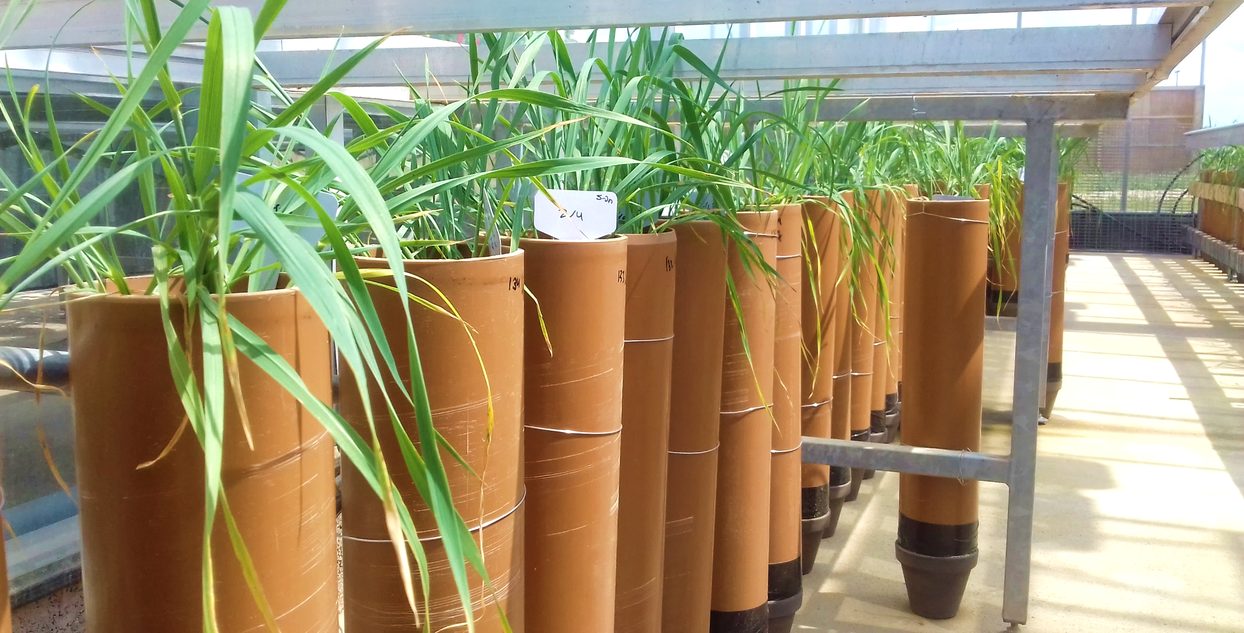
Soil response to amendments
Do these materials change the properties of the soil amended with them?
Would this change over time?
Top layer (2cm) 0→ 1→ 2
Initial Conditions June 2018
After first harvest August 2018
After second harvest June 2019
Bottom layer (2cm) 0→ 2
Initial Conditions June 2018
After second harvest June 2019
PROFILE
Single treatments contain a thermal derivative from SS1 (3 rates to compare : 5-10-20 t/ha “r1-r2-r3”)
Combined treatments contain a thermal derivative + SS2 (3 rates to compare : 10-20-40 t/ha, mix 50-50%)

Slide 11
Soil response to amendments – pH & EC
Do these materials change the properties of the soil amended with them?
Would this change over time?
Yes, 2 seasons of crop production acidified the soil intensified by treatments combined with SS2. Single treatments of pyrochars, specially P400 maintain pH season to season and reduces SS2 acidification.
a)
Yes, EC increases considerably from season to season, especially at highest rates of combined amendments and single SS2.
b)
Figure-3. Changes in soil pH and EC after amendments with SS1 derivatives and SS2 mixed in the combined treatments.

Slide 12
Soil response to amendments – Available P
Do these materials change the properties of the soil amended with them?
Would this change over time?
Yes, there is an overall tendency of available- P increment over time. However after the second season combined treatments reduce their available- P
Single amendments Combined amendments
Figure-4. Available P (Olsen-P) in soil changes after initial conditions (Y0), first harvest (Y1) and second harvest (Y2) of spring wheat.

Slide 13
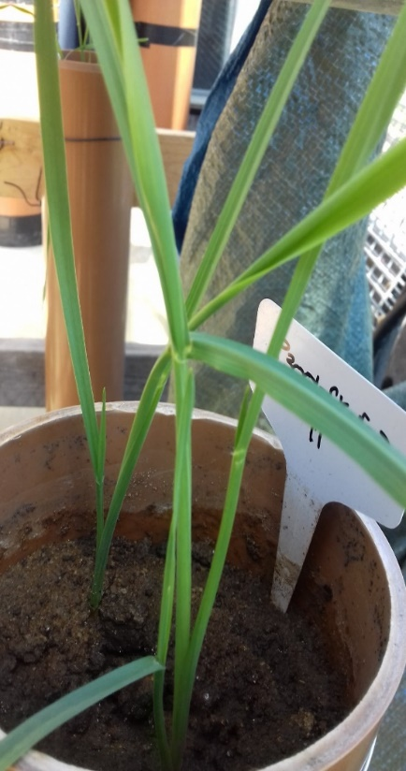
Soil response to amendments – O.M. (LOI)
Do these materials change the properties of the soil amended with them?
Would this change over time?
Yes, there is an increase of organic matter (O.M.), measured through loss in ignition (LOI) favoured by higher rates, especially of combination with SS2. O.M. increase is a result of amendments and root decomposition inputs
Bottom layer
No significant differences were detected in any of the analysis for the bottom layer of the highest rates, indicating a low risk of contamination of soil and water systems

Slide 14
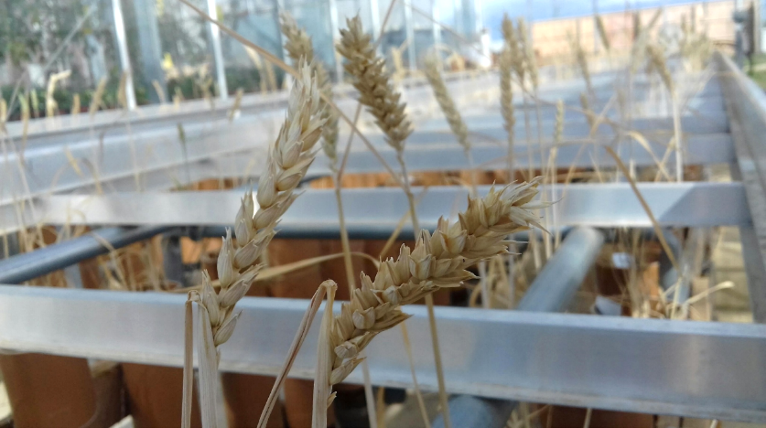
Spring wheat response to amendments
Do these amendments improve yield production?
Yes/No
First season: According to ANOVA and Tukey test, in the first season the only significant improvement in grain yield were for H180+SS2 r3, P300+SS2 r3, P400+SS2 r3 and SS1+SS2 r3.
Second season: No significant differences were found due to the high variability between replicates (4 per treatment).
This is the improvement of averages per treatment on grain yield:
Control maintains a production of 1995 kg/ha
And grain quality?
- On going
Figure-6. Changes on spring wheat grain production compared to control soil (%).

Slide 15
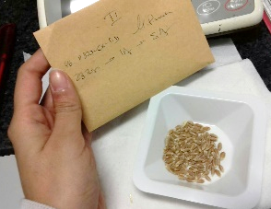
Conclusion
The perception of sewage sludge amendment as an object of debate
Little negative effects have reported with the data gathered to date, the bottom layer analysis indicated a low risk of contamination of soil and water systems
The type of thermal treatments and temperature selected were different enough to significantly change the properties of the original feedstock (pH, organic carbon content, C stability, H:C, O:C ratios)
.
The dried sewage sludge (SS1) proved already to benefit from the thermal treatments reducing its phytotoxicity (best through pyrolysis) and increasing organic matter in soil. SS derivatives amendments realise available P slower over time (specially if added an their own).
Sludge (SS2) seemed to enhance wheat’s growth cycle and grain yield in the first season, in a sandy loam soil with low organic matter and low P-Index.
Quality of the grains (both seasons)
phosphorus use efficiency (PUE) and total metal concentration changes in soil are on going

Slide 16
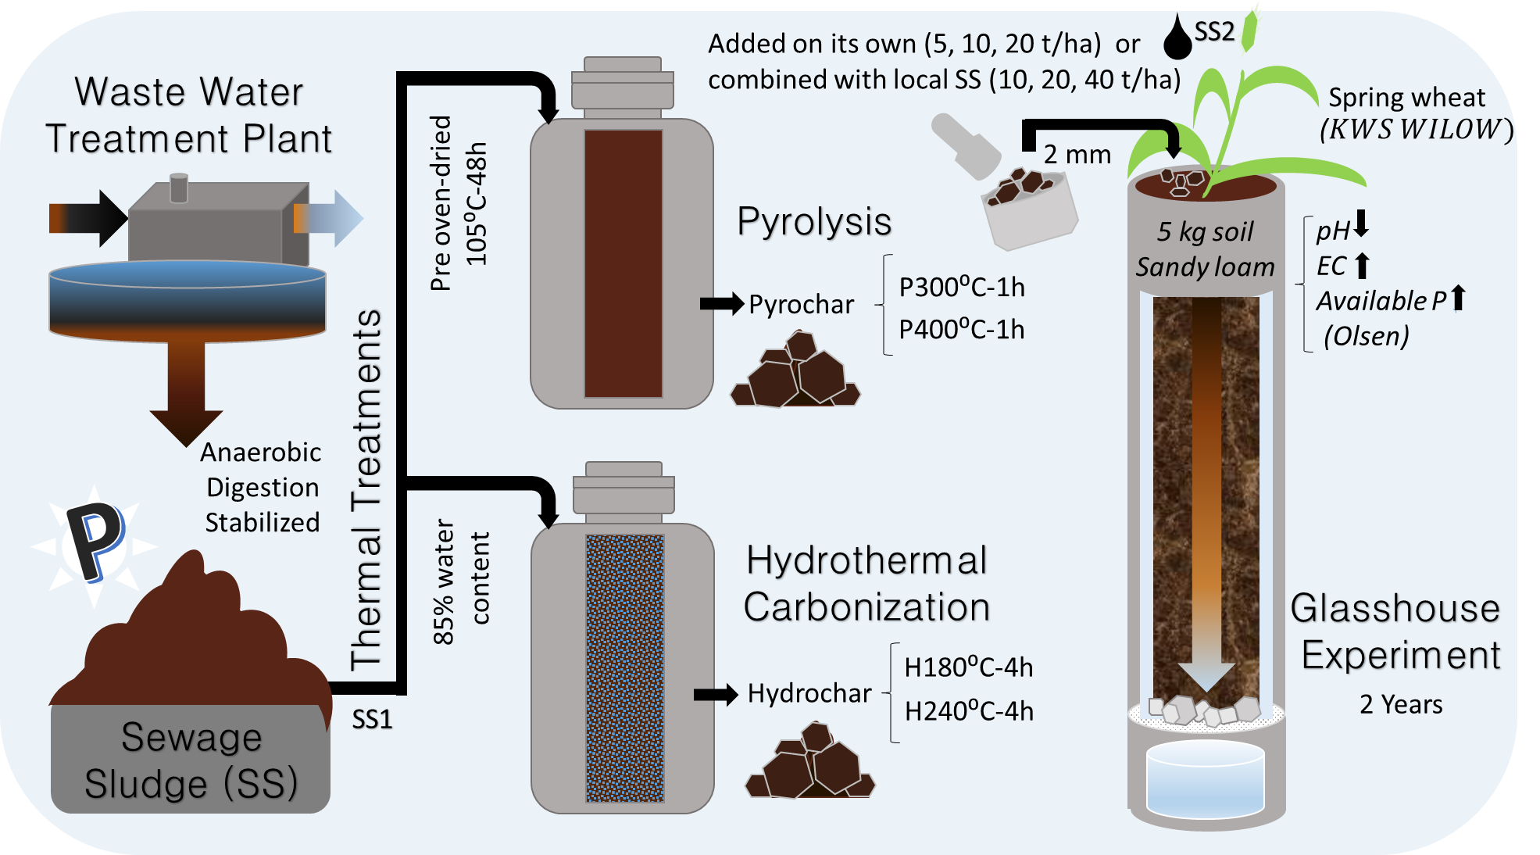
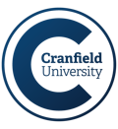
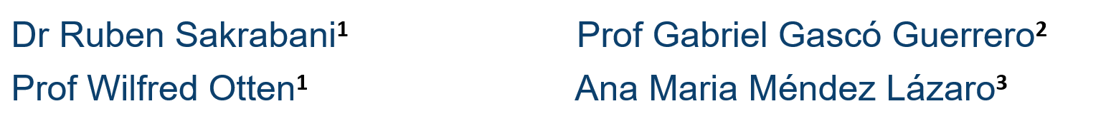
Thank you
EUROPEAN PARTNERSHIP PROGRAMME
Contact:
María Pimenta da Costa Ocampo ¹ M.Pimenta-Ocampo@cranfield.ac.uk
¹School of Water, Energy and Environment, Vincent Building, Cranfield University, Cranfield, Bedfordshire MK43 0AL, UK www.cranfield.ac.uk
²Department of Agricultural Production. E.T.S.I. Agronomic, Food and Biosystems. Technical University of Madrid, Ciudad Universitaria, 28004 Madrid, Spain
³Department of Geological and Mining Engineering. E.T.S.I. Mines and Energy. Technical University of Madrid, 21 Ríos Rosas Rd, 28003 Madrid, Spain

