Slide 1




EVALUATION OF THE SEISMIC RESPONSE
AT THE ARQUATA DEL TRONTO HAMLET
THROUGH 3D NUMERICAL ANALYSES
Primofiore Ilaria
(1) University “G. d' Annunzio” of Chieti-Pescara, Department of Engineering and Geology, Chieti, Italy
(ilaria.primofiore@gmail.com; g.vessia@unich.it)
(2) National Institute of Oceanography and Applied Geophysics (INOGS), Trieste, Italy
(jbaron@inogs.it; glaurenzano@inogs.it; pklin@inogs.it)
(3) Italian Institute for Environmental Protection and Research (ISPRA), Italian Geological Survey, Roma, Italy
(cristina.muraro@isprambiente.it)

Slide 2
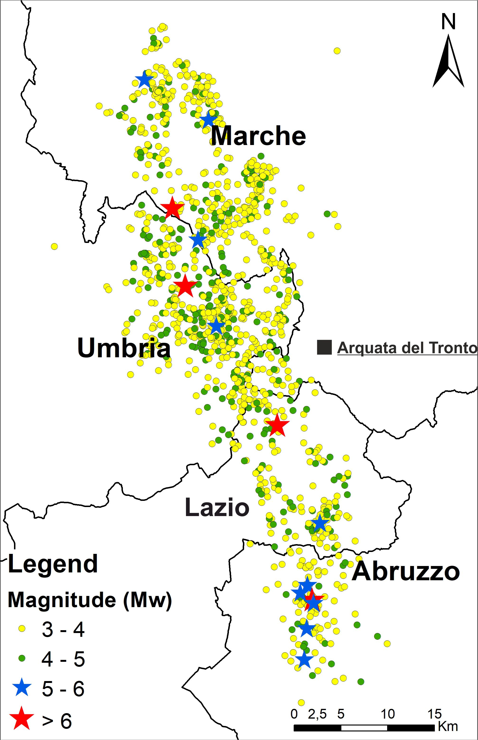
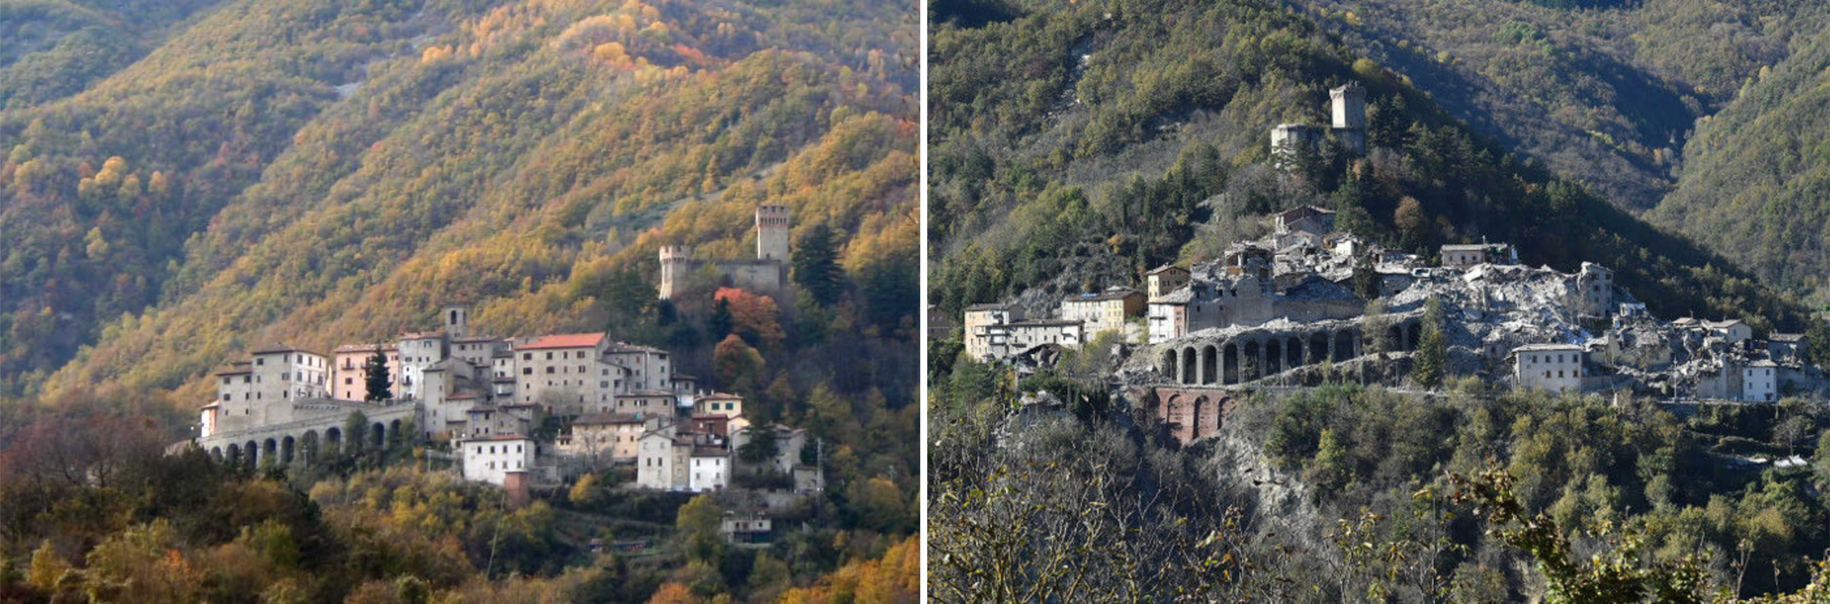
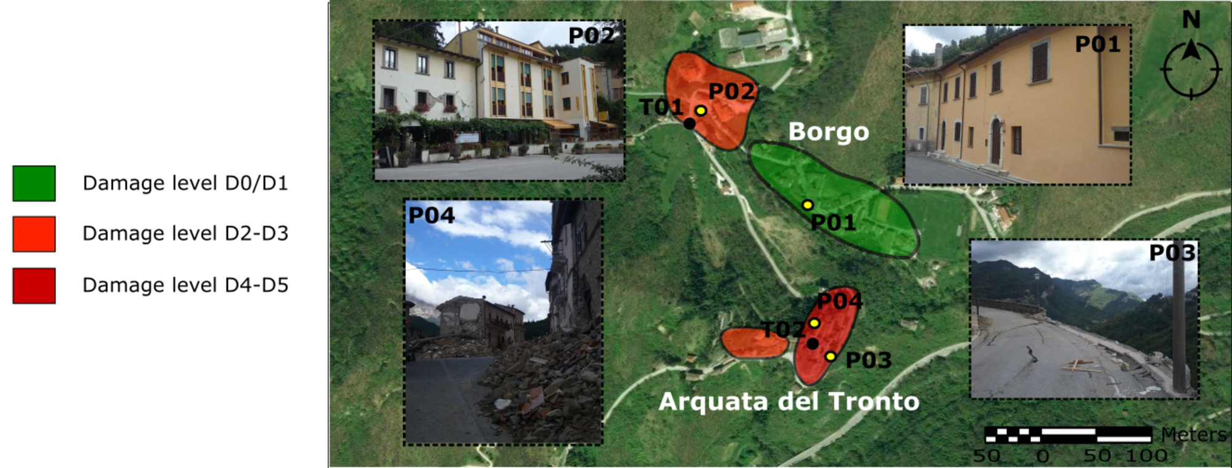

Before and after the Central Italy 2016-2017 seismic sequence
The aims of the study are to understand:
Resonance frequencies and amplitude of the shaking
The role of the topography and buried geometries
Different damages in nearby locations
After Lanzo et al. (2019), modified

Slide 3
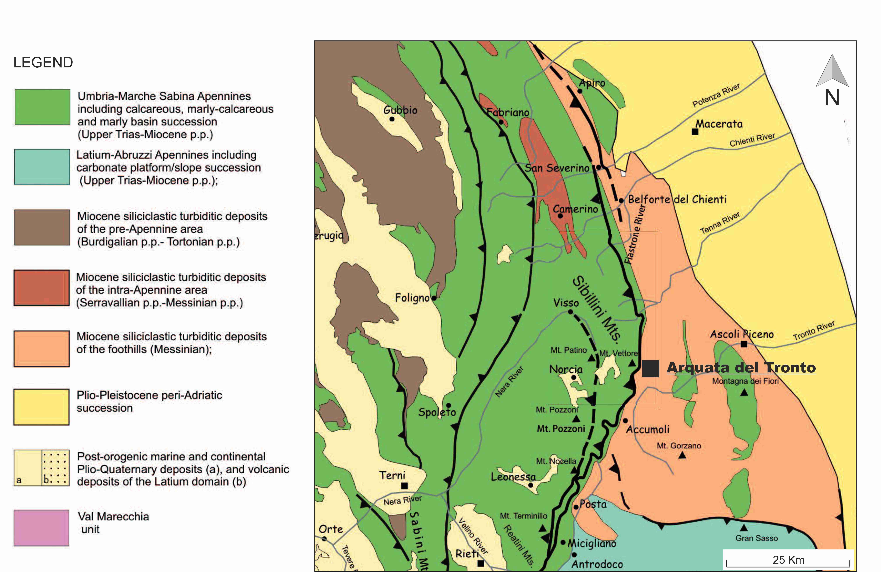
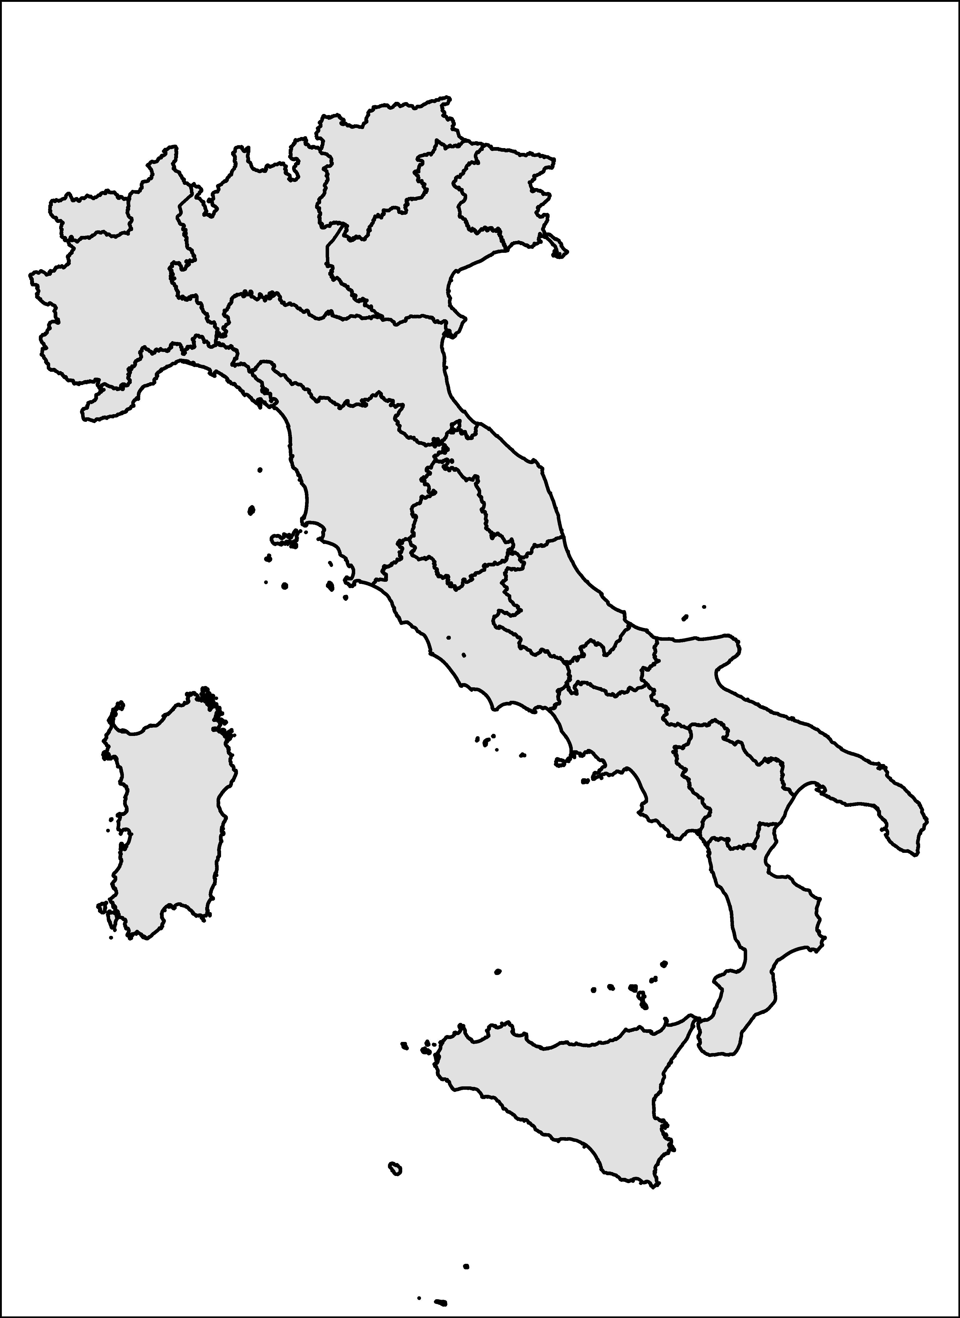
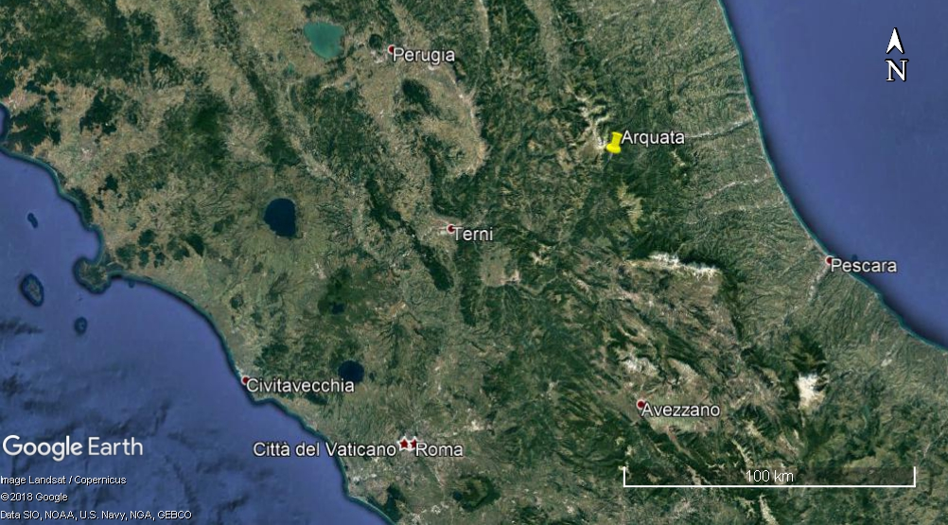

The case study
Italy
After Pierantoni et al. (2013), modified

Slide 4
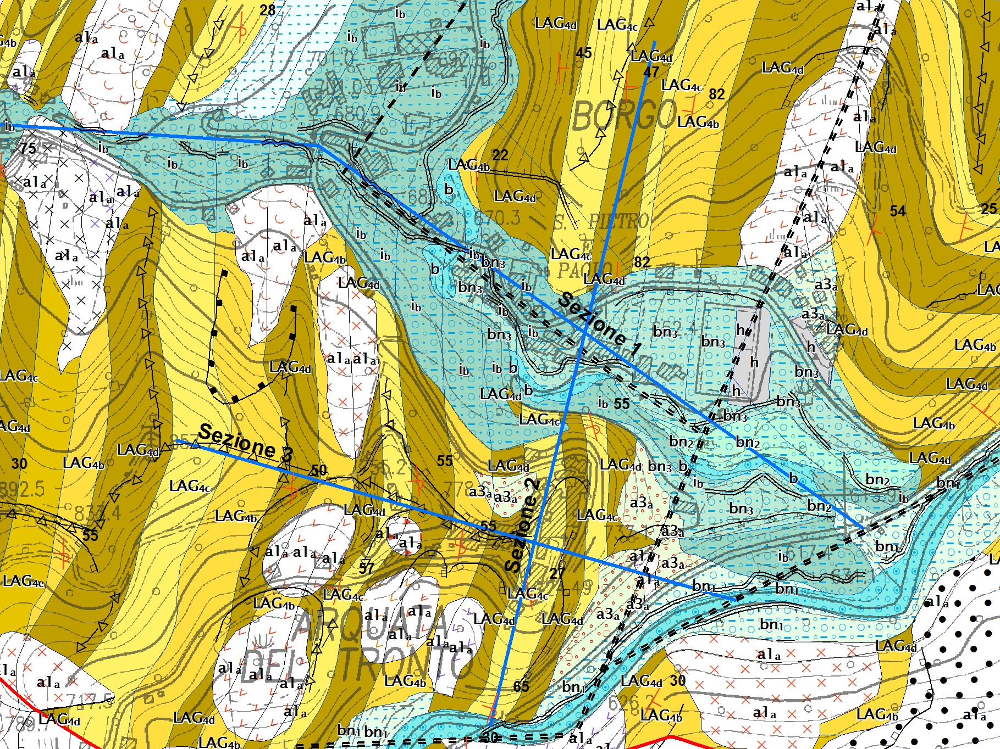
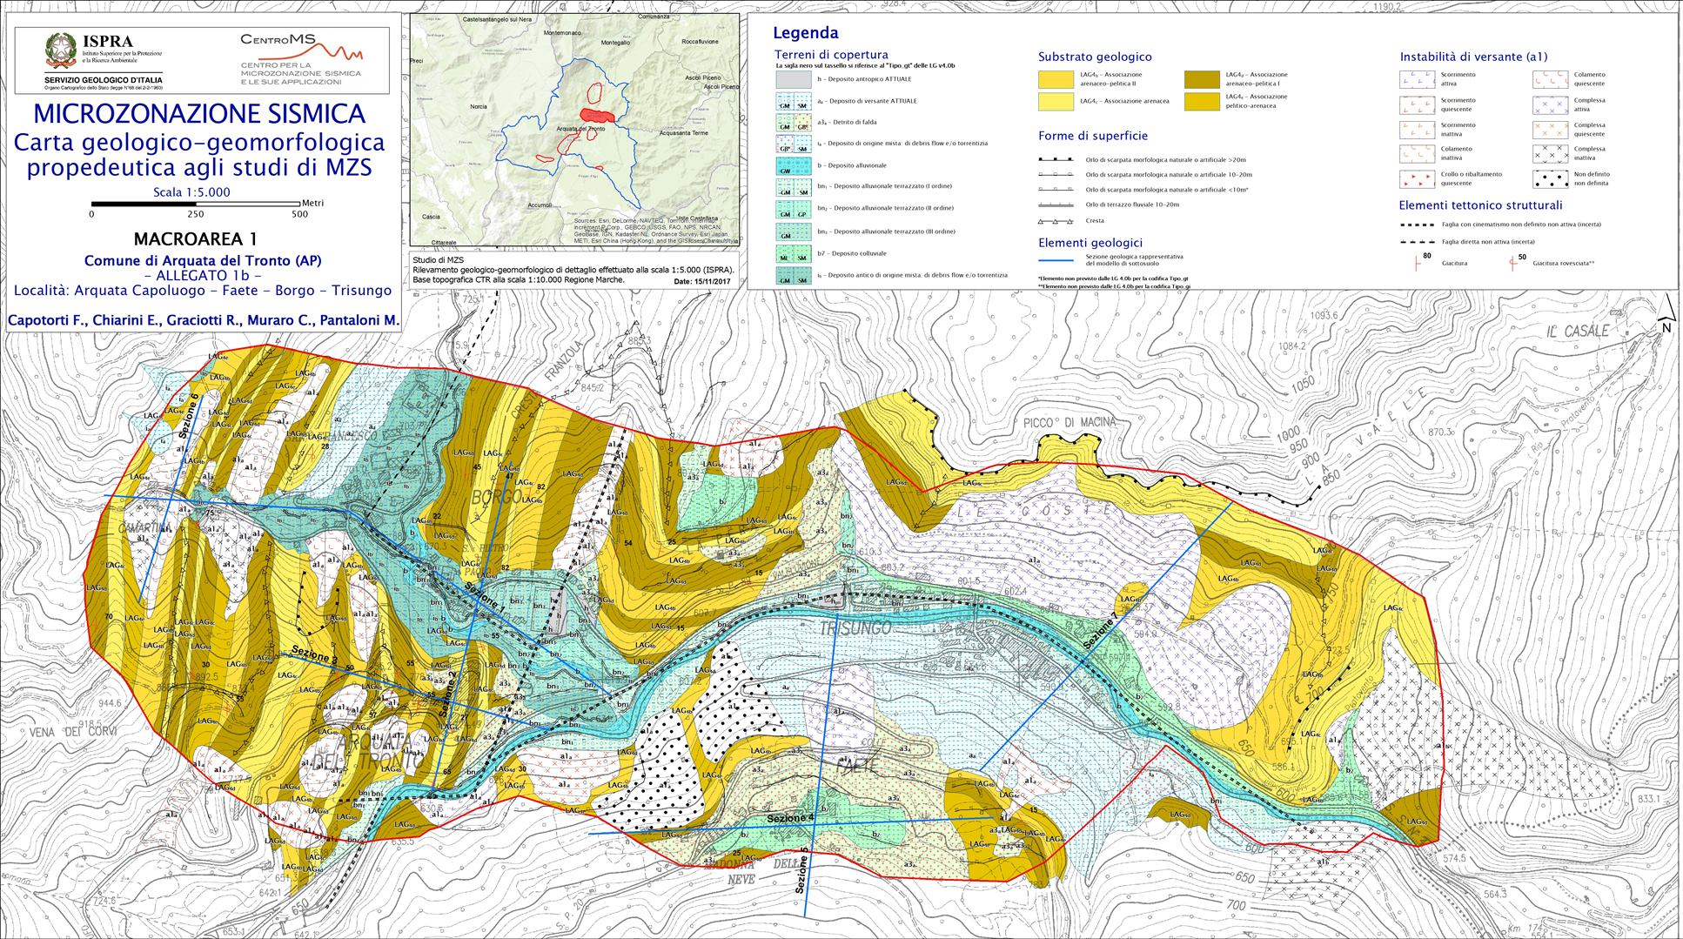
Specific sites of
the study area:
A → Arquata del Tronto old town
B → Borgo hamlet
C → Middle age castle
N
B
Section 1-1’
A
C
Section 3-3’
Section 2-2’

Slide 5
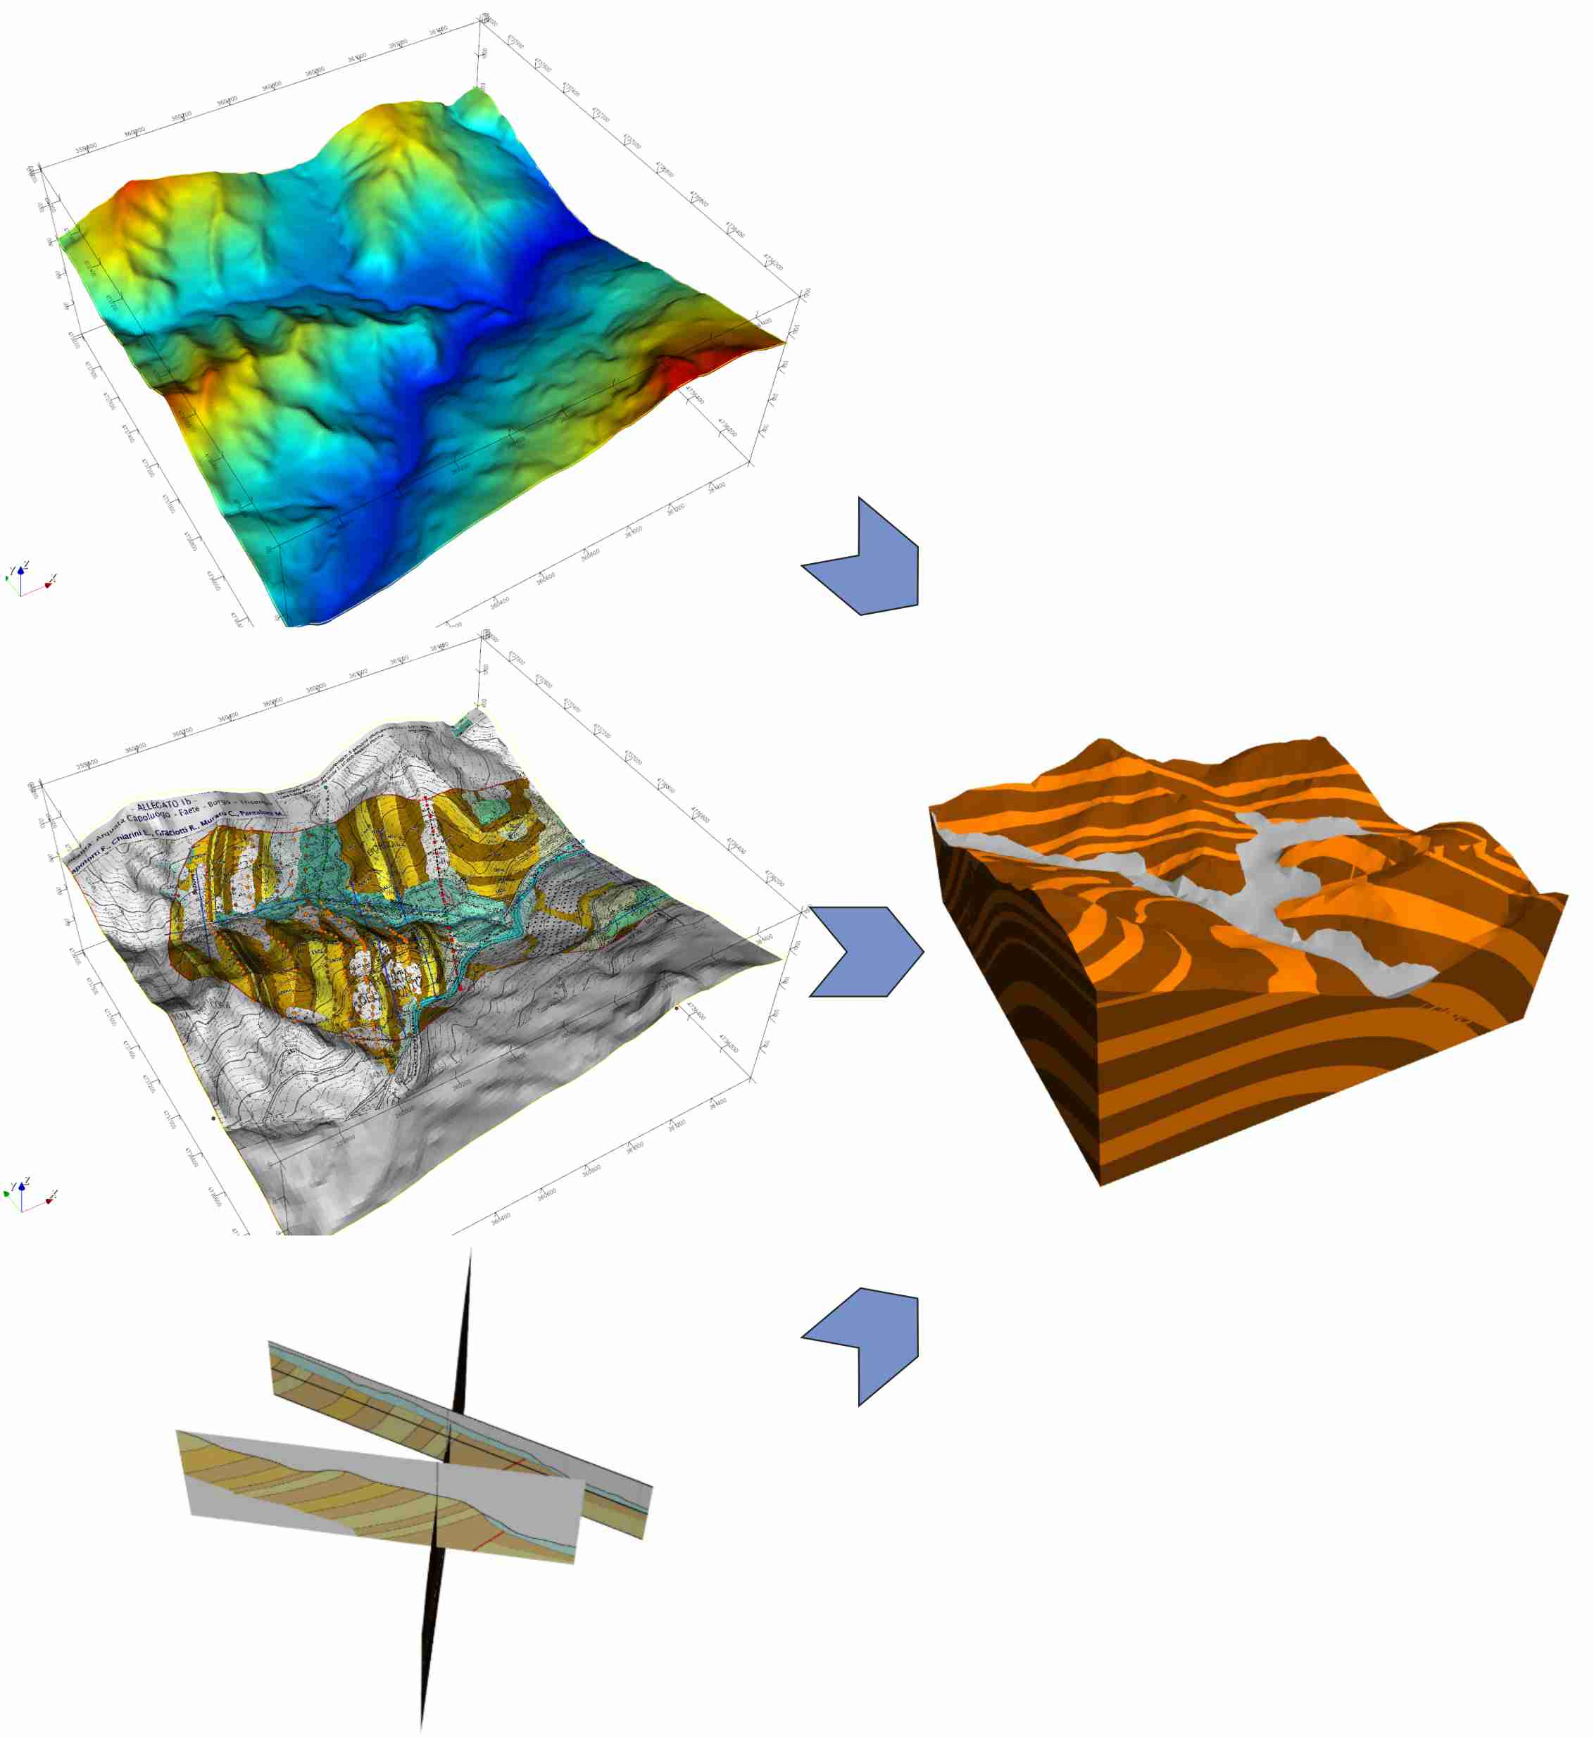
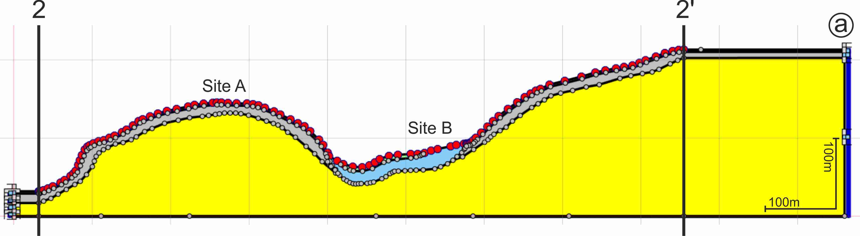

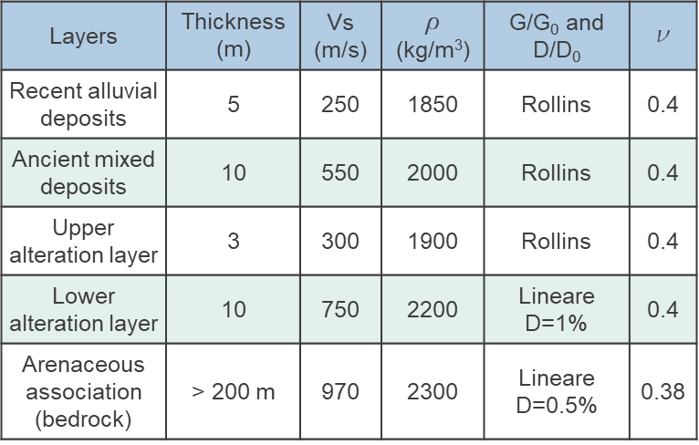
LSR2D
Geomodeller+SpecFEM3D
SSW
NNE

Slide 6
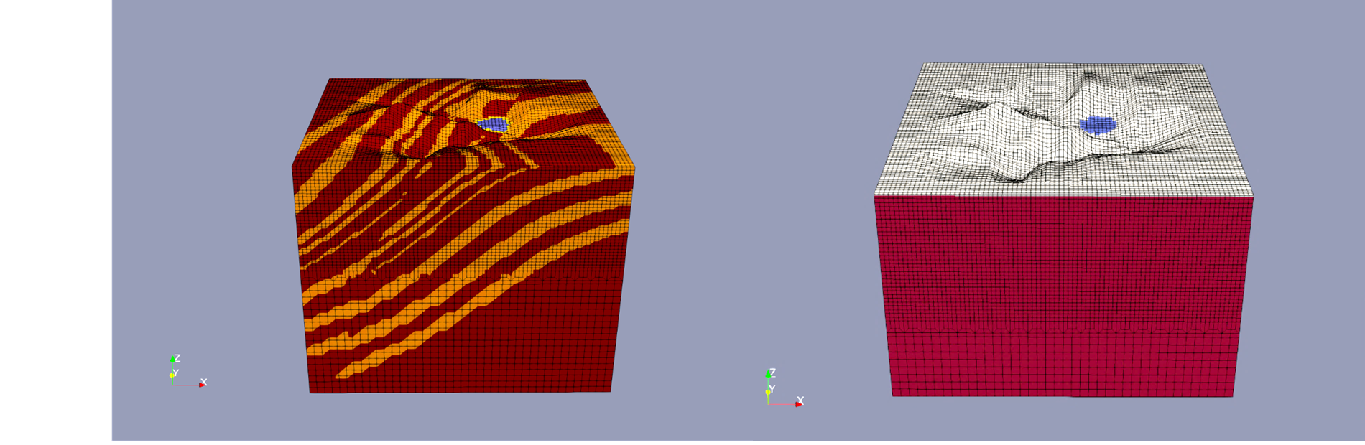

3D models
Model with Geological Reconstruction
Model with surface Alteration Layer
GR model
AL model
Layers | Vs (m/s) | Vp (m/s) | ρ (kg/m³) | Q_{μ} | Q_{K}
Alluvial deposits | 450 | 1100 | 1800 | 45 | 160
Alteration layer | 700 | 1700 | 2000 | 70 | 245
Pelitic association | 900 | 2250 | 2100 | 90 | 315
Arenaceous association | 1000 | 2500 | 2200 | 100 | 350

Slide 7
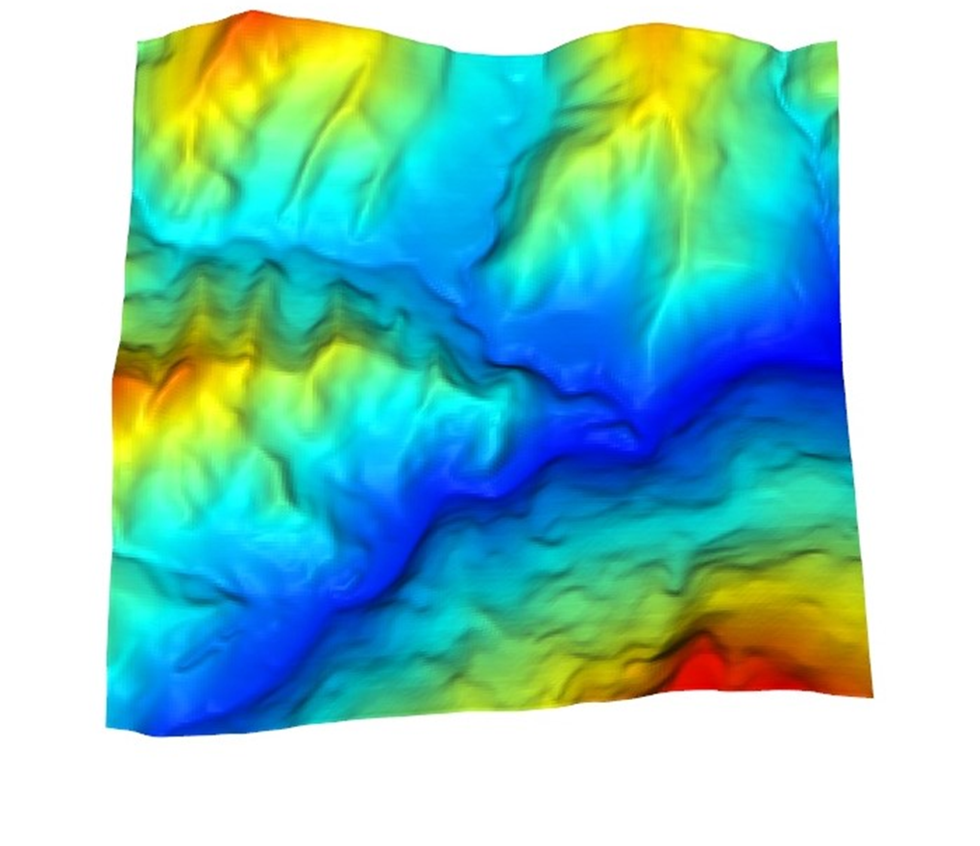
Results and discussions
Topographic effects
N
0 500m

Slide 8
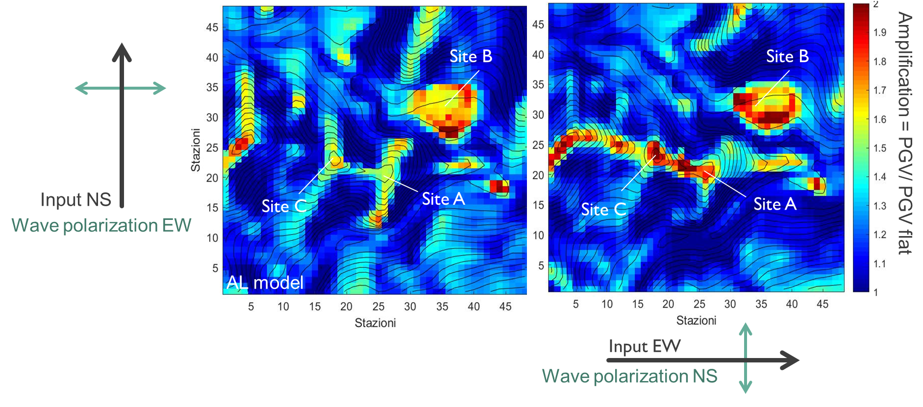
Results and discussions
Topographic effects
N
N

Slide 9
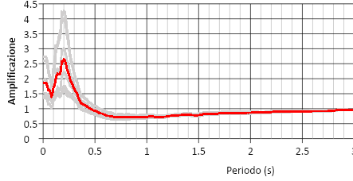
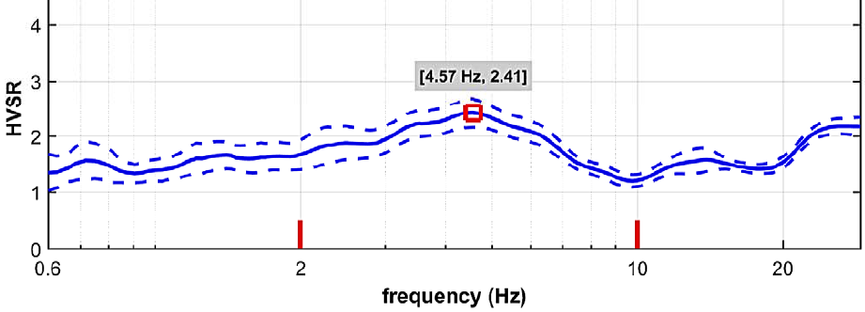
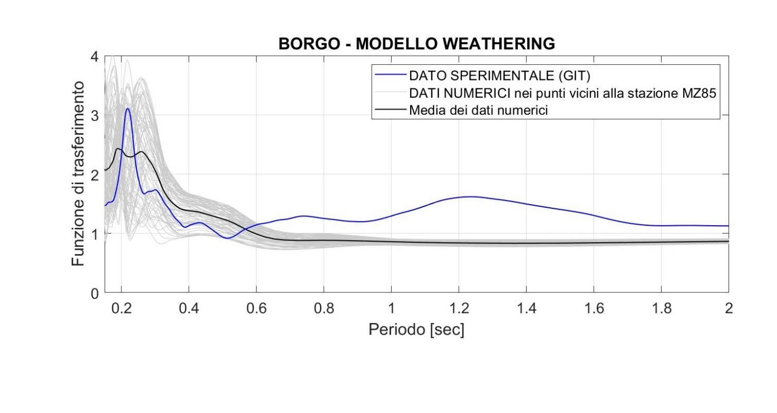
Results and discussions
Site B (Borgo)
2D
2D numerical data
Mean in site B
HVSR
Amplification
GIT experimental data
3D numerical data
Mean in site B
Period (s)
3D
3D analysis confirms the effect of alluvial valley amplification
Amplification
Period (s)

Slide 10
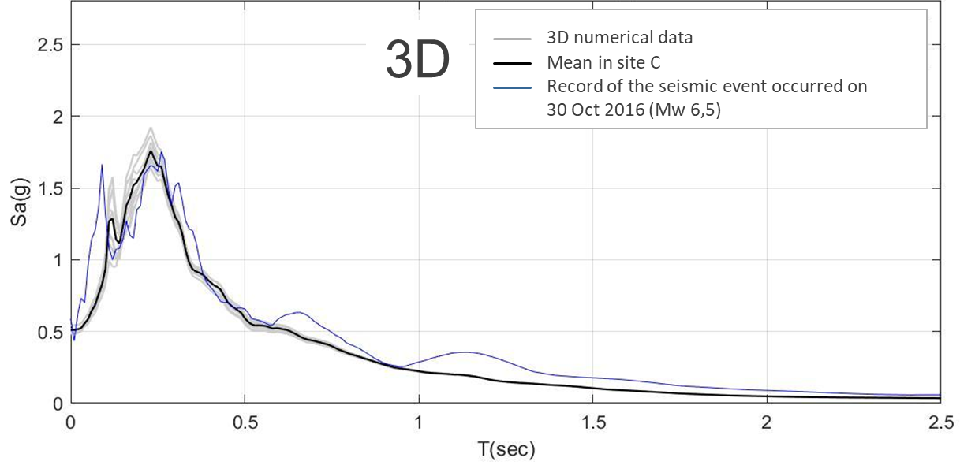
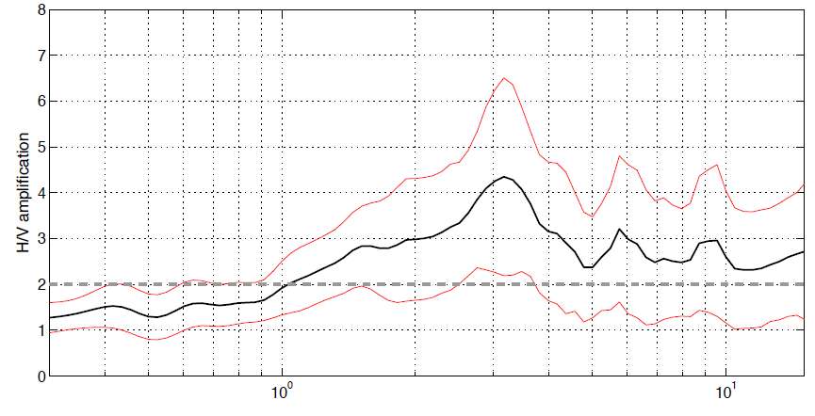
Results and discussions
Site C (Castle)
HVSR
3 Hz
3,1 Hz
3 Hz
The 3D simulation convoluted with the seismic signal of the sevenfold spectrum
compatible perfectly reflects the recording in situ of 30 October 2016

Slide 11
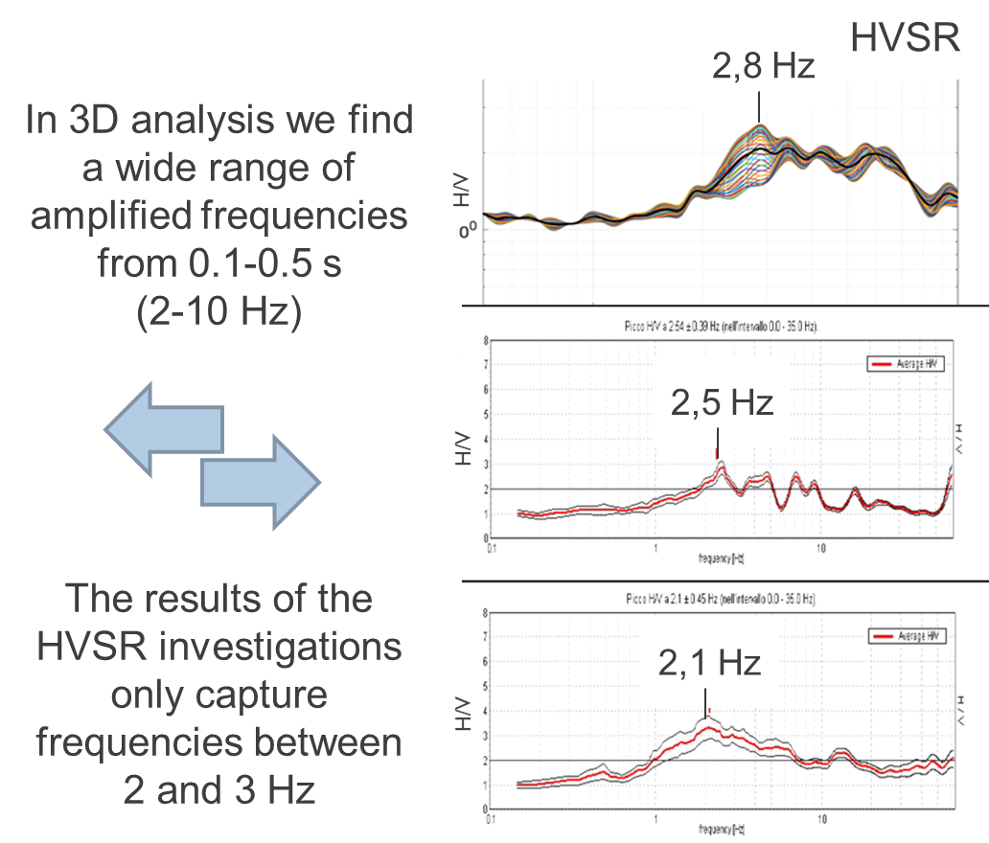
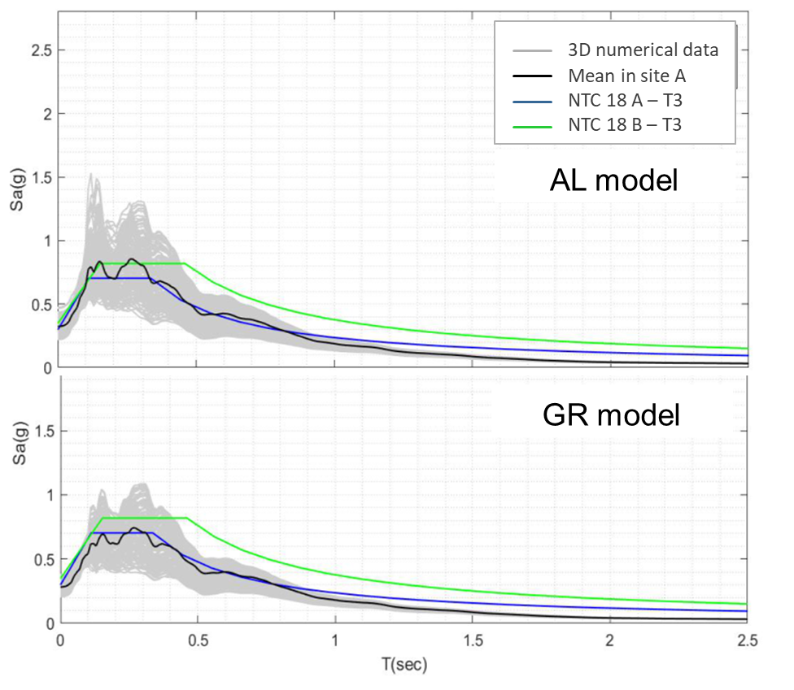
Results and discussions
Site A (Arquata del Tronto ridge)

Slide 12
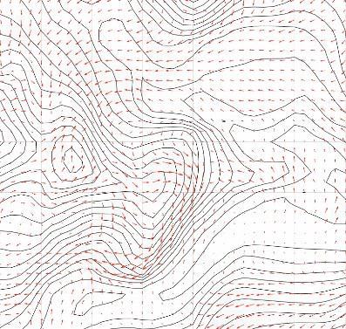

Results and discussions
Particle motion
TIME: 6,4 sec
N
TIME: 6,4 sec
N
Borgo
Castle
Arquata
del Tronto

Slide 13
Conclusions
SIMULATIONS
SITE B
SITE C
3D simulation captures the recording of the strong motion. Directional effects and small twisting effects have been found.
3D simulation confirmed the site's non-directional behavior and typical of sediment-filled valleys.
SITE A
3D simulation allowed us to evaluate the great directional effects and strong twisting effects.
3D EFFECTS
DIRECTIONALITY
TWIST
Different structures resonate according to the polarization of the seismic wave.
The rotary motion could be the cause of the greater damage to Arquata del Tronto, compared to other sites.

Slide 14
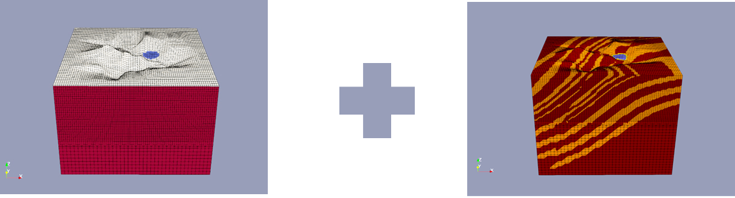
Purpose for the future
To combine both GR and AL models, in a single complete model, with:
Surface alteration layer
Deposits
Buried geometries
…Thanks for your attention!

