Slide 1
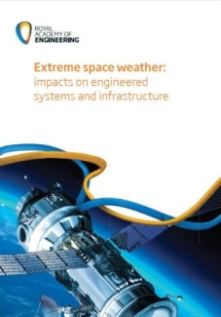
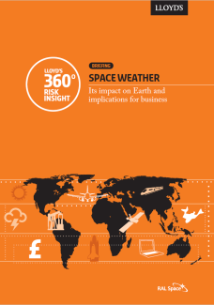
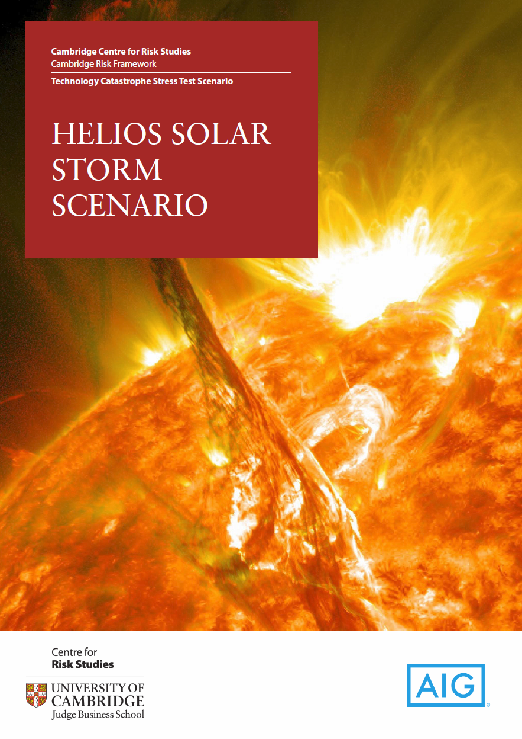
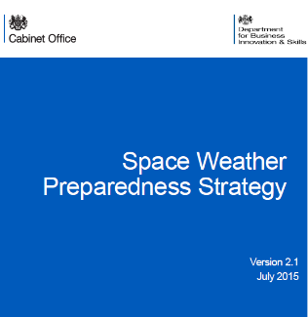
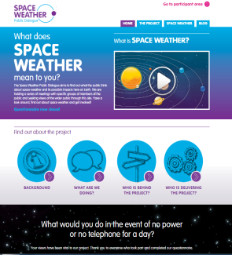
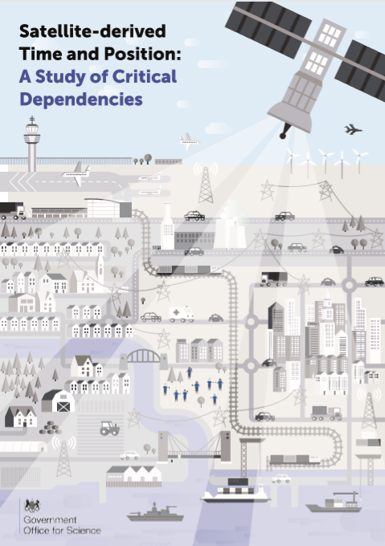
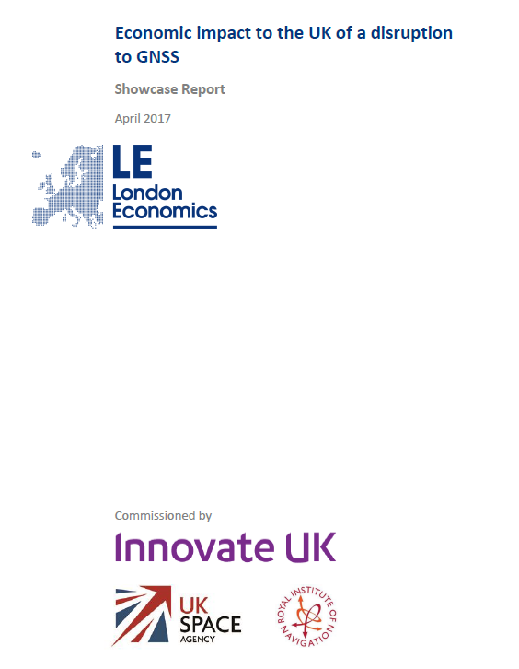
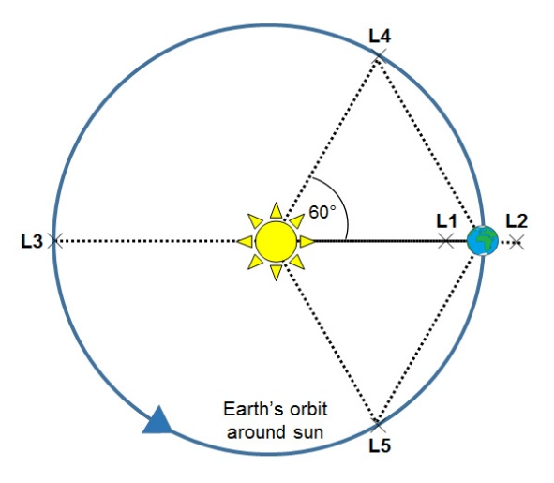
Mario M. Bisi (1), Mark Gibbs (2), Mike A. Hapgood (1), Mike Willis (3), Richard A. Harrison (1), Simon Machin (2), and Ian W. McCrea (1).
Please note that this is as of December 2019 – no updates due to the COVID-19 pandemic…
(1) RAL Space, UK Research and Innovation – Science & Technology Facilities Council – Rutherford Appleton Laboratory, Harwell Campus, Oxfordshire, OX11 0QX, UK
(2) Met Office Space Weather Operations Centre, Met Office, FitzRoy Road, Exeter, Devon, EX1 3PB, UK
(3) UK Space Agency, Polaris House, North Star Avenue, Swindon, Wiltshire, SN2 1SZ, UK
***All rights reserved – NOT for
reproduction, use, or further distribution…
Don’t panic, do prepare!
£3B inferred for the loss GNSS for three days…
Space Weather in the UK: Updates on the UK Strategy, Investment, and International Engagements (Invited)
These reports have collectively provided valuable information for UK Government Departments trying to understand what their vulnerabilities to space weather might be and are used to inform
the development of proportionate risk
mitigation strategies…

Slide 2
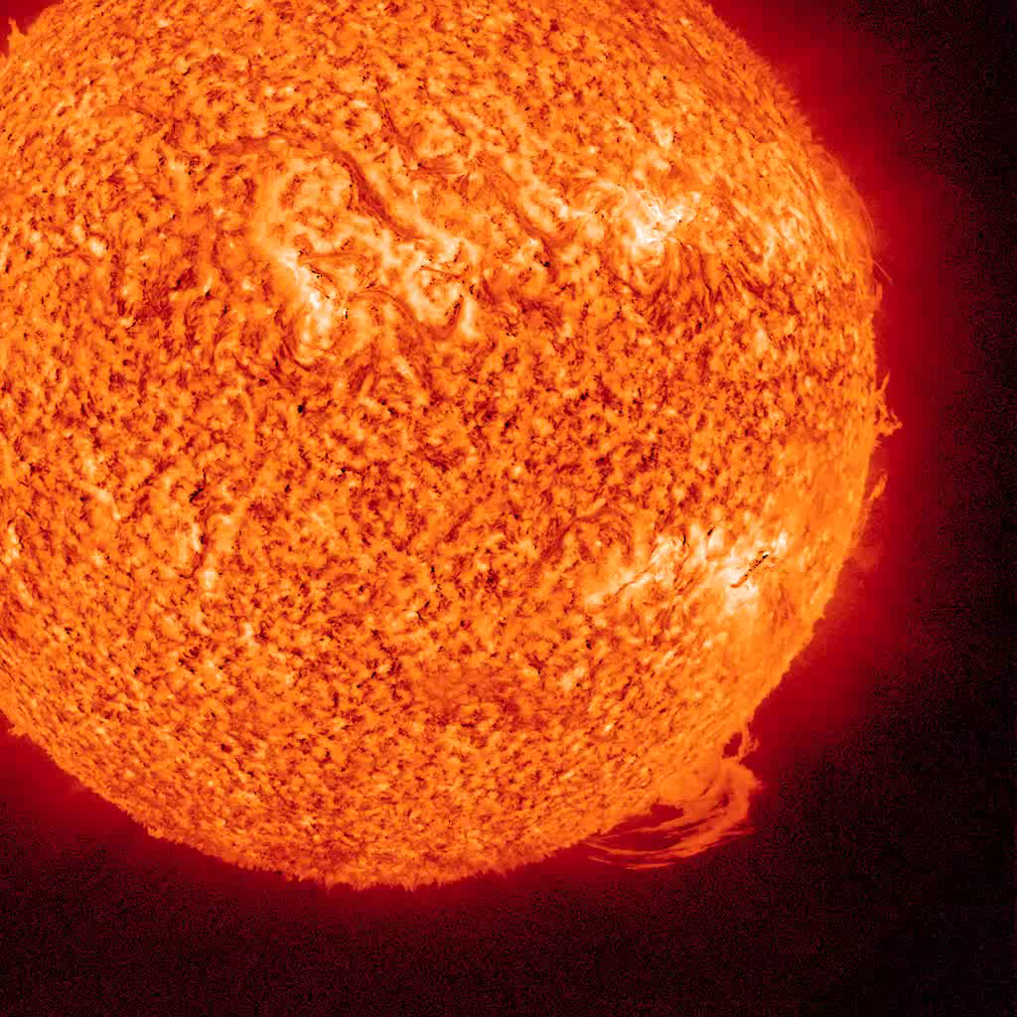
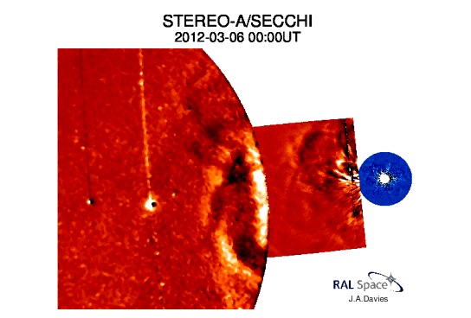
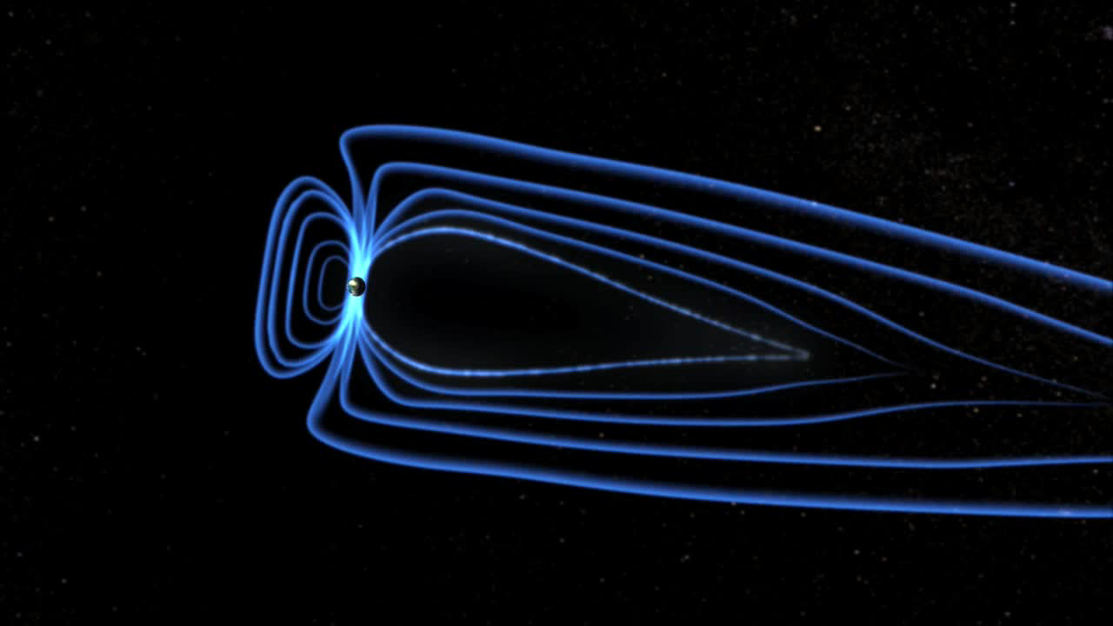

Space Weather
© 2019 RAL Space
Space weather at Earth is the Sun’s influence on the Earth’s space environment and connection down into ground…
  Need to understand energy flow:
    Source (Sun) and transmission (solar wind), processing by the Earth’s own magnetically-confined system (magnetosphere, ionosphere/atmosphere, lithosphere), and into the ground (solid Earth).
Space Weather is a global threat that is of national and
international concern with global and local /regional impacts…
Courtesy: Jackie Davies
Solar → Heliosphere → Space Environment

Slide 3

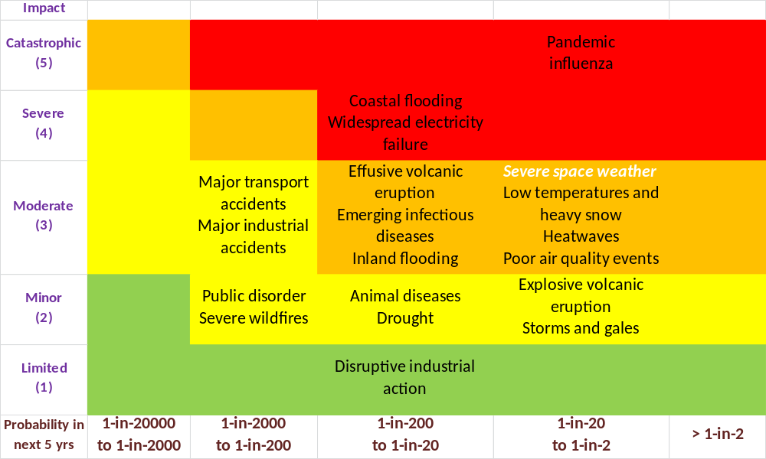
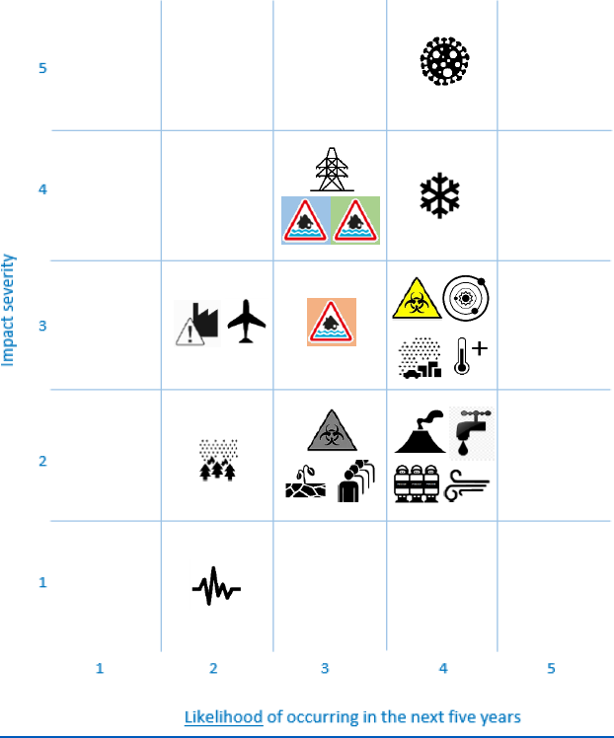
Assessing the Risk
© 2019 RAL Space
UK’s National Risk Register (NRR – 2017 edition) – non-malicious risks.
Severe space weather has been on the UK’s NRR since 2011.
This, along with other additional risks, were brought to the Government’s attention following the problems caused by the Iceland ‘Eyjafjallajökull’ volcanic ash clouds in 2010.
Not just the UK government is concerned here though – other governments are also taking account of the risks of space-weather!
UK Space Agency has funded socio-economic studies on space-weather impacts and others, such as ESA and NOAA, have followed…

Slide 4










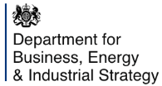






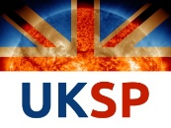

UK Organisation
© 2019 RAL Space
An overview (Venn diagram) of the UK Government’s Governance of Space Weather…
Government
Entities
Academics, Research, and Development
SEIEG
Impacts and Mitigations
Improving Capability
Technology, Data, and Forecasting
Scenarios
International Engagement
Acknowledgements: Adapted from the Department for Business, Energy, & Industrial Strategy – BEIS, UK.
4

Slide 5
Scenarios (1)
© 2019 RAL Space
Primary objective of the Reasonable Worst-Case Scenarios (RWCS) is to assist the UK government officials working on risk management policy…
  “Civil contingencies”.
Must be impact-driven:
  What is the infrastructure at risk from space weather? => Economic and societal disruption?
  What is the impact on people: health, psychological distress?
Provide the RWCS to guide impact assessment:
  Typically aim around 1-in-100 years’ scenarios.
  Science vital to provide knowledge on these timescales.
  Personal/organisational experience rarely >20 years.
Policy officials can use this in wider discussions:
  To explore resilience of societally vital activities.
  With infrastructure operators, regulators, governmental departments, local/regional governments, etc…
Also guides preparedness for major events:
  Engineering resilience, forecasting, awareness-raising and exercises…

Slide 6
Scenarios (2)
© 2019 RAL Space
RWCS gives policy officials concise summary targeted on each impact area:
  Key environmental parameter(s).
  Rationale for that parameter, based on impact.
  Reasonable worst case of parameter, plus temporal and spatial extent.
  Outline of anticipated impacts.
  Assessment of quality of summary.
  Provenance of summary, strong preference for peer-reviewed evidence.
  How to improve the quality of summary.
  Additional background.
Current Impact Areas…
  Power grids – Rail systems – Terrestrial electronics: cumulative effects/aging/damage…
  Satellite operators: cumulative effects/aging/damage, single-effect events, internal and surface charging, atmospheric drag…
  Aviation: avionics and human exposure…
  Radio systems: GNSS, Satcom, HF (various scintillations, TEC, blackout effects)…
  Wireless systems.
  Public behaviours.
  Need to monitor new technologies: increasing automation, etc…

Slide 7
Ongoing Work…
© 2019 RAL Space
Ongoing UK Developments and Priorities
National Risk Assessment (and hence NRR) updated:
  Loss of GNSS and economic impacts improved; and
  Adjustments for increases in knowledge, understanding, and current capabilities.
Table top exercises continue to improve knowledge and understanding.
UK Space Weather Strategy being developed:
  Includes close working with the USA on the Benchmarks activities.
UK continues to see a UK programmatic lead on ESA L5 mission a priority.
UK has an interest in other avenues for space-weather data, forecasting, modelling, and potential backup/fall-back options; e.g.:
  Increased number of radiation monitors on satellites; and
  Use of IPS as part of the Worldwide IPS Stations (WIPSS) Network and investigating potential use of heliospheric Faraday rotation (FR).

Slide 8
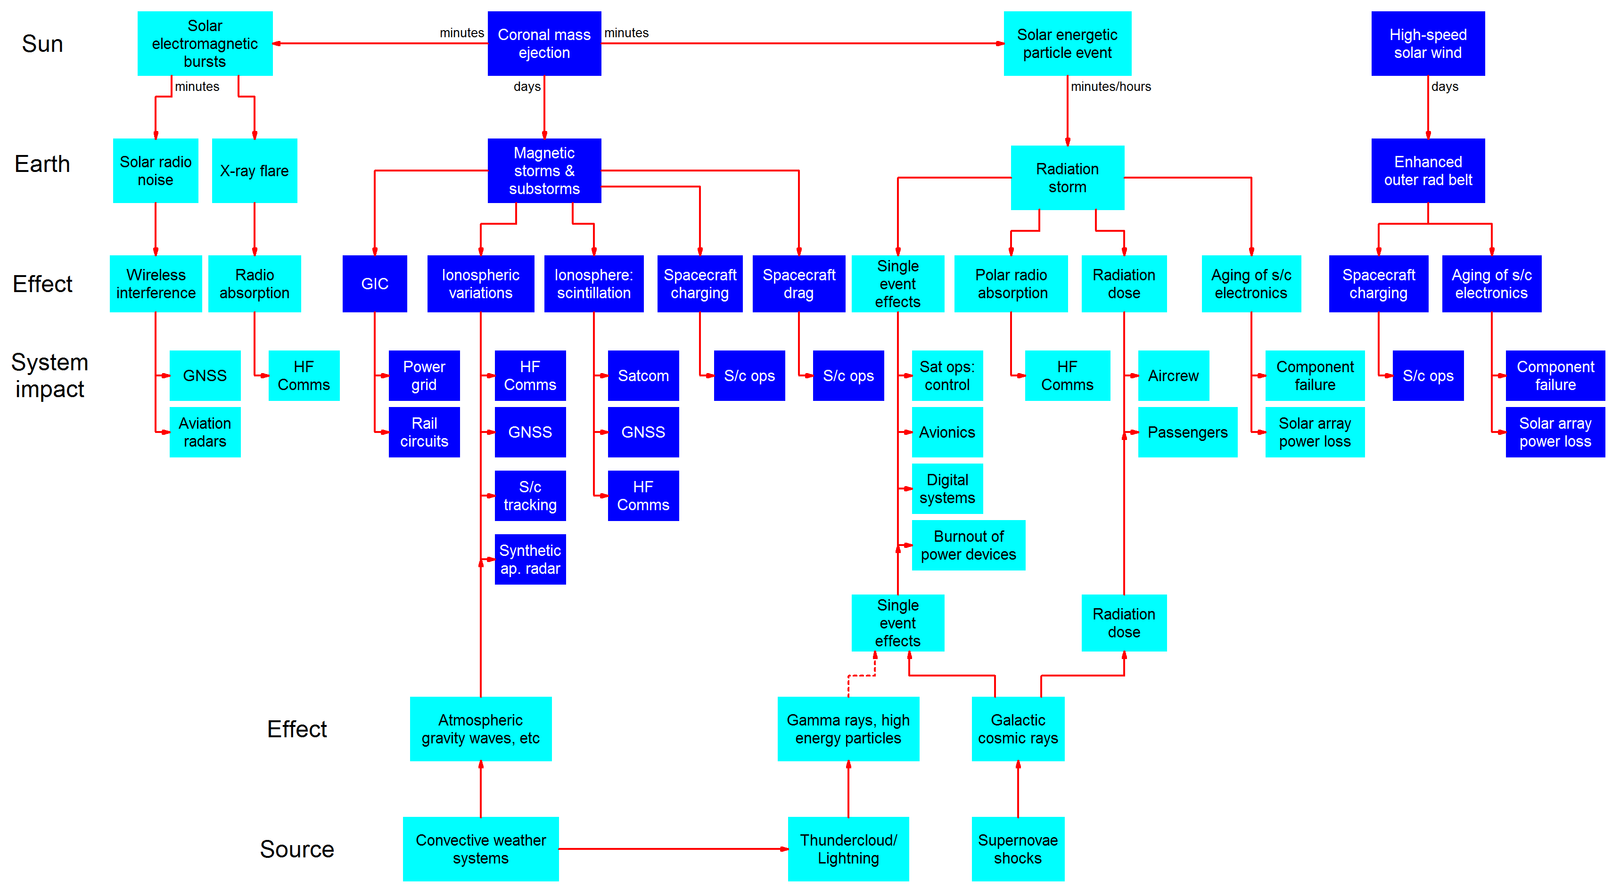
Impact Trees…
© 2019 RAL Space
Government officials requested this graphic to explain why very different effects and impacts occur close to time. It shows that the different RWCS’s should be considered as an ensemble of impacts, as well as individual cases.

Slide 9
UK SWx Strategy
© 2019 RAL Space
We will work with the
International community to ensure the UK
is resilient and able to respond to Space Weather.
The UK Space-Weather Mission Statement:
  “We will ensure the UK is resilient, and able to respond to a Severe Space Weather Event, on the basis of proportionate risk mitigation”.
The UK SWx strategy will be established around three key strands:
A five-year period detailing outcomes and challenges in order to achieve our strategic objectives above, with each strand underpinning the next…
ASSESS
PREPARE
RESPOND & RECOVER

Slide 10
SWIMMR
© 2019 RAL Space
New ~£20M UK SWx Programme…
Under the UKRI Strategic Priorities Fund (SPF) – a four-year programme that will improve the UK's capabilities for space weather monitoring and prediction.
Space Weather Instrumentation, Measurements, Modelling & Risk (SWIMMR) high-level goals/objectives:
  Develop a framework for supporting the transition of models and data sets from research in the academic community to operational use for space weather forecasting by MOSWOC​.
  Produce an updated space weather impact assessment study, building on the Royal Academy of Engineering report of 2013.
  Mitigate the potential radiation hazards of space weather to satellite and aviation operations (includes technology developments and electronics testing and model developments for spacecraft and aviation purposes).
  Mitigate potential space weather effects on communication and global positioning (includes improved modelling for ionospheric effects on these systems).
  Mitigate the potential risks of space weather to electric power distribution (includes improved GIC models and predicting the evolution of the solar wind to L1).

