Slide 1
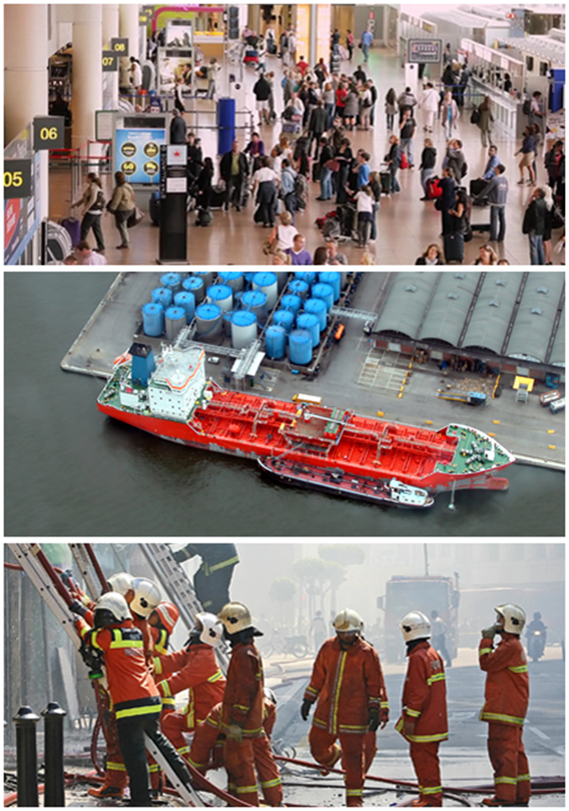
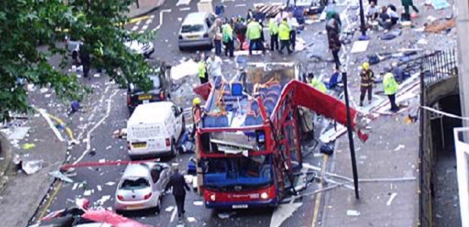
Bridging Science, Policy, industry, Practitioners and Societal dimensions for enhancing disaster resiience
Philippe QUEVAUVILLER
Innovation and Industry for Security
DG HOME

Slide 2
COMMUNITY BUILING
Relevance and challenges
Gathering Actors: from upstream (research) to downstream (industry/SMEs) as well as key users (policy, practitioners)
NEED FOR INTEGRATED POLICY FRAMEWORK
POLICY
Sendai Framework for Disaster Risk Reduction
POLICY Key Actors:
UN bodies
EU Policy DGs
EU Member States
UNION CIVIL PROTECTION MECHANISM
Security (CBRN)
Civil Protection
UN-DRR
ECHO
NATURAL HAZARDS
MAN-MADE HAZARDS
UNICRI HOME DEVCO
Climate Adaption
Strategy
Cross-border
Theats to Health
Non-Intentional Intentional
Intern. Cooperation
Environment (Nat. Disasters)
UNECE ENV
WFD
Floods Directive
Marine Strategy
Decision 1082
Environment (Seveso)
SevesoIII Directive
Protection of Public Spaces
Infrastructure Protection
CBRN-E Action Plan
INTERNAL SECURITY STRATEGY

Slide 3
COMMUNITY BUILING
Relevance and challenges
Gathering Actors: from upstream (research) to downstream (industry/SMEs) as well as key users (policy, practitioners)
RESEARCH &
INNOVATION
DISASTER RISK REDUCTION POLICIES
SECURITY POLICIES
LEADING PROJECTS Joint communication, critical mass / synergies
FP7/H2020 projects Capacity-Building projects
POLICY- MAKERS
RESEARCH, ACADEMIA
INDUSTRY, SMEs
PRACTI-
TIONERS
CIVIL SOCIETY,
CITIZENS
RESEARCH & CAPACITY-BUILDING
Theme Specific
Horizontal
Subtheme
Subtheme
Subtheme
Subtheme
Technologies,
Tools, Solutions
PCPs
Networking
Standar-
disation
Intern.
Cooperation
Subtheme
DISASTER RESILIENCE
PREVENTION / PREPAREDNESS / RESPONSE
Disaster forecasting
systems
(alert, communication,
Command control)
First
Responders’
protection
Citizen
Behavourial
Responses,
awareness
Cascade
effects
on infra-
stuctures
Faster alert,
Evacuation,
Victim triage

Slide 4
COMMUNITY BUILING
Relevance and challenges
Community of Users
Gathering Actors: from upstream (research) to downstream (industry/SMEs) as well as key users (policy, practitioners)
RESEARCH &
INNOVATION
INTERFACE
POLICY
LEADING PROJECTS Joint communication, critical mass / synergies
FP7/H2020 projects Capacity-Building projects
NETWORKS Information, mediation Practitioners, policy-makers
POLICY Key Actors:
UN bodies
EU Policy DGs
EU Member States
Subtheme
Subtheme
Subtheme
Subtheme
Subtheme
Subtheme
Subtheme
Security (CBRN)
Civil Protection
UN-DRR
ECHO
Subtheme
Subtheme
UNICRI HOME DEVCO
Intern. Cooperation
Environment (Nat. Disasters)
Subtheme
UNECE ENV
Environment (Seveso)
MARKET DIMENSION Industry / SMEs
USERS: Critical Infrastructures Operators, First Responders, Regional Authorities, Research, Civil Society etc.

Slide 5
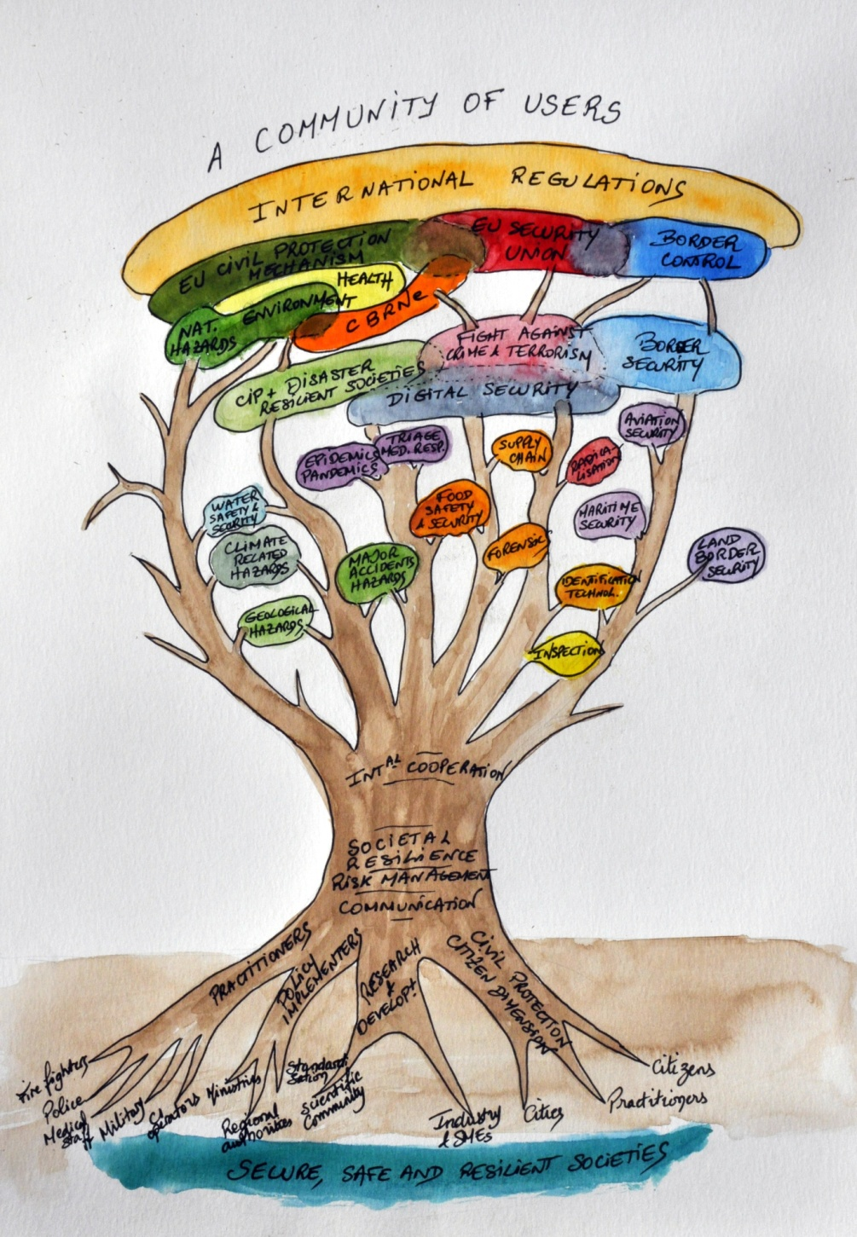
We are belonging to a same “tree”

