Slide 1
3D simulation of Levee breach
Rajkumari Kaurav
Prof. Pranab Mohapatra
Department of Civil Engineering
Indian Institute of Technology Gandhinagar, India

Slide 2
Outline
Introduction
Study highlights
Numerical model
Experimental set up
Conditions adopted in the numerical simulation
Calibration
Bed evolution
Velocity profile at breach section
Turbulent characteristics at breach section
Shear stress
Turbulent energy and turbulent intensity
Conclusions
References

Slide 3
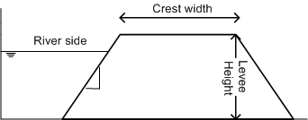
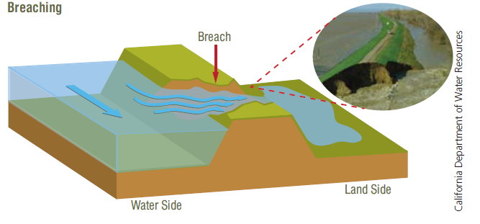
Introduction
Levees : constructed along the river
Levee breaching: erosion of the levee material causing failure and water to flood
Vertical erosion due to the shear velocity of the
flow on the bed
Lateral erosion due to instabilities
Experimental and numerical studies to analyse
levee breach
Levee on river bank
California Department of water resources
The complex process of levee breaching involves hydrodynamics, sediment transport, and soil water interaction.

Slide 4
Study highlights
3D simulation of levee breach due to overtopping using CFD software, FLOW-3D
1.
Calibration for turbulence model and the parameters used in sediment scour model using the experimental results
2.
Results for evolution of breach profiles
3.
velocity vectors and turbulence characteristics in breach section are presented.
3.

Slide 5
Numerical model (FLOW-3D)
Governing equations
Flow: (Reynolds-averaged Navier–Stokes equations)
Continuity equation
$$\frac{∂U}{∂x}+\frac{∂V}{∂y}+\frac{∂W}{∂z}=0$$
Momentum Equations
$$\frac{∂U}{∂t}+\frac{1}{V_{F}}\left\{U\frac{∂U}{∂x}+V\frac{∂U}{∂y}+W\frac{∂U}{∂z}\right\}=−\frac{1}{ρ}\frac{∂p}{∂x}+ν\left(\frac{∂^{2}U}{∂x^{2}}+\frac{∂^{2}U}{∂y^{2}}+\frac{∂^{2}U}{∂z^{2}}\right)+\left[\frac{∂\overline{\left(−u^{′2}\right)}}{∂x}+\frac{∂\overline{\left(−u^{′}v^{′}\right)}}{∂y}+\frac{∂\overline{\left(−u^{′}w^{′}\right)}}{∂z}\right]$$
$$\frac{∂V}{∂t}+\frac{1}{V_{F}}\left\{U\frac{∂V}{∂x}+V\frac{∂V}{∂y}+W\frac{∂V}{∂z}\right\}=−\frac{1}{ρ}\frac{∂p}{∂y}+ν\left(\frac{∂^{2}V}{∂x^{2}}+\frac{∂^{2}V}{∂y^{2}}+\frac{∂^{2}V}{∂z^{2}}\right)+\left[\frac{∂\overline{\left(−u^{′}v^{′}\right)}}{∂x}+\frac{∂\overline{\left(−v^{′2}\right)}}{∂y}+\frac{∂\overline{\left(−v^{′}w^{′}\right)}}{∂z}\right]$$
$$\frac{∂W}{∂t}+\frac{1}{V_{F}}\left\{U\frac{∂W}{∂x}V\frac{∂W}{∂y}+W\frac{∂W}{∂z}\right\}=−\frac{1}{ρ}\frac{∂p}{∂z}+ν\left(\frac{∂^{2}W}{∂x^{2}}+\frac{∂^{2}W}{∂y^{2}}+\frac{∂^{2}W}{∂z^{2}}\right)+\left[\frac{∂\overline{\left(−u^{′}w^{′}\right)}}{∂x}+\frac{∂\overline{\left(−v^{′}w^{′}\right)}}{∂y}+\frac{∂\overline{\left(−w^{′2}\right)}}{∂z}\right]$$

Slide 6
Volume of flow to compute free surface profile
$$\frac{∂F}{∂t}+U\frac{∂F}{∂x}+V\frac{∂F}{∂y}+W\frac{∂F}{∂z}=0$$
U, V and W - average velocity components in x, y and z direction; $μ$ - kinematic viscosity, $V_{F}$ -fractional volume open to flow; p - pressure and $−\overline{u_{i}^{′}u_{j}^{′}}$ - components of stress tensor,
Reynold’s Stress
$$τ_{ij}=−ρ\overline{{u_{i}}^{′}{u_{j}}^{′}}=μ_{t}\left(\frac{∂U_{i}}{∂x_{j}}+\frac{∂U_{j}}{∂x_{i}}\right)−\frac{2}{3}ρkδ_{ij}$$
Turbulent viscosity
$$μ_{t}=ρC\frac{k^{2}}{ε}$$
Sediment scour model for erosion
A grid convergence test is used to decide the mesh size.
Notes:
Velocity Scale
$υ=k^{1/2}$ Length Scale $ι=\frac{k^{3/2}}{ε}$

Slide 7
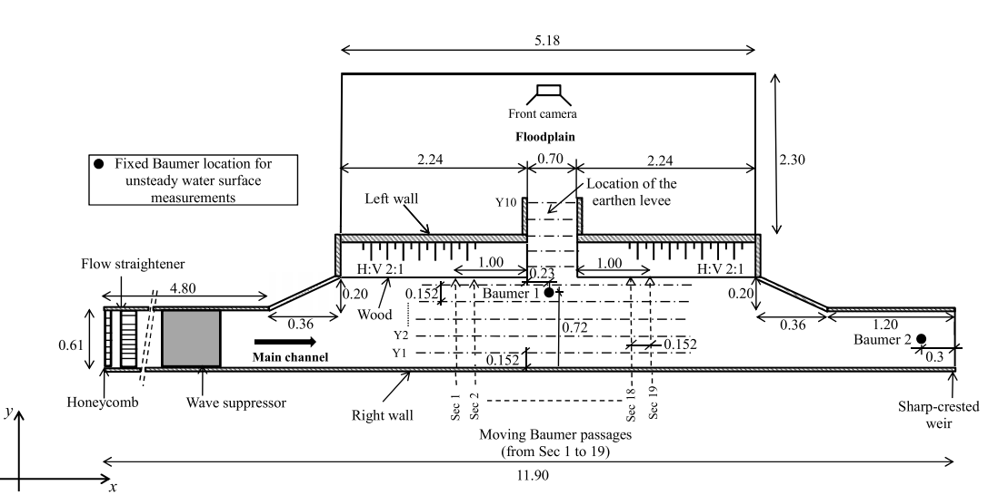
Experimental set up (Elalfy et al. (2018)
Notes:
The inflow discharge to the flume was 0.055

Slide 8
Conditions adopted in the numerical simulation
0.10 m
Levee Configuration
Q
1
Pilot Channel
0.20 m
0.05 m
2
0.10 m
Dam material: d₅₀ = 0.6 mm
Density = 2650 kg/ m³
Levee length = 0.7 m
Channel length – 11.9 m
s = 2:1 (H:V)
Boundary condition
Inflow: Q = 0.055 m³/s
Out flow: free flow
Top: Atmospheric pressure
Bottom: Wall type
Side: Symmetric
Selected Parameters
turbulence model = RNG
BLT = 12;
CSN = 0.05;
and EC = 0.018

Slide 9
Calibration
Time (s) | RNG | k-$ε$ | LES
5 | 11.5 | 10.9 | 14.8
15 | 18.2 | 19.9 | 28.6
25 | 27.7 | 42.5 | 61.9
35 | 5.5 | 22.7 | 62.8
CSN -0.05 | CSN -0.03 | CSN -0.1
11.5 | 7.2 | 21.7
18.2 | 16.4 | 25.1
27.7 | 19.3 | 59.2
5.5 | 26.8 | 53.3
MPM | VR | NE
18.3 | 21.3 | 11.5
21.4 | 44.6 | 18.2
31.7 | 63.2 | 27.7
8.6 | 59.1 | 5.5
VR – Van Rijn Equation
NE – Nielsen Equation
CSN – Critical shield number
MPM – Meyer- Peter & Muller equation
Ae – Experimental area of breach
As – simulated area of breach
Mesh-0.01 | Mesh-0.02 | Mesh-0.03
7.6 | 11.5 | 23.1
13.2 | 18.2 | 25.1
22.3 | 27.7 | 53.8
1.9 | 5.5 | 64.8
$$Error=\left(\frac{Ae−As }{Ae}\right)×100$$

Slide 10
Bed evolution
t =5 seconds | t = 15 seconds
t = 25 seconds | t = 35 seconds

Slide 11
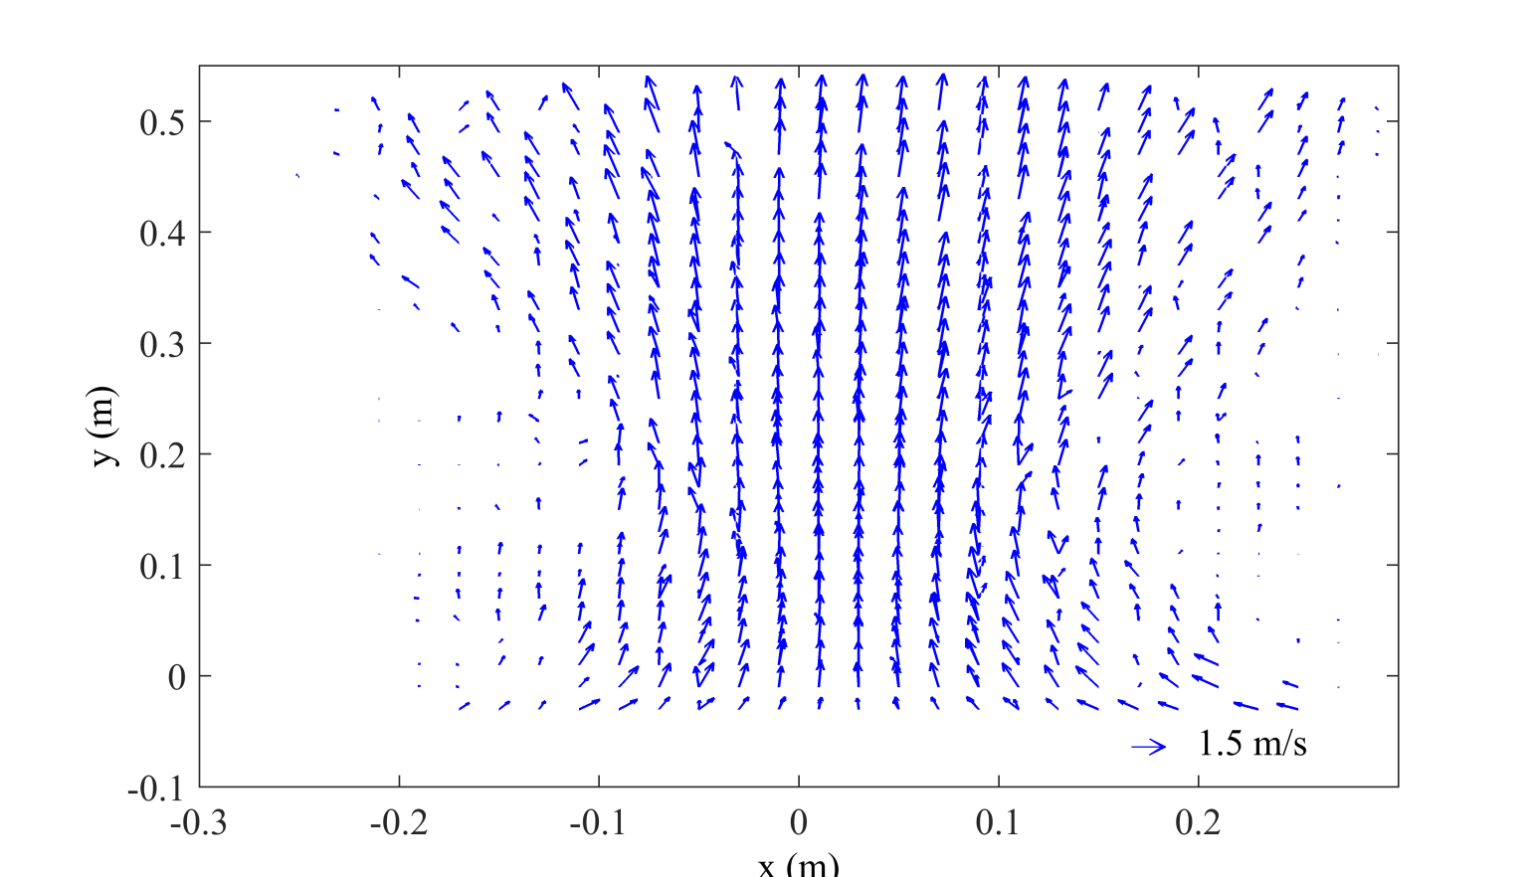
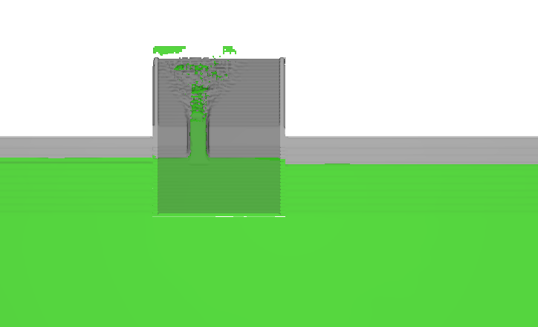
Velocity profile at breach section
Flow Direction

Slide 12
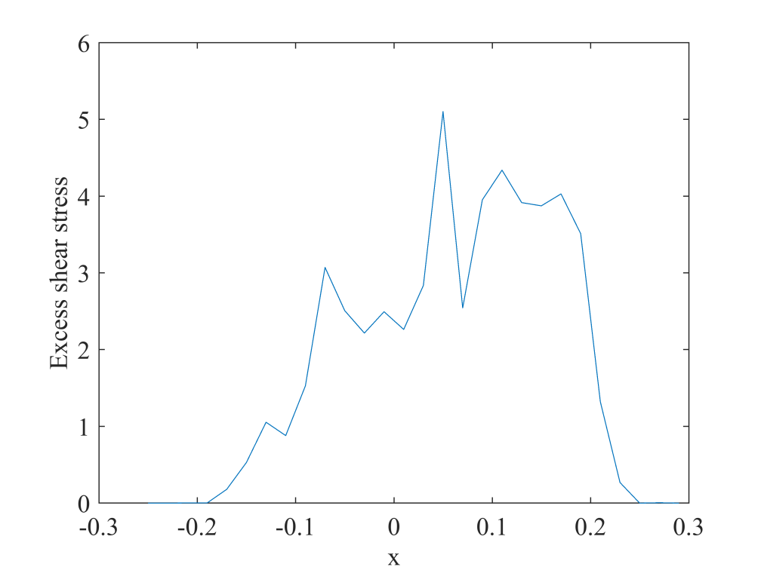
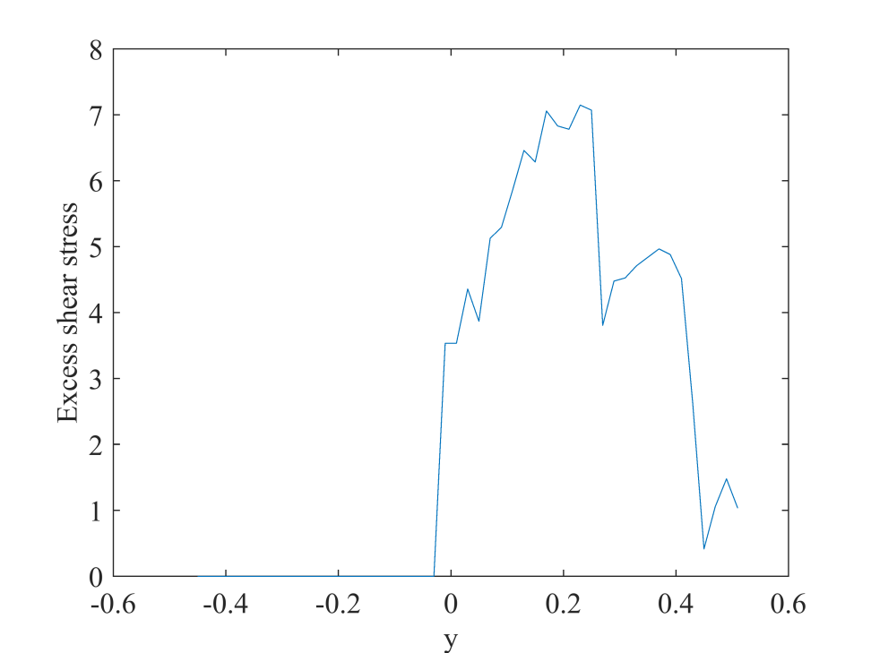
Turbulent characteristics at breach section
Shear stress at breach section
(a)
(b)
(b)
(a)
Flow Direction

Slide 13
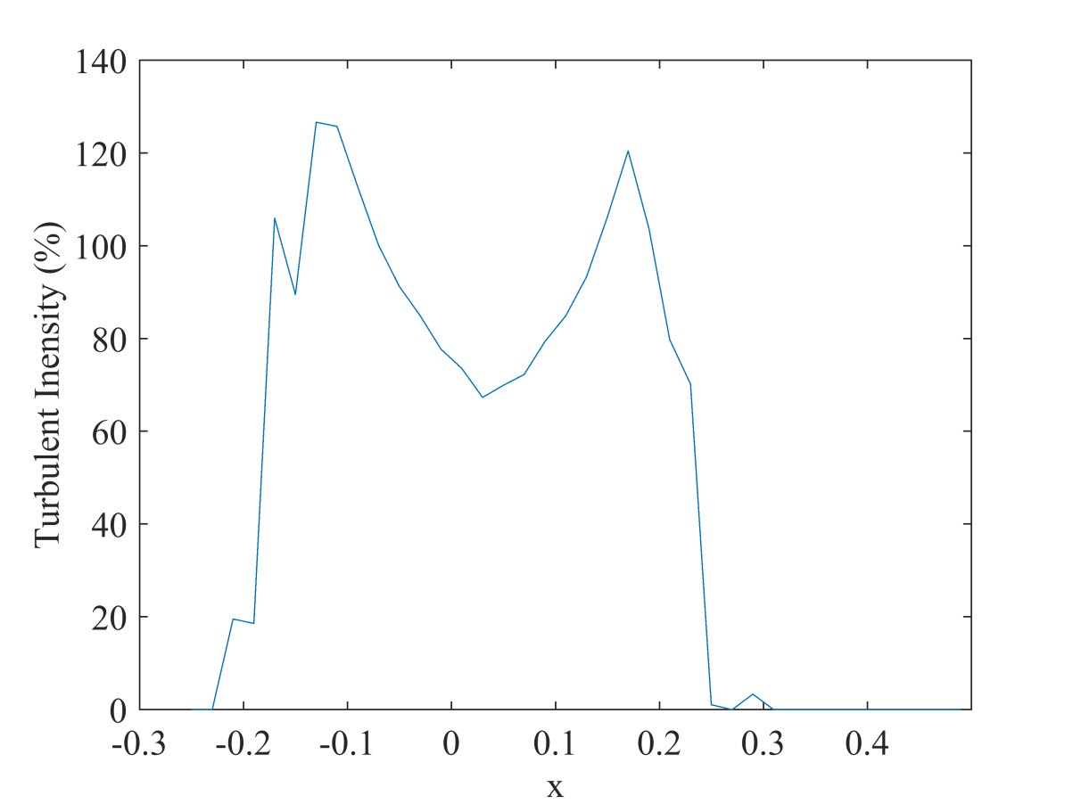
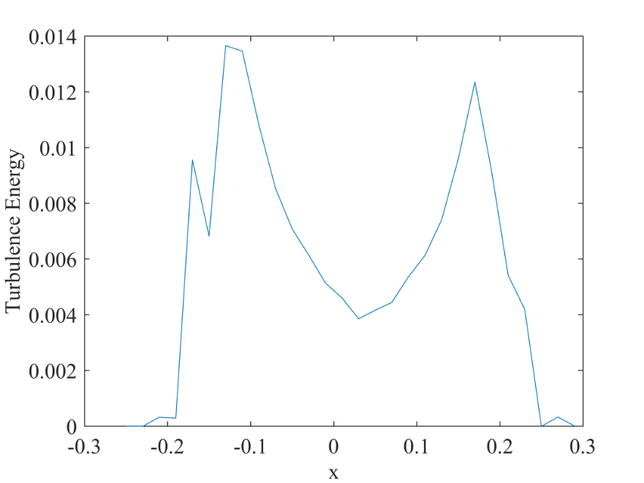
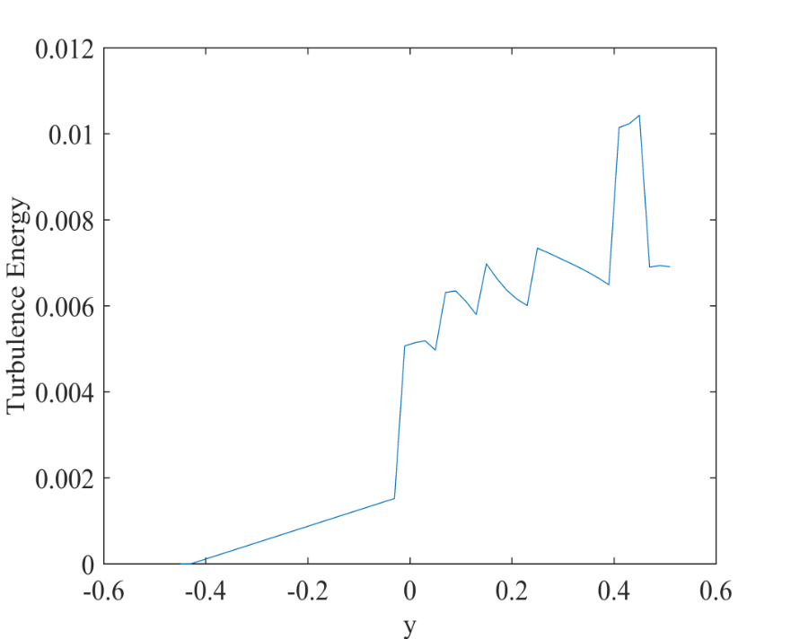
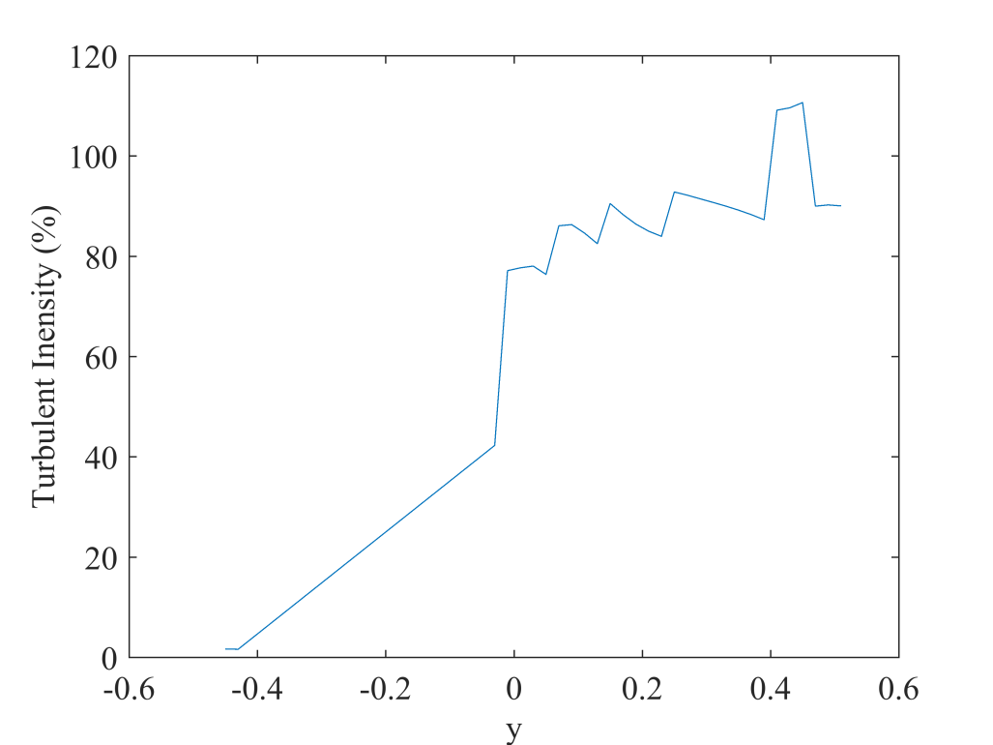
Turbulent kinetic energy at breach section
(a)
(a)
Turbulence intensity (%) at breach section
(b)
(b)

Slide 14
Conclusions
The Renormalized group (RNG) turbulence model along with Nielson equation for bedload transport optimally simulate the breach process for the considered case.
The velocity is higher in the breach area and downstream of levee.
The shear stress on the downstream face of levee if higher as compared to the upstream.
The turbulent energy and turbulent intensity are minimum at the middle of the breach. However, these quantities are higher on the downstream face similar to shear stress.

Slide 15
References
Fujita, Y., and Tamamura, T. (1987). Enlargement of breaches in flood levees on alluvial plains. Nat. Disaster Sci., 9(1), 37–60.
Kakinuma, T. and Shimizu, Y. (2014). Large-Scale Experiment and Numerical Modeling of a Riverine Levee Breach. J. Hydraul. Eng. 2014.140:1-9.
Evangelista Stefania (2015). Experiments and Numerical Simulations of Dike Erosion due to a Wave Impact. Water 2015, 7, 5831-5848.
Elalfy, E., Tabrizi, A. A., & Chaudhry, M. H. (2018). Numerical and experimental modeling of levee breach including slumping failure of breach sides. Journal of Hydraulic Engineering, 144(2), 04017066.

Slide 16
Thank you

