Slide 1


Nowcasting Lightning Occurrence Using Machine Learning Techniques
The Challenge of Identifying Outliers
Amirhossein Mostajabi¹, Declan L. Finney², Marcos Rubinstein³, Farhad Rachidi¹
¹ Swiss Federal Institute of Technology (EPFL), Switzerland
² University of Leeds, UK
³ University of Applied Sciences of Western Switzerland (HES-SO), Switzerland

Slide 2
Outline
Data
Training
Model
Prediction
Forming the database
  12 stations in Switzerland
  Gathering the data points and labeling criterion
  Data visualization
Algorithm workflow
  Data preparation
  Training
  Evaluation metrics
  Prediction results
Challenge of Identifying the outliers
  Influence on the model’s performance
  Possible approaches to optimize the process

Slide 3
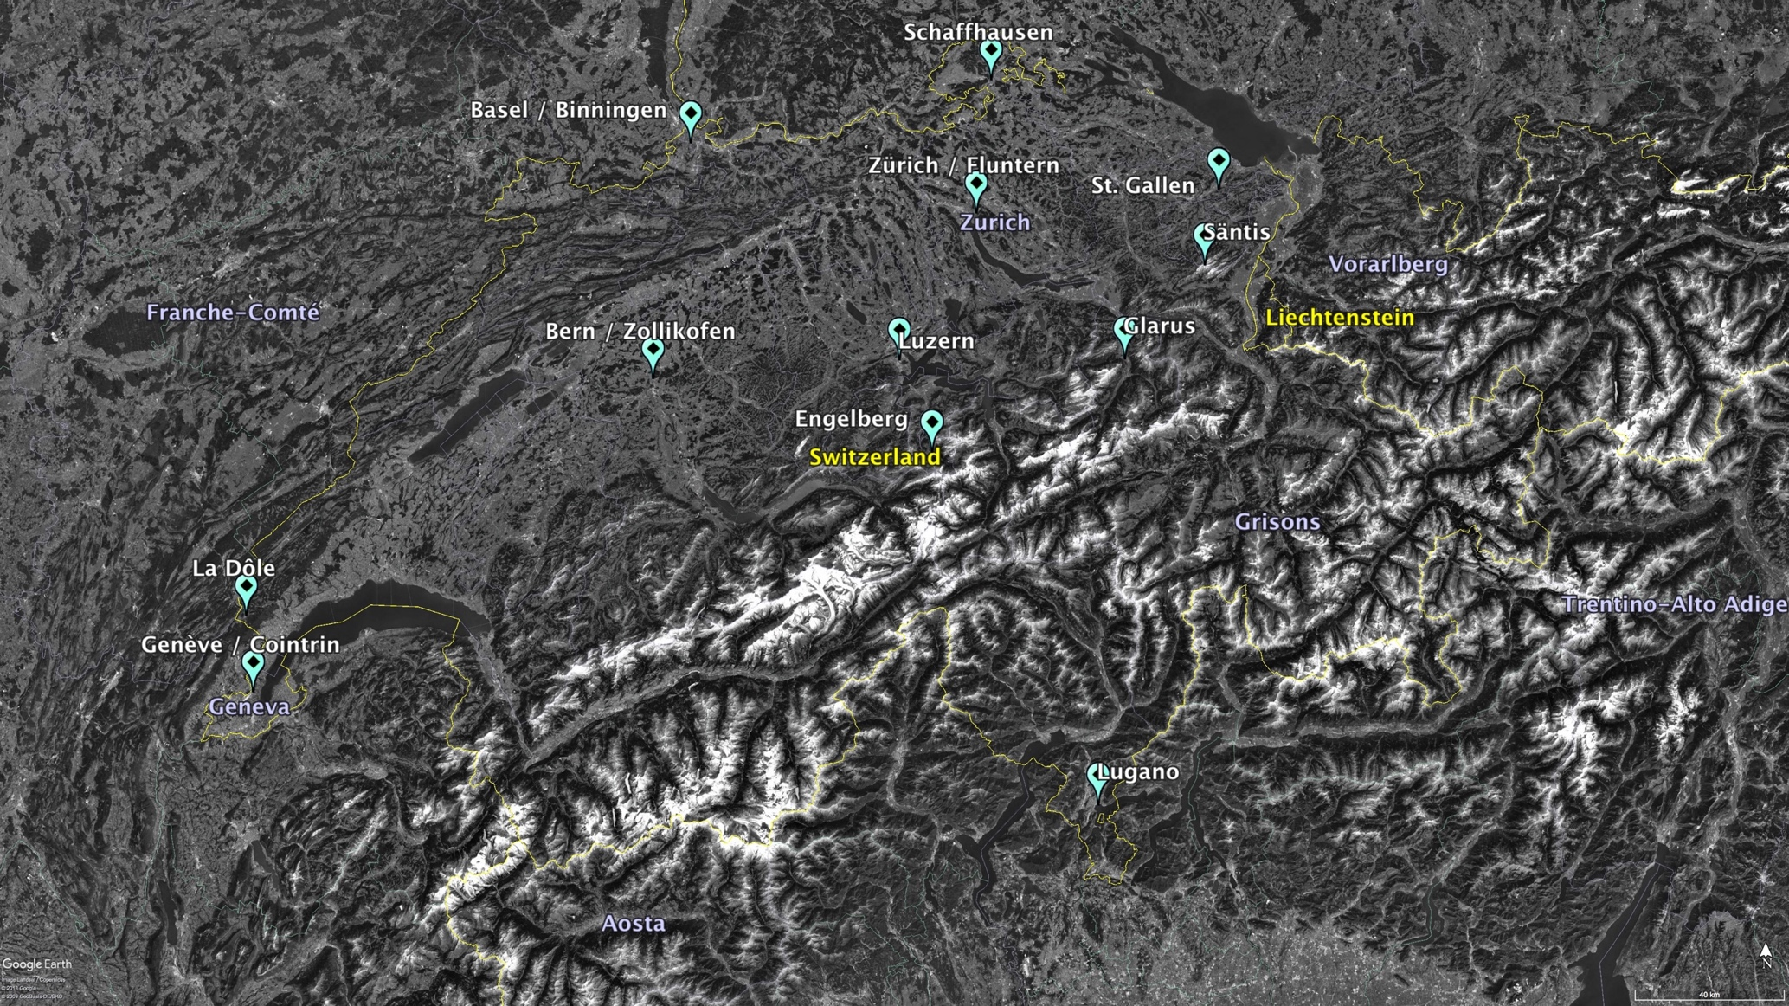
Selected sites
12 meteorological stations in Switzerland
Meteorological station
r = 30 km
Area of interest

Slide 4
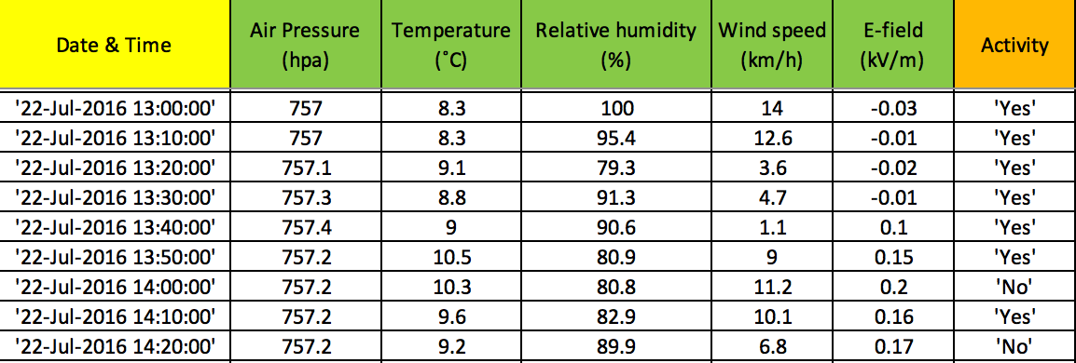
Database
[Period of gathering data: 2006-2017]
Electric field
(maximum value in 10 min)
Any activity in 30 km (from LLS)
Meteorological features
(mean value in 10 min)
Time Stamp in UTC
Only available at Säntis station
Used as a competitive baseline
End of the 10 minute time intervals
Area of interest
.
.
.
r = 30 km
Notes:
The database consists of around 7 million data, each includes values for 4 meteorological features in 10-min intervals.

Slide 5
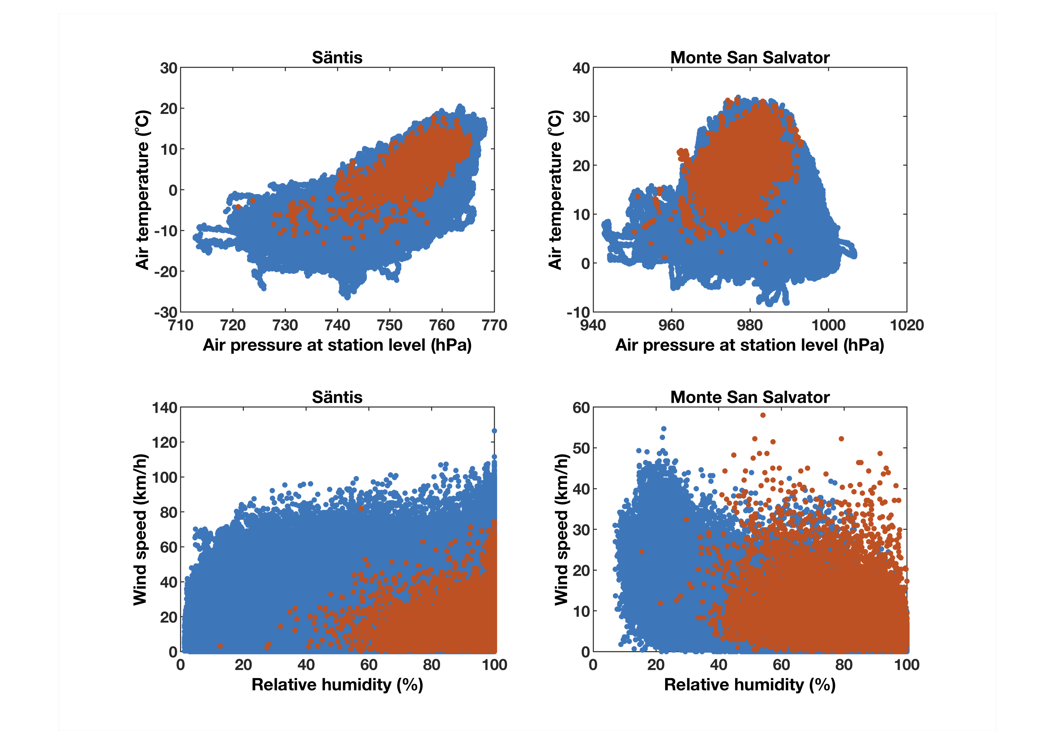
Data visualization
Säntis and Monte San Salvatore
[2006-2017]
Lightning activity: “Yes”
Lightning activity: “No”

Slide 6
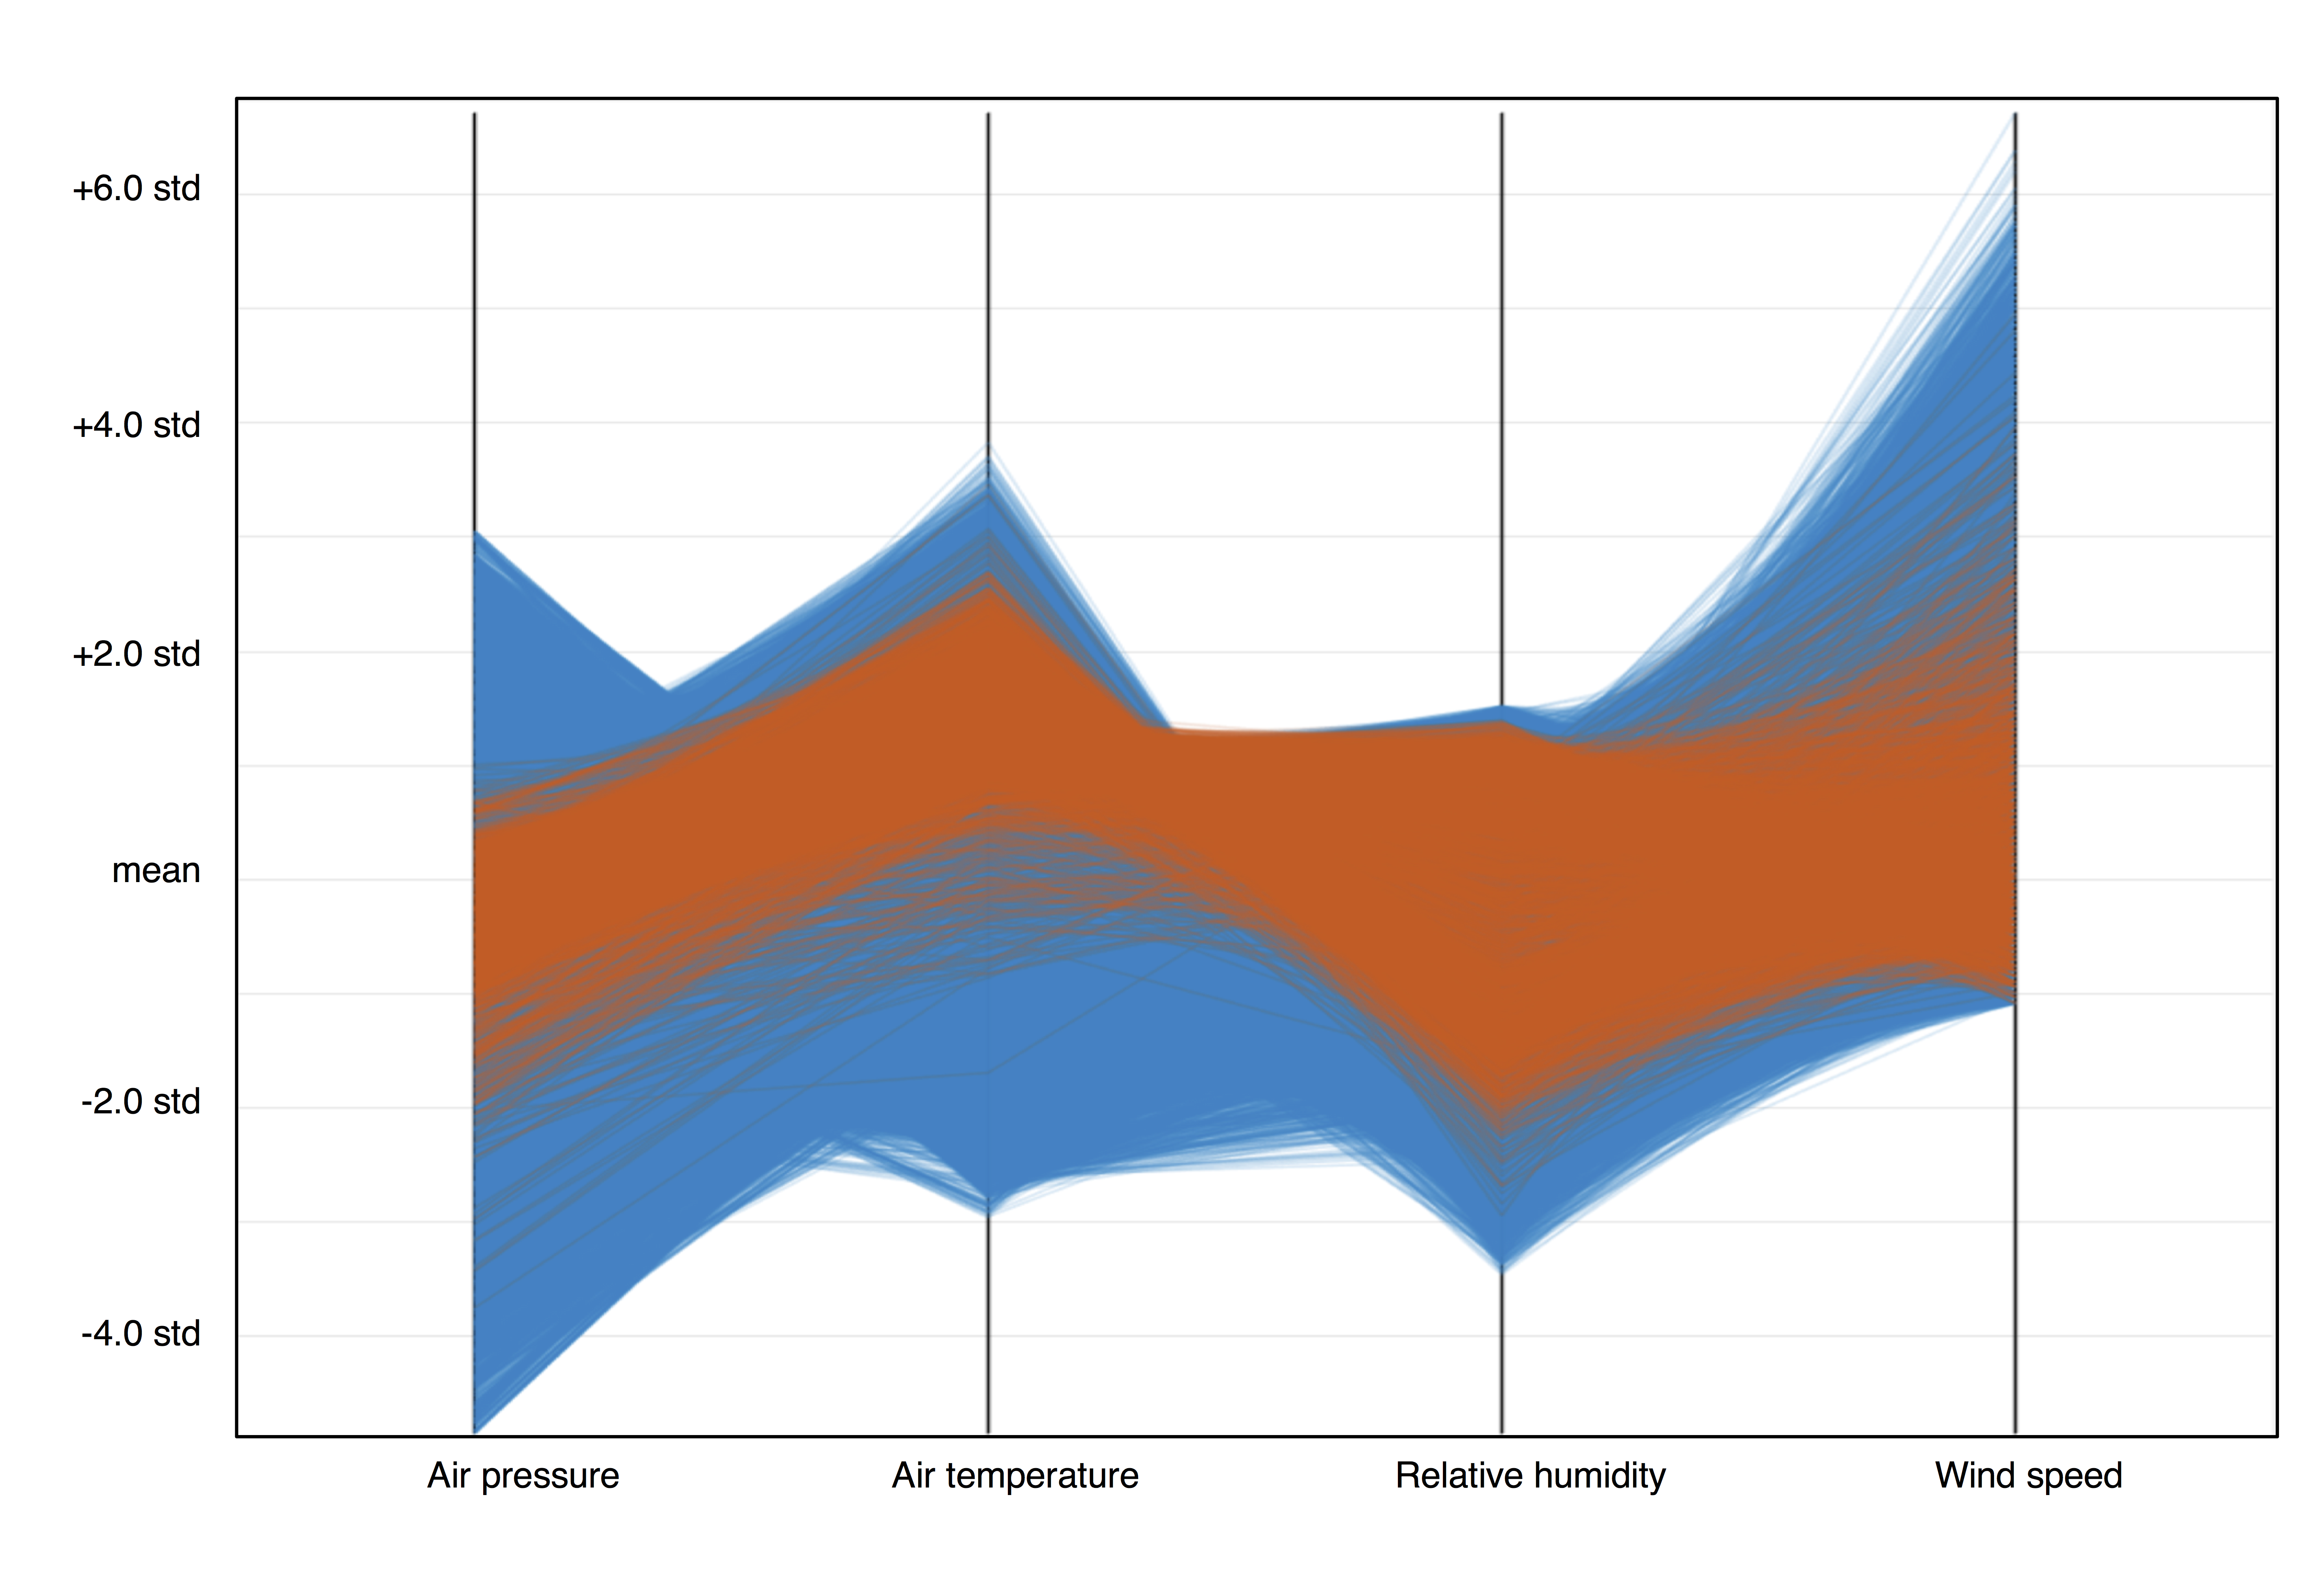
Parallel coordinate plot
Luzern
[2006-2017]
Lightning activity: “Yes”
Lightning activity: “No”

Slide 7
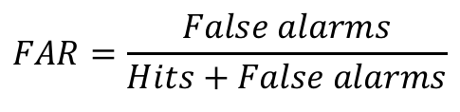

Algorithm
1
Partitioning data at each station into
Data Part 1 (2006-2009) and Data Part 2 (2010-2017)
2
Feeding the model with Data Part 1 and evaluating the results using 4-fold CV
Hits
Misses
Correct rejections
False Alarms
Target=0
Target=1
Output=1
Target=1
Output=0
Target=0
Output=0
Output=1
$$POD=\frac{Hits}{Hits+Misses}$$
$$FAR=\frac{False alarms}{Hits+False alarms}$$

Slide 8
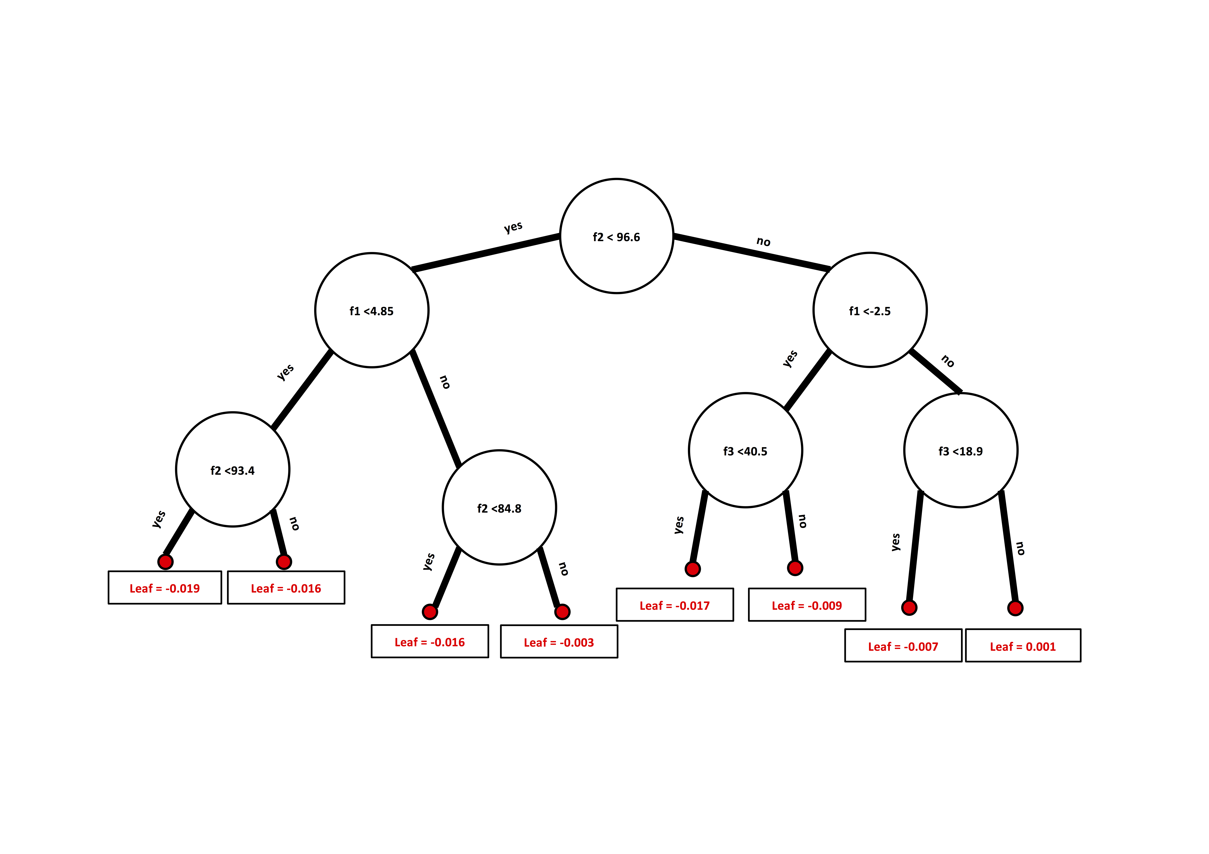
Training the model
XGBoost algorithm
Illustration is adopted from https://blog.quantinsti.com/xgboost-python/.
Notes:
Illustration is adopted from https://blog.quantinsti.com/xgboost-python/
Xgboost stands for eXtreme Gradient Boosting and is developed on the framework of gradient boosting.
The sequential ensemble methods, also known as “boosting”, creates a sequence of models that attempt to correct the mistakes of the models before them in the sequence. The first model is built on training data, the second model improves the first model, the third model improves the second, and so on.
In the example image above, the train dataset is passed to the classifier 1. The yellow background indicates that the classifier predicted hyphen and the blue background indicates that it predicted plus. The classifier 1 model incorrectly predicts two hyphens and one plus. These are highlighted with a circle. The weights of these incorrectly predicted data points are increased and sent to the next classifier. That is, to classifier 2. The classifier 2 correctly predicts the two hyphens that classifier 1 was not able to classify. But classifier 2 also makes some other errors. This process continues and we have a combined final classifier which predicts all the data points correctly.

Slide 9
3
Re-labeling the data in Data Part 1 based on the evaluation results as either “accepted” or “rejected” and training another model (i.e., detector)
4
Feeding Data Part 2 into the ”detector”

Slide 10
5
Air pressure
Air temperature
Relative humidity
Comparing the distribution of rejected samples in both, Data Parts 1 and 2, and trying to fit the two distributions
Wind speed
month
Distribution of rejected
Samples at Data Part 1
Distribution of rejected
Samples at Data Part 2
6
Repeating steps 2-5 many times and calculating the similarity score for each execution
7
Selecting the data corresponding to the execution with the highest similarity score
8
Final evaluation of the ML model using 8-fold cross validation using Data Part 2

Slide 11
Model evaluation results using Data Part 2
Säntis station
Evaluation metrics
3 competitive
baselines
To generate forecasts based on the data, the PERSISTENCE model assumes that in every 10-min interval, the forecast is the same as the observation in the previous interval.
The CAPE model uses a threshold of Convective Available Potential Energy (CAPE) to assess the risk of lightning.
The electrostatic field method (the E-FIELD model) is based on detecting when the vertical electrostatic field (E(z)) exceeds a specific threshold to issue the warning.
Notes:
Evaluation of the skill of warnings of long-range lightning activity for one of the lead time ranges Säntis station. The results from ML model are shown as solid black columns, results from PERSISTENT model are shown as columns filled with dot patterns, results from CAPE model are shown as columns filled with vertical lines, and results from E-FIELD model are shown as solid gray columns (POD: Probability of Detection, FAR: False Alarm Ratio, CSI: Critical Success Index, HSS: Heidke Skill Score)

Slide 12
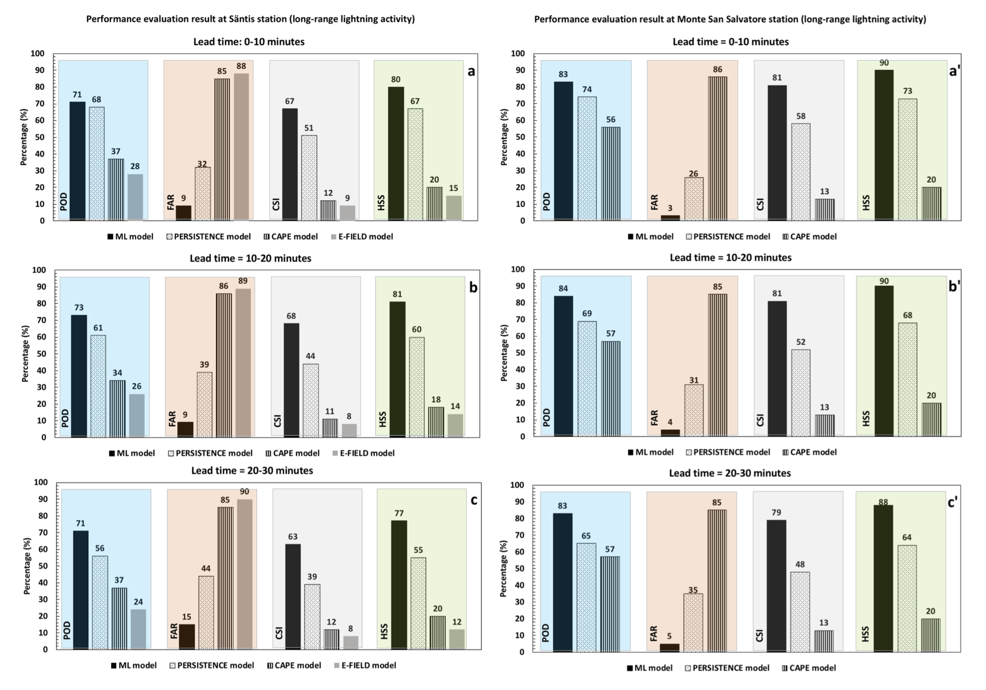
Model evaluation results for Data Part 2
Säntis and Monte San Salvatore
[Three lead time ranges]
Similar performance was obtained for different lead times and different locations.
Notes:
Evaluation of the skill of warnings of long-range lightning activity for three ranges of lead times at a, b, c Säntis (Subset 1) and a′, b′, c′ Monte San Salvatore (Subset 2) station. The results from ML model are shown as solid black columns, results from PERSISTENT model are shown as columns filled with dot patterns, results from CAPE model are shown as columns filled with vertical lines, and results from E-FIELD model are shown as solid gray columns (POD: Probability of Detection, FAR: False Alarm Ratio, CSI: Critical Success Index, HSS: Heidke Skill Score)

Slide 13
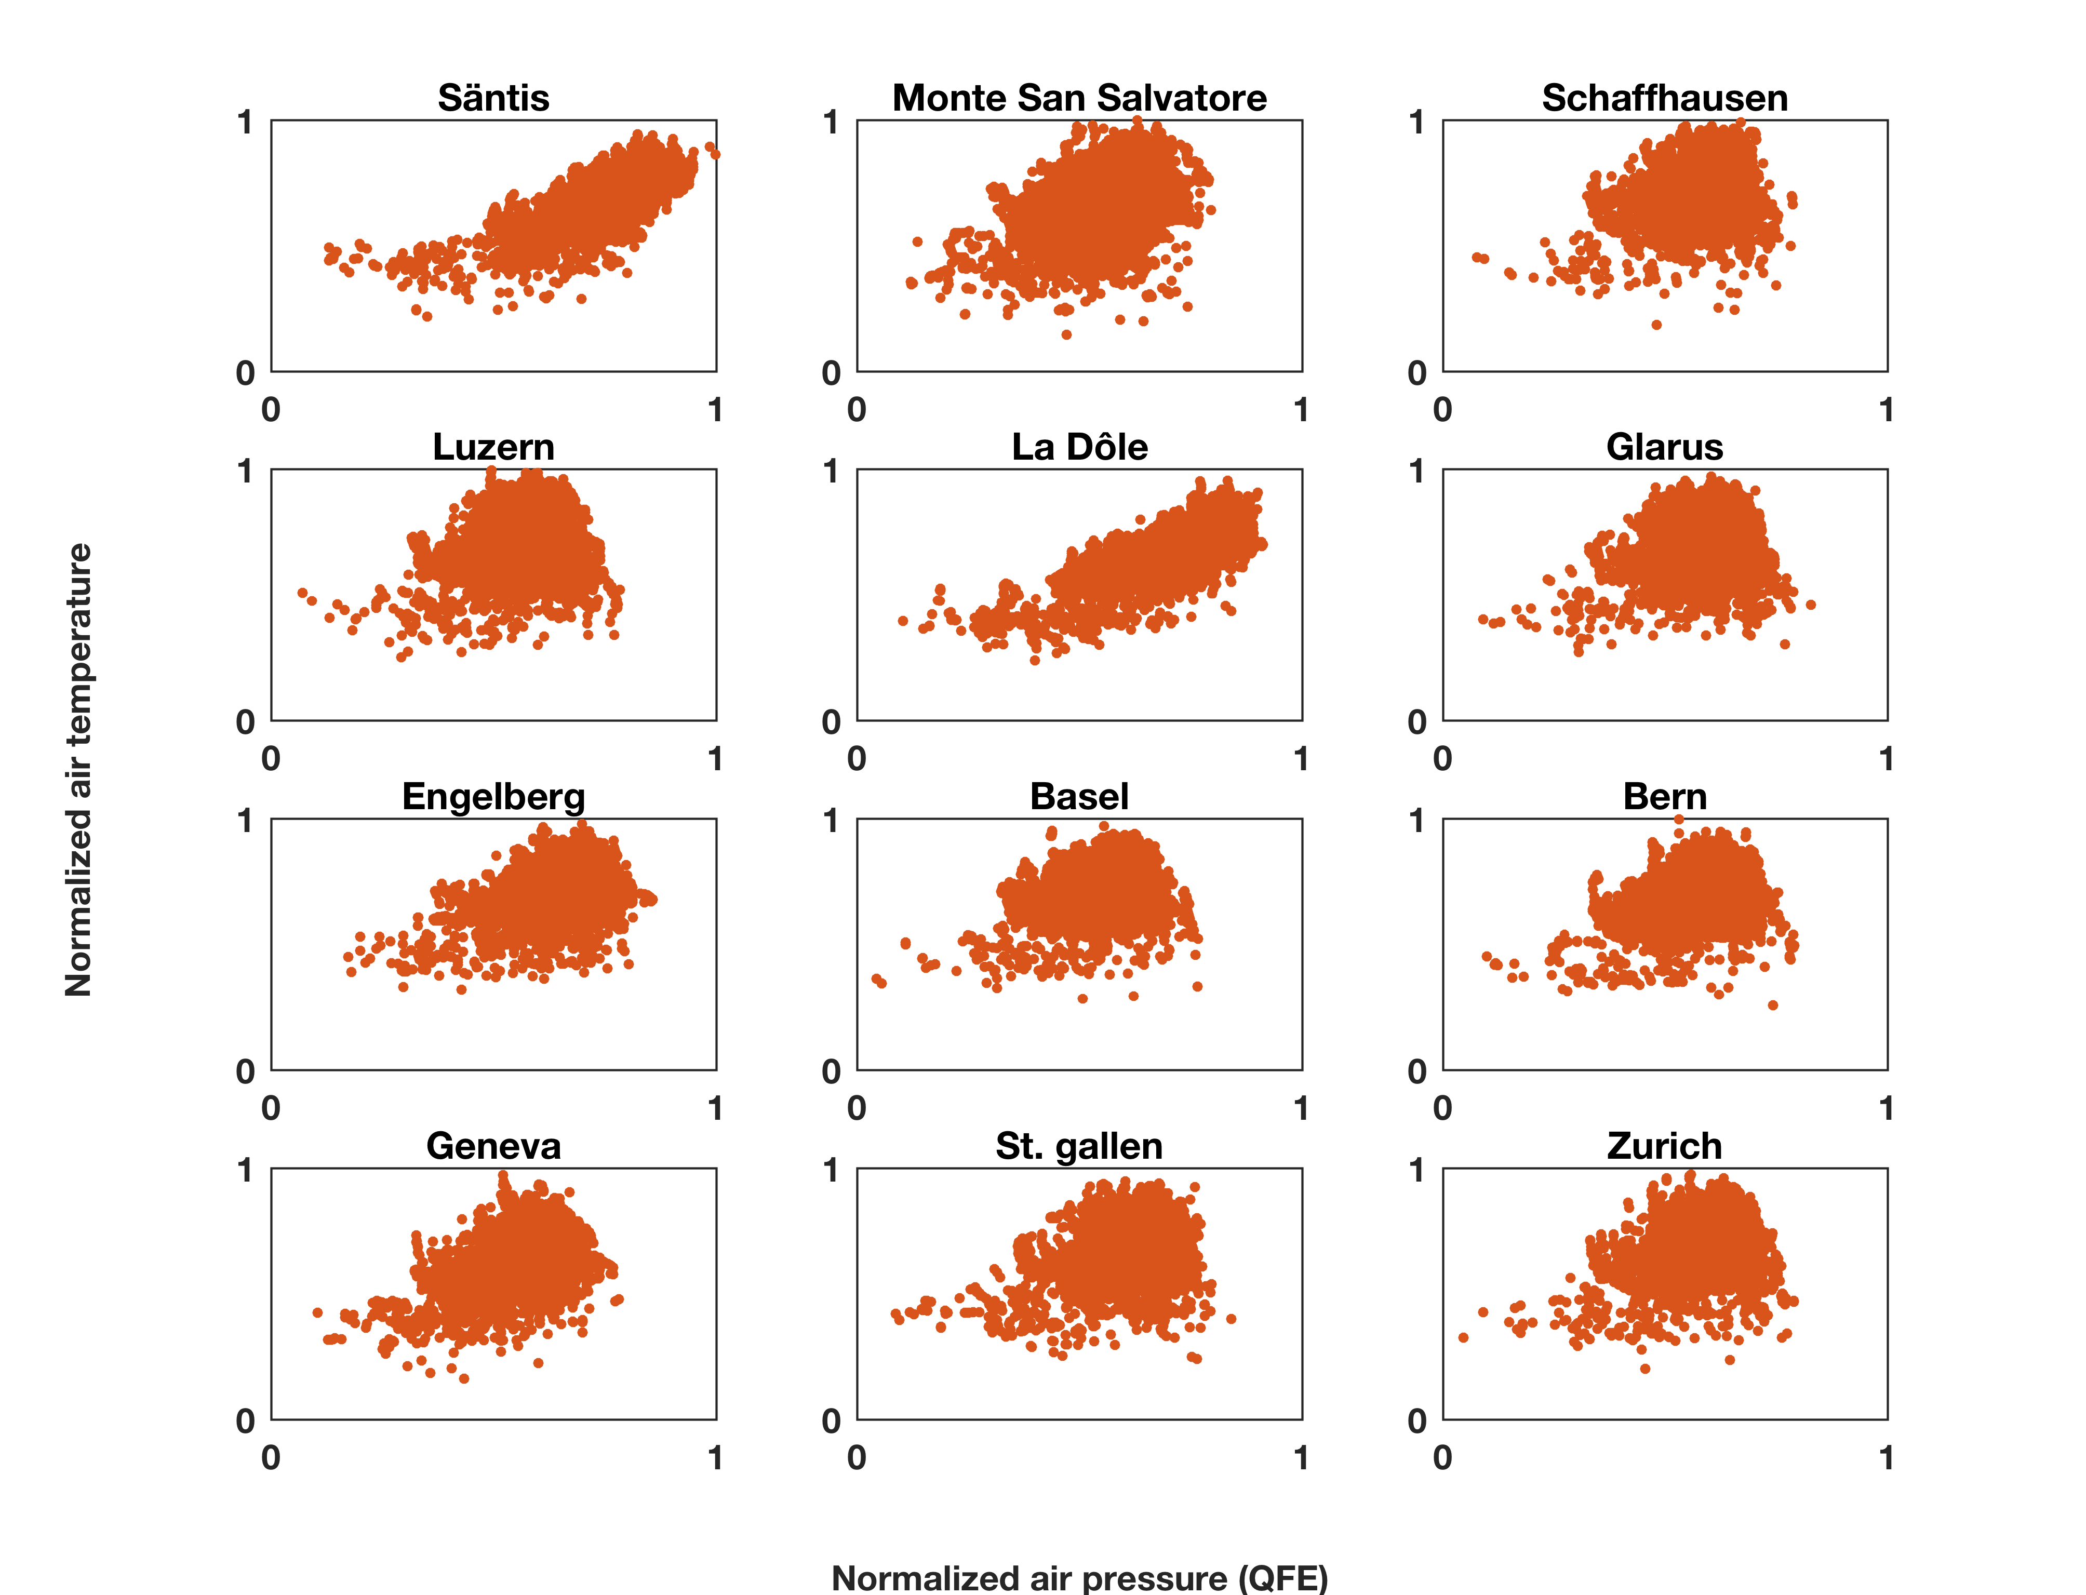
Distribution pattern of positive samples
Group A and B
[2006-2017]

Slide 14
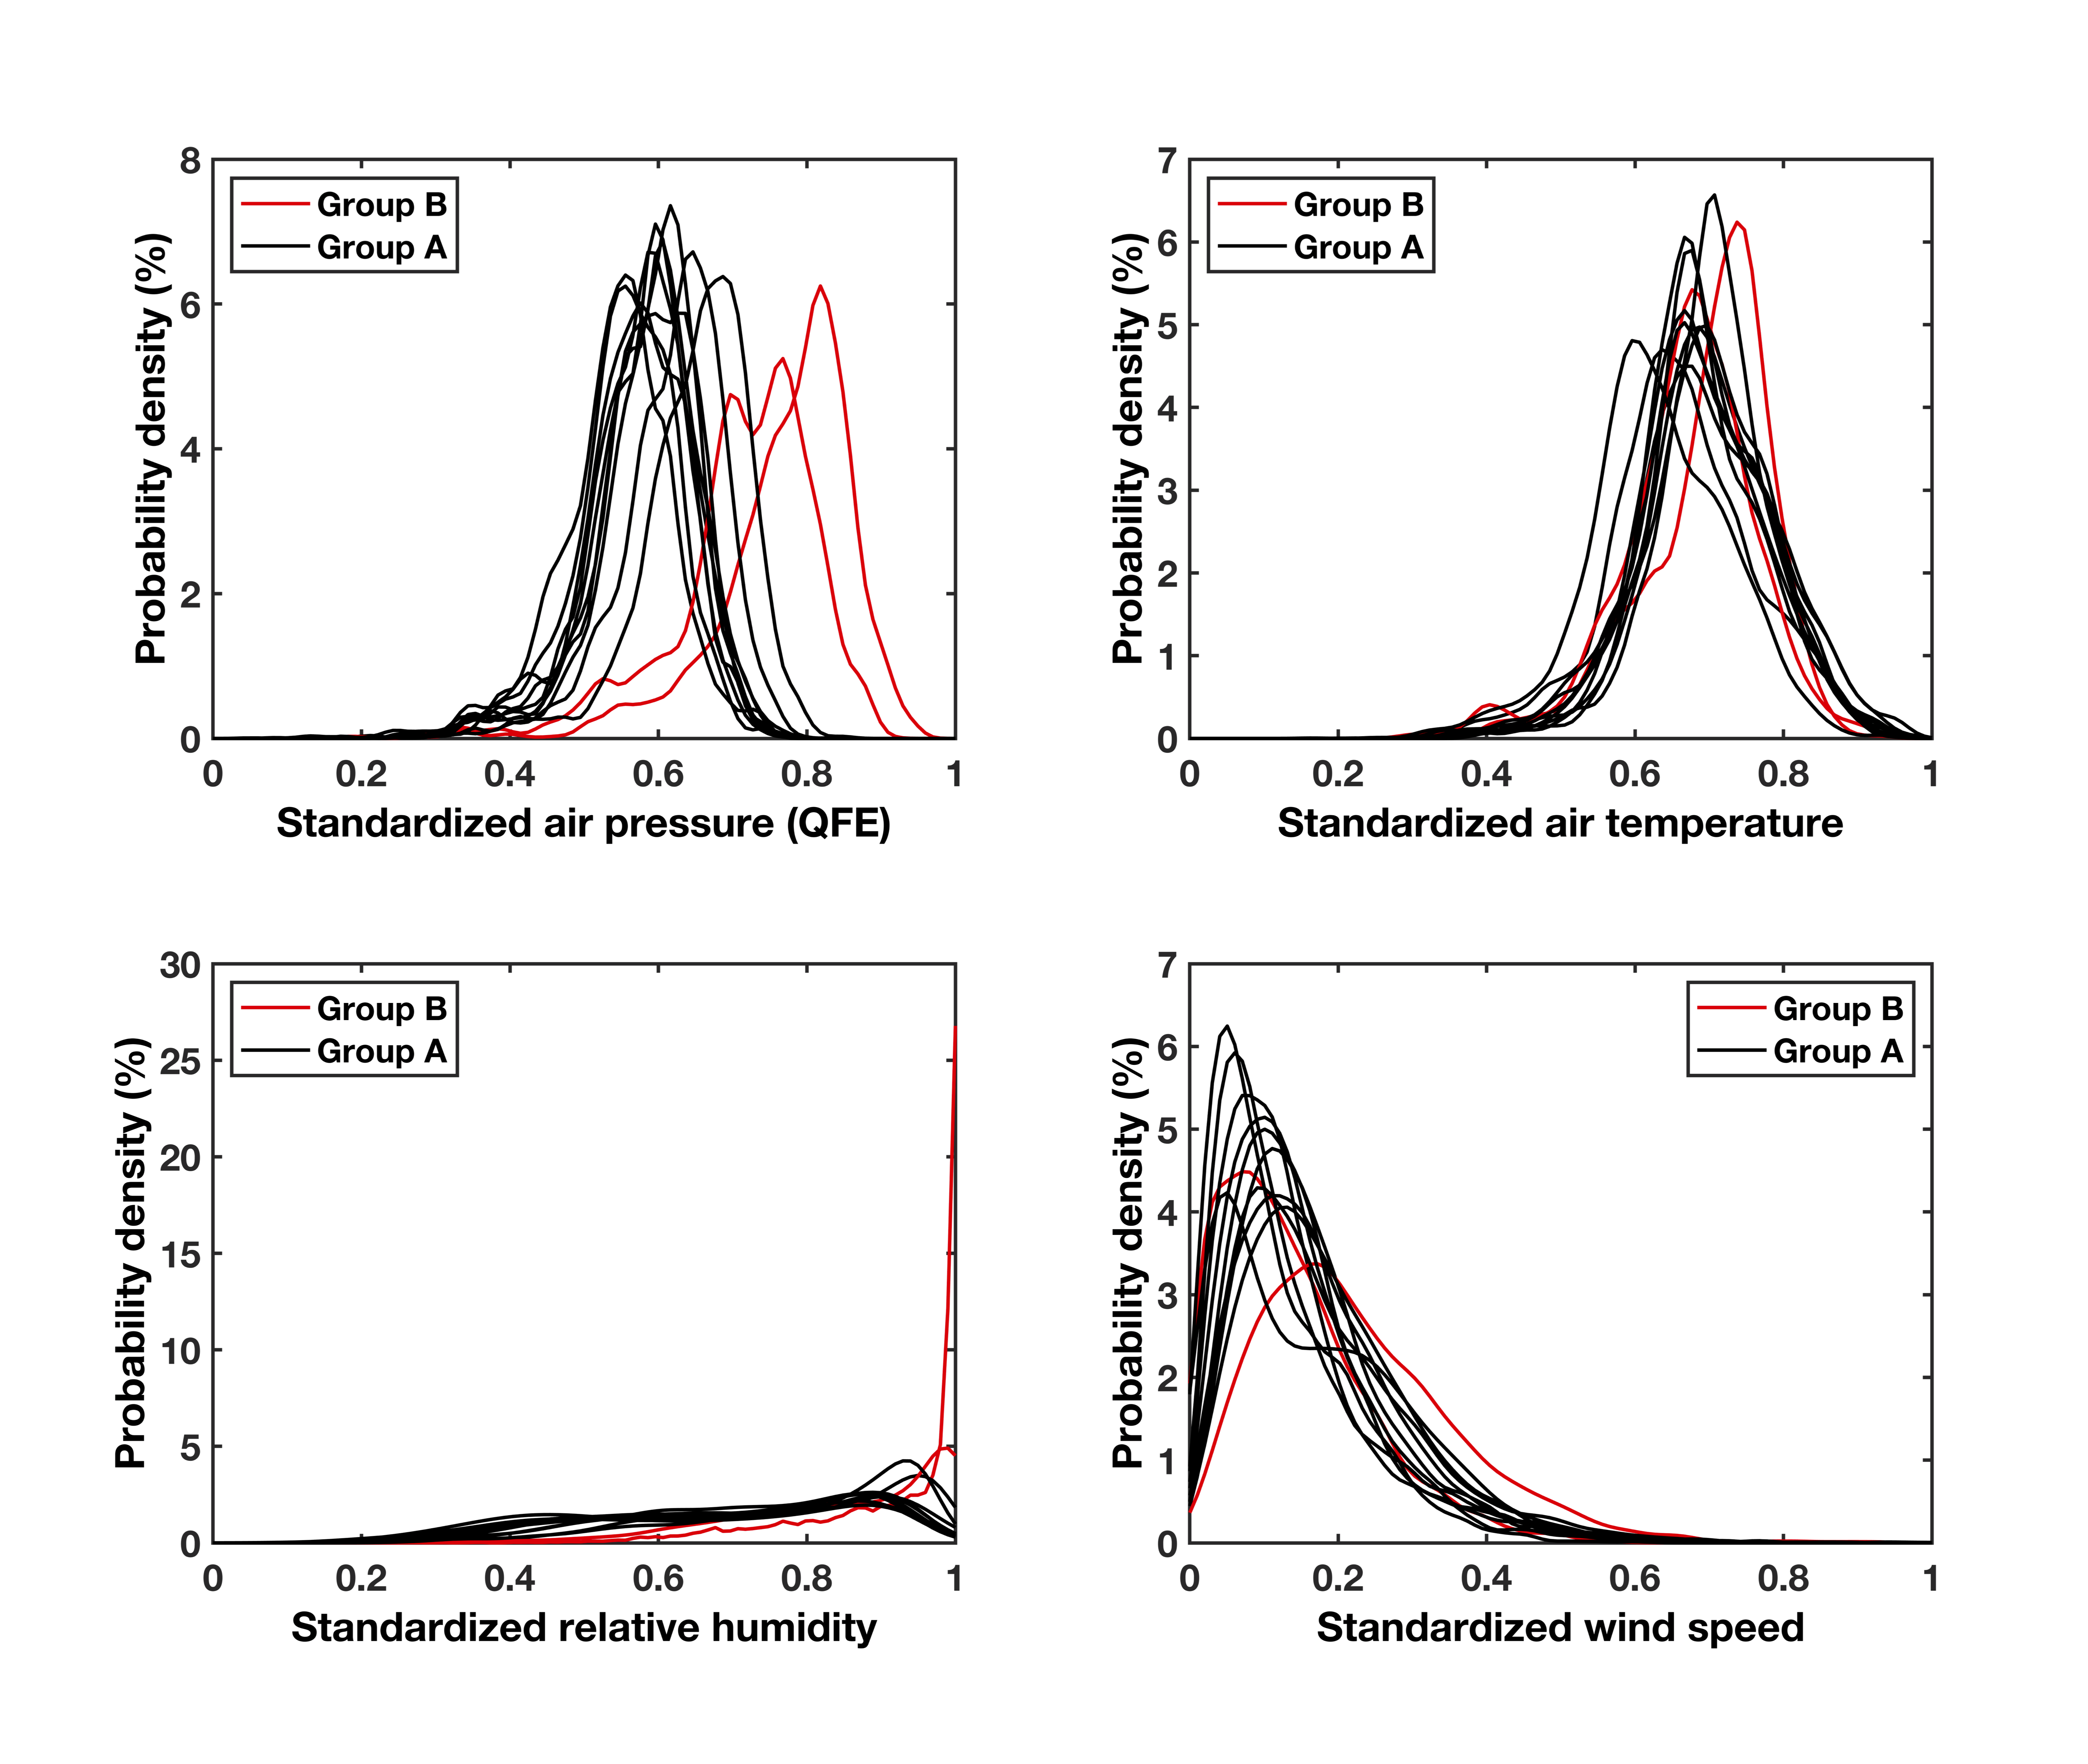
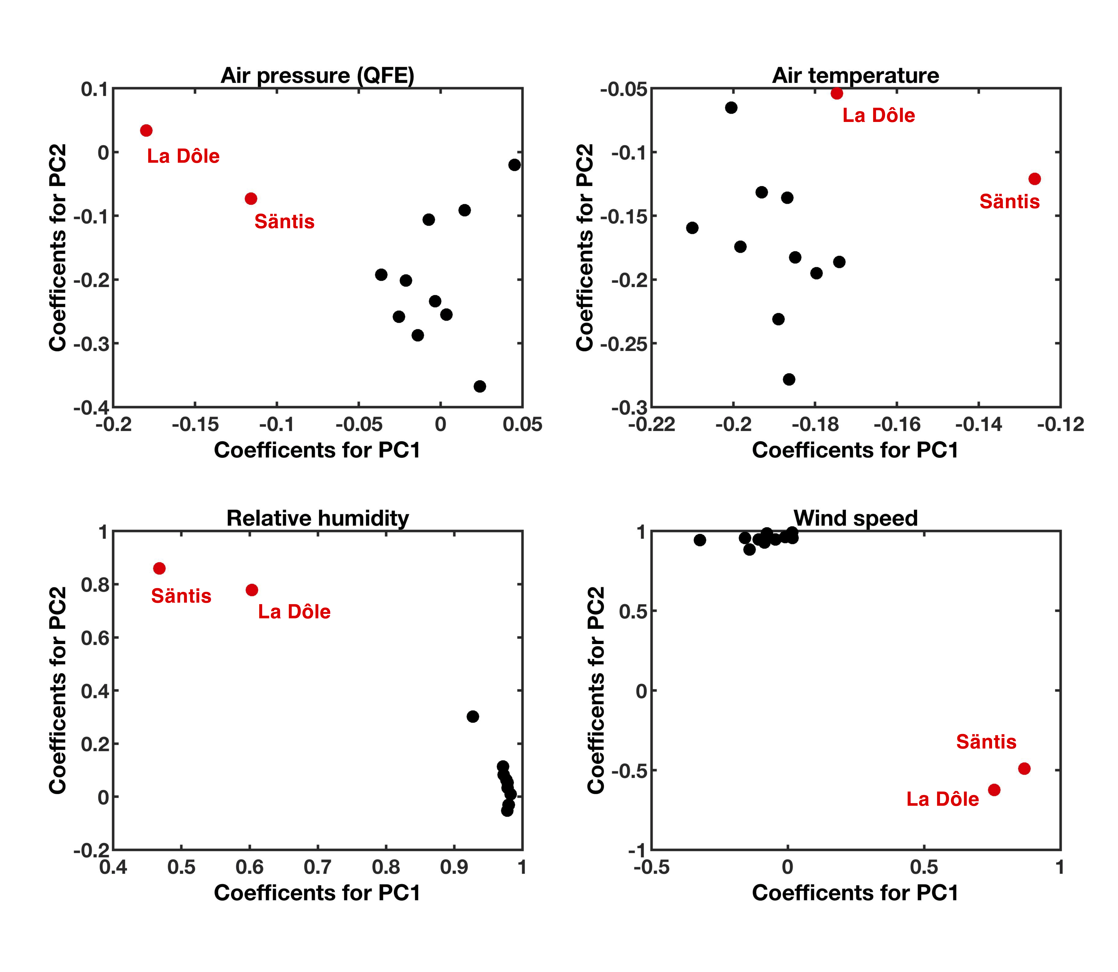
Distribution pattern of the positive class
PDF and PCA analysis
[2006-2017]
PDF analysis
PCA analysis

Slide 15
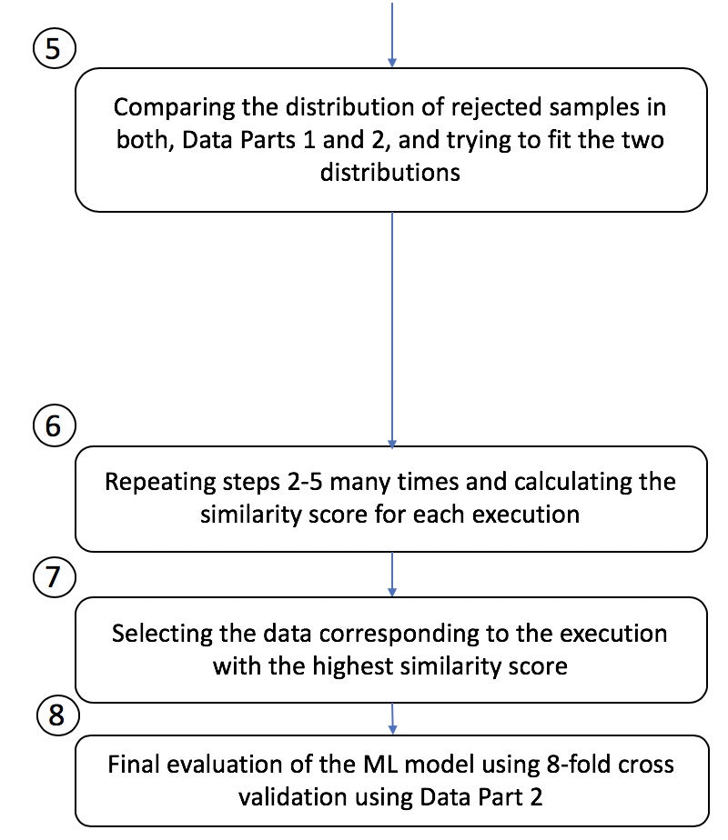
The challenge of identifying the outliers
Different executions might lead to different results
The final evaluation is done only on the accepted samples
The unknown section is not considered either in the training or the testing stage
The portion of each class in the “unknown” category is important

Slide 16
Possible approaches to optimize the process
Including more input parameters:
  Temporal (month, day, hour)
  Atmospheric (dew point, precipitation, cloud coverage, …)
  Lightning (previous records of lightning activity)
Limiting the portion of lightning-active and lightning-inactive samples inside the rejected subset.
Simultaneous training of the main model and the detector to reduce the number of rejected samples
Trying time series algorithms to take into account the changes in the information from previous time steps

Slide 17
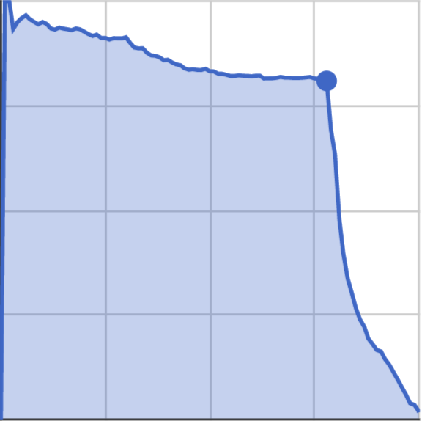
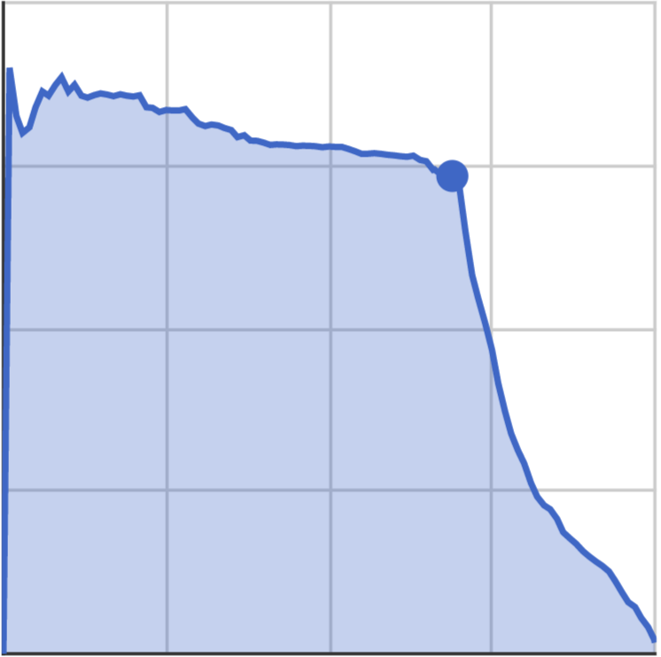
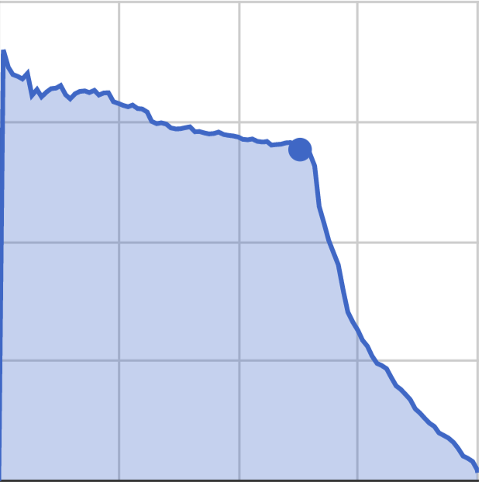
Results for approach 1: extending the input parameters
Initial input parameters
Air pressure
Air temperature
Wind speed
Relative humidity
1. Adding more parameters
Hour
Day
Month
Previous lightning record
2. Optimizing the hyperparameters
Advantages
No detector is required anymore.
Fast online inference is possible.
Recall = POD
Precision= 100%-FAR
Lead time= 0-10 min
Lead time= 10-20 min
Lead time= 20-30 min
100 %
Precision = 81 %
Recall = 78 %
100 %
Precision = 72 %
Recall = 70 %
100 %
Precision = 70 %
Recall = 63 %
Persistence
Precision
Precision
Persistence
Precision
Persistence
0 %
0 %
0 %
0 %
Recall
100 %
0 %
Recall
100 %
0 %
Recall
100 %

