Slide 1
Development of an operational forecast verification system
Georgios Boumis, Daniel Twigt and Jan Verkade
EGU General Assembly 2020 - DOI

Slide 2
Motivation
Few operational verification practices of hydrological forecasts up-to-date
Verification contributes to forecast informed decision making – it is an estimate of the forecasting system’s uncertainties
Verification aids advance the processes of a forecasting system (model parametrization, data assimilation, post-processing etc.)

Slide 3
What is forecast verification?
Verification is the posterior assessment of the skill and value of forecast
Mathematically speaking, it is the examination of the joint distribution of forecasts and observations
It provides the answer to the question “How good are my forecasts?”
-Quality
-Value
-Consistency
(Murphy, 1993)

Slide 4
Why verify?
Administrative purpose
Periodical monitoring of the quality of a forecasting system and justification of additional investments
Scientific purpose
Which aspect(s) of the forecasting system can be improved?
Economic purpose
What is the value to the end-user?

Slide 5
The forecasting system
Deltares Global Flood Forecasting and Information System (GLOFFIS):
Medium-ranged fluvial flood forecasts with global coverage
Ingests both deterministic and ensemble weather products
Data assimilation wherever applicable (basins with available observations)
Matthijs den Toom, Jan Verkade, Albrecht Weerts, and Gert-Jan Schotmeijer, Development of the Deltares global fluvial forecast system, EGU2020-22344

Slide 6
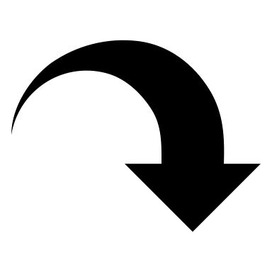
Verification system’s setup
Deltares OpenArchive
FEWS PI REST Web Service
Python
Ensemble Verification System (JD Brown, 2010)
Delft-FEWS
Archived forecasts queried (Scripting + API)
EVS template construction (Scripting + EVS)
Verification with multiple metrics (EVS)
Verification information storage (Scripting + Delft-FEWS)
Automated and robust routine forecast verification

Slide 7
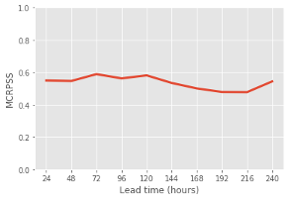
Communicating verification information
GLOFFIS client
Online
Technical reports

Slide 8
Summary
A prototype verification system comprising a mixture of software, programming languages and web APIs
Currently ---> Monitoring the quality of GLOFFIS in a routine basis (i.e. monthly)
Future work ---> Towards a scientific verification (improve GLOFFIS forecasting processes)

