Slide 1
Seasonal to interannual variations of wind forcing in the Peruvian upwelling
Dr. Sadegh Yari
Dr. Volker Mohrholz
Physical oceanography and Instrumentation
IOW
EGU 2020 4 May 2020

Slide 2
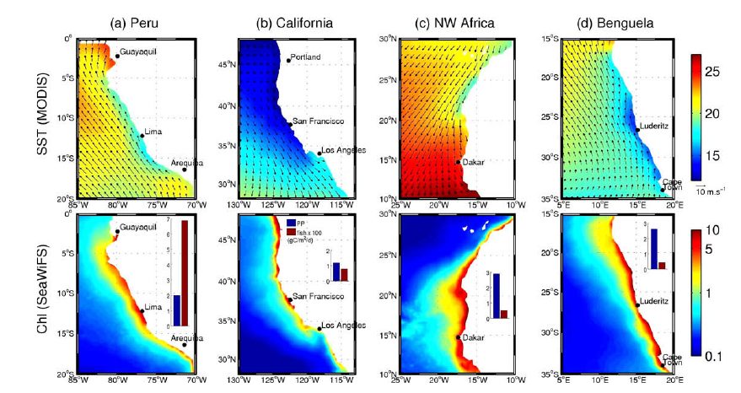
Introduction
SST(MODIS monthly averaged Jul2002- Apr. 2008)
Chlorophyl (SeaWiFS monthly averaged Sep 1997 - Sep 2007
Winds QuikSCAT (weekly averaged from Jul 1999 -July 2008)
Blue bar: mean primary productivity (PP)
Red bar: fish catch for the years 1998–2005.
EGU 2020 4 May 2020

Slide 3
Eastern Boundary Upwelling Systems (EBUS) are among the most productive marine regions:
<2% of the ocean area
Providing 7% of total marine primary production
20% of global marine fish landings (Sydeman et al. 2014)
The HU System is the largest
Inspite of similar upwelling intensities (1.0-1.6 Sv), similar primary productivity per unit area (600-1200 g C m-2 a -1) and a relatively simple trophodynamic structure the HUS provides 8- to 10-times higher fisheries yields than the other systems (Chavez & Messié 2009).
EGU 2020 4 May 2020
Notes:
3

Slide 4
Coastal Upwelling System in a Changing Ocean (CUSCO)
CUSCO has 6 workpackages. WKP 1 is dedicated to the study of
Influence of wind field variability on upwelling dynamics and water mass distribution on the Peruvian shelf.
CUSCO will employ observational, experimental and modelling approaches to better understand the linkages between upwelling intensity, community productivity, food web structure, export and trophic transfer efficiency leading up to fish recruitment.
CUSCO will be closely linked with complementary projects investigating other aspects of climate change in the HUS and their social and economic implications.
EGU 2020 4 May 2020
Notes:
4

Slide 5
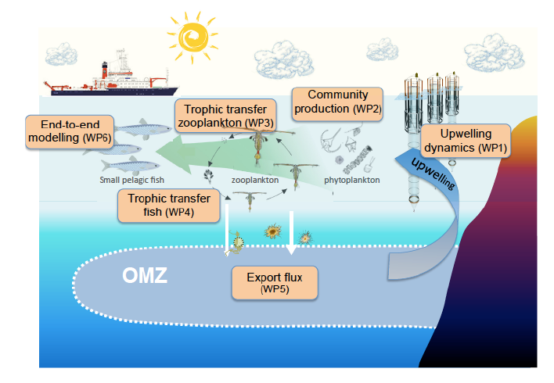
Subproject: Influence of wind field variability on upwelling dynamics and water mass distribution on the Peruvian shelf CUSCO project
EGU 2020 4 May 2020
Notes:
5

Slide 6
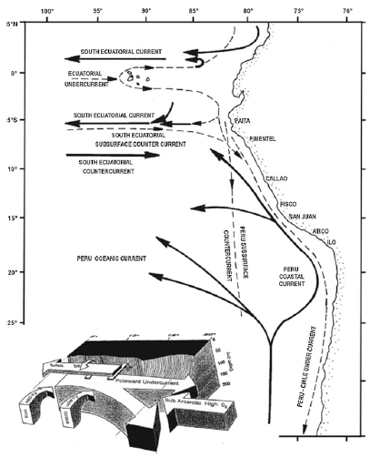
Coastal Upwelling System in the Peruvian shelf
Codispoti et al. 1989
EGU 2020 4 May 2020

Slide 7
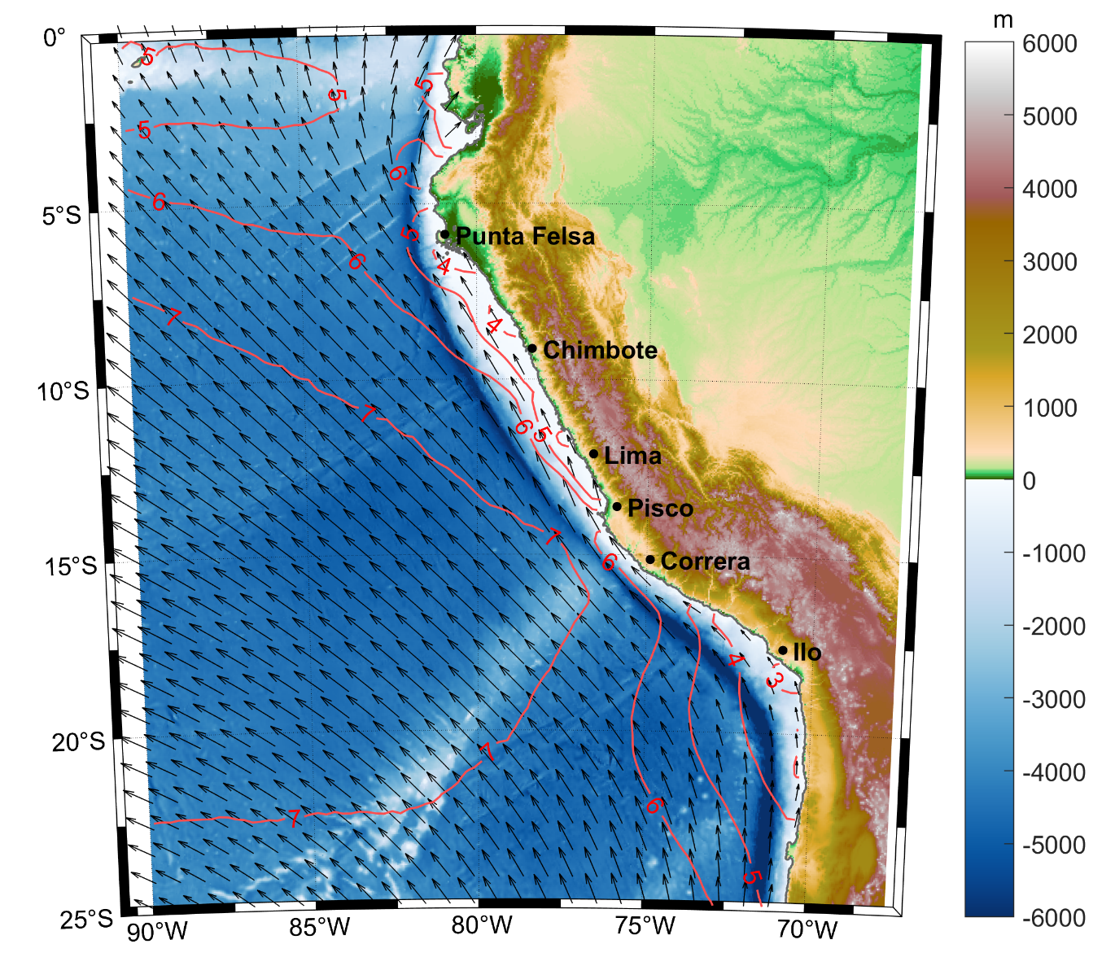
Wind data are used to investigate the long-term variations in wind field and coastal upwelling.
AScat data 2008-2019
Long term (12 years) mean
EGU 2020 4 May 2020
Notes:
7

Slide 8
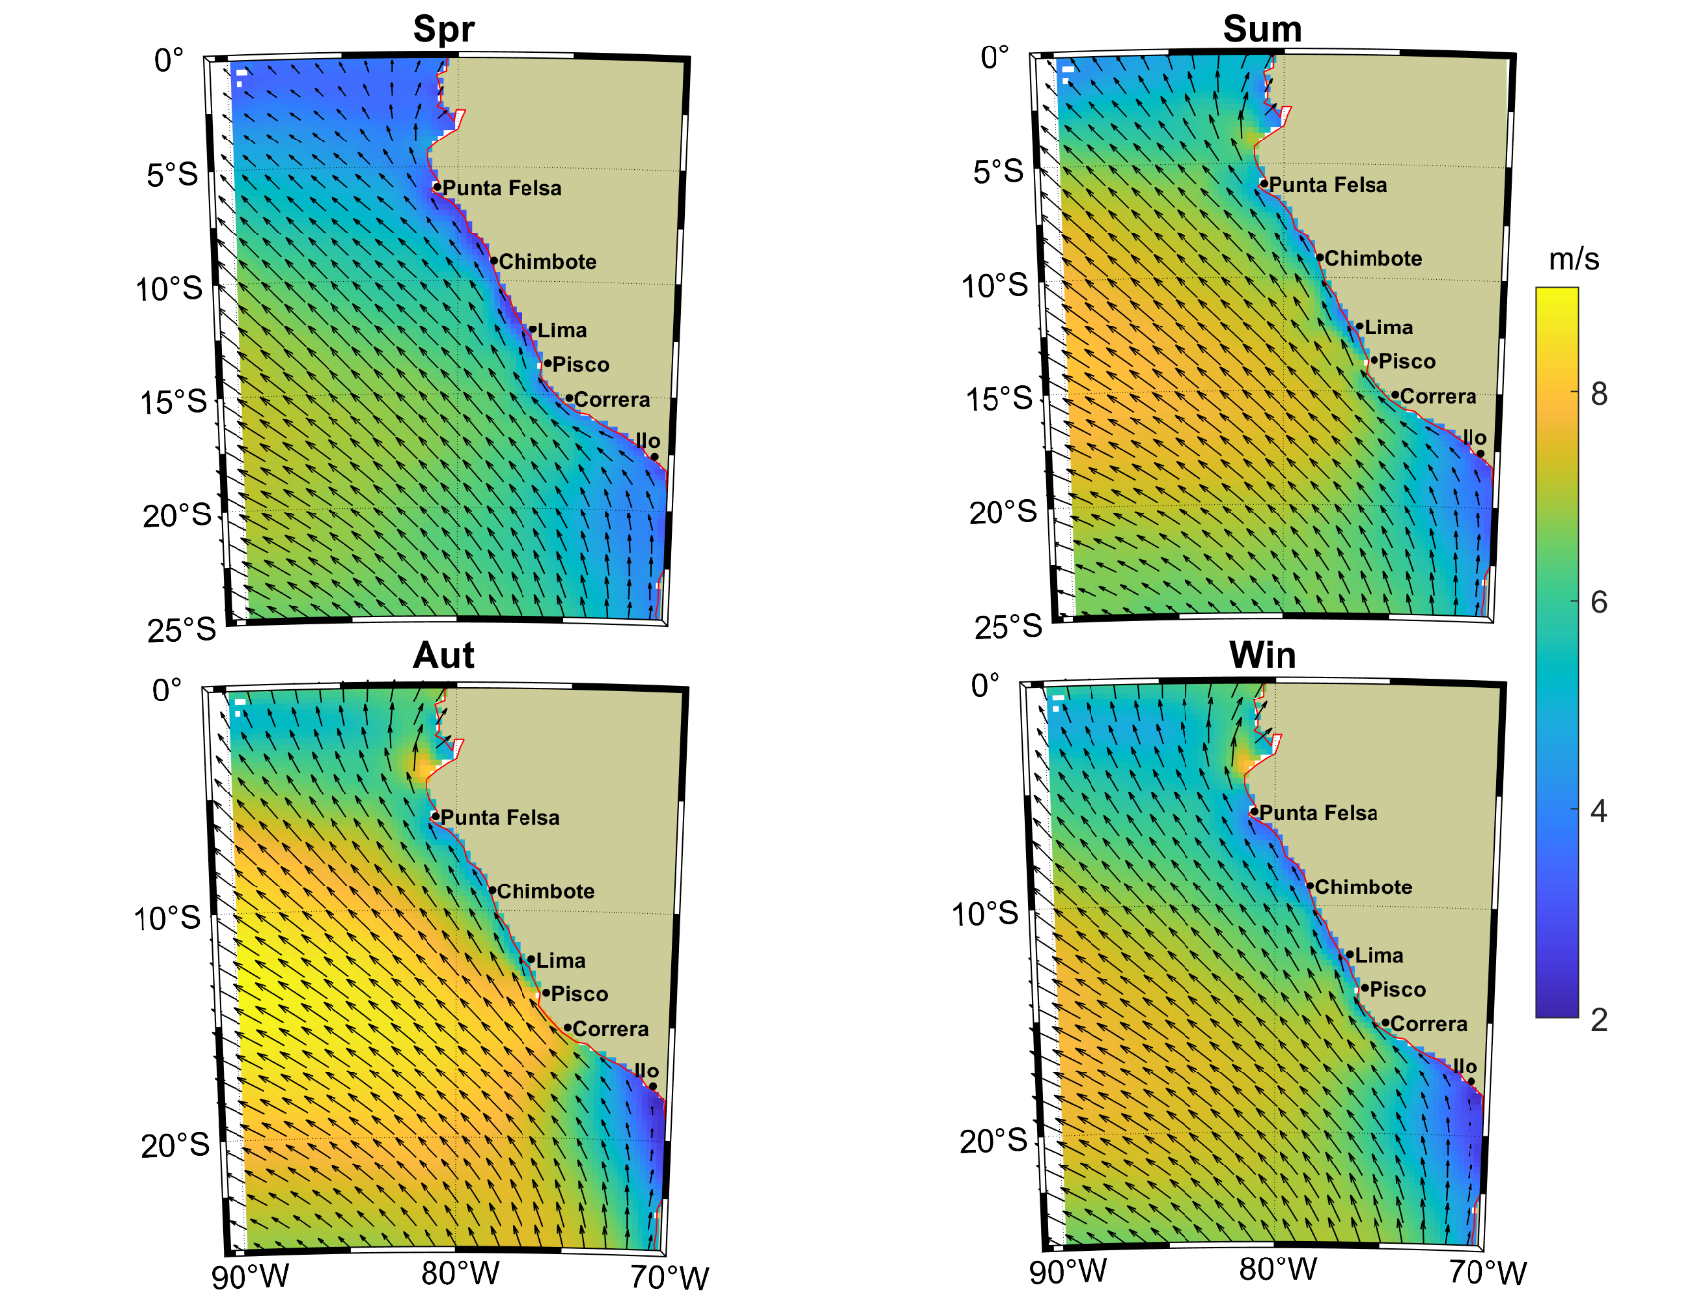
Seasonal wind
EGU 2020 4 May 2020
Notes:
8

Slide 9
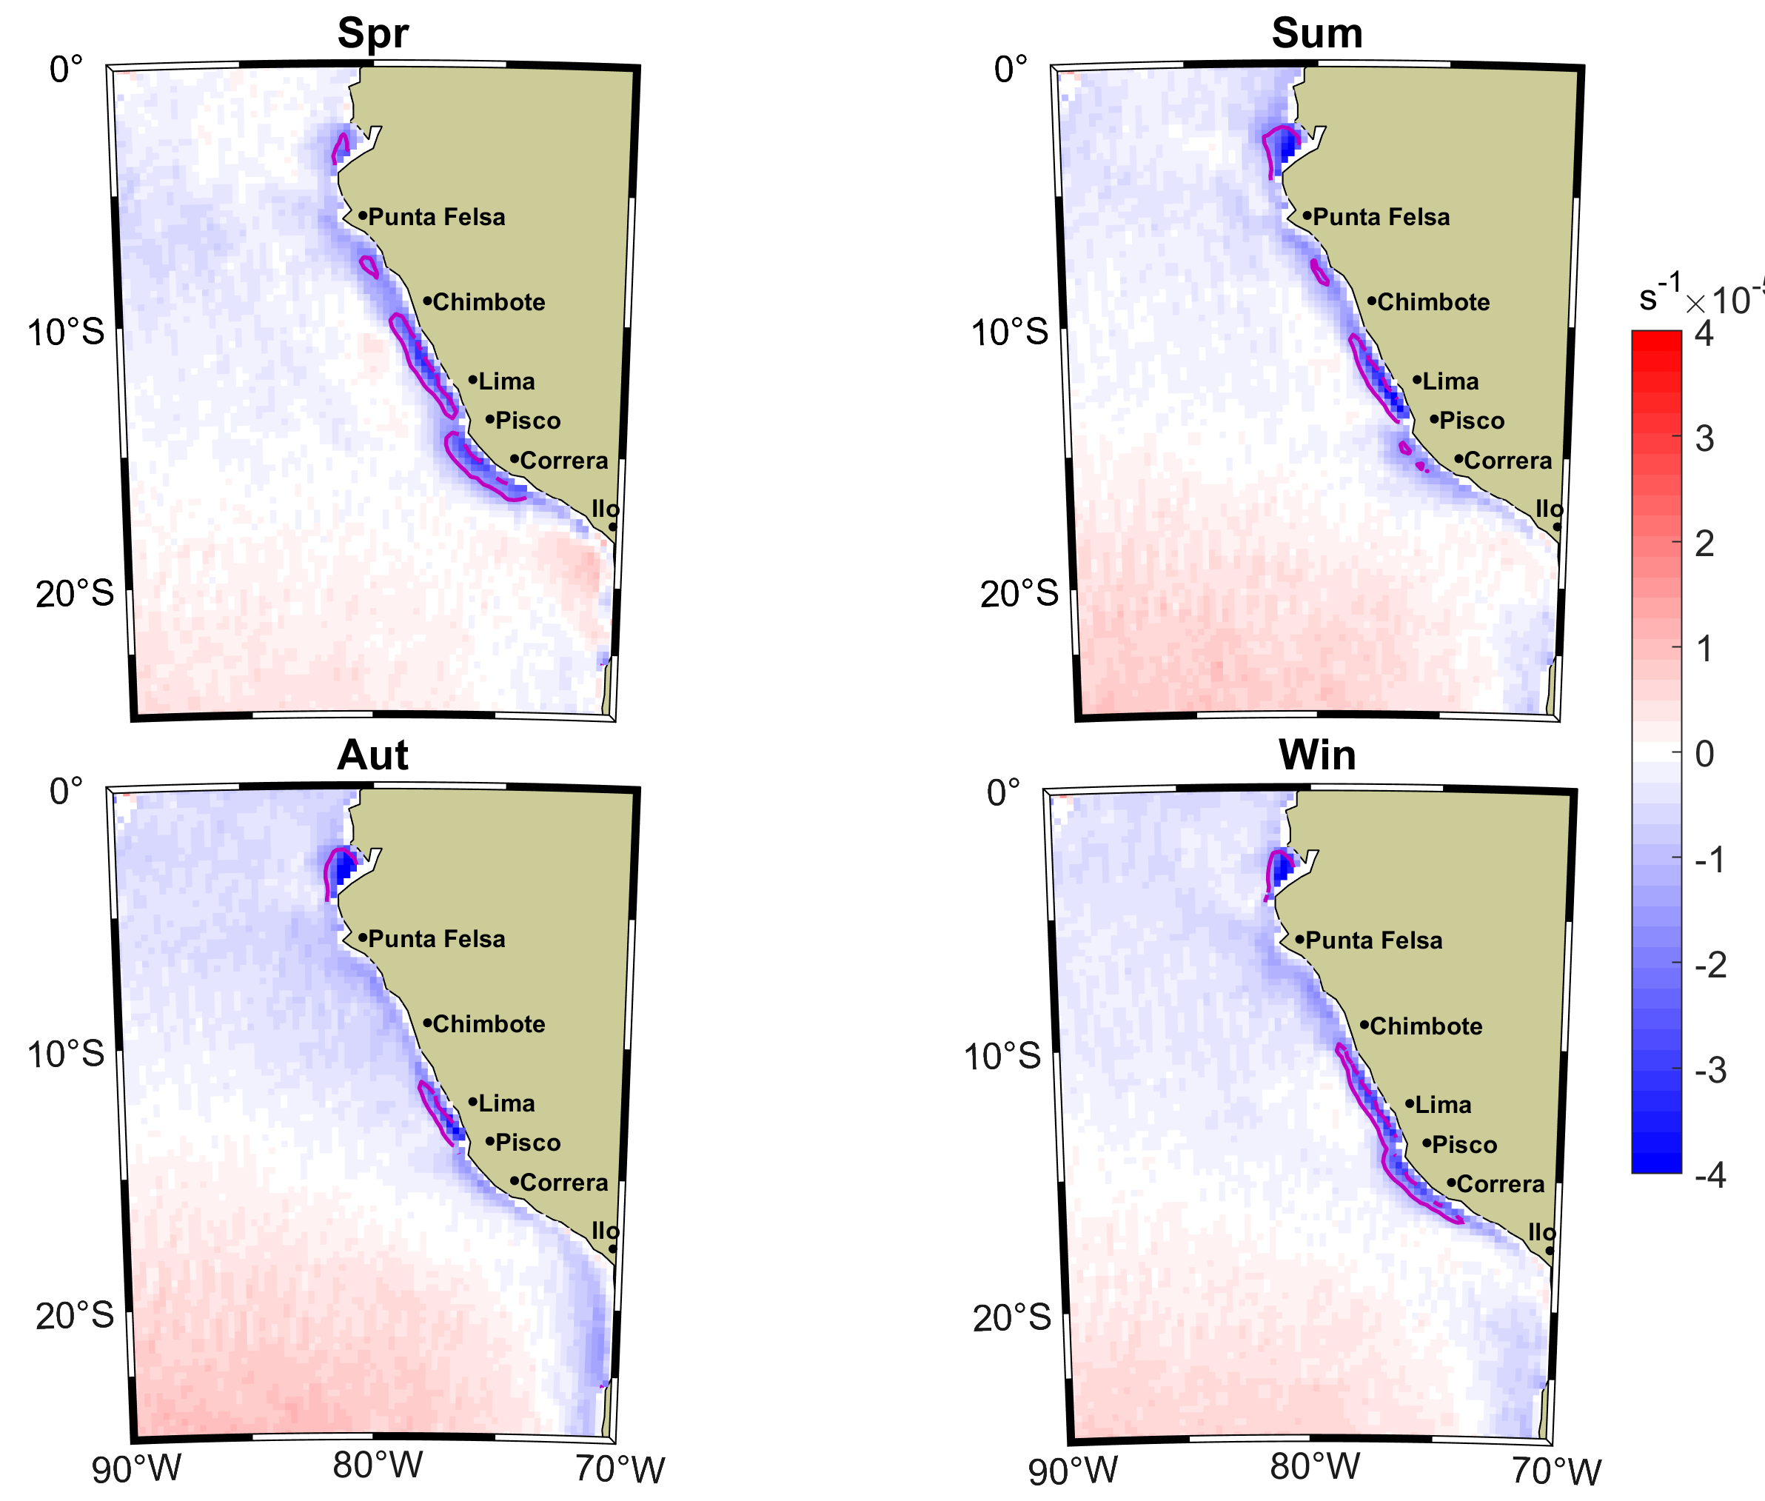
Seasonal wind curl as wind drop off index. The reddish line shows 1.8x10⁻⁵ s⁻¹
EGU 2020 4 May 2020

Slide 10
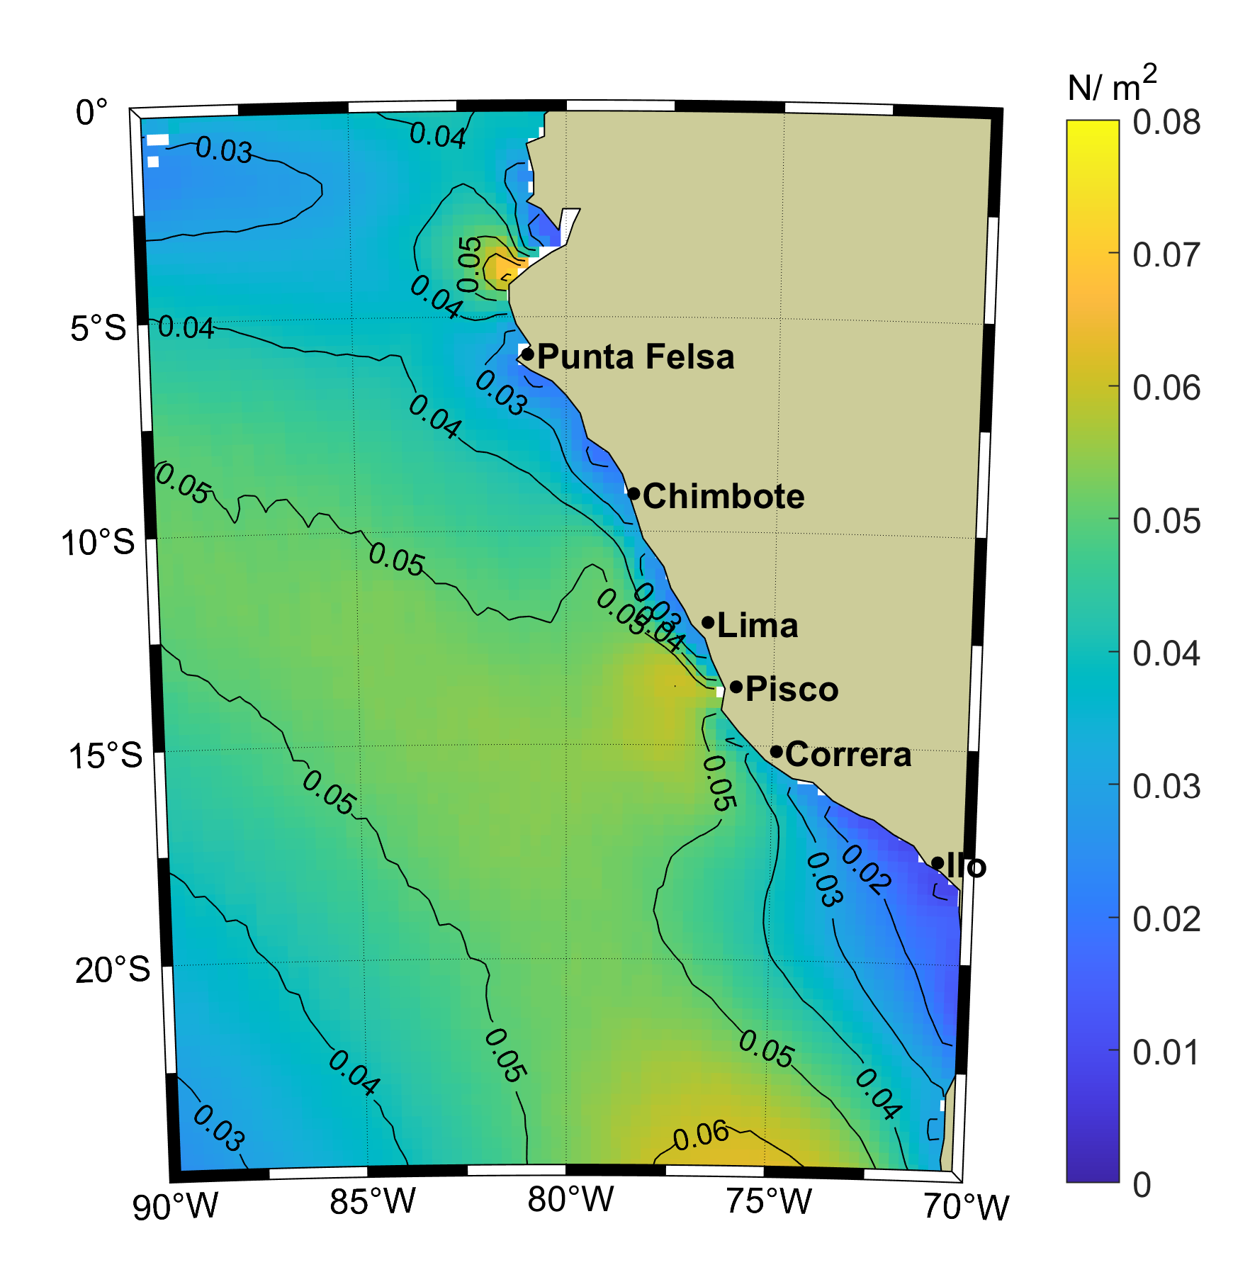
climatological Meridional wind stress
EGU 2020 4 May 2020
Notes:
10

Slide 11
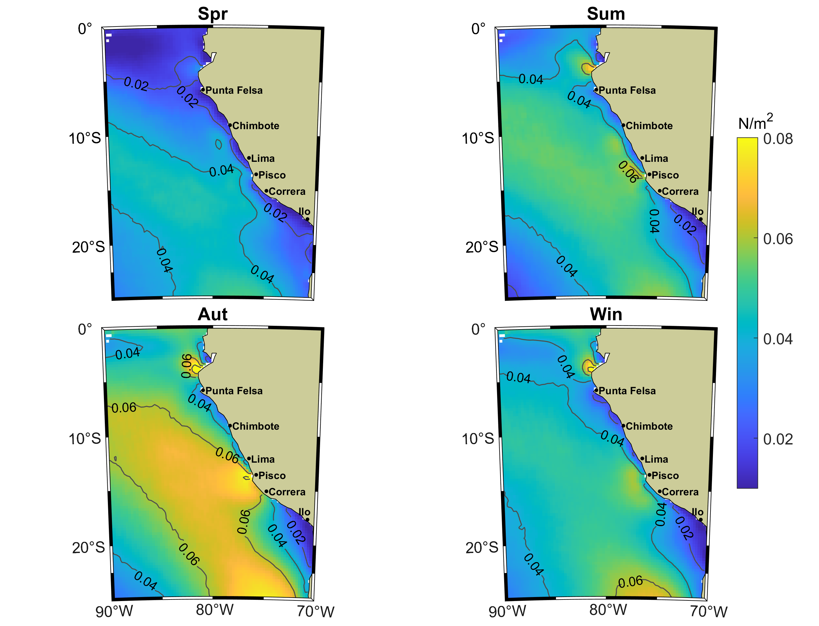
Seasonal Meridional wind stress
EGU 2020 4 May 2020
Notes:
11

Slide 12
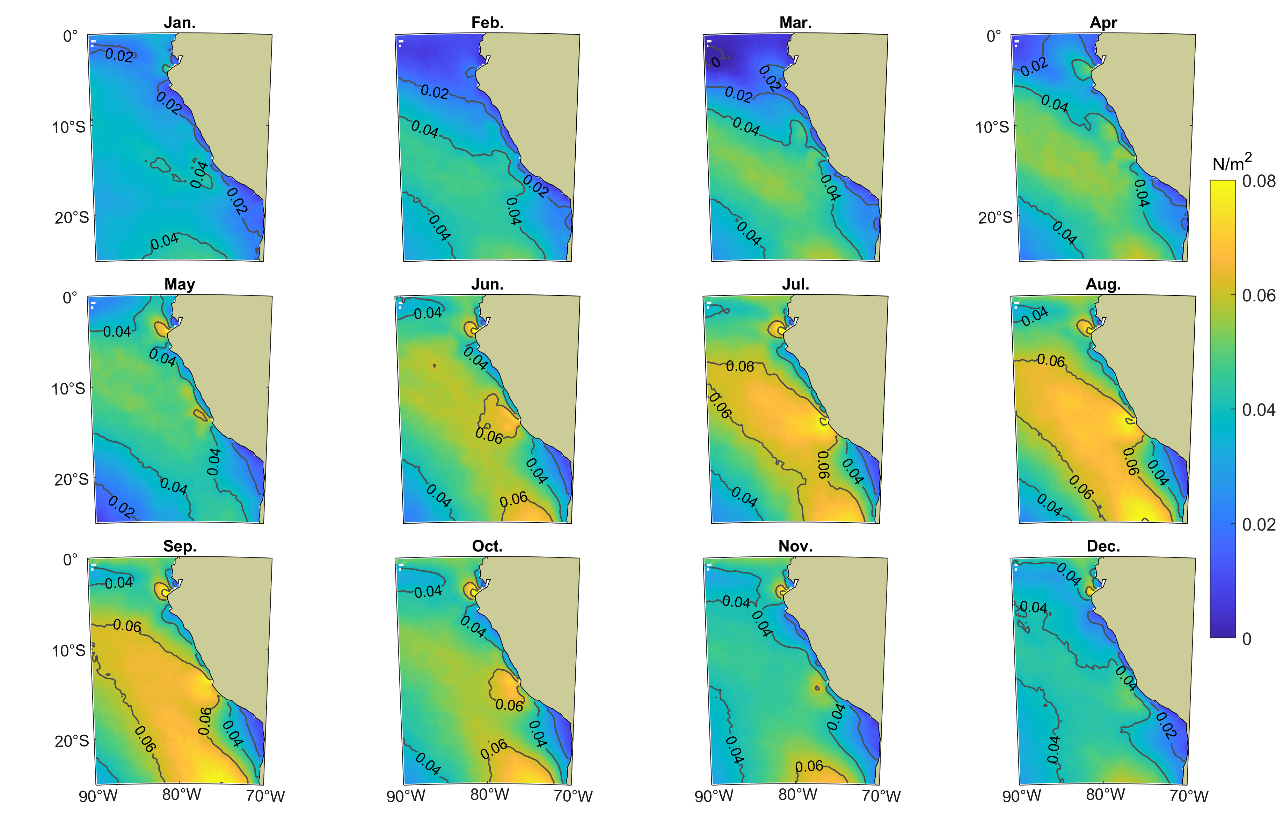
Monthly climatology Meridional wind stress
EGU 2020 4 May 2020
Notes:
12

Slide 13
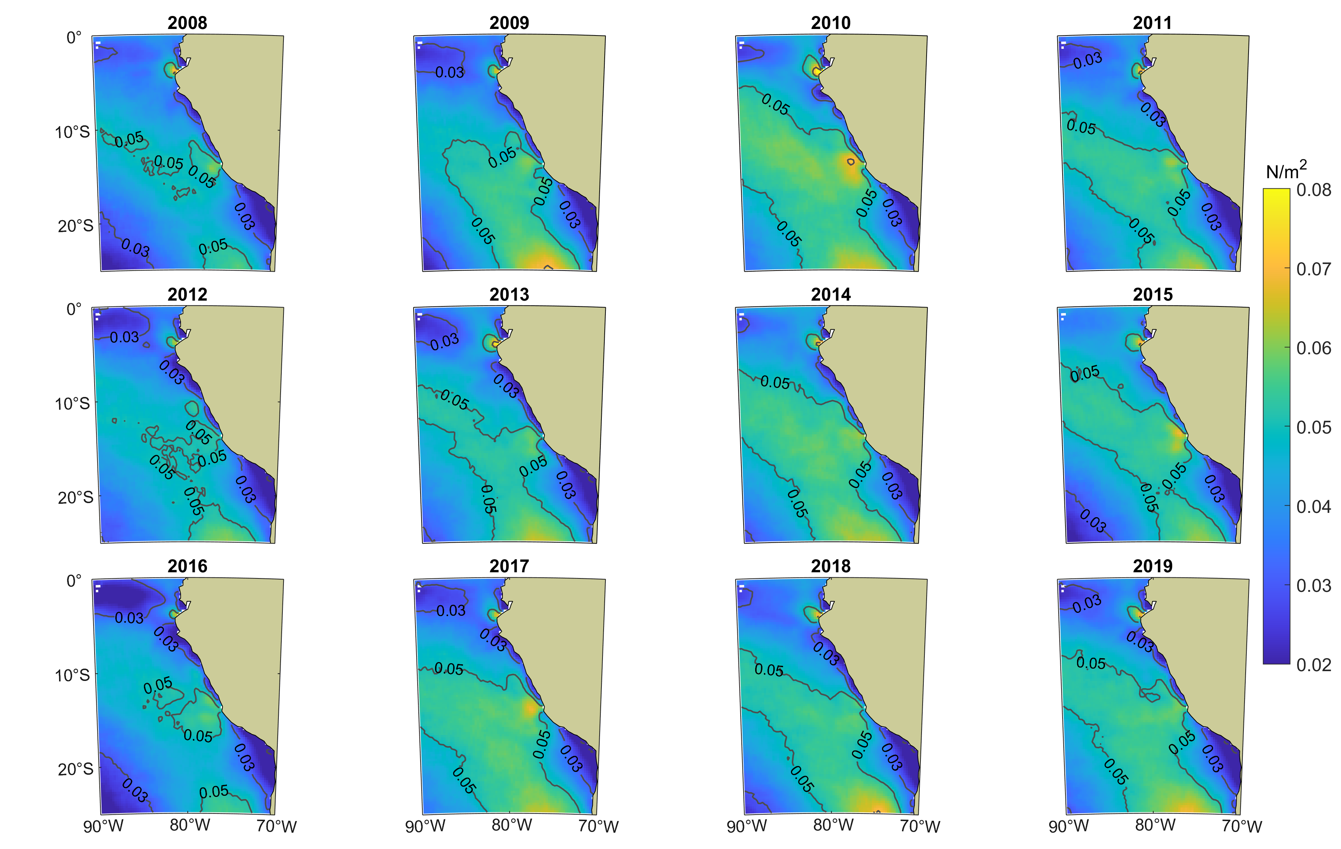
Annual mean Meridional wind stress
EGU 2020 4 May 2020
Notes:
13

Slide 14
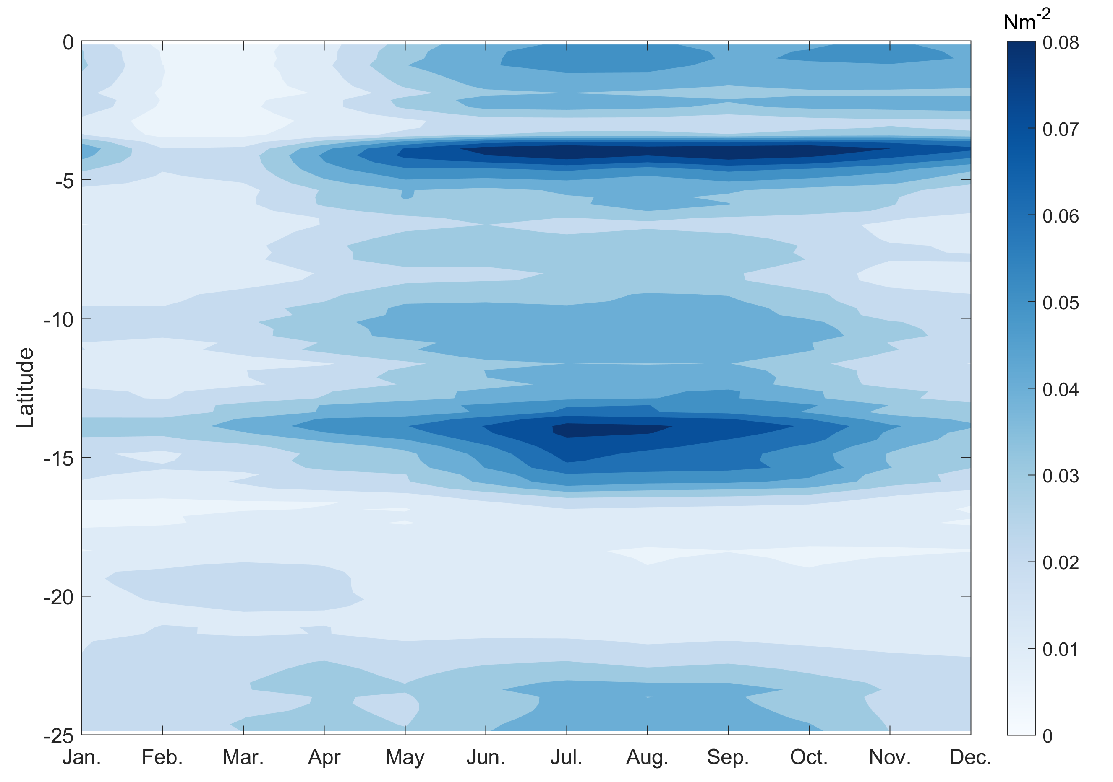
Monthly climatology of τy in the 100 km coastal band
EGU 2020 4 May 2020
Notes:
14

Slide 15
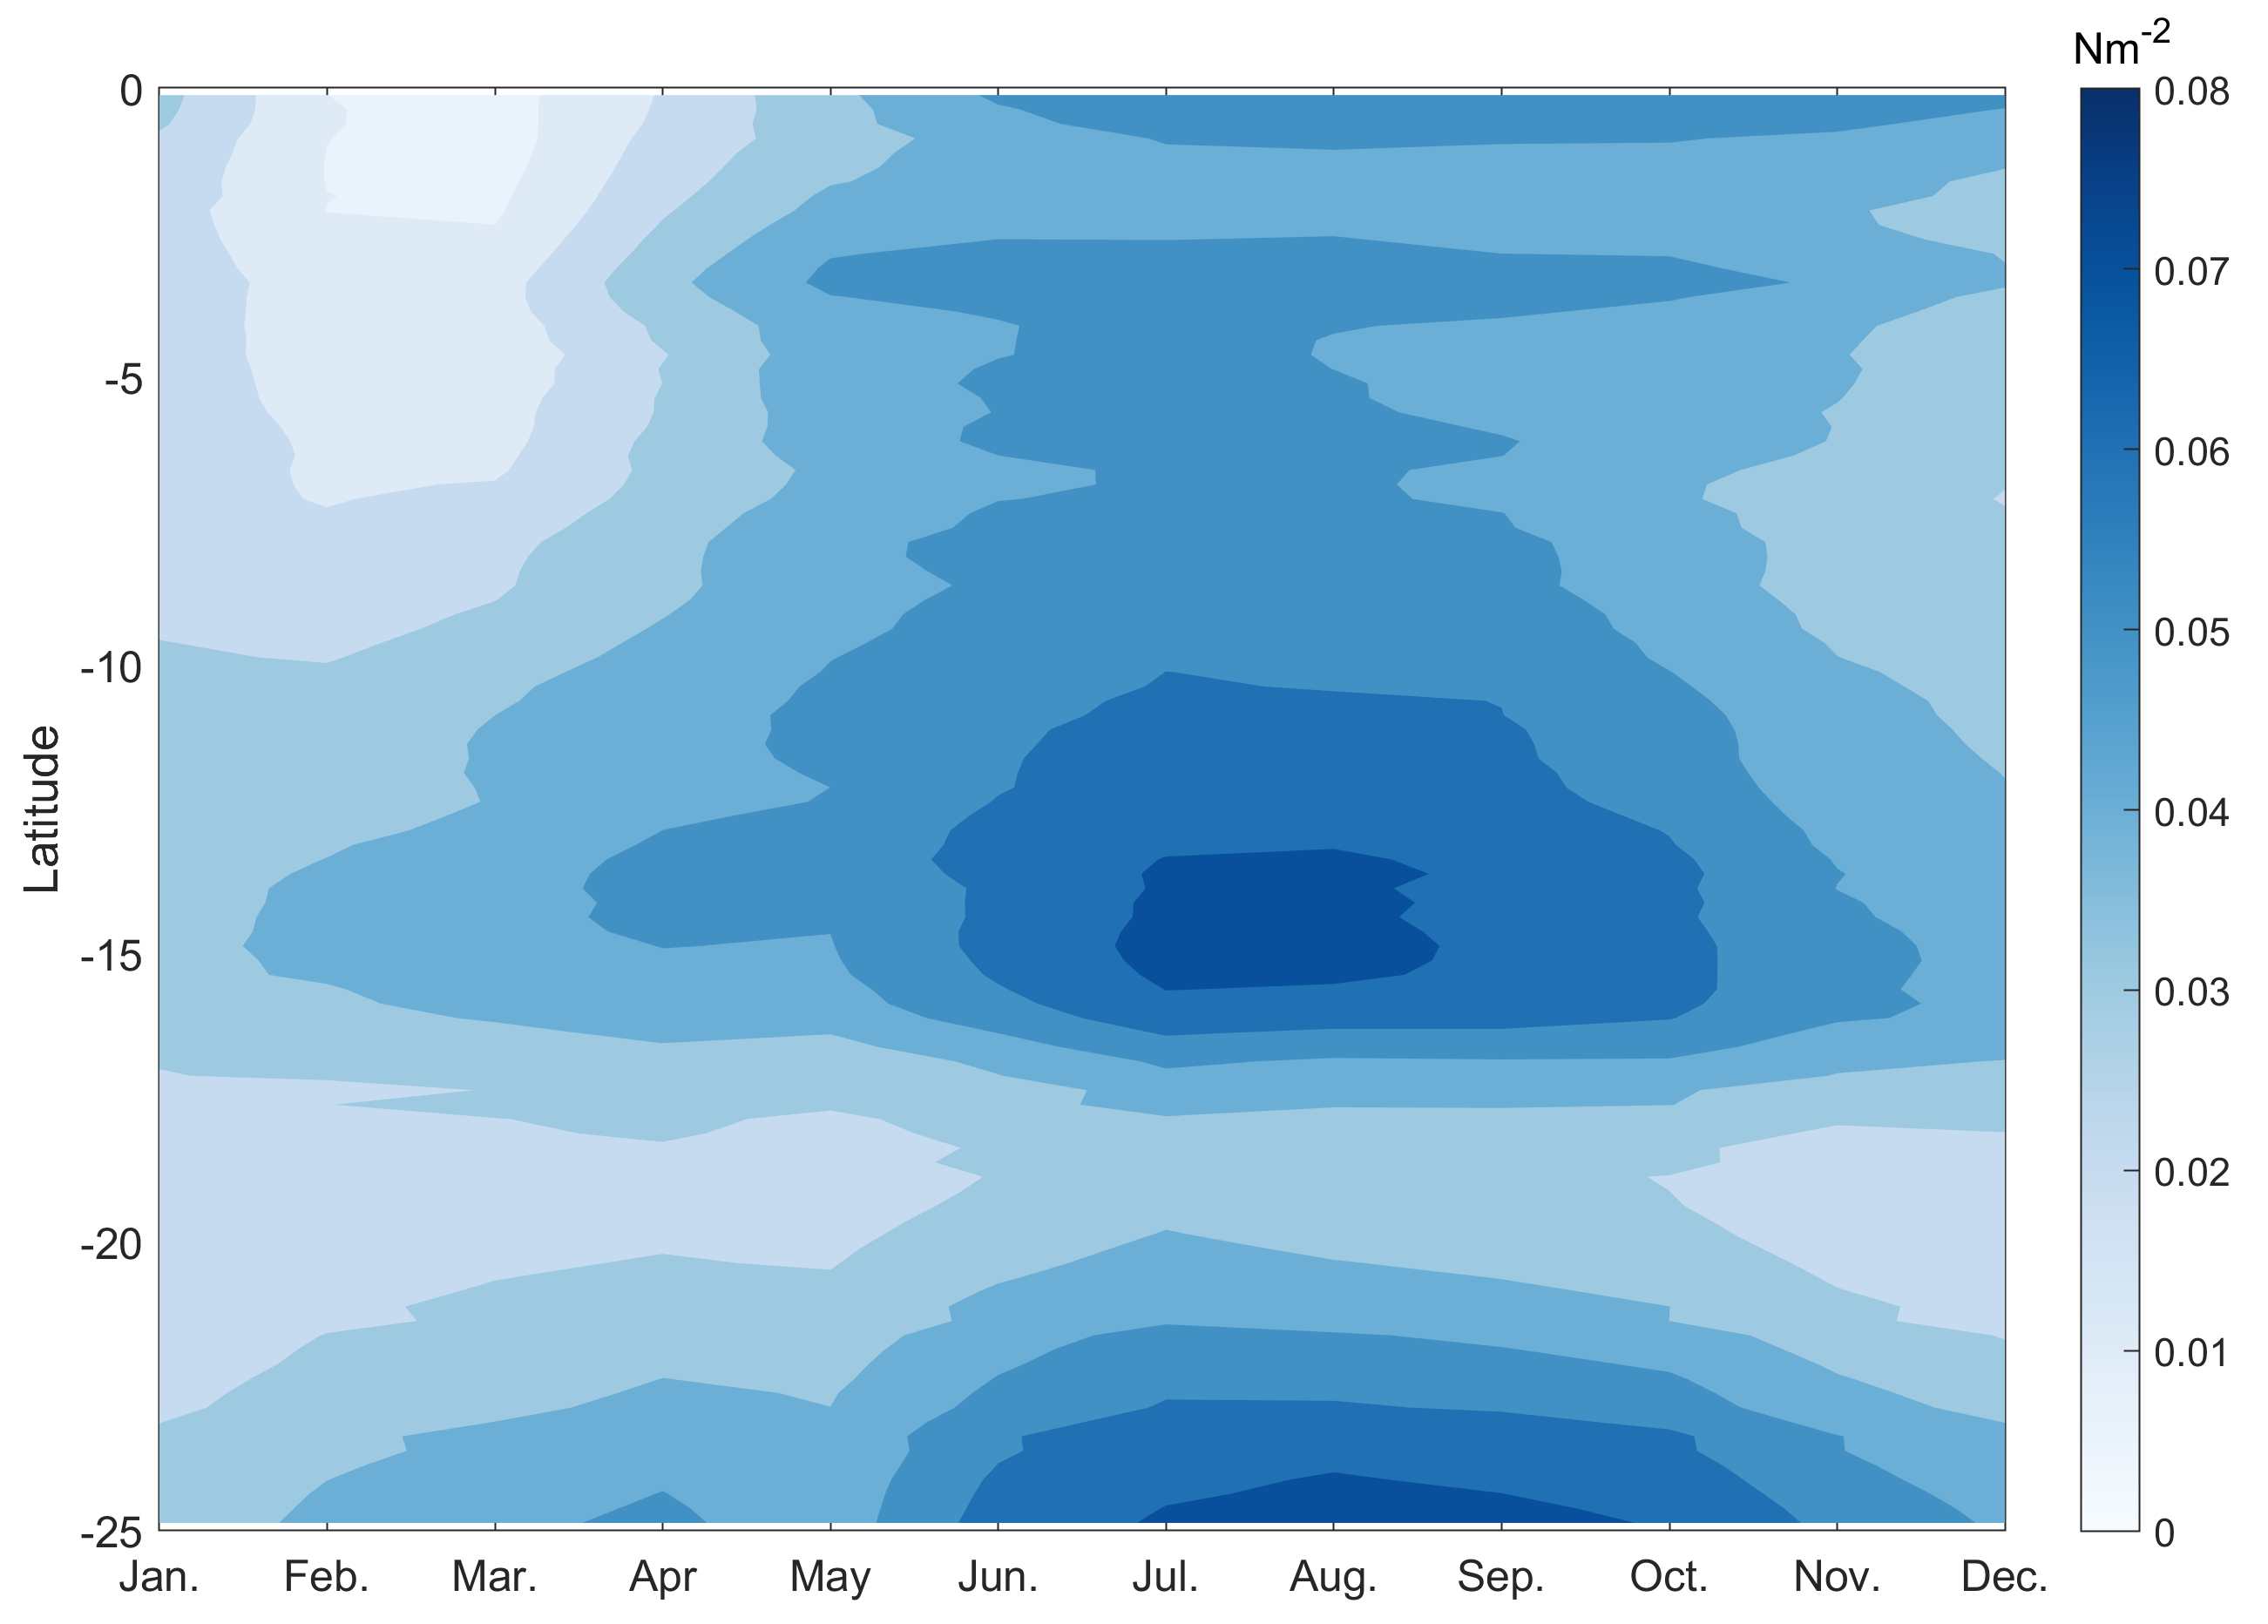
Monthly climatology of τy in the 400 km off-shore
EGU 2020 4 May 2020
Notes:
15

Slide 16
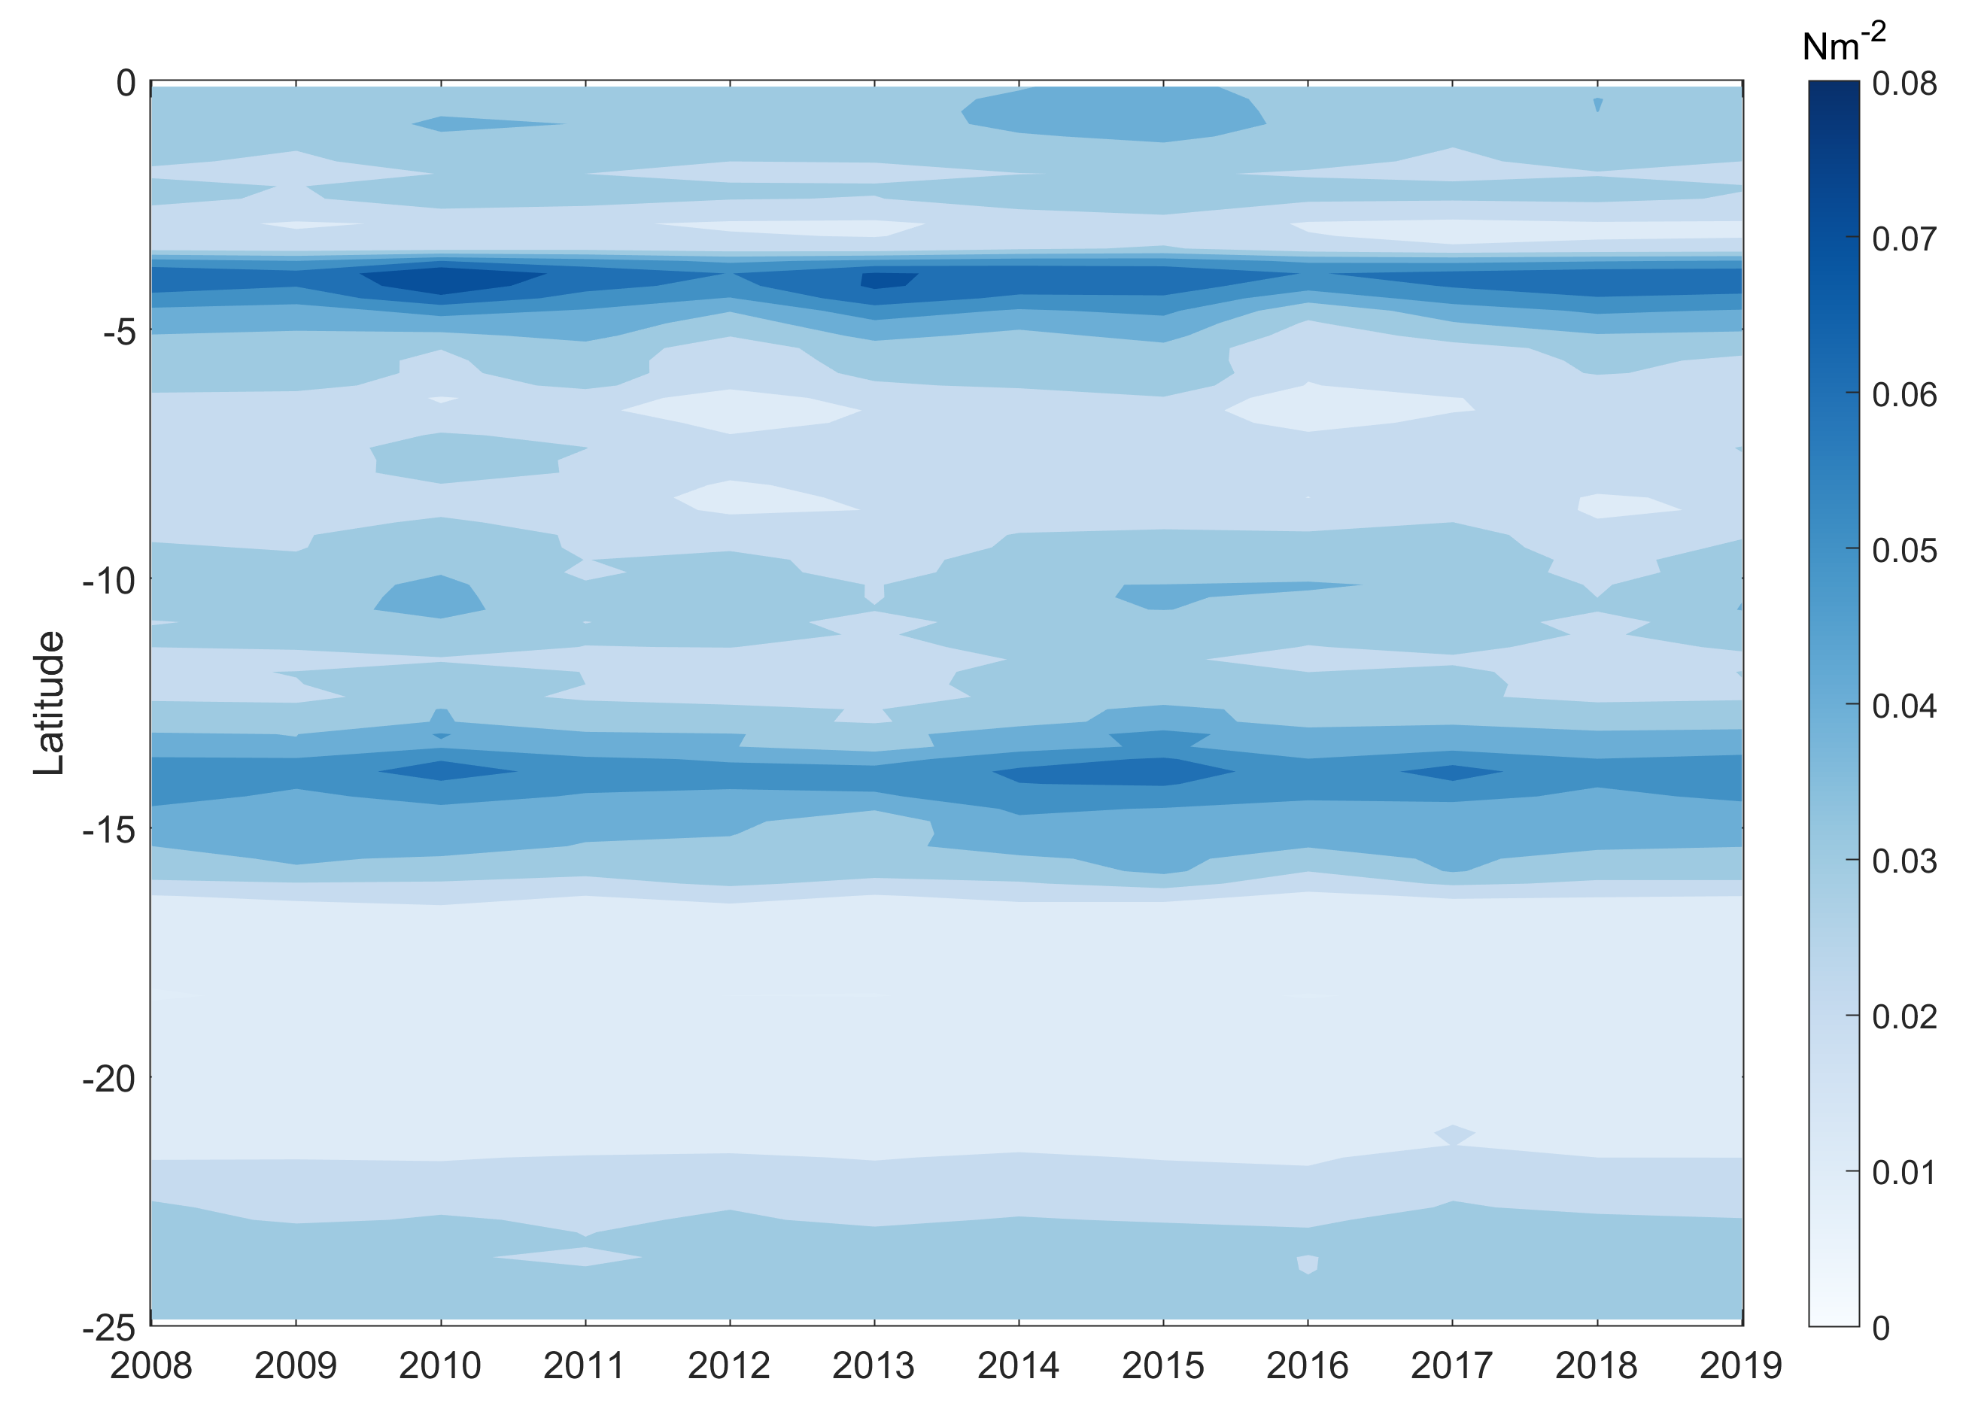
Annual mean of τy in the 100 km coastal band
EGU 2020 4 May 2020
Notes:
16

Slide 17
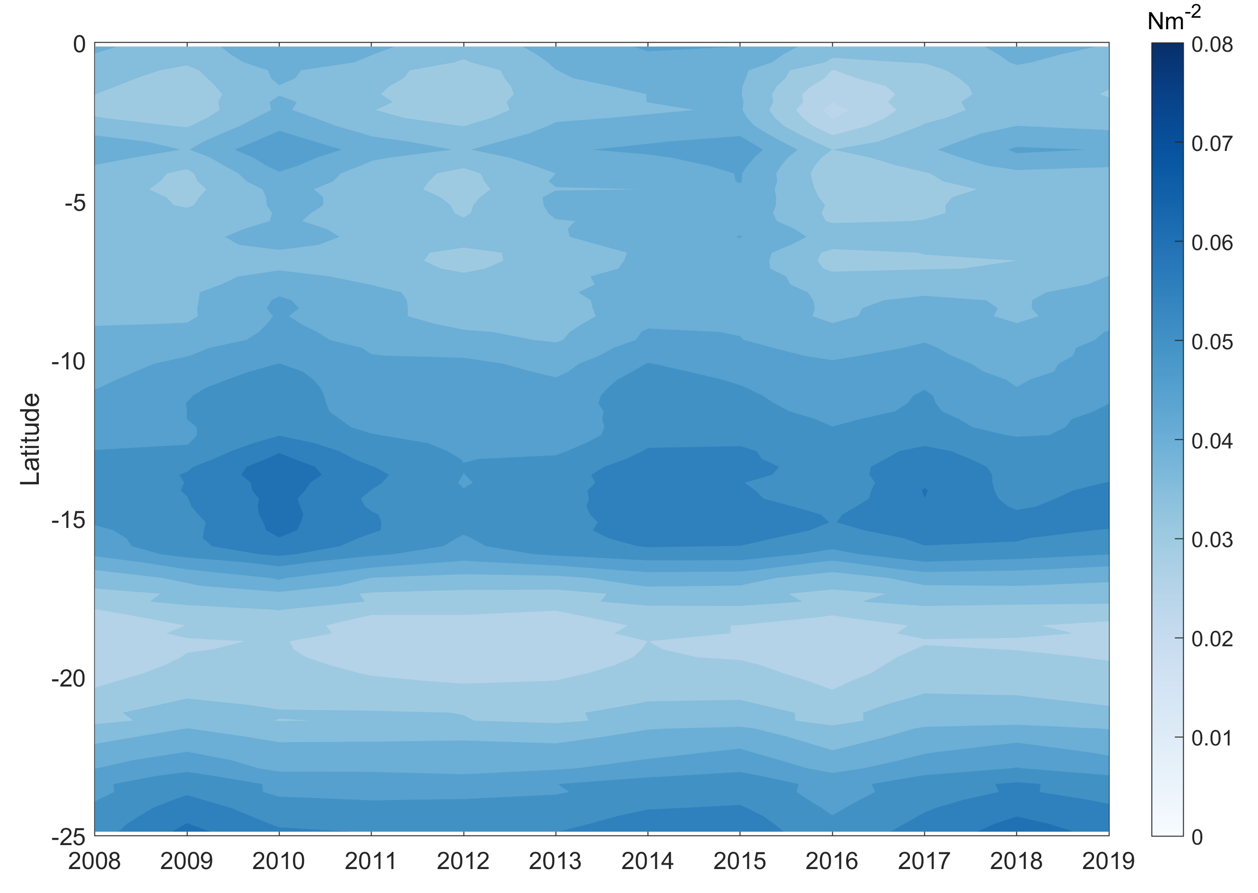
Annual mean of τy in the 400 km off-shore
EGU 2020 4 May 2020
Notes:
17

Slide 18
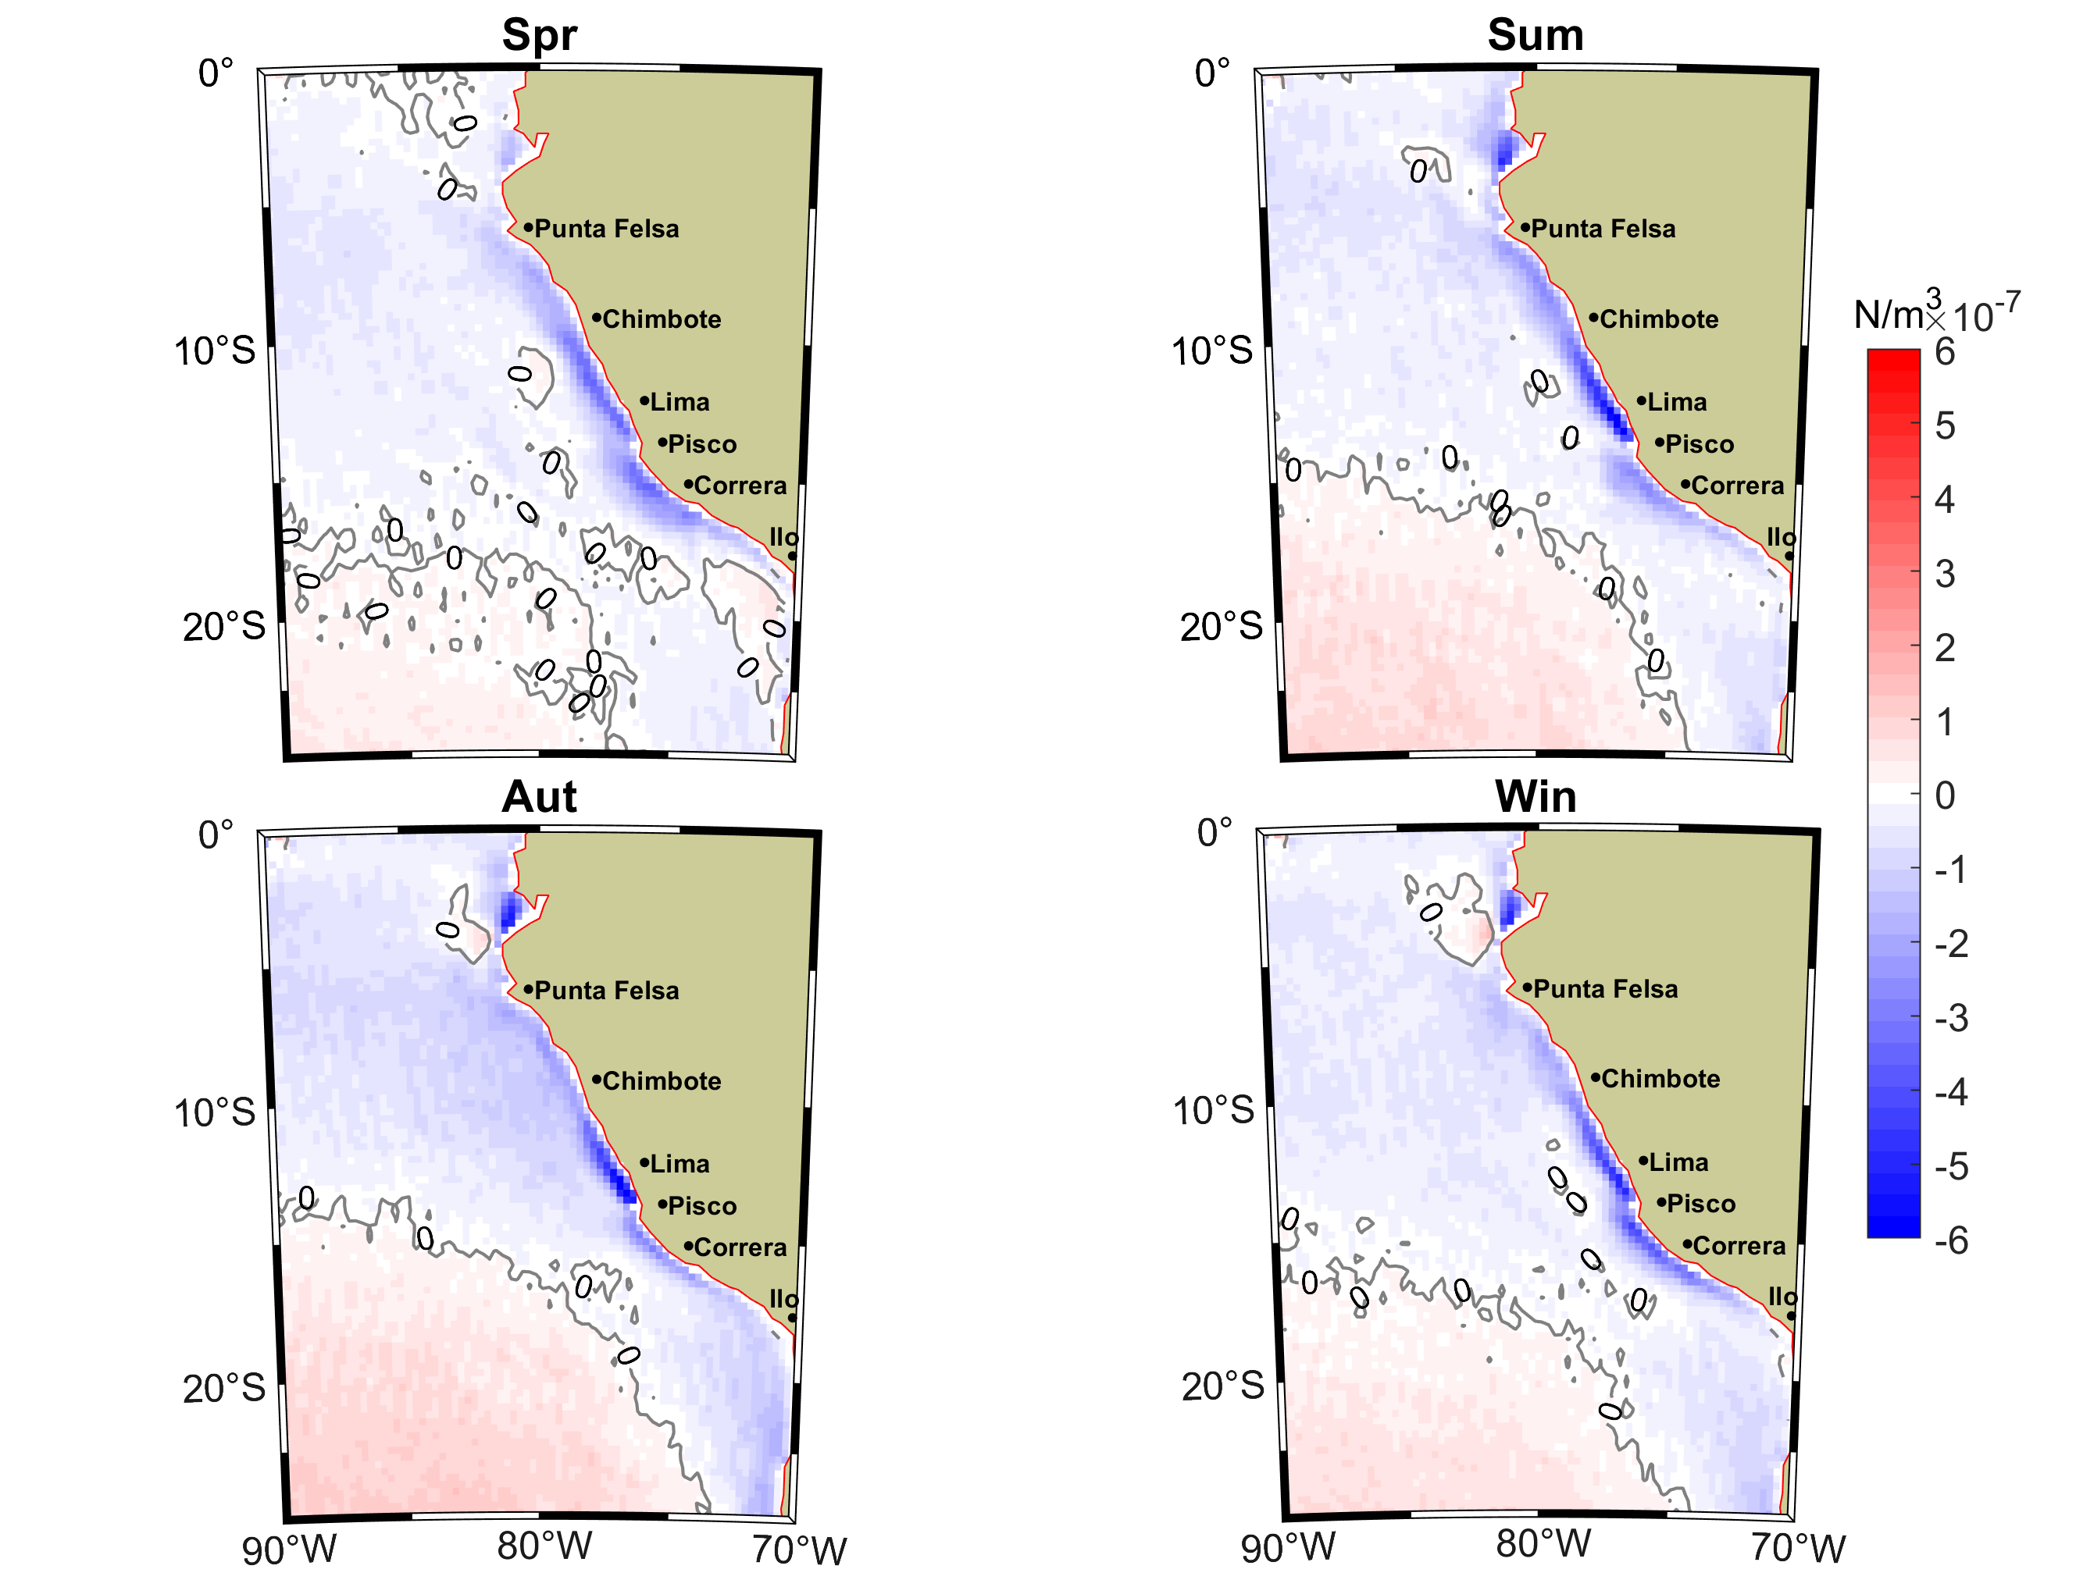
Seasonal wind stress curl
EGU 2020 4 May 2020
Notes:
18

Slide 19
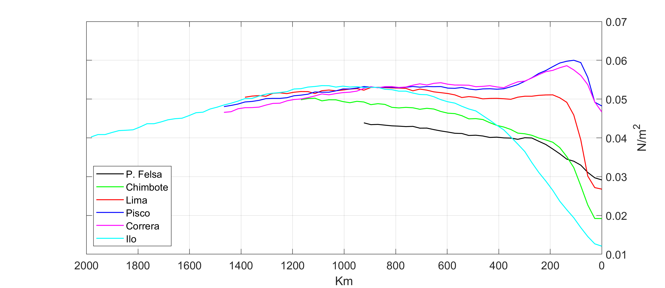
Spatial variation of τy on 6 transects
EGU 2020 4 May 2020
Notes:
19

Slide 20
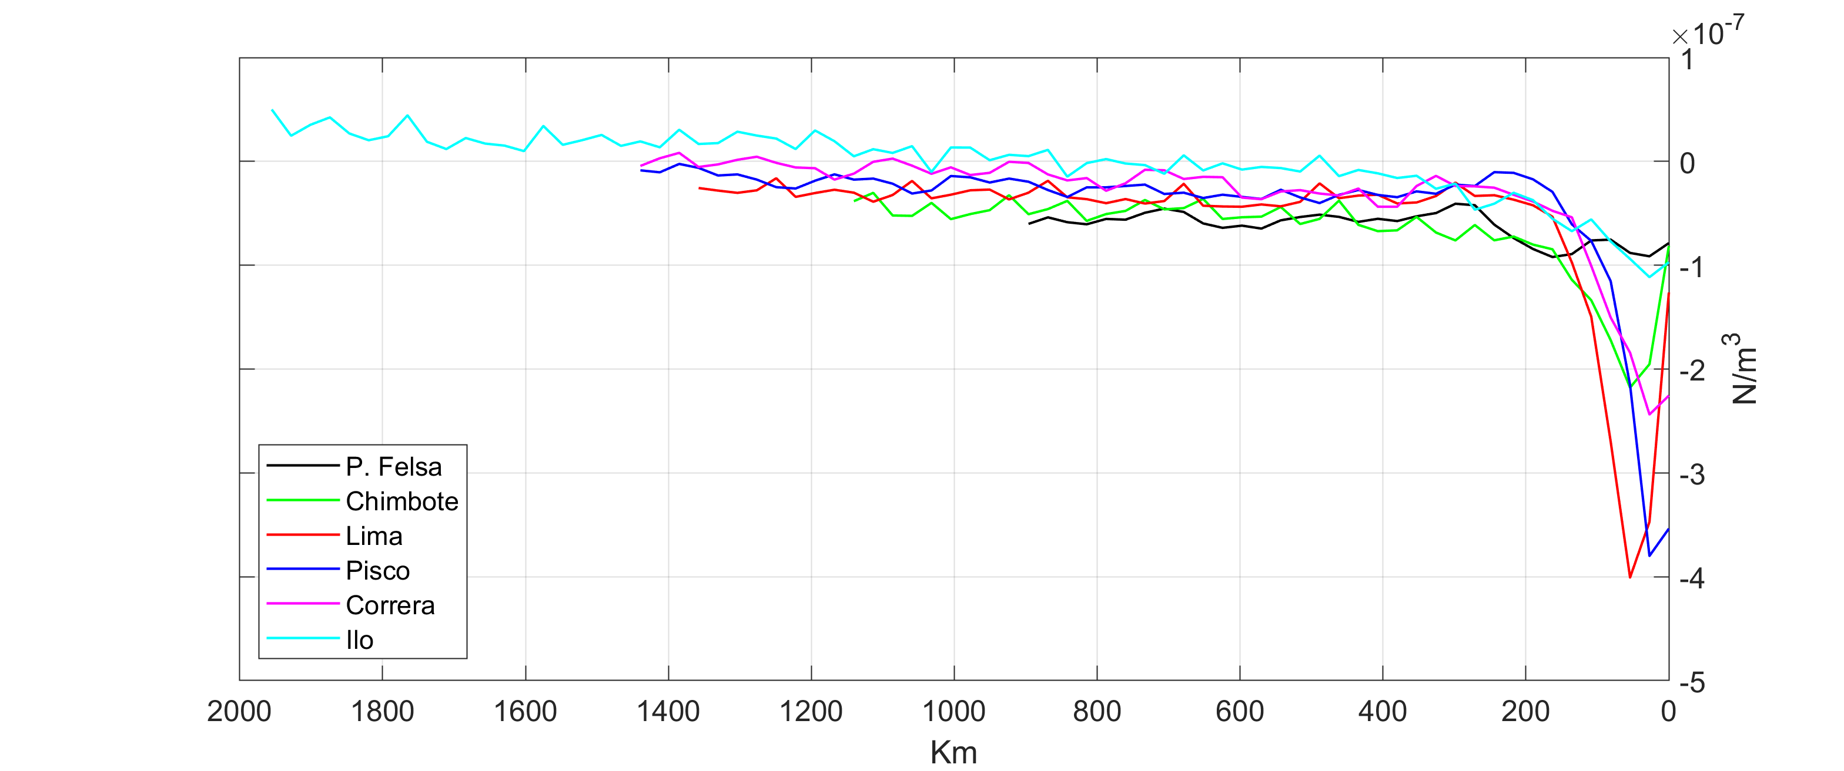
Spatial variation of curl(τy) on 6 transects
EGU 2020 4 May 2020
Notes:
20

Slide 21
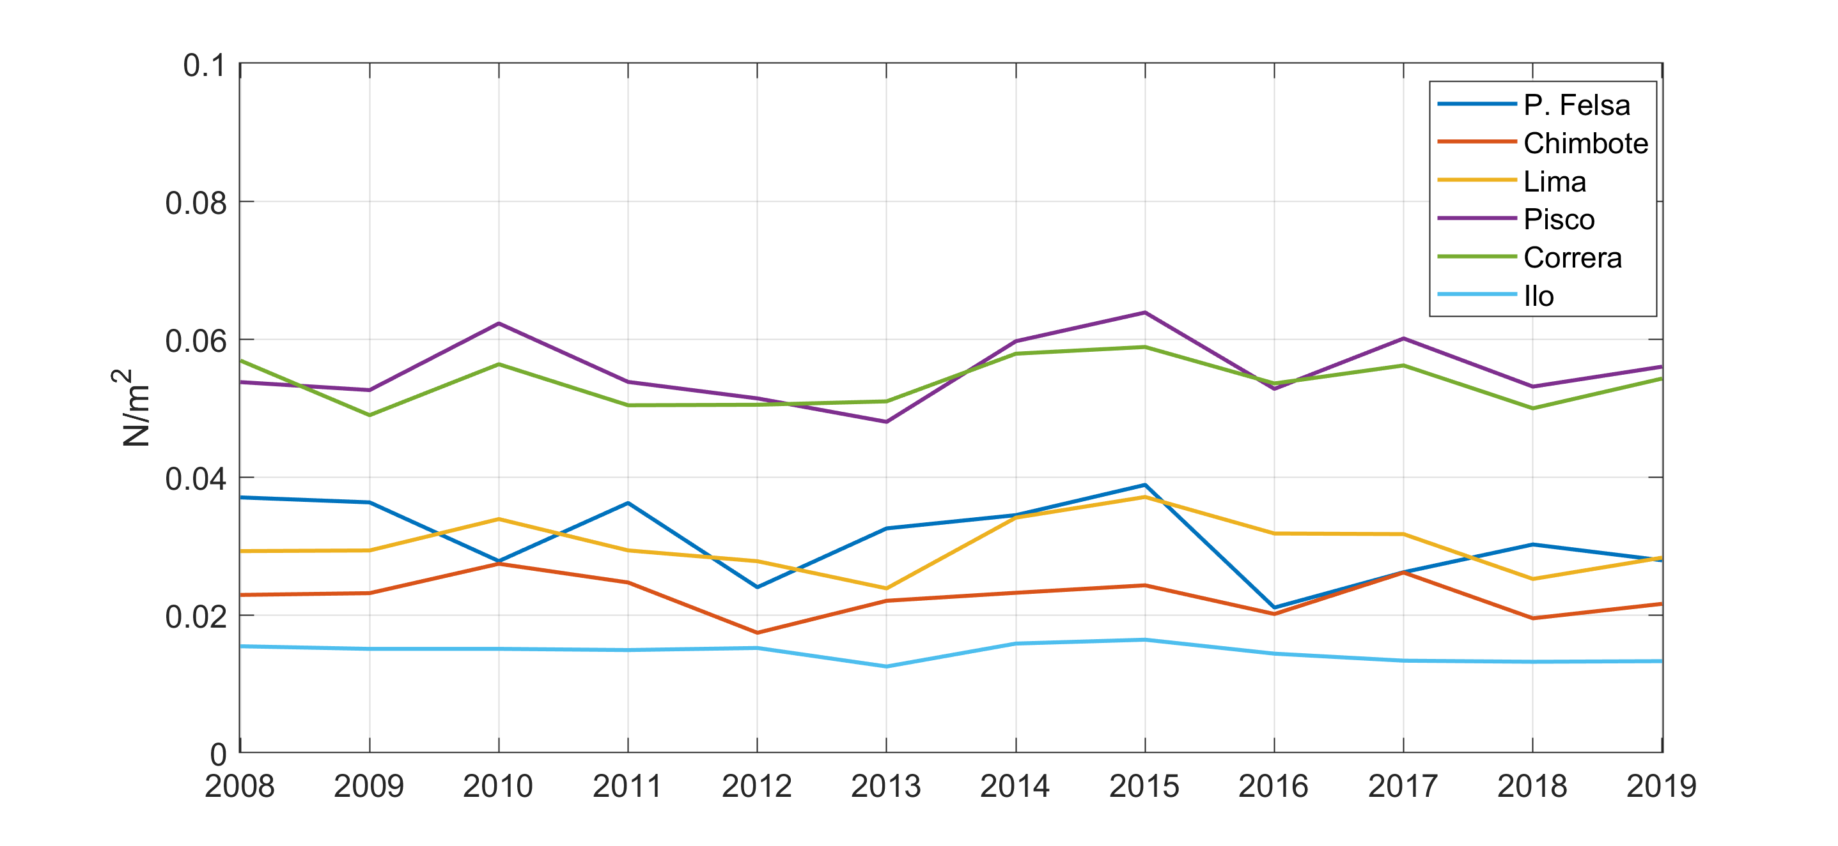
Annual mean of τy on 6 transects
EGU 2020 4 May 2020
Notes:
21

Slide 22
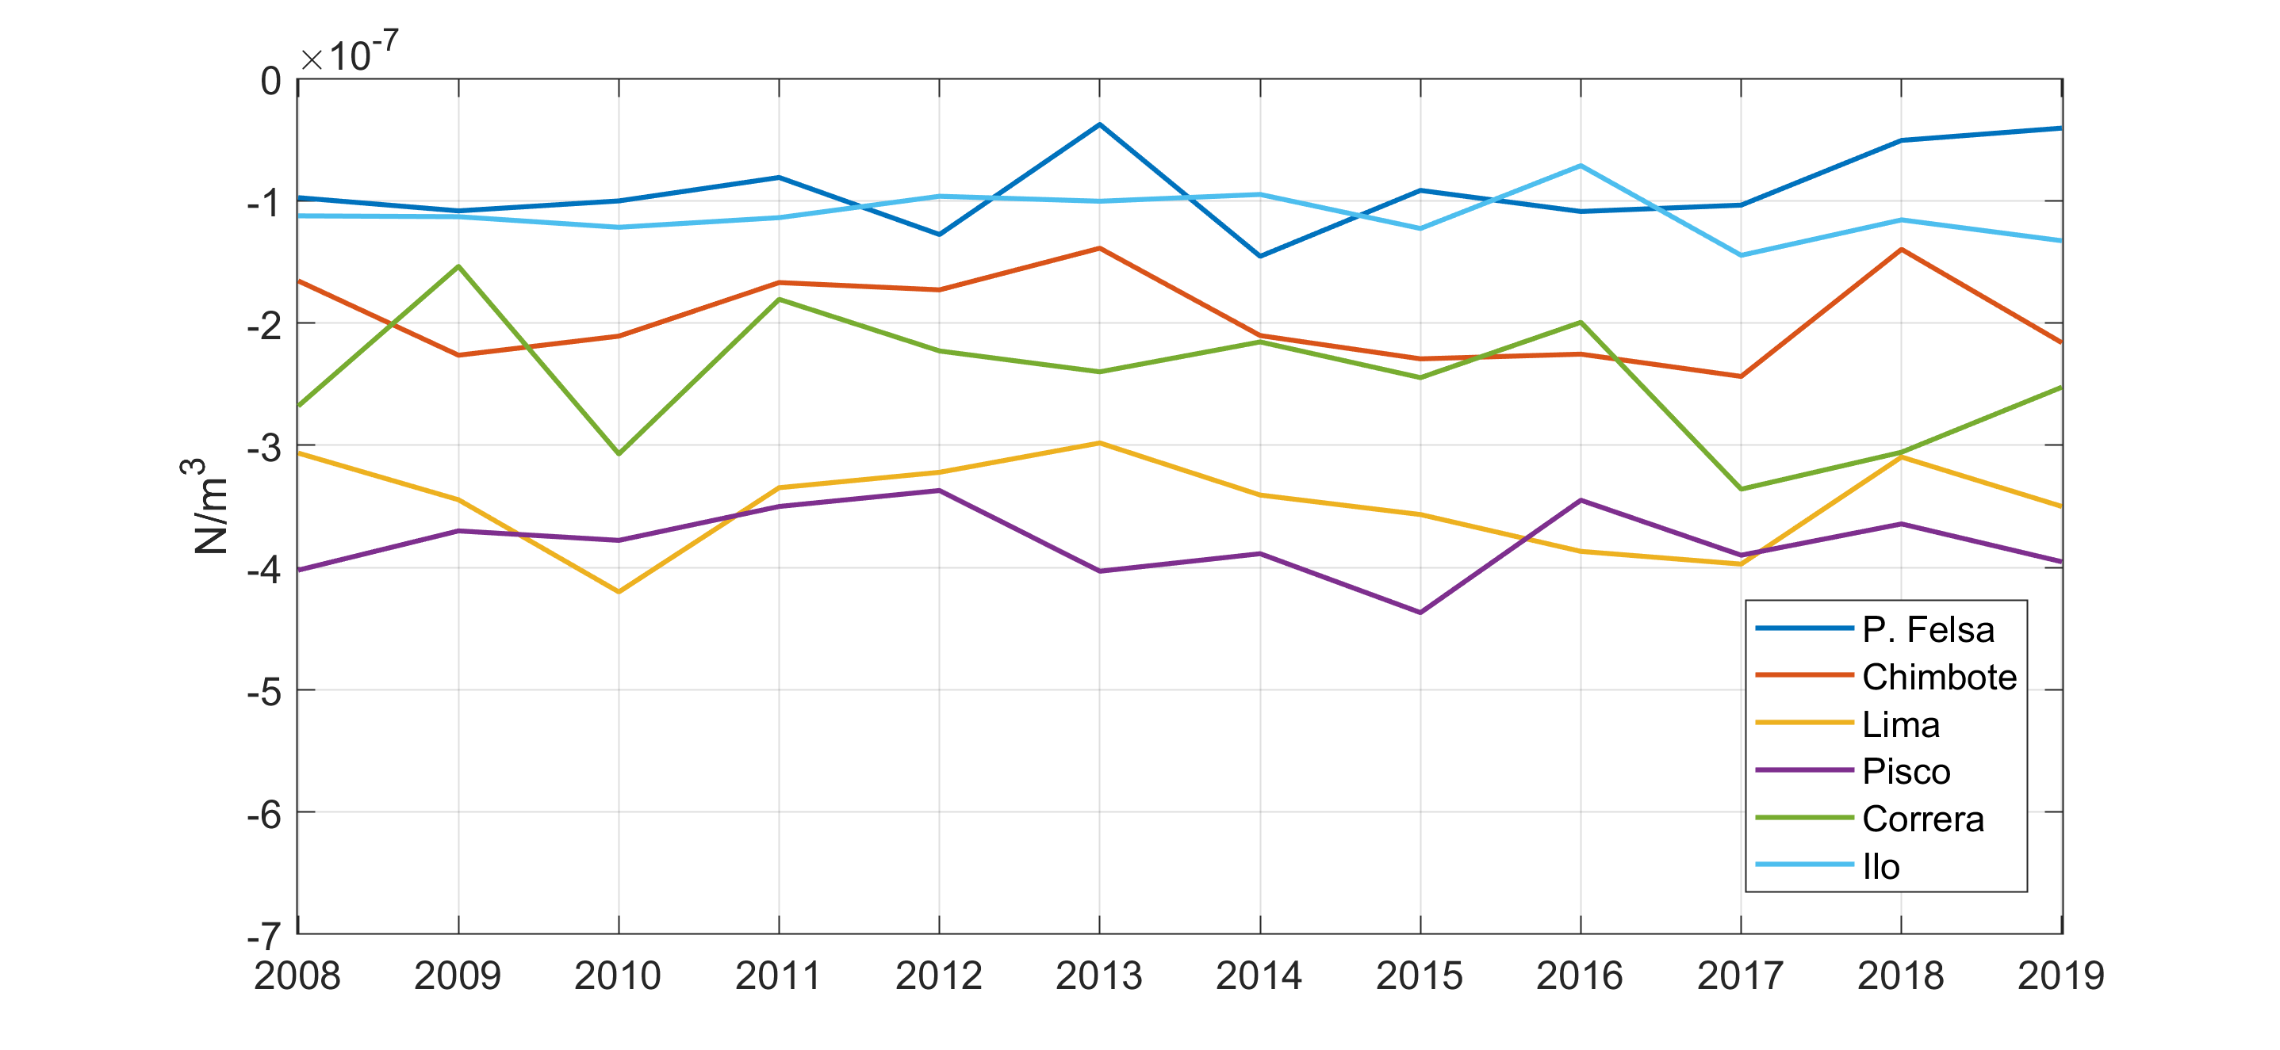
Annual mean of curl(τy) on 6 transects
EGU 2020 4 May 2020
Notes:
22

Slide 23
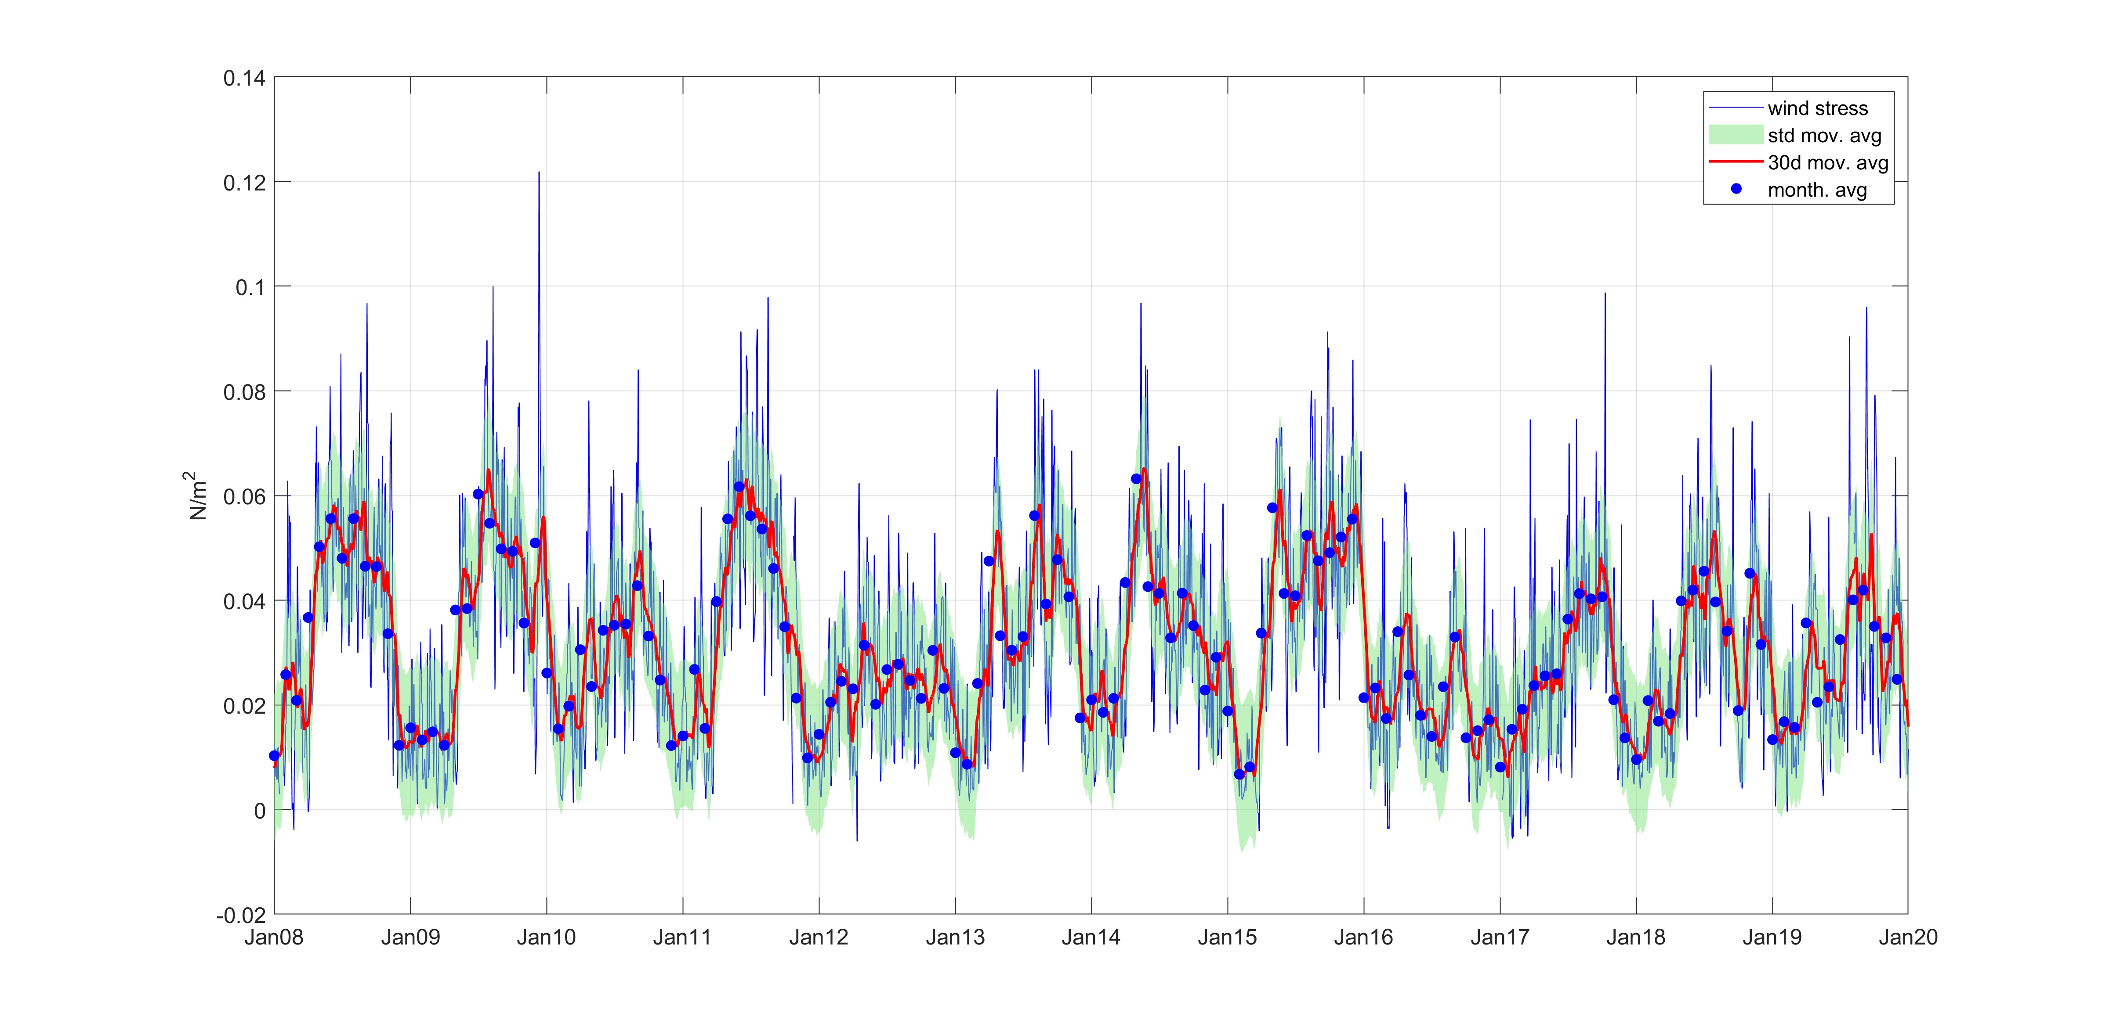
Time series of τy at Pisco station
EGU 2020 4 May 2020
Notes:
23

Slide 24
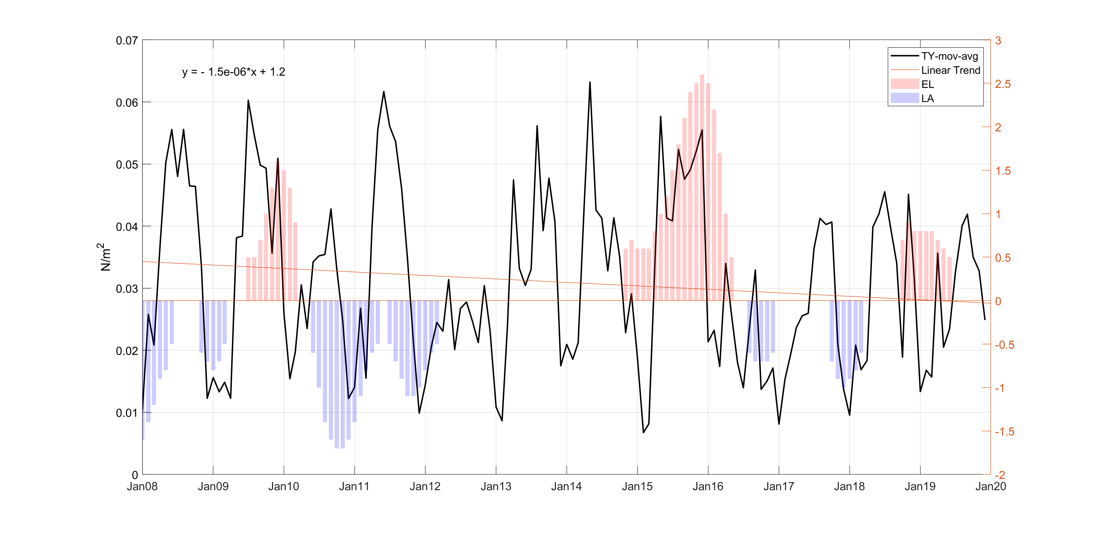
Monthly mean of τy at Pisco station comparing to Elnino/ Lanina events
EGU 2020 4 May 2020
Notes:
24

Slide 25
THANK YOU
EGU 2020 4 May 2020
Notes:
25

