Slide 1




Air Pollution and its potential climate effect in Delhi, India
EGU2020-223 D3110
Presenter: Ying Chen
Lancaster Environment Centre
Email: y.chen65@lancaster.ac.uk
Luke Conibear, Yu Wang, Liang Ran, Jianjun He, Lina Wang, Oliver Wild

Slide 2
Outline
PM2.5 pollution in Delhi (health impact)
What is unique of PM2.5 in Delhi? (climate impact)
Summary

Slide 3
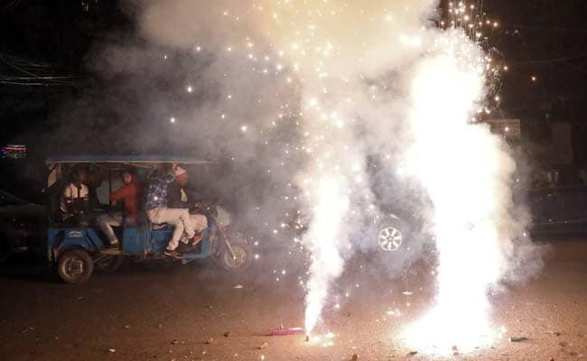
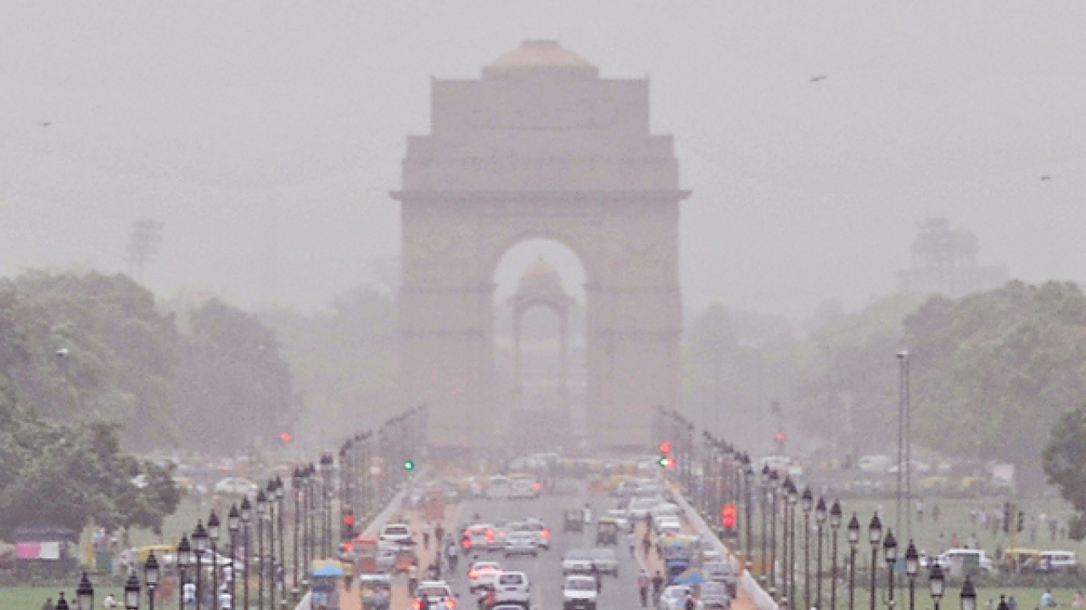
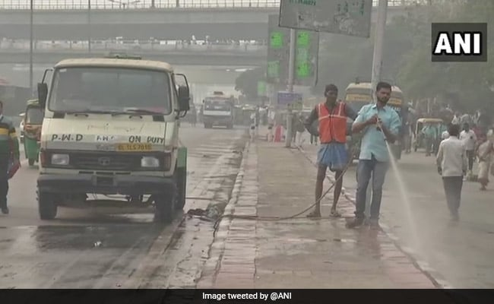
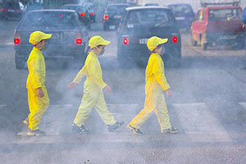
Air Quality in Delhi
Source: www.urbanupdate.in & www.ndtv.com
2018 Diwali
India: 9 out of top-10 most polluted cities in the World
Delhi: ranking at 6th according to WHO
~11K mortality in Delhi (Chowdhury et al., 2016)
~ 1M mortality over India (Luke et al., 2018)

Slide 4
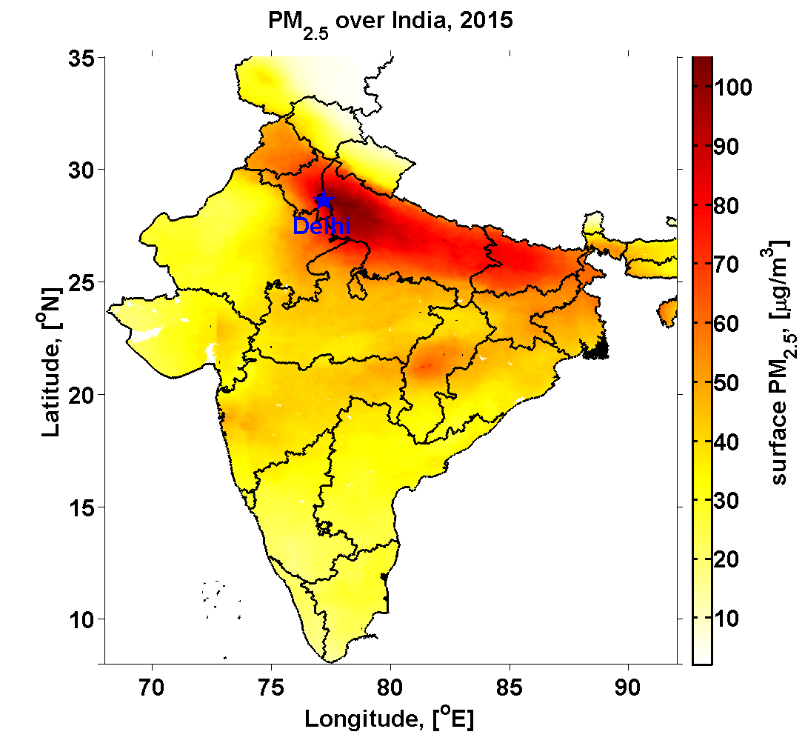
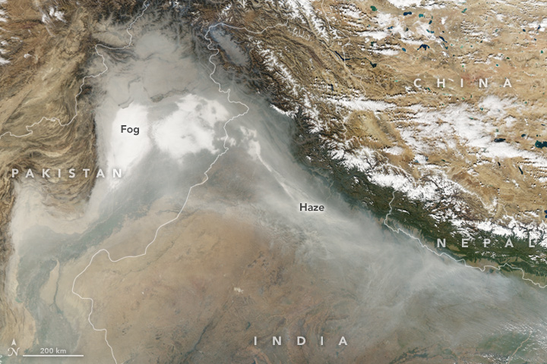
Air Quality in Delhi
Delhi
Beijing
Chinese City-level
Delhi
Global Pop.-weighted
MODIS image

Slide 5
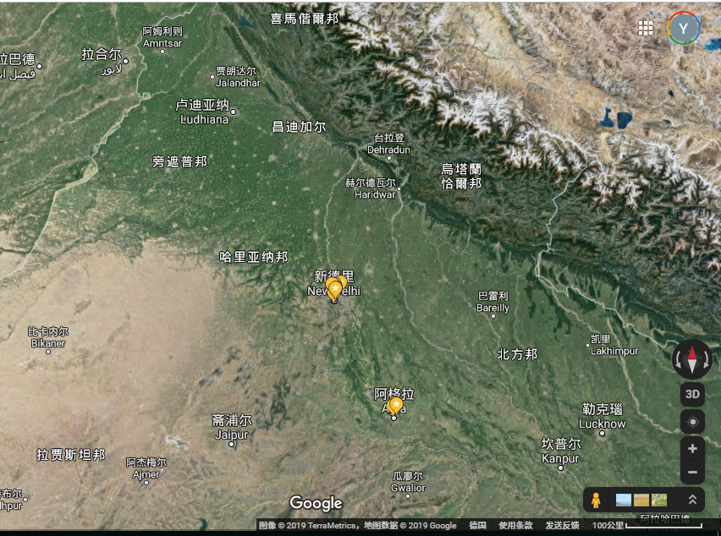
Representativeness of Obs@US Embassy

Slide 6
Representativeness of Obs@US Embassy
Source: Chen et al., 2020 AEX

Slide 7
How bad is PM2.5 in Delhi
95%
75%
Mean
Median
25%
5%
Source: Chen et al., 2020 AEX

Slide 8
How bad is PM2.5 in Delhi
Source: Chen et al., 2020 AEX
Weekdays = Weekend
Winter > Post-monsoon (Autumn) > Pre-monsoon (Summer) > Monsoon
Shift morning peak from 8-9am (Summer) to 10am (Winter)

Slide 9
How bad is PM2.5 in Delhi
Unhealthy
Healthy
short-term exposure: ~22 person/day
Monthly: 180 µg/m³
Diwali: 320 µg/m³
New Year Fest
Diwali Fest
Source: Chen et al., 2020 AEX

Slide 10
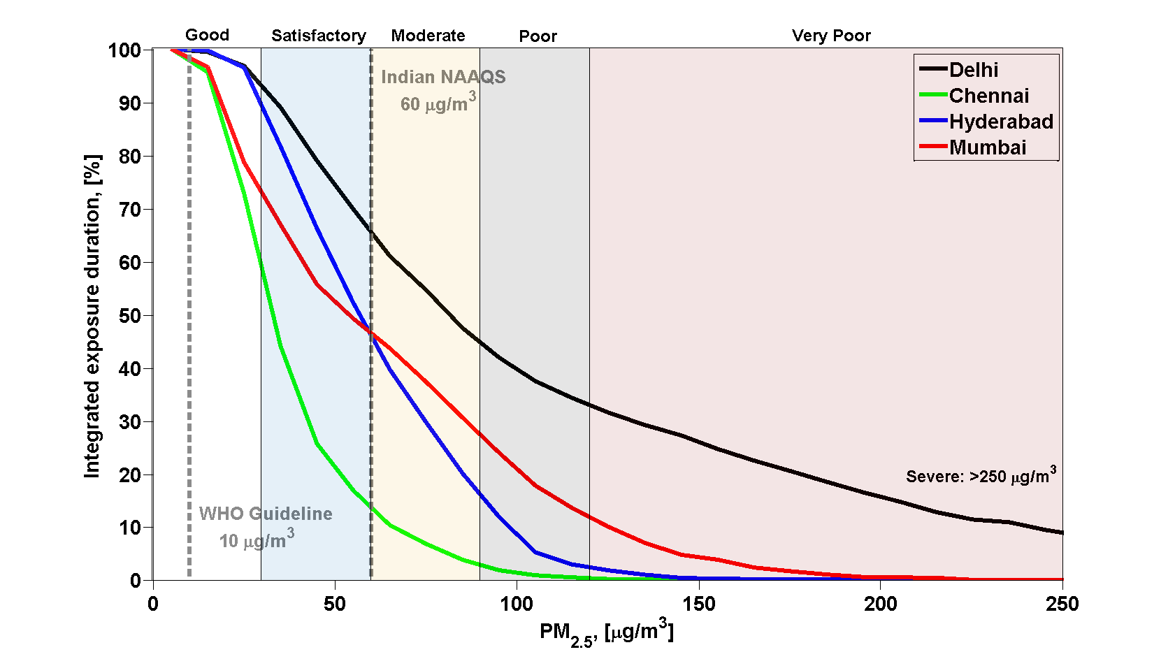
How bad is PM2.5 in Delhi
255 days/year
Source: Chen et al., 2020 AEX

Slide 11
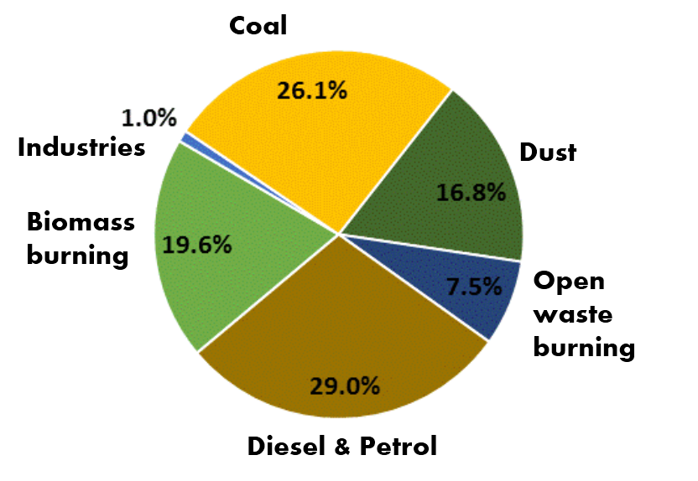
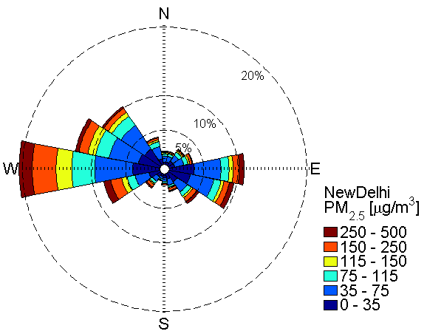
Where does PM2.5 come from?
Local Sources
Regional Transport
Road Dust
Source: Dr. Mukesh Sharma@IIT-Kanpur
Combination of local and regional sources (NCR).
However, not transport from too far (unless dust storm), since faster windspeed lower PM2.5

Slide 12
Outline
PM2.5 pollution in Delhi (health impact)
What is unique of PM2.5 in Delhi? (climate impact)
Summary

Slide 13
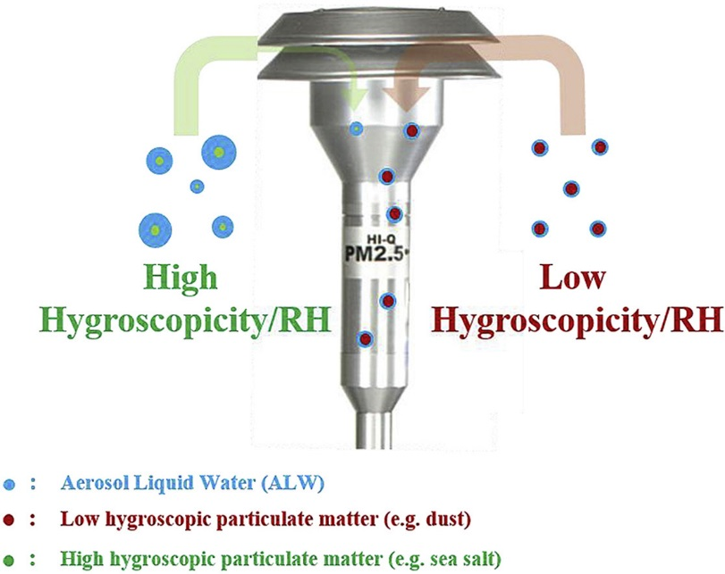



Physical Property: Hygroscopicity
Source: Chen et al. (2018)
Hygroscopic growth:
Direct radiative forcing
Lower visibility
Fasten heteo. reactions
Deposition rate
Influence obs. directly
…
Cloud activation:
Indirect radiative forcing
Hydrologic cycle
Wet scavenging
…
RH increase and water uptake

Slide 14
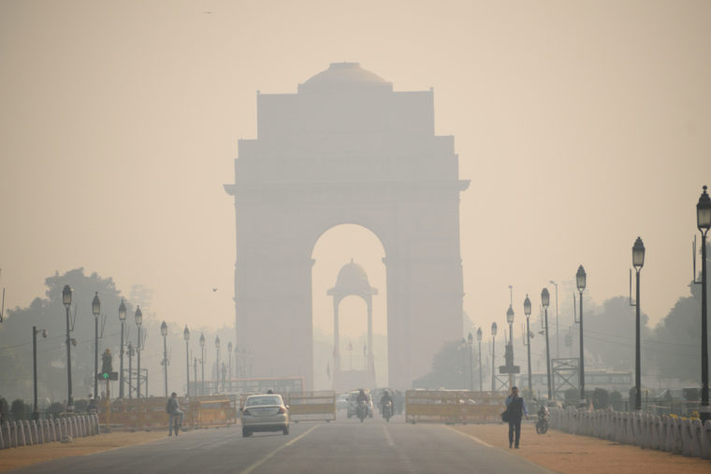

Physical Property: Hygroscopicity
High hygroscopicity (κ_{chem}) and RH → Bigger size → larger light scattering → lower visibility
hygroscopicity ← κ-kӧhler + Mie Theories ← retrieve -- Key parameters (Meteo., PM2.5 and Vis.)
Water uptake ←→ visibility
Water
Visible light scattering
Wang, Y., and Chen, Y.*: Hygroscopicity in Delhi, GRL (2019)
κ_{chem}:
indicator of hygroscopicity of chemical components mixtures

Slide 15
Physical Property: Hygroscopicity
Study in Beijing
Source: Mukherjee and Toohey, 2016
Check retrieve method with Beijing data: good agreement
κ_{chem} bias of 0.01-0.04 (~5-30%), compare with 9-month direct measurements

Slide 16
Physical Property: Hygroscopicity
Wang, Y., and Chen, Y.*: Hygroscopicity in Delhi, GRL (2019)

Slide 17
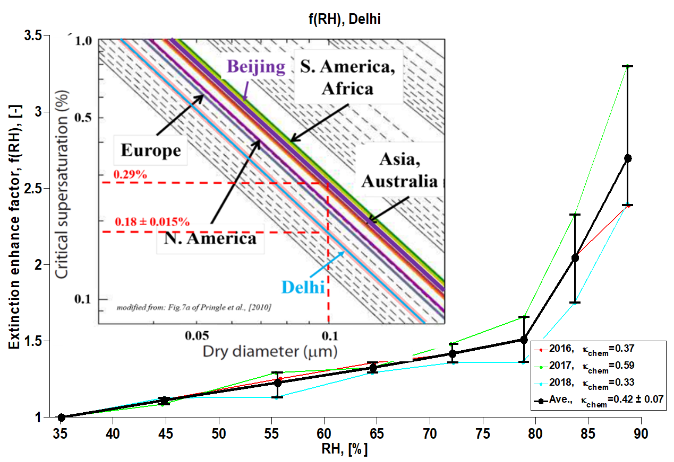
Physical Property: Hygroscopicity
Source: Petters and Kreidenweis, (2007)
Examples of κ_{chem} values:
Dust = 0
Organics = 0.1-0.3
Beijing = 0.20
Delhi = 0.42
Sulfate/Nitrate = 0.67
Sea-salt = 1.2
Wang, Y., and Chen, Y.*: Hygroscopicity in Delhi, GRL (2019)

Slide 18
Summary
Pollution:
Severe PM2.5 in Delhi, with annual ave. ~110 µg/m3, much worse than Beijing
About 70% of citizens’ lifetime expose to an unhealthy PM2.5 condition, cause more than 10k mortality per year
Diwali Fest (fireworks) increase ave. PM2.5 from 180 µg/m3 to 320 µg/m3, leads to extra 22 person/day mortality
Climate:
Higher hygroscopicity in Delhi (κ_{chem}=0.42) than in Beijing and Asian ave. (κ_{chem}=0.2)
Higher light scattering enhancement and cloud activation, leads to more important DRF/IRF on climate
(Chen Y., et al., 10.1016/j.aeaoa.2019.100052, 2020)
(Wang, Y., and Chen, Y, 10.1029/2019GL082339, 2019)

Slide 19
Acknowledgements:
I would like to thanks the contributions from Luke Conibear, Yu Wang, Liang Ran, Jianjun He, Lina Wang, Oliver Wild.
This work is funded by NERC DelhiFlux (NE/P01531X/1) projects. The archived hourly measurements of PM2.5 recorded at the U.S. Embassy in Delhi are available through the AirNow platform maintained by the U.S. Department of State and the U.S. Environmental Protection Agency at https://www.airnow.gov/. The archived meteorology variables recorded are available through the Integrated Surface Database—Surface Data Hourly Global data product maintained by the U.S. National Oceanic and Atmospheric Administration—National Climatic Data Center at https://www.ncdc.noaa.gov/.

Slide 20
References:
Chen Y., et al., Local characteristics of and exposure to fine particulate matter (PM2.5) in four indian megacities, 10.1016/j.aeaoa.2019.100052, 2020.
Chen Y., et al., Influence of cutoff shift on aerosol measurements, https://doi.org/10.1016/j.atmosenv.2018.09.049, Atmospheric Environment, (2018).
Wang, Y., and Chen, Y.*: Significant Climate Impact of Highly Hygroscopic Atmospheric Aerosols in Delhi, India, Geophysical Research Letters, 0, 10.1029/2019GL082339, 2019.
Chowdhury, S. & Dey, S., Environment International 91, 283-290, doi:https://doi.org/10.1016/j.envint.2016.03.004 (2016).
Conibear, L., Butt, E. W., Knote, C., Arnold, S. R. & Spracklen, D. V., Nature Communications 9, 617, doi:10.1038/s41467-018-02986-7 (2018).
CPCB, National Ambient Air Quality Standards, Central Pollution Control Board, New Delhi, India, (2009).
CPCB, National Air Quality Index Report, Central Pollution Control Board, New Delhi, India, (2014).
Mukherjee, A., and Toohey, D. W.:, Earth's Future, 4, 381-395, doi:10.1002/2016EF000367, (2016).
Titos, G., et al., Atmospheric Environment, 141, 494-507, https://doi.org/10.1016/j.atmosenv.2016.07.021, (2016).
Pringle, K. J., et al., Atmos. Chem. Phys., 10, 5241-5255, 10.5194/acp-10-5241-2010, (2010).
Petters, M. D., and Kreidenweis, S. M.:, Atmos. Chem. Phys., 7, 1961-1971, 10.5194/acp-7-1961-2007, (2007).
Sharma, S. K., et al., Bulletin of Environmental Contamination and Toxicology, 100, 695-701, 10.1007/s00128-018-2313-9, (2018).
Huang et al., Nature, 10.1038/nature13774, (2014).

Slide 21

Thank you for your attention !

