Slide 1
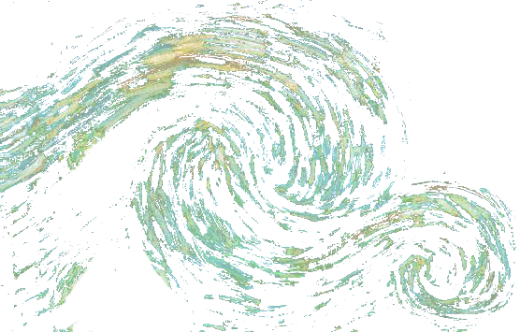
Using Spatial Eddy Covariance to Investigate Energy Balance Closure over a Heterogeneous Ecosystem
Brian J. Butterworth¹, Ankur Desai¹, Sreenath Paleri¹, Stefan Metzger², David Durden², Christopher Florian², Matthias Mauder³, Luise Wanner³, Matthias Sühring⁴, and Ke Xu⁵
[1] University of Wisconsin-Madison, Department of Atmospheric and Oceanic Sciences
[2] National Ecological Observatory Network, Battelle
[3] Karlsruher Institut für Technologie, Institut für Meteorologie und Klimaforschung Atmosphärische Umweltforschung
[4] Institut für Meteorologie und Klimatologie, Hannover, Germany
[5] University of Michigan-Ann Arbor, Climate and Space Sciences and Engineering
© Brian J. Butterworth. All rights reserved

Slide 2
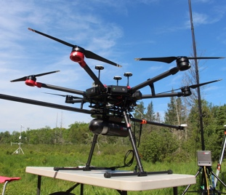
CHEESEHEAD project
Chequamegon Heterogeneous Ecosystem Energy-balance Study Enabled by a High-density Extensive Array of Detectors
Objectives
Determine how spatial heterogeneity of the land surface impacts the Earth’s energy balance
Evaluate the hypothesis that mesoscale features are an important cause of energy budget non-closure
Use observations to improve model representation of sub-grid processes (scaling)
Measurements
Ground-based fluxes and meteorology
Airborne fluxes and meteorology
Atmospheric profiling
Surface environment characterization
© Brian J. Butterworth. All rights reserved

Slide 3
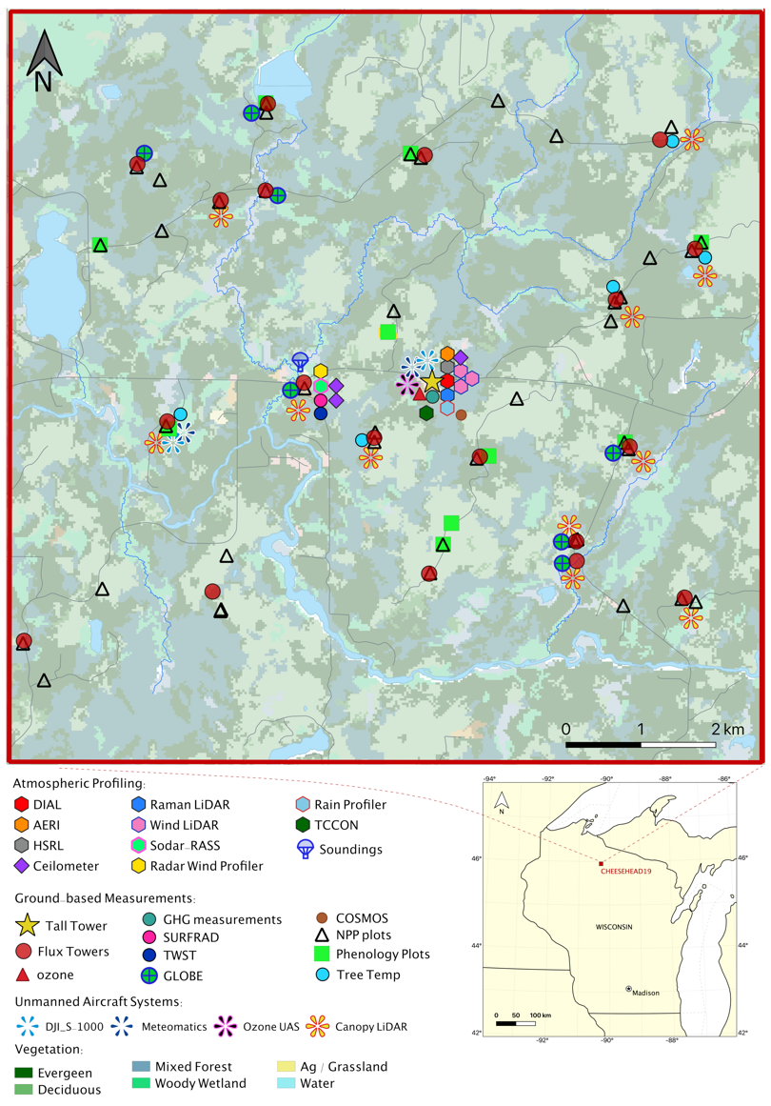
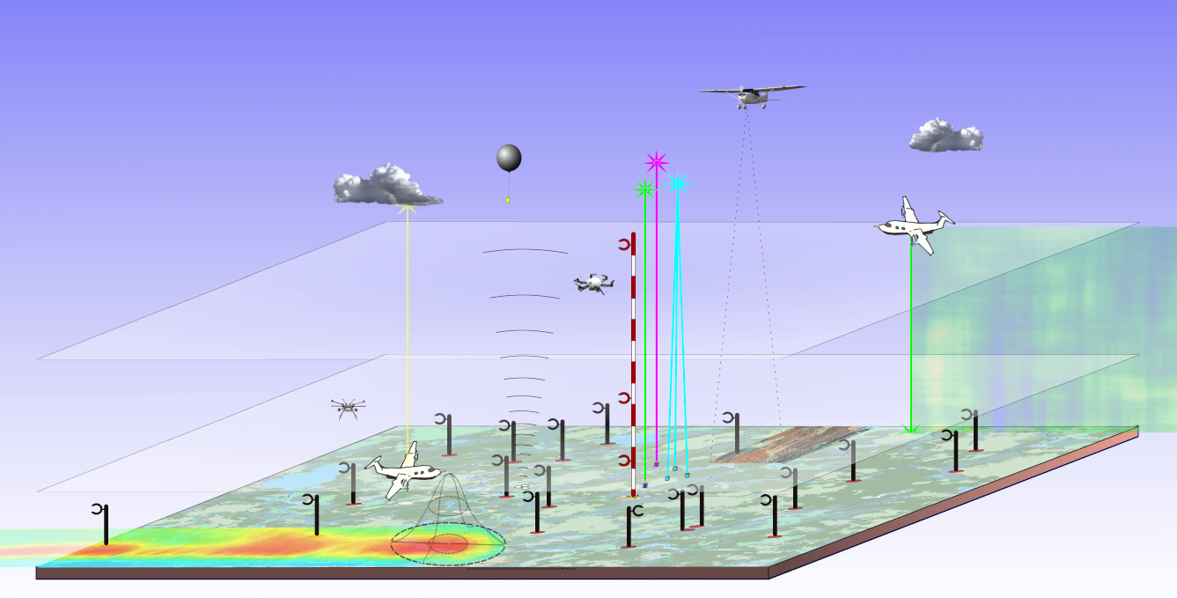
CHEESEHEAD domain
10 km
10×10 km - heterogeneous forest ecosystem in Wisconsin USA
20 eddy covariance towers
1 very tall (447-m) tower - Ameriflux/NOAA (US-PFa/WLEF)
Suite of ground-base remote sensing (lidar, sodar, radar) for measuring profiles of H₂O, T, aerosols
Airborne eddy covariance
10 km
400 m
100 m
© Brian J. Butterworth. All rights reserved

Slide 4
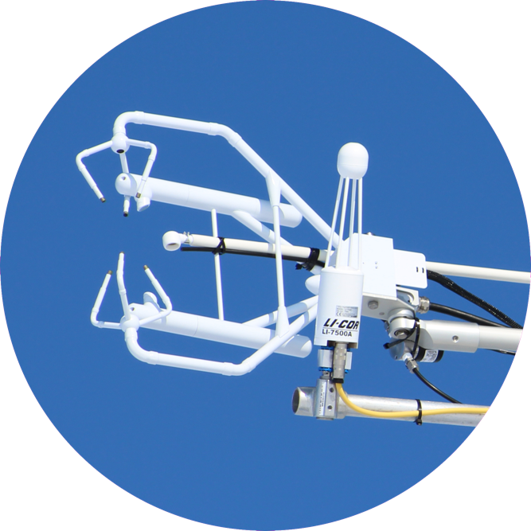
The Problem: Energy Balance Non-closure
Energy balance equation: R_{N} - G = H_{L} + H_{S} + S R_{N} = Net Radiation
S = Storage
G = Ground flux
H_{L} = Latent heat flux
H_{S} = Sensible heat flux
It is typical for traditional EC to measure greater incoming energy (net radiation – ground flux) than outgoing energy (sensible + latent heat flux); even though they are expected to balance.
© Brian J. Butterworth. All rights reserved

Slide 5
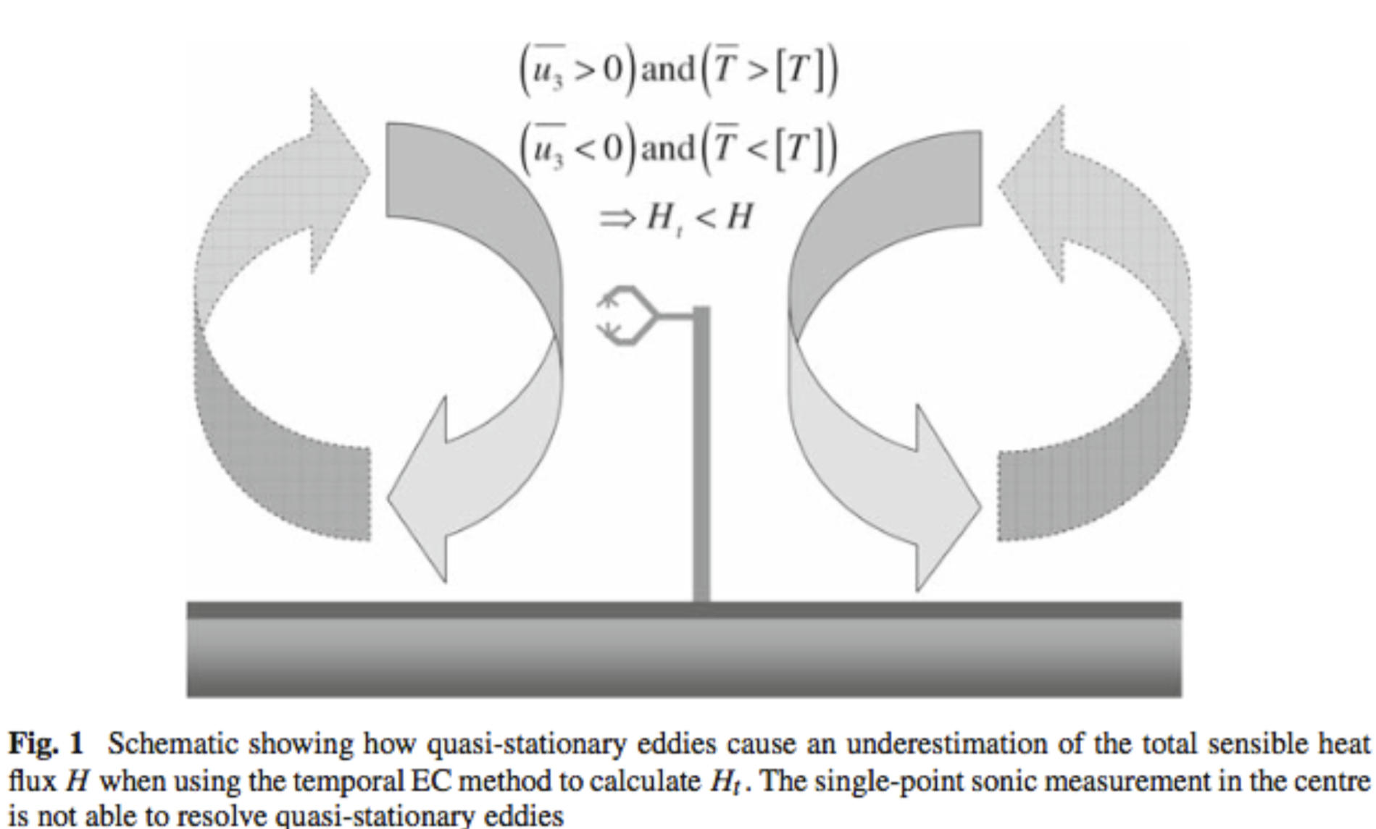
Possible explanation from recent literature:
Landscape variance drives stationary eddies whose influence on the flux are not captured well by traditional EC methods
Figure from Mauder et al. (2008)
© Brian J. Butterworth. All rights reserved

Slide 6
Can spatial EC improve energy balance closure?
Recent LES results (Xu et al. 2020) showed:
Spatial EC captured 89% of prescribed energy fluxes
Spatio-temporal capture 95% of prescribed energy fluxes with even fewer towers (reducing energy balance non-closure)
Our goal: to test these findings with field data
© Brian J. Butterworth. All rights reserved

Slide 7
Temporal Eddy Covariance (EC)
$$Flux=\overline{ρ_{a}} \overline{w^{′}x^{′}}$$
where $\overline{ρ_{a}}$ is the mean dry air density, w’ is fluctuations in the vertical wind, x’ is fluctuations in the flux quantity (e.g., temperature), and overbar denotes a time average
For the temporal (standard) method of calculating EC fluxes, the fluctuation components are calculated for individual sites as:
Fluctuation = Instantaneous Value – Time mean
Example: $w^{′}=w−\overline{w}$
© Brian J. Butterworth. All rights reserved

Slide 8
Spatial Eddy Covariance
For the spatial eddy covariance:
Fluctuation = Instantaneous Value – Spatial mean
(where the spatial mean represents the mean value across many sites)
Example: $w^{′}=w−\left\langle w\right\rangle$
For the spatio-temporal eddy covariance:
Fluctuation = Instantaneous Value – Space-time mean
(where the space-time mean represents the mean value across many sites over a given period of time)
Example: $w^{′}=w−\overline{\left\langle w\right\rangle }$
© Brian J. Butterworth. All rights reserved

Slide 9
For this analysis:
Temporal EC data were calculated for each tower individually and then averaged to get domain-wide fluxes
Spatial and spatio-temporal EC were calculated across all flux towers as if the entire set of towers was one super site. Note, this is different from spatial EC as originally conceived, whereby a flux time series is produced for each tower separately. Here we’ve built on that approach by processing data from all towers as samples in one flux calculation. Assuming the towers sufficiently sample landscape variation, the final flux time series represents the domain-wide flux.
© Brian J. Butterworth. All rights reserved

Slide 10
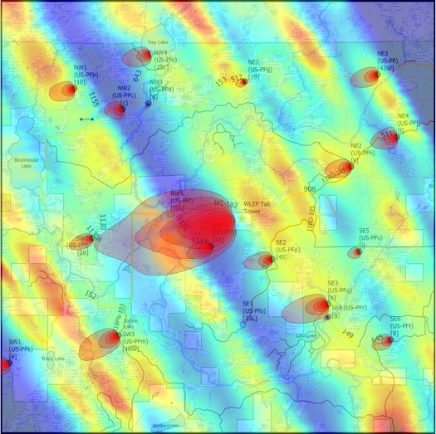
Flux Footprints
10 km
Good coverage over the 10 x 10 km domain
The distribution of towers enables measurements across mesoscale eddies (when they are present)
Using spatial EC across all towers we expect will more effectively incorporate flux contributions from mesoscale eddies
10 km
Figure. Flux footprints from towers and aircraft on Sep 26, 2019. Tower footprints (10:90%) calculated based on Kljun et al. (2015). Aircraft footprints calculated based on Metzger et al. (2013)
© Brian J. Butterworth. All rights reserved

Slide 11
Energy balance varies across time
Largest imbalances occur during daytime
Residual peaks midday at 140 W m²
Magnitude of residual is larger than sensible heat flux
Figure. Mean diurnal cycle of energy balance components calculated using temporal EC method for all towers averaged over the entire study period.
© Brian J. Butterworth. All rights reserved

Slide 12
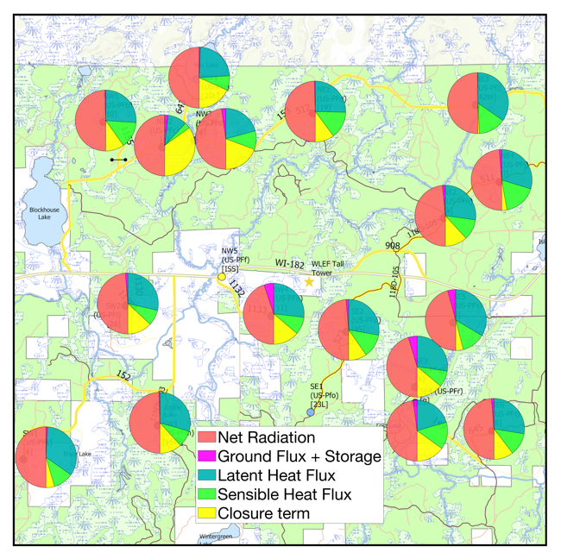
Energy balance varies across space
Energy balance components measured at 17 EC towers on Aug 21, 2019
Large variation in the size of the residual across the sites
Figure. Energy balance components for each site on August 21, 2019, calculated using temporal EC method
© Brian J. Butterworth. All rights reserved

Slide 13
How do different eddy covariance methods impact energy fluxes?
Daytime latent and sensible heat fluxes averaged over the entire study period (June – Oct 2019)
Spatio-temporal EC method showed the largest flux magnitudes
At peak, the combined H_{S}+H_{L} of spatio-temporal EC increased 40 W m² over traditional EC
© Brian J. Butterworth. All rights reserved

Slide 14
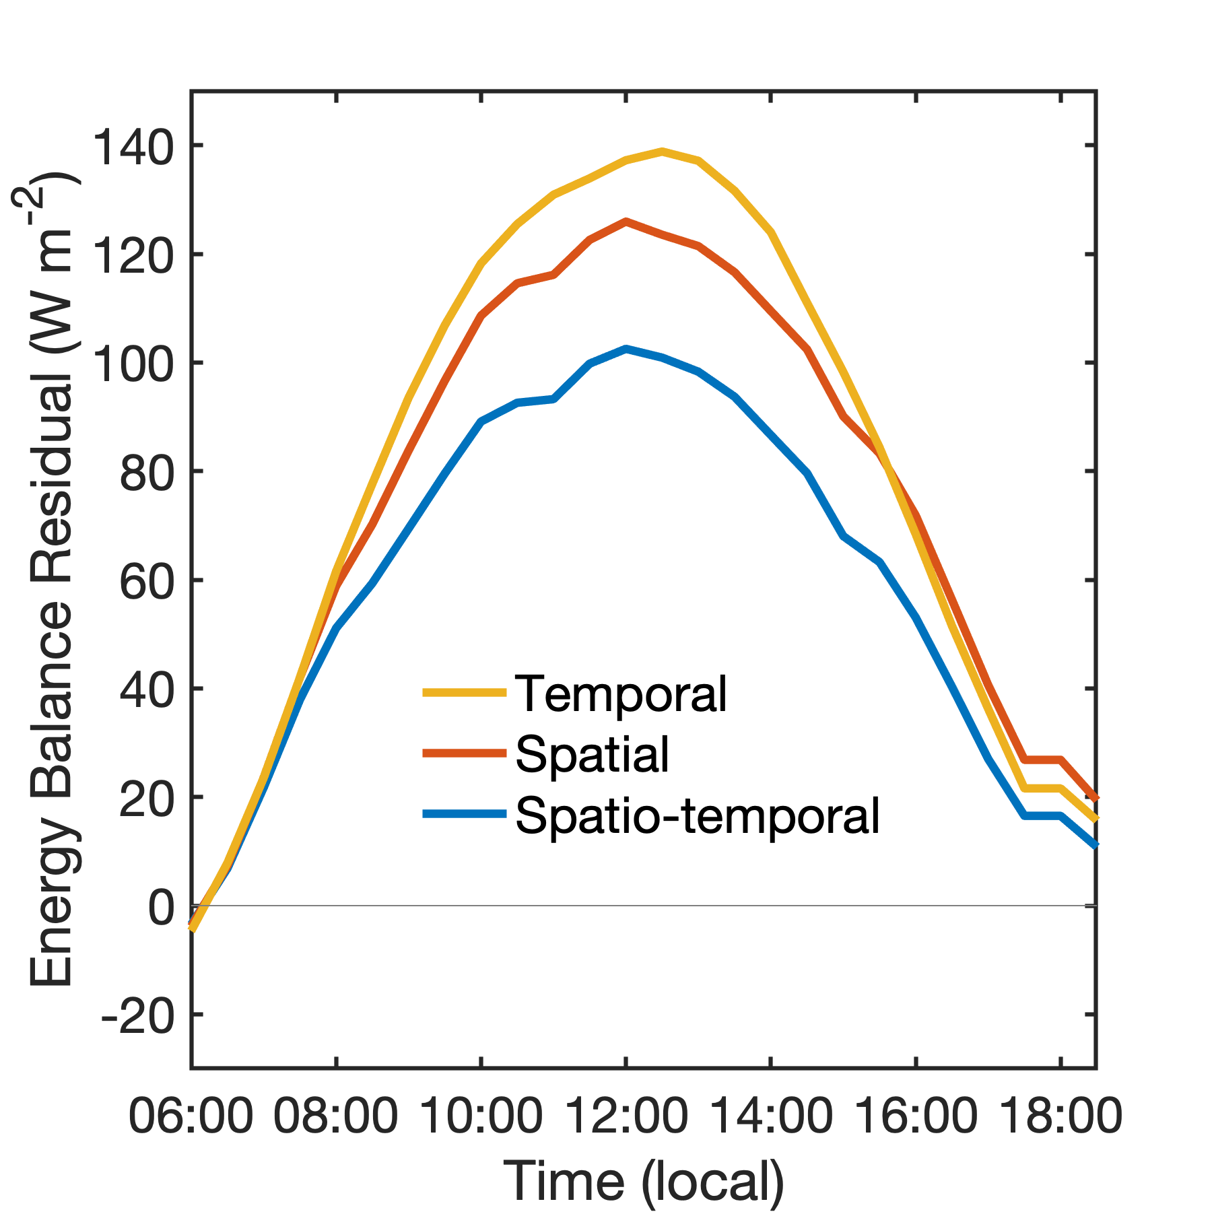
How do these energy fluxes impact energy balance closure?
Spatial EC:
Daytime energy balance residual reduced by 7%
No nighttime reduction in residual
Spatio-temporal EC:
Daytime energy balance residual reduced by 25%
No nighttime reduction in residual
© Brian J. Butterworth. All rights reserved

Slide 15
Conclusions
Both spatial and spatio-temporal EC increased the magnitude of sensible and latent heat flux compared with temporal EC
Spatio-temporal EC improved daytime energy balance closure by 25% - suggests that it may be a useful technique in accounting for some of the missing energy
Confirmed the LES findings of Xu et al. (2020) that spatio-temporal EC showed improved closure over the other EC methods; however we did not find the same degree of closure
© Brian J. Butterworth. All rights reserved

Slide 16
Future Work
Investigate flux cospectra to determine how spatio-temporal EC is contributing to the overall flux
Use ground-based and aircraft lidar data to identify mesoscale eddies and determine their influence on energy fluxes across the domain
Investigate spatial patterns in fluxes for relationships with surface characteristics (surface temperature, vegetation types, etc).
© Brian J. Butterworth. All rights reserved

Slide 17
Acknowledgements
Thank you to the collaborating organizations that have made this project happen, including ECB, NCAR EOL, NEON, U Wyoming, SSEC, KIT, NOAA ATDD, NOAA ESRL, UW AOS, UW FWE, UW Milwaukee, Montana State University, Jackson State University, and Butternut Ridge Schools
Get the Data:
Funding provided by the National Science Foundation (Award #1822420)

Slide 18
References
Kljun, N., P. Calanca, M. W. Rotach, and H. P. Schmid, 2015: A simple two-dimensional parameterisation for Flux Footprint Prediction (FFP). Geosci. Model Dev., 8, 3695–3713, https://doi.org/10.5194/gmd-8-3695-2015.
Mauder, M., R. L. Desjardins, E. Pattey, Z. Gao, and R. van Haarlem, 2008: Measurement of the Sensible Eddy Heat Flux Based on Spatial Averaging of Continuous Ground-Based Observations. Boundary-Layer Meteorol., 128, 151–172, https://doi.org/10.1007/s10546-008-9279-9.
Metzger, S., and Coauthors, 2013: Spatially explicit regionalization of airborne flux measurements using environmental response functions. Biogeosciences, 10, 2193–2217, https://doi.org/10.5194/bg-10-2193-2013.
Xu, K., Sühring, M., Metzger, S., Durden,D., Desai, A.R., 2020: Can data mining help eddy-covariance see the landscape? A large-eddy simulation study, Boundary-Layer Meteorology, https://doi.org/10.1007/s10546-020-00513-0, in press.

