Slide 1
From tree to stand: Scaling relationships of water uptake and climate in a reclaimed boreal mixedwood stand
Morgane Merlin¹, Sean K. Carey² & Simon M. Landhäusser¹
¹ Department of Renewable Resources, University of Alberta, Canada
² Faculty of Science, School of Geography & Earth Sciences, McMaster University, Canada
NOTE: there are animations and notes in this document. Please use them and follow along!

Slide 2
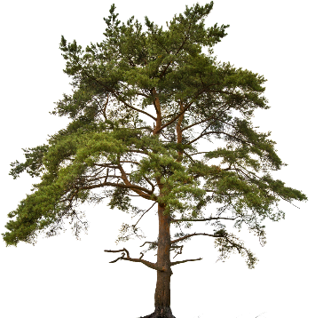
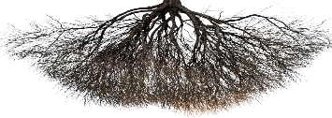
Water transport in trees
→ At the individual tree level, water uptake depends on the combination of the following factors:
Weather
Species
Topography
Rooting space
Physical & chemical barriers
Soil water availability
Notes:
Tree water uptake are is tightly linked to the trees’ species, leaf area development (<animation>) and environmental conditions.
<animation>
Water uptake can only be supported if the water resources are available in the soil, and as such the rooting space, defined as the volume of soil accessible to roots) is crucial in determining water uptake. Both physical and chemical barriers can restrict root expansion, and together with soil composition, texture and water holding properties, they will define the soil water availability for root uptake.
<animation>
Atmospheric conditions are one of the main drivers of transpiration at the leaf level, through opening and closure of the stomates.
<animation>
At a larger spatial scale, position on the landscape, and more specifically topography will affect the availability of water to the trees, as upper slope position may have restricted water availability due to increased exposure to climate and while lower slope position may have higher soil water availability for trees’ uptake due to water pooling following rainfalls, run off and flow.

Slide 3
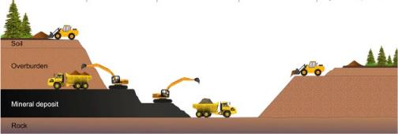
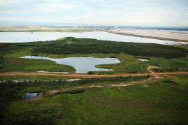
Disentangling the effects of climate, topography, rooting space & species
Water uptake = Species × Leaf area × Rooting space × Weather × Topography
Mixedwood Stand Restoration after Mining
Favas et al., 2018
Syncrude Canada
Notes:
Thus when trying to defined and understand tree water uptake, we have to consider that it is the result of a complex interaction between all those parameters: species, leaf area development, rooting space, weather and topography.
Trying to address the effects of each of those variables in natural forest stands is challenging, as legacies related to soil development and stand history may further complicate the interpretation of the responses seen in trees.
<animation>
We have here, in Alberta, the unique opportunity to be able to isolate these variables when using reclamation sites after open-pit mining. Reclamation and forest restoration of these sites requires the re-construction of a landform (topography) and a complete soil profiles (rooting space) with few legacy effects, before planting different tree species. These sites provide a unique opportunity to attempt to disentangle the effects of available rooting space, topography and climate on the water uptake of different tree species.

Slide 4
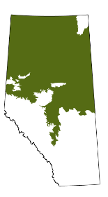
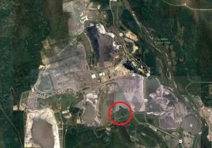
Site and instrumentation
N
Effective rooting depth
35 cm cap
100 cm cap
350
Upper slope
20 cm
15 cm
Map of the boreal region of Alberta, from Alberta Parks, 2015
20 cm
340
0
150
300 km
80 cm
Syncrude Basemine Pit
Down slope
330
10 m contour
Peat and mineral soil mix
Swale
Mineral soil
15 years-old site
Eddy covariance tower
Overburden
Soil moisture station
Notes:
Our research site was a reclaimed hillslope near Fort McMurray, established in 1999, so a 15 years old site at the time of the study. The landscape feature was constructed using saline sodic overburden material considered unsuitable for root and plant growth. Soil was reconstructed with salvaged materials to two capping thicknesses:
a 100 cm cap, with 20 cm peat mineral mix over 80 subsoil
a 35 cm cap with 15 cm peat mineral soil mix over 20 cm of subsoil
<animation>
Since the underlying overburden material is unsuitable for root development we considered the depth of each soil cap (35 and 100 cm) the effective rooting depth, thus illustrating a physical restriction of rooting space for the 35 cm cap.
<animation>
Topographically we can define an upper slope, and a lower down slope position in this landscape across both capping treatments. Soil water content was continuously measured at 5 cm depth in the middle of the slope.
<animation>
On the site, we have a soil moisture station and an eddy covariance tower providing us with half-hourly weather measurements

Slide 5
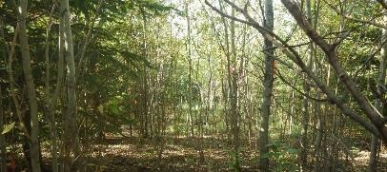
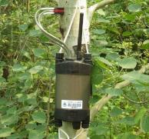
Site and instrumentation
N
100 cm cap
35 cm cap
350
Plots:
2014
Map of the boreal region of Alberta, from Alberta Parks, 2015
340
2014/2015
White spruce / sap flow sensor spruce
0
150
300 km
2015
Trembling aspen / sap flow sensor aspen
Syncrude Basemine Pit
330
Different rooting strategies & leaf physiology
Notes:
Both capping treatments were planted with a 50/50 mixture of trembling aspen and white spruce in 2004. We established plots in 2014 and 2015 across capping treatments and slope position.
<animation>
In each plot, three aspen trees and three spruce trees were equipped with a sap flow sensor each to monitor their water uptake throughout the growing season in these two years.
<animation>
Those two species have different rooting strategies and leaf physiologies and thus we expect their response to the combination of daily weather conditions will differ across the different capping treatments (representing available rooting space) and across the site topography.

Slide 6
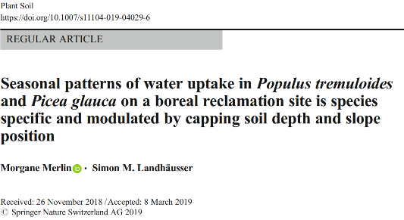
Seasonal patterns of water uptake of individual trees on the site
Q^{c}
Reduction in rooting space
Trembling aspen
Q^{c}
Represents ~10 – 20% of the total water uptake Q_{c} for white spruce
Topography
White spruce
How do the environmental controls of sap velocity express themselves across the landscape?
Notes:
A first initial study on this site looked at overall patterns of daily and cumulative water uptake in relation with tree size and leaf area.
<animation>
This study showed that aspen was mostly responding to a reduction in capping depth and rooting space, as it limits the vertical expansion of aspen roots. The potential for aspen to develop lateral roots spanning dozens of meters could have contributed to mitigating the effects of topography on aspen trees’ water uptake. aspen showed a very limited response to the rewetting event in 2015.
<animation>
Spruce however, mostly responded to topography, and little to the capping depth, as it bears a much shallower root system than aspen. Increased soil water stress on the upper slope position thus contributed to lower water uptake and size of spruce trees growing upslope.
<animation>
In 2015, the occurrence of a large precipitation event during the otherwise dry season represented between 10 and 20% of the total water uptake of spruce, whereas it represented less than 5% of aspen’s total summer water uptake.
<animation>
From this study, we wanted to expand and look more specifically how the weather controls of water uptake were expressed on both species across the landscape (across topographical position and capping treatments) in 2014 and 2015.

Slide 7
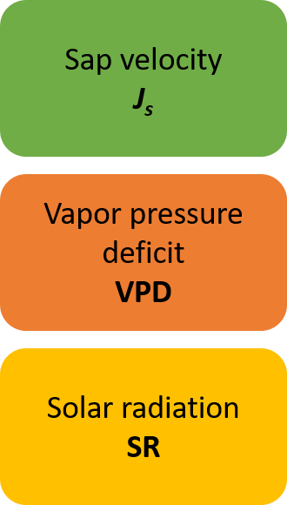
Time lags between sap velocity & weather variables
2014 ~ P. glauca ~ 35 cm ~ lower slope
Half-hourly timescale
The daily (24 hr cycle) component is extracted from each J_{s} time series (each tree) and each weather variables using STL decomposition: Seasonal and Trend decomposition using Loess
Notes:
In a first step, we used the half-hourly data available to investigate the time lag observed on site between the sap velocity and the weather variables vapor pressure deficit and solar radiation.
<animation>
To do so, we extracted the daily component, i.e. 24 hour cycle, from the sap velocity time series of each tree using seasonal and trend decomposition using loess. This enabled us to focus on the cycle, without interferences from random variations in absolute sap velocity between trees and overall seasonal trend in sap velocity.
<animation>
Here is an example for spruce growing on the lower slope of the 35 cm cap in 2014. We have the raw data, sap velocity Js at the top, and the STL decomposition below, separated into a remainder, seasonal (i.e. daily cycle) and trend components.
<animation>
For our analysis we focus on the seasonal component. We did a similar decomposition for the weather variables VPD and SR and extracted the daily cycle.

Slide 8
Time lags between sap velocity & weather variables
The time lag at which the cross-correlation between the seasonal components of J_{s} and weather time series is maximal is recorded for each tree
The daily (24 hr. cycle) component from each J_{s} time series (each tree) and each weather variables
No differences among slopes, capping depths or species in the time lag between J_{s} and SR & VPD.
Notes:
We then computed the cross-correlation between the daily sap velocity cycle (at 30 minutes timesteps) and the daily VPD and SR cycles for each tree. We recorded the lag at which the cross-correlation was maximum, and assessed how capping treatment, slope position and species affected this time lag.
<animation>
Overall, there were no differences among slopes, capping depths or species in the time lag between the daily cycle of sap velocity and VPD & SR. The figure here represents the average daily dynamic of sap velocity for both species (dark green for white spruce, light green for aspen), solar radiation (solid line) and VPD (dotted line) across the landscape. On average, peak sap velocity occurred about an hour after peak solar radiation, and an hour before peak VPD.

Slide 9
Daily correlation between sap velocity & environmental variables
Daily timescale
Soil water content (at 5 cm depth)
SWC
Sap velocity
J_{s}
Vapor pressure deficit
VPD
Solar radiation
SR
Precipitation
P
Notes:
At the daily timescale, we have daily sap velocity integrals for each species, slope position and capping treatment for 2014 and 2015.
<animation>
In terms of environmental variables, we have four of them
<animation>
Vapor pressure deficit
<animation>
Solar radiation
<animation>
Soil water content at 5 cm and daily precipitation

Slide 10
Daily correlation between sap velocity & environmental variables
Daily timescale
Soil water content (at 5 cm depth)
SWC
Sap velocity
J_{s}
Vapor pressure deficit
VPD
Solar radiation
SR
Precipitation
P
Rolling correlation: using a 15-days window, we calculated the Pearson’s correlation to assess whether there was a temporal dynamic to the correlation between daily J_{s} and the environmental variables
To avoid spurious correlation, we differenced the individual J_{s} and environmental time series
$$J_{s,}^{diff}=J_{s; t} −J_{s; t−1}$$
Notes:
To link the sap velocity integrals to the daily environmental variables, we looked at their correlation. In order to avoid spurious correlation, due to the existence of a common trend linked to a potential third factor not explicit in the study, we differenced the sap velocity and environmental time series. Differencing stabilizes the mean of a time series, by computing the differences between consecutive observations.
<animation>
We then applied a rolling correlation. Instead of computing a single correlation value for the entire time series, we used a 15-days window to calculate the Pearson’s correlation. This way, we obtain a time series of Pearson’s correlation of sap velocity with each environmental variable for each tree. We can then assess whether there is a temporal dynamic to the strength of the correlation between sap velocity and environmental variables.

Slide 11
Daily correlation between sap velocity & environmental variables
Rolling correlation: ~ temporal dynamic to the correlation between daily J_{s} and the environmental variables
→ Dynamic temporal development of the correlation between daily J_{s} and VPD on the 35 cm cap for both species.
Notes:
Having a first look, here for both white spruce and trembling aspen on the 35 cm cap in 2014 and 2015.
<animation>
We observe that the correlation between daily sap velocity and daily VPD is highly dynamic during the summer, ranging from nearly zero to more than 0.8 for spruce, and between 0.4 and 0.8 for aspen.
Overall we see periods of decrease of the correlation between sap velocity and VPD, quite steady decline in 2014 for both species till mid August. In 2015, we observe more variability in the dynamics of the rolling correlation.
<animation>

Slide 12
Daily correlation between sap velocity & environmental variables
Rolling correlation: ~ temporal dynamic to the correlation between daily J_{s} and the environmental variables
→ Dynamic temporal development of the correlation between daily J_{s} and VPD on the 35 cm cap for both species.
Significant difference between slope positions
→ Trees at the lower slope position maintained a higher correlation with VPD than trees at the upper slope.
Notes:
In shaded grey areas, we highlight the periods during which the upper and lower slope position are significantly different from each other.
<animation>
Overall, as the summer progresses and get drier, the correlation between sap velocity and VPD decreases faster at the upper slope position than at the lower slope position. This difference is present in both species, but more pronounced for white spruce.
We also looked at the differences between the two capping treatments, but they are not presented in this document.
We did this for VPD as presented here, but also for solar radiation SR and soil water content SWC.

Slide 13
Daily correlation between sap velocity & environmental variables
Assess the temporal dynamics of the 15-days rolling correlation of each environmental variable against each other
Dynamic switches in the importance of the correlations between daily J_{s} and the different weather variables, mostly visible over the course of the 2015 summer.
Notes:
Interesting patterns emerged when looking simultaneously at the dynamics of the rolling correlations for VPD, SR and SWC for each species. So we looked at each of the rolling correlation dynamics, across all trees in the study, for VPD against SWC and SR, and for SR against SWC.
Doing so allowed us to observe whether there were switches, i.e. when the correlation with one environmental variable decreased, did the correlation with another variable increased ? This would give us a starting point in understanding how dynamic and interrelated the environmental controls of sap velocity are on the site in 2014 and 2015.
<animation>
Here we present in this figure the results for white spruce. We plotted the average rolling correlation between sap velocity and solar radiation SR (red) against soil water content SWC (green, panel 1), against VPD (orange, panel 2) and VPD against SWC (panel 3) for both 2014 (top row) and 2015 (bottom row).
<animation>
We see some interesting patterns as mentioned before: at different instances during the summer, we see increases in the correlation with VPD accompanied by a decrease in the correlation with SR, or more obviously, with SWC especially in 2015. More to investigate in this topic in the future.

Slide 14
Daily correlation between sap velocity & environmental variables
Assess the temporal dynamics of the 15-days rolling correlation of each environmental variable against each other
→ Information about the dynamic environmental controls on daily sap velocity across years and species
Notes:
For aspen, it may not be as pronounced as for spruce. However we have similar dynamics between VPD and SR, both increase at the same time, whereas we have an opposite dynamic between VPD and SWC, when correlation with VPD increases, correlation with SWC decreases.
<animation>
There is more to explore on this topic, as these are somehow preliminary analysis, but they already inform us about the dynamic nature of the environmental controls of daily sap velocity for aspen and spruce across the landscape and in two distinct years.

Slide 15
Scaling up to daily stand sap flow
Obtain estimates of tree water uptake across all trees planted on the landscape for 2014 and 2015
100 cm cap
35 cm cap
100 cm cap
35 cm cap
N
350
350
340
340
330
330
Notes:
Using the measures of daily sap velocity on a sample of trees across the landscape, we can try to scale these measurements up to the entire stand and estimate the daily and cumulative water uptake of all planted trees on the landscape for 2014 and 2015.

Slide 16
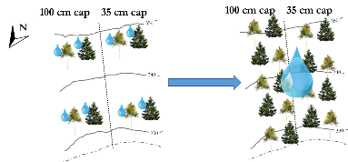
Scaling up to daily stand sap flow
Normalize daily Js for all trees (i) → $J_{s, norm}^{i}$
Obtain a mean normalized daily sap velocity per combination (j) of species x capping depth x slope position x year
$$J_{s, norm, j}^{M}=mean(J_{s, norm}^{i})$$
Model non-linear relationships between sap velocity and weather variables for each j
$$J_{s, norm, j}^{M}=f_{j}(VPD, SWC, SR, P)$$
Neural network algorithm
Convert into daily sap flow Q_{d} for all trees sampled on site (k) using an estimate of their sapwood area in 2014 & 2015
$$Q_{d}^{k}=J_{s, j}^{M}×{SA}_{est}^{k}$$
Convert back to absolute sap velocity values using the mean maximum sap velocity for each combination j
$$J_{s, j}^{M}=J_{s, norm, j}^{M}×J_{s, j}^{max, M}$$
Forecast the normalized daily sap velocity for the missing treatments (i.e. upper slope 100 cm in 2014 and lower slope in 2015)
Notes:
To do so requires the obtention of a method to extrapolate measurements of daily sap velocity on our sampled trees, to the entire cohort of trees present on the site. The workflow is the following:
First we normalize the daily sap velocity for each tree to remove the influence of absolute values of daily sap velocity resulting from non-measured differences between individual trees.
Second, we average those normalized daily sap velocity per Species x Capping treatment x Slope position x Year combination (combination j). In this study, this means averaging 9 daily normalized daily sap velocity time series into one. At the end of this process, we have 3 mean normalized daily sap velocity time series per year per species
<animation>
Third, we model each mean normalized daily sap velocity as a non-linear relationship with the four environmental variables VPD, SR, SWC and daily precipitation P. Neural network algorithms were used here as they provided higher accuracy than arima models. These models allow complex non-linear relationship between the response variable and its predictors.
<animation>
Using these models we can fill in the treatment gaps we had (i.e. the lower slope position of the 100 cm in 2015 and the upper slope of the 100 cm cap in 2014) by forecasting daily normalized sap velocity values using the models for these positions, and the environmental data for the year selected.
Then we convert the modeled daily normalized sap velocity back into absolute daily sap velocity values by multiplying by the average maximum daily sap velocity for each combination j
<animation>
To obtain sap flow, a volumetric measurement, we multiply the velocity measurement by the sapwood area for each tree on site. Using allometric equations deriving sapwood area from measured diameter at breast height, we calculated daily sap flow for each tree on site (each tree measured by measurement campaigns by the company operating the site)

Slide 17
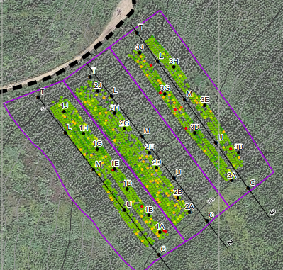
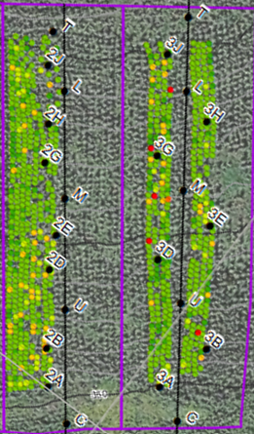
Scaling up to daily stand sap flow
Eddy covariance tower
Notes:
On the landscape, we focus on the 100 cm (on the left) and 35 cm caps (on the right)
<animation>

Slide 18
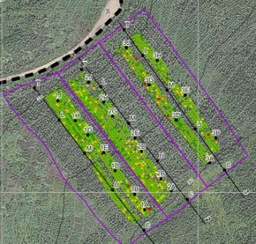
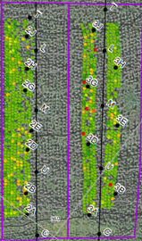
Scaling up to daily stand sap flow
Cumulative Q
P. glauca
P. tremuloides
→ Large contribution of white spruce to total water uptake across all planted trees across the site (both capping treatments and slope positions)
Notes:
Across a surface of totaling approximately 0.6 ha, where all planted aspen and spruce trees were measured and thus used to calculate stand daily sap flow. Stacking the daily cumulative sap flow, we can observe the partitioning between aspen and spruce on the landscape, as well as the cumulative tree water uptake in black.
<animation>
Overall, white spruce represented the bulk of the total stand sap flow, especially on the 35 cm and early in the season. We can also note that aspen’s water uptake almost doubled at the stand level when comparing the 100 cm to the 35 cm capping treatments, regardless of slope position.

Slide 19
Scaling up to daily stand sap flow
Eddy covariance tower
First look at the comparison between sap flow estimate of the stand evapotranspiration (upper slope) and the eddy covariance measurements.
Notes:
We can compare those stand level sap fluxes to the measured evapotranspiration from the eddy covariance measurements.
<animation>
This is a very first coarse look at the comparison between the daily evapotranspiration estimate obtained from the sap flow data (averaging the upper slope positions across the two capping treatments) and the estimate from the eddy covariance measurements.
More on this comparison will come as the analysis progresses.

Slide 20
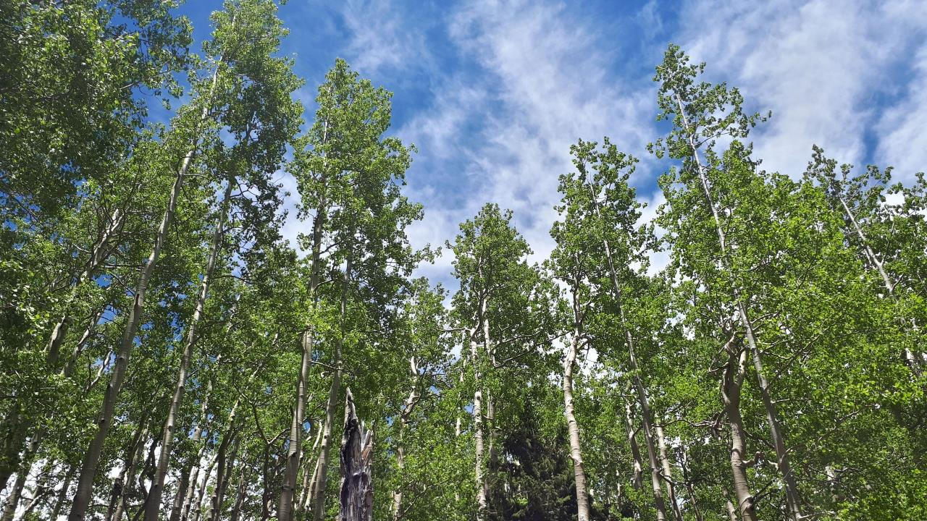
Time lag between sap velocity and VPD is quite consistent across species, capping treatments and slope position at the site
Dynamic development of the environmental controls of daily sap velocity in the rolling correlation analysis, with differences between slope positions, capping treatments and species.
At the stand level in 2014 and 2015 white spruce represented the bulk of the water uptake on site, especially early in the season.
Continue exploring the data at ½ h timescale, investigate further the results emerging from the rolling correlation analysis and link with eddy covariance measurements
Notes:
So overall, here is a summary of what we have observed in this study and (<animation>) the future directions we are taking with the available data. These are somewhat preliminary analyses and results; we welcome any input or advice.

Slide 21
We welcome any comments, advice or recommendations !

