Slide 1
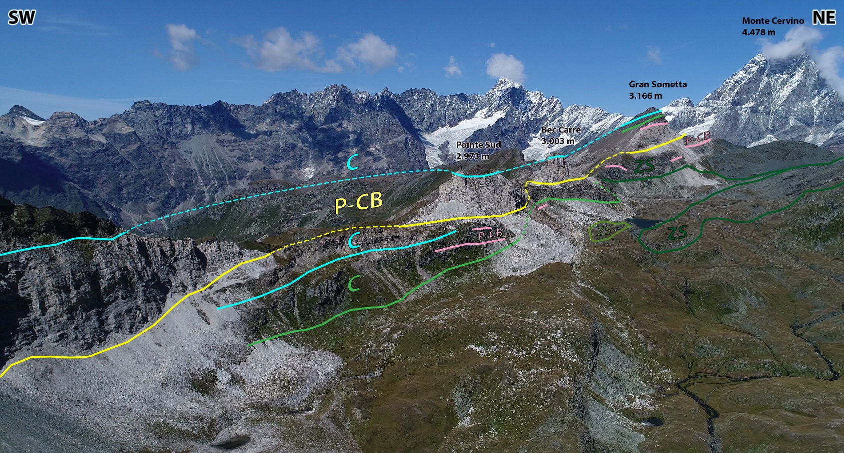
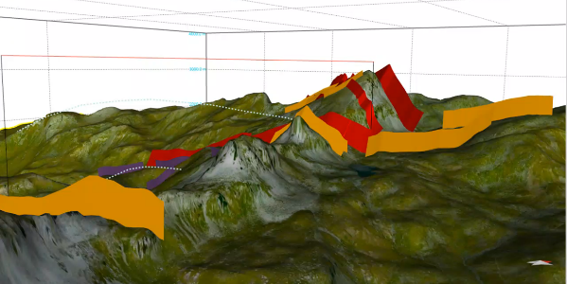
Structural and geological mapping of the
Gran Sometta -Tournalin ridge (Aosta Valley, Italy)
Matteo Pozzi
Gloria Arienti
Anna Losa
Andrea Bistacchi Università degli Studi di Milano - Bicocca

Slide 2
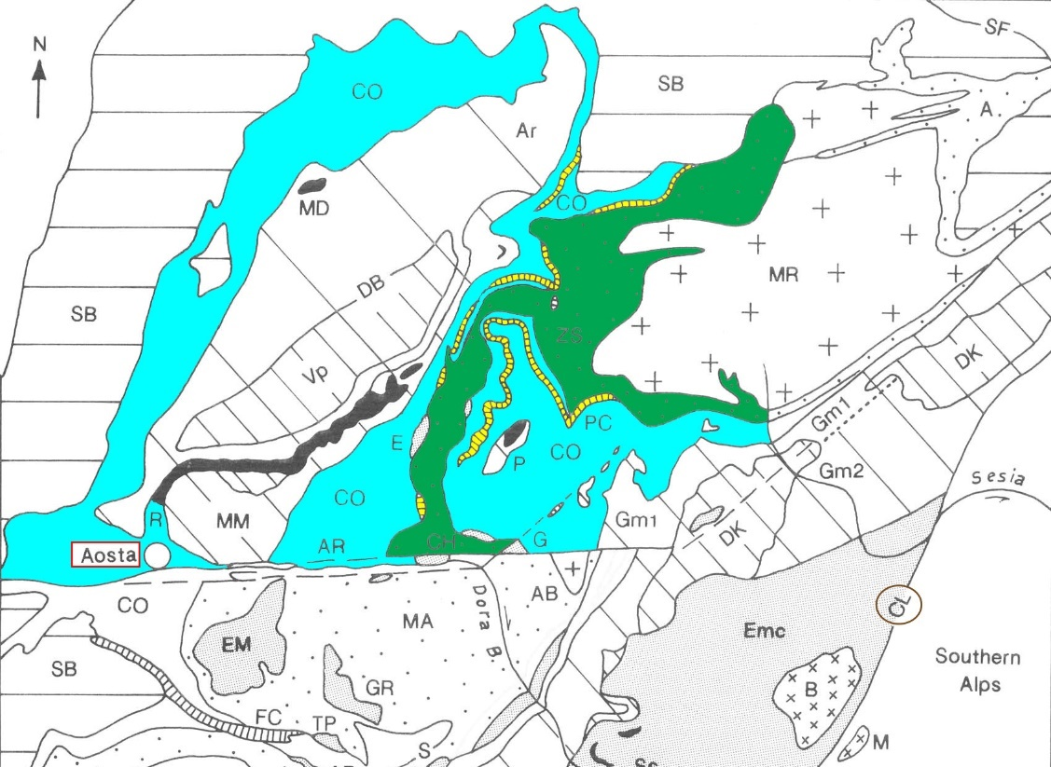
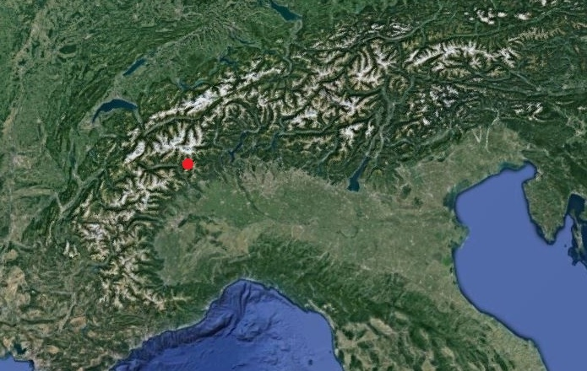
zs
Tectonic units of the Piedmont ophiolitic zone:
Combin Zone (CO) 0.5-0.7 Gpa e 350-400°C -> blueschists/greenschists metamorphism
Pancherot-Cime Bianche-Bettaforca Unit (PC) -> blueschists/greenschists metamorphism
Zermatt-Saas Zone (ZS) 2.7-2.9 Gpa, 600-700°C (Cignana metasediments) 2.0±0.3 Gpa, 550±50°C (Southward zone) -> eclogitic metamorphism
Polyphasic tectono-metamorphic greenschists overprint related to later continental collision
Major tectonic transport towards NNW
(Dal Piaz, 2010, JVE)

Slide 3
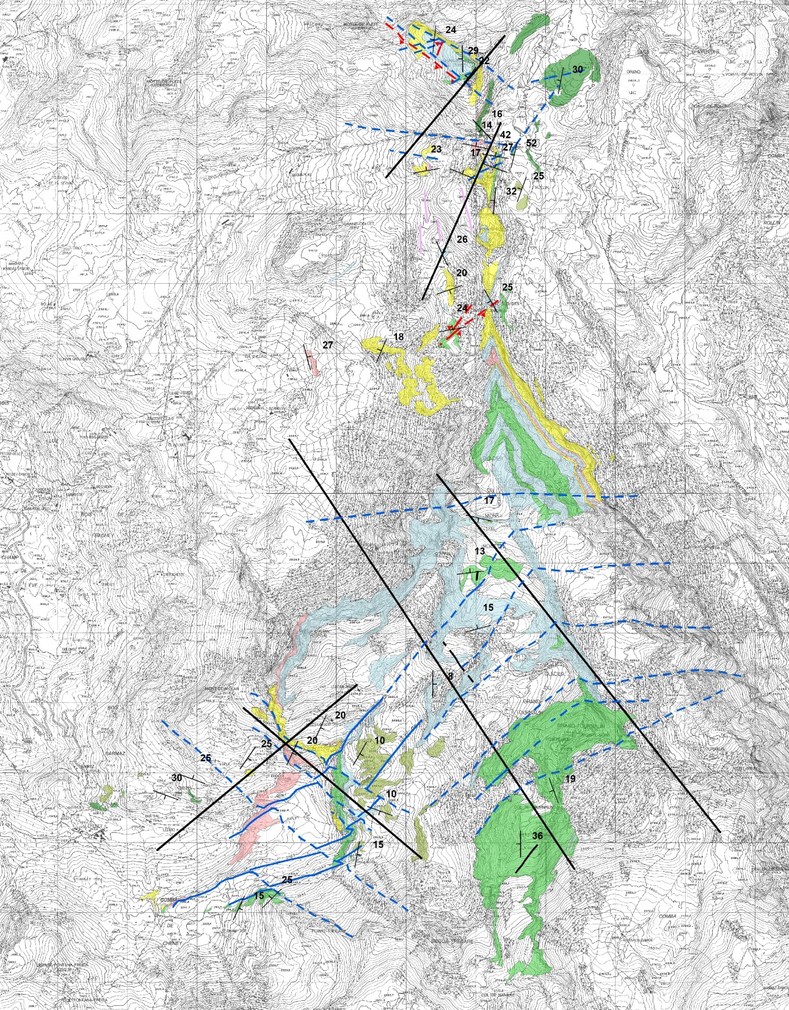
Goal of the project: to increase the detail on brittle structures, starting from the updated 1:10.000 national geological map (CARG project)
A
N
Combin Zone
Calcschists
Metabasalts
Antigoritic Serpentinites
Pancherot-Cime Bianche-Bettaforca Unit
B
Marbles and dolomitic Marbles
White quartzites
Zermatt-Saas Unit
Amphibolites
Serpentinites
Gravitational slope deformation
Reverse Fault (certain)
C
Reverse Fault (inferred)
Normal Fault (certain)
Normal Fault (inferred)
Sinistral Strike Slip Fault (certain)
Sinistral Strike Slip Fault (inferred)
1 km

Slide 4
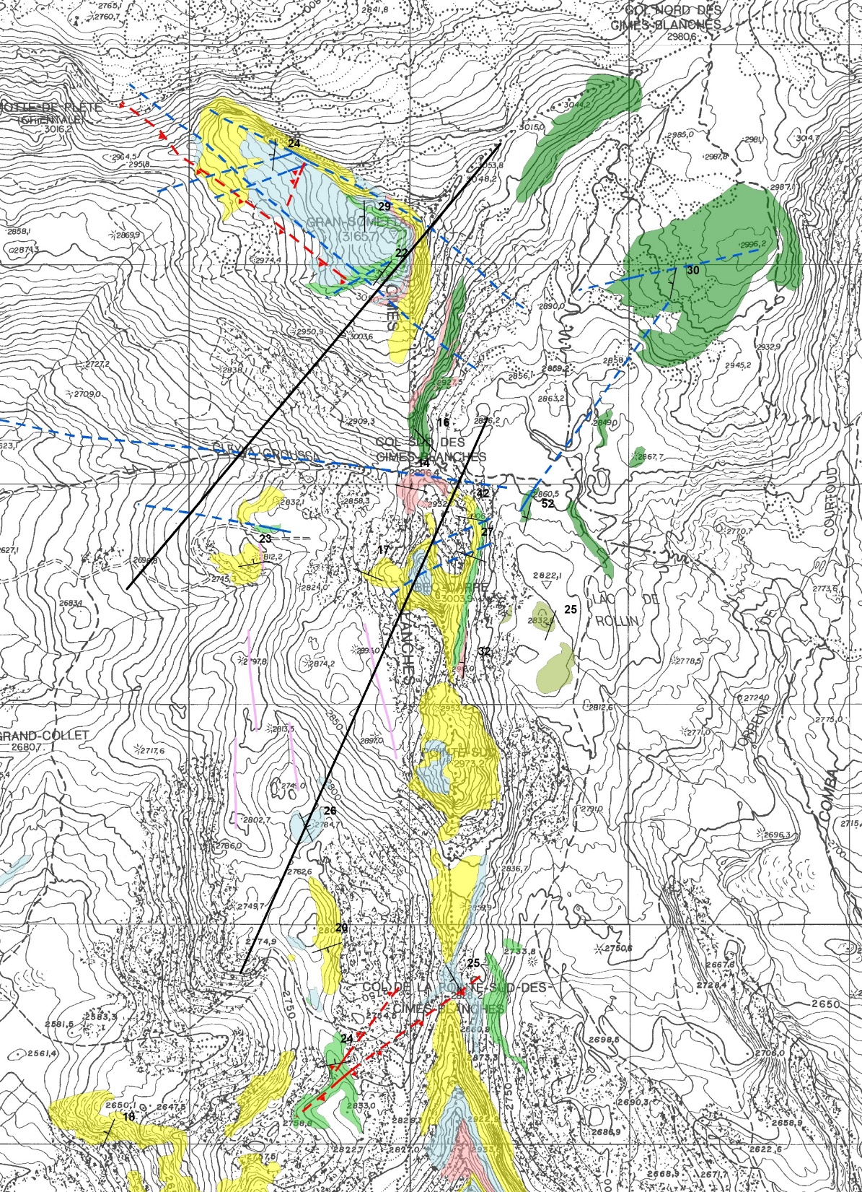
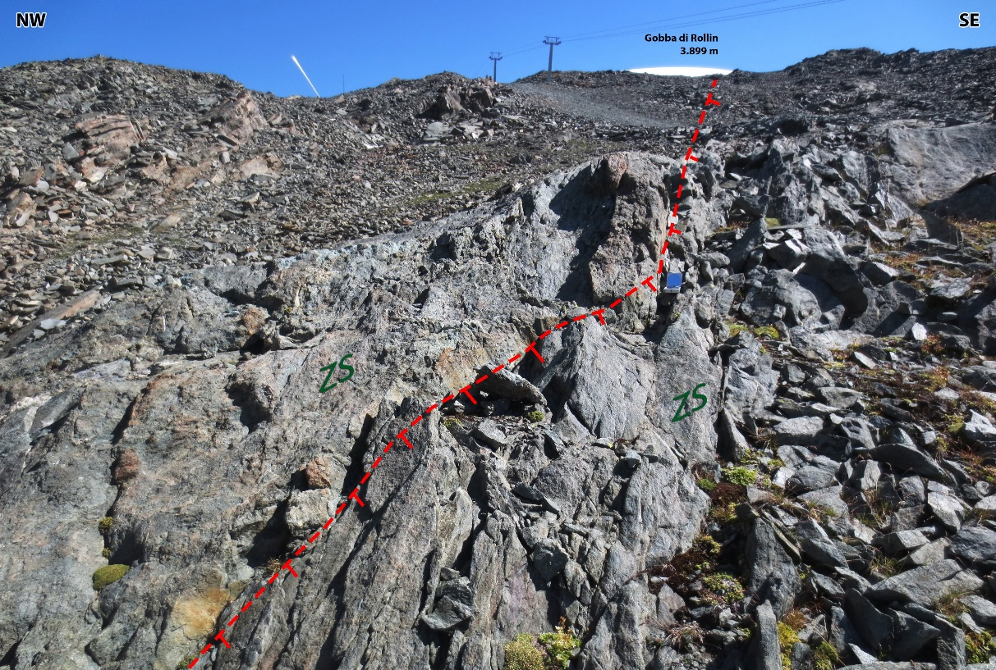
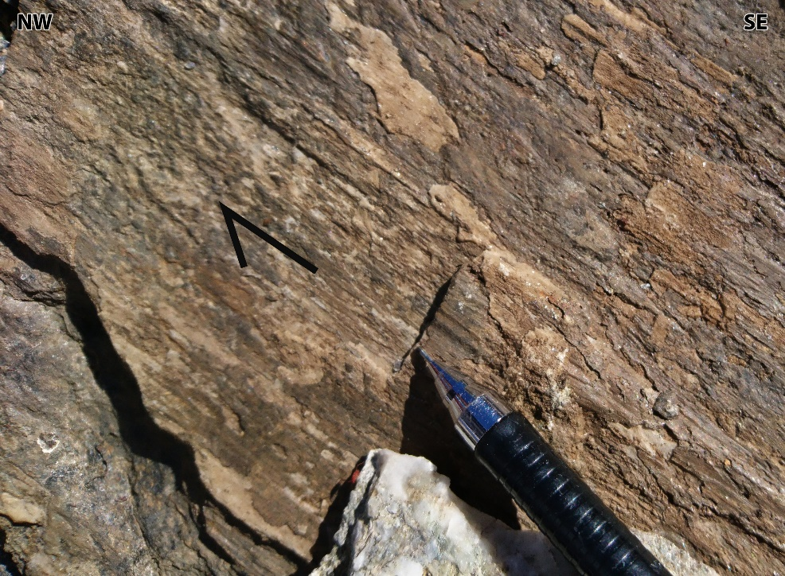
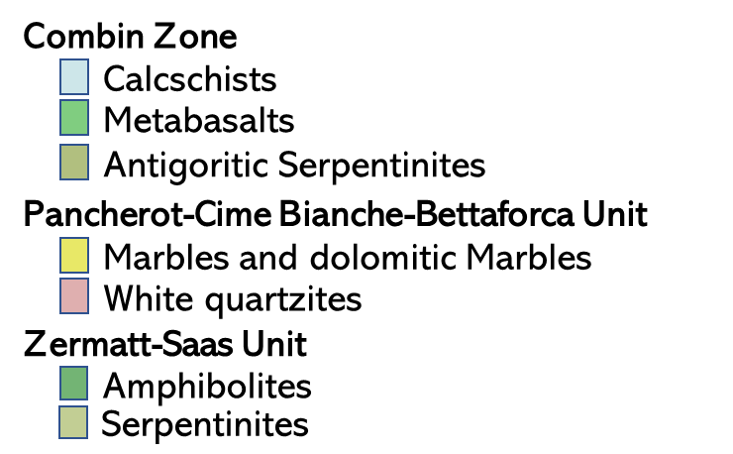
Zone A
N
A
B
A'
B'
Hanging wall

Slide 5
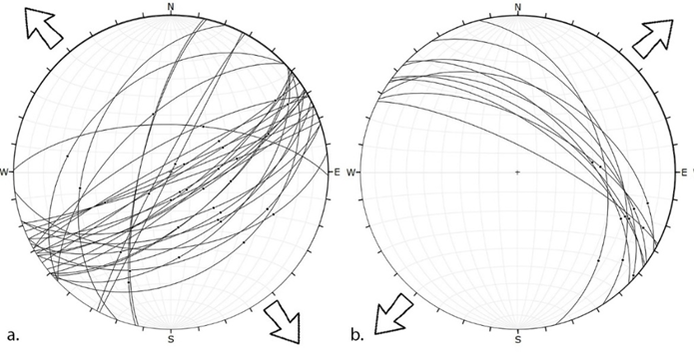
Zone A
N
A
Two brittle deformation phases
NE-SW high- to intermediate-angle normal faults
→ D1 (Oligocene) of Bistacchi & Massironi, 2000, TPh
NW-SE high-angle normal faults
→ D2 (Miocene) of Bistacchi & Massironi, 2000, TPh
B
A'
B'
D1
D2

Slide 6
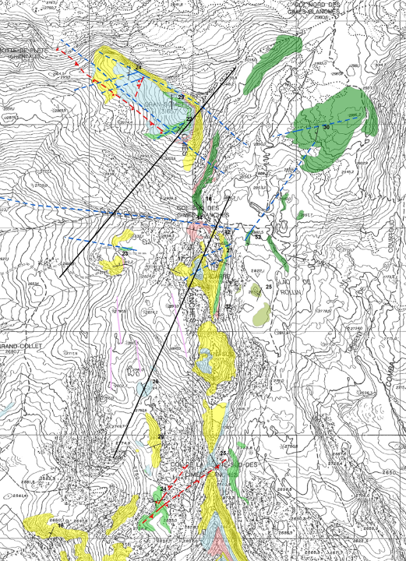
Zone A
N
A
Two brittle deformation phases
NE-SW high- to intermediate-angle normal faults
→ D1 (Oligocene) of Bistacchi & Massironi, 2000, TPh
NW-SE high-angle normal faults
→ D2 (Miocene) of Bistacchi & Massironi, 2000, TPh
B
A'
B'

Slide 7
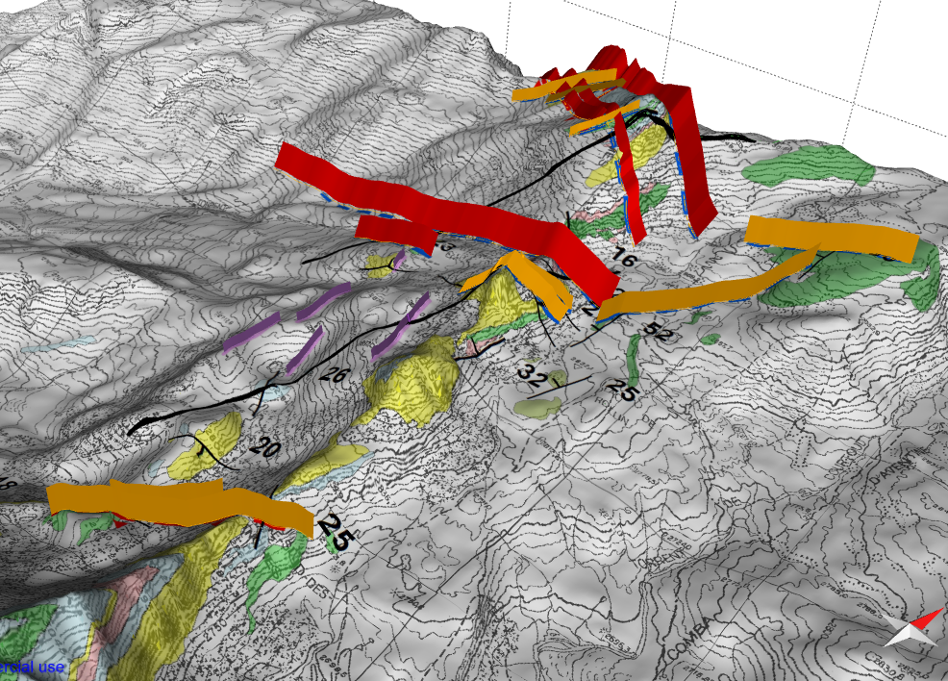

Slide 8
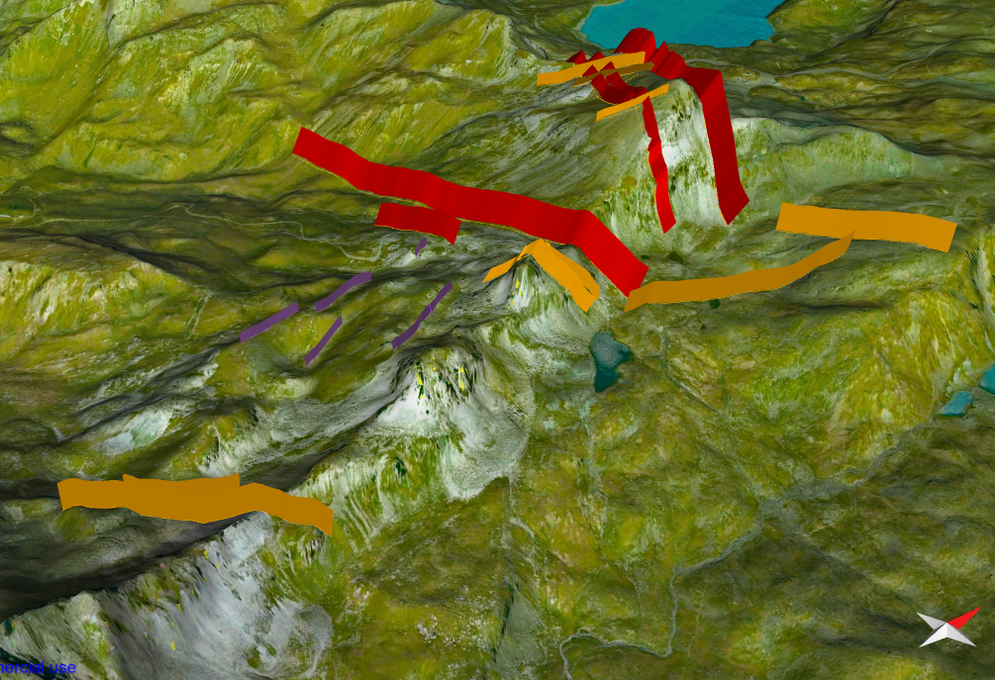

Slide 9
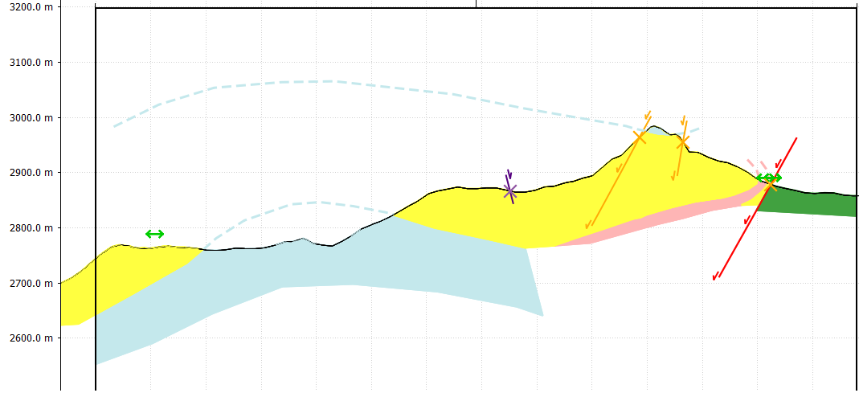
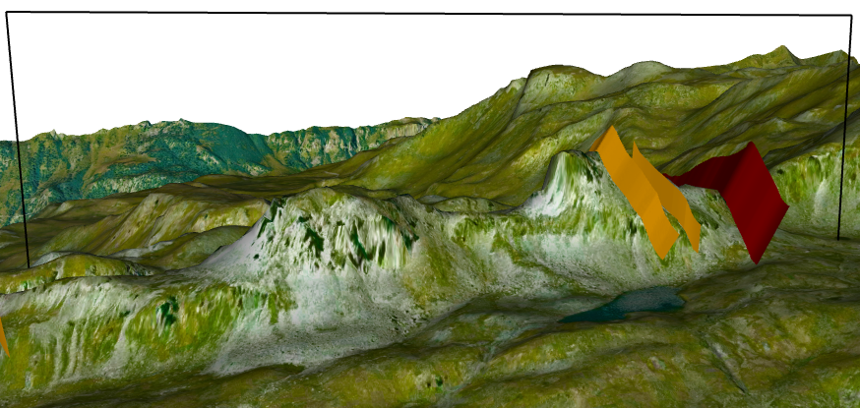
Zone A
Two brittle deformation phases
NE-SW high- to intermediate-angle normal faults
→ D1 (Oligocene) of Bistacchi & Massironi, 2000, TPh
NW-SE high-angle normal faults
→ D2 (Miocene) of Bistacchi & Massironi, 2000, TPh
N
A
B
B'
B
A'
B'

Slide 10
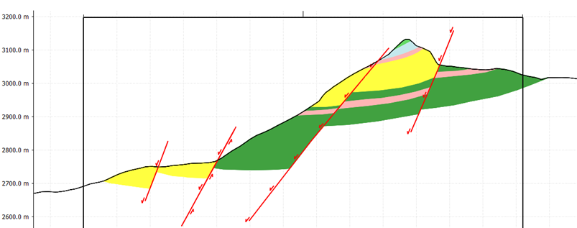
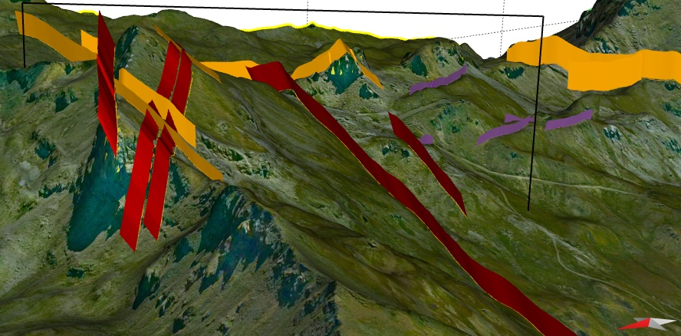
Zone A
A
Two brittle deformation phases
NE-SW high- to intermediate-angle normal faults
→ D1 (Oligocene) of Bistacchi & Massironi, 2000, TPh
NW-SE high-angle normal faults
→ D2 (Miocene) of Bistacchi & Massironi, 2000, TPh
N
B
A
A'
A'
B'

Slide 11
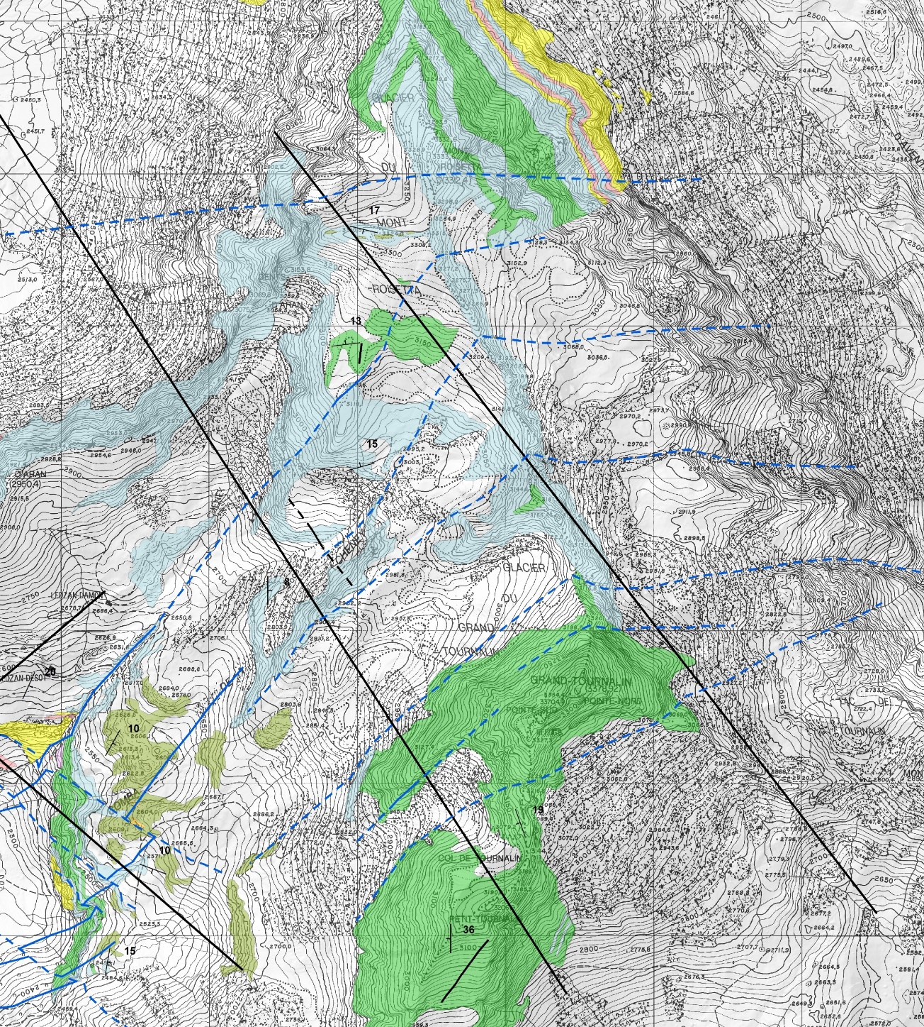
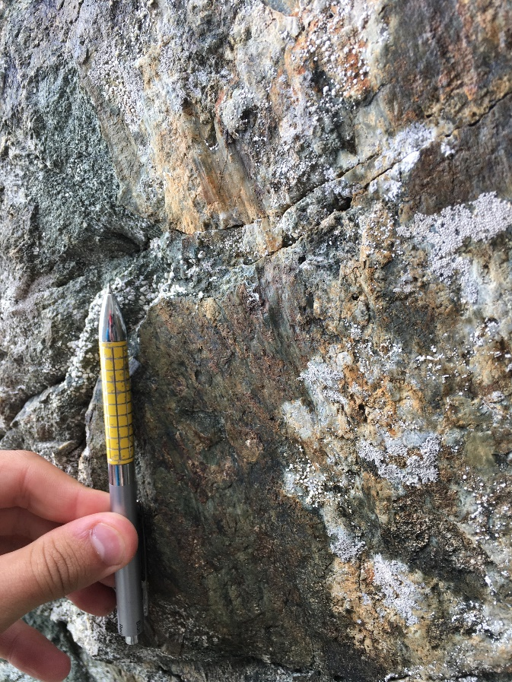
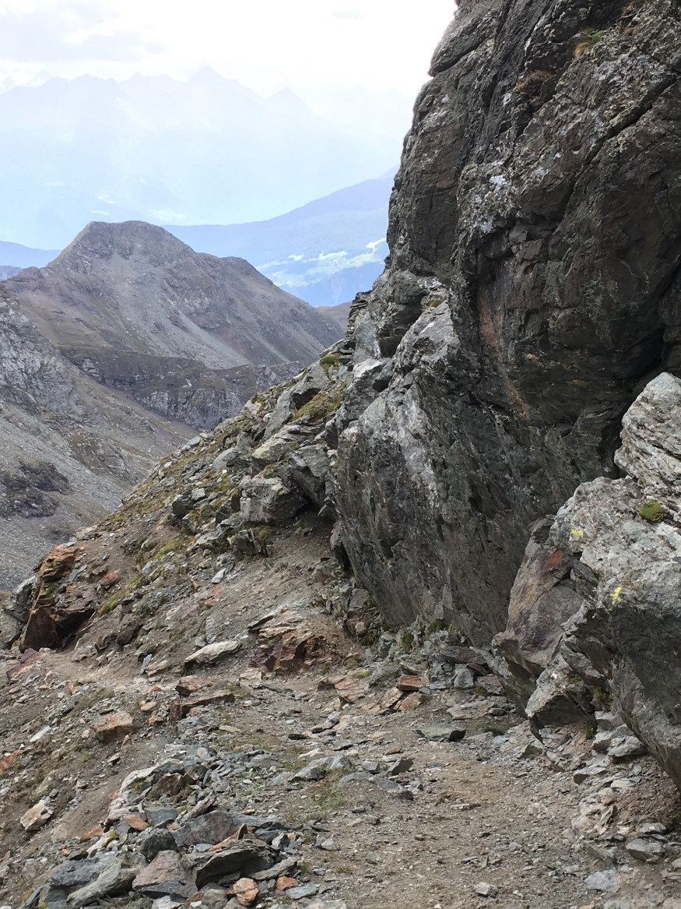
Zone B
C
D
N
D'
C'

Slide 12
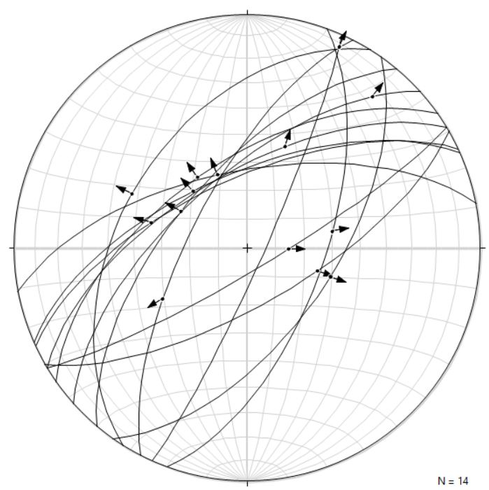
Zone B
C
D
Just one brittle deformation phase
NE-SW high- to intermediate-angle normal faults
→ D1 (Oligocene) of Bistacchi & Massironi, 2000, TPh
N
D'
C'

Slide 13
Zone B
C
D
Just one brittle deformation phase
NE-SW high- to intermediate-angle normal faults
→ D1 (Oligocene) of Bistacchi & Massironi, 2000, TPh
N
D'
C'

Slide 14
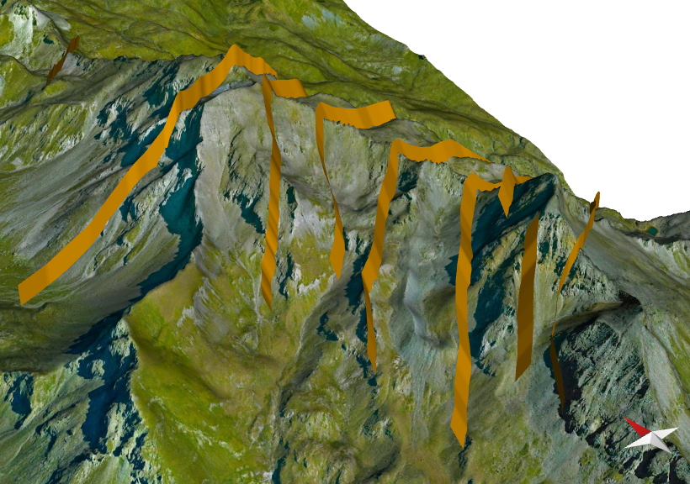

Slide 15
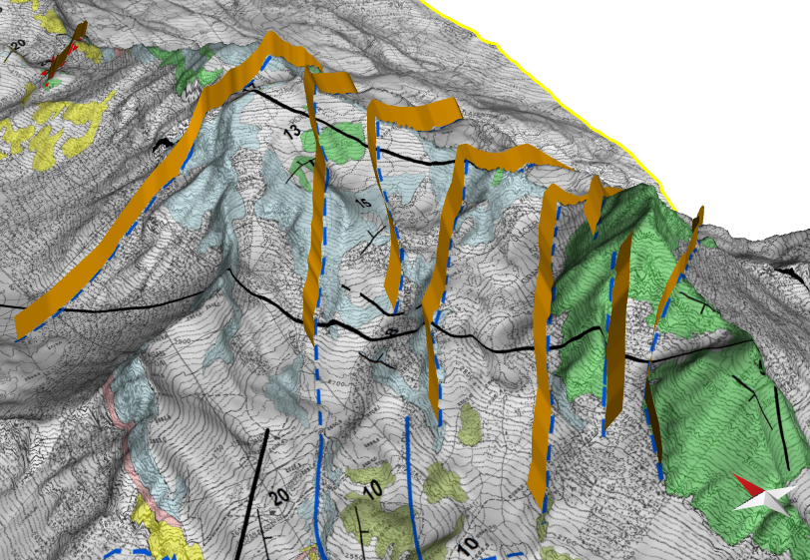

Slide 16
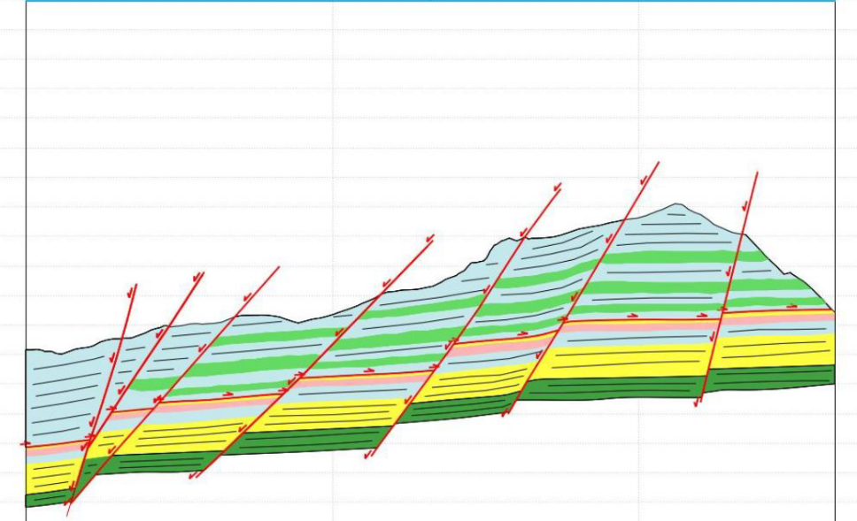
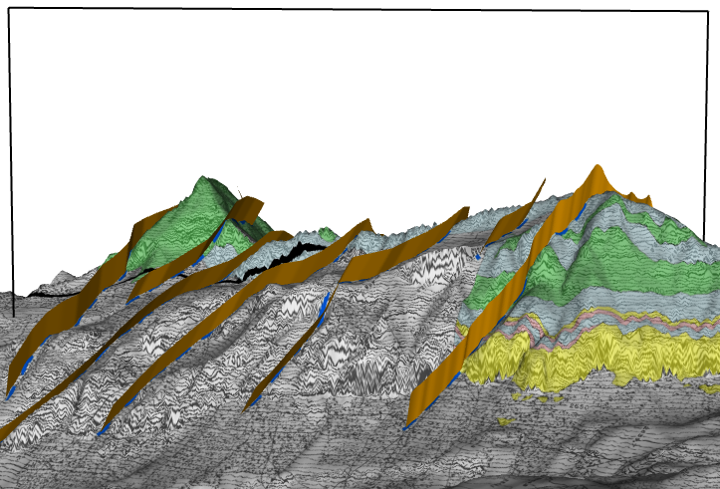
Zone B
Just one brittle deformation phase
NE-SW high- to intermediate-angle normal faults
→ D1 (Oligocene) of Bistacchi & Massironi, 2000, TPh
C
D
N
D'
D
D'
C'

Slide 17
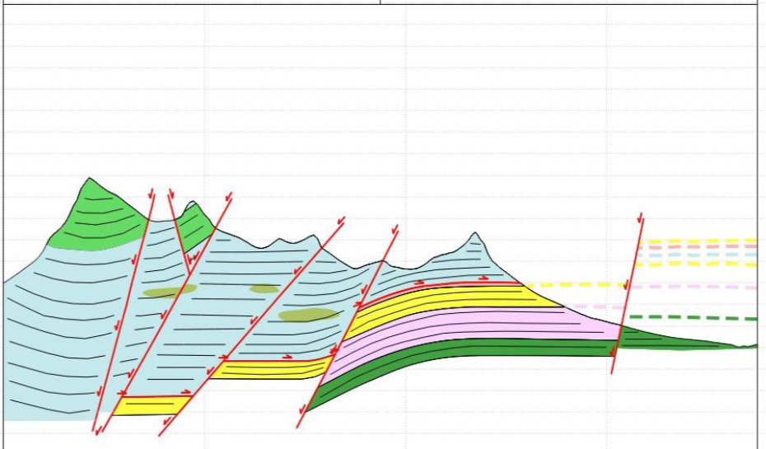
Zone B
Just one brittle deformation phase
NE-SW high- to intermediate-angle normal faults
→ D1 (Oligocene) of Bistacchi & Massironi, 2000, TPh
C
D
N
C'
C
D'
C'

Slide 18
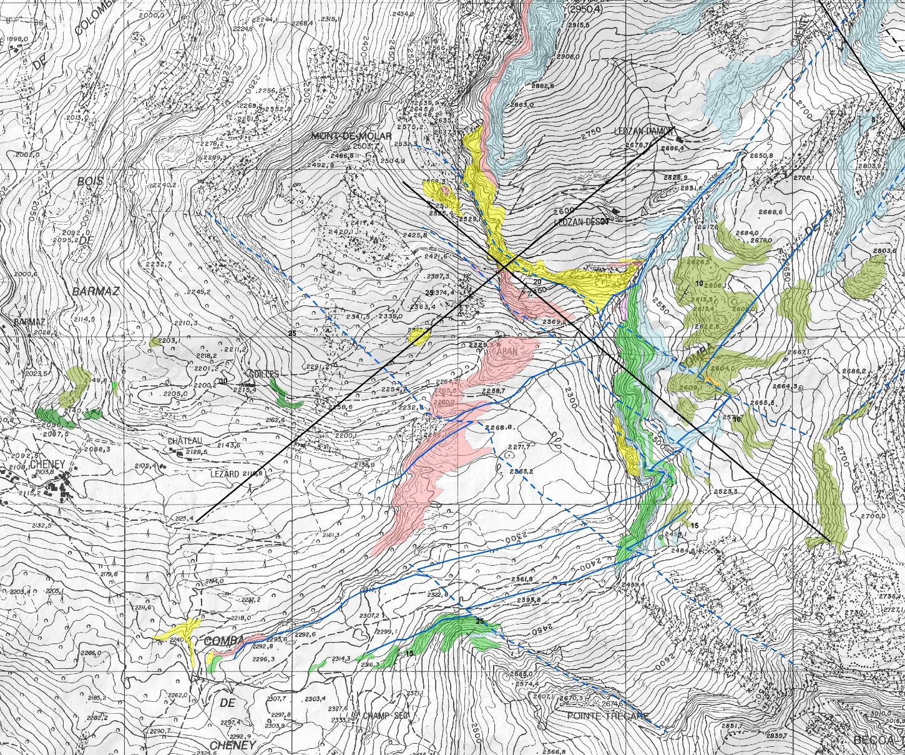
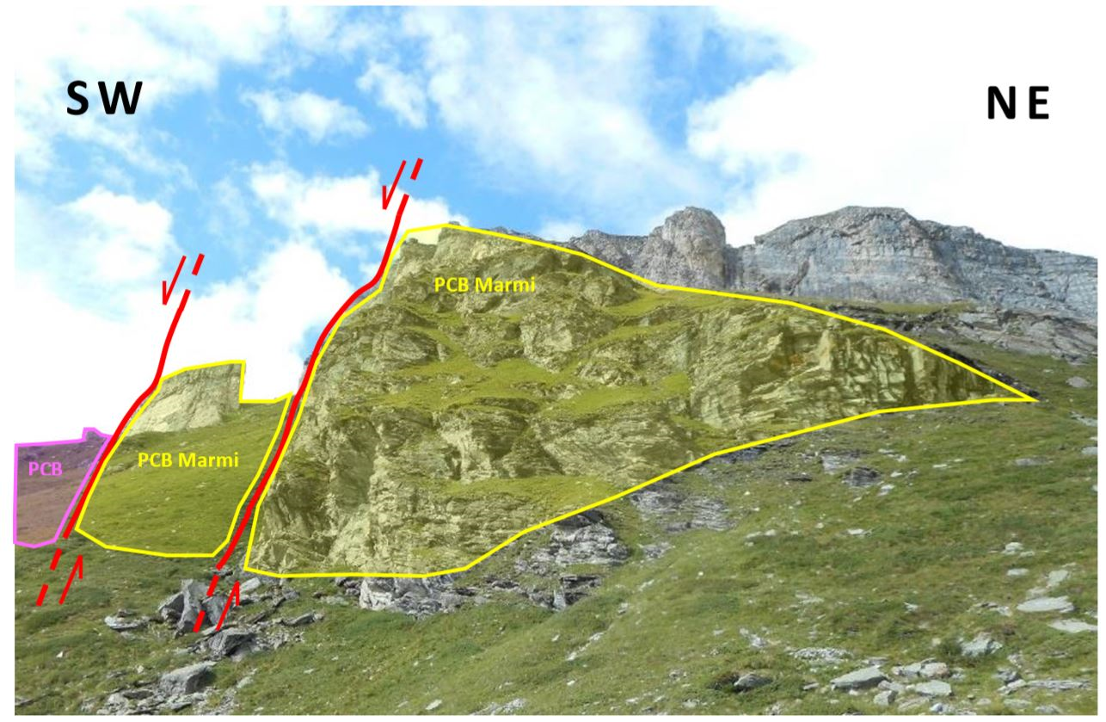
Zone C
N
F
E
F'
E'

Slide 19
Zone C
Two brittle deformation phases
NE-SW high- to intermediate-angle normal faults
→ D1 (Oligocene) of Bistacchi & Massironi, 2000, TPh
NW-SE high-angle normal faults
→ D2 (Miocene) of Bistacchi & Massironi, 2000, TPh

Slide 20
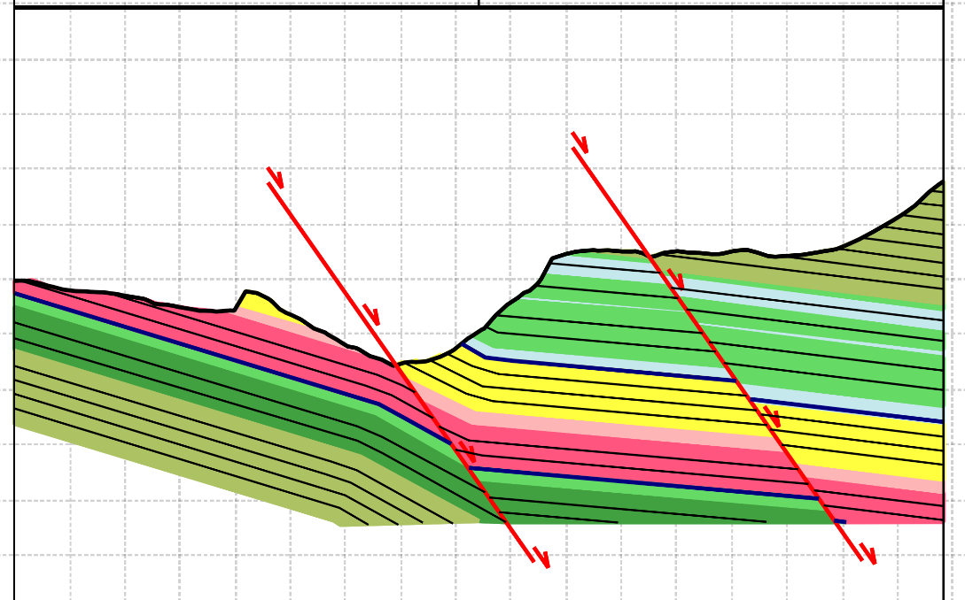
Zone C
Two brittle deformation phases
NE-SW high- to intermediate-angle normal faults
→ D1 (Oligocene) of Bistacchi & Massironi, 2000, TPh
NW-SE high-angle normal faults
→ D2 (Miocene) of Bistacchi & Massironi, 2000, TPh
F
E
E
E'
F'
E'

Slide 21
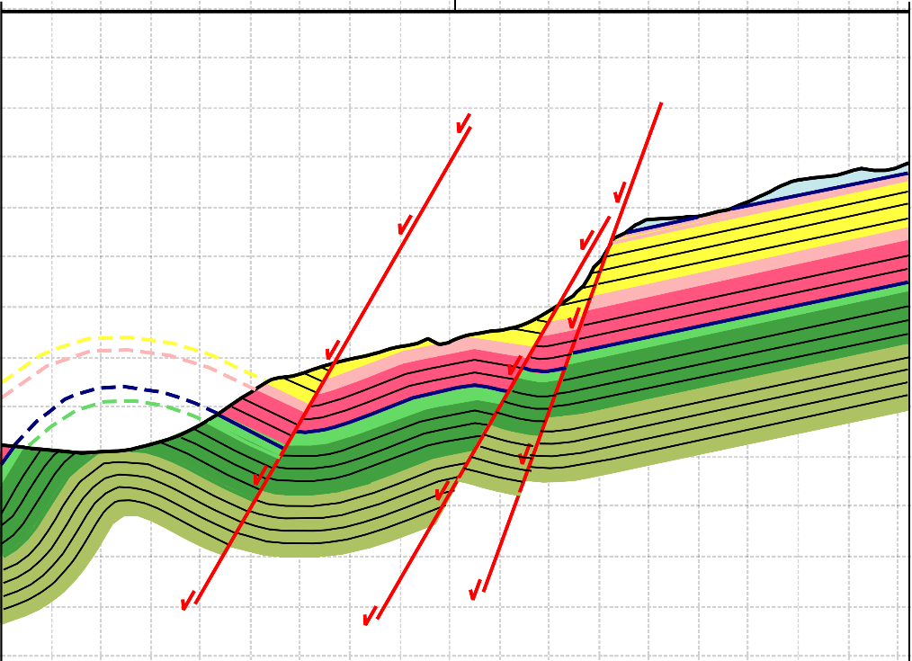
Zone C
Two brittle deformation phases
NE-SW high- to intermediate-angle normal faults
→ D1 (Oligocene) of Bistacchi & Massironi, 2000, TPh
NW-SE high-angle normal faults
→ D2 (Miocene) of Bistacchi & Massironi, 2000, TPh
F
E
F'
F
F'
E'

Slide 22
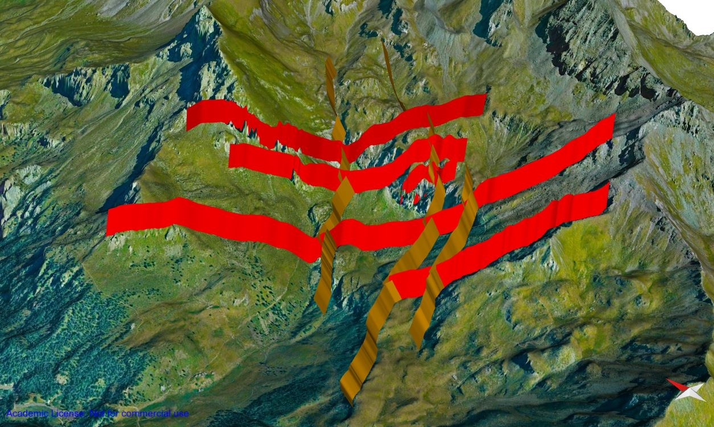

Slide 23
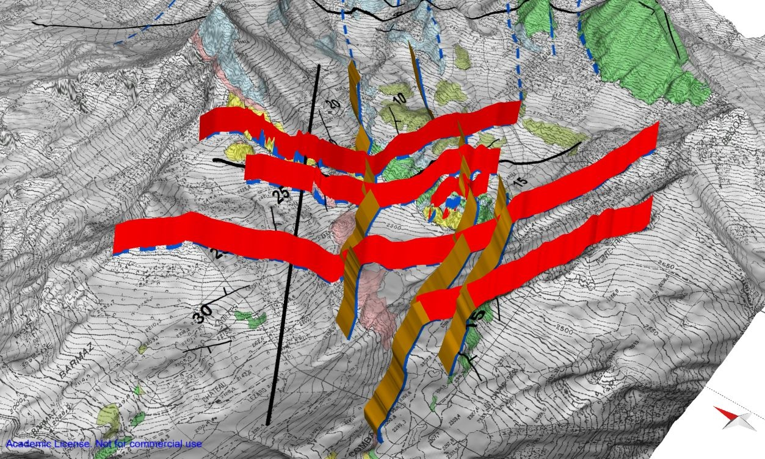

Slide 24
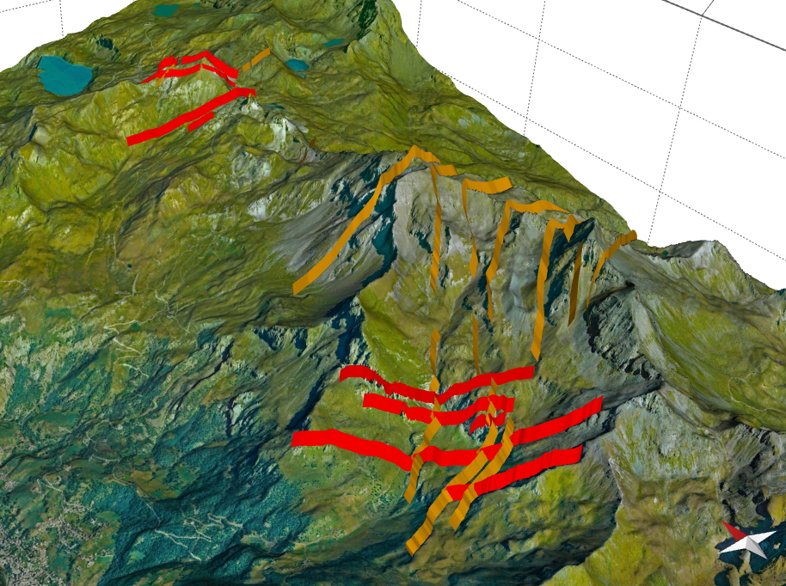
Two brittle deformation phases
NE-SW high- to intermediate-angle normal faults
→ D1 (Oligocene) of Bistacchi & Massironi, 2000, TPh
NW-SE high-angle normal faults
→ D2 (Miocene) of Bistacchi & Massironi, 2000, TPh
Zone A
D1
Zone B
D1
D2
Zone C
1 km

Slide 25
We will be happy to answer any question!
Matteo Pozzi m.pozzi53@campus.unimib.it
Gloria Arienti g.arienti5@campus.unimib.it
Anna Losa a.losa3@campus.unimib.it
Andrea Bistacchi andrea.bistacchi@unimib.it
Acknowledgements
We warmly thank Davide Bertolo and the Regione Autonoma Valle d’Aosta for logistic support during our fieldwork.
References
Bistacchi, A., Massironi, M., 2000. Post-nappe brittle tectonics and kinematic evolution of the north-western Alps: an integrated approach. Tectonophysics 327, 267–292. DOI: 10.1016/S0040-1951(00)00206-7
Dal Piaz, G.V., 2010. The Italian Alps: a journey across two centuries of Alpine geology. Journal of the Virtual Explorer 36. DOI: 10.3809/jvirtex.2010.00234

